Slide 1
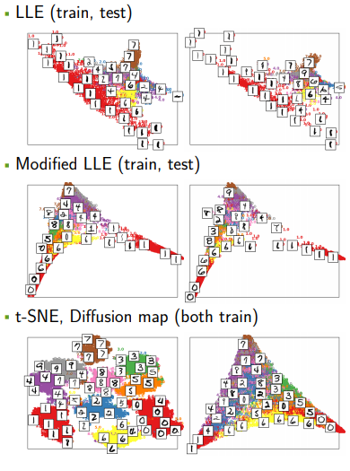
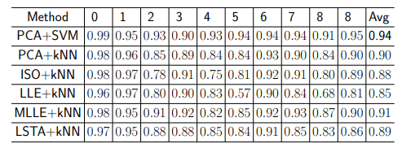
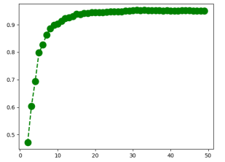


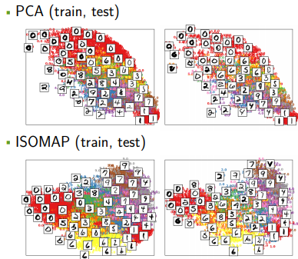
MATH 5473/CSIC5011 Mini-Project 1: MNIST Hand Written Digit Data Visualization
Ng Yui Hong¹ yhngap@connect.ust.hk
¹: Department of Mathematics, HKUST
1. Introduction
3.1 Visualization (Cont.)
3.2 Classification (Cont.)
In this project, we want to investigate the following
• How to perform dimension reduction and visualize the data distribution on principle components?
• How to classify and predict the Hand-Written Digits using dimensionality reduction.
• What’s the relationship between classification accuracy and dimension?
Classification Result
We can conclude that the PCA+SVM method acheived best averaging performance, while in manifold learning methods, modified LLE achieved the high averaging accuracy Classification result can be seen in next box.
• Dimension on classification (PCA)
Finally, we investigated the relationship between dimension (number
of features) and classification accuracy, we use the PCA+SVM
method to dig this relationship plotted in the following figure. We
can conclude that the accuracy increasing nearly stops when
dimension is greater than 20
Note that all the parameter in embedding method and regression method are the same, in my implementation, I used 20 dimensions and 60 nearest neighbours on building the embeddings and training the classifiers.
1.1 Dataset
We use MNIST as our dataset in this project.
MNIST is a simple yet effective dataset to explore the learnt feature of networks, given it is made up of numerous hand-written digits. It consists of 60000 gray-scale training images of size 28×28 and 10 classes. In our experiment we resize all the images to 224×224 and choose only a subset of the train/test images due to time concern.
3.1 Visualization
We first perform the dimension reduction using following
methods, PCA, ISOMAP, LLE, Modified LLE, LSTA,
t-SNE and Diffusion map. Then, we visualize the sample
distribution on the first two components.
4 Conclusion
Aming on solving the three objective problems, this project has the following contribution
• Visualized the dataset distribution on low dimension embeddings, we can easily distinguish the existence of certain clusters of hand-written digits, digits with the same type stay closer with each other.
• Estimated the classification accuracy using different embedding methods and its suitable classifiers, for example, linear classifier SVM is not suitable for manifold learning methods. The combinations all achieved acceptable classification accuracy, while among them PCA+SVM achieved the best performance in all combination and MLLE+kNN won the race within manifold learning methods.
• We also explored the relationship between dimension reduction with accuracy, we took PCA+SVM as an example and found that the accuarcy converges when dimension is greater than a certain level
3.2 Clasification
Classification with different embeddings and classifiers
In training process, we use the embedding models to fit to the training data, and using the transformed embedding on training data, then we use the training embedding and labels to train classifier. In regression phase, testing data are transformed using the same embedding, then these features are used to predict the classification label.
Noted that the ISOMAP, LLE, Modified LLE, LSTA are highly nonlinear, so SVM is not suitable with these kind of features.
Reference
• Hastie, Zip code digits datasets of "The Elements of Statistical Learning";
• Y. Yao, A Mathematical Introduction to Data Science, Chapter6 - Chapter7, 2017;
• J. Vanderplas, Comparison of Manifold Learning methods, replicated at 13, October, 2017;

