Slide 1
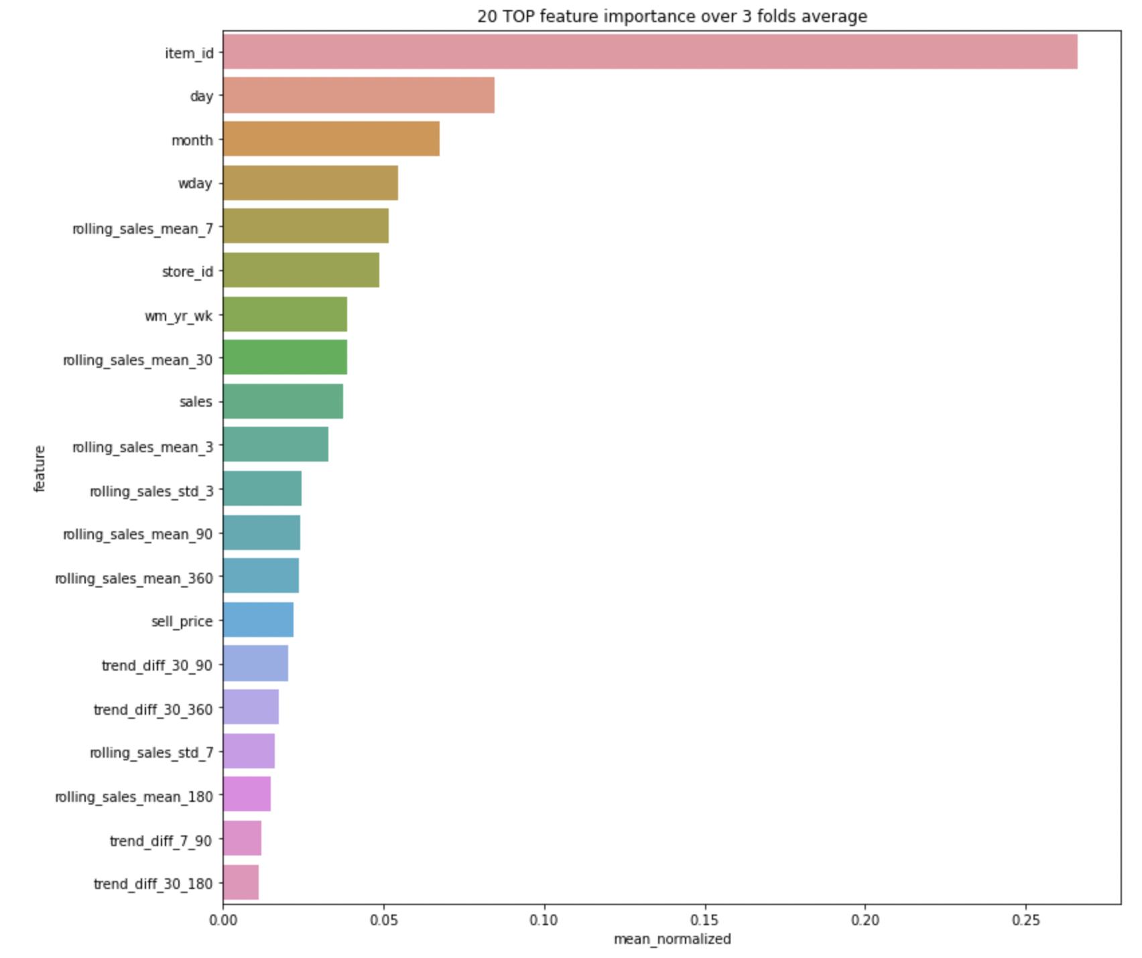
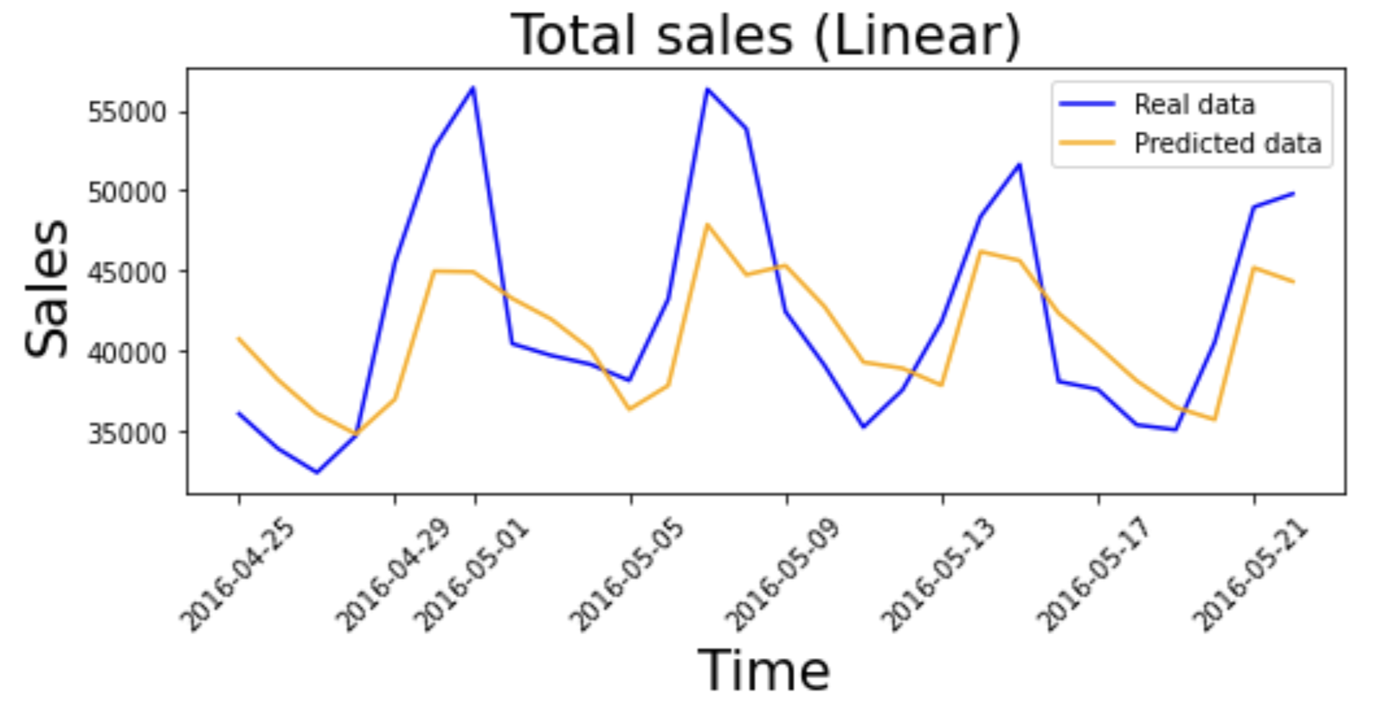
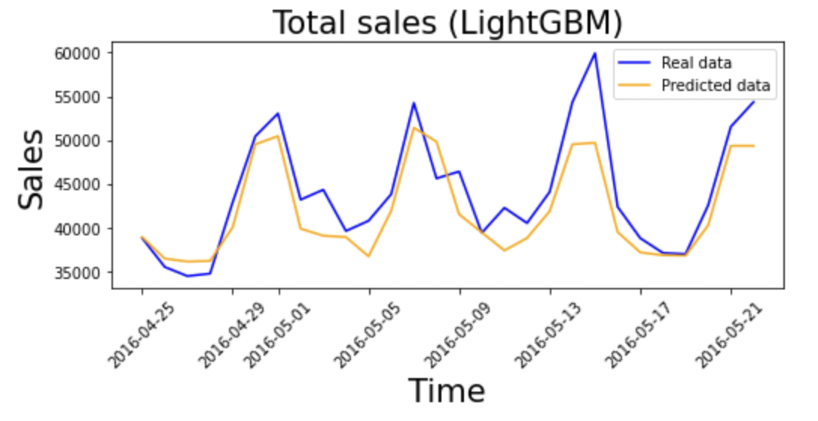


MSBD 5013 Project 2: M5 Forecasting Accuracy & Uncertainty
CHENG, Pak Hei(20795962) and LO, Ngai Hung(20787771)
1. Introduction
4. Model selection
Introduction
Model Selection & Training
Feature Importance
The challenge requires participants to predict Walmart sales in particular US stores for the next 28 days, the prediction uncertainty is also required to be reported.
We will construct various rolling statistical features, categorical features that reflect the hierarchical information of the time series, as well as integrating some external data.
We will train a baseline model using linear regression and compare subsequent models with it.
Accuracy Prediction:
Linear regression is used as baseline model
LightGBM, is selected as final model, which is suitable to handle mixed data type.
To prevent over-fitting, following measurement is adopted on LightGBM :
ElasticNet regularization
Stratified 3-fold cross validation to obtain averaging prediction
We are training a model to predict t+28 sales (${\hat{y}}_{t+28}$) based on day t features ($x_{t}$).*
Uncertainty:
To provide uncertainty prediction, we use Normal$(μ, σ)$ with $μ=\hat{y}$ and $σ$ chosen through private WSPL minimization
Tree models have an inherent measure of feature importance, namely the number of times a feature was chosen during a split. We used this as our measure of feature importance and plot top 20 features ranked by this importance
Data set
There are 4 CSV files provided for the challenge.
"sales_train_validation.csv" & "sales_train_evaluation.csv" : Provide the historical daily (totally 1941 days) sales data on each product and store.
"calendar.csv“: Provide details information on the date. (e.g. weekday & event)
"sell_prices.csv" : Provide the price of each product sold in each store.
*We use$x_{1 to 1885}$ to train a model. Then, use $x_{1886 to 1913}$ to predict ${\hat{y}}_{1914−1941}$ and calculate the RMSE between prediction and ground truth. Then, we use $x_{1 to 1913}$ to train a model and use $x_{1914 to 1941}$ to predict ${\hat{y}}_{1942−1969}$for Kaggle submission.
Experimental Results
Data Analysis
Prediction Accuracy:
Over 30,000 items sales time series. Each time series contain hierarchical information, such as store, state the item is sold in, category of the item
Correlation analysis at different hierarchies between features and target
Identify groups of similar times series using hierarchical clustering with Euclidean norm and dynamic time wrapping [1]
 | Validation RMSE | Kaggle Private RMSSE
Liner Reg. | 2.23960 | 0.84297
LightGBM | 2.16752 | 0.65377
Contribution
Uncertainty scores:
CHENG, Pak Hei:
Feature engineering, uncertainty model training
LO, Ngai Hung:
Feature engineering, accuracy model training
 | Validation RMSE | Kaggle Private WSPL
Bayesian Ridge | 2.8664 | 0.26793
LightGBM | 2.22265 | 0.20878
Feature Engineering
Rolling mean, standard deviation using multiple windows of 3, 7, 30, 90, 180 and 360 days
Difference between rolling mean of long and short windows to capture trend change
Binary features indicating special days in the week, such as Friday and weekends.
Mean encoding for hierarchical information
References
[1] TamirBennatan. "Time series clustering for forecasting prepara- tion". Kaggle. https://www.kaggle.com/code/timib1203/time-series-clustering-for-forecasting-preparation

