Slide 1
MSBD5013: M5-forecasting
Group7: Yi Liu, Zhixuan Peng

Slide 2
Outline
Introduction
Kaggle competition:
m5-forecasting accuracy and m5-forecasting uncertainty
Dataset
Sales data from Walmart.
Model Construction
ARIMA + LightGBM + Prophet + LSTM
Evaluation
RMSSE + WSPL

Slide 3


Introduction
In this project, we try to predict, the point forecasts and the uncertainty distribution of the realized values of the same series of the unit sales of various products sold in the USA by Walmart, as precisely as possible. For these two different goals, we propose two different model construction schemes, and improve them in a targeted manner. We tried both traditional statistical approach and machine learning methods.

Slide 4
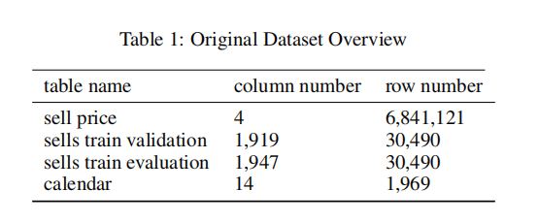
Dataset
we use hierarchical sales data from Walmart, the world’s largest company by revenue, to forecast daily sales for the next 28 days and to make uncertainty estimates for these forecasts. The data, covers stores in three US States (California, Texas, and Wisconsin) and includes item level, department, product categories, and store details. In addition, it has explanatory variables such as price, promotions, day of the week, and special events. Together, this robust dataset can be used to improve forecasting accuracy. The original data has four tables, and their specific data are shown in Table 1.

Slide 5
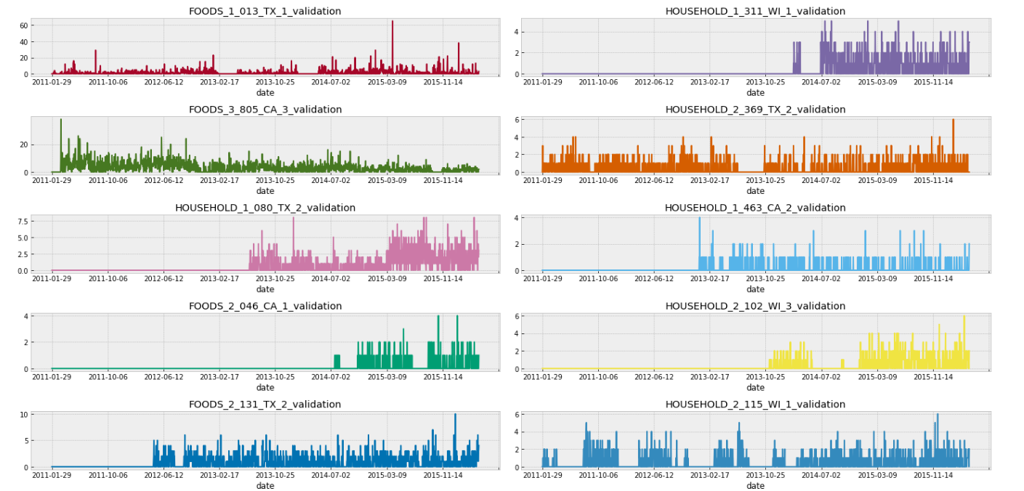
Exploratory Data Analysis
In order to better understand and use the data we obtained, we performed EDA to visualize the data.
Firstly, we randomly obtained 10 items as samples to see if there is any trend in each data .
Then, we found that many items that were not sold before and are now on sale, and many items that were sold before but are no longer available, we need to deal with these products uniformly.

Slide 6
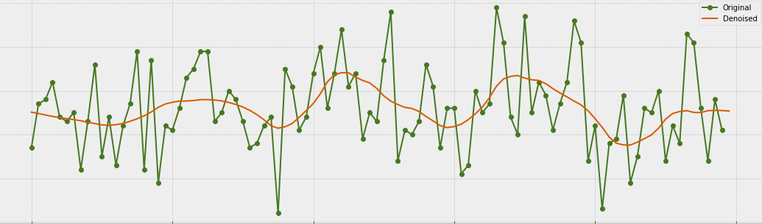
Exploratory Data Analysis
In order to further understand the sales trend of products, we used the wavelet denoising method to observe the sales trend of several sample products and this figure gives an example.

Slide 7
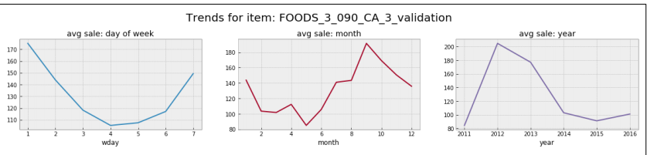
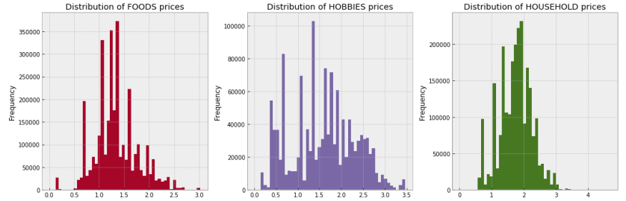
Exploratory Data Analysis
We also observed some commodities according to different time periods. We intercepted the average
sales of each week, month and year to observe the changes in the sales of the commodity in a fixed period of time, and figure 3 shows some examples.
Since there is category information for items in the original dataset, to see the relationship between category and sales we looked at the sales frequency distribution for each category.

Slide 8
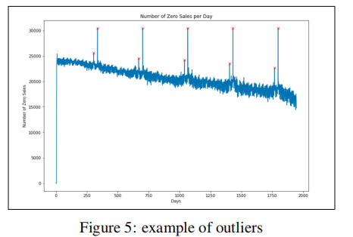
Exploratory Data Analysis
We also found some outliers in sales due to holidays or weekends, which should be considered, when necessary, in subsequent data processing and forecasting.

Slide 9
Data Preprocessing
We use R language for data preprocessing. Because the data set is too large, we did memory compression to avoid running out of memory. The original dtype was changed to the dtype with the smallest memory. Results show that this method greatly saves the memories. After doing some basic preprocessing on the data , we focus on feature engineering.

Slide 10
Feature Engineering
• One-hot encode
events
We associate the events in the table with items with one-hot encoding, adding feature columns for items.
Create features from date
We add year, month, day of month, day of week and whether it is a weekend (day of week is either 7 or 1) as features. More importantly, holiday is added because there are outliers which are all holidays like thanksgiving.
Price Momentum
We have calculated weekly price momentum, which is helpful in analyzing sales trends.
We generated lags using time intervals of 7 days, 14 days, 30 days, 60 days, and 180 days, and calculated their mean and standard deviation, and made them into data as items’ features.
Generate lags

Slide 11
Model Construction
Statistical Model：ARIMA
Ensemble Tree Model：LightGBM
Time Series Model：Prophet
Deep Learning Model: LSTM

Slide 12
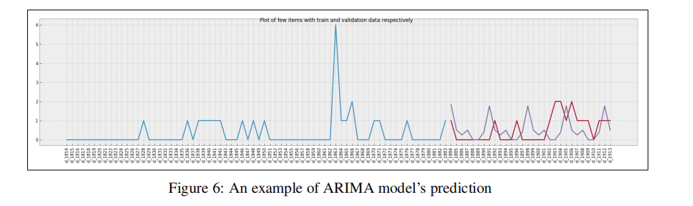
Statistical Model: ARIMA
Since the data we are going to predict is a time series, we first thought of trying the traditional statistical model ARIMA to see the prediction effect. The detailed operation is in the report.
The final prediction example result is shown in Figure 6. It can be seen that although ARIMA’s prediction is not very accurate at the point level, it can get roughly accurate predictions for data having a typical trend, and this might be useful to predict the uncertainty distribution.

Slide 13
LightGBM
Gradient Boosting Decision Tree (GBDT)
Fitting residuals
Feature combination and selection
strong robustness to outliers
Low variance and low bias
LightGBM
distributed framework of GBDT
efficient parallel computation
faster training speed
less memory limits
Support categorcial feature

Slide 14




Prophet
Trend function: g(t)
Seasonality function: s(t)
holiday funcion: h(t)
Error term: εt

Slide 15
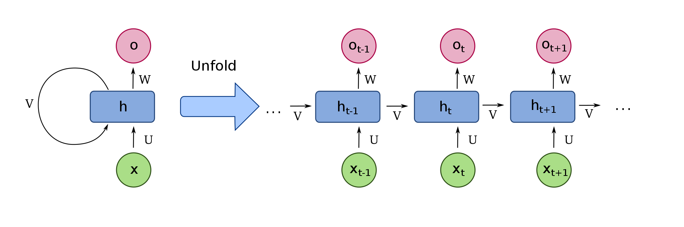

LSTM
Recurrent Neural network (RNN)
Sequence Tasks with memory
Shared Parameters
Gradient vanishing
Long distance dependency Problem

Slide 16
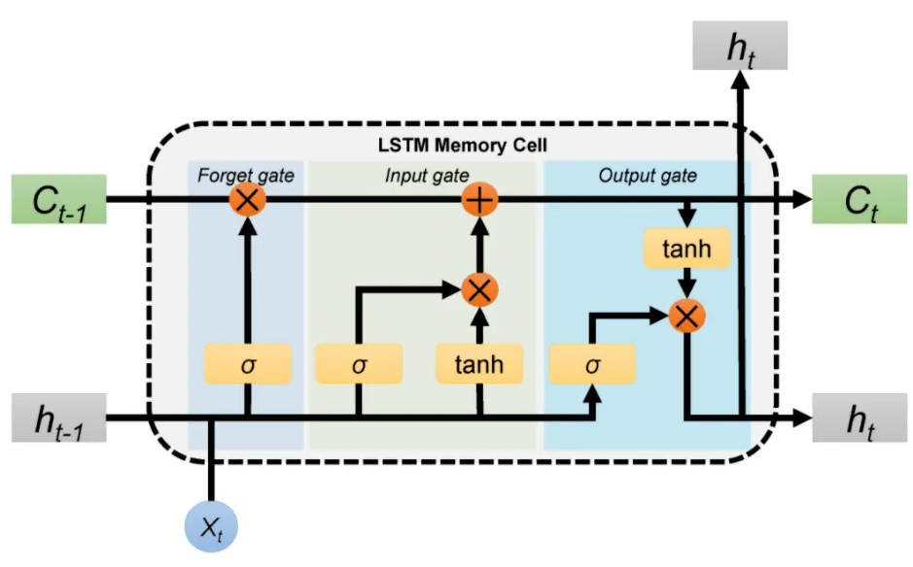
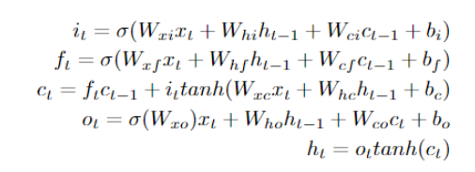
LSTM
Long Short-term Memor (RNN)
Sequence Tasks with memory
Shared Parameters
Several gates for accuracy
Residual network

Slide 17
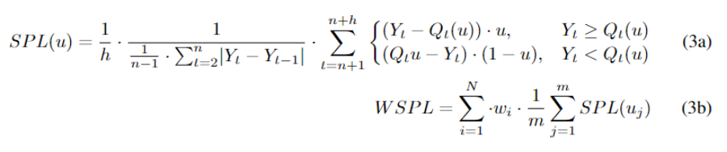
Evaluation
M5-Uncertainty
M5-Accuracy
Weighted Root Mean Squared Scaled Error
Weighted Scaled Pinball Loss

Slide 18

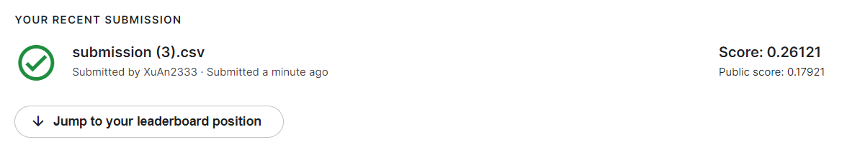
Results
Simple Average
Weighted average
Linear regression

Slide 19
summary
In this project, we forecast both accuracy and uncertainty of M5 data.
We analyzed the data thoroughly with a lot of data and figures.
After that we apply some data preprocess and feature engineering such as memory compression and time-related feature creation.
We propose several models, namely ARIMA, LightGBM, Prophet and LSTM and integrate the results of them to achieve better results.

Slide 20
Thanks!
yliujt@connect.ust.hk
zpengan@connect.usy.hk

