Slide 1
Order the faces by Manifold Learning for Face dataset
Yingxue XU ^{1, 4}, Jiaxin ZHUANG ^{2, 4}, Fengtao ZHOU ^{3, 4}
2023.05.15
Notes:
Hello everyone. Here I’m going to introduce our final project of “Order the faces by Manifold Learning for Face dataset”.

Slide 2
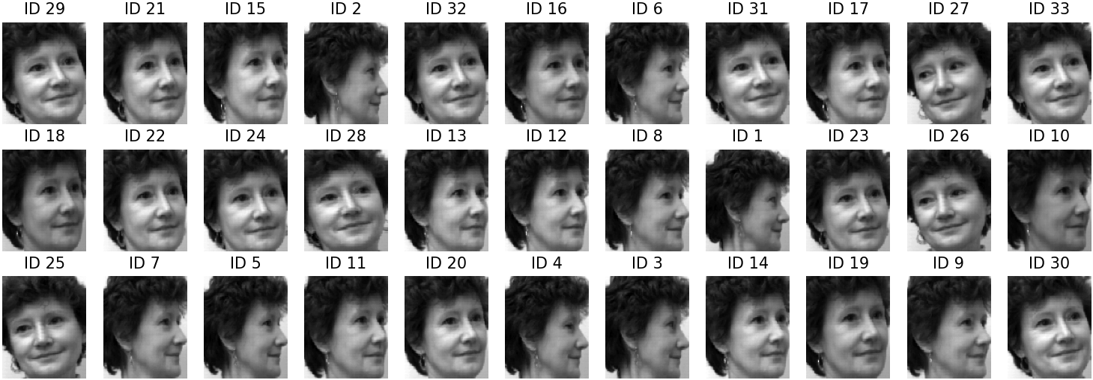
Introduction – Face Pose Estimation
arrange 33 out-of-order images of the same individual based on their face orientation
allows us to understand a person's focus and behavior by analyzing their facial orientation
various manifold learning techniques: Diffusion map, MDS, ISOMAP, LLE, LSTA, TSNE, and UMAP.
Notes:
In this project, we’re going to do face pose estimation, in which we’ll arrange 33 out-of-order images of the same individual based on their face orientation. This is a data example. And we will rearrange them in the correct order.
This task actually allows us to understand a person's focus and behavior by analyzing their facial orientation.
And we’re going to use various manifold learning techniques to do that.

Slide 3
Introduction – Overview
Organize
Comparison and optimal nearest neighbor number
Acquire the embedding results
Notes:
In this project, first of all, we’re going to acquire the embedding results from the different methods,
And then organize them based on the size of their first eigenvector.
Finally, we compared the results of the manifold learning methods and determine the optimal nearest neighbor number for UMAP.

Slide 4
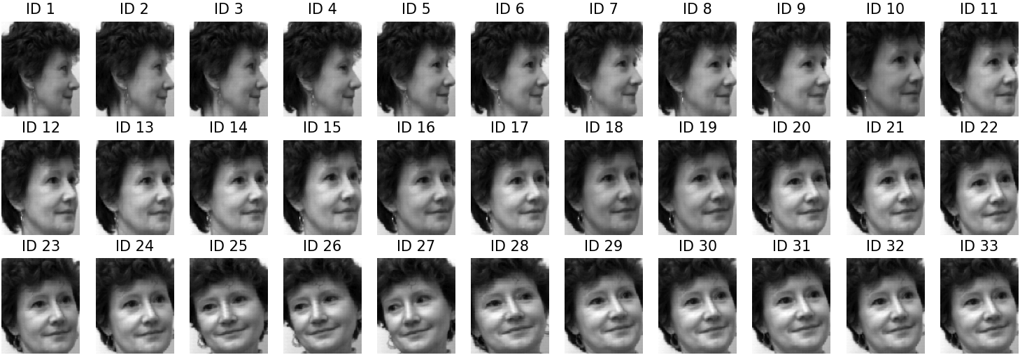

Dataset
10,304 images in total
33 faces of the same person $(Y ∈ ℝ^{112×92×33})$ in different angles
(a) Original Data
(b) Ground truth
Notes:
We used a face dataset containing 10304 images in total, in which each person has 33 faces images in different angles.
Here is an example.
As shown in the left, we should order them into the figure (b).

Slide 5
Methodology
7 manifold learning methods: Diffusion map, MDS, ISOMAP, LLE, LSTA, TSNE, and UMAP
Diffusion map
nonlinear dimensionality reduction algorithm
compute embeddings of a dataset into Euclidean space based on the eigenvectors and eigenvalues of a diffusion operator
MDS
aims to reveal the underlying structure of the data and provide a better understanding of the relationships between individual cases
visualize the similarity between individual cases
create a low-dimensional space using pairwise dissimilarities based on Euclidean distance
Coifman, Ronald R., et al. Geometric diffusions as a tool for harmonic analysis and structure definition of data: Diffusion maps. PNAS. 2005
Mead, A. L. Review of the development of multidimensional scaling methods. Journal of the Royal Statistical Society: Series D.
Notes:
We apply these seven well-known manifold learning methods.
And I’ll quickly review these approaches.
The first one is Diffusion map, which is a nonlinear dimensionality reduction algorithm that extracts features or reduces dimensionality by computing embeddings of a dataset into Euclidean space based on the eigenvectors and eigenvalues of a diffusion operator.
Diffusion maps aim to discover the underlying manifold structure of the data and integrate local similarities at different scales to provide a global dataset description.
MDS is a technique for visualizing the similarity between individual cases in a dataset by creating a low-dimensional space using pairwise dissimilarities based on Euclidean distance.
This approach aims to reveal the underlying structure of the data and provide a better understanding of the relationships between individual cases.

Slide 6
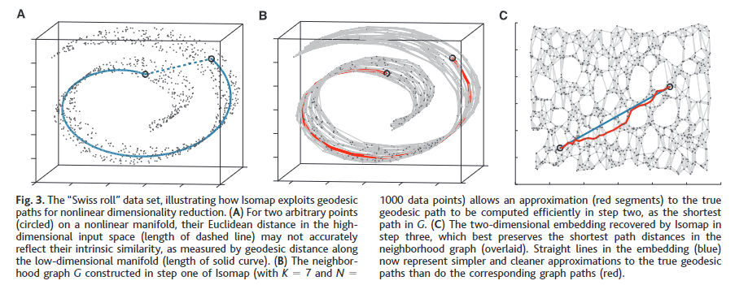
Methodology
7 manifold learning methods: Diffusion map, MDS, ISOMAP, LLE, LSTA, TSNE, and UMAP
ISOMAP
an extension of MDS
incorporates geodesic distances based on a weighted graph
Tenenbaum, Joshua B ., et al. A global geometric framework for nonlinear dimensionality reduction. Science. 2000
Notes:
ISOMAP[4] is an extension of MDS that incorporates geodesic distances based on a weighted graph. It defines the geodesic distance as the sum of the edge weights along the shortest path between two nodes. By incorporating these geodesic distances, it aims to better capture the underlying structure of the data and provide a more accurate low-dimensional representation of the dataset.

Slide 7
Methodology
7 manifold learning methods: Diffusion map, MDS, ISOMAP, LLE, LSTA, TSNE, and UMAP
LLE
preserve the local linearity of the sample when reducing data dimensionality
LTSA
a variation of LLE
the assumption that the tangent hyperplanes of the manifold will align if the manifold is unfolded accurately.
TSNE
a variation of the SNE algorithm
treats the coordinates in the lower dimension as the t-distribution.
Roweis, Sam T ., et al. Nonlinear dimensionality reduction by locally linear embedding. Science.
Zhang, Zhenyue., et al. Principal manifolds and nonlinear dimensionality reduction via tangent space alignment." SIAM. 2004.
Hinton, Geoffrey E., et al. Stochastic neighbor embedding. NIPS. 2002.
Notes:
LLE[5] focuses on preserving the local linearity of the sample when reducing data dimensionality.
LTSA[6] is a variation of LLE based on the assumption that the tangent hyperplanes of the manifold will align if the manifold is unfolded accurately.
TSNE[7] is a variation of the SNE algorithm that treats the coordinates in the lower dimension as the t-distribution.

Slide 8
Methodology
7 manifold learning methods: Diffusion map, MDS, ISOMAP, LLE, LSTA, TSNE, and UMAP
UMAP assumes that
the data is uniformly distributed on a locally connected Riemannian manifold
the Riemannian metric is either locally constant or approximately locally constant.
McInnes, L., et al. Uniform manifold approximation and projection for dimension reduction. arXiv preprint. 2018
Notes:
Similar to TSNE, UMAP[8] assumes that the data is uniformly distributed on a locally connected Riemannian manifold and that the Riemannian metric is either locally constant or approximately locally constant.

Slide 9
Evaluation
Kendall’s
a correlation coefficient that measures the agreement between two rankings.
Given two ranking lists X and Y,
ranges from -1 to 1:
1 indicates perfect agreement
0 indicates no correlation
-1 indicates perfect disagreement
Notes:
For the evaluation protocol, we’re going to use Kendall's $τ$ which is a correlation coefficient that measures the agreement between two rankings.
Given two ranking lists X and Y of the same set of elements, it measures the similarity between the two rankings by counting the number of pairwise agreements and disagreements between the rankings.
A pair of elements (i,j) is considered to agree if their order is the same in both rankings, and disagree if their order is different.
Based on that, you can see the formulation of tau
We can calculate the proportion of the difference between the number of concordant pairs and the number of discordant pairs in the total number of pairs.
So tau ranges from -1 to 1, in which
1 indicates perfect agreement
0 indicates no correlation
-1 indicates perfect disagreement

Slide 10
Experimental Results
Table 1 Quantitative Results of different methods.
The first eigenvector was calculated using each method to represent each image.
Diffusion map, MDS and ISOMAP showed poor performance
UMAP, TSNE, and LLE showed the best performance:
UMAP has the most similar distribution to the ground truth.
Notes:
We used seven manifold learning methods to analyze the Face dataset, conducting both quantitative and qualitative analyses.
The first eigenvector was calculated using each method to represent each image
We display the quantitative results of the seven methods with respect to Kendall's 𝜏 and the ground truth.
You can see that
Diffusion map, MDS and ISOMAP showed poor performance when ordered by the first eigenvector
UMAP, TSNE, and LLE showed the best performance, in which UMAP has the most similar distribution to the ground truth.

Slide 11
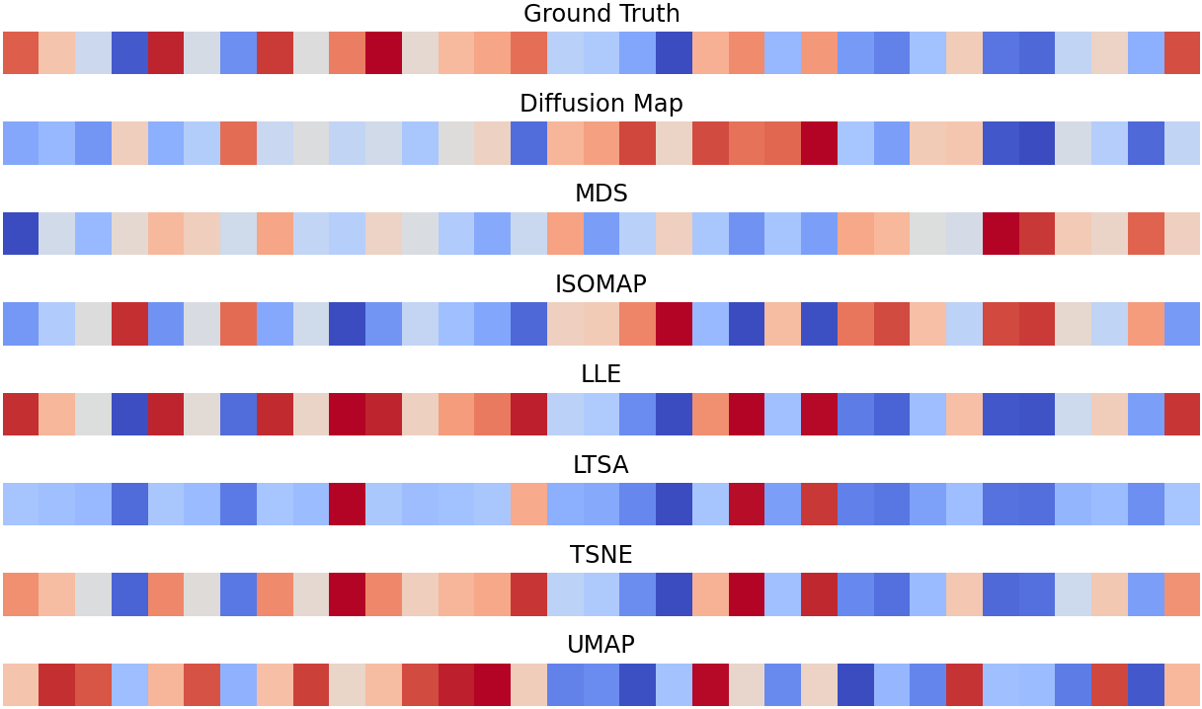
Experimental Results
Figure 2 Comparison of eigenvectors for different methods
Notes:
For qualitative analysis, we also visualized the eigenvectors generated by these methods using an exemplar, and we can see that UMAP, TSNE and LLE also achieve the better performance.

Slide 12
Conclusion
We utilized multiple manifold learning techniques (including Diffusion map, MDS, ISOMAP, LLE, LSTA, t-SNE, and UMAP) to arrange the face orientation from left to right.
To measure the sorting performance, we computed the 𝜏 between the predicted results and the ground truth ranking labels.
Diffusion map, MDS and ISOMAP showed poor performance when ordered by the first eigenvector, while LLE, LSTA, TSNE, and UMAP demonstrated good performance.
Notes:
To summarize that,

Slide 13
Thanks
Notes:
That’s all in our project. Thank you.

