Slide 1
Paper Replication: Empirical Asset Pricing via Machine Learning
Yuxuan Chen
Department of Mathematics

Slide 2
Dataset
In the project we used predictive characteristics and monthly total individual equity returns from CRSP for all firms listed in the NYSE, AMEX, and NASDAQ. Our sample begins in March 1957 (the start date of the S&P 500) and ends in December 2016, totaling 60 years. The number of stocks in our sample is almost 30,000, with the average number of stocks per month exceeding 6,200.
Dataset that contains 94 stock level predictive characteristics and the first two digits of Standard Industrial Classification (SIC) codes is downloaded from the website of the original paper.
Dataset of the monthly CRSP returns is downloaded from WRDS. We calculate individual excess returns by subtracting Treasury-bill rates from CRSP returns.
8 macroeconomic predictors are constructed following Welch and Goyal (2008), according to the description in the original paper.

Slide 3
Data Processing
Missing Characteristics: We replace missing values with the cross-sectional median at each month for each stock, respectively.
Data Normalization: We perform standard normalization procedure with sample mean and deviation to facilitate training.

Slide 4
Machine Learning Methods
Ordinary Least Square (OLS + H, OLS-3, OLS-3 + H), where OLS-3 preselects size, book-to-market, and momentum as the only covariates.
Elastic Net + H (ENET + H)
Lasso + H
Ridge + H
Principal components regression (PCR)
Partial least squares (PLS)
Gradient boosted regression trees + H (GBRT + H)
Random Forest (RF)
Here ‘+ H’ means that we have used a robust objective function: Huber Loss.

Slide 5
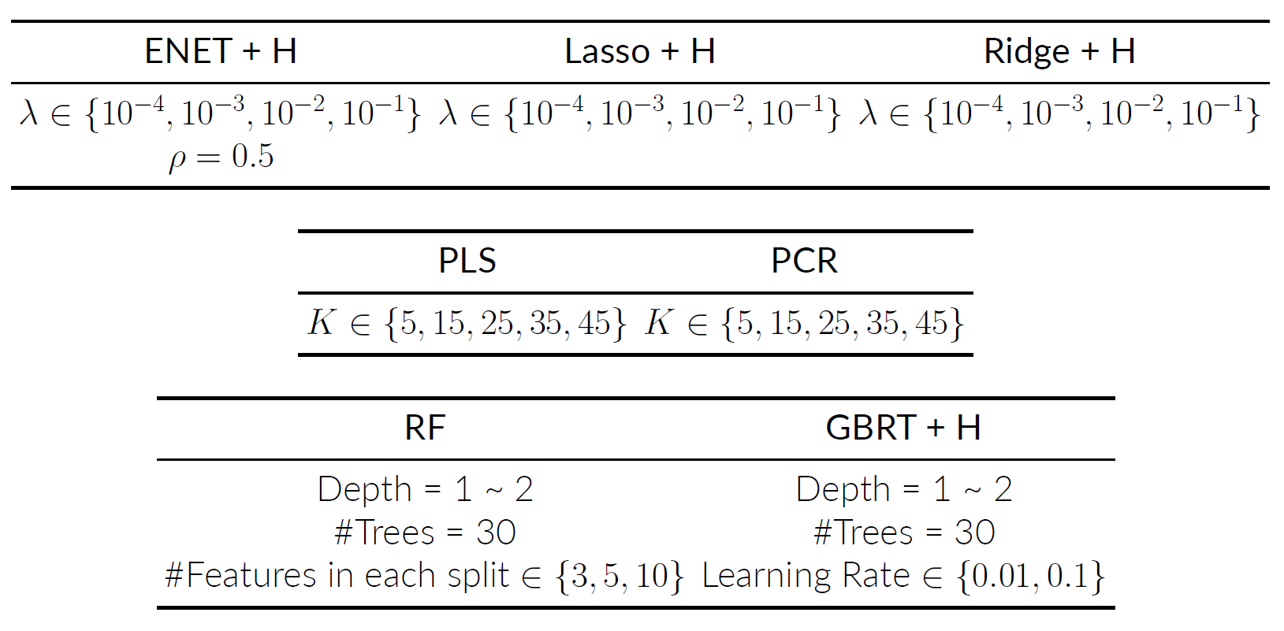
Hyperparameter Tuning

Slide 6
Data Splitting
Recursive Performance Evaluation Scheme
The data from year 1987 to 2017 as test data, and take only one test year’sdata at a time for testing.
The data for the 12 years prior to the test year will beused as validation set for hyperparameter tuning.
The data for the years before the start of the validation set from 1957 will be used as training set.

Slide 7
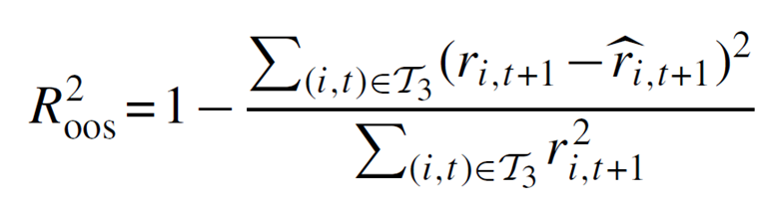
Performance Evaluation
Evaluate the models by comparing the predictive performance using the out-of-sample R².
We use only those data in the testing period.
The denominator are targeting the zero to achieve a better prediction analysis.

Slide 8
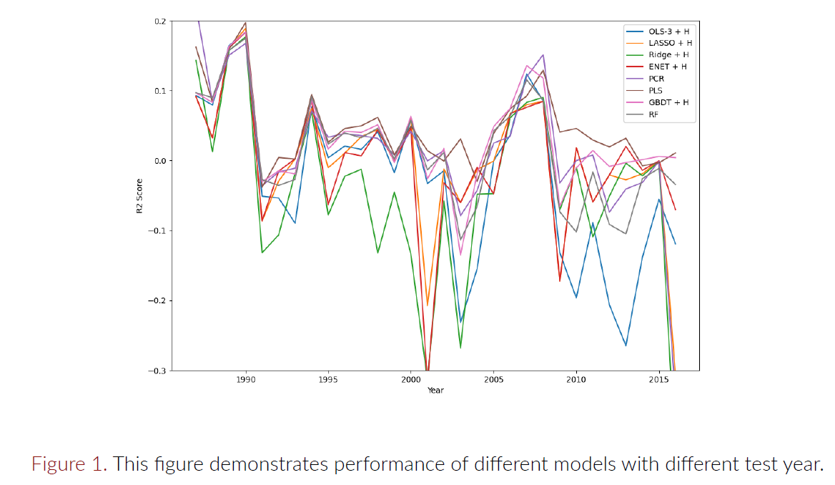
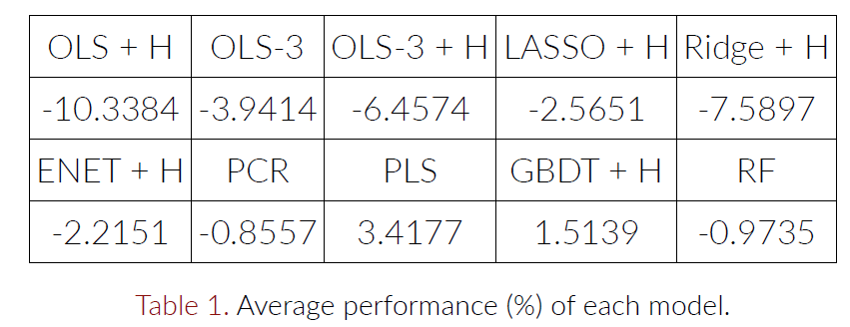
Performance Evaluation
PLS can obtain the best performance, and OLS-3, LASSO, Ridge and ENET all outperform OLS, which illustrates that OLS model suffers from overfitting.
Tree based methods Boosted Regression Trees and Random Forests outperform most of the methods based on Linear Regression, although the number of trees is only 30.
Over 30-year out-of-sample test, compare with tree-based methods, the linear models exhibit high volatility.

Slide 9
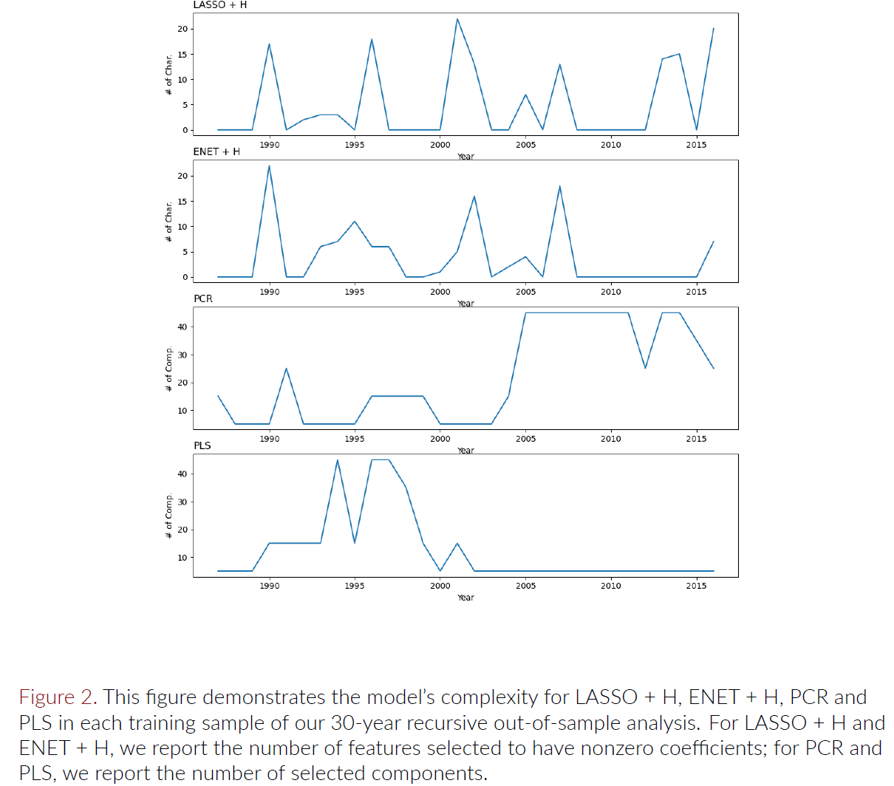
Model Complexity
Models with higher degrees of freedom don’t always perform better, which also illustrates that OLS model suffers from overfitting.

Slide 10
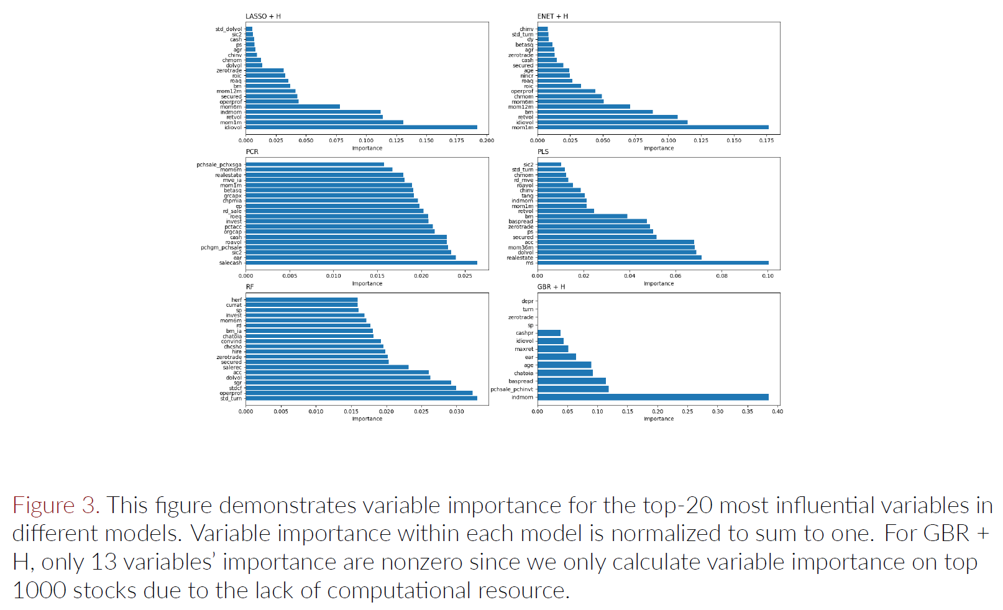
Variable Importance

Slide 11
Variable Importance
Characteristics with visible impact:
Recent price trends Short-term reversal (mom1m), industry momentum (indmom), stock momentum, (mom12m), momentum change (chmom).
Liquidity Turnover & turnover volatility (turn, std turn), and log market equity (mvel1), dollar volume (dolvol).
Risk measures The total and idiosyncratic return volatility (retvol, idiovol).

Slide 12
Further Improvement
More models are available (Generalized linear and Neural Network) in literature but not in this study due to the computational resource and manpower constraints.
Hyperparameter tuning can be more detailed, number of trees for tree-based methods can be increased and variable importance can be applied on all training sets to obtain more convincing results, if have enough computational resource.

Slide 13
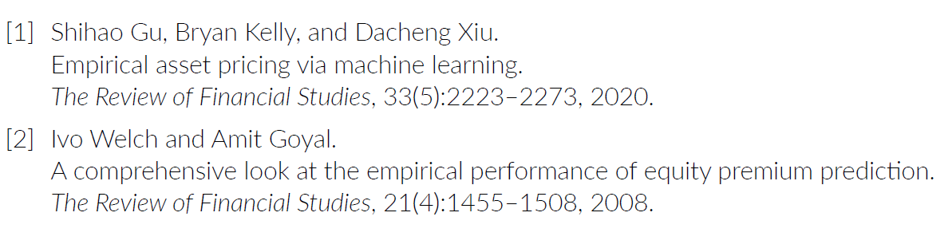
Reference

