Slide 1
G-Research Crypto Forecasting Project Presentation
Zezhen DING
MATH 5470
2024.4.23
https://www.youtube.com/watch?v=5MhllnCfp40

Slide 2
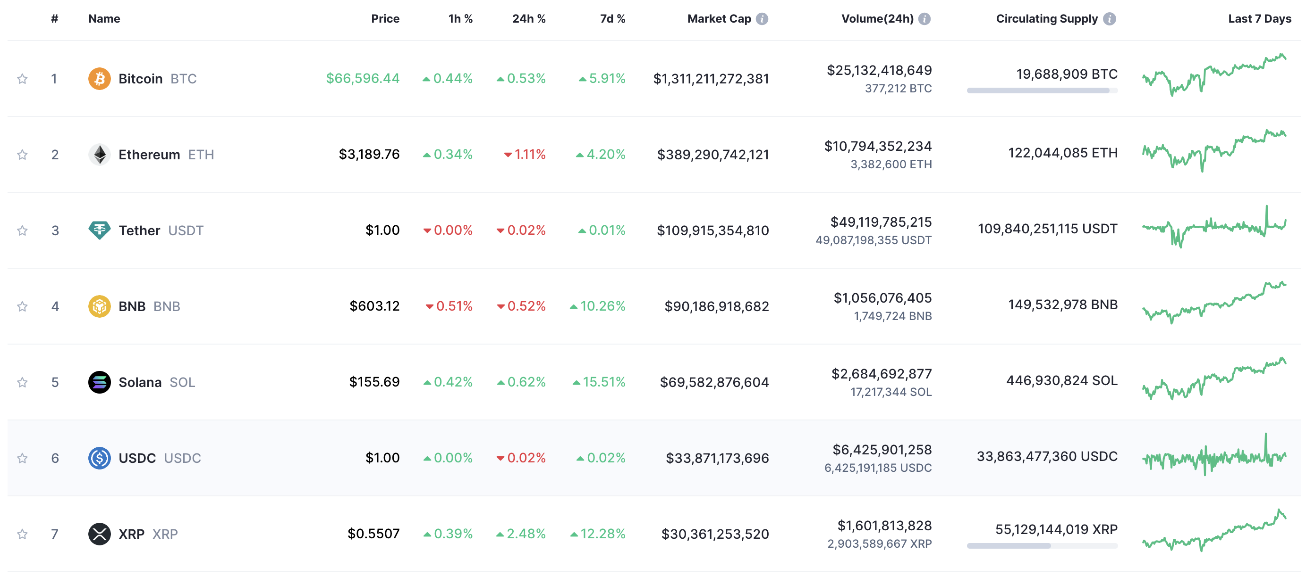
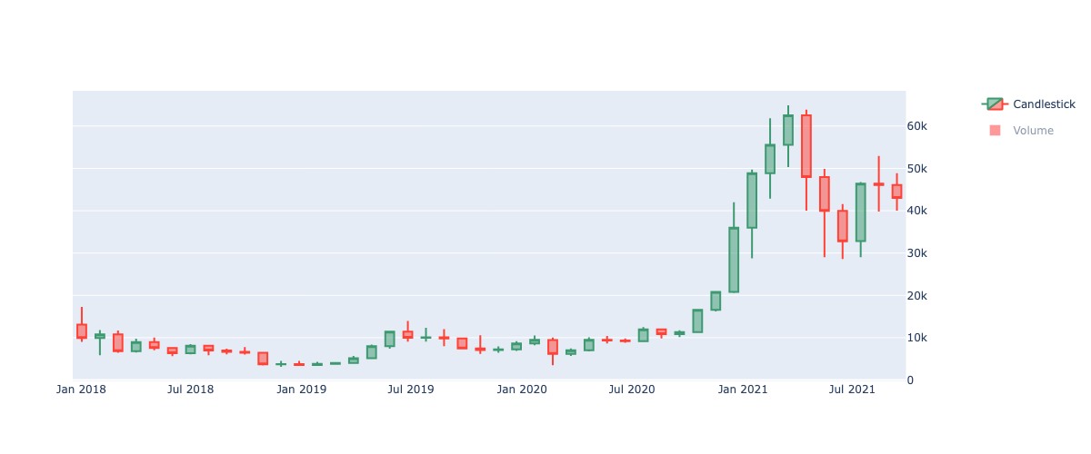
Introduction

Slide 3
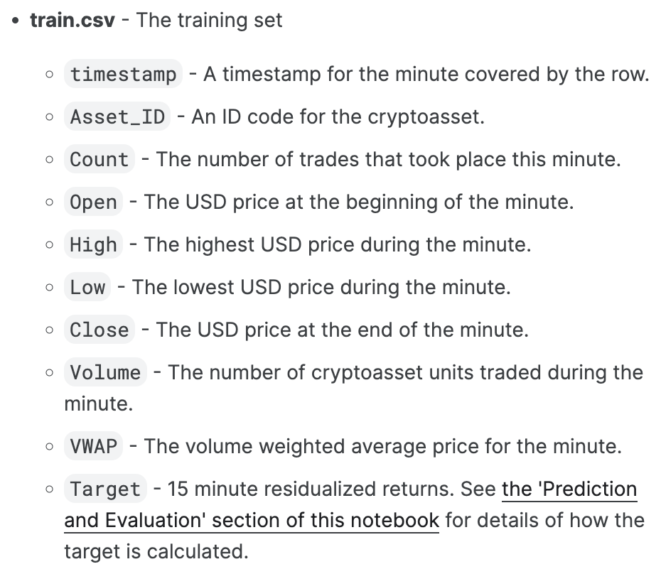
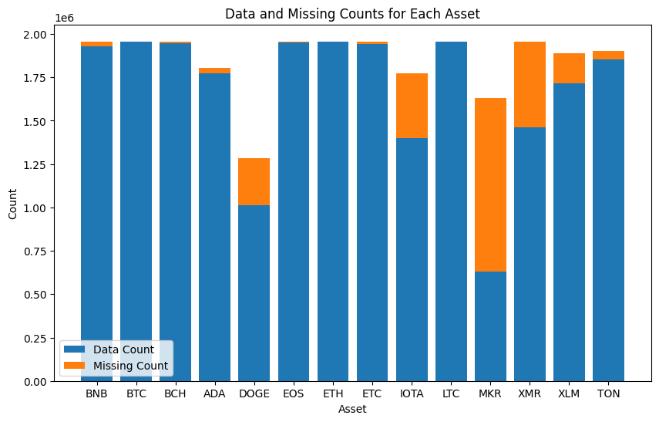
Data analysis
* 14 crypto-assets
* 24236807 samples
* 1956960 unique timestamp’s, from 2018.01.01 to 2021.09.21

Slide 4

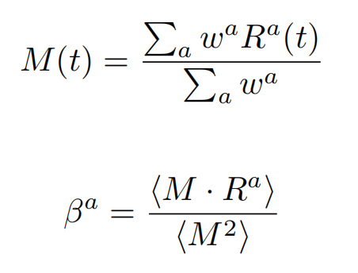

Project target
Ret900s
Original Target

Slide 5
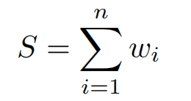
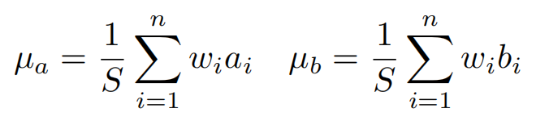
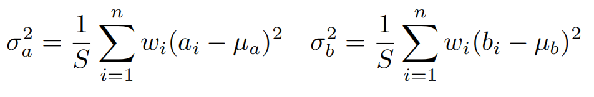
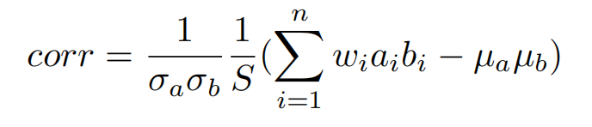
Evalation
Weighted correlation

Slide 6
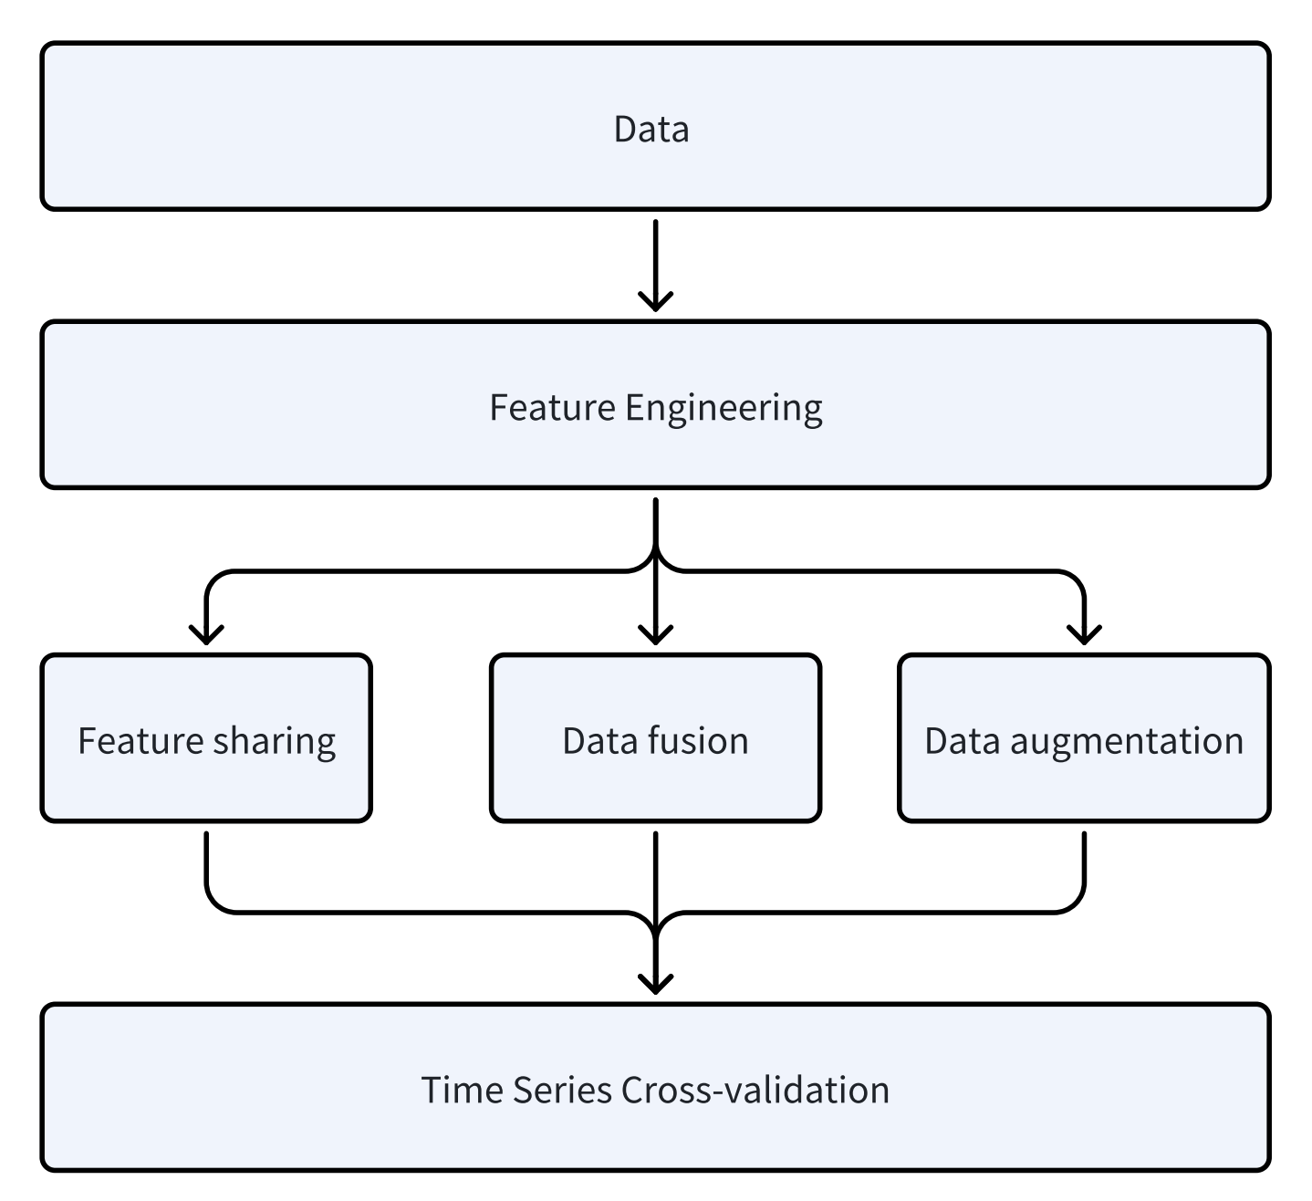
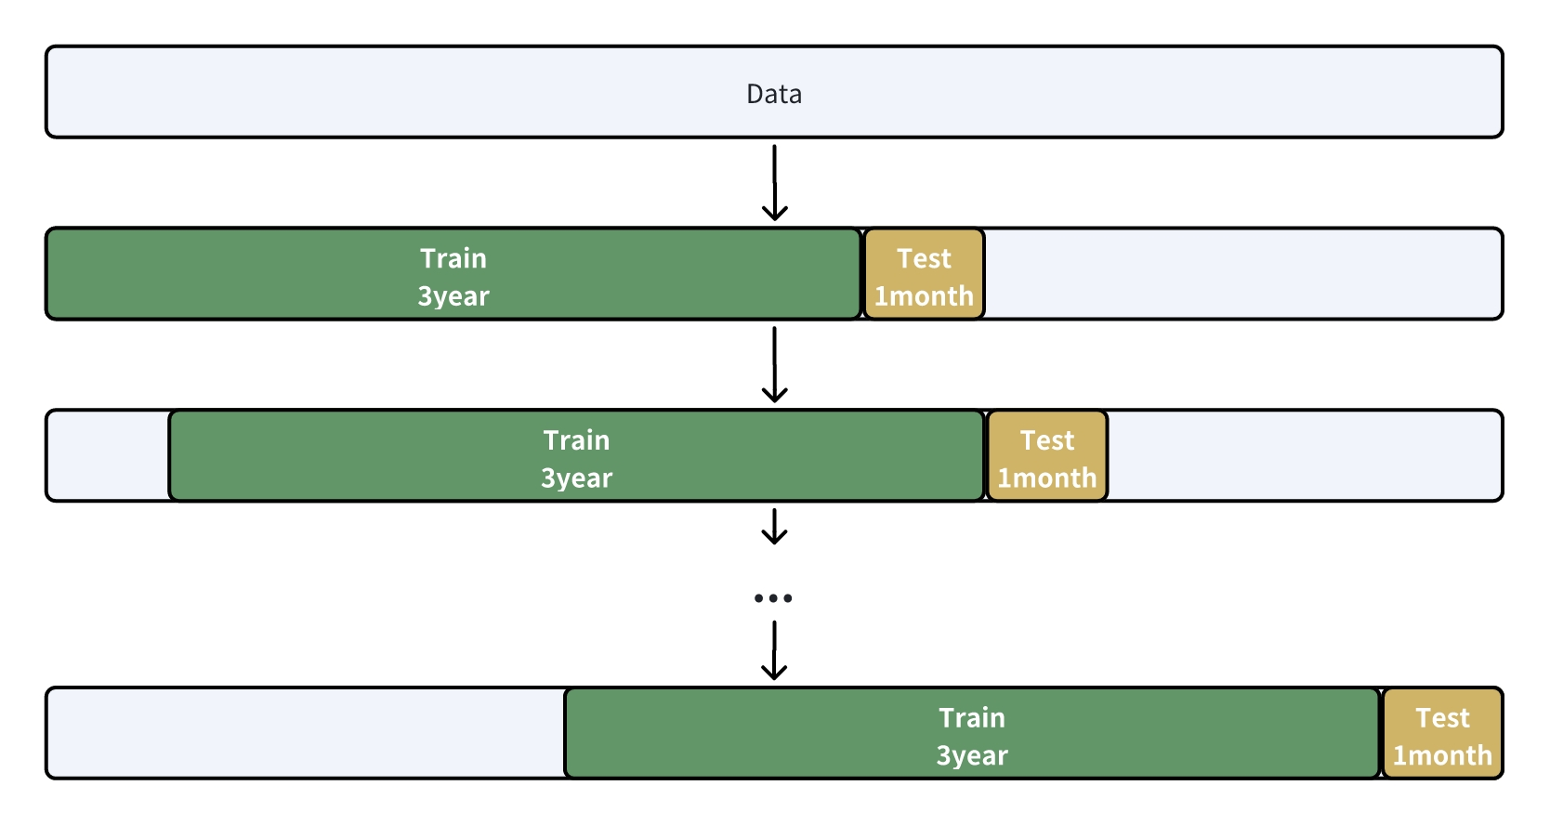
Pipline

Slide 7
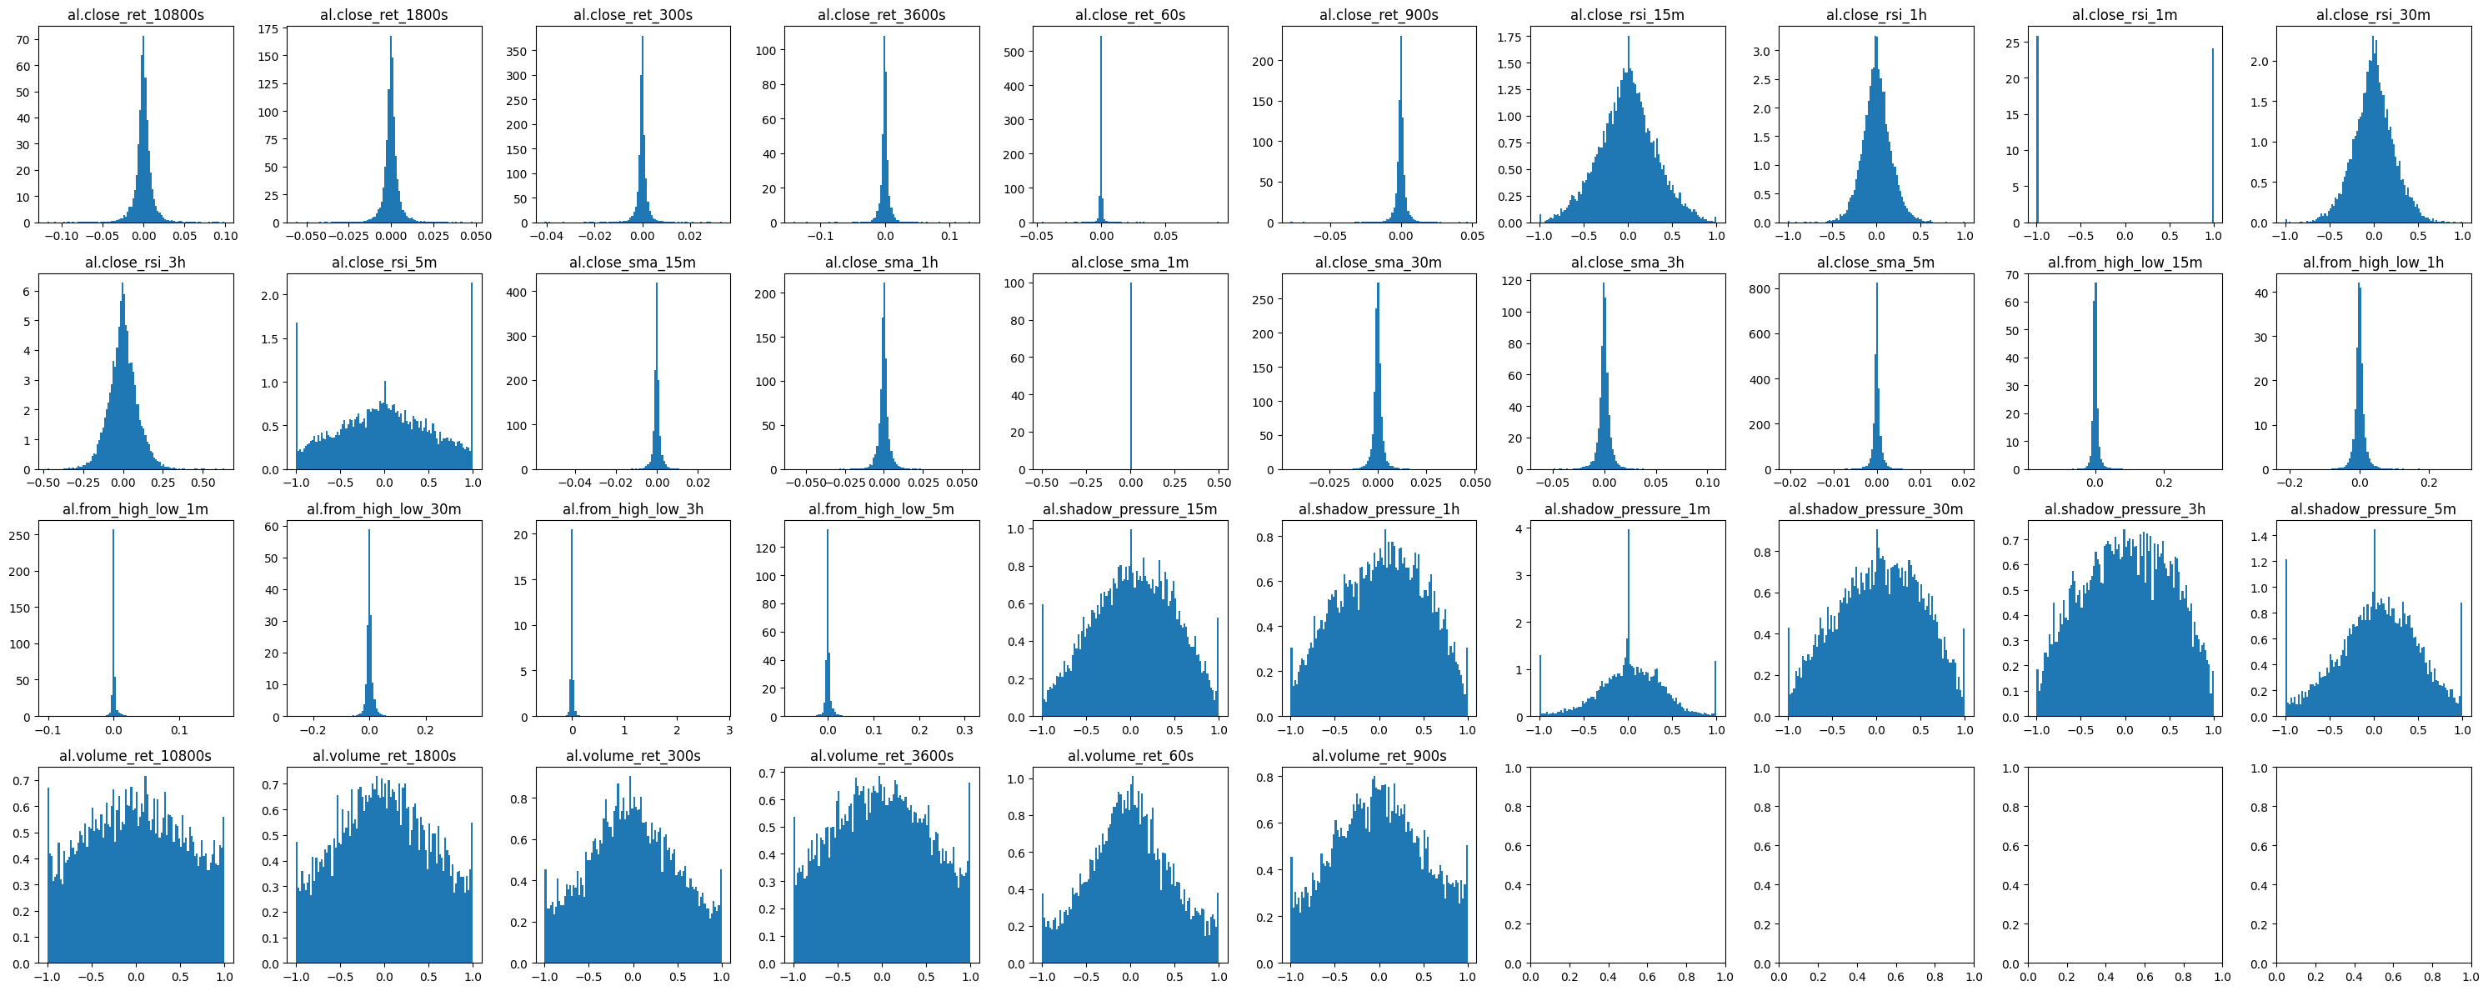
Feature Engineering
Simple Moving Average (SMA)
Exponential Moving Average (EMA)
Moving Average Convergence Divergence(MACD)
Relative Strength Index(RSI)
Bollinger Bands
Back Return
Shadow features

Slide 8
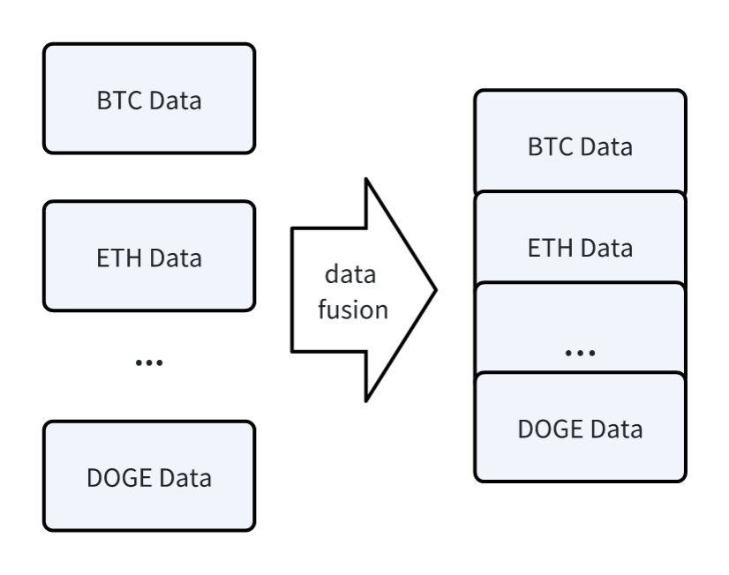
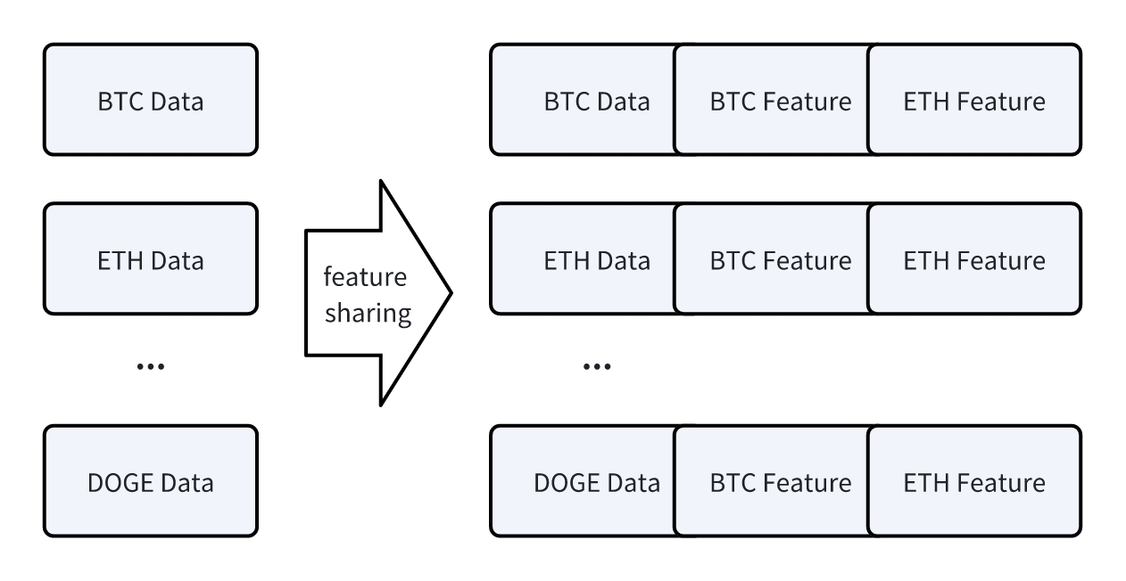
Data Process
Data fusion
Feature sharing

Slide 9
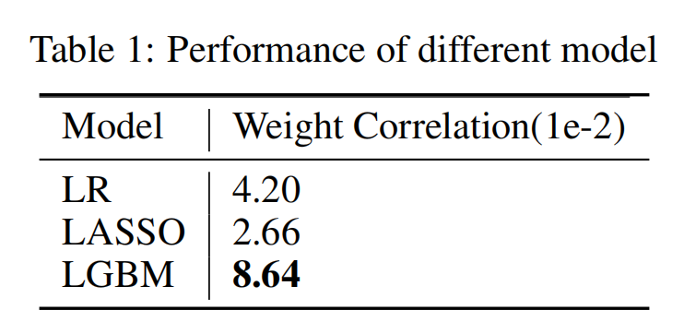
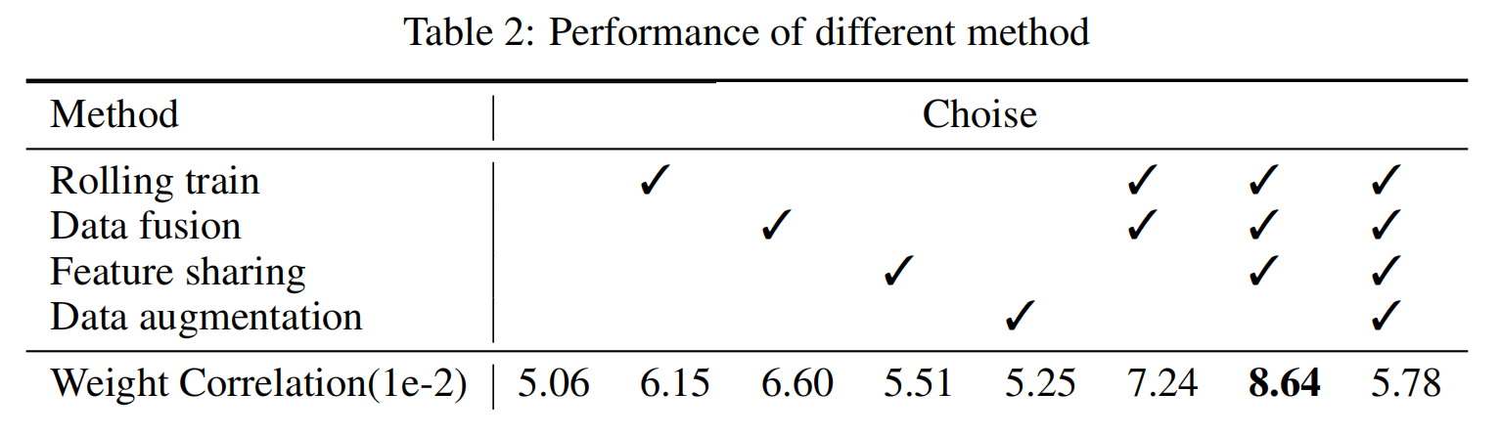
Experiments

Slide 10
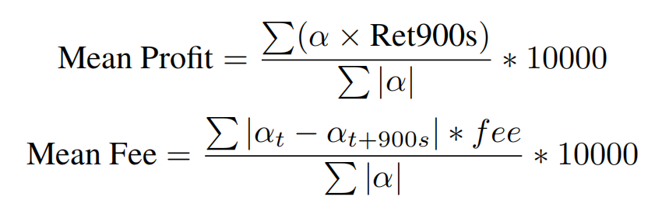
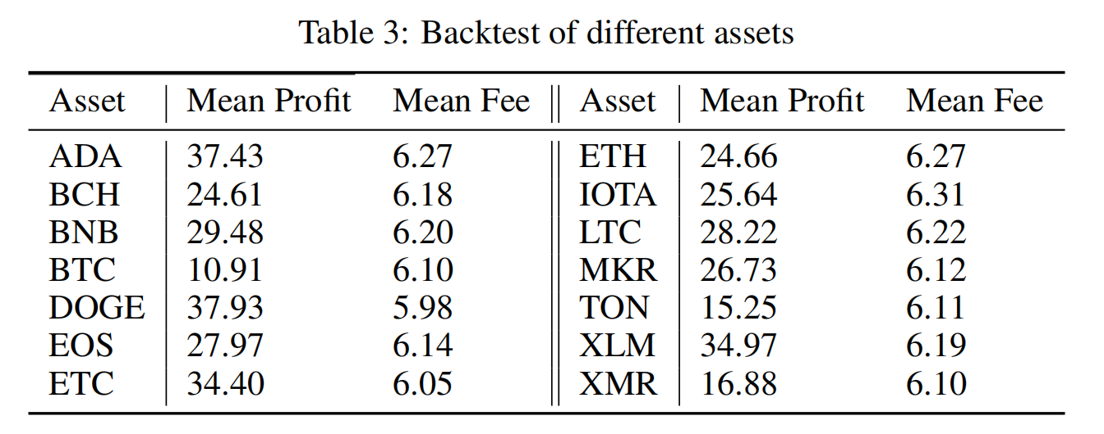
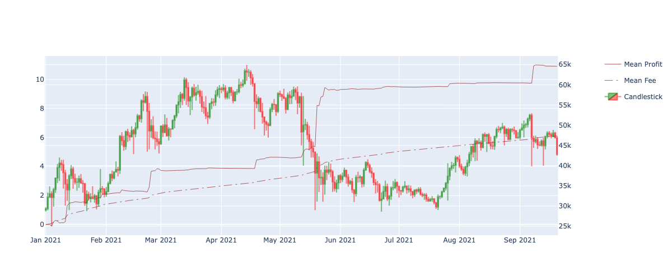
Simple backtest
Strategy: Assume that the signal output by the model is α. We open a positionwith the value of α every minute. If α is positive, we will go long, and if α is negative, we will go short. The position will be closed after 15 minutes.

Slide 11
Conclusion and future work
Conclusion:
* Build a profitable model and strategy.
* LGBM is better than linear regression and lasso regression
* Data processing is useful and brings big performance improvements
* Different assets can share one model
Problem:
* Profits are concentrated at certain times
Future:
* Post-processing fitting value to reduce handling fees
* Feature engineering and data process
* Try training the model with deep learning

