Slide 1
MATH5470 Project
Home Credit Default Risk
Student name: LI Shihao
Department: Civil and Environmental Engineering
https://youtu.be/uDfEL4mmJKk

Slide 2
Table of Contents
Background
Data overview
Methods
Results and analysis
Conclusions and future work

Slide 3

Part 1 Background
Kaggle competition: Home Credit Default Risk
Clients with insufficient credit history
To predict the default risk by machine learning
Data of loan experiences and alternative data (e.g. telecommunication information)

Slide 4
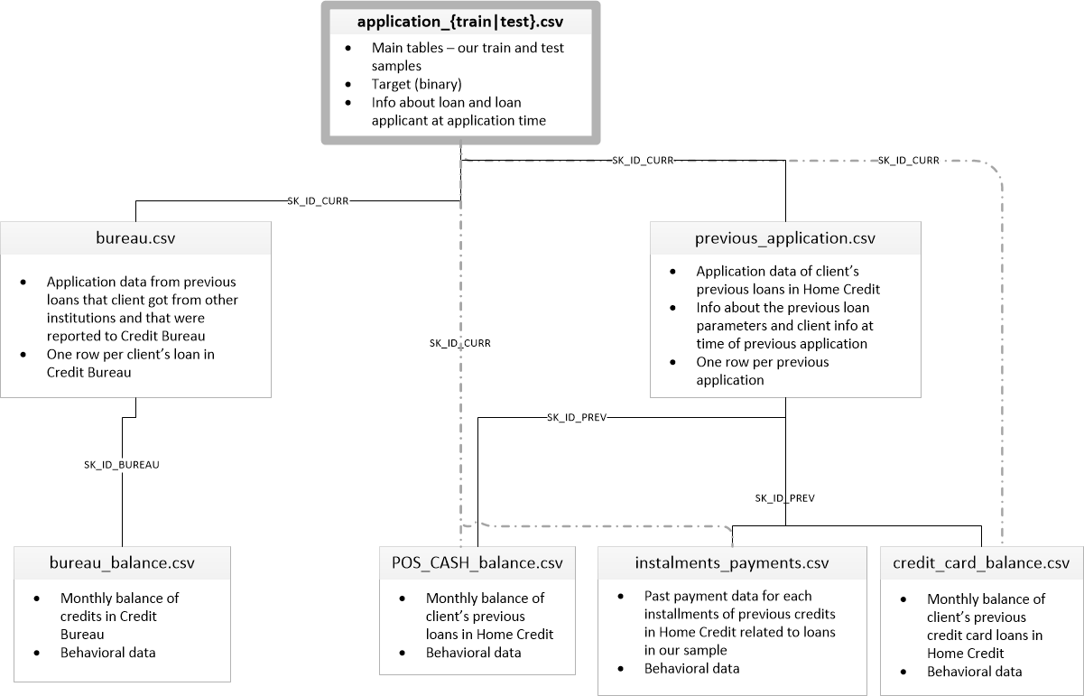
Part 2 Data overview
122 columns in the training data
Numerical values and categorical values
67 of 122 columns has missing values in the training data

Slide 5
Part 3 Methods
Data preprocessing
Drop columns with missing value numbers over the threshold
Missing value is replaced with mean value of the column
Label encoding for categorical values
Remove outliers of abnormal large values
Time data are corrected to positive values
Ratio of training data and validation data is 4:1
Training
Training
Training
Training
Validation
Model Training
Logistic regression
Random forest
XGBoost

Slide 6
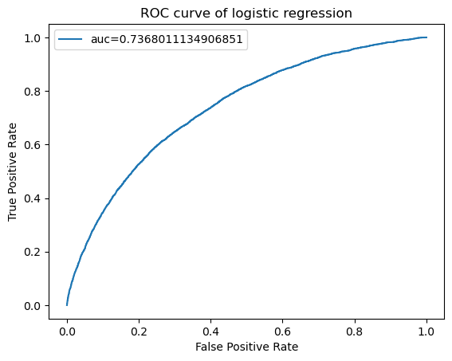
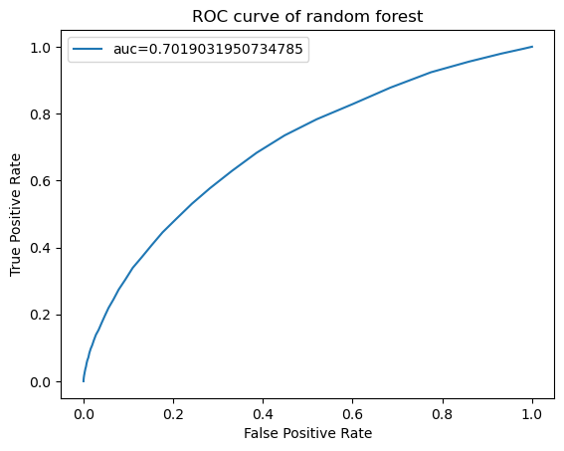
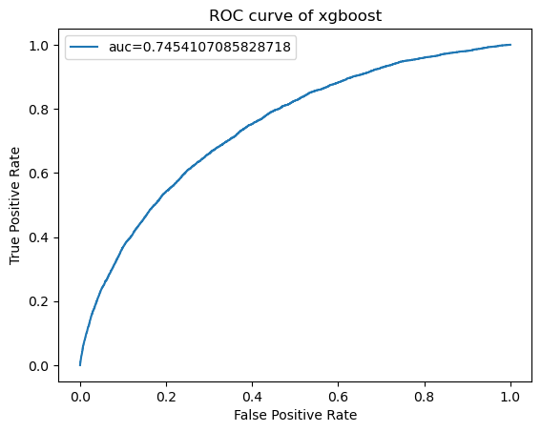
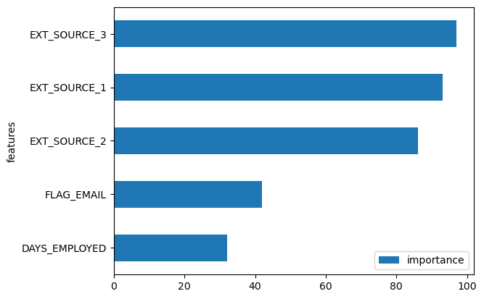
Part 4 Results and analysis
Method | ROC-AUC (validation) | Public score
Linear regression | 0.7368 | 0.7320
Random forest | 0.7019 | 0.6545
XGBoost | 0.7454 | 0.7234

Slide 7
Part 5 Conclusions and future work
Machine learning is powerful in make predictions of credit default but appropriate training model should be analysed and adopted.
Datasets need to be corrected based on financial knowledge and missing values should be replaced with characteristic values.
Lack of enough feature selection and analysis
Hyperparameters
Other training models like neural networks

Slide 8
Thank you

