Slide 1
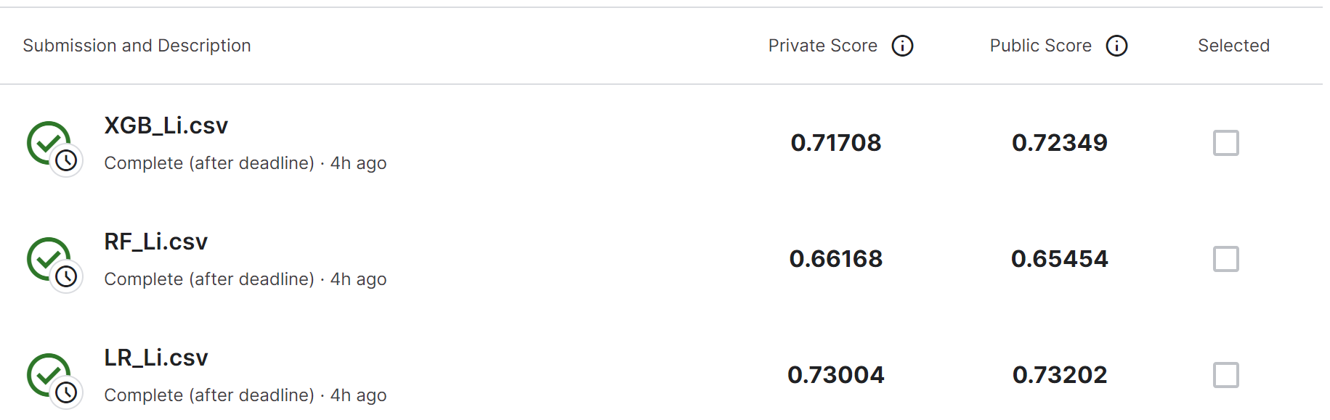
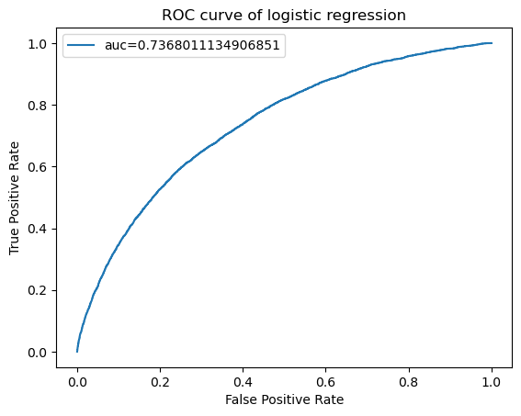
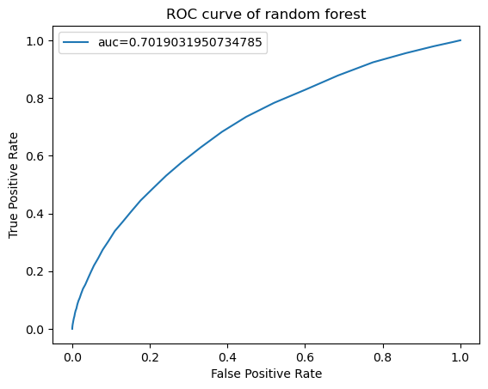
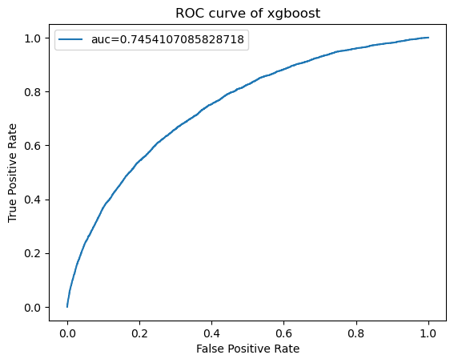
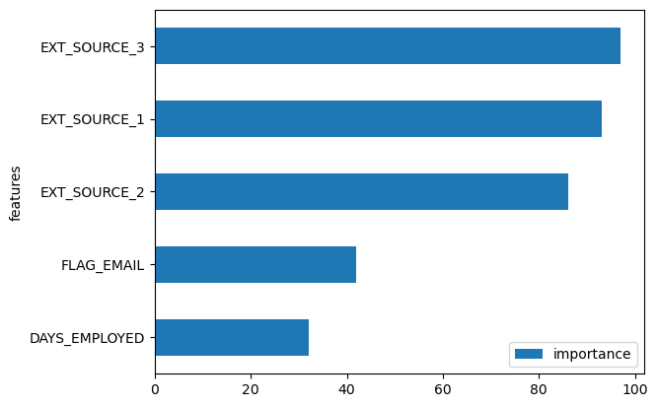
MATH 5470 Project: Home Credit Default Risk
Shihao Li¹ sliek@connect.ust.hk
¹: Department of Civil and Environmental Engineering, HKUST
1. Introduction
4. Results and analysis
For clients with insufficient credit histories, Home Credit aims to provide financial service for these people by evaluating their loan experiences and alternative data. The key challenge is to make accurate prediction of default using techniques of machine learning , and in the mean time demonstrate its potential in good predictive performance.
After model training, the ROC curves of logistic regression, random forest and XGBoost are plotted and the ROC-AUC score are 0.7368, 0.7019, 0.7454, respectively. Public scores by Kaggle are 0.7320, 0.6545, 0.7234.
Bsed on the public scores, linear regression performs best and random forest is relatively weak in prediction. This is in consistency with the ROC-AUC scores of training.
After extracting feature importance for XGBoost, it can be seen that EXT_SOURCE 1, 2 and 3 is of great importance.
Private and public scores
2. Dataset
5. Conclusions
Home Crdeic Default Risk competition from Kaggle provide 10 files containg clients’ data and column description for analysis. “application_train.csv” is used for model training and features in the “application_train.csv” are used to predict the default.
Data Distribution
Through statistical analysis, there are 122 and 121 columns in application_train and application_test. Missing values occur in 67 and 64 columns for application_train and application_test. Both numerical variables and categorical variables exist in the data, and there are time values that violates the meaning of the feature. These abnormal values need to be tackled with for the training of models.
Machine learning is powerful in make predictions of credit default but appropriate training model should be analysed and adopted.
Datasets need to be corrected based on financial knowledge and missing values should be replaced with characteristic values.
6. Future work
The prediction score is not satisfying enough, which may be due to lack of enough feature selection and analysis. Hyperparameters involved in the methods could be tuned to optimize the training process. In addition, other training models like neural networks could be added to compare the performance.
3. Methods
ROC curve of linear regression
ROC curve of random forest
Data preprocessing
Drop columns with missing value numbers over the threshold
Missing value is replaced with mean value of the column
Label encoding for categorical values
Remove outliers of abnormal large values
Time data are corrected to positive values
Ratio of training data and validation data is 4:1
Model Training
Logistic regression
Random forest
XGBoost
7. References
Addo, P. M., Guegan, D., & Hassani, B. (2018). Credit risk analysis using machine and deep learning models. Risks, 6(2), 38.
8. Contribution
Data processing, analysis and presentation
LI Shihao
ROC curve of XGBoost
Feature importance

