Slide 1
Paper Replication: (Re-)Imag(in)ing Price Trends
Wang wentao, HAN Yingyue, JIN Yuhang
May 06, 2024

Slide 2

Outline
1. Background
2. Methodology
2.1. Data processing
2.2. Convolutional neural network
3. Replication results
3.1. CNN model prediction
4. Extensions
4.1. Robustness test
4.2. Implementation of Grad-CAM
4.3. Regression analysis
5. Conclusion

Slide 3
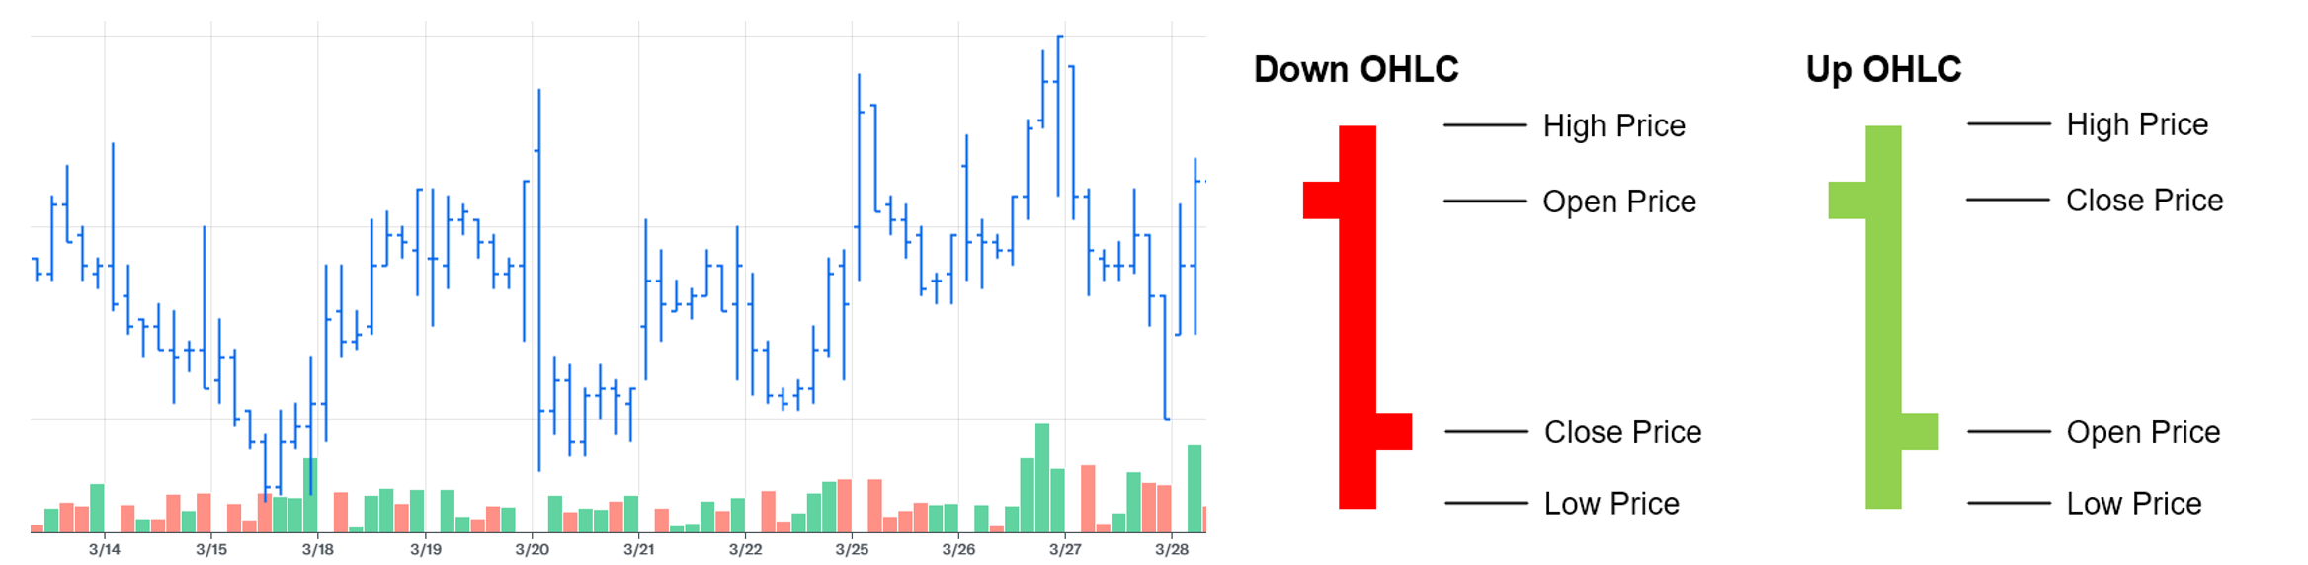
Background
Background
The predictive capacity of past prices for future returns has been a subject of enduring interest
OHLC chart for Xiaomi Corporation stock with daily volume bars
Our tasks
Replication
Construct a CNN model to learn stock price patterns
Evaluate the performance of the trained CNN model
Extension
Robustness test
Implementation of Grad-CAM
Regression analysis

Slide 4
Outline
1. Background
2. Methodology
2.1. Data processing
2.2. Convolutional neural network
3. Replication results
3.1. CNN model prediction
4. Extensions
4.1. Robustness test
4.2. Implementation of Grad-CAM
4.3. Regression analysis
5. Conclusion

Slide 5
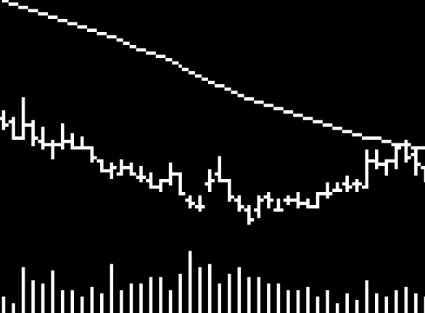
Methodology
Data processing
Input: 20-day OHLC images from 1993 to 2019 in gray scale
Each image in our dataset is represented as a matrix of pixel values (0 or 255 for black or white pixels)
Label: 1 if next 20-day return is positive, and 0 otherwise

Slide 6
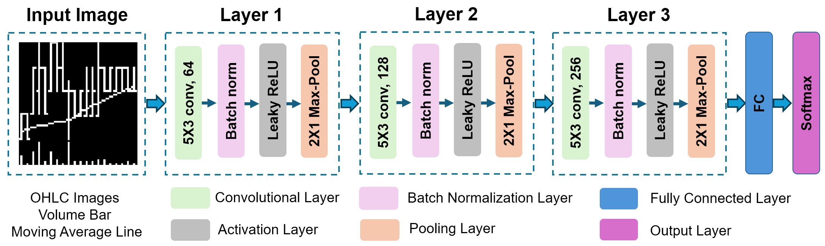
Methodology
Convolutional neural network
CNN impose cross-parameter restrictions that dramatically reducem parameterization
CNN embed tools that make the model resilient to deformation and re-positioning of important objects in the image
A baseline CNN architectures with 3 conv blocks and connected with a fully connected layer as a classifier head

Slide 7
Outline
1. Background
2. Methodology
2.1. Data processing
2.2. Convolutional neural network
3. Replication results
3.1. CNN model prediction
4. Extensions
4.1. Robustness test
4.2. Implementation of Grad-CAM
4.3. Regression analysis
5. Conclusion

Slide 8
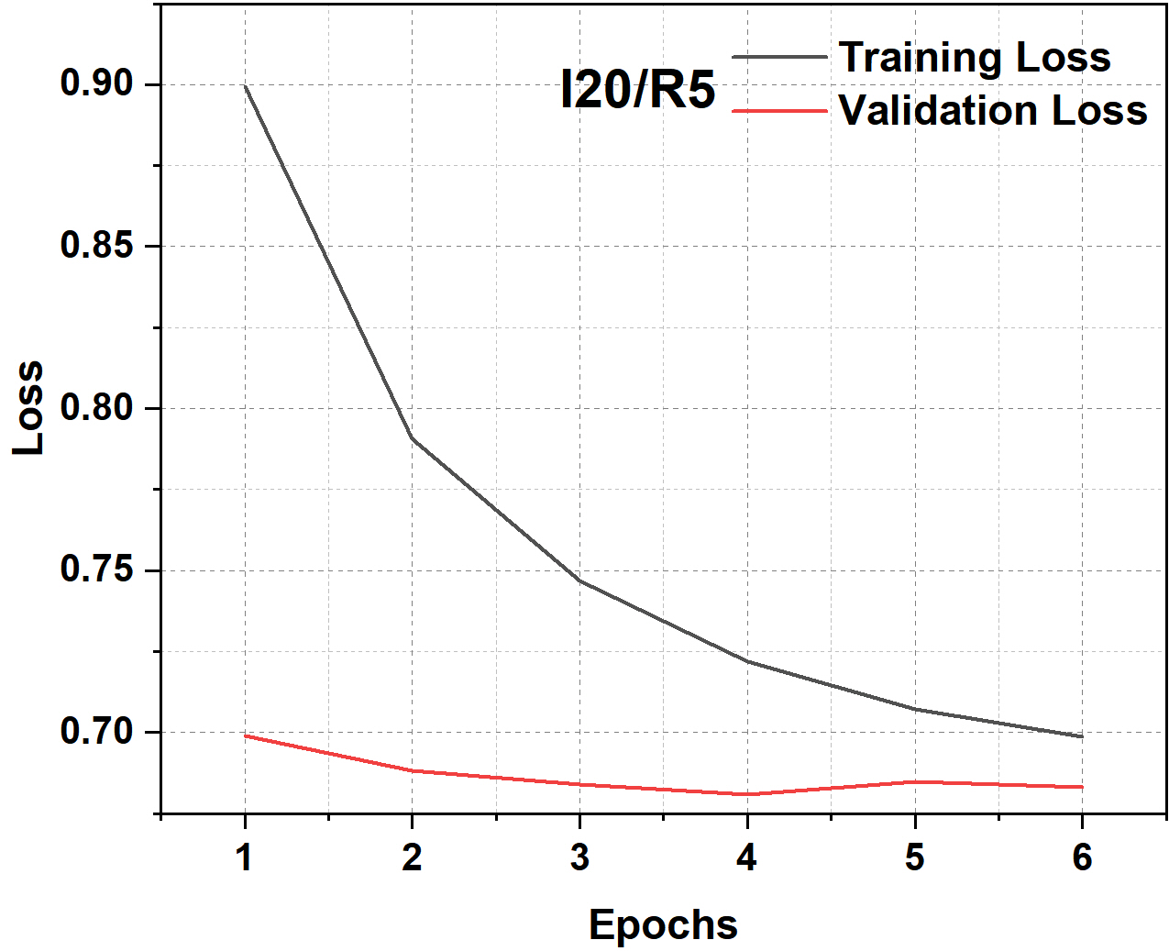
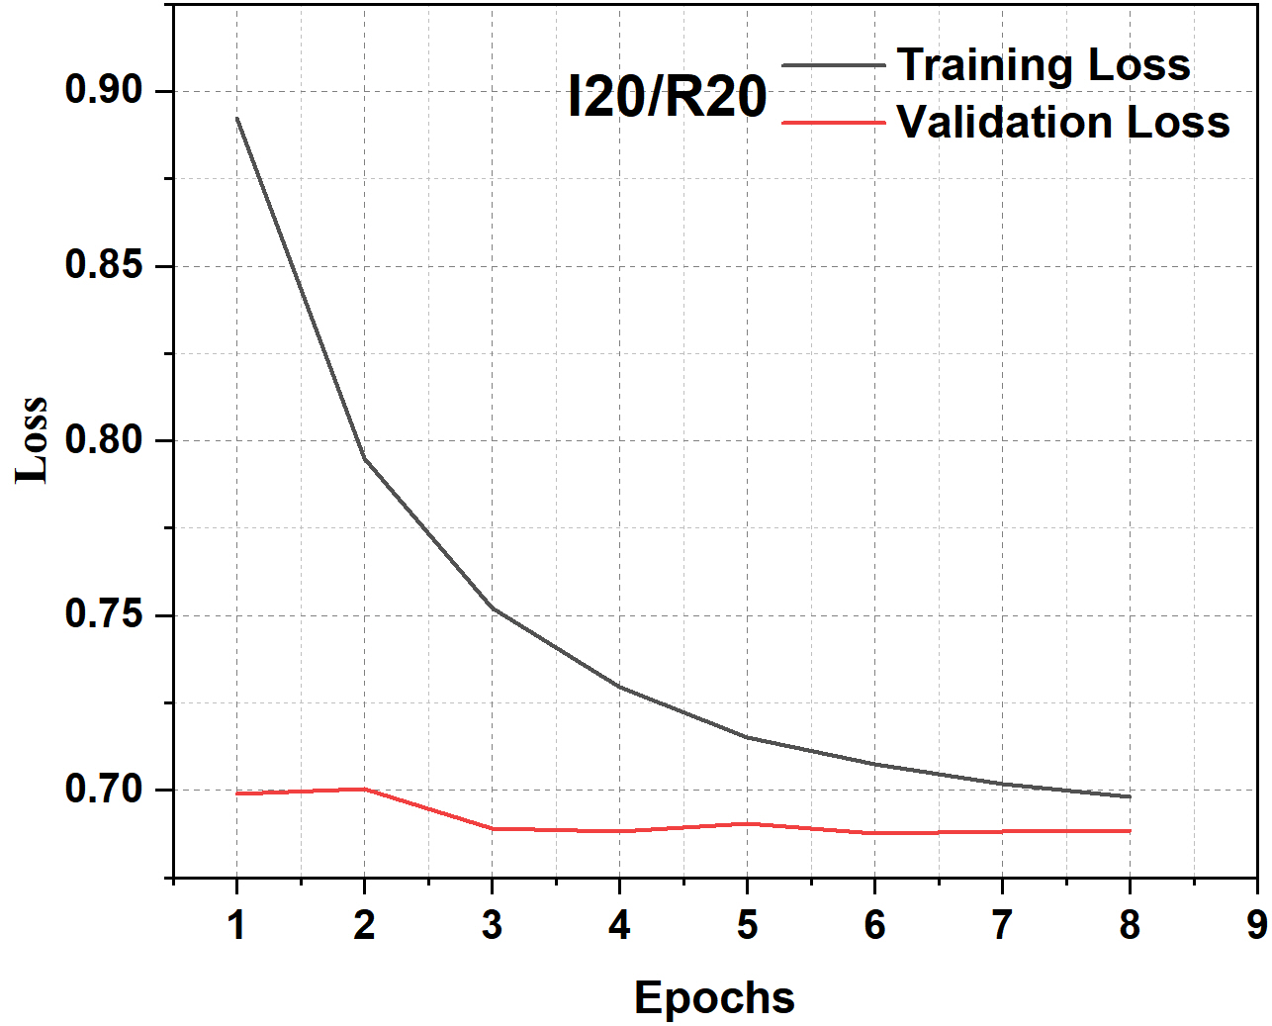
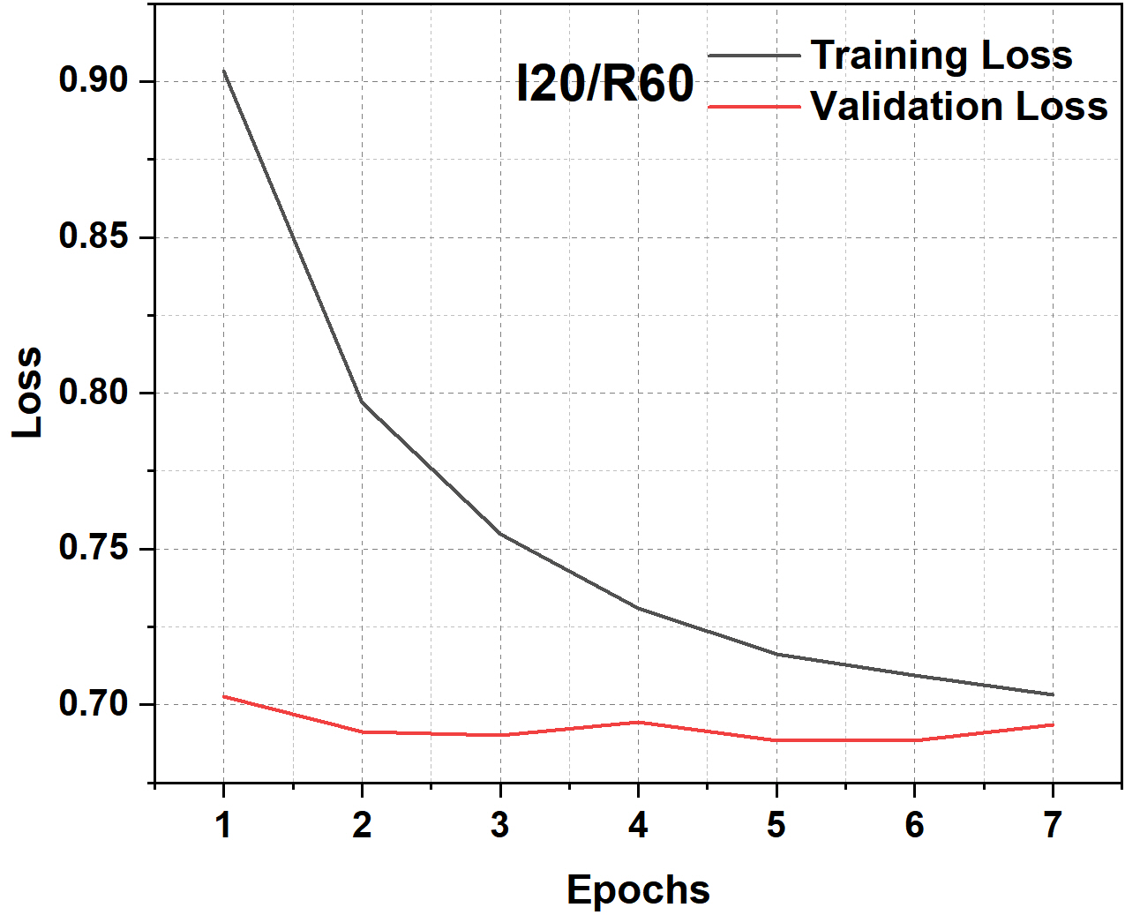
Replication results
CNN model prediction
CNN performance among three predicting tasks, including the 5-day, 20-day, and 60-day return trends
Return Horizon | Accuracy | F1-score | Recall | ROC AUC | Sharp Ratio
05-Day | 0.531 | 0.585 | 0.649 | 0.503 | 1.278
20-Day | 0.518 | 0.471 | 0.411 | 0.485 | 0.797
60-Day | 0.535 | 0.603 | 0.654 | 0.508 | 1.309
Training and validation losses

Slide 9
Outline
1. Background
2. Methodology
2.1. Data processing
2.2. Convolutional neural network
3. Replication results
3.1. CNN model prediction
4. Extensions
4.1. Robustness test
4.2. Implementation of Grad-CAM
4.3. Regression analysis
5. Conclusion

Slide 10
Extensions
Robustness test
Sensitivity to model structure and estimation
 | Variation | Accuracy | F1-score | Recall | ROC | Sharp Ratio
Baseline |  | 0.518 | 0.471 | 0.411 | 0.485 | 0.797
Filter (64) | 32 | 0.527 | 0.548 | 0.549 | 0.498 | 1.050
 | 128 | 0.528 | 0.578 | 0.621 | 0.504 | 1.220
Layer (3) | 2 | 0.522 | 0.521 | 0.499 | 0.494 | 0.955
 | 4 | 0.528 | 0.584 | 0.634 | 0.505 | 1.255
Dropout (0.50) | 0.00 | 0.502 | 0.380 | 0.293 | 0.486 | 0.626
 | 0.25 | 0.524 | 0.575 | 0.617 | 0.501 | 1.219
 | 0.75 | 0.532 | 0.581 | 0.623 | 0.503 | 1.215
BN (yes) | no | 0.523 | 0.527 | 0.509 | 0.493 | 0.972
Xavier (yes) | no | 0.530 | 0.577 | 0.613 | 0.504 | 1.195
Activation (LReLU) | ReLU | 0.525 | 0.553 | 0.563 | 0.496 | 1.087
Max-pool Size (2×1) | (2×2) | 0.525 | 0.595 | 0.669 | 0.508 | 1.366
Filter Size (5×3) | (3×3) | 0.521 | 0.506 | 0.471 | 0.491 | 0.901
Dilation/Stride (2,1)/(3,1) | (2,1)/(1,1) | 0.528 | 0.578 | 0.621 | 0.505 | 1.220
 | (1,1)/(3,1) | 0.527 | 0.582 | 0.630 | 0.507 | 1.249
 | (1,1)/(1,1) | 0.528 | 0.560 | 0.575 | 0.502 | 1.105

Slide 11
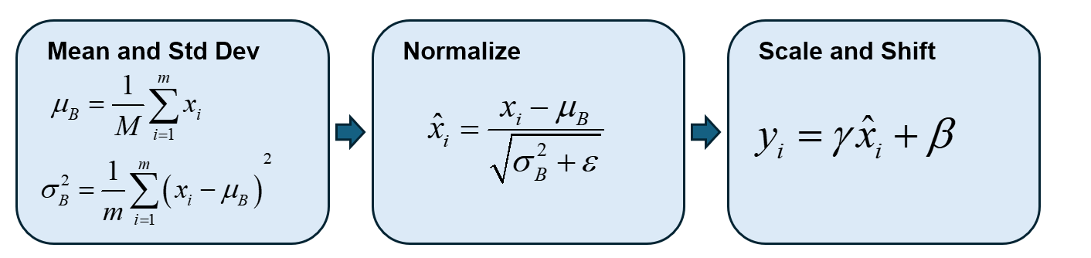
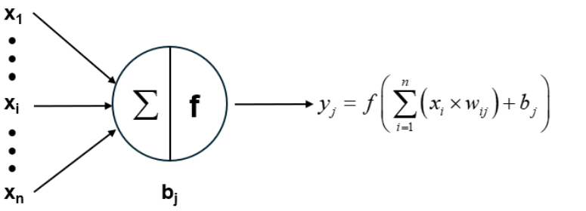
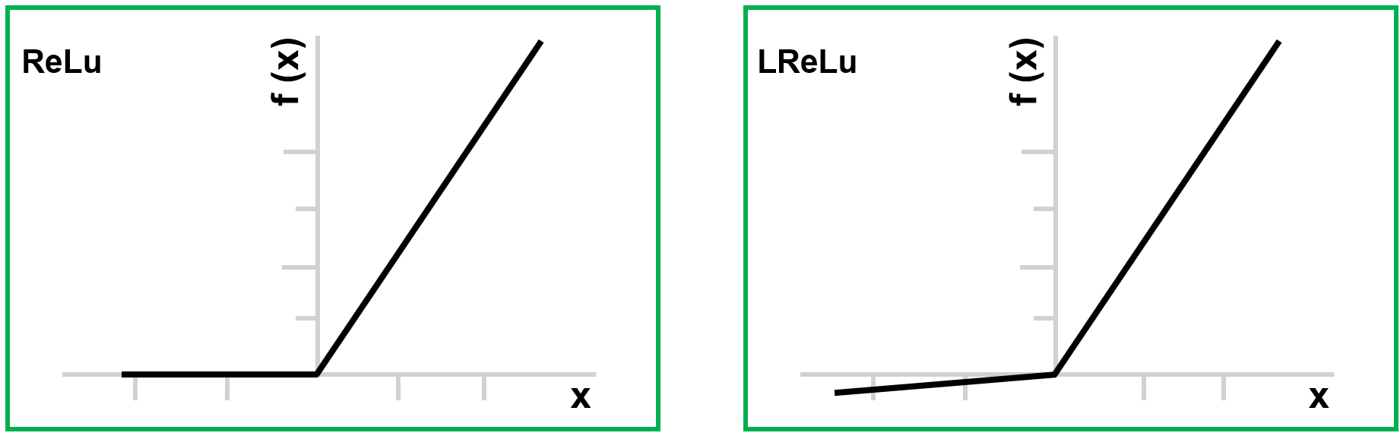
Extensions
Robustness test
Batch Normalization (BN)
Diagram of Batch Normalization steps
Activation function
General activation function structure
Diagrams of ReLu and LReLU

Slide 12
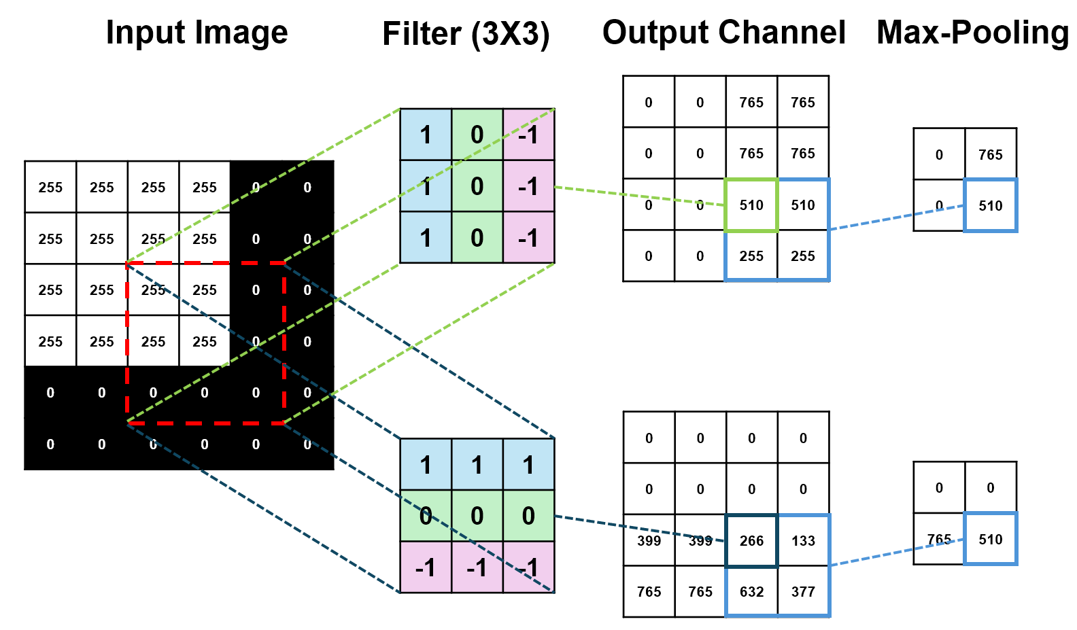
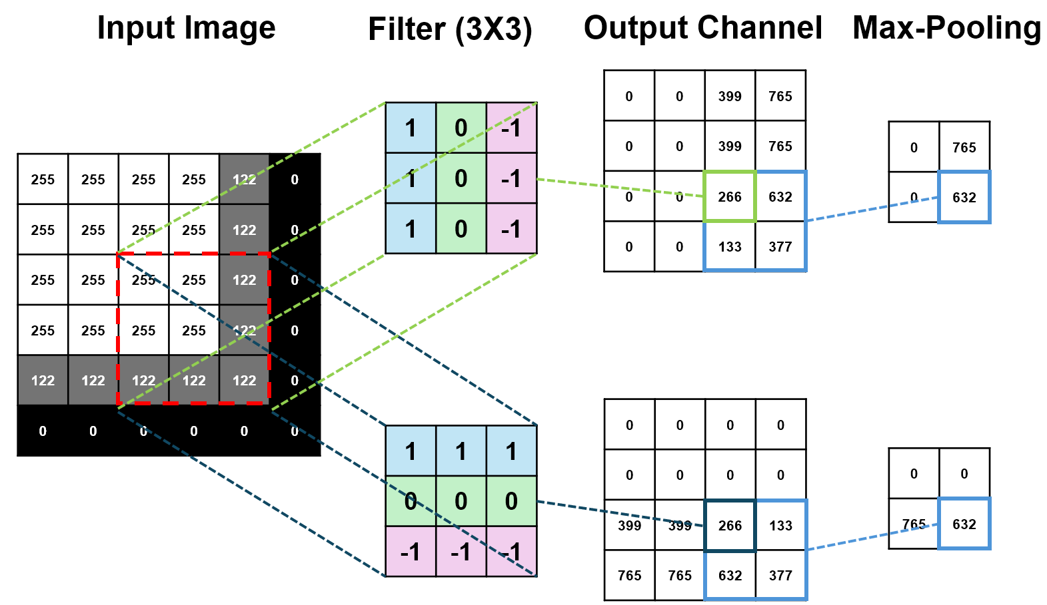
Extensions
Robustness test
A pooling layer capitalizes on the principle of local correlation within images to condense the image size effectively
It curtails the parameter count by eliminating inconsequential features, streamlining the network's complexity without compromising its ability to capture significant patterns
Illustration of a convolutional and max-pooling operations
Robustness to Noise from Max-Pooling

Slide 13
Extensions
Robustness test
Dilation refers to spacing between the values in a kernel
Dilation rate = 1
Dilation rate = 2
Dilation | Accuracy | F1-score | Recall | ROC AUC | Sharp Ratio
(1,1) (1,1) (1,1) | 0.525 | 0.542 | 0.538 | 0.497 | 1.028
(2,2) (2,2) (2,2) | 0.522 | 0.542 | 0.551 | 0.499 | 1.065
(1,1) (2,2) (3,3) | 0.531 | 0.630 | 0.763 | 0.517 | 1.700
(1,1) (2,1) (3,1) | 0.523 | 0.542 | 0.542 | 0.495 | 1.042
(2,1) (2,1) (2,1) | 0.520 | 0.481 | 0.426 | 0.482 | 0.821

Slide 14
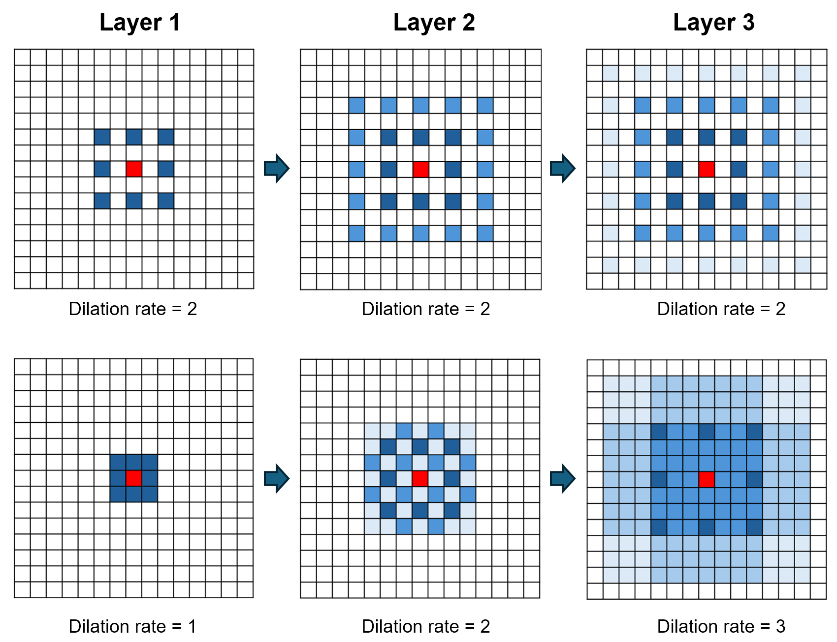
Extensions
Robustness test
How the dilation rate leads to a “grid effect”
Illustration of gridding effect problem

Slide 15
Extensions
Robustness test
Stride is the number of pixels by which we move the filter across the input.
To counteract the omission of border information, padding is employed, extending the input with zeros to subtly alter its size
Stride = 1, Padding = 0
Stride = 1, Padding = 1
Stride = 2, Padding = 0
Stride = 2, Padding = 1

Slide 16
Outline
1. Background
2. Methodology
2.1. Data processing
2.2. Convolutional neural network
3. Replication results
3.1. CNN model prediction
4. Extensions
4.1. Robustness test
4.2. Implementation of Grad-CAM
4.3. Regression analysis
5. Conclusion

Slide 17
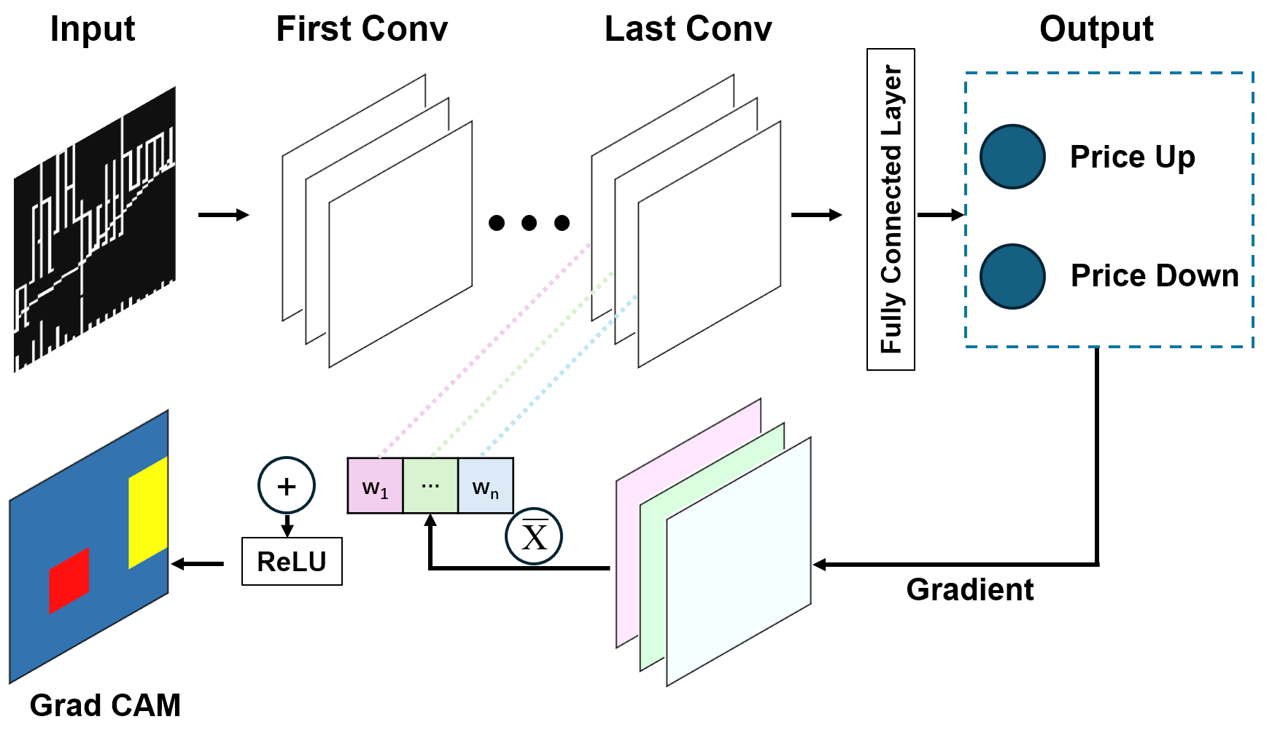
Extensions
Implementation of Grad-CAM
A visualization method Gradient-weighted Class Activation Mapping (Grad-CAM) is used
To understand how different image examples activate the regions of the CNN to trigger up or down return predictions
A schematic representation of the Grad CAM method adapted for CNN

Slide 18
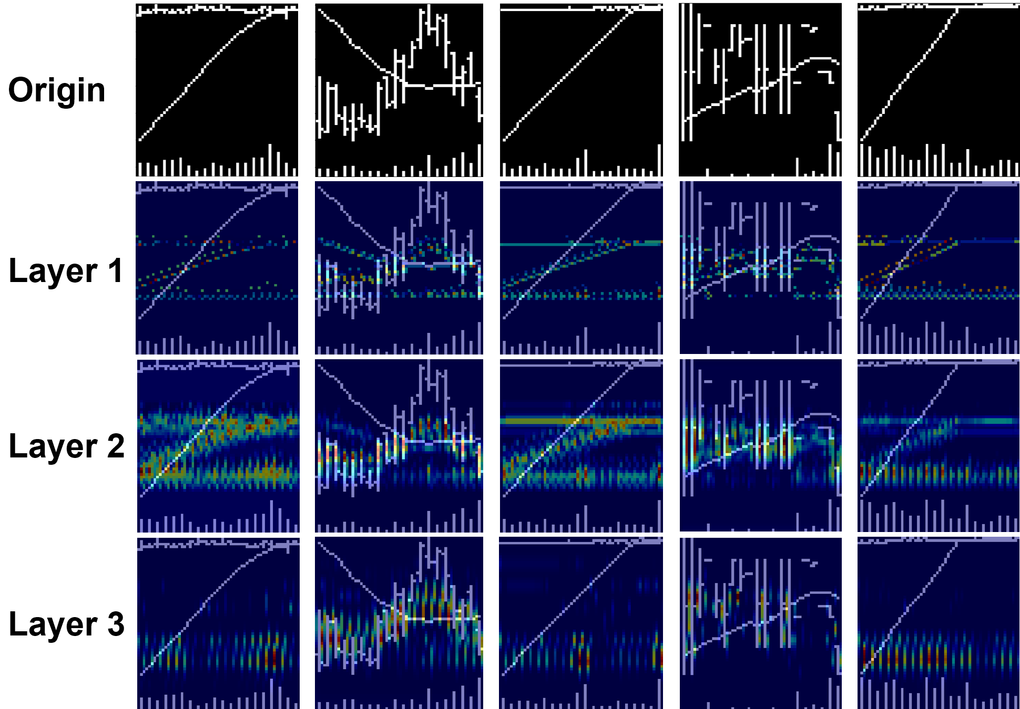
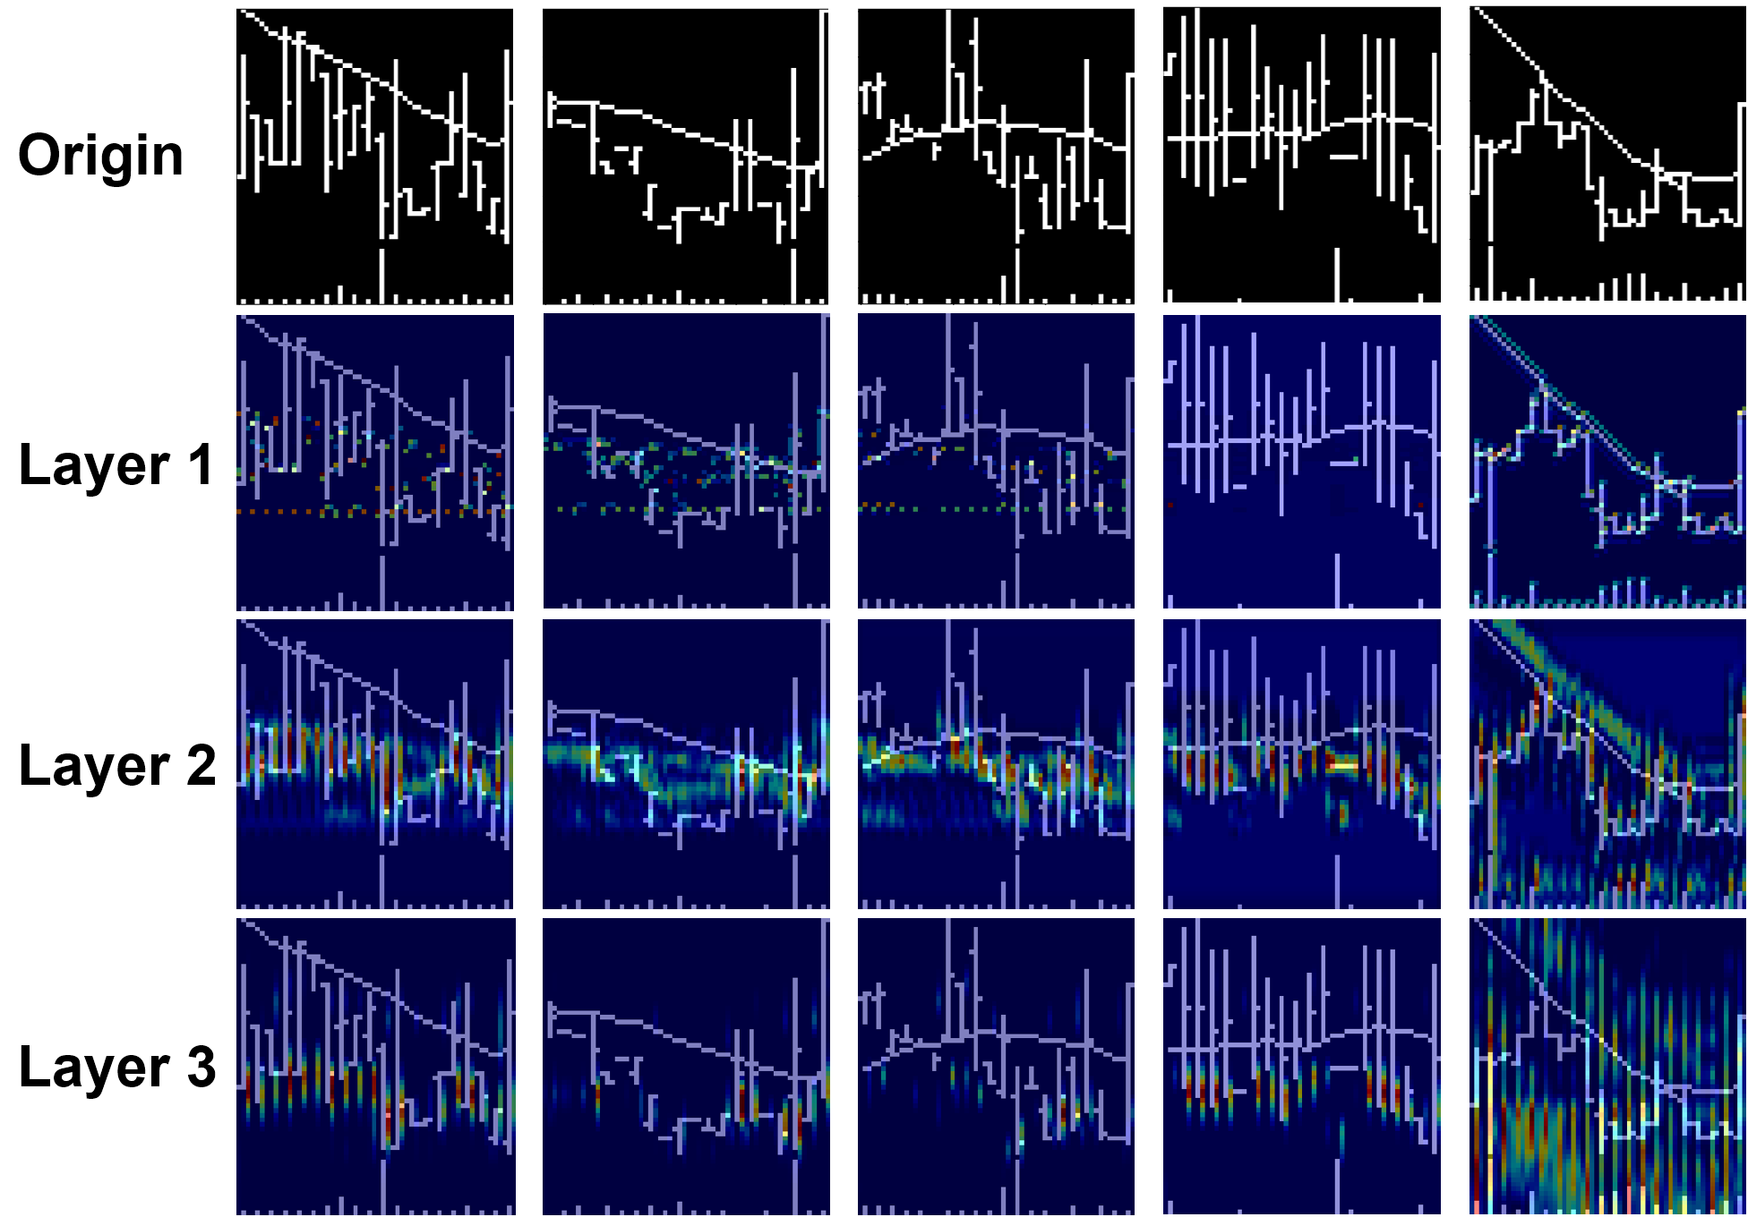
Extensions
Implementation of Grad-CAM
In the first convolutional layer, the areas of interest are relatively small
In the second and third layers, the areas of interest are larger
Areas of interest are consistent with the trend
In a down trend, the lowest price receives more attention
For images classified as "up"
For images classified as “down"

Slide 19
Outline
1. Background
2. Methodology
2.1. Data processing
2.2. Convolutional neural network
3. Replication results
3.1. CNN model prediction
4. Extensions
4.1. Robustness test
4.2. Implementation of Grad-CAM
4.3. Regression analysis
5. Conclusion

Slide 20
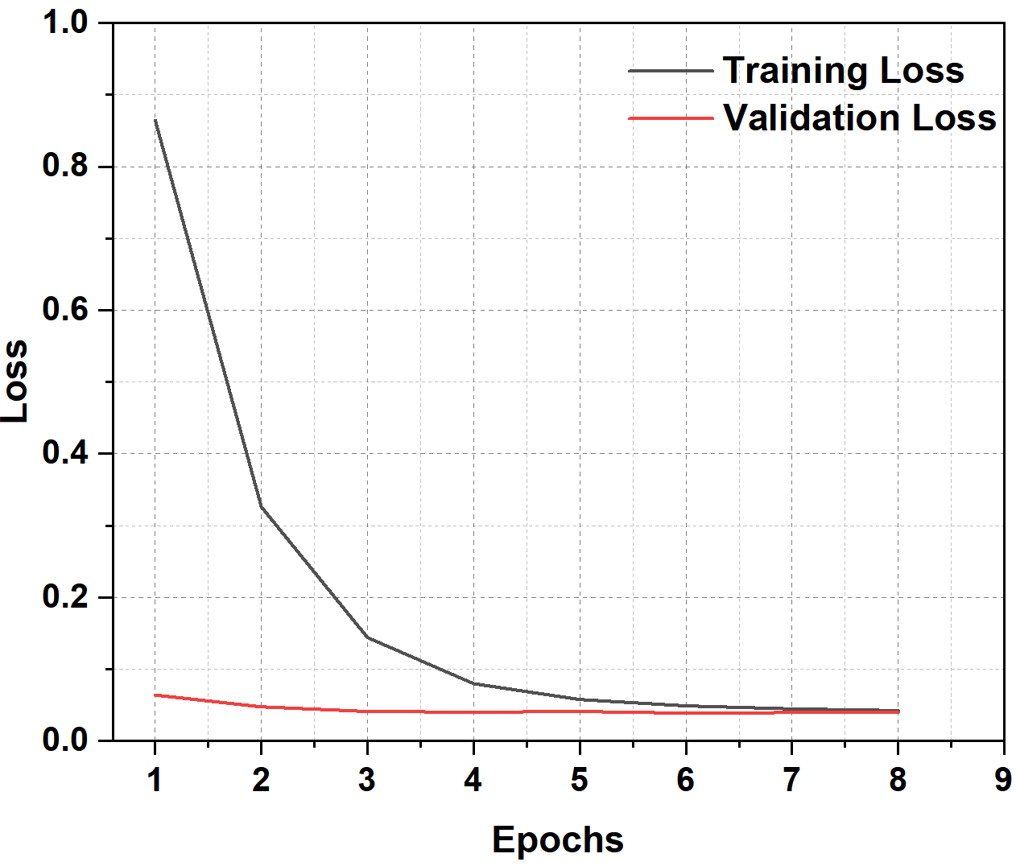
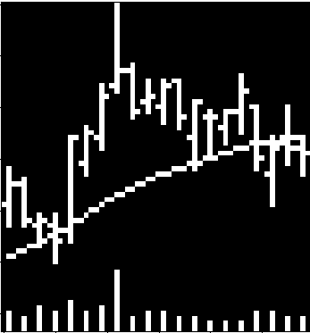
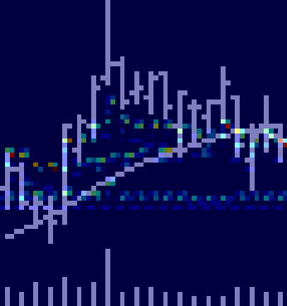
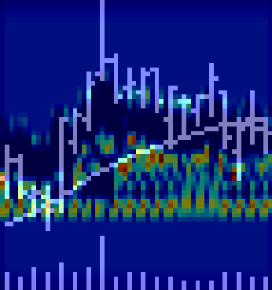
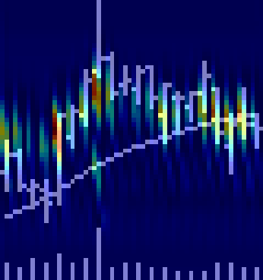
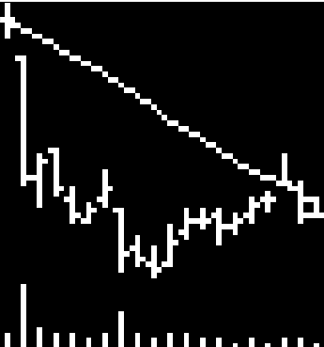
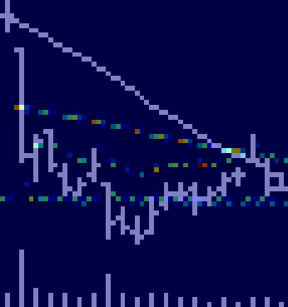
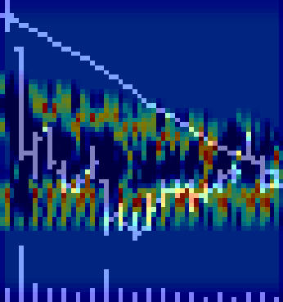
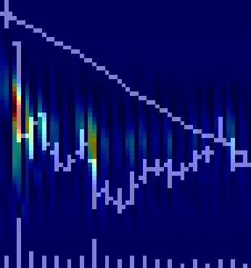
Extensions
Regression analysis
Mean absolute error
 | MAE | MAPE | R-Squared | Pearson Correlation | Sharpe Ratio
Baseline | 0.097 | 30.307 | -0.018 | 0.032 | 0.566
Origin
Layer 1
Layer 2
Layer 3
Up
Down
Training and validation losses

Slide 21
Outline
1. Background
2. Methodology
2.1. Data processing
2.2. Convolutional neural network
3. Replication results
3.1. CNN model prediction
4. Extensions
4.1. Robustness test
4.2. Implementation of Grad-CAM
4.3. Regression analysis
5. Conclusion

Slide 22
Conclusion
The replication project has substantiated the robust predictive ability of CNNs in analyzing stock-level price chart
Our findings reaffirm the original study's conclusions, underscoring the potential of machine learning in financial economic
This project conducts sensitivity tests on the parameters in the model and focuses on the influence and principles of important parameters on the prediction effect of the CNN model
Grad-CAM is used and serves as a powerful visualization tool that sheds light on the decision-making process within CNN
We go beyond simple binary classification tasks and train a regression model that can predict not only the trend but also the magnitude of the corresponding change

Slide 23
THANK YOU!

