Slide 1

MATH 5470 (Spring 2024): Final Project
G-Research Crypto Forecasting
MATH 5470: Statistical Machine Learning
May 6, 2024
Group Members: HU, Bo; WU, Hongfan; QIU, Wenxi; WANG, Zetao

Slide 2

G-Research Crypto Forecasting
Content
Introduction
Data Analysis
Network Structure
Model Improvement
Prediction Results
Conclusions

Slide 3


1. Introduction
Background: Cryptocurrencies have become an extremely popular and volatile market, with an average volume of over $40 billion traded every day, delivering massive returns as well as crushing losses to investors.
Objective: To predict short term returns of 14 popular cryptocurrencies using advanced deep learning methods. A dataset comprising of millions of rows of high-frequency (minute-by-minute) cryptocurrency trading data dating back to 2018 is used to build the model.
Challenges: Cryptocurrency returns prediction is a very challenging forecasting task considering the extreme volatility of the assets, the high interconnection between different cryptocurrencies, the market and meme manipulation, and the very fast changing market conditions. Moreover, the simultaneous activity of thousands of traders makes most signals transitory, persistent alpha will be exceptionally difficult to find, and the danger of overfitting will be considerable.
1

Slide 4
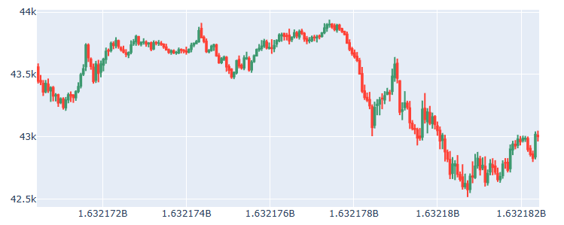
2. Data Analysis
Data structure
Candlestick chart of Bitcoin price
Data characteristics & findings
The price of the cryptocurrencies is a time-series based dataset, so the hierarchical time series model may be useful.
The volatility and correlation structure in the data are likely to be highly non-stationary.
Due to rapid changes in the overall market environment, fluctuations in currency value may be misleading.
Methodology
Based on the characteristics of the data, the training model was constructed combining the LSTM model and ResNet residual network. (Note: the target data excluding the influence of market signals were expected to be the prediction target or output result by the training model).
2
Notes:
This dataset contains information on historic trades for several cryptocurrencies, such as Bitcoin and Ethereum. The target is Residual log-returns over a 15 minute horizon.

Slide 5

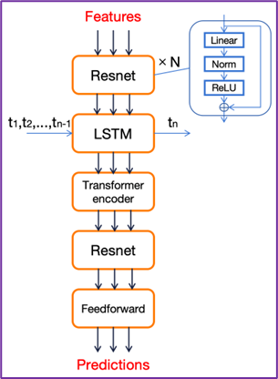
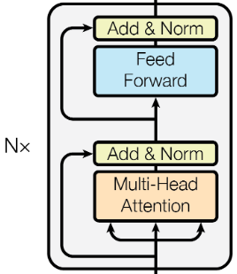
3. Network Structure
Model architecture
Transformer structure
Input: (N, 128, 14, 12)
Assets
14
Features
12
Minutes
128
Note
9 original features in the dataset: timestamp, Asset_ID, Count, Open, High, Low, Close, Volume, and VWAP.
3 additional features: mean prices over 200, 100 and 50 minutes.
References:
Vaswani, Ashish, et al. "Attention is all you need." Advances in Neural Information Processing Systems 30 (2017).
Lu, Wenjie, et al. "A CNN-BiLSTM-AM method for stock price prediction." Neural Computing and Applications 33.10 (2021): 4741-4753.
3

Slide 6
4. Model Improvement
The overall training model
Initially, a CNN-LSTM-Transformer model was employed to guarantee that the features of the time series data can be extracted, but the experimental results were not satisfactory.
Then, the CNN was replaced by a multi-layer ResNet model for better feature extraction.
During the training process, we continuously updated the learning rate to allow the model to converge to better results, and the numbers of layers in both Resnet and Transformer encoder were adjusted.
The LSTM structure
Firstly, we split the data into segments of 128 units in length, feeding them into the model and outputting the same length of predicted data (i.e., we input an entire sequence and made the LSTM predict the current time step for each time step in the sequence). However, the results indicated that the performance of such a training model structure was not satisfactory.
Thus, we modified the model to predict only the next time step following the input sequence (i.e., by using a training length segmentation of 128 units of data while outputting multi-dimensional data of one unit in length). The upgraded model showed significant improvement in the test dataset.
References:
Vaswani, Ashish, et al. "Attention is all you need." Advances in Neural Information Processing Systems 30 (2017).
Lu, Wenjie, et al. "A CNN-BiLSTM-AM method for stock price prediction." Neural Computing and Applications 33.10 (2021): 4741-4753.
4

Slide 7
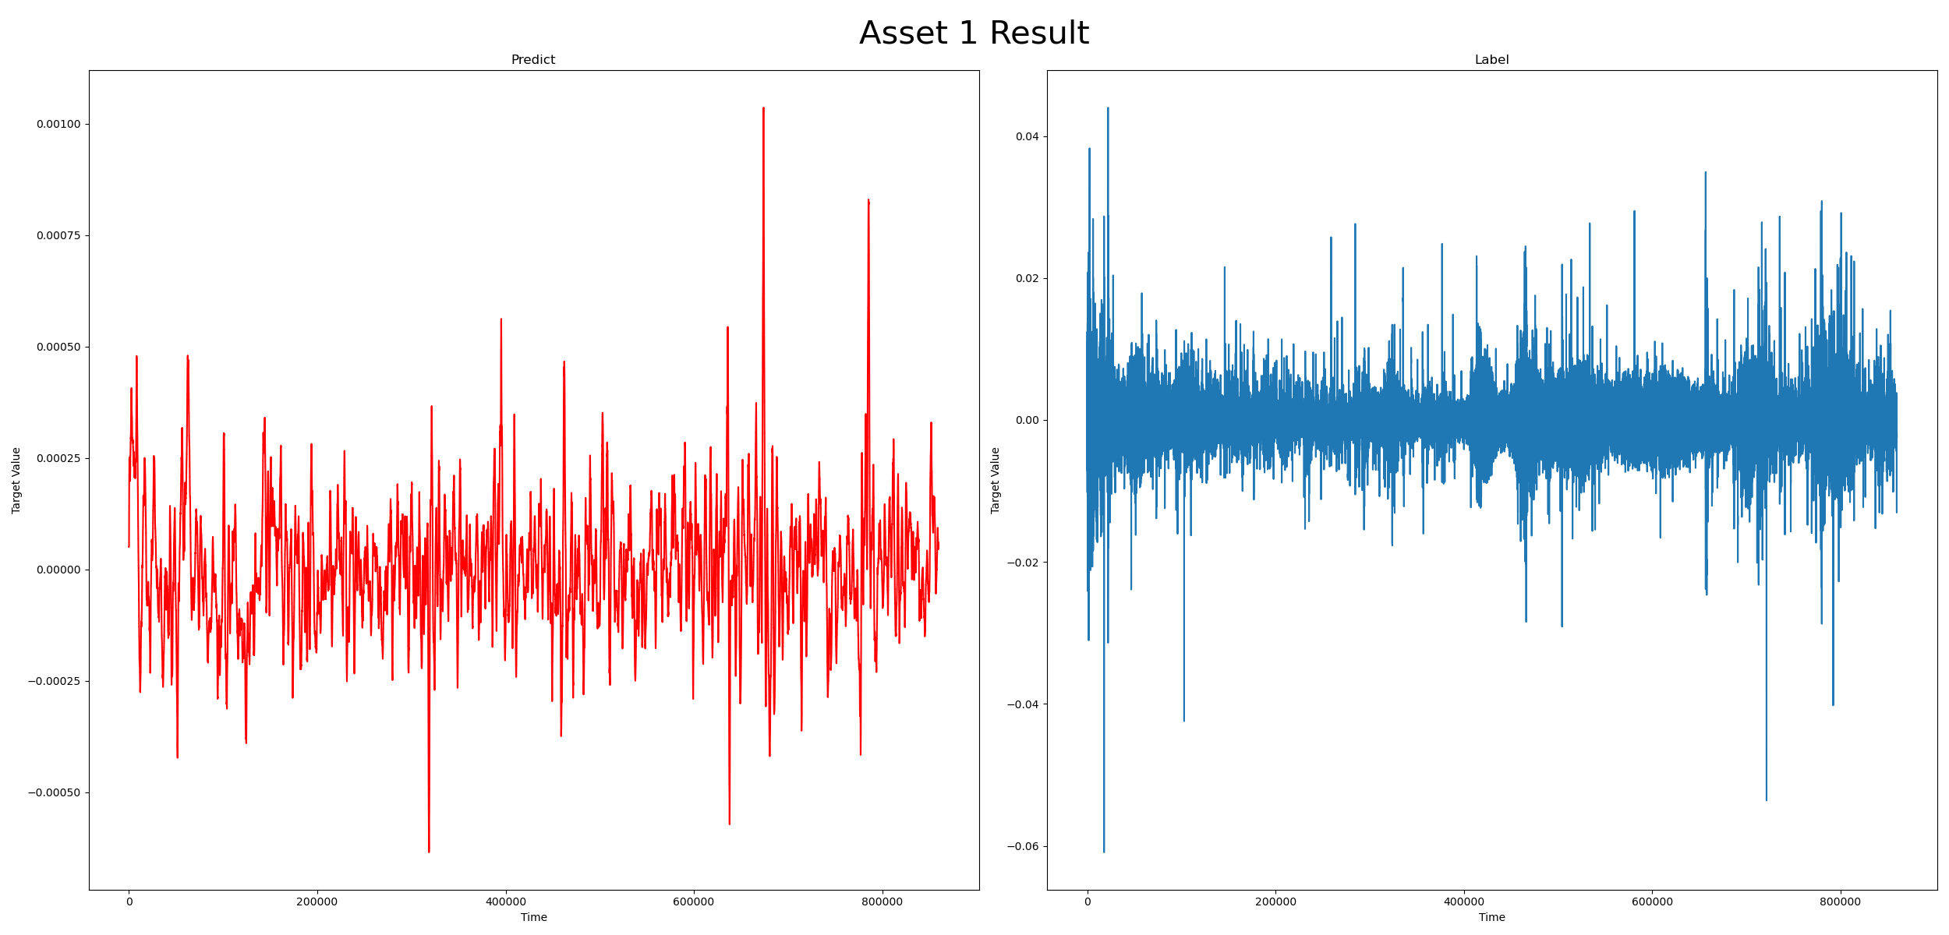
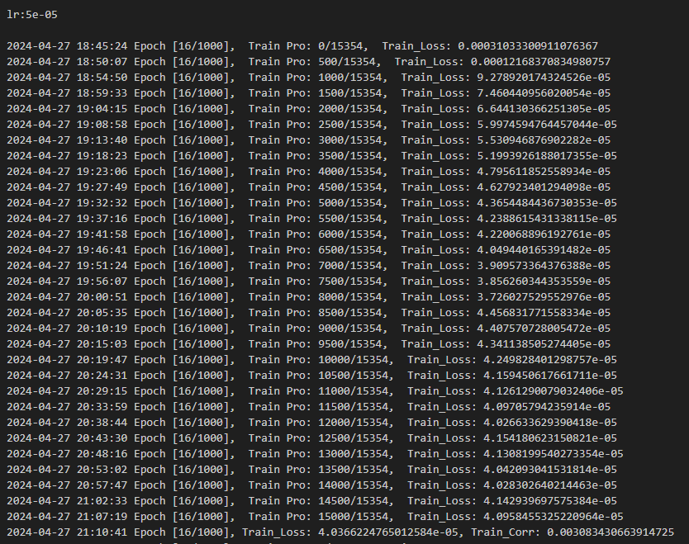
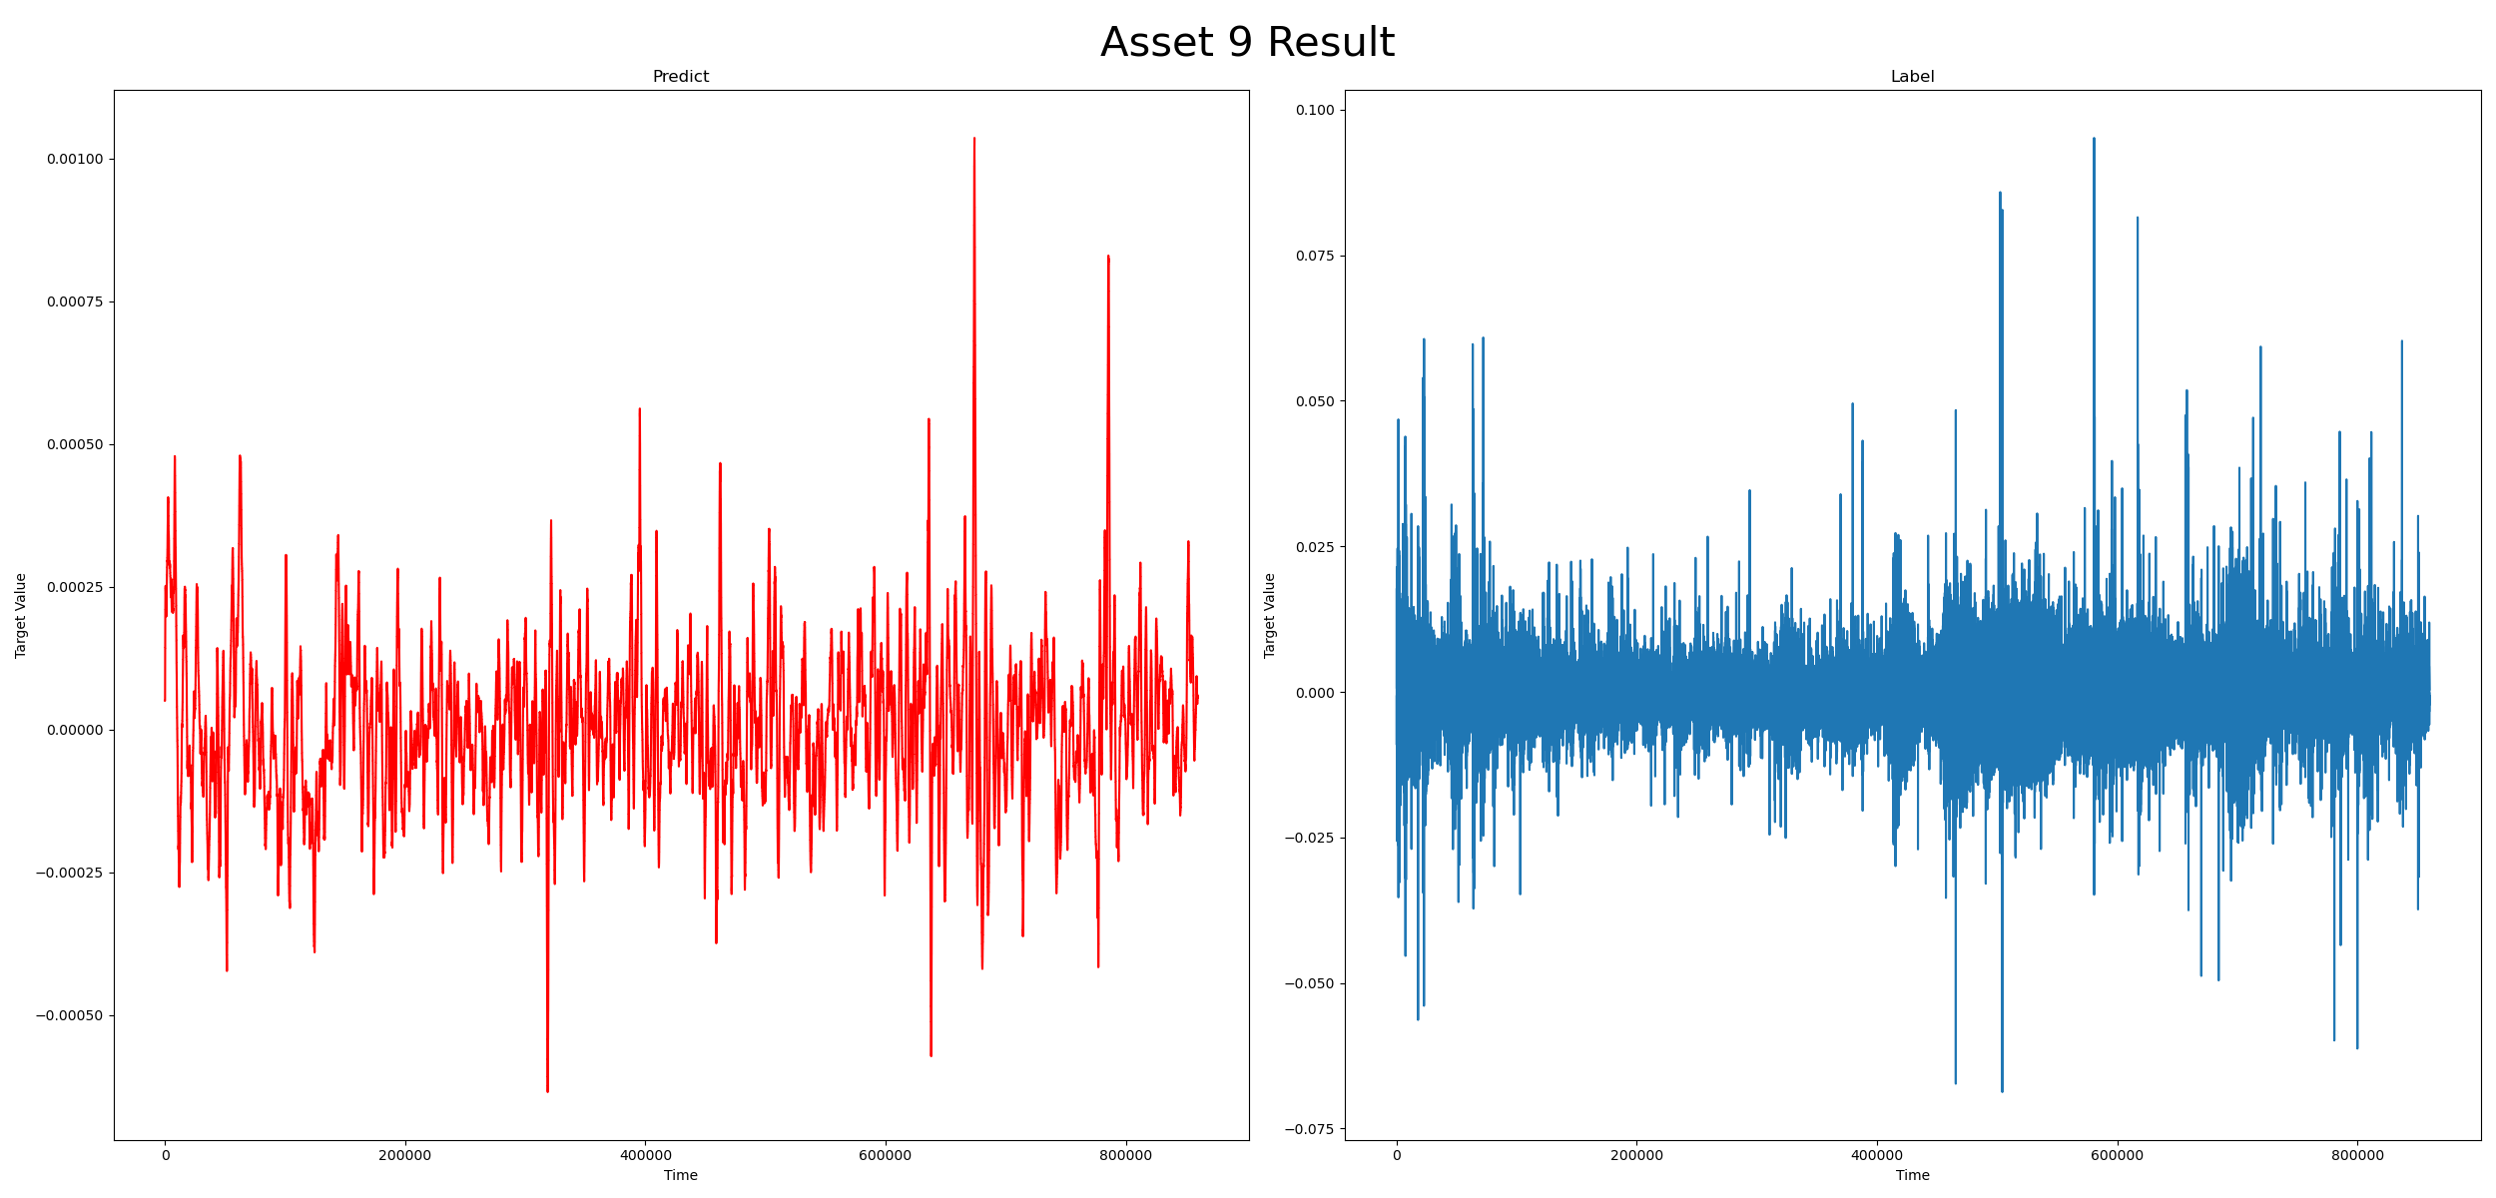
5. Prediction Results
Without target feature, long output: ρ = 0.001
With target feature, long output: ρ = 0.002
With target feature, short output: ρ = 0.003
5

Slide 8
6. Conclusions
Conclusions
Based on the available advanced deep learning models, and through modifying model architecture and optimizing hyperparameters, we successfully improved the performance of the training model. Specifically, by adopting ResNet for feature extraction and adjusting the prediction method of LSTM, the correlation metric significantly increased, reaching 0.003.
The model showed reasonable performance in feature extraction and sequence prediction, laying the foundation for further model optimization.
The prediction results also revealed the challenges of cryptocurrency returns forecasting, and more investigations should be directed into the performance and accuracy improvement of deep learning methods.
6

Slide 9
MATH 5470 (Spring 2024): Final Project
Thanks for your attention!
Any questions are welcome
Group member contributions
HU, Bo: data analysis, coding, model construction and training
WU, Hongfan: data analysis, model construction and training, poster (report) writing
QIU, Wenxi: poster (report) writing, slides preparing
WANG, Zetao: poster (report) writing, slides preparing, presentation

