Slide 1
Django
2021/04/28

Slide 2
introduction
What’s django
What’s Web & framework
How does it work (MVT)
What’s T?
What’s V?
What’s M?
What can we do ? Try the example on Mozilla

Slide 3
Python 最著名的 Web Framework

Slide 4

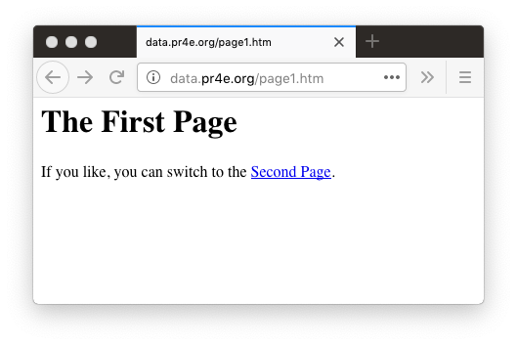
Web Server
80
Browser
App
Click

Slide 5
Web Server
80
Request
GET http://data.pr4e.org/page2.htm
Browser
App
Click

Slide 6
Web Server
<h1>The Second Page</h1><p>If you like, you can switch back to the <a href="page1.htm">First Page</a>.</p>
80
Response
Request
GET http://data.pr4e.org/page2.htm
Browser
App
Click

Slide 7
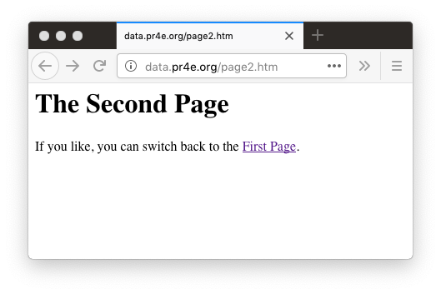
Web Server
<h1>The Second Page</h1><p>If you like, you can switch back to the <a href="page1.htm">First Page</a>.</p>
80
Response
Request
GET http://data.pr4e.org/page2.htm
Browser
App
Click
Parse/
Render

Slide 8
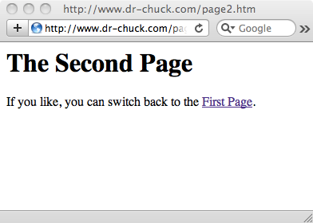
<h1>The Second Page</h1>
<p>
If you like, you can switch back to the
<a href="page1.htm">
First Page</a>.
</p>

Slide 9
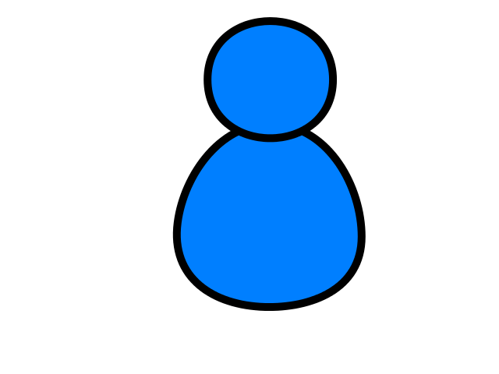
Browser
Linux
D
O
M
N
G
I
N X
WGSIConfig
settings.py
Django
Routing
Click
urls.py
views.py
Parse
Response
Views
Templates
forms.py
Javascript
Database
Shell
Models
models.py
/admin
admin.py

Slide 10
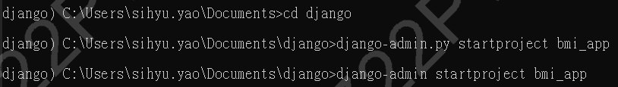


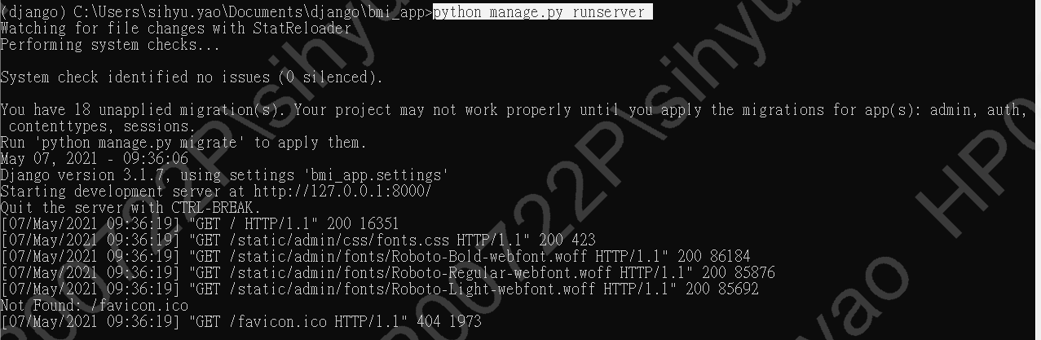
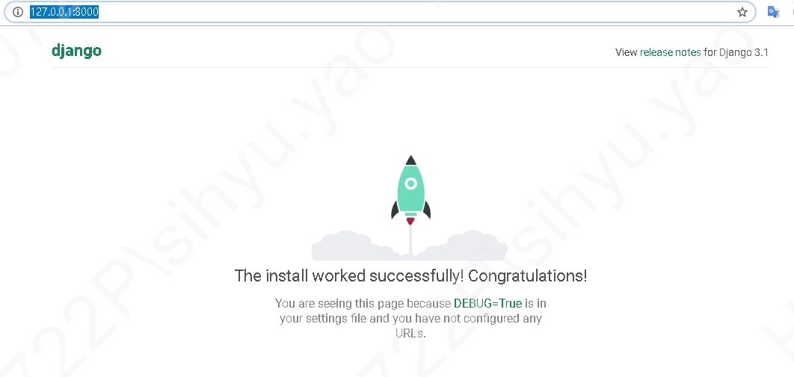
1. 建立第一個project
2. 進入資料夾
3. 試跑，http://127.0.0.1:8000/

Slide 11
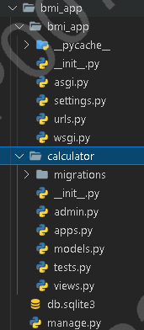
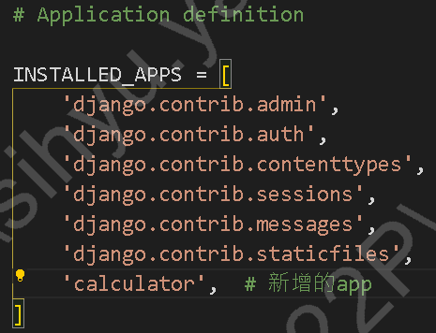
4. 讓我們利用 startapp 建立第一個 Django app calculator
5. 將新增的 Django app 加入設定檔
在前一個指令，我們透過 Django 命令列工具建立了 calculator這個 app。但若要讓 Django 知道要管理哪些 apps，還需再調整設定檔。Bmi_app > setting.py

Slide 12
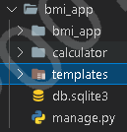
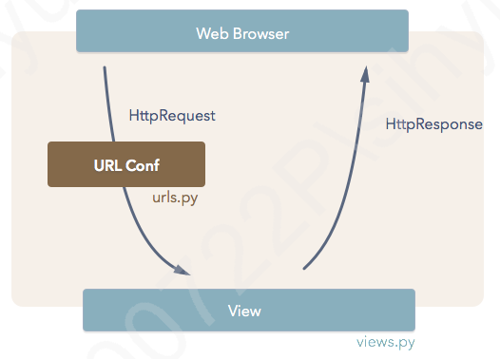
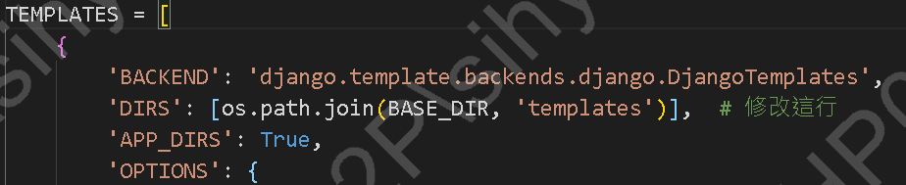

Slide 13
