Slide 1
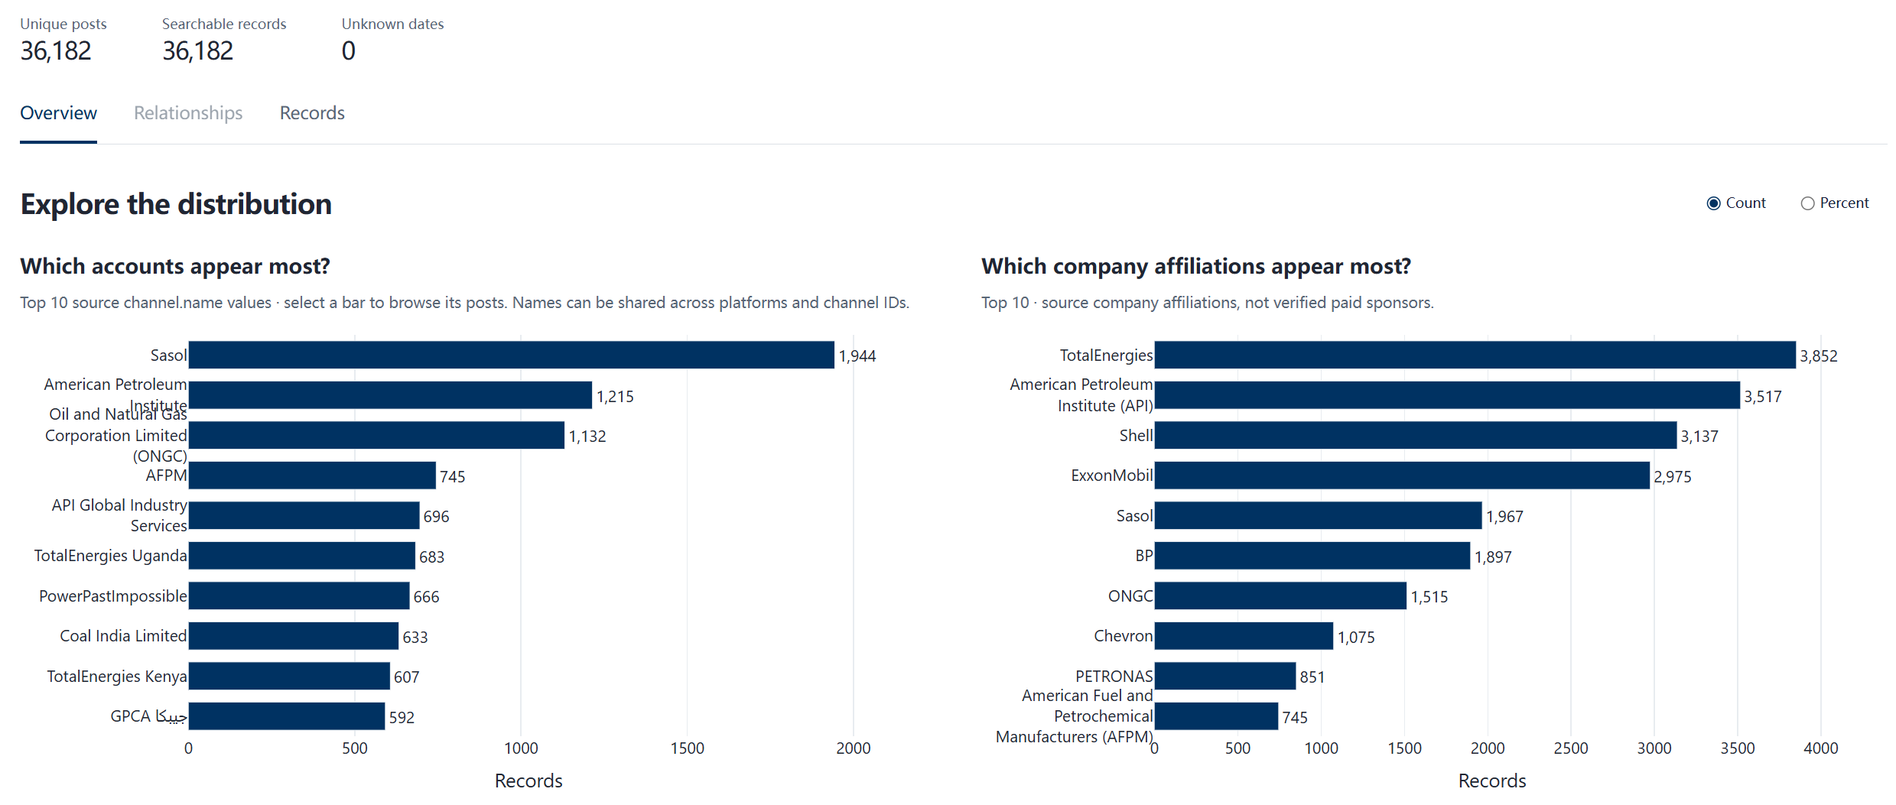
Dashboard progress & evaluation
263
36,182
Latest evaluation
Native ads
Company social posts
83.0%
Company view
Overall pass rate
78 of 94 new questions
50 list questions
94.6%
89.9%
Precision
Recall
Browse by company and date.
Open records and original sources.
Notes:
The collection now has 263 native ads and 36,182 company social posts. The social posts are collected company posts, not verified paid ads.
The dashboard shows both collections together. Here is Shell: 10 native ads and 3,137 posts. You can browse by company and date and open each record's original source.
On the right is our latest test run: 94 new questions, 78 passed, which is 83%. For the 50 questions that ask for a list of ads, precision is about 95% and recall about 90%. This is automated scoring, so it is an internal benchmark, not a human-reviewed accuracy figure.

Slide 2
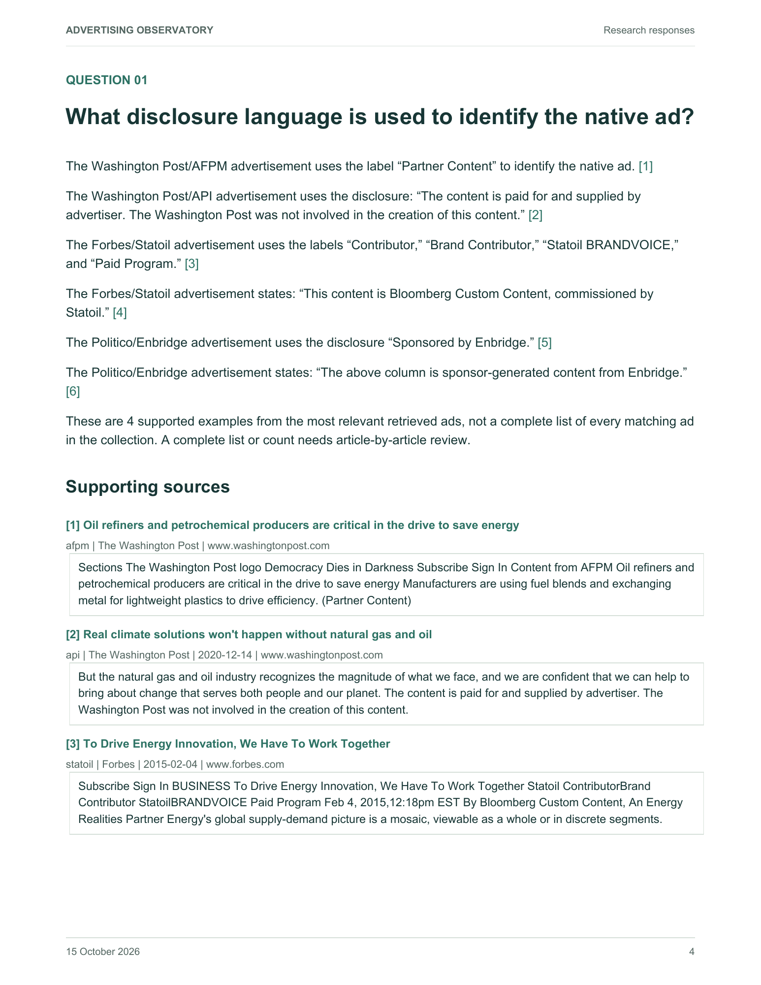
LLM responses & feedback
24 client questions. 23 responses available.
After the meeting
Example response
The full replies are
shared for reference.
We are checking fit with
the research questions.
Comments on gaps or
conclusions are welcome.
Supporting source
This week
Content from AFPM Oil refiners and petrochemical producers are critical in the drive to save energy … (Partner Content)
Complete the ongoing
optimization cycle.
Monday, Oct 19: share updated replies on Slack.
Notes:
We ran your 24 questions, and 23 returned a response. One failed for a technical reason.
Here is an example from question 1. Each statement cites the passage it comes from, so you can check it against the source. When an answer gives examples, it says it is not a complete list.
We'll share the full replies after the meeting. This week we finish the current optimization round, and we'll post the updated replies on Slack on Monday, October 19.

Slide 3
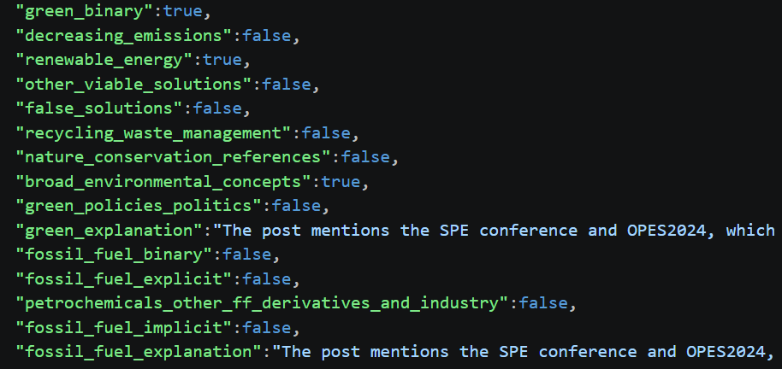
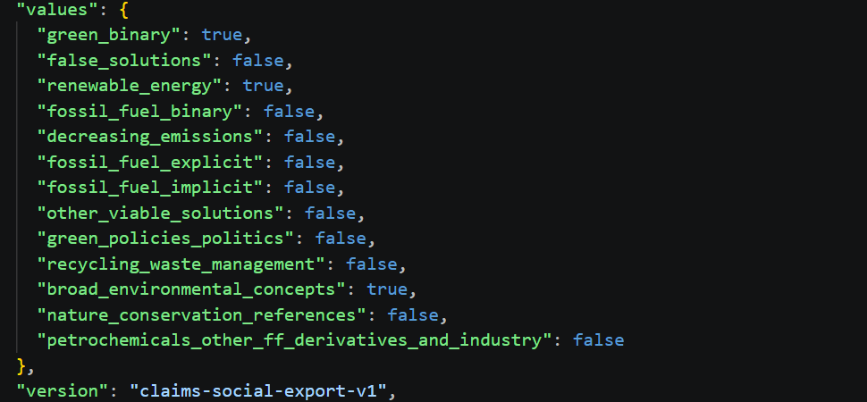
CLAIMS 1.0: label example
BP Oman, 23 April 2024
“affordable, sustainable, and clean energy”
Original export
Saved labels
Open point: consistency with CLAIMS 1.0
Whether “clean energy” counts as renewable energy here.
Notes:
This is a BP Oman post from April 23, 2024, about "affordable, sustainable, and clean energy."
On the left is the original export, on the right the labels we saved. All 13 labels match. The post is labeled as green messaging, renewable energy and broad environmental concepts.
One open point: whether "clean energy" should count as renewable energy under CLAIMS 1.0. We'd like to align on that before we apply the labels more widely.

Slide 4
Next steps
Workstream | Planned delivery
Source highlighting | Open the source from an answer citation. Scroll to and highlight the matching passage.
Native and social comparison | Compare companies and themes over the same period. Show separate time series for ads and social posts.
Release and feedback | Publish the dashboard with stable Ask the data. Use review feedback to improve the replies.
Validation and CLAIMS | Confirm the labels and expand evaluation. Check dates and source-to-dashboard consistency.
Next data expansion: Facebook and Instagram.
Notes:
Slide 4 – Next steps
Four workstreams:
- Source highlighting: clicking a citation in an answer opens the source and highlights the matching passage.
- Native and social comparison: compare companies and themes over the same period, with separate time series for ads and posts.
- Release: publish the dashboard with a stable "Ask the data" feature, and use feedback to improve the replies.
- Validation: confirm the labels, expand the evaluation, and check that dates and records match between the sources and the dashboard.
Validation: expand precision and recall evaluation, add human review and error analysis, and investigate 1970 date anomalies and other inconsistencies across source records and dashboard displays. Budgets and dates for these follow-on tasks remain to be set.

