Slide 1

GG Team
Team member:
Yaodong Wang
Siyu Liu
Yang Li
Yaoye Lu
LOGO
ALLPPT.com _ Free PowerPoint Templates, Diagrams and Charts

Slide 2
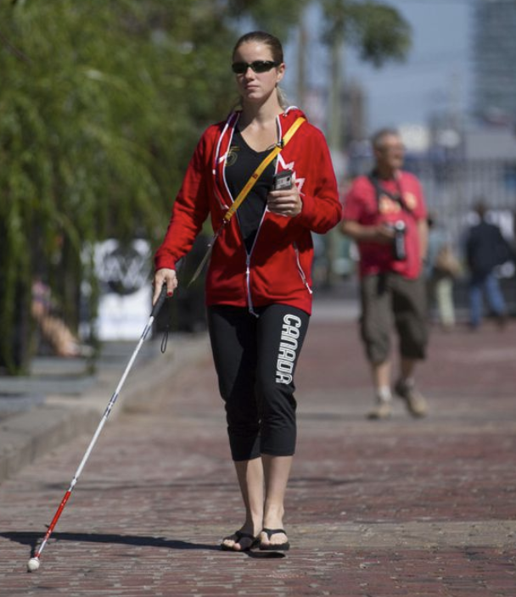
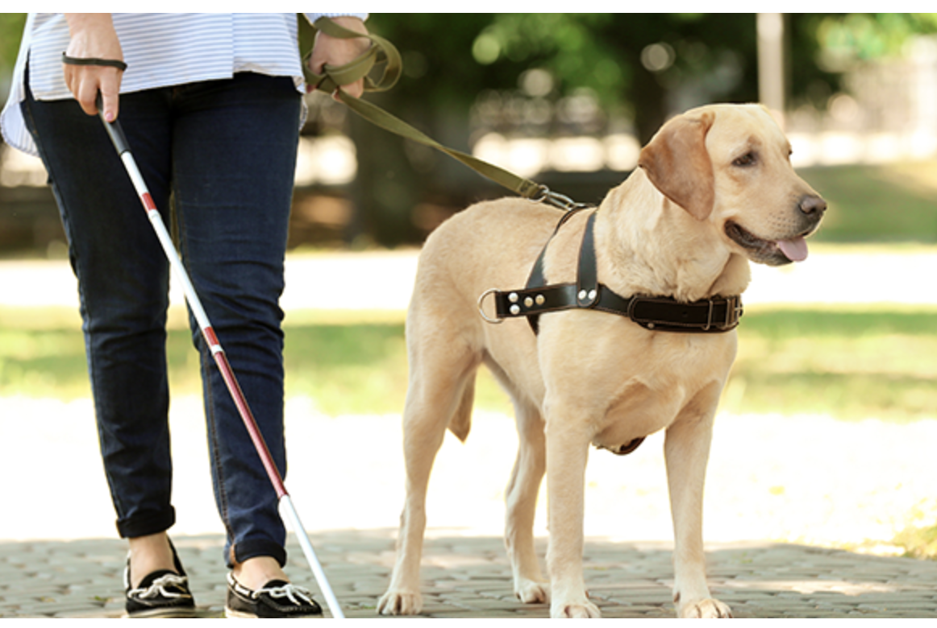
blind
https://www.thestar.com/news/gta/2015/08/13/virtual-vision-system-is-a-boost-for-blind-independence.html
https://probonoaustralia.com.au/news/2019/05/guide-dogs-business-venture-set-to-shake-up-traditional-charity-model/

Slide 3

The problem of owning Guide god
Expensive cost
$35,000 /guide dog (the whole life need 3-4)
Long term cost for feeding
Time cost
Training for around 1.5-2 years
Accompany for 8-10 years
Frequency for changing dog
Dog will dead
Dog is not suite for the owner
Unreliable
When Dog sicked
Inconvenient
Taxi driver forbidden get in

Slide 4
Customer segments
User-people who

Slide 5
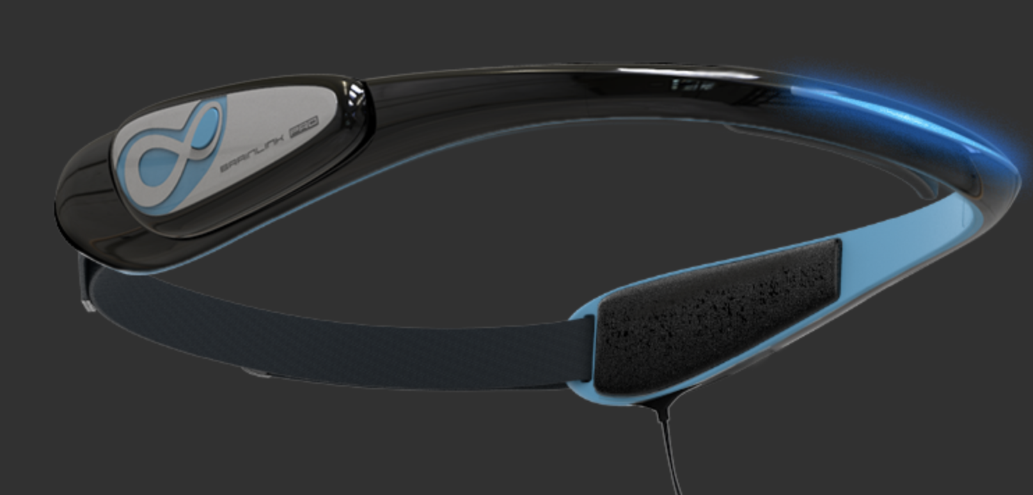
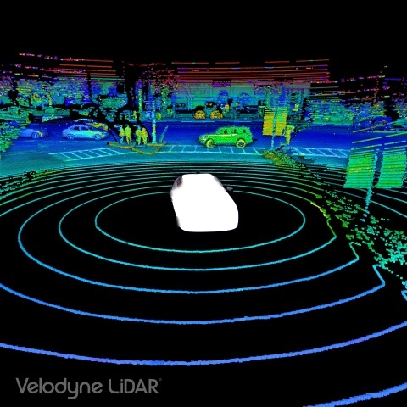
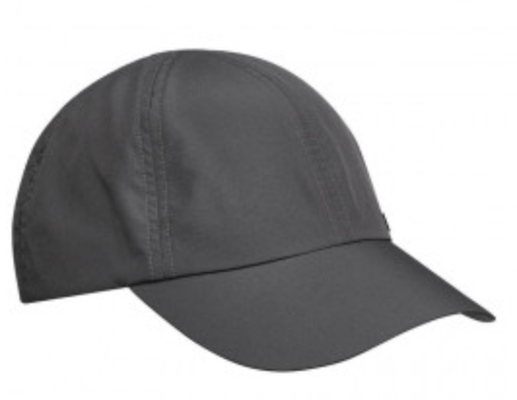
Solution
4 sensors at the frond, back, left and right
https://www.businesswire.com/news/home/20181109005344/zh-HK/

Slide 7
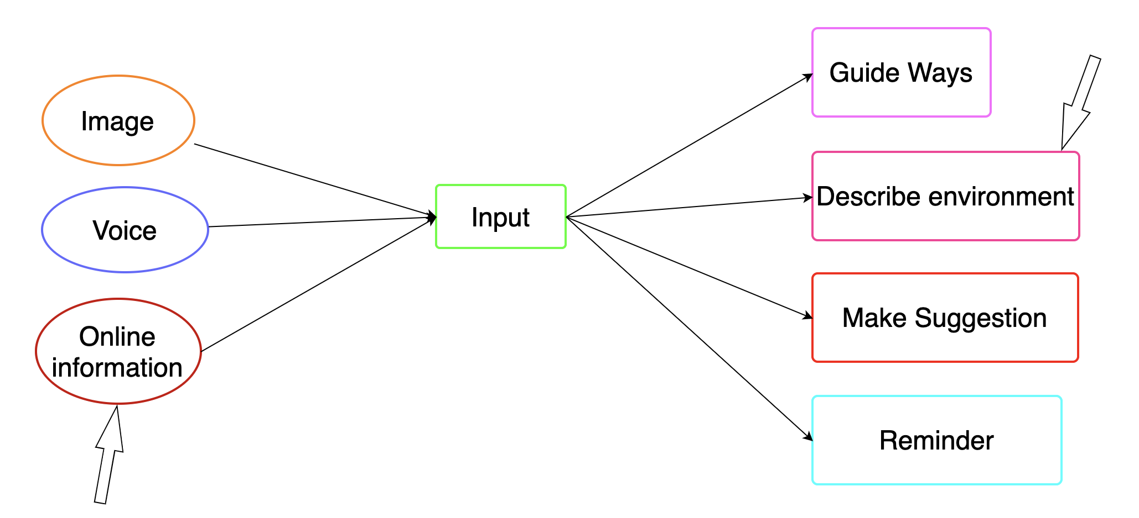
Product realization
API → to process image → generate sentence
Hardware:
1. Hat imbedded sensor and cameras
2. Earphones

Slide 8
Technical issue

Slide 9
The advantage of Guide god
cost
Cheaper than owning a dog
Time cost
No
reliable
The product just running as former-designed code
convenient
Yes

Slide 10
THANK YOU
ALLPPT.com _ Free PowerPoint Templates, Diagrams and Charts

