Slide 1

ROS - Lesson 1
Fall 2014
Teaching Assistant: Roi Yehoshua
roiyeho@gmail.com

Slide 2
Agenda
Introduction to ROS
ROS Main Features
ROS Main Concepts
Basic ROS Commands
Turtlesim Demo

Slide 3
Course Administration
Course’s home page: http://www.cs.biu.ac.il/~yehoshr1/89-685/
Assignments
Two exercises (each one is 10% of the final grade)
Final project (20% of the final grade)
Can be done in pairs
E-mail: roiyeho@gmail.com

Slide 4
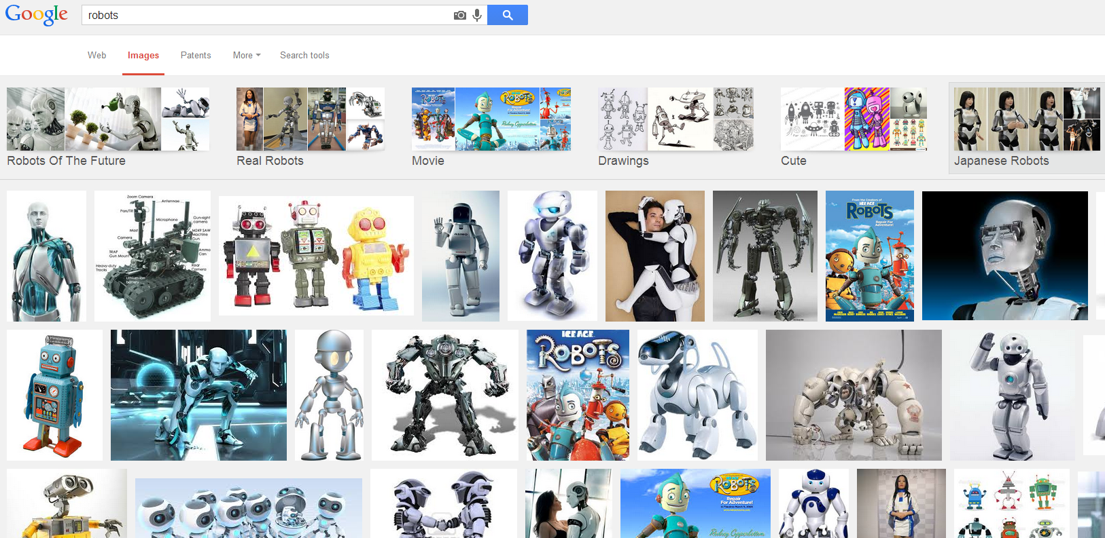
The Problem
Lack of standards for robotics

Slide 5

What is ROS?
ROS is an open-source robot operating system
ROS is a set of software libraries and tools that help you build robot applications that work across a wide variety of robotic platforms
Originally developed in 2007 at the Stanford Artificial Intelligence Laboratory and development continued at Willow Garage
Since 2013 it is managed by OSRF (Open Source Robotics Foundation)
Celebrating 5 years of ROS

Slide 6
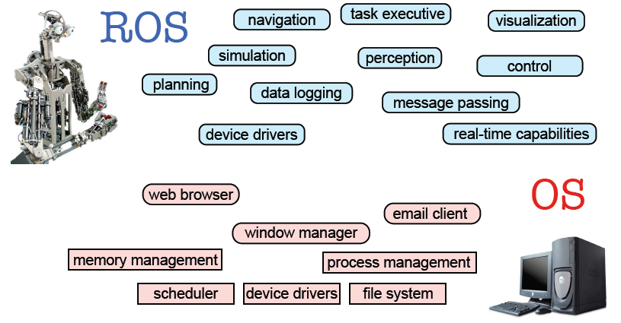
ROS Main Features
Taken from Sachin Chitta and Radu Rusu (Willow Garage)

Slide 7
ROS Main Features
ROS has two "sides"
The operating system side, which provides standard operating system services such as:
hardware abstraction
low-level device control
implementation of commonly used functionality
message-passing between processes
package management
A suite of user contributed packages (organized into sets called stacks) that implement common robot functionality such as SLAM, planning, perception, simulation etc.

Slide 8
ROS Wiki
http://wiki.ros.org/
Installation: http://wiki.ros.org/ROS/Installation
Tutorials: http://wiki.ros.org/ROS/Tutorials
ROS Tutorial Videos
http://www.youtube.com/playlist?list=PLDC89965A56E6A8D6
ROS Cheat Sheet
http://www.tedusar.eu/files/summerschool2013/ROScheatsheet.pdf

Slide 9
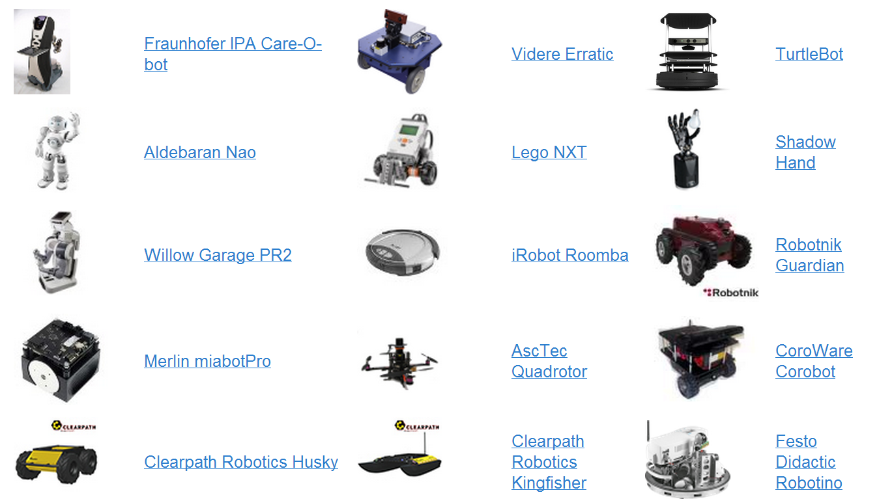
Robots using ROS
http://wiki.ros.org/Robots

Slide 10
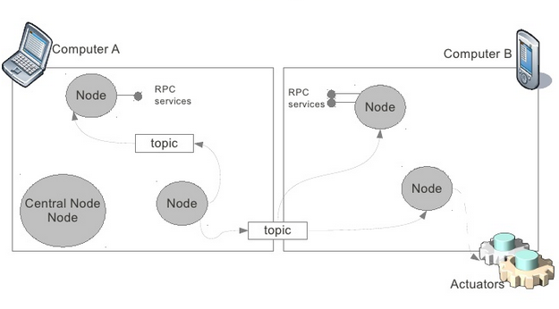
ROS Distributed Architecture

Slide 11
ROS Core Concepts
Nodes
Messages and Topics
Services
ROS Master
Parameters
Stacks and packages

Slide 12
ROS Nodes
Single-purposed executable programs
e.g. sensor driver(s), actuator driver(s), mapper, planner, UI, etc.
Modular design
Individually compiled, executed, and managed
Nodes are written using a ROS client library
roscpp – C++ client library
rospy – python client library
Nodes can publish or subscribe to a Topic
Nodes can also provide or use a Service

Slide 13
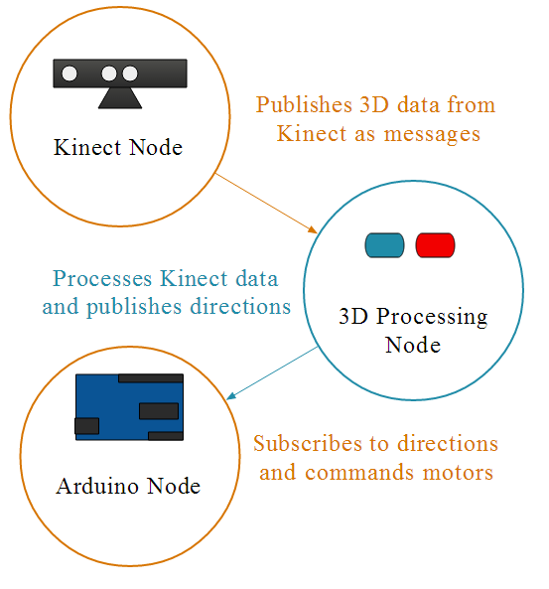
ROS Topics
Nodes communicate with each other by publishing messages to topics
Publish/Subscribe model: 1-to-N broadcasting

Slide 14
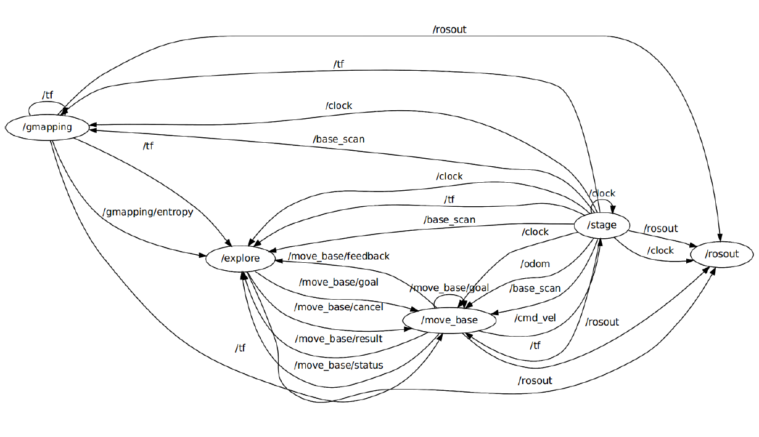
ROS Computation Graph

Slide 15
ROS Messages
Strictly-typed data structures for inter-node communication
For example, geometry_msgs/Twist is used to express velocity broken into linear and angular parts:
Vector3 is another message type composed of:
Vector3 linear
Vector3 angular
float64 x
float64 y
float64 z

Slide 16
ROS Services
Synchronous inter-node transactions / RPC
Service/Client model: 1-to-1 request-response
Service roles:
carry out remote computation
trigger functionality / behavior
Example:
map_server/static_map – retrieves the current grid map used by the robot for navigation

Slide 17
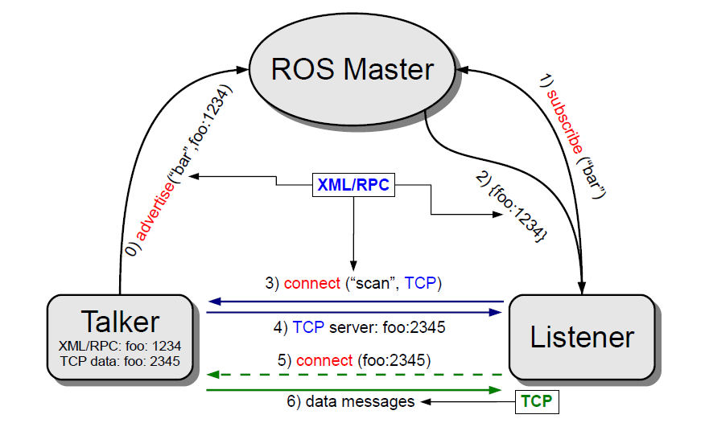
ROS Master
Enable ROS nodes to locate one another
Think of it as a ROS directory service, sort of DNS
Provides naming & registration services for nodes, topics, services, etc

Slide 18
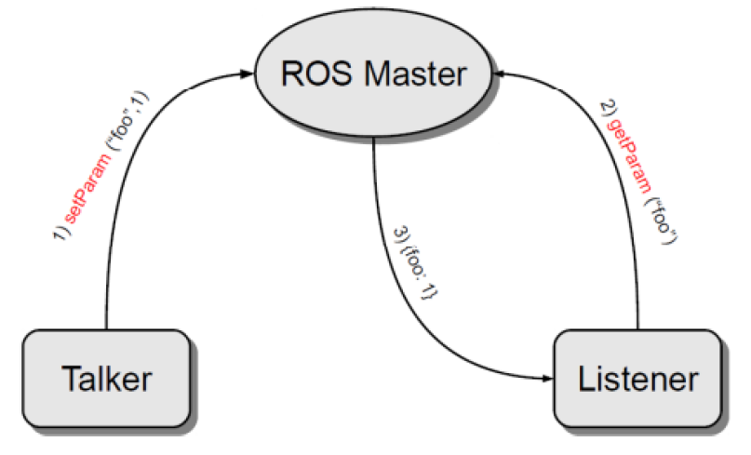
Parameter Server
A shared, multi-variate dictionary that is accessible via network APIs.
Best used for static, non-binary data such as configuration parameters.
Runs inside the ROS master

Slide 19
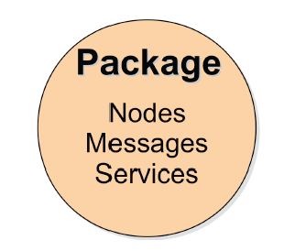
ROS Packages
Software in ROS is organized in packages.
A package contains one or more nodes and provides a ROS interface
Most of ROS packages are hosted in GitHub

Slide 20
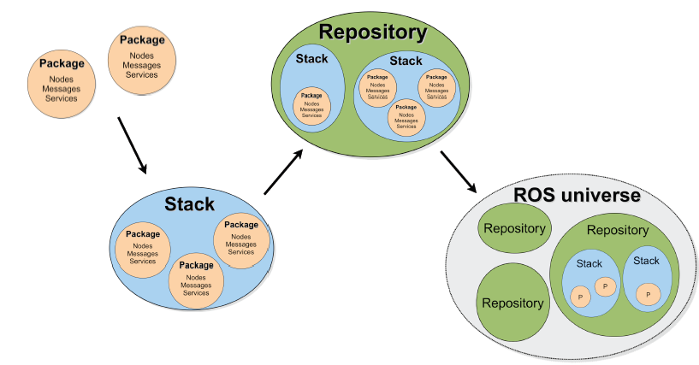
ROS Package System
Taken from Sachin Chitta and Radu Rusu (Willow Garage)

Slide 21
ROS Important Packages
 | Package
Maintains the relationship between multiple coordinate frames over time | TF
Provides a standardized interface for interfacing with preemptable tasks. | actionlib
Provides laser-based SLAM (Simultaneous Localization and Mapping) using a grid map | gmapping
a probabilistic localization system for a robot moving in 2D | amcl
implements the action of movement to a destination location | move_base
Stage 2-D multi-robot simulator | stage_ros

Slide 22
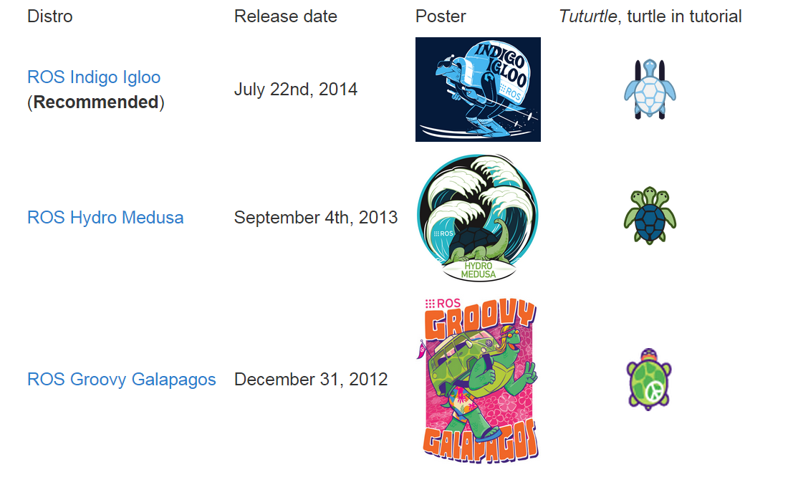
ROS Distribution Releases

Slide 23
ROS Supported Platforms
ROS is currently supported only on Ubuntu
other variants such as Windows and Mac OS X are considered experimental
ROS distribution supported is limited to <=3 latest Ubuntu versions
ROS Indigo is supported on:
Ubuntu Trusty (14.04 LTS)
Ubuntu Saucy (13.10)

Slide 24
ROS Installation
If you already have Ubuntu installed, follow the instructions at:
http://wiki.ros.org/indigo/Installation/Ubuntu
You can also download a VM with ROS Indigo Pre-installed from here:
http://nootrix.com/downloads/#RosVM
Two VMs are available: one with Ubuntu 32Bits and the other with Ubuntu 64Bits (.ova files)
You can import this file into VirtualBox or VMWare

Slide 25
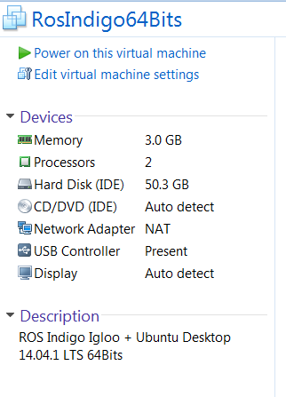
ROS Installation
Default VM settings:
The admin user account is:
login: viki
password: viki

Slide 26
ROS Environment
ROS relies on the notion of combining spaces using the shell environment
This makes developing against different versions of ROS or against different sets of packages easier
After you install ROS you will have setup.*sh files in '/opt/ros/<distro>/', and you could source them like so:
You will need to run this command on every new shell you open to have access to the ros commands, unless you add this line to your bash startup file (~/.bashrc)
If you used the pre-installed VM it’s already done for you
$ source /opt/ros/indigo/setup.bash

Slide 27
ROS Basic Commands
roscore
rosrun
rosnode
rostopic

Slide 28
roscore
roscore is the first thing you should run when using ROS
roscore will start up:
a ROS Master
a ROS Parameter Server
a rosout logging node
$ roscore

Slide 29
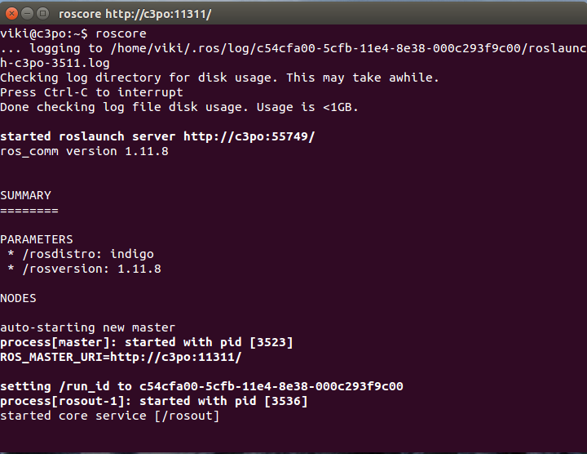
roscore

Slide 30
rosrun
rosrun allows you to run a node
Usage:
Example:
$ rosrun <package> <executable>
$ rosrun turtlesim turtlesim_node

Slide 31
Demo - Turtlesim
In separate terminal windows run:
roscore
rosrun turtlesim turtlesim_node
rosrun turtlesim turtle_teleop_key

Slide 32
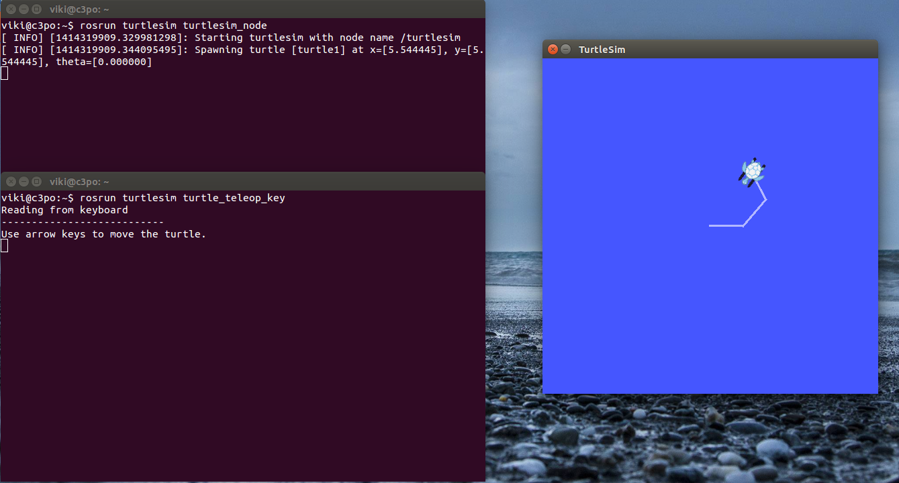
Demo - Turtlesim

Slide 33
rosnode
Displays debugging information about ROS nodes, including publications, subscriptions and connections
Commands:
 | Command
List active nodes | $rosnode list
Test connectivity to node | $rosnode ping
Print information about a node | $rosnode info
Kill a running node | $rosnode kill
List nodes running on a particular machine | $rosnode machine

Slide 34
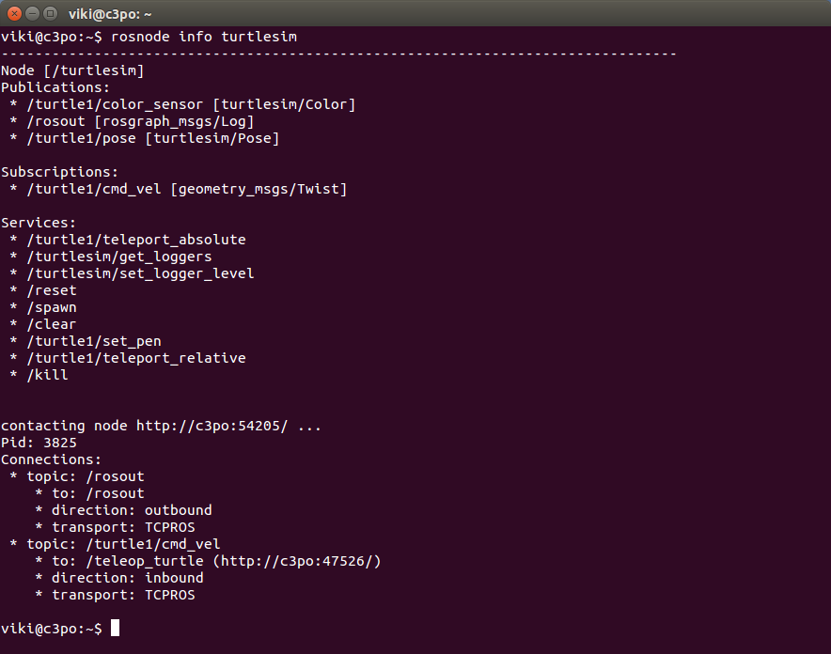
rosnode info

Slide 35
rostopic
Gives information about a topic and allows to publish messages on a topic
 | Command
List active topics | $rostopic list
Prints messages of the topic to the screen | $rosnode echo /topic
Print information about a topic | $rostopic info /topic
Prints the type of messages the topic publishes | $rostopic type /topic
Publishes data to a topic | $rostopic pub /topic type args

Slide 36
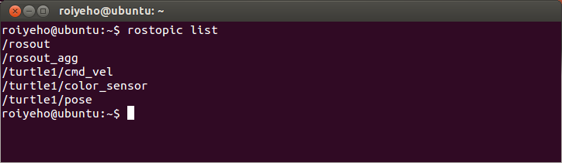
rostopic list
Displays the list of current topics:

Slide 37
Publish to ROS Topic
Use the rostopic pub command to publish messages to a topic
For example, to make the turtle move forward at a 0.2m/s speed, you can publish a cmd_vel message to the topic /turtle1/cmd_vel:
You can specify only the linear x velocity:
$ rostopic pub /turtle1/cmd_vel geometry_msgs/Twist '{linear: {x: 0.2, y: 0, z: 0}, angular: {x: 0, y: 0, z: 0}}'
$ rostopic pub /turtle1/cmd_vel geometry_msgs/Twist '{linear: {x: 0.2}}'

Slide 38
Publish to ROS Topic
Some of the messages like cmd_vel have a predefined timeout
If you want to publish a message continously use the argument -r with the loop rate in Hz
For example, to make the turtle turn in circles: continuously
$ rostopic pub /turtle1/cmd_vel -r 10 geometry_msgs/Twist '{linear: {x: 0.2, y: 0, z: 0}, angular: {x: 0, y: 0, z: 0.5}}'

Slide 39
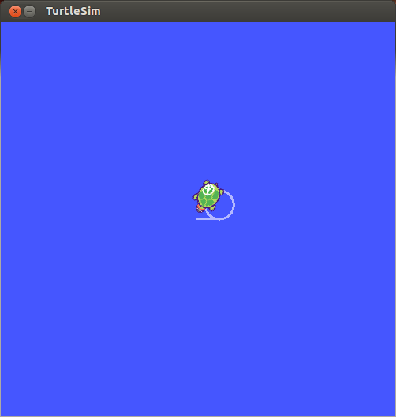
Publish to ROS Topic

Slide 40
Homework (not for submission)
Install ROS Indigo
Read and perform all the Beginner Level tutorials
http://wiki.ros.org/ROS/Tutorials
Send a command to turtlesim to move backwards continuously at 10Hz rate

