Slide 1

ROS - Lesson 11
Fall 2014
Teaching Assistant: Roi Yehoshua
roiyeho@gmail.com

Slide 2
Agenda
Adding laser sensor to our URDF model
Gazebo sensor and motor plugins
Moving the robot in Gazebo

Slide 3
Adding Laser Sensor
Adding a sensor to a URDF model consists of:
Placing the sensor on the robot by adding a new link and an appropriate joint
Adding an appropriate Gazebo plugin that simulates the sensor itself
Next, we are going to add a Hokuyo laser sensor to our r2d2 URDF model

Slide 4
Adding Laser Sensor
We will first add a new link and joint to the URDF of the r2d2 robot
We will place the laser sensor at the center of the robot’s head
For the visual part of the sensor we'll use the mesh of the Hokuyo laser model from the Gazebo models repository
Open r2d2.urdf and add the following lines before the closing </robot> tag

Slide 5
Hokuyo Link
<!-- Hokuyo Laser -->
<link name="hokuyo_link">
<collision>
<origin xyz="0 0 0" rpy="0 0 0"/>
<geometry>
<box size="0.1 0.1 0.1"/>
</geometry>
</collision>
<visual>
<origin xyz="0 0 0" rpy="0 0 0"/>
<geometry>
<mesh filename="package://r2d2_description/meshes/hokuyo.dae"/>
</geometry>
</visual>
<inertial>
<mass value="1e-5" />
<origin xyz="0 0 0" rpy="0 0 0"/>
<inertia ixx="1e-6" ixy="0" ixz="0" iyy="1e-6" iyz="0" izz="1e-6" />
</inertial>
</link>

Slide 6
Hokuyo Joint
<joint name="hokuyo_joint" type="fixed">
<axis xyz="0 0 1" />
<origin xyz="0 0.22 0.05" rpy="0 0 1.570796"/>
<parent link="head"/>
<child link="hokuyo_link"/>
</joint>
The new <joint> connects the inserted hokuyo laser onto the head of the robot
The joint is fixed to prevent the sensor from moving

Slide 7
Hokuyo Mesh File
Now copy the Hokuyo mesh file from the local Gazebo repository into r2d2_desciption package
If you don’t have hokuyo model in your local cache, then insert it once in Gazebo so it will be downloaded from Gazebo models repository
$ roscd r2d2_description
$ mkdir meshes
$ cp meshes
$ cp ~/.gazebo/models/hokuyo/meshes/hokuyo.dae .

Slide 8
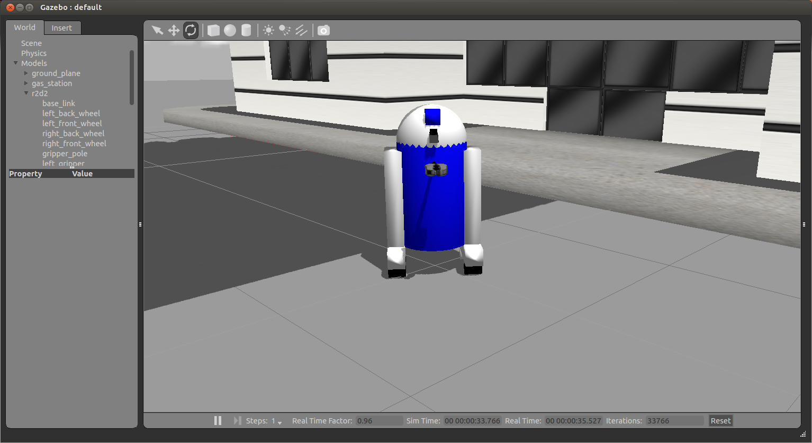
Adding Laser Sensor
Run r2d2.launch file to watch the hokuyo laser sensor in Gazebo

Slide 9
Sensors and Motors Plugins
In Gazebo you need to program the behaviors of the robot - joints, sensors, and so on
Gazebo plugins give your URDF models greater functionality and can tie in ROS messages and service calls for sensor output and motor input
For a list of available of plugins look at ROS Motor and Sensor Plugins

Slide 10
Adding Plugins
Plugins can be added to any of the main elements of a URDF - <robot>, <link>, or <joint>
The <plugin> tag must be wrapped within a <gazebo> element
For example, adding a laser plugin to a link:
<gazebo reference="your_link_name">
<plugin name="your_link_laser_controller" filename="libgazebo_ros_laser.so">
... plugin parameters ...
</plugin>
</gazebo>

Slide 11
Adding Laser Sensor Plugin (1)
<gazebo reference="hokuyo_link">
<sensor type="ray" name="laser">
<pose>0 0 0 0 0 0</pose>
<visualize>true</visualize>
<update_rate>40</update_rate>
<ray>
<scan>
<horizontal>
<samples>720</samples>
<resolution>1</resolution>
<min_angle>-2.26889</min_angle>
<max_angle>2.2689</max_angle>
</horizontal>
</scan>
<range>
<min>0.10</min>
<max>30.0</max>
<resolution>0.01</resolution>
</range>
<noise>
<type>gaussian</type>-->
<!-- Noise parameters based on published spec for Hokuyo laser
achieving "+-30mm" accuracy at range < 10m. A mean of 0.0m and
stddev of 0.01m will put 99.7% of samples within 0.03m of the true reading. -->
<mean>0.0</mean>
<stddev>0.01</stddev>
</noise>
</ray>

Slide 12
Sensor Plugin Values
The sensor parameter values should match the manufacturer's specs on your physical hardware
Important parameters:
update_rate – number of times per second a new laser scan is performed within Gazebo
min_angle, max_angle – the scanner’s field of view
samples – how many angles are covered in one scan

Slide 13
Sensor Noise
In the real world sensors exhibit noise
By default Gazebo's sensors observe the world perfectly
To present a more realistic environment, you can explicitly add noise to the data generated by Gazebo's sensors
For ray (laser) sensors, we can add Gaussian noise to the range of each beam
You can set the mean and the standard deviation of the Gaussian distribution of the noise values

Slide 14
Adding Laser Sensor Plugin (2)
<plugin name="gazebo_ros_head_hokuyo_controller" filename="libgazebo_ros_laser.so">
<topicName>/base_scan</topicName>
<frameName>hokuyo_link</frameName>
</plugin>
</sensor>
</gazebo>
Here you specify the file name of the plugin that will be linked to Gazebo as a shared object
The code of the plugin can be found here is located at gazebo_plugins/src/gazebo_ros_laser.cpp
The topicName is the rostopic the laser scanner will be publishing to

Slide 15
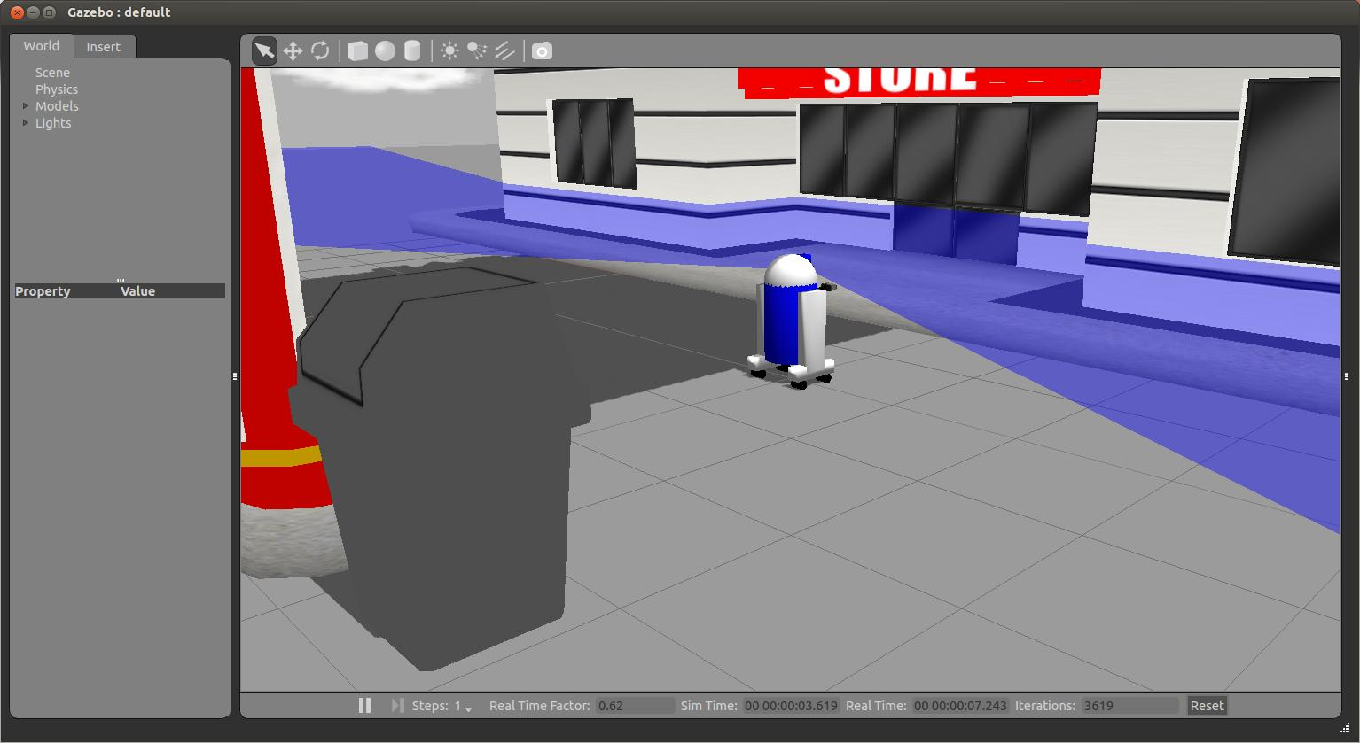
Laser Sensor Plugin

Slide 16
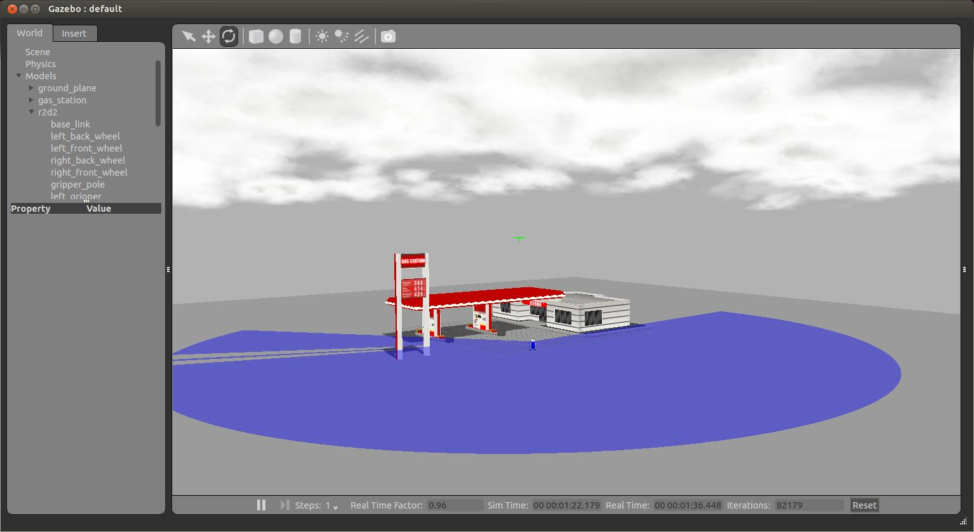
Laser Sensor Plugin
The full range of the sensor:

Slide 17
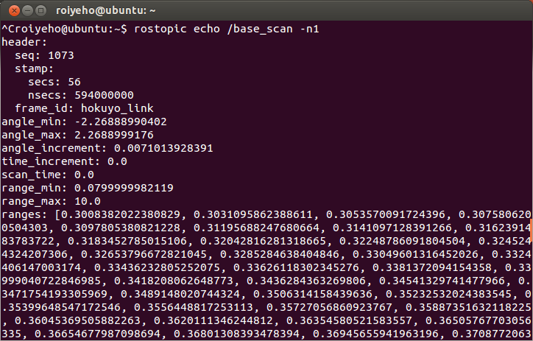
Laser Sensor Plugin
Make sure that the laser data is being published to /base_scan by using rostopic echo:

Slide 18
Moving the Robot with Gazebo
Gazebo comes with a few built-in controllers to drive your robot already:
differential_drive_controller - a plugin for two wheeled robots
You can find the source of the controller here
skid_steer_drive_controller – a plugin for four wheeled robots
You can find the source of the controller here

Slide 19
Skid Steer Drive Controller
Add the following lines at the end of r2d2.urdf:
<gazebo>
<plugin name="skid_steer_drive_controller" filename="libgazebo_ros_skid_steer_drive.so">
<alwaysOn>true</alwaysOn>
<updateRate>100.0</updateRate>
<leftFrontJoint>left_front_wheel_joint</leftFrontJoint>
<rightFrontJoint>right_front_wheel_joint</rightFrontJoint>
<leftRearJoint>left_back_wheel_joint</leftRearJoint>
<rightRearJoint>right_back_wheel_joint</rightRearJoint>
<wheelSeparation>0.4</wheelSeparation>
<wheelDiameter>0.07</wheelDiameter>
<torque>10</torque>
<commandTopic>cmd_vel</commandTopic>
<odometryTopic>odom</odometryTopic>
<odometryFrame>odom</odometryFrame>
<robotBaseFrame>base_footprint</robotBaseFrame>
</plugin>

Slide 20
Controller Parameters
wheelDiameter – should be equal to twice the radius of the wheel cylinder
in our case it is 0.035
wheelSeparation – the distance between the wheels
In our case it is equal to the diameter of base_link (0.4)
torque – moment of force, the tendency of a force to rotate an object about an axis
Default is 20 Newton per meter
If the robot falls after a rotation, you need to decrease this
commandTopic – the rostopic where we need to publish commands in order to control the robot
By default, this topic is “cmd_vel”

Slide 21
Moving the Robot with Gazebo
For the controller to publish the needed frames for the navigation stack, we need to add a base_footprint link to our URDF model
The controller will make the transformation between base_link and base_footprint and will also create another link called odom
The odom link will be used later on with the navigation stack

Slide 22
Moving the Robot with Gazebo
Add the following lines in r2d2.urdf after the definition of base_link:
<link name="base_footprint">
<visual>
<geometry>
<box size="0.001 0.001 0.001"/>
</geometry>
<origin rpy="0 0 0" xyz="0 0 0"/>
</visual>
<inertial>
<mass value="0.0001"/>
<inertia ixx="1.0" ixy="0.0" ixz="0.0" iyy="1.0" iyz="0.0" izz="1.0"/>
</inertial>
</link>
<gazebo reference="base_footprint">
<material>Gazebo/Blue</material>
</gazebo>
<joint name="base_footprint_joint" type="fixed">
<origin xyz="0 0 0" />
<parent link="base_footprint" />
<child link="base_link" />
</joint>

Slide 23
Add Joint and State Publishers
To work with the robot model in ROS, we need to publish its joint states and TF tree
For that purpose we need to start two nodes:
joint_state_publisher – this node reads the robot’s model from the URDF file (defined in the robot_description param) and publishes /joint_states messages
robot_state_publisher – this node listens to /joint_states messages from the joint_state_controller and then publishes the transforms to /tf
This allows you to see your simulated robot in rviz as well as do other tasks

Slide 24
Add Joint and State Publishers
Add the following lines to r2d2.launch:
<!-- start joint and robot state publishers -->
<param name="robot_description" textfile="$(find r2d2_description)/urdf/r2d2.urdf"/>
<node name="joint_state_publisher" pkg="joint_state_publisher" type="joint_state_publisher" ></node>
<node name="robot_state_publisher" pkg="robot_state_publisher" type="robot_state_publisher" output="screen" />

Slide 25
Moving the Robot with Teleop
Now we are going to move the robot using the teleop_twist_keyboard node
Run the following command:
You should see console output that gives you the key-to-control mapping
$ rosrun teleop_twist_keyboard teleop_twist_keyboard.py

Slide 26
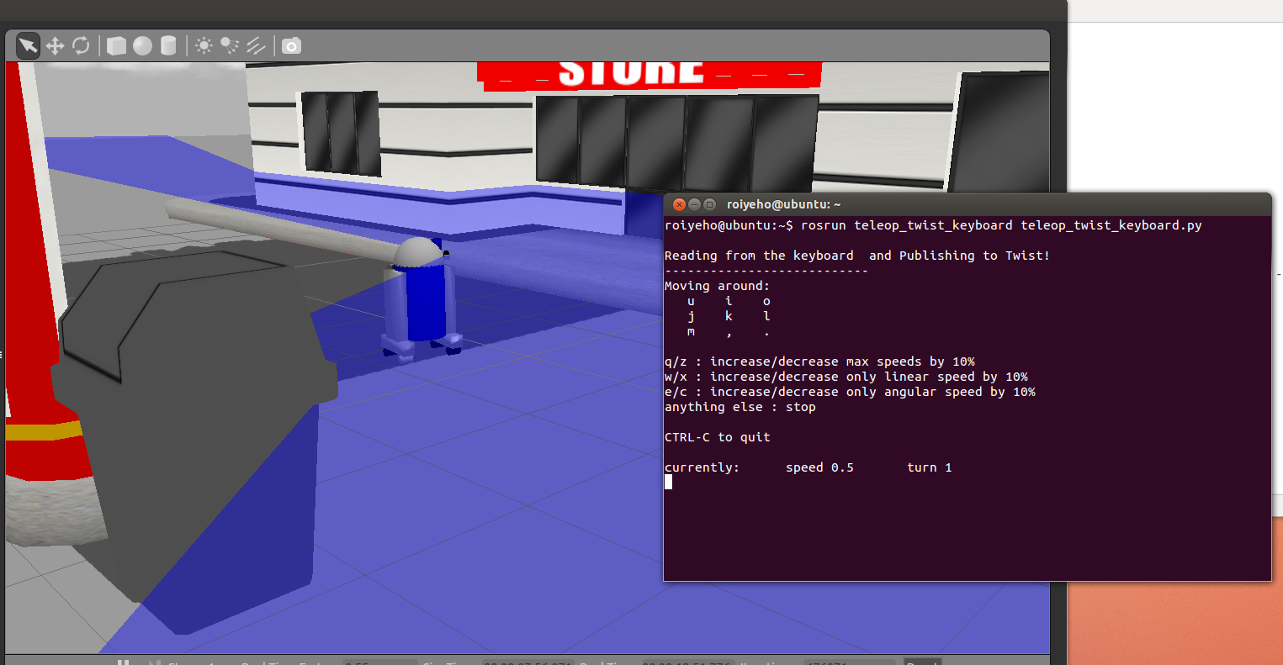
Moving the Robot with Teleop

Slide 27
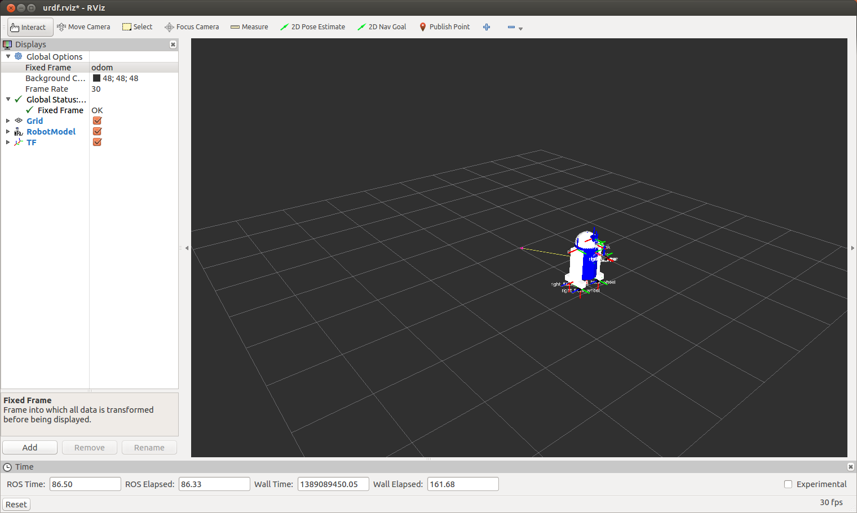
Moving the Robot with Teleop
In rviz, change the fixed frame to /odom and you will see the robot moving on rviz as well

Slide 28
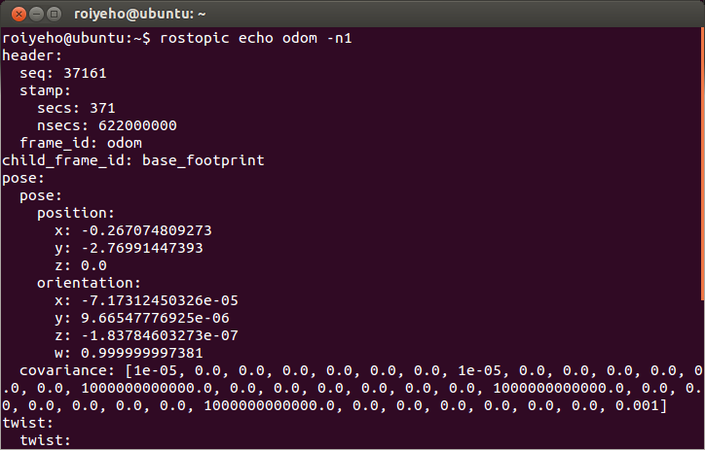
How Gazebo creates the odometry
The controller publishes the odometry generated in the simulated world to the topic /odom
Compare the published position of the robot to the pose property of the robot in Gazebo simulator

Slide 29
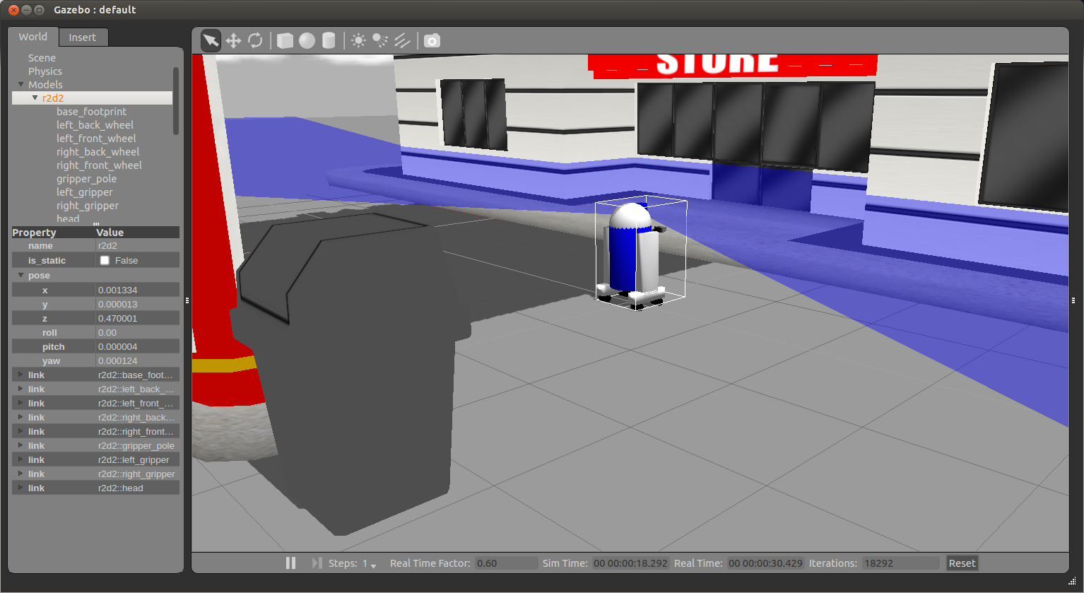
How Gazebo creates the odometry

Slide 30
Moving the robot from code
We will now add a node that will make r2d2 start random walking in the environment
The code of the node is the same as the one we used to control the robot in Stage simulator
Gazebo is publishing the same topics as Stage
Create a new package gazebo_random_walk
Create a launch subdirectory within the package and add the following launch file to it
$ cd ~/catkin_ws/src
$ catkin_create_pkg gazebo_random_walk std_msgs rospy roscpp

Slide 31
random_walk.launch
<launch>
<param name="/use_sim_time" value="true" />
<!-- Launch world -->
<include file="$(find gazebo_ros)/launch/willowgarage_world.launch"/>
<arg name="init_pose" value="-x -5 -y -2 -z 1"/>
<param name="robot_description" textfile="$(find r2d2_description)/urdf/r2d2.urdf"/>
<!-- Spawn robot's model -->
<node name="spawn_urdf" pkg="gazebo_ros" type="spawn_model" args="$(arg init_pose) -urdf -param robot_description -model my_robot" output="screen"/>
<node name="joint_state_publisher" pkg="joint_state_publisher" type="joint_state_publisher"/>
<node pkg="robot_state_publisher" type="robot_state_publisher" name="robot_state_publisher" output="screen"/>
<!-- Launch random walk node -->
<node name="random_walk_node" pkg="gazebo_random_walk" type="random_walk_node" output="screen"/>
</launch>

Slide 32
Moving the robot from code
Add random_walk.cpp to your package

Slide 33
random_walk.cpp (1)
#include <ros/ros.h>
#include <tf/transform_listener.h>
#include <iostream>
#include <vector>
#include "geometry_msgs/Twist.h"
#include "sensor_msgs/LaserScan.h"
using namespace std;
#define MIN_SCAN_ANGLE_RAD -60.0/180*M_PI
#define MAX_SCAN_ANGLE_RAD +60.0/180*M_PI
void readSensorCallback(const sensor_msgs::LaserScan::ConstPtr &sensor_msg);
bool obstacleFound = false;

Slide 34
random_walk.cpp (2)
int main(int argc, char **argv) {
ros::init(argc, argv, "random_walk_node");
ros::NodeHandle nh;
ros::Publisher cmd_vel_pub = nh.advertise<geometry_msgs::Twist>("cmd_vel", 10);
ros::Subscriber base_scan_sub = nh.subscribe<sensor_msgs::LaserScan>(
"base_scan", 1, &readSensorCallback);
geometry_msgs::Twist moveForwardCommand;
moveForwardCommand.linear.x = 0.5;
geometry_msgs::Twist turnCommand;
turnCommand.angular.z = 1.0;
ros::Rate loop_rate(10);
while (ros::ok()) {
if (obstacleFound) {
cmd_vel_pub.publish(turnCommand);
cmd_vel_pub.publish(turnCommand);
} else {
cmd_vel_pub.publish(moveForwardCommand);
}
ros::spinOnce(); // let ROS process incoming messages
loop_rate.sleep();
}
return 0;
}

Slide 35
random_walk.cpp (3)
void readSensorCallback(const sensor_msgs::LaserScan::ConstPtr &scan) {
bool isObstacle = false;
int minIndex = ceil((MIN_SCAN_ANGLE_RAD - scan->angle_min) / scan->angle_increment);
int maxIndex = floor((MAX_SCAN_ANGLE_RAD - scan->angle_min) / scan->angle_increment);
for (int i = minIndex; i <= maxIndex; i++) {
if (scan->ranges[i] < 0.5) {
isObstacle = true;
}
}
if (isObstacle) {
ROS_INFO("Obstacle found! Turning around");
obstacleFound = true;
} else {
obstacleFound = false;
}
}

Slide 36
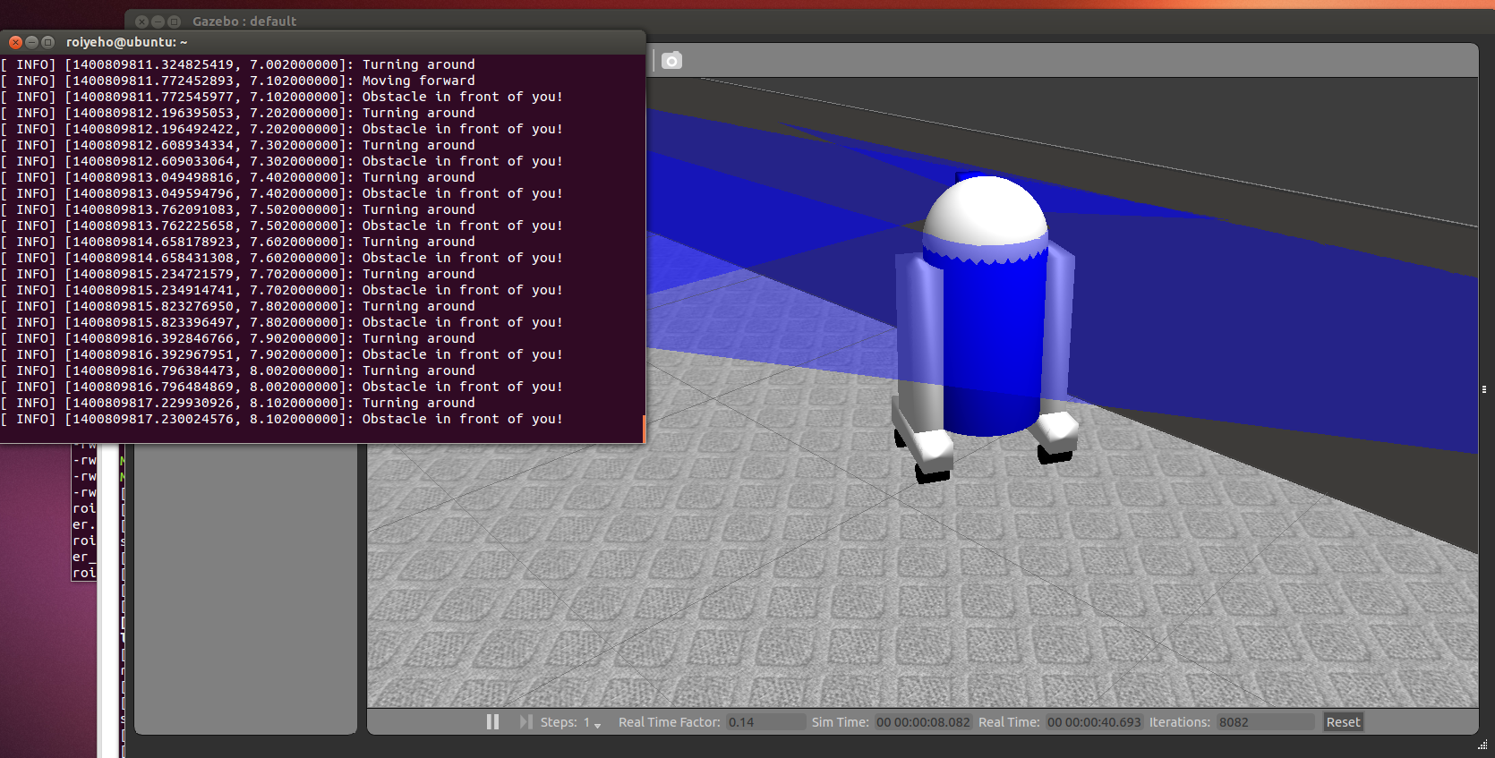
Launch Random Walk Node
To launch the random walk node type:
$ rosrun gazebo_random_walk random_walk_node

Slide 37
Homework (not for submission)
Create a 3D model of a robot and move it around a simulated world in Gazebo using the random walk node

