Slide 1

ROS - Lesson 12
Fall 2014
Teaching Assistant: Roi Yehoshua
roiyeho@gmail.com

Slide 2
Agenda
Run navigation stack with Gazebo
Send goals to robots in Gazebo
Robotic coverage problem

Slide 3
Setting Up Navigation Stack
Copy the package send_goals into a new package called gazebo_navigation
Change the name of the package in package.xml, CMakeLists.txt and move_base.xml
Remove stage_config subdirectory
Copy the launch file random_walk.launch from the launch directory in gazebo_random_walk package
Rename it to gazebo_navigation.launch
Add the following lines to the launch file

Slide 4
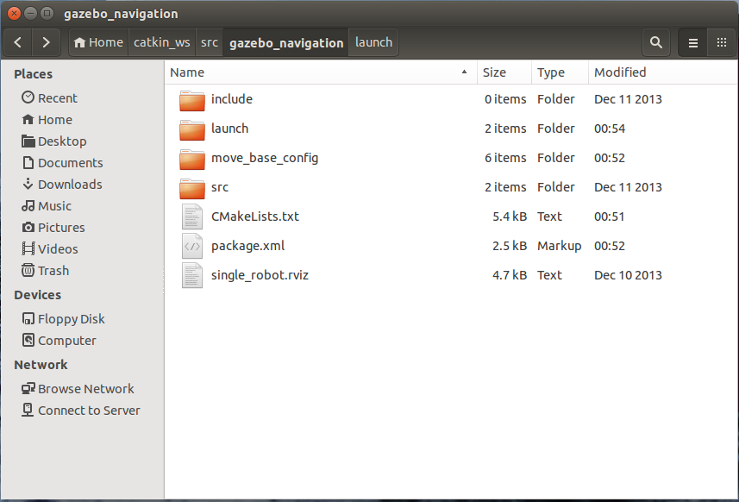
gazebo_navigation package

Slide 5
Maps Directory
We will run the navigation stack with a given map
Create a maps directory in your package and copy willow-full.pgm file into it
$ roscd navigation_stage/stage_config/maps
$ cp willow-full.pgm ~/catkin_ws/src/gazebo_navigation/maps

Slide 6
Map’s Pose in Gazebo and ROS
By default the origin of the map is different in Gazebo and ROS
In Gazebo the origin is by default at the center of the map while in ROS it is at the lower-left corner
The map’s pose in Gazebo can be changed by adjusting its model in Gazebo’s world file
For that purpose, we first need to copy the world’s file into our package

Slide 7
Change Map’s Pose in Gazebo
Create worlds directory in your package
Copy willowgarage.world file from gazebo’s worlds directory to worlds directory of your package
Now edit the world’s file to adjust the model’s pose
The pose parameter consists of 6 values: <x y z r p y>
Angles are specified in degrees
$ roscd gazebo_navigation/worlds
$ cp /usr/share/gazebo-2.2/worlds/willowgarage.world .

Slide 8
willowgarage.world
<?xml version="1.0" ?>
<sdf version="1.4">
<world name="default">
<include>
<uri>model://ground_plane</uri>
</include>
<include>
<uri>model://sun</uri>
</include>
<include>
<uri>model://willowgarage</uri>
<pose>-3 54 0 0 0 30</pose>
</include>
</world>
</sdf>

Slide 9
Change Map’s Pose in Gazebo
We also need to change the launch file of Gazebo’s world to launch our own version of the world file
First copy willowgarage_world.launch from gazebo_ros package to the launch directory of your package
Now edit this file
$ roscd gazebo_ros/launch
$ cp willowgarage_world.launch ~/catkin_ws/src/gazebo_navigation/launch

Slide 10
willowgarage_world.launch
<launch>
<!-- We resume the logic in empty_world.launch, changing only the name of the world to be launched -->
<include file="$(find gazebo_ros)/launch/empty_world.launch">
<arg name="world_name" value="$(find gazebo_navigation)/worlds/willowgarage.world"/>
<arg name="paused" value="false"/>
<arg name="use_sim_time" value="true"/>
<arg name="gui" value="true"/>
<arg name="headless" value="false"/>
<arg name="debug" value="false"/>
</include>
</launch>

Slide 11
TF Tree
For the navigation stack to work properly, the robot needs to publish the following transformations:
map
published by the localization system
robotX/odom
published by Gazebo’s driver controller
robotX/base_link
published by static tf defined in your launch file
robotX/laser_link

Slide 12
Gazebo position_3d Controller
First, you need to make Gazebo publish the robot’s position to ROS
This can be done with the position_3d controller
Add the following to the URDF file:
<plugin name="p3d_base_controller" filename="libgazebo_ros_p3d.so">
<alwaysOn>true</alwaysOn>
<updateRate>100.0</updateRate>
<bodyName>base_link</bodyName>
<topicName>base_pose_ground_truth</topicName>
<gaussianNoise>0</gaussianNoise>
<frameName>/map</frameName>
<xyzOffsets>0 0 0</xyzOffsets>
<rpyOffsets>0 0 0</rpyOffsets>
</plugin>

Slide 13
Laser Scanner Controller
The gazebo model, written in URDF, makes use of an Hokuyo laser scanner through the libgazebo_ros_laser.so plugin
The frameName property of the plugin specifies the TF frame that corresponds to the laser link
Change it to laser_link
<plugin name="gazebo_ros_laser_controller" filename="libgazebo_ros_laser.so">
<topicName>base_scan</topicName>
<frameName>laser_link</frameName>
</plugin>

Slide 14
Laser Scanner Controller
However, the laser plugin doesn't automatically publishes a transform from base_link to the frame that you specified in the file (laser_link)
Thus we need to manually specify a static transform publisher between the laser_link and base_link frames
We will add this publisher to the launch file

Slide 15
gazebo_navigation.launch
<launch>
<param name="/use_sim_time" value="true" />
<!-- Launch world -->
<include file="$(find gazebo_ros)/launch/willowgarage_world.launch"/> <arg name="init_pose" value="-x 20 -y 15 -z 0"/>
<!--<param name="robot_description" textfile="$(find r2d2_description)/urdf/r2d2.urdf"/>-->
<param name="robot_description" textfile="$(find lizi_description)/urdf/lizi.urdf"/>
<!-- Spawn robot's model -->
<node name="spawn_urdf" pkg="gazebo_ros" type="spawn_model" args="$(arg init_pose) -urdf -param robot_description -model my_robot" output="screen"/>
<node name="joint_state_publisher" pkg="joint_state_publisher" type="joint_state_publisher"/>
<node pkg="robot_state_publisher" type="robot_state_publisher" name="robot_state_publisher" output="screen"/>
<node pkg="tf" type="static_transform_publisher" name="laser_link_broadcaster" args="0 0 1 0 0 0 base_link laser_link 100" />
<!-- Run navigation stack with AMCL -->
<node name="map_server" pkg="map_server" type="map_server" args="$(find gazebo_navigation)/maps/willow-full.png 0.1"/>
<include file="$(find gazebo_navigation)/move_base_config/move_base.xml"/>
<include file="$(find gazebo_navigation)/move_base_config/amcl_node.xml"/>
<param name="amcl/initial_pose_x" value="20" />
<param name="amcl/initial_pose_y" value="15" />
<node name="rviz" pkg="rviz" type="rviz" args="-d $(find gazebo_navigation)/single_robot.rviz" />
</launch>

Slide 16
Running the Navigation Stack
Now we are ready to run the navigation stack
$ roslaunch gazebo_navigation gazebo_navigation.launch

Slide 17
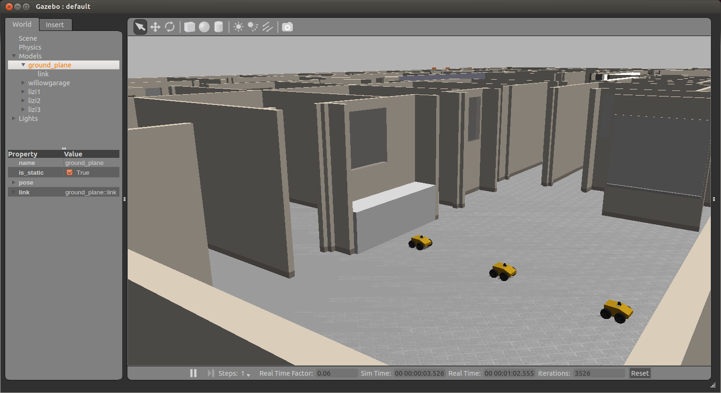
Gazebo

Slide 18
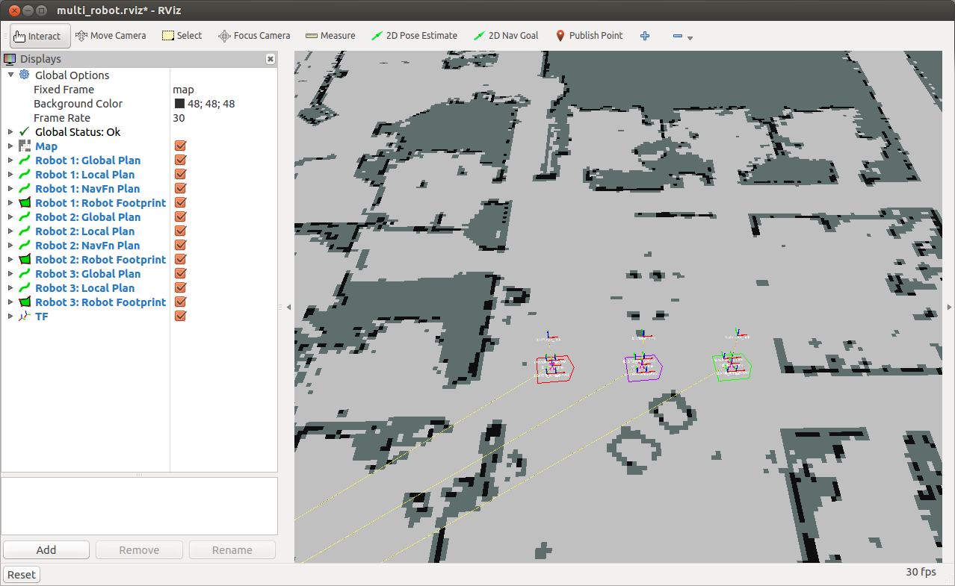
rviz

Slide 19
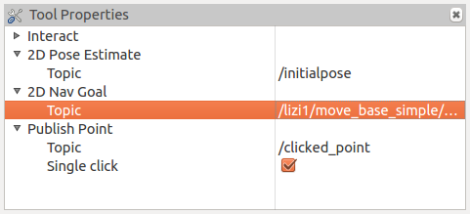
Set Navigation Goal
Open rviz menu – Tool Properties
Change the topic name for the 2D Nav Goal according to the robot that you want to activate:

Slide 20
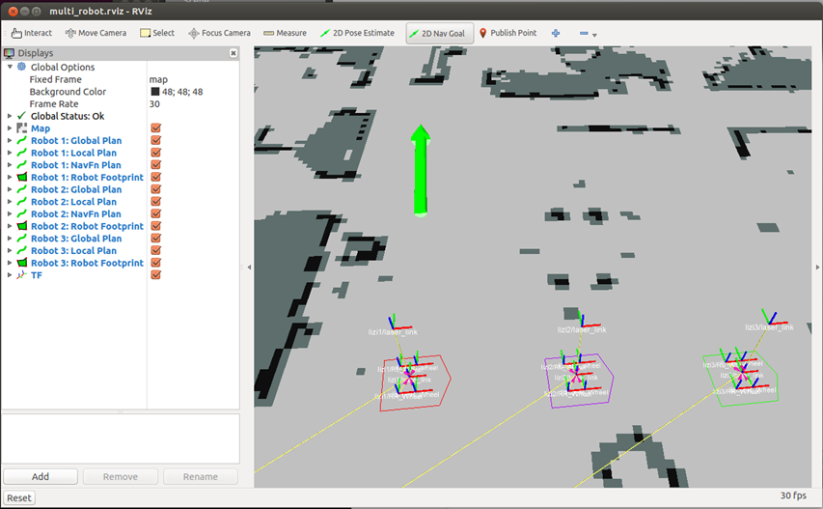
Set Navigation Goal

Slide 21
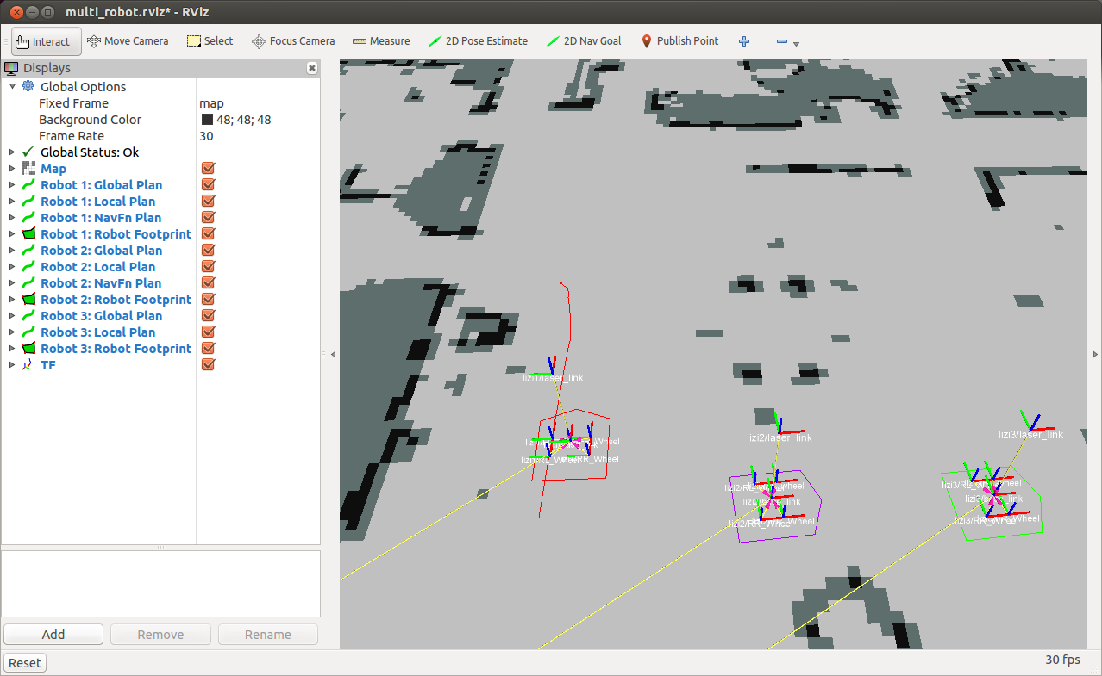
Following the Global Plan

Slide 22

Final Pose

Slide 23
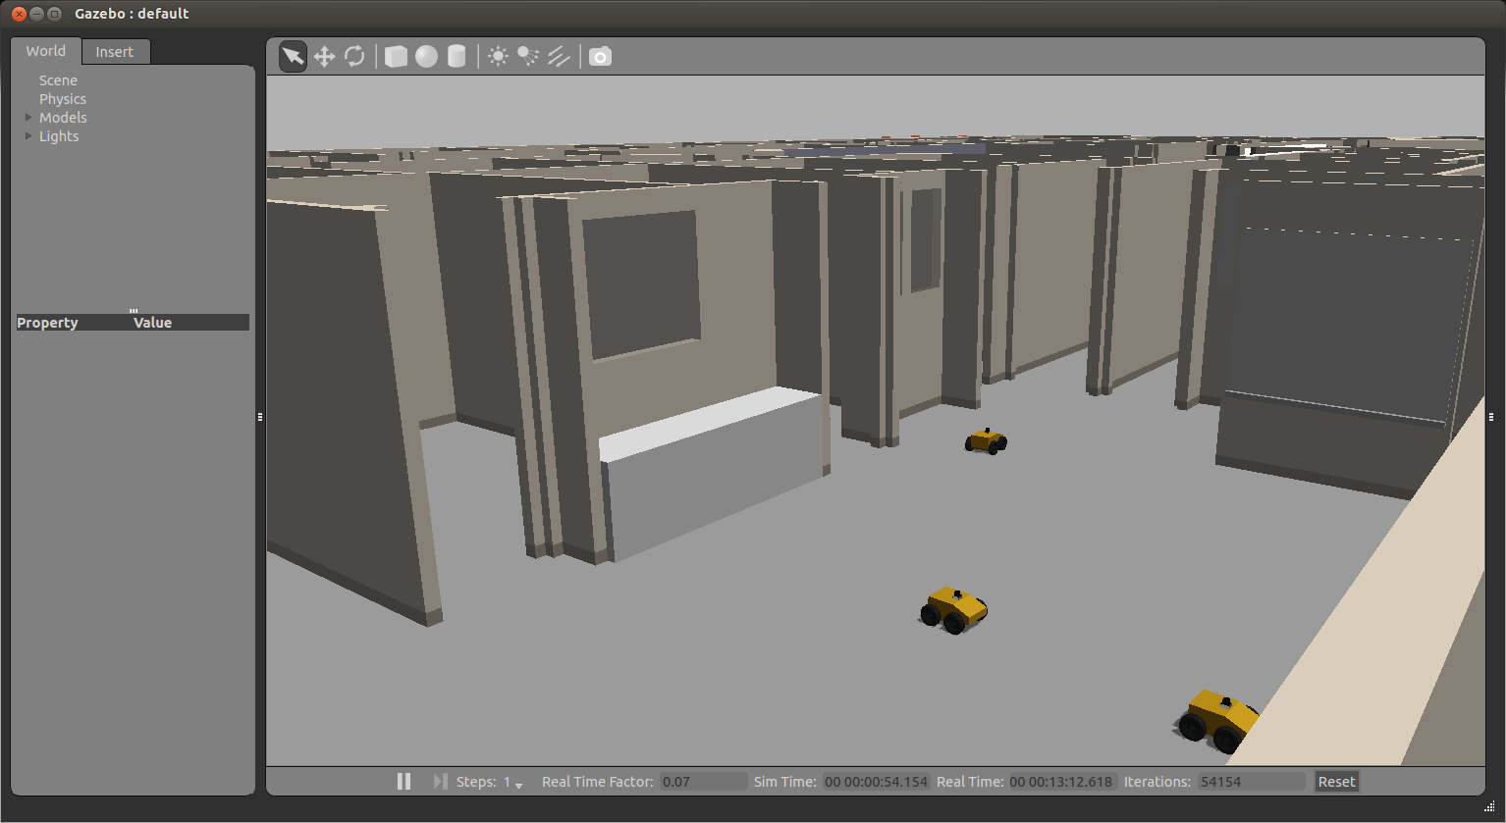
Final Pose in Gazebo

Slide 24
Robotic Coverage Problem
In robotic coverage, a robot is required to visit every part of a given area using the most efficient path possible
Coverage has many applications in a many domains, such as search and rescue, mapping, and surveillance.
The general coverage problem is analogous to the TSP problem, which is NP-complete

Slide 25
Grid-Based Methods
Assume that the environment can be decomposed into a collection of uniform grid cells
Each cell is either occupied or free

Slide 26
STC Algorithm
Gabrieli and Rimon [2001]
Assumption: the robot is equipped with a square shaped tool of size D (the coverage tool)
Switch to coarse grid, each cell of size 4D
Create Spanning Tree (ST) on the coarse grid
Using Prim or Kruskal’s algorithms
The robot walks along the ST, creating a Hamiltonian cycle visiting all cells of the fine grid.
The algorithm finds the optimal coverage path in linear time

Slide 27
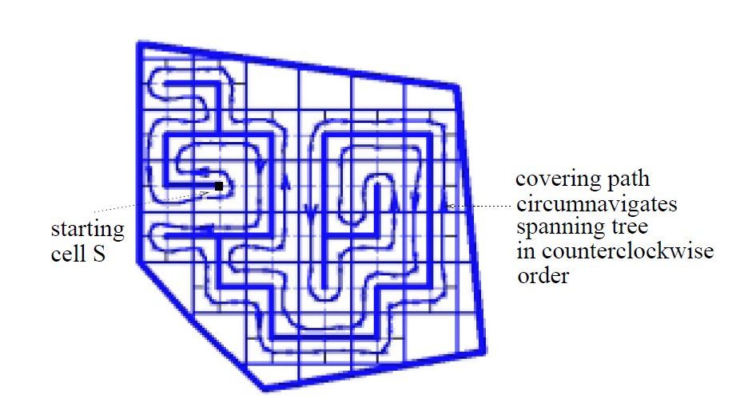
STC Execution Example
Taken from Gabriely and Rimon, 2001

Slide 28
Moving with Odometry Data
As we have learned, you can publish Twist messages to the /cmd_vel topic to make the robot move in the environment
However, calculating the exact number of commands needed to send to the robot to make it move only one cell in the grid can be error-prone
Moreover, the accuracy and reliability of this process depend on the current condition of the robot and its internal sensors
For example, if the robot just started moving, the first velocity command will take some time to take effect

Slide 29
Moving with Odometry Data
Rather than guessing distances and angles based on time and speed, we can monitor the robot's position and orientation as reported by the transform between the /odom and /base_footprint frames (odometry data)
This way we can be more precise about moving our robot

Slide 30
Moving with Odometry Data
void moveToRightCell()
{
// Set the forward linear speed to 0.2 meters per second
float linearSpeed = 0.2f;
geometry_msgs::Twist move_msg;
move_msg.linear.x = linearSpeed;
// Set the target cell
int targetCell = currCell.first + 1;
// How fast will we update the robot's movement?
ros::Rate rate(20);
// Move until we reach the target cell
while (ros::ok() && currCell.first < targetCell)
{
cmdVelPublisher.publish(move_msg);
rate.sleep();
getRobotCurrentPosition();
showCurrentPosition();
}
// Stop the robot (in case the last command is still active)
geometry_msgs::Twist stop_msg;
cmdVelPublisher.publish(stop_msg);
sleep(1);
}

Slide 31
Final Project
Implement the STC algorithm using ROS + Gazebo
More details can be found at: http://u.cs.biu.ac.il/~yehoshr1/89-685/FinalProject/FinalProject.html

