Slide 1

Fall 2014
ROS - Lesson 2
Teaching Assistant: Roi Yehoshua
roiyeho@gmail.com

Slide 2
Agenda
ROS development environment setup
ROS packages structure
ROS Integration with Eclipse
Writing your first Node
Running and debugging your node
(C)2014 Roi Yehoshua

Slide 3
catkin Build System
catkin is the official build system of ROS
The original ROS build system was rosbuild
Still used for older packages
Catkin is implemented as custom CMake macros along with some Python code
Supports development on large sets of related packages in a consistent and conventional way
(C)2014 Roi Yehoshua

Slide 4
ROS Development Setup
Create a new catkin workspace
Create a new ROS package
Download and configure Eclipse
Create Eclipse project file for your package
Import package into Eclipse
Write the code
Update the make file
Build the package
(C)2014 Roi Yehoshua

Slide 5
catkin Workspace
A workspace in which one or more catkin packages can be built
Contains up to four different spaces:
 | Space
Contains the source code of catkin packages. Each folder within the source space contains one or more catkin packages. | Source space
is where CMake is invoked to build the catkin packages in the source space. CMake and catkin keep their cache information and other intermediate files here. | Build Space
is where built targets are placed prior to being installed | Development (Devel) Space
Once targets are built, they can be installed into the install space by invoking the install target. | Install Space
(C)2014 Roi Yehoshua

Slide 6
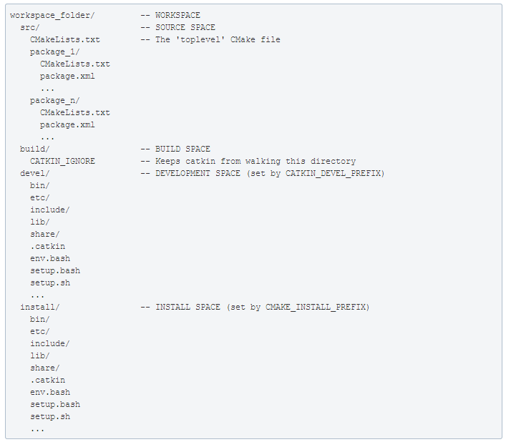
catkin Workspace Layout
(C)2014 Roi Yehoshua

Slide 7
Creating a catkin Workspace
http://wiki.ros.org/catkin/Tutorials/create_a_workspace
Initially, the workspace will contain only the top-level CMakeLists.txt
Note that in the ready-made ROS Indigo VM you already have a catkin_ws workspace with the beginner_tutorials package
$ mkdir -p ~/catkin_ws/src
$ cd ~/catkin_ws/src
$ catkin_init_workspace
(C)2014 Roi Yehoshua

Slide 8
Building catkin Workspace
catkin_make command builds the workspace and all the packages within it
cd ~/catkin_ws
catkin_make
(C)2014 Roi Yehoshua

Slide 9
ROS Package
A ROS package is simply a directory inside a catkin workspace that has a package.xml file in it
Packages are the most atomic unit of build and the unit of release
A package contains the source files for one node or more and configuration files
(C)2014 Roi Yehoshua

Slide 10
Common Files and Directories
Explanation | Directory
C++ include headers | include/
Source files | src/
Folder containing Message (msg) types | msg/
Folder containing Service (srv) types | srv/
Folder containing launch files | launch/
The package manifest | package.xml
CMake build file | CMakeLists.txt
(C)2014 Roi Yehoshua

Slide 11
The Package Manifest
XML file that defines properties about the package such as:
the package name
version numbers
authors
dependencies on other catkin packages
(C)2014 Roi Yehoshua

Slide 12
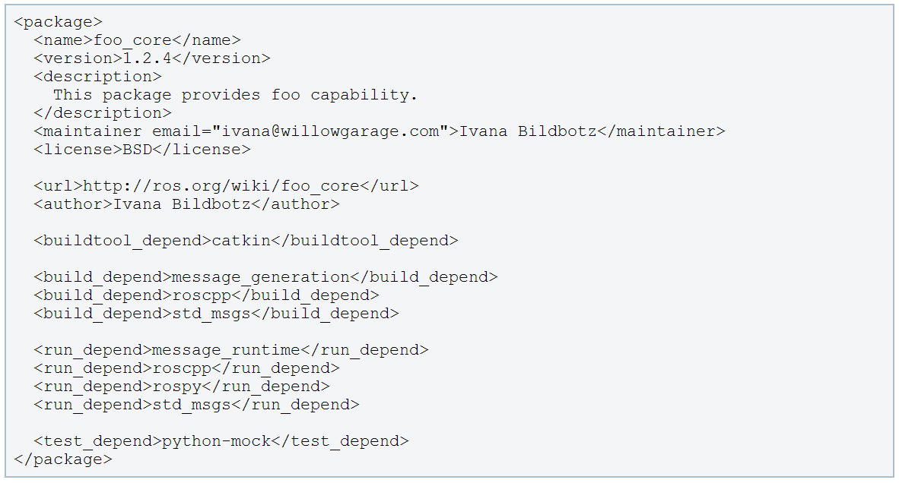
The Package Manifest
Example for a package manifest:
(C)2014 Roi Yehoshua

Slide 13
Creating a ROS Package
http://wiki.ros.org/catkin/Tutorials/CreatingPackage
Change to the source directory of the workspace
catkin_create_pkg creates a new package with the specified dependencies
For example, create a first_pkg package:
$ cd ~/catkin_ws/src
$ catkin_create_pkg <package_name> [depend1] [depend2] [depend3]
$ catkin_create_pkg first_pkg std_msgs rospy roscpp
(C)2014 Roi Yehoshua

Slide 14
Installing Eclipse
Make sure JVM is installed
$sudo apt-get install default-jre
Download eclipse IDE for C/C++ developers from http://www.eclipse.org/downloads/
Latest version of the file is: eclipse-cpp-luna-SR1-linux-gtk-x86_64.tar.gz
Extract eclipse into a folder of your choice
Move eclipse to the /opt folder.
$sudo mv eclipse /opt
Create a link to it so it can be used by all users
$sudo ln -s /opt/eclipse/eclipse /usr/bin/eclipse
(C)2014 Roi Yehoshua

Slide 15
Installing Eclipse
Make an entry in the Unity Dash for easier access
$sudo gedit /usr/share/applications/eclipse.desktop
The bash –i - c command will cause your IDE's launcher icon to load your ROS-sourced shell environment before launching eclipse
[Desktop Entry]
Name=Eclipse
Type=Application
Exec=bash -i -c "/opt/eclipse/eclipse"
Terminal=false
Icon=/opt/eclipse/icon.xpm
Comment=Integrated Development Environment
NoDisplay=false
Categories=Development;IDE
Name[en]=eclipse.desktop
(C)2014 Roi Yehoshua

Slide 16
Make Eclipse Project Files
Go to workspace directory and run catkin_make with options to generate eclipse project files:
The project files will be generated in ~/catkin_ws/build
$ cd ~/catkin_ws
$ catkin_make --force-cmake -G"Eclipse CDT4 - Unix Makefiles"
(C)2014 Roi Yehoshua

Slide 17
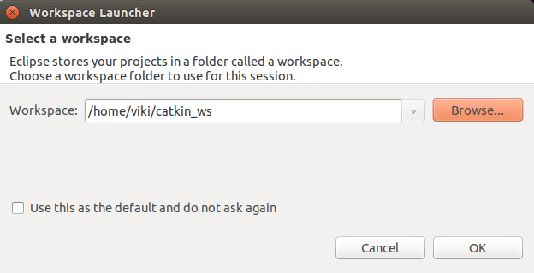
Import the Project into Eclipse
Now start Eclipse
Choose catkin_ws folder as the workspace folder
(C)2014 Roi Yehoshua

Slide 18
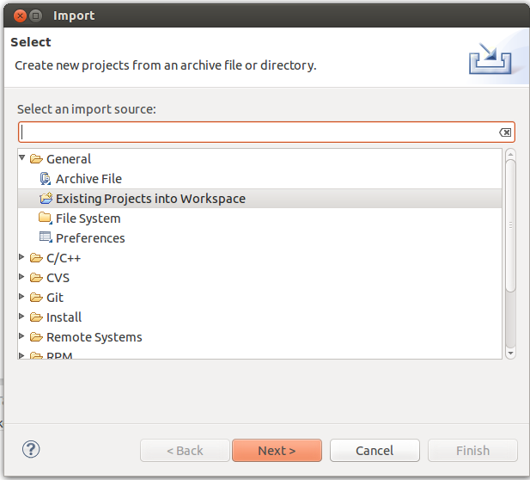
Import the Project into Eclipse
Choose File --> Import --> General --> Existing Projects into Workspace
(C)2014 Roi Yehoshua

Slide 19
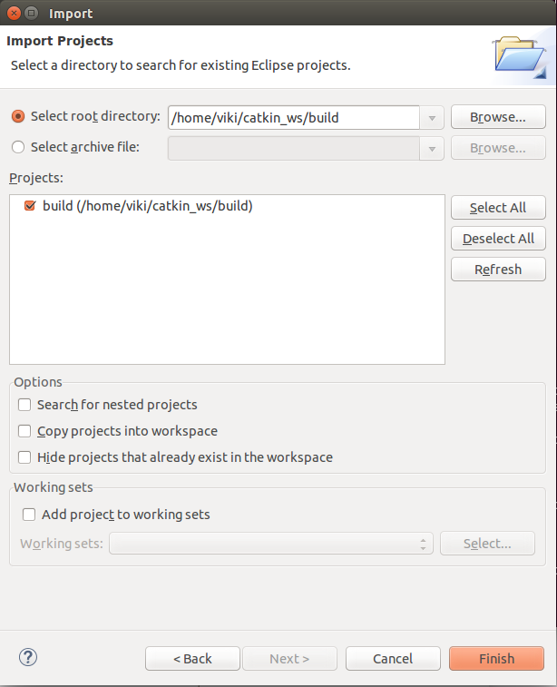
Import the Project into Eclipse
Now import the project from the ~/catkin_ws/build folder
(C)2014 Roi Yehoshua

Slide 20
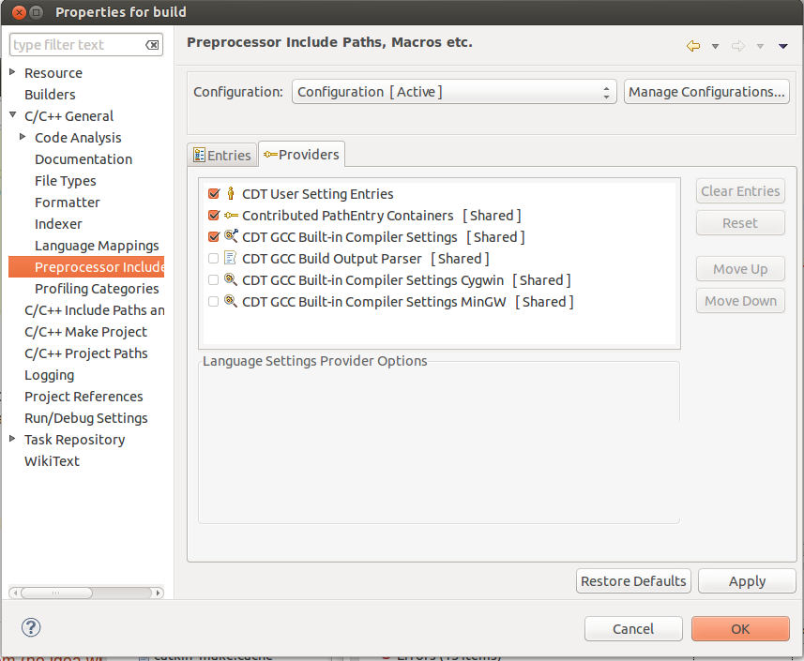
Fix Preprocessor Include Paths
By default, the intellisense in Eclipse won’t recognize the system header files (like <string>). To fix that:
Go to Project Properties --> C/C++ General --> Preprocessor Include Paths, Macros, etc. --> Providers tab
Check CDT GCC Built-in Compiler Settings [Shared]
(C)2014 Roi Yehoshua

Slide 21
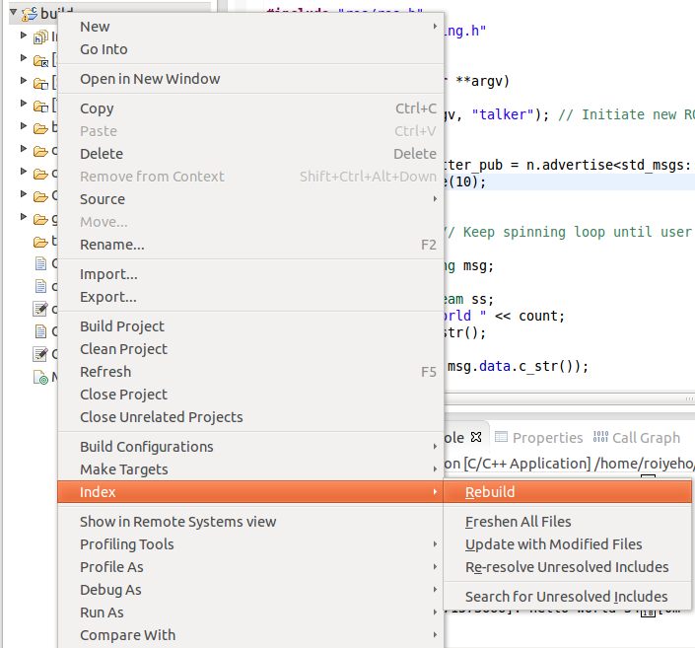
Fix Preprocessor Include Paths
After that rebuild the C/C++ index by Right click on project -> Index -> Rebuild
(C)2014 Roi Yehoshua

Slide 22
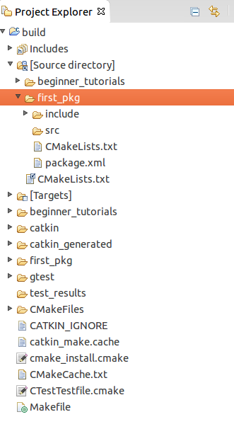
Project Structure
Eclipse provides a link "Source directory" within the project so that you can edit the source code
(C)2014 Roi Yehoshua

Slide 23
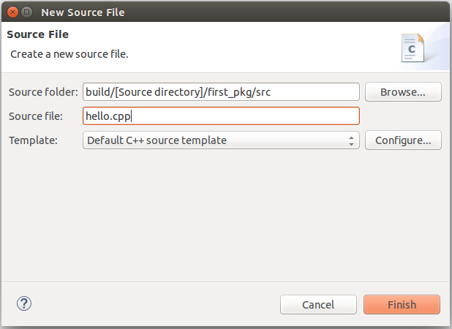
Add New Source File
Right click on src and select New –> Source File, and create a file named hello.cpp
(C)2014 Roi Yehoshua

Slide 24
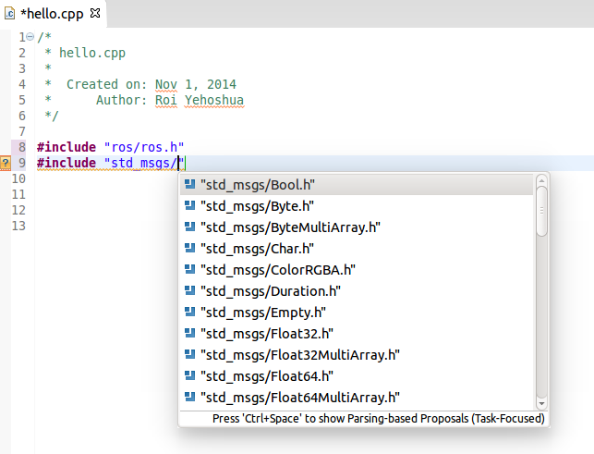
Code Completion
Use Eclipse standard shortcuts to get code completion (i.e., Ctrl+Space)
(C)2014 Roi Yehoshua

Slide 25
ROS C++ Client Library
roscpp is a ROS client implementation in C++
Library documentation can be found at:
http://docs.ros.org/api/roscpp/html/
ROS main header file is “ros/ros.h”
(C)2014 Roi Yehoshua

Slide 26
ROS Init
A version of ros::init() must be called before using any of the rest of the ROS system
Typical call in the main() function:
Node names must be unique in a running system
ros::init(argc, argv, "Node name");
(C)2014 Roi Yehoshua

Slide 27
ros::NodeHandle
The main access point to communications with the ROS system.
Provides public interface to topics, services, parameters, etc.
Create a handle to this process’ node (after the call to ros::init()) by declaring:
The first NodeHandle constructed will fully initialize the current node
The last NodeHandle destructed will close down the node
ros::NodeHandle node;
(C)2014 Roi Yehoshua

Slide 28
ros::Rate
A class to help run loops at a desired frequency.
Specify in the c’tor the destired rate to run in Hz
ros::Rate::sleep() method
Sleeps for any leftover time in a cycle.
Calculated from the last time sleep, reset, or the constructor was called
ros::Rate loop_rate(10);
(C)2014 Roi Yehoshua

Slide 29
ros::ok()
Call ros::ok() to check if the node should continue running
ros::ok() will return false if:
a SIGINT is received (Ctrl-C)
we have been kicked off the network by another node with the same name
ros::shutdown() has been called by another part of the application.
all ros::NodeHandles have been destroyed
(C)2014 Roi Yehoshua

Slide 30
ROS Debug Messages
ROS_INFO prints an informative message
ROS_INFO( "My INFO message." );
All messages are printed with their level and the current timestamp
[ INFO] [1356440230.837067170]: My INFO message.
This function allows parameters as in printf:
ROS_INFO("My INFO message with argument: %f", val );
(C)2014 Roi Yehoshua

Slide 31
ROS Debug Messages
ROS comes with five classic logging levels: DEBUG, INFO, WARN, ERROR, and FATAL
These names are part of the macro used to output messages that follows this syntax:
ROS_<LEVEL>[_<OTHER>]
Also, C++ STL streams are supported with *_STREAM functions
ROS_INFO_STREAM("My INFO stream message with argument: " << val);
(C)2014 Roi Yehoshua

Slide 32
C++ First Node Example
/*
* hello.cpp
*
* Created on: Nov 1, 2014
* Author: Roi Yehoshua
*/
#include "ros/ros.h"
int main(int argc, char **argv)
{
ros::init(argc, argv, "hello");
ros::NodeHandle nh;
ros::Rate loop_rate(10);
int count = 0;
while (ros::ok()) // Keep spinning loop until user presses Ctrl+C
{
ROS_INFO_STREAM("hello world" << count);
ros::spinOnce(); // Allow ROS to process incoming messages
loop_rate.sleep(); // Sleep for the rest of the cycle
count++;
}
return 0;
}
(C)2014 Roi Yehoshua

Slide 33
Building Your Node
Before building your node, you should modify the generated CMakeLists.txt in the package
The following slide shows the changes that you need to make in order to create the executable for the node
(C)2014 Roi Yehoshua

Slide 34
CMakeLists.txt
cmake_minimum_required(VERSION 2.8.3)
project(first_pkg)
## Find catkin macros and libraries
find_package(catkin REQUIRED COMPONENTS roscpp rospy std_msgs)
## Declare ROS messages and services
# add_message_files(FILES Message1.msg Message2.msg)
# add_service_files(FILES Service1.srv Service2.srv)
## Generate added messages and services
# generate_messages(DEPENDENCIES std_msgs)
## Declare catkin package
catkin_package()
## Specify additional locations of header files
include_directories(${catkin_INCLUDE_DIRS})
## Declare a cpp executable
add_executable(hello src/hello.cpp)
## Specify libraries to link a library or executable target against
target_link_libraries(hello ${catkin_LIBRARIES})
(C)2014 Roi Yehoshua

Slide 35
Building Your Nodes
To compile the project in Eclipse press Ctrl-B
To build the package in the terminal call catkin_make
(C)2014 Roi Yehoshua

Slide 36
Running the Node From Terminal
Make sure you have sourced your workspace's setup.sh file after calling catkin_make:
Can add this line to your .bashrc startup file
Now you can use rosrun to run your node:
$ cd ~/catkin_ws
$ source ./devel/setup.bash
$ rosrun first_pkg hello
(C)2014 Roi Yehoshua

Slide 37
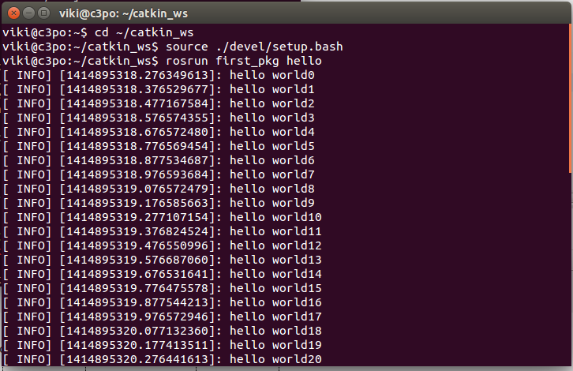
Running the Node From Terminal
(C)2014 Roi Yehoshua

Slide 38
Running the Node Inside Eclipse
Create a new launch configuration, by clicking on Run --> Run configurations... --> C/C++ Application (double click or click on New).
Select the correct binary on the main tab (use the Browse… button)
~/catkin_ws/devel/lib/first_pkg/hello
Make sure roscore is running in a terminal
Click Run
(C)2014 Roi Yehoshua

Slide 39
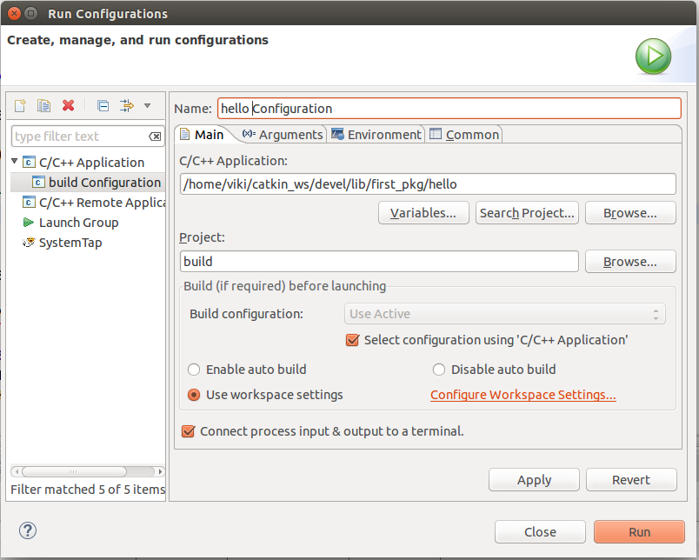
Running the Node Inside Eclipse
(C)2014 Roi Yehoshua

Slide 40
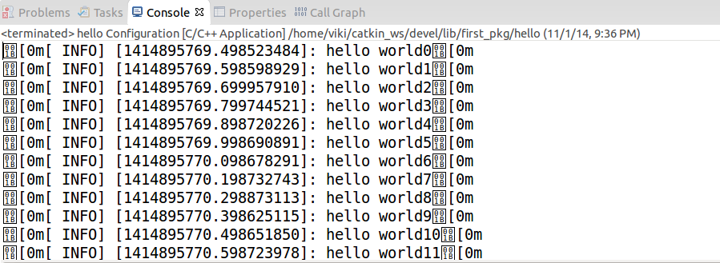
Running the Node Inside Eclipse
(C)2014 Roi Yehoshua

Slide 41
Debugging
To enable debugging, you should first execute the following command in catkin_ws/build:
Restart Eclipse
Then you will be able to use the standard debugging tools in Eclipse
$ cmake ../src -DCMAKE_BUILD_TYPE=Debug
(C)2014 Roi Yehoshua

Slide 42
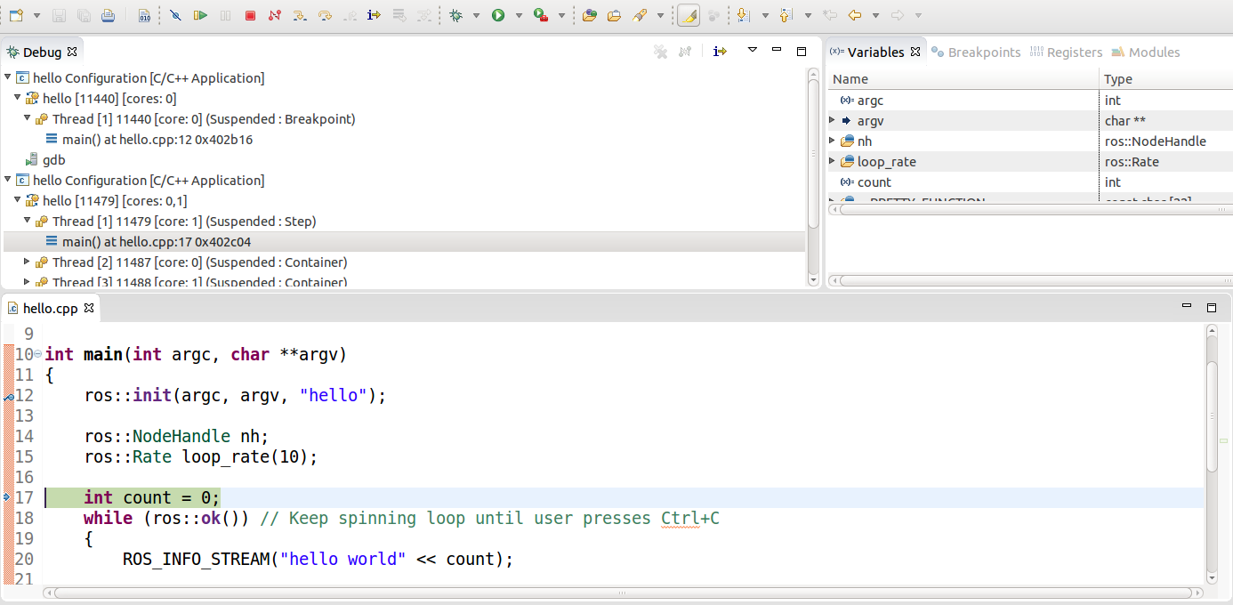
Debugging
(C)2014 Roi Yehoshua

Slide 43
Homework (not for submission)
Install Eclipse and integrate it with ROS
Create a new ROS package called "timer_package"
Create a node in this package called "timer_node"
The node should print to the console the current time every 1 second
(C)2014 Roi Yehoshua

