Slide 1

ROS - Lesson 3
Fall 2014
Teaching Assistant: Roi Yehoshua
roiyeho@gmail.com

Slide 2
Agenda
Publishing messages to topics
Subscribing to topics
Differential drive robots
Sending velocity commands
roslaunch

Slide 3
ros::Publisher
Manages an advertisement on a specific topic
A Publisher is created by calling NodeHandle::advertise()
Registers this topic in the master node
Example for creating a publisher:
First parameter is the topic name
Second parameter is the queue size
Once all the publishers for a given topic go out of scope the topic will be unadvertised
ros::Publisher chatter_pub = node.advertise<std_msgs::String>("chatter", 1000);

Slide 4
ros::Publisher
Messages are published on a topic through a call to publish()
Example:
The type of the message object must agree with the type given as a template parameter to the advertise<>() call
std_msgs::String msg;
chatter_pub.publish(msg);

Slide 5
Talker and Listener
We now create a new package with two nodes:
talker publishes messages to topic “chatter”
listener reads the messages from the topic and prints them out to the screen
First create the package
Open the package source directory in Eclipse and add a C++ source file named Talker.cpp
Copy the following code into it
$ cd ~/catkin_ws/src
catkin_create_pkg chat_pkg std_msgs rospy roscpp

Slide 6
Talker.cpp
#include "ros/ros.h"
#include "std_msgs/String.h"
#include <sstream>
int main(int argc, char **argv)
{
ros::init(argc, argv, "talker"); // Initiate new ROS node named "talker"
ros::NodeHandle node;
ros::Publisher chatter_pub = node.advertise<std_msgs::String>("chatter", 1000);
ros::Rate loop_rate(10);
int count = 0;
while (ros::ok()) // Keep spinning loop until user presses Ctrl+C
{
std_msgs::String msg;
std::stringstream ss;
ss << "hello world " << count;
msg.data = ss.str();
ROS_INFO("%s", msg.data.c_str());
chatter_pub.publish(msg);
ros::spinOnce(); // Need to call this function often to allow ROS to process incoming messages
loop_rate.sleep(); // Sleep for the rest of the cycle, to enforce the loop rate
count++;
}
return 0;
}

Slide 7
Subscribing to a Topic
To start listening to a topic, call the method subscribe() of the node handle
This returns a Subscriber object that you must hold on to until you want to unsubscribe
Example for creating a subscriber:
First parameter is the topic name
Second parameter is the queue size
Third parameter is the function to handle the message
ros::Subscriber sub = node.subscribe("chatter", 1000, messageCallback);

Slide 8
Listener.cpp
#include "ros/ros.h"
#include "std_msgs/String.h"
// Topic messages callback
void chatterCallback(const std_msgs::String::ConstPtr& msg)
{
ROS_INFO("I heard: [%s]", msg->data.c_str());
}
int main(int argc, char **argv)
{
// Initiate a new ROS node named "listener"
ros::init(argc, argv, "listener");
ros::NodeHandle node;
// Subscribe to a given topic
ros::Subscriber sub = node.subscribe("chatter", 1000, chatterCallback);
// Enter a loop, pumping callbacks
ros::spin();
return 0;
}

Slide 9
ros::spin()
The ros::spin() creates a loop where the node starts to read the topic, and when a message arrives messageCallback is called
ros::spin() will exit once ros::ok() returns false
For example, when the user presses Ctrl+C or when ros::shutdown() is called

Slide 10
Using Class Methods as Callbacks
Suppose you have a simple class, Listener:
Then the NodeHandle::subscribe() call using the class method looks like this:
class Listener
{
public: void callback(const std_msgs::String::ConstPtr& msg);
};
Listener listener;
ros::Subscriber sub = node.subscribe("chatter", 1000, &Listener::callback, &listener);

Slide 11
Compile the Nodes
Add the following to the package’s CMakeLists file
cmake_minimum_required(VERSION 2.8.3)
project(chat_pkg)
…
## Declare a cpp executable
add_executable(talker src/Talker.cpp)
add_executable(listener src/Listener.cpp)
## Specify libraries to link a library or executable target against
target_link_libraries(talker ${catkin_LIBRARIES})
target_link_libraries(listener ${catkin_LIBRARIES})

Slide 12
Building the Nodes
Now build the package and compile all the nodes using the catkin_make tool:
This will create two executables, talker and listener, at ~/catkin_ws/devel/lib/chat_pkg
cd ~/catkin_ws
catkin_make

Slide 13
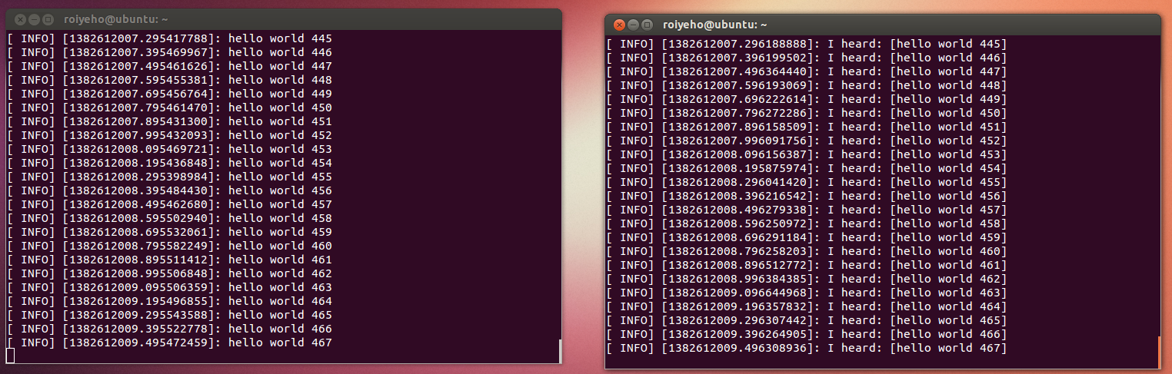
Running the Nodes From Terminal
Run roscore
Run the nodes in two different terminals:
$ rosrun chat_pkg talker
$ rosrun chat_pkg listener

Slide 14
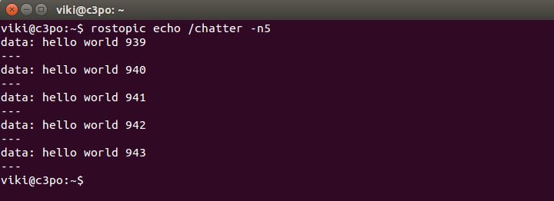
Running the Nodes From Terminal
You can use rosnode and rostopic to debug and see what the nodes are doing
Examples:
$rosnode info /talker
$rosnode info /listener
$rostopic list
$rostopic info /chatter
$rostopic echo /chatter

Slide 15
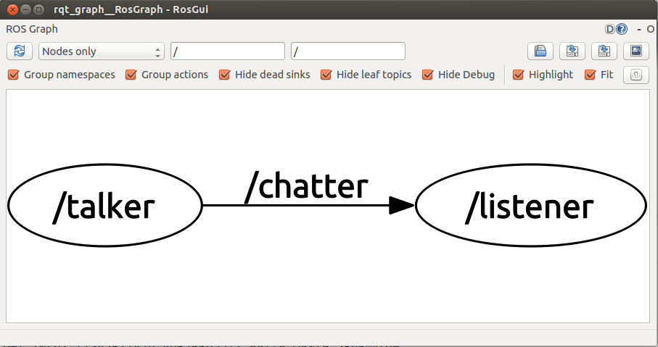
rqt_graph
rqt_graph creates a dynamic graph of what's going on in the system
Use the following command to run it:
$ rosrun rqt_graph rqt_graph

Slide 16
roslaunch
roslaunch is a tool for easily launching multiple ROS nodes as well as setting parameters on the Parameter Server
It takes in one or more XML configuration files (with the .launch extension) that specify the parameters to set and nodes to launch
If you use roslaunch, you do not have to run roscore manually

Slide 17
Launch File Example
Launch file for launching both the talker and listener nodes (chat.launch):
output=“screen” makes the ROS log messages appear on the launch terminal window
To run a launch file use:
<launch>
<node name="talker" pkg="chat_pkg" type="talker" output="screen"/>
<node name="listener" pkg="chat_pkg" type="listener" output="screen"/>
</launch>
$ roslaunch chat_pkg chat.launch

Slide 18
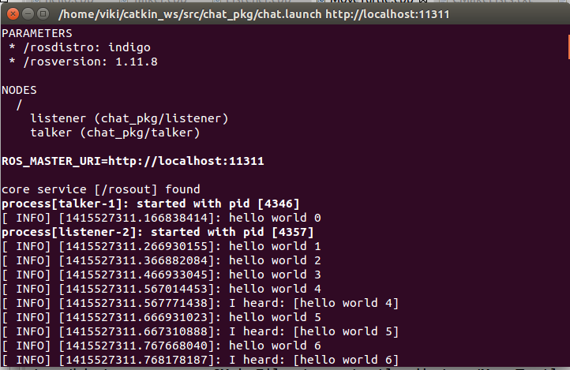
Launch File Example

Slide 19
Velocity Commands
To make a robot move in ROS we need to publish Twist messages to the topic cmd_vel
This message has a linear component for the (x,y,z) velocities, and an angular component for the angular rate about the (x,y,z) axes
geometry_msgs/Vector3 linear
float64 x
float64 y
float64 z
geometry_msgs/Vector3 angular
float64 x
float64 y
float64 z

Slide 20
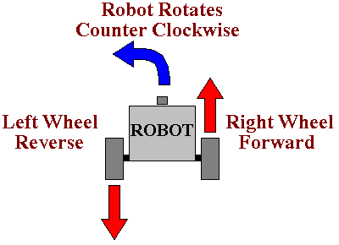
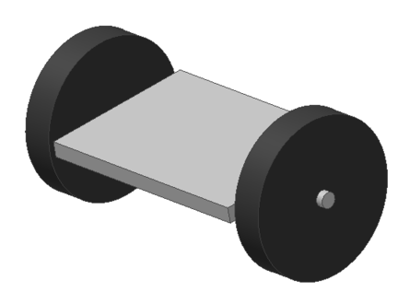
Differential Drive Robots
The movement of a differential wheeled robot is based on two separately wheels placed on both sides of the robot
It can change its direction by varying the relative rate of rotation of its wheels and hence does not require an additional steering motion.

Slide 21
Differential Drive Robots
A differential drive robot can only move forward/backward along its longitudinal axis and rotate only around its vertical axis
The robot cannot move sideways or vertically
Thus we only need to set the linear x component and the angular z component in the Twist message
An omni-directional robot would also use the linear y component while a flying or underwater robot would use all six components

Slide 22
A Move Turtle Node
For the demo, we will create a new ROS package called my_turtle
In Eclipse add a new source file to the package called Move_Turtle.cpp
Add the following code
$ cd ~/catkin_ws/src
$ catkin_create_pkg my_turtle std_msgs rospy roscpp

Slide 23
MoveTurtle.cpp
#include "ros/ros.h"
#include "geometry_msgs/Twist.h"
int main(int argc, char **argv)
{
const double FORWARD_SPEED_MPS = 0.5;
// Initialize the node
ros::init(argc, argv, "move_turtle");
ros::NodeHandle node;
// A publisher for the movement data
ros::Publisher pub = node.advertise<geometry_msgs::Twist>("turtle1/cmd_vel", 10);
// Drive forward at a given speed. The robot points up the x-axis.
// The default constructor will set all commands to 0
geometry_msgs::Twist msg;
msg.linear.x = FORWARD_SPEED_MPS;
// Loop at 10Hz, publishing movement commands until we shut down
ros::Rate rate(10);
ROS_INFO("Starting to move forward");
while (ros::ok()) {
pub.publish(msg);
rate.sleep();
}
}

Slide 24
Launch File
Add move_turtle.launch to your package:
Run the launch file:
<launch>
<node name="turtlesim_node" pkg="turtlesim" type="turtlesim_node" />
<node name="move_turtle" pkg="my_turtle" type="move_turtle" output="screen" />
</launch>
$ roslaunch my_turtle move_turtle.launch

Slide 25
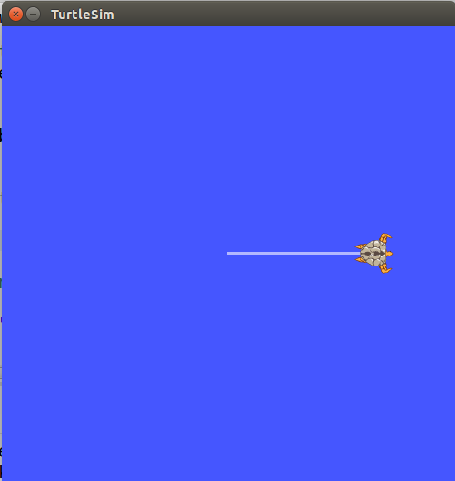
Move Turtle Demo
You should see the turtle in the simulator constantly moving forward until it bumps into the wall

Slide 26
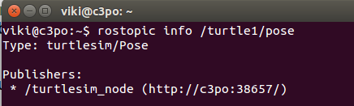
Print Turtle’s Pose
In order to print the turtle’s pose we need to subscribe to the topic /turtle1/pose
First, we find the message type of the topic by running the command rosmsg type /turtle1/pose
Message type is turtlesim/Pose
This is a specific message in turtlesim package, thus we need to include the header “turtlesim/Pose.h” in order to work with message of this type

Slide 27
MoveTurtle.cpp (1)
#include "ros/ros.h"
#include "geometry_msgs/Twist.h"
#include "turtlesim/Pose.h"
// Topic messages callback
void poseCallback(const turtlesim::PoseConstPtr& msg)
{
ROS_INFO("x: %.2f, y: %.2f", msg->x, msg->y);
}
int main(int argc, char **argv)
{
const double FORWARD_SPEED_MPS = 0.5;
// Initialize the node
ros::init(argc, argv, "move_turtle");
ros::NodeHandle node;
// A publisher for the movement data
ros::Publisher pub = node.advertise<geometry_msgs::Twist>("turtle1/cmd_vel", 10);
// A listener for pose
ros::Subscriber sub = node.subscribe("turtle1/pose", 10, poseCallback);

Slide 28
MoveTurtle.cpp (2)
// Drive forward at a given speed. The robot points up the x-axis.
// The default constructor will set all commands to 0
geometry_msgs::Twist msg;
msg.linear.x = FORWARD_SPEED_MPS;
// Loop at 10Hz, publishing movement commands until we shut down
ros::Rate rate(10);
ROS_INFO("Starting to move forward");
while (ros::ok()) {
pub.publish(msg);
ros::spinOnce(); // Allow processing of incoming messages
rate.sleep();
}
}

Slide 29
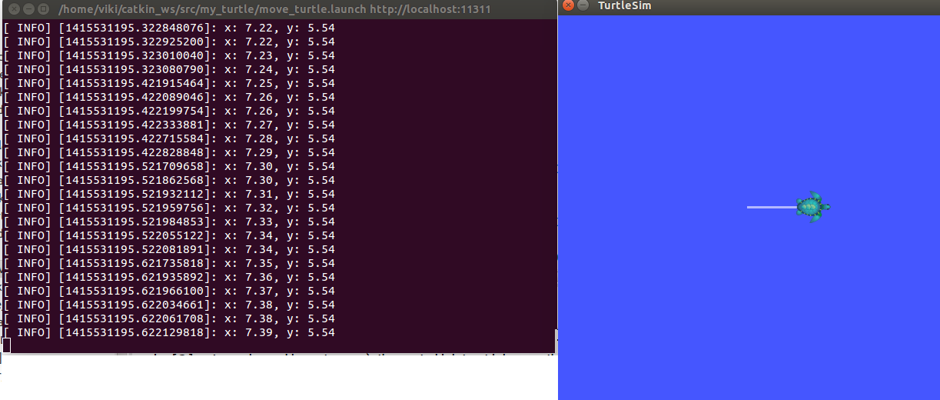
Print Turtle’s Pose
roslaunch my_turtle move_turtle.launch

Slide 30
Passing Arguments To Nodes
In the launch file you can use the args attribute to pass command-line arguments to node
In our case, we will pass the name of the turtle as an argument to move_turtle
<launch>
<node name="turtlesim_node" pkg="turtlesim" type="turtlesim_node" />
<node name="move_turtle" pkg="my_turtle" type="move_turtle" args="turtle1" output="screen"/>
</launch>

Slide 31
MoveTurtle.cpp
int main(int argc, char **argv)
{
const double FORWARD_SPEED_MPS = 0.5;
string robot_name = string(argv[1]);
// Initialize the node
ros::init(argc, argv, "move_turtle");
ros::NodeHandle node;
// A publisher for the movement data
ros::Publisher pub = node.advertise<geometry_msgs::Twist>(robot_name + "/cmd_vel", 10);
// A listener for pose
ros::Subscriber sub = node.subscribe(robot_name + "/pose", 10, poseCallback);
geometry_msgs::Twist msg;
msg.linear.x = FORWARD_SPEED_MPS;
ros::Rate rate(10);
ROS_INFO("Starting to move forward");
while (ros::ok()) {
pub.publish(msg);
ros::spinOnce(); // Allow processing of incoming messages
rate.sleep();
}
}

Slide 32
Exercise
Write a program that moves the turtle 1m forward from its current position, rotates it 45 degrees and then causes it to stop
Print the turtle’s initial and final locations

