Slide 1

ROS - Lesson 4
Fall 2014
Teaching Assistant: Roi Yehoshua
roiyeho@gmail.com

Slide 2
Agenda
Stage simulator
Reading laser sensor data
Writing a simple walker
Your first assignment

Slide 3
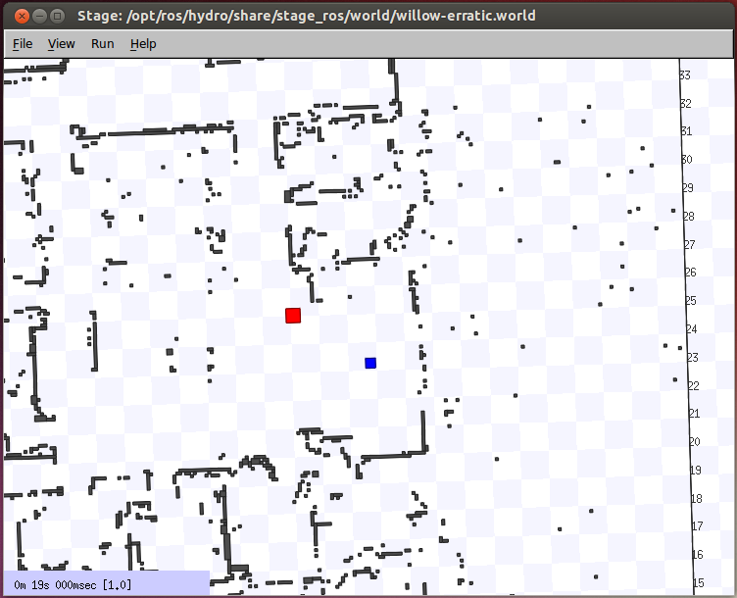
ROS Stage Simulator
http://wiki.ros.org/simulator_stage
A 2D simulator that provides a virtual world populated by mobile robots, along with various objects for the robots to sense and manipulate

Slide 4
Run Stage with an existing world file
Stage is already installed with ROS Indigo
Stage ships with some example world files, including one that puts an Erratic-like robot in a Willow Garage-like environment
To run it with an existing world file
Browsing the stage window should show up 2 little squares: a red square which is a red box and a blue square which is the erratic robot
rosrun stage_ros stageros `rospack find stage_ros`/world/willow-erratic.world

Slide 5
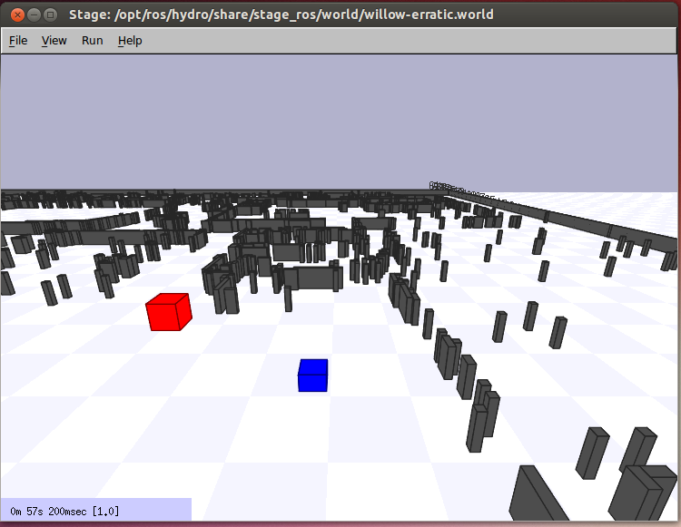
Run Stage with an existing world file
Click on the stage window and press R to see the perspective view.

Slide 6
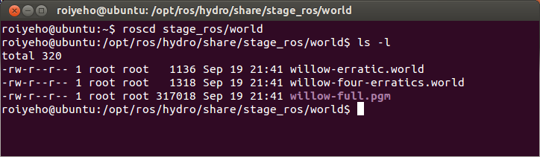
Stage World Files
The world file is a description of the world that Stage must simulate.
It describes robots, sensors, actuators, moveable and immovable objects.
Sample world files can be found at the /world subdirectory in ros_stage package

Slide 7
World File Format
The basic syntactic features of the world file format: comments, entities and properties
The define statement can be used to define new types of entities.
define myrobot position (player() laser() )
Entities have properties, indicated using name value pairs
myrobot (name "robot1" port 6665 pose [1 1 0])
This entry creates a position device named "robot1" attached to port 6665, with initial position (1, 1) and orientation of 0

Slide 8
Stage World File Example
define block model
(
size [0.5 0.5 0.75]
gui_nose 0
)
define topurg ranger
(
sensor(
range_max 30.0
fov 270.25
samples 1081
)
# generic model properties
color "black"
size [ 0.05 0.05 0.1 ]
)
define pr2 position
(
size [0.65 0.65 0.25]
origin [-0.05 0 0 0]
gui_nose 1
drive "omni"
topurg(pose [ 0.275 0.000 0 0.000 ])
)

Slide 9
Stage World File Example
define floorplan model
(
# sombre, sensible, artistic
color "gray30"
# most maps will need a bounding box
boundary 1
gui_nose 0
gui_grid 0
gui_outline 0
gripper_return 0
fiducial_return 0
ranger_return 1
)
# set the resolution of the underlying raytrace model in meters
resolution 0.02
interval_sim 100 # simulation timestep in milliseconds
window
(
size [ 745.000 448.000 ]
rotate [ 0.000 -1.560 ]
scale 18.806
)

Slide 10
Stage World File Example
# load an environment bitmap
floorplan
(
name "willow"
bitmap "../maps/willow-full-0.05.pgm"
size [58.25 47.25 1.0]
pose [ -23.625 29.125 0 90.000 ]
)
# throw in a robot
pr2( pose [ -28.610 13.562 0 99.786 ] name "pr2" color "blue")
block( pose [ -25.062 12.909 0 180.000 ] color "red")
block( pose [ -25.062 12.909 0 180.000 ] color "red")
block( pose [ -25.062 12.909 0 180.000 ] color "red“)

Slide 11
Move the robot around
You have a simulated robot - let's make it move
An easy way to do this is keyboard-based teleoperation
For keyboard teleoperation, you need to get a package called teleop_twist_keyboard which is part of the brown_remotelab stack
http://wiki.ros.org/brown_remotelab

Slide 12
Installing External ROS Packages
Create a directory for downloaded packages
For example, ~/ros/stacks
Edit ROS_PACKAGE_PATH in your .bashrc to include your own ros stacks directory
Check the package out from the SVN:
Compile the package
export ROS_PACKAGE_PATH=~/ros/stacks:${ROS_PACKAGE_PATH}
$ cd ~/ros/stacks
$ svn co https://brown-ros-pkg.googlecode.com/svn/trunk/distribution/brown_remotelab
$ rosmake brown_remotelab

Slide 13
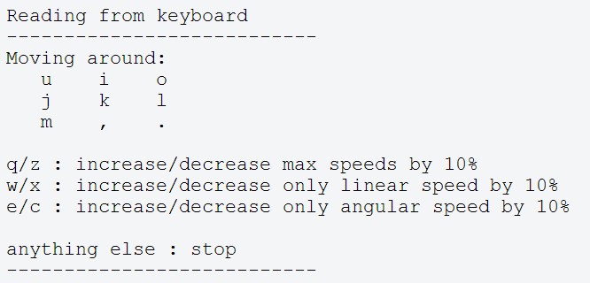
Move the robot around
Now run teleop_twist_keyboard:
You should see console output that gives you the key-to-control mapping, something like this:
Hold down any of those keys to drive the robot. E.g., to drive forward, hold down the i key.
$ rosrun teleop_twist_keyboard teleop_twist_keyboard.py

Slide 14
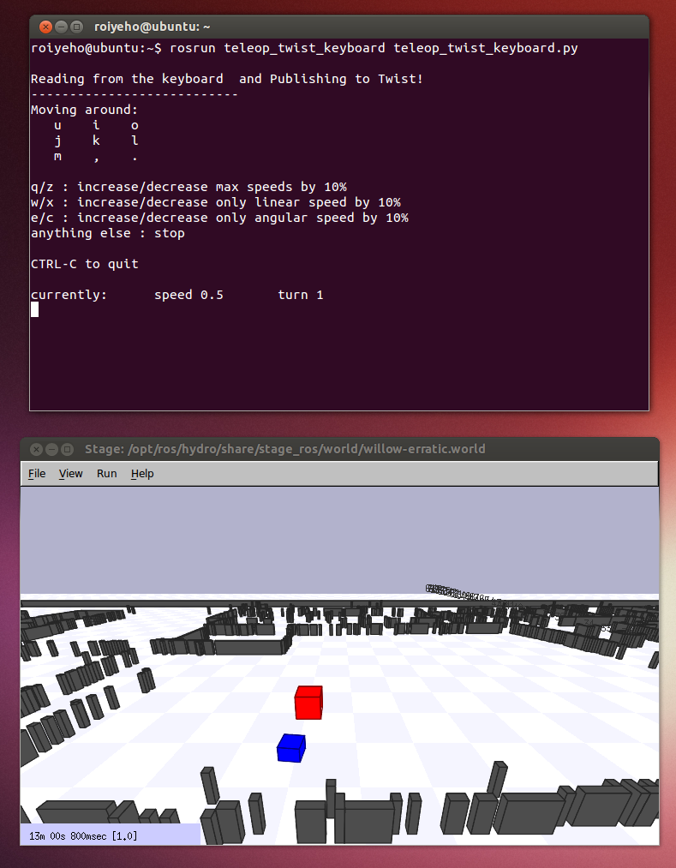
Move the robot around

Slide 15
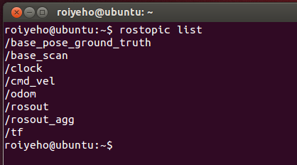
Stage Published Topics
The stage simulator publishes several topics
See what topics are available using rostopic list
You can use rostopic echo -n 1 to look at an instance of the data on one of the topics

Slide 16
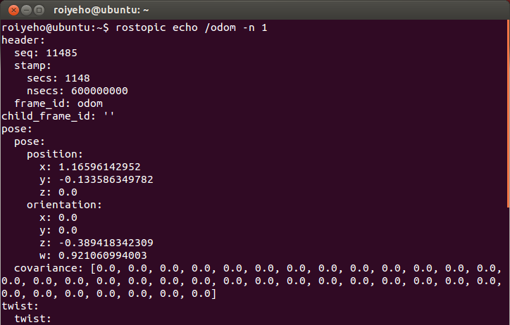
Odometry Messages

Slide 17
A Stopper Node
We will create a node called stopper that will make the robot move forward until it detects an obstacle in front of it
We will use the laser sensor data to achieve this
Create a new package called my_stage
$ cd ~/catkin_ws/src
$ catkin_create_pkg my_stage std_msgs rospy roscpp

Slide 18
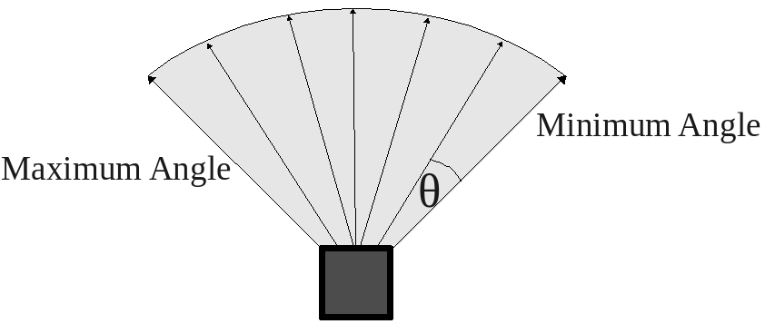
Laser Scanner

Slide 19
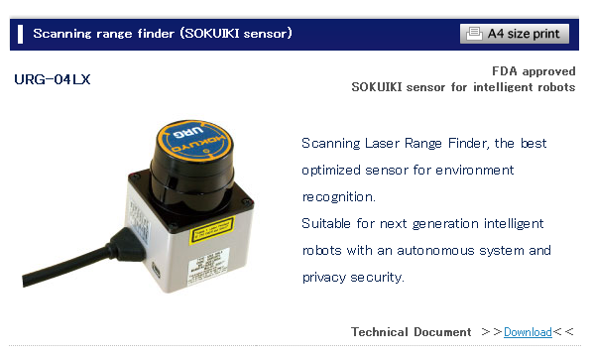
Hokuyo Laser
A common laser sensor used in robotics
http://www.hokuyo-aut.jp/02sensor/07scanner/urg_04lx.html

Slide 20
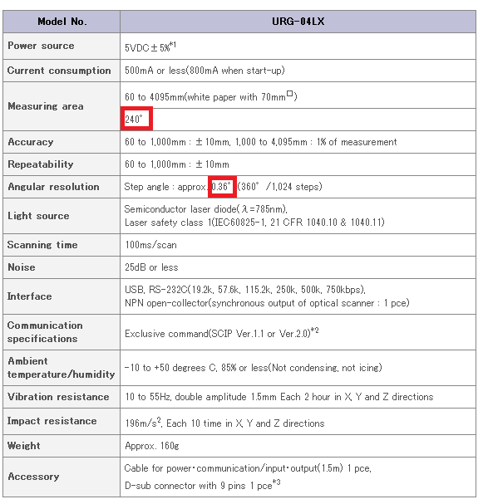
Hokuyo Laser

Slide 21
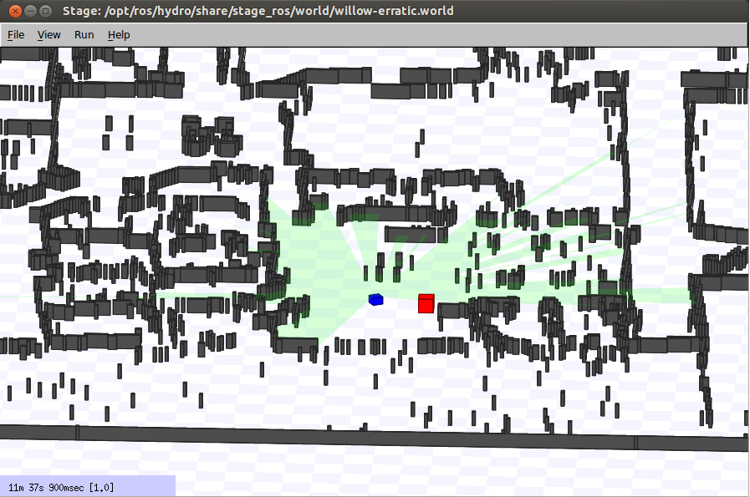
Laser Scan Data
In Stage Click D (or choose View > Data) to see the laser data on the map

Slide 22
Laser Scan Data
Laser data is published to the topic /base_scan
The message type that used to send information of the laser is sensor_msgs/LaserScan
You can see the structure of the message using
Note that Stage produces perfect laser scans
Real robots and real lasers exhibit noise that Stage isn't simulating
$rosmsg show sensor_msgs/LaserScan

Slide 23
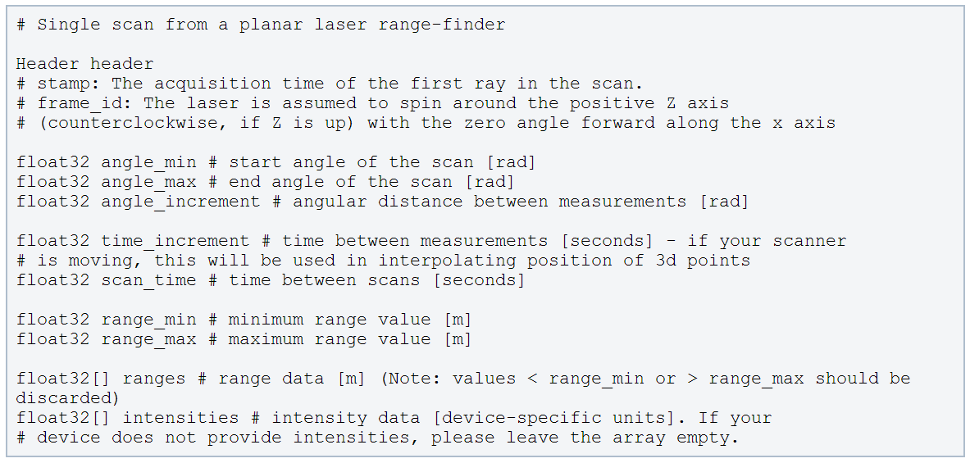
LaserScan Message
http://docs.ros.org/api/sensor_msgs/html/msg/LaserScan.html

Slide 24
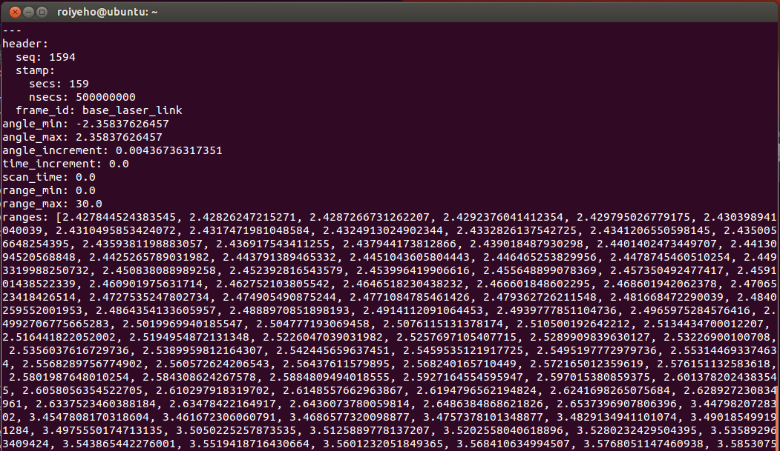
LaserScan Message
Example of a laser scan message from Stage simulator:

Slide 25
A Stopper Node
In Eclipse under the package’s src directory add a new class named Stopper
This will create Stopper.h and Stopper.cpp
Add a source file run_stopper.cpp
This will contain the main function

Slide 26
Stopper.h
#include "ros/ros.h"
#include "sensor_msgs/LaserScan.h"
class Stopper {
public:
// Tunable parameters
const static double FORWARD_SPEED_MPS = 0.5;
const static double MIN_SCAN_ANGLE_RAD = -30.0/180*M_PI;
const static double MAX_SCAN_ANGLE_RAD = +30.0/180*M_PI;
const static float MIN_PROXIMITY_RANGE_M = 0.5; // Should be smaller than sensor_msgs::LaserScan::range_max
Stopper();
void startMoving();
private:
ros::NodeHandle node;
ros::Publisher commandPub; // Publisher to the robot's velocity command topic
ros::Subscriber laserSub; // Subscriber to the robot's laser scan topic
bool keepMoving; // Indicates whether the robot should continue moving
void moveForward();
void scanCallback(const sensor_msgs::LaserScan::ConstPtr& scan);
};

Slide 27
Stopper.cpp (1)
#include "Stopper.h"
#include "geometry_msgs/Twist.h"
Stopper::Stopper()
{
keepMoving = true;
// Advertise a new publisher for the simulated robot's velocity command topic
commandPub = node.advertise<geometry_msgs::Twist>("cmd_vel", 10);
// Subscribe to the simulated robot's laser scan topic
laserSub = node.subscribe("base_scan", 1, &Stopper::scanCallback, this);
}
// Send a velocity command
void Stopper::moveForward() {
geometry_msgs::Twist msg; // The default constructor will set all commands to 0
msg.linear.x = FORWARD_SPEED_MPS;
commandPub.publish(msg);
};

Slide 28
Stopper.cpp (2)
// Process the incoming laser scan message
void Stopper::scanCallback(const sensor_msgs::LaserScan::ConstPtr& scan)
{
// Find the closest range between the defined minimum and maximum angles
int minIndex = ceil((MIN_SCAN_ANGLE_RAD - scan->angle_min) / scan->angle_increment);
int maxIndex = floor((MAX_SCAN_ANGLE_RAD - scan->angle_min) / scan->angle_increment);
float closestRange = scan->ranges[minIndex];
for (int currIndex = minIndex + 1; currIndex <= maxIndex; currIndex++) {
if (scan->ranges[currIndex] < closestRange) {
closestRange = scan->ranges[currIndex];
}
}
ROS_INFO_STREAM("Closest range: " << closestRange);
if (closestRange < MIN_PROXIMITY_RANGE_M) {
ROS_INFO("Stop!");
keepMoving = false;
}
}

Slide 29
Stopper.cpp (3)
void Stopper::startMoving()
{
ros::Rate rate(10);
ROS_INFO("Start moving");
// Keep spinning loop until user presses Ctrl+C or the robot got too close to an obstacle
while (ros::ok() && keepMoving) {
moveForward();
ros::spinOnce(); // Need to call this function often to allow ROS to process incoming messages
rate.sleep();
}
}

Slide 30
run_stopper.cpp
#include "Stopper.h"
int main(int argc, char **argv) {
// Initiate new ROS node named "stopper"
ros::init(argc, argv, "stopper");
// Create new stopper object
Stopper stopper;
// Start the movement
stopper.startMoving();
return 0;
};

Slide 31
CMakeLists.txt
Edit the following lines in CMakeLists.txt:
cmake_minimum_required(VERSION 2.8.3)
project(my_stage)
…
## Declare a cpp executable
add_executable(stopper src/Stopper.cpp src/run_stopper.cpp)
## Specify libraries to link a library or executable target against
target_link_libraries(stopper ${catkin_LIBRARIES})

Slide 32
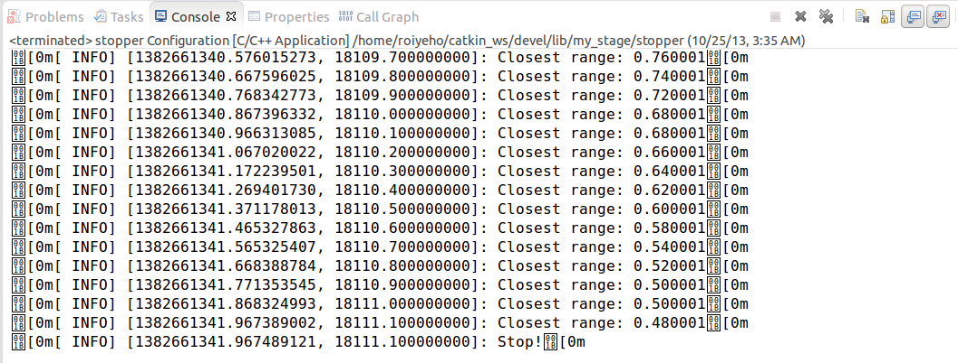
Stopper Output

Slide 33
Launch File
Launch file for launching both the Stage simulator and the stopper node:
To run the launch file use:
<launch>
<node name="stage" pkg="stage_ros" type="stageros" args="$(find stage_ros)/world/willow-erratic.world"/>
<node name="stopper" pkg="my_stage" type="stopper" output="screen"/>
</launch>
$ roslaunch my_stage my_stage.launch

Slide 34
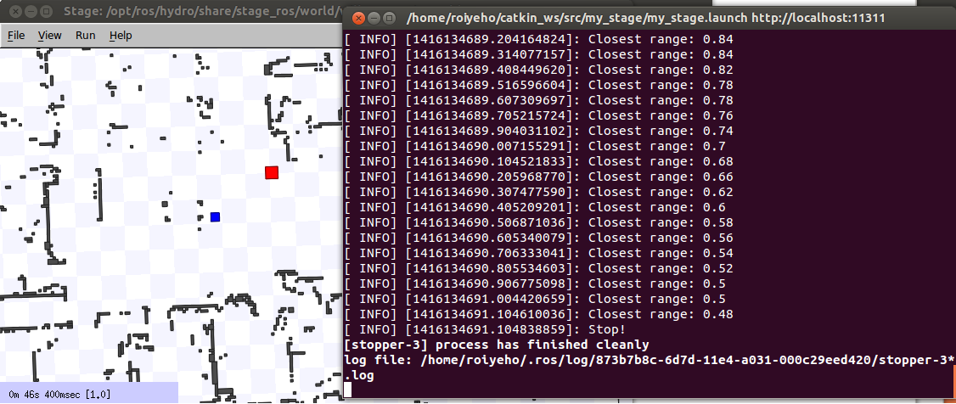
Launch File

Slide 35
Assignment #1
In your first assignment you will implement a simple walker algorithm much like a Roomba robot vaccum cleaner
Read assignment details at http://u.cs.biu.ac.il/~yehoshr1/89-685/assignment1/assignment1.html

