Slide 1

ROS - Lesson 5
Fall 2014
Teaching Assistant: Roi Yehoshua
roiyeho@gmail.com

Slide 2
Agenda
Mapping in ROS
ROS visualization tool (rviz)
ROS services

Slide 3
Why Mapping?
Learning maps is one of the fundamental problems in mobile robotics
Maps allow robots to efficiently carry out their tasks, such as localization, path planning, activity planning, etc.
There are different ways to represent the world space, such as:
Grid maps
Geometric maps
Voronoi graphs
Quadtrees
and more

Slide 4
Occupancy Grid Map
Maps the environment as a grid of cells
Cell sizes typically range from 5 to 50 cm
Each cell holds a probability value that the cell is occupied in the range [0,100]
Unknown is indicated by -1
Usually unknown areas are areas that the robot sensors cannot detect (beyond obstacles)

Slide 5
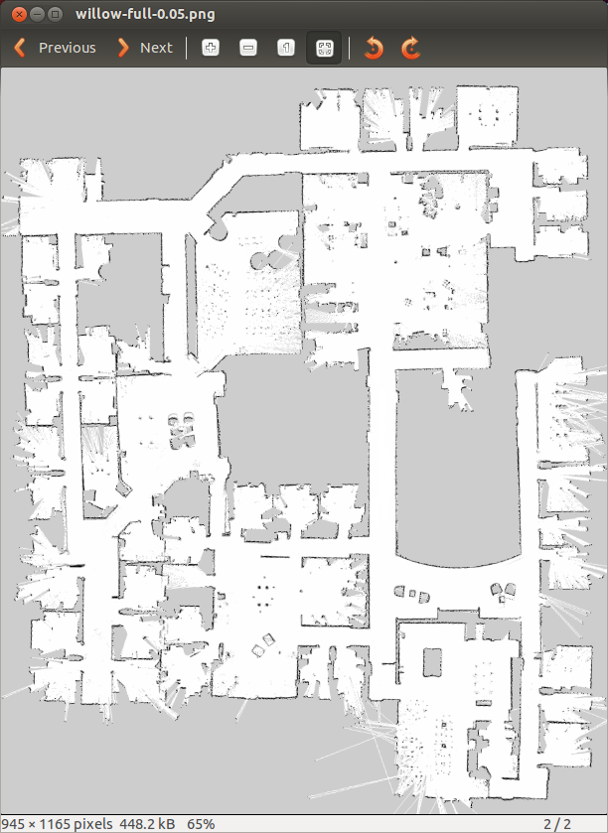
Occupancy Grid Map
White pixels represent free cells
Black pixels represent occupied cells
Gray pixels are in unknown state

Slide 6
Occupancy Grid Maps
Pros:
Simple representation
Speed
Cons:
Not accurate - if an object falls inside a portion of a grid cell, the whole cell is marked occupied
Wasted space

Slide 7
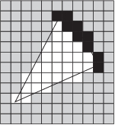
Marking and Clearing
The grid map is built using a process called marking and clearing
A marking operation inserts obstacle information into the map
A clearing operation removes obstacle information from the map
It consists of raytracing through a grid from the origin of the sensor outwards for each observation reported

Slide 8
SLAM
Simultaneous localization and mapping (SLAM) is a technique used by robots to build up a map within an unknown environment while at the same time keeping track of their current location
SLAM can be thought of as a chicken or egg problem: An unbiased map is needed for localization while an accurate pose estimate is needed to build that map

Slide 9
Particle Filter – FastSLAM
Represent probability distribution as a set of discrete particles which occupy the state space
Main steps of the algorithm:
Start with a random distribution of particles
Compare particle’s prediction of measurements with actual measurements
Assign each particle a weight depending on how well its estimate of the state agrees with the measurements
Randomly draw particles from previous distribution based on weights creating a new distribution
Efficient: scales logarithmically with the number of landmarks in the map

Slide 10
Particle Filter

Slide 11
gmapping
http://wiki.ros.org/gmapping
The gmapping package provides laser-based SLAM as a ROS node called slam_gmapping
Uses the FastSLAM algorithm
It takes the laser scans and the odometry and builds a 2D occupancy grid map
It updates the map state while the robot moves
ROS with gmapping video

Slide 12
Install gmapping
gmapping is not part of ROS Indigo installation
To install gmapping run:
You may need to run sudo apt-get update before that to update package repositories list
$ sudo apt-get install ros-indigo-slam-gmapping

Slide 13
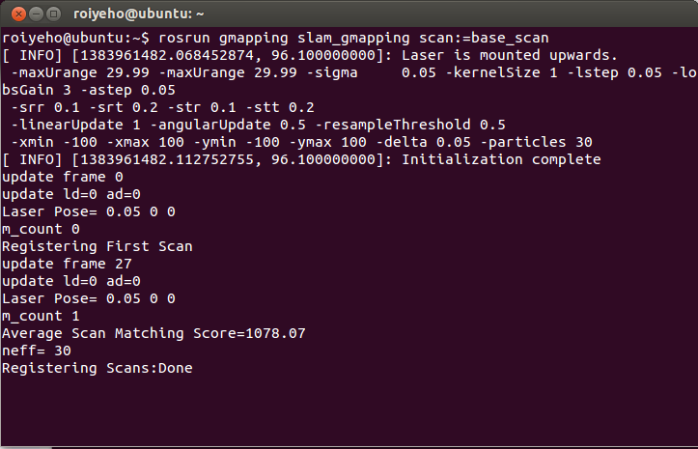
Run gmapping
Run roscore and the Stage simulator
Start gmapping in a new terminal window
Move the robot around
$ rosrun gmapping slam_gmapping scan:=base_scan

Slide 14
Run gmapping
The map is published to the topic /map
Message type is nav_msgs/OccupancyGrid
Occupancy is represented as an integer in the range [0,100], with:
0 meaning completely free
100 meaning completely occupied
the special value -1 for completely unknown
You can watch the map by executing:
$ rostopic echo /map -n1

Slide 15
map_server
map_server allows you to load and save maps
To install the package:
To save dynamically generated maps to a file:
map_saver generates the following files in the current directory:
map.pgm – the map itself
map.yaml – the map’s metadata
$ sudo apt-get install ros-indigo-map-server
$ rosrun map_server map_saver [-f mapname]

Slide 16
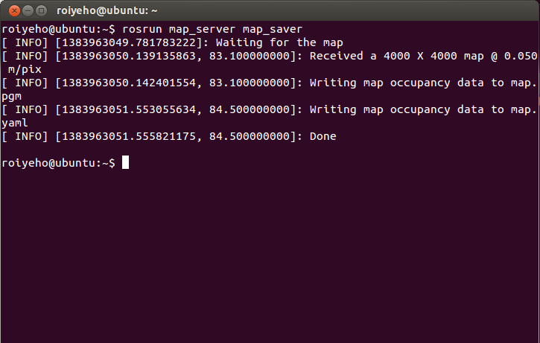
Saving the map using map_server

Slide 17
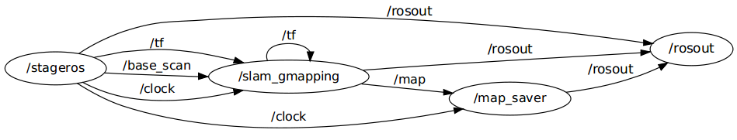
Nodes Graph

Slide 18
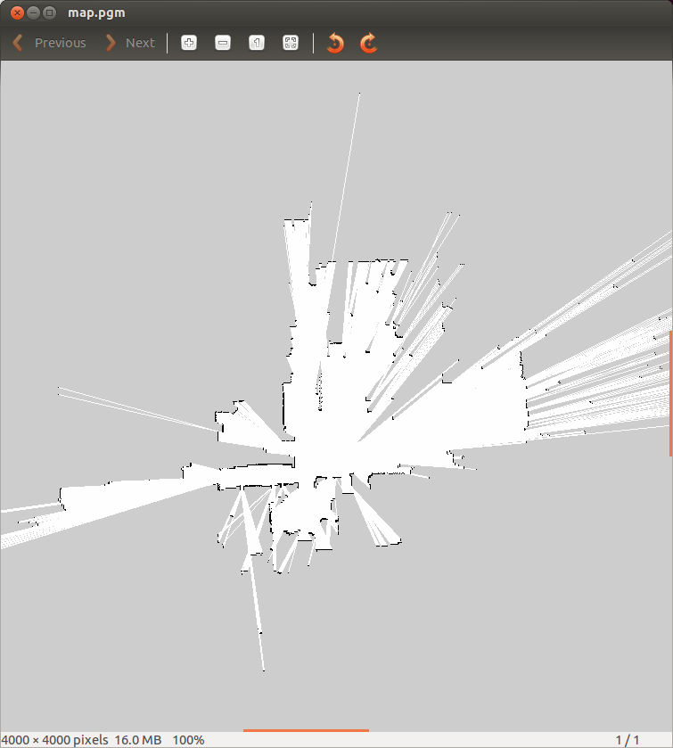
map_server
You can open the pgm file with the default Ubuntu image viewer program (eog)

Slide 19
Map YAML File
Important fields:
resolution: Resolution of the map, meters / pixel
origin: The 2-D pose of the lower-left pixel in the map as (x, y, yaw)
occupied_thresh: Pixels with occupancy probability greater than this threshold are considered completely occupied.
free_thresh: Pixels with occupancy probability less than this threshold are considered completely free.
image: map.pgm
resolution: 0.050000
origin: [-100.000000, -100.000000, 0.000000]
negate: 0
occupied_thresh: 0.65
free_thresh: 0.196

Slide 20
Watching the Mapping Progress
You can watch the mapping progress in rviz
rviz is a ROS 3D visualization tool that lets you see the world from a robot's perspective
Execute the following code to run rviz:
$ rosrun rviz rviz

Slide 21
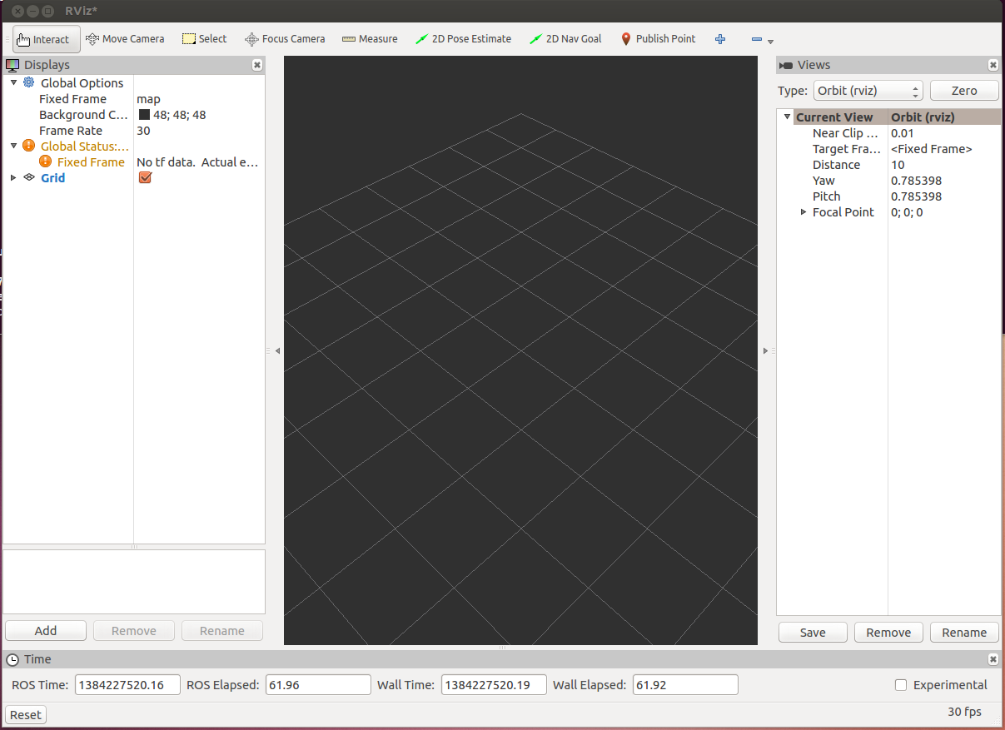
rviz

Slide 22
rviz Useful Commands
Use right mouse button or scroll wheel to zoom in or out
Use the left mouse button to pan (shift-click) or rotate (click)

Slide 23
rviz Displays
The first time you open rviz you will see an empty 3D view
On the left is the Displays area, which contains a list of different elements in the world, that appears in the middle.
Right now it just contains global options and grid
Below the Displays area, we have the Add button that allows the addition of more elements.

Slide 24
rviz Displays
Messages Used | Description | Display name
 | Displays a set of Axes | Axes
sensor_msgs/JointStates | Shows the effort being put into each revolute joint of a robot. | Effort
sensor_msgs/Image sensor_msgs/CameraInfo | Creates a new rendering window from the perspective of a camera, and overlays the image on top of it. | Camera
 | Displays a 2D or 3D grid along a plane | Grid
nav_msgs/GridCells | Draws cells from a grid, usually obstacles from a costmap from the navigation stack. | Grid Cells
sensor_msgs/Image | Creates a new rendering window with an Image. | Image
sensor_msgs/LaserScan | Shows data from a laser scan, with different options for rendering modes, accumulation, etc. | LaserScan
nav_msgs/OccupancyGrid | Displays a map on the ground plane. | Map

Slide 25
rviz Displays
Messages Used | Description | Display name
visualization_msgs/Marker visualization_msgs/MarkerArray | Allows programmers to display arbitrary primitive shapes through a topic | Markers
nav_msgs/Path | Shows a path from the navigation stack. | Path
geometry_msgs/PoseStamped | Draws a pose as either an arrow or axes | Pose
sensor_msgs/PointCloud sensor_msgs/PointCloud2 | Shows data from a point cloud, with different options for rendering modes, accumulation, etc. | Point Cloud(2)
nav_msgs/Odometry | Accumulates odometry poses from over time. | Odometry
sensor_msgs/Range | Displays cones representing range measurements from sonar or IR range sensors. | Range
 | Shows a visual representation of a robot in the correct pose (as defined by the current TF transforms). | RobotModel
 | Displays the tf transform hierarchy. | TF

Slide 26
LaserScan Display
Click the Add button under Displays and choose the LaserScan display
In the LaserScan display properties change the topic to /base_scan
In Global Options change Fixed Frame to base_link
To see the robot’s position also add the TF display
The laser “map” that is built will disappear over time, because rviz can only buffer a finite number of laser scans

Slide 27
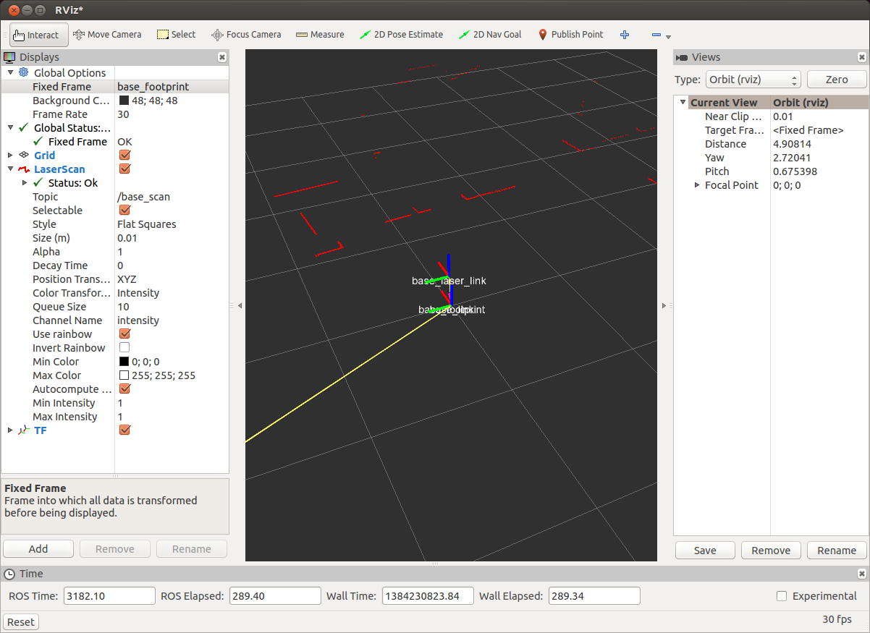
LaserScan Display

Slide 28
Map Display
Add the Map display
Set the topic to /map
Now you will be able to watch the mapping progress in rviz

Slide 29
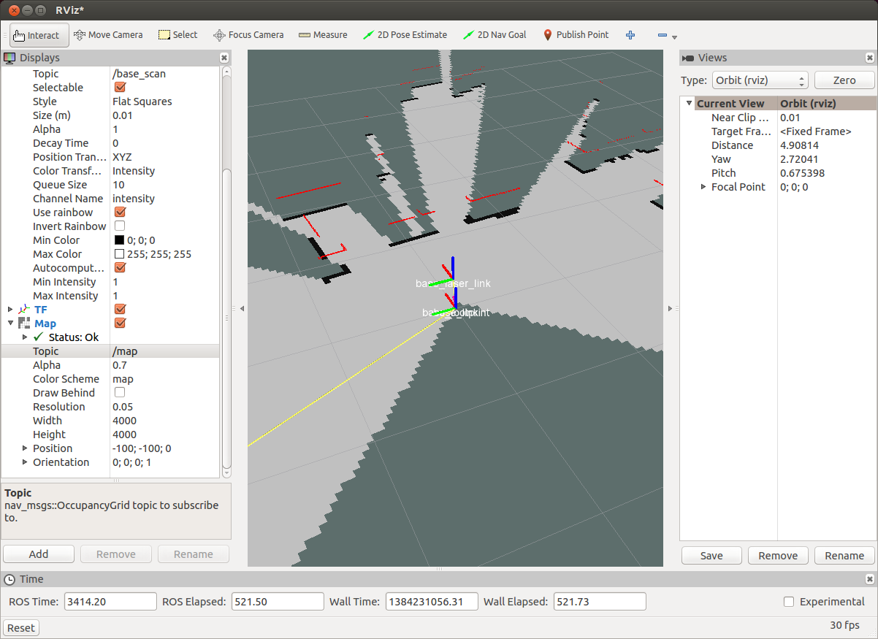
Map Display

Slide 30
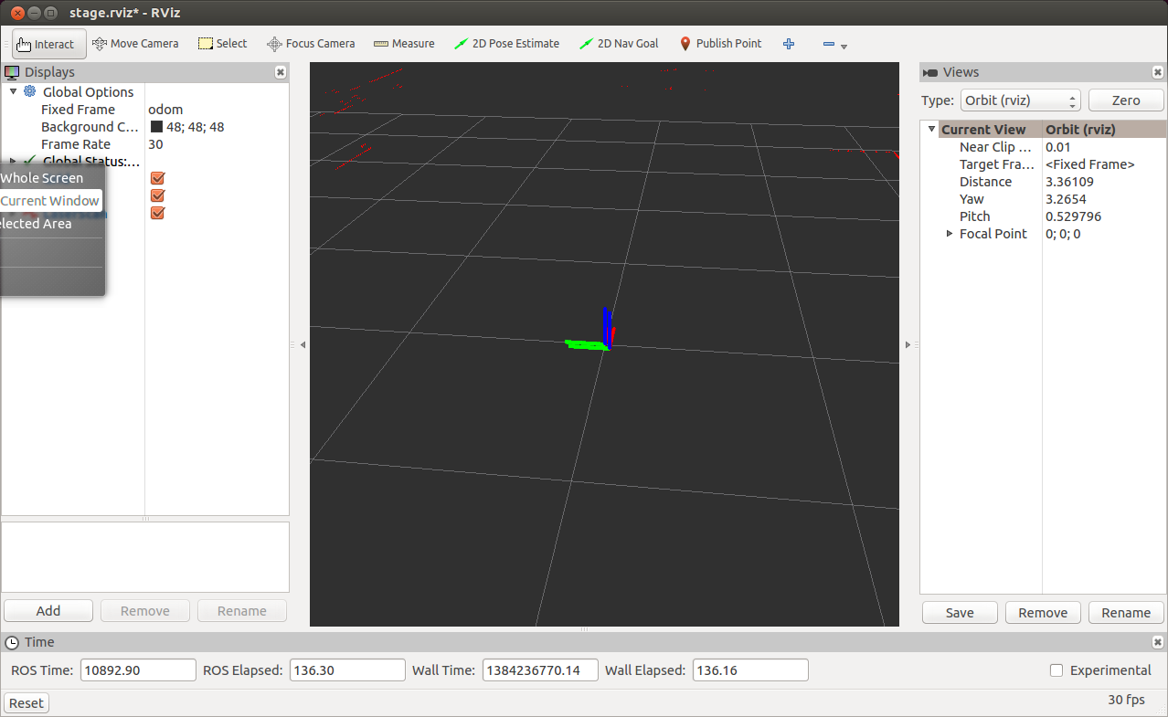
Run rviz with Predefined Configuration
You can run rviz, using a configuration file that is already defined in the stage_ros package:
$ rosrun rviz rviz -d `rospack find stage_ros`/rviz/stage.rviz

Slide 31
Launch File for gmapping
<launch>
<node name="stage" pkg="stage_ros" type="stageros" args="$(find stage_ros)/world/willow-erratic.world"/>
<node name="gmapping" pkg="gmapping" type="slam_gmapping">
<param name="scan" value="base_scan"/>
</node>
<node name="rviz" pkg="rviz" type="rviz" args="$(find stage_ros)/rviz/stage.rviz"/>
</launch>

Slide 32
Loading an Existing Map
Copy the map file (.pgm) to a /map sub-directory of your package
Run the map_saver node
Takes as arguments the path to the map file and the map resolution
A sample launch file:
<launch>
<arg name="map_file" default="$(find my_package)/maps/willow-full-0.05.pgm"/>
<!-- Run the map server -->
<node name="map_server" pkg="map_server" type="map_server" args="$(arg map_file) 0.05" />
</launch>

Slide 33
ROS Services
The next step is to learn how to read the map in your ROS nodes
For that purpose we will use a ROS service called static_map from the package map_server
Services use the request/reply paradigm instead of the publish/subscribe model

Slide 34
Service Definitions
ROS Services are defined by srv files, which contains a request message and a response message.
These are identical to the messages used with ROS Topics
roscpp converts these srv files into C++ source code and creates 3 classes
The names of these classes come directly from the srv filename:
my_package/srv/Foo.srv →
my_package::Foo – service definition
my_package::Foo::Request – request message
my_package::Foo::Response – response message

Slide 35
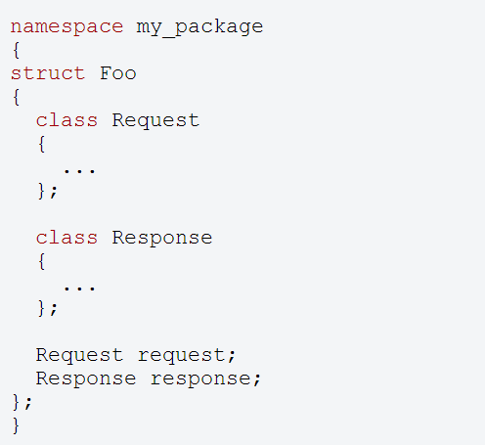
Generated Structure

Slide 36
Calling Services
ros::NodeHandle nh;
ros::ServiceClient client = nh.serviceClient<my_package::Foo>("my_service_name");
my_package::Foo foo;
foo.request.<var> = <value>;
...
if (client.call(foo)) {
...
}
Since service calls are blocking, it will return once the call is done
If the service call succeeded, call() will return true and the value in srv.response will be valid.
If the call did not succeed, call() will return false and the value in srv.response will be invalid.

Slide 37
static_map Service
To get the OGM in a ROS node you can call the service static_map
This service gets no arguments and returns a message of type nav_msgs/OccupancyGrid
The message consists of two main structures:
MapMetaData – metdata of the map, contains:
resolution – map resolution in m/cell
width – number of cells in the y axis
height – number of cells in the x axis
int8[] data – the map’s data

Slide 38
Loading a Map in C++ (1)
#include <ros/ros.h>
#include <nav_msgs/GetMap.h>
#include <vector>
using namespace std;
// grid map
int rows;
int cols;
double mapResolution;
vector<vector<bool> > grid;
bool requestMap(ros::NodeHandle &nh);
void readMap(const nav_msgs::OccupancyGrid& msg);
void printGrid();

Slide 39
Loading a Map in C++ (2)
int main(int argc, char** argv)
{
ros::init(argc, argv, "load_ogm");
ros::NodeHandle nh;
if (!requestMap(nh))
exit(-1);
printGrid();
return 0;
}

Slide 40
Loading a Map in C++ (3)
bool requestMap(ros::NodeHandle &nh)
{
nav_msgs::GetMap::Request req;
nav_msgs::GetMap::Response res;
while (!ros::service::waitForService("static_map", ros::Duration(3.0))) {
ROS_INFO("Waiting for service static_map to become available");
}
ROS_INFO("Requesting the map...");
ros::ServiceClient mapClient = nh.serviceClient<nav_msgs::GetMap>("static_map");
if (mapClient.call(req, res)) {
readMap(res.map);
return true;
}
else {
ROS_ERROR("Failed to call map service");
return false;
}
}

Slide 41
Loading a Map in C++ (4)
void readMap(const nav_msgs::OccupancyGrid& map)
{
ROS_INFO("Received a %d X %d map @ %.3f m/px\n",
map.info.width,
map.info.height,
map.info.resolution);
rows = map.info.height;
cols = map.info.width;
mapResolution = map.info.resolution;
// Dynamically resize the grid
grid.resize(rows);
for (int i = 0; i < rows; i++) {
grid[i].resize(cols);
}
int currCell = 0;
for (int i = 0; i < rows; i++) {
for (int j = 0; j < cols; j++) {
if (map.data[currCell] == 0) // unoccupied cell
grid[i][j] = false;
else
grid[i][j] = true; // occupied (100) or unknown cell (-1)
currCell++;
}
}
}

Slide 42
Loading a Map in C++ (5)
void printGrid()
{
printf("Grid map:\n");
int freeCells = 0;
for (int i = 0; i < rows; i++)
{
printf("Row no. %d\n", i);
for (int j = 0; j < cols; j++)
{
printf("%d ", grid[i][j] ? 1 : 0);
}
printf("\n");
}
}

Slide 43
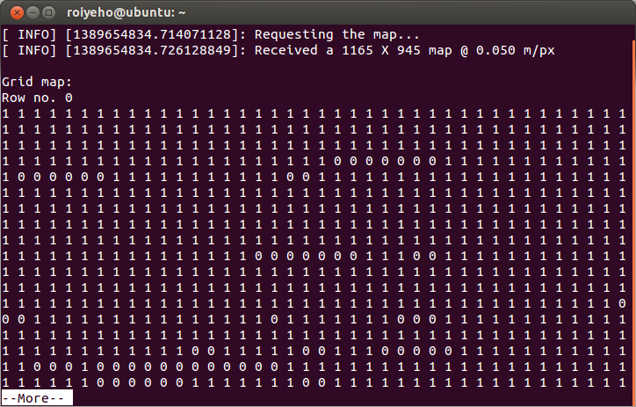
Loading the Map

Slide 44
Homework (not for submission)
Create a map of the willow garage environment using your random walker from the previous assignment
Compare the resultant map to the original willow’s garage map located at /opt/ros/hydro/share/stage_ros/world/willow-full.pgm
How long did it take the random walker to create a map of the area?

