Slide 1

ROS - Lesson 6
Fall 2014
Teaching Assistant: Roi Yehoshua
roiyeho@gmail.com

Slide 2
Agenda
ROS transformation system
Writing a tf broadcaster
Writing a tf listener

Slide 3
What is tf?
A robotic system typically has many coordinate frames that change over time, such as a world frame, base frame, gripper frame, head frame, etc.
tf is a transformation system that allows making computations in one frame and then transforming them to another at any desired point in time
tf allows you to ask questions like:
What is the current pose of the base frame of the robot in the map frame?
What is the pose of the object in my gripper relative to my base?
Where was the head frame relative to the world frame, 5 seconds ago?

Slide 4
Values of tf
No data loss when transforming multiple times
No computational cost of intermediate data transformations between coordinate frames
The user does not need to worry about which frame their data started
Information about past locations is also stored and accessible (after local recording was started)

Slide 5
tf Nodes
There are two types of tf nodes:
Publishers – publish transforms between coordinate frames on /tf
Listeners – listen to /tf and cache all data heard up to cache limit
tf is distributed - there is no central source of tf information

Slide 6
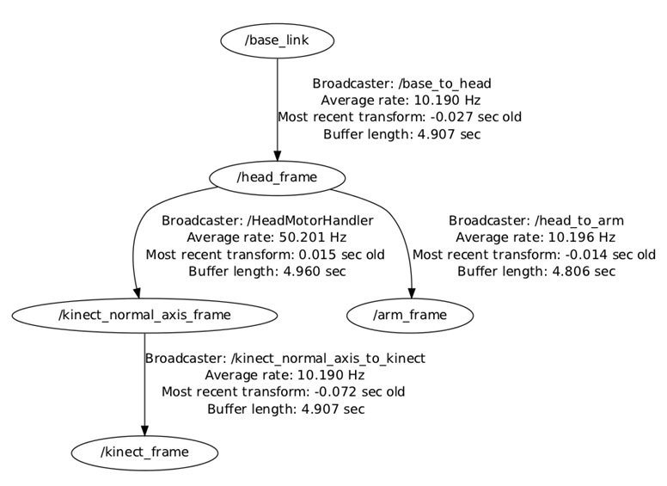
Transform Tree
TF builds a tree of transforms between frames
Can support multiple disconnected trees
Transforms only work within the same tree

Slide 7
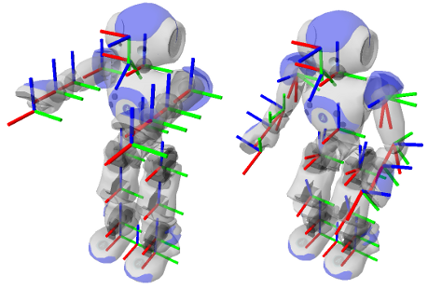
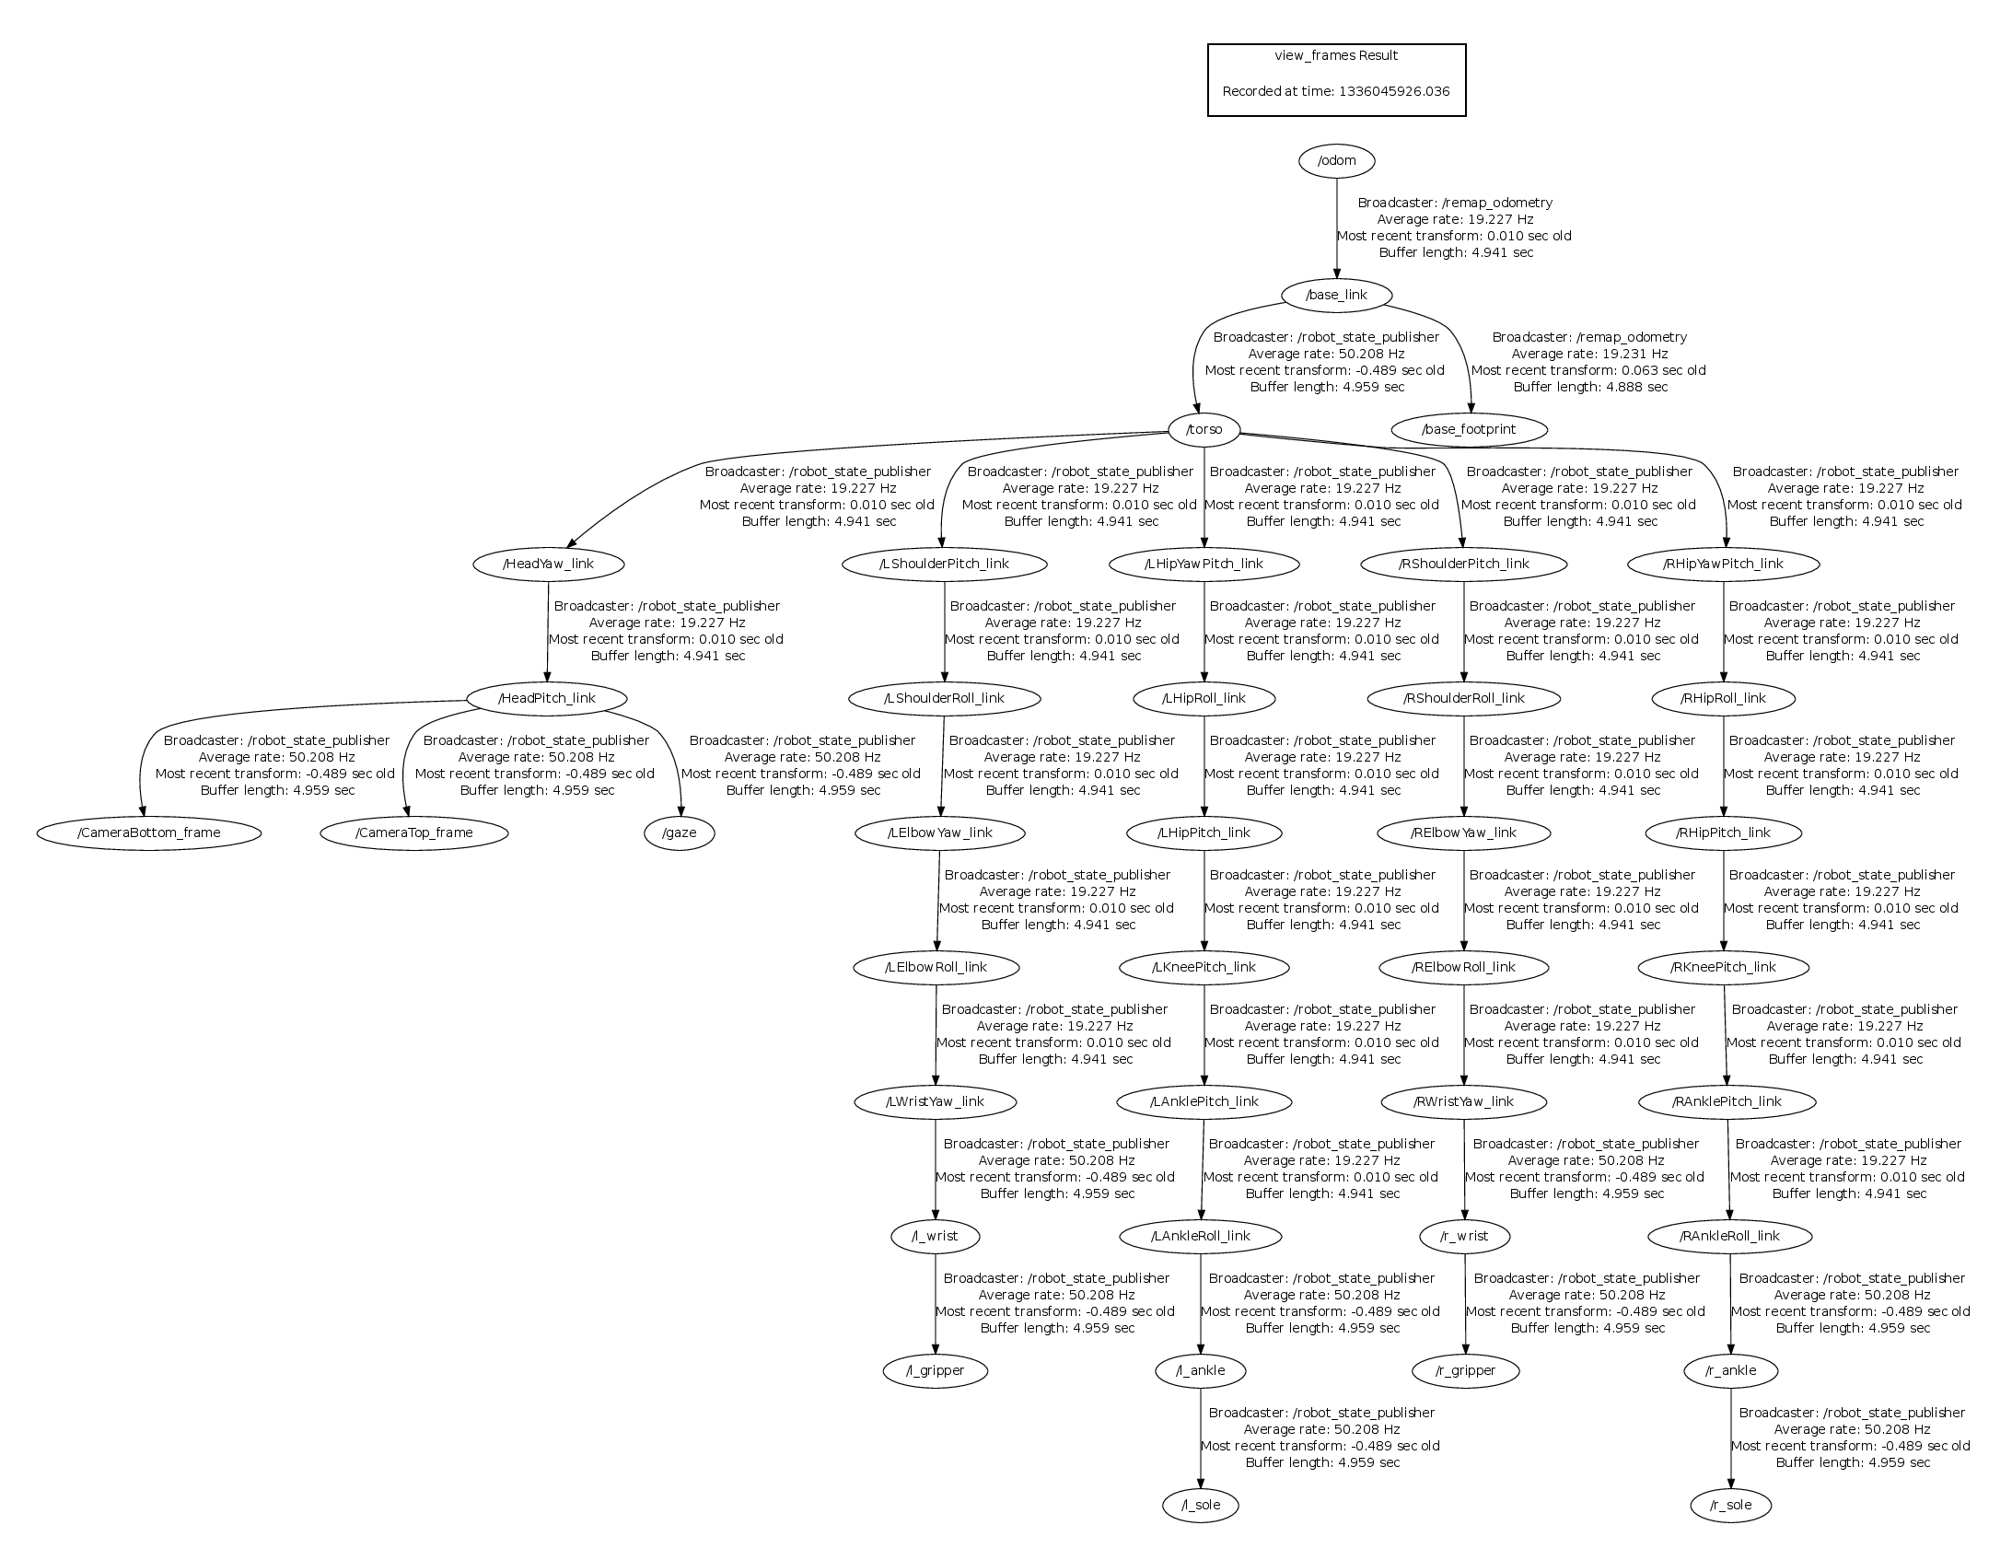
Transform Tree Example
Nao’s TF tree

Slide 8
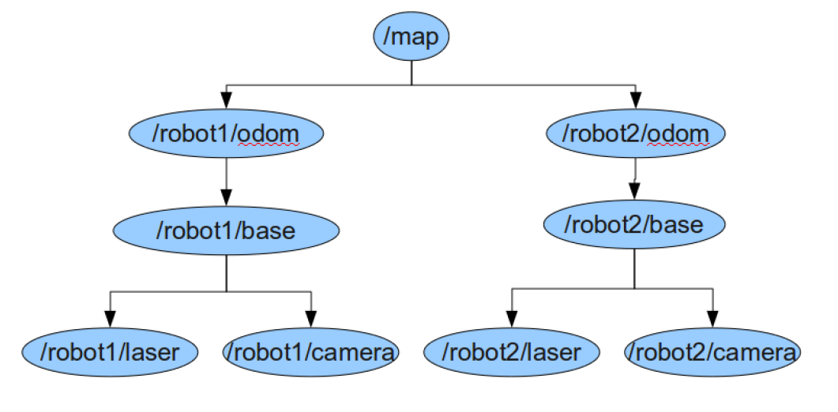
How does this work?
Given the following TF tree, let’s say we want robot2 to navigate based on the laser data coming from robot1

Slide 9
How does this work?
Inverse Transform
Forward Transform

Slide 10
tf Demo
Launch the turtle_tf_demo by typing:
In another terminal run the turtle_tf_listener
Now you should see a window with two turtles where one follows the other
You can drive the center turtle around in the turtlesim using the keyboard arrow keys
$ roslaunch turtle_tf turtle_tf_demo.launch
$ rosrun turtle_tf turtle_tf_listener
$ rosrun turtlesim turtle_teleop_key

Slide 11
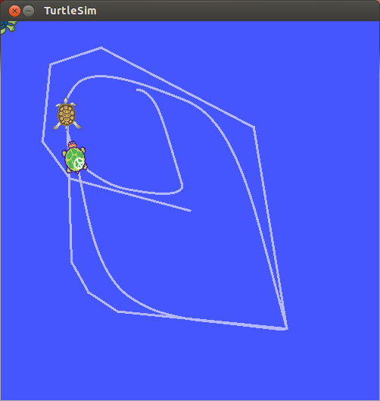
tf Demo

Slide 12
tf Demo
This demo is using the tf library to create three coordinate frames: a world frame, a turtle1 frame, and a turtle2 frame.
It uses a tf broadcaster to publish the turtle coordinate frames and a tf listener to compute the difference in the turtle frames and move one turtle to follow the other

Slide 13
tf Command-line Tools
view_frames: visualizes the full tree of coordinate transforms
tf_monitor: monitors transforms between frames
tf_echo: prints specified transform to screen
roswtf: with the tfwtf plugin, helps you track down problems with tf
static_transform_publisher is a command line tool for sending static transforms

Slide 14
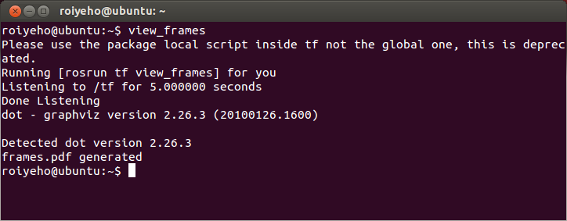
view_frames
view_frames creates a diagram of the frames being broadcast by tf over ROS
Here a tf listener is listening to the frames that are being broadcast over ROS and drawing a tree of how the frames are connected

Slide 15
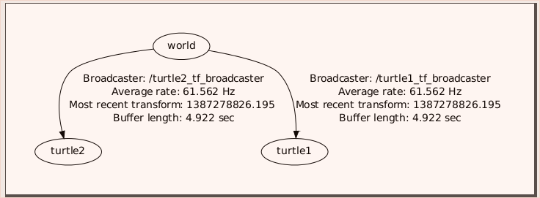
view_frames
To view the tree:
$ evince frames.pdf

Slide 16
tf_echo
tf_echo reports the transform between any two frames broadcast over ROS
Usage:
Let's look at the transform of the turtle2 frame with respect to turtle1 frame which is equivalent to: T_{turtle1_turtle2} = T_{turtle1_world} * T_{world_turtle2}
$ rosrun tf tf_echo [reference_frame] [target_frame]
$ rosrun tf tf_echo turtle1 turtle2

Slide 17
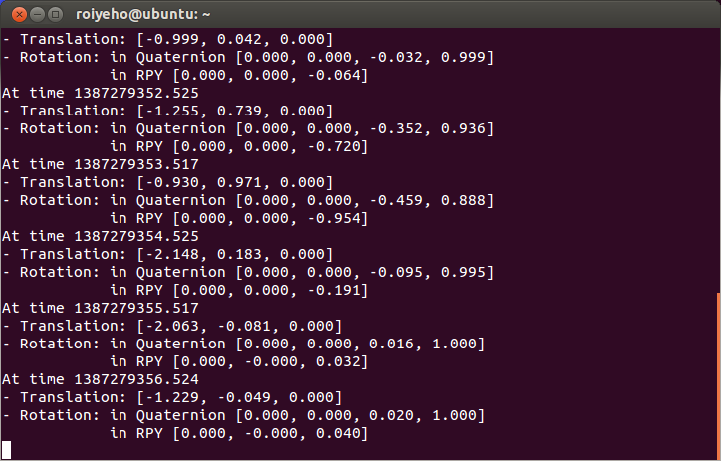
tf_echo
As you drive your turtle around you will see the transform change as the two turtles move relative to each other

Slide 18
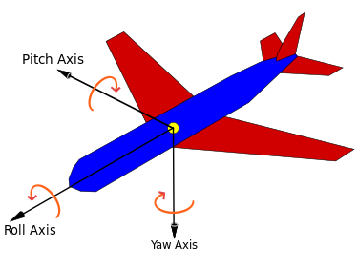
Rotation Representation
There are many ways to represent rotations:
Euler angles yaw, pitch, and roll about Z, Y, X axes respectively
Rotation matrix
Quaternions

Slide 19
Quaternions
In mathematics, quaternions are a number system that extends the complex numbers
The fundamental formula for quaternion multiplication (Hamilton, 1843):
Quaternions find uses in both theoretical and applied mathematics, in particular for calculations involving 3D rotations such as in computers graphics and computer vision
i² = j² = k² = ijk = −1

Slide 20

Quaternions and Spatial Rotation
Any rotation in 3D can be represented as a combination of a vector u (the Euler axis) and a scalar θ (the rotation angle)
A rotation with an angle of rotation θ around the axis defined by the unit vector
is represented by

Slide 21
Quaternions and Spatial Rotation
Quaternions give a simple way to encode this axis–angle representation in 4 numbers
Can apply the corresponding rotation to a position vector using a simple formula
http://en.wikipedia.org/wiki/Quaternions_and_spatial_rotation
Advantages of using quaternions:
Nonsingular representation
there are 24 different possibilities to specify Euler angles
More compact (and faster) than matrices.

Slide 22
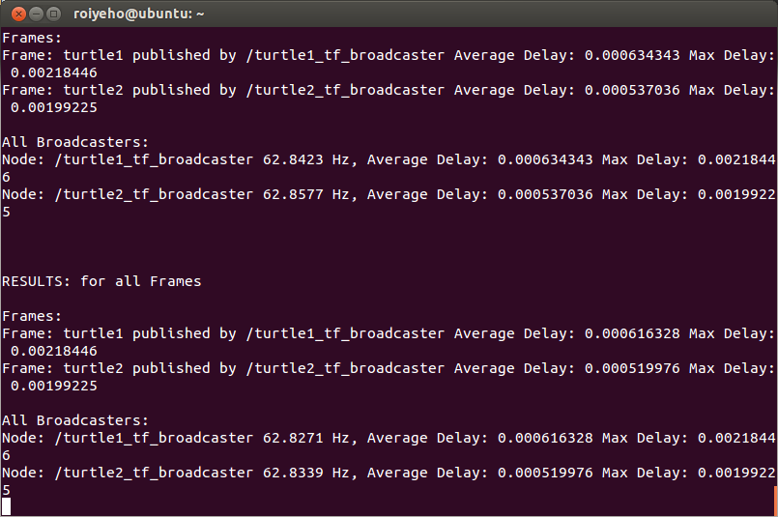
tf_monitor
Print information about the current coordinate transform tree to console
$ rosrun tf tf_monitor

Slide 23
rviz and tf
Let's look at our turtle frames using rviz
Let's start rviz with the turtle_tf configuration file using the -d option for rviz:
In the side bar you will see the frames broadcast by tf.
Note that the fixed frame is /world
The fixed frame is assumed not to be moving over time
As you drive the turtle around you will see the frames move in rviz.
$ rosrun rviz rviz -d `rospack find turtle_tf`/rviz/turtle_rviz.rviz

Slide 24
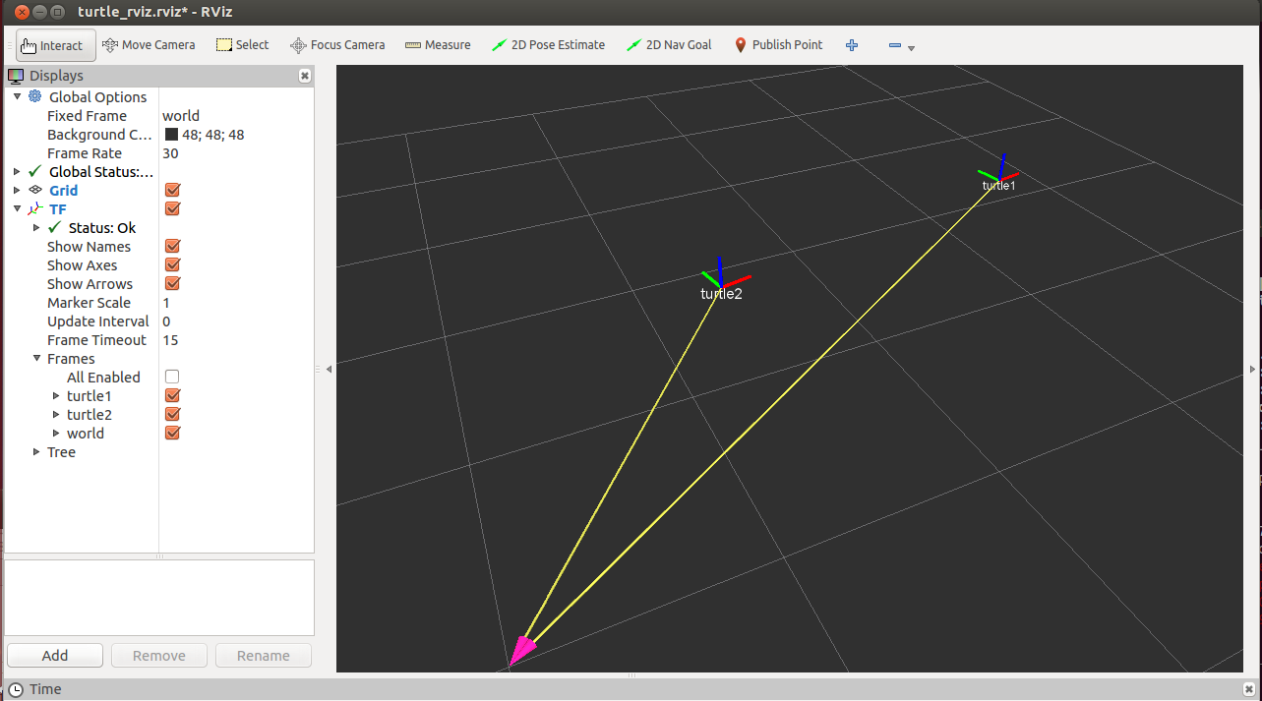
rviz and tf

Slide 25
Broadcasting Transforms
A tf broadcaster sends out the relative pose of coordinate frames to the rest of the system
A system can have many broadcasters, each provides information about a different part of the robot
We will now write the code to reproduce the tf demo

Slide 26
Writing a tf broadcaster
First create a new package called tf_demo that depends on tf, roscpp, rospy and turtlesim
Build the package by calling catkin_make
Open the package in Eclipse and add a new source file called tf_broadcaster.cpp
$ cd ~/catkin_ws/src
$ catkin_create_pkg tf_demo tf roscpp rospy turtlesim

Slide 27
tf_broadcaster.cpp (1)
#include <ros/ros.h>
#include <tf/transform_broadcaster.h>
#include <turtlesim/Pose.h>
std::string turtle_name;
void poseCallback(const turtlesim::PoseConstPtr& msg)
{
static tf::TransformBroadcaster br;
tf::Transform transform;
transform.setOrigin(tf::Vector3(msg->x, msg->y, 0.0));
tf::Quaternion quaternion;
transform.setRotation(tf::createQuaternionFromYaw(msg->theta));
br.sendTransform(tf::StampedTransform(transform, ros::Time::now(), "world", turtle_name));
}

Slide 28
tf_broadcaster.cpp (2)
int main(int argc, char** argv){
ros::init(argc, argv, "my_tf_broadcaster");
if (argc != 2) {
ROS_ERROR("need turtle name as argument");
return -1;
};
turtle_name = argv[1];
ros::NodeHandle node;
ros::Subscriber sub = node.subscribe(turtle_name + "/pose", 10, &poseCallback);
ros::spin();
return 0;
};

Slide 29
Sending Transforms
Sending a transform with a TransformBroadcaster requires 4 arguments:
The transform object
A timestamp, usually we can just stamp it with the current time, ros::Time::now()
The name of the parent frame of the link we're creating, in this case "world"
The name of the child frame of the link we're creating, in this case this is the name of the turtle itself
br.sendTransform(tf::StampedTransform(transform, ros::Time::now(), "world", turtle_name));

Slide 30
Running the Broadcaster
Create tf_demo.launch in the /launch subfolder
Run the launch file
<launch>
<!-- Turtlesim Node-->
<node pkg="turtlesim" type="turtlesim_node" name="sim"/>
<node pkg="turtlesim" type="turtle_teleop_key" name="teleop" output="screen"/>
<!-- tf broadcaster node -->
<node pkg="tf_demo" type="turtle_tf_broadcaster"
args="/turtle1" name="turtle1_tf_broadcaster" />
</launch>
$ cd ~/catkin_ws/src
$ roslaunch tf_demo tf_demo.launch

Slide 31
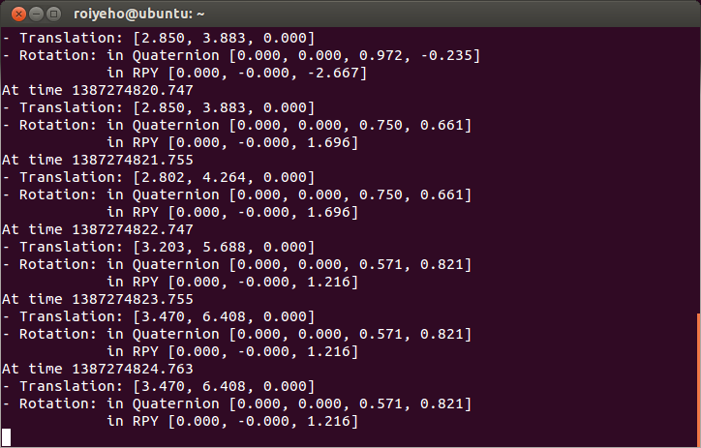
Checking the Results
Use the tf_echo tool to check if the turtle pose is actually getting broadcast to tf:
$ rosrun tf tf_echo /world /turtle1

Slide 32
Writing a tf listener
A tf listener receives and buffers all coordinate frames that are broadcasted in the system, and queries for specific transforms between frames
Next we'll create a tf listener that will listen to the transformations coming from the tf broadcaster
Add tf_listener.cpp to your project with the following code

Slide 33
tf_listener.cpp (1)
#include <ros/ros.h>
#include <tf/transform_listener.h>
#include <turtlesim/Spawn.h>
#include <geometry_msgs/Twist.h>
int main(int argc, char** argv) {
ros::init(argc, argv, "my_tf_listener");
ros::NodeHandle node;
ros::service::waitForService("spawn");
ros::ServiceClient add_turtle =
node.serviceClient<turtlesim::Spawn>("spawn");
turtlesim::Spawn srv;
add_turtle.call(srv);
ros::Publisher turtle_vel =
node.advertise<geometry_msgs::Twist>("turtle2/cmd_vel", 10);
tf::TransformListener listener;
ros::Rate rate(10.0);

Slide 34
tf_listener.cpp (2)
while (node.ok()) {
tf::StampedTransform transform;
try {
listener.waitForTransform("/turtle2", "/turtle1", ros::Time(0), ros::Duration(10.0));
listener.lookupTransform("/turtle2", "/turtle1", ros::Time(0), transform);
} catch (tf::TransformException ex) {
ROS_ERROR("%s",ex.what());
}
geometry_msgs::Twist vel_msg;
vel_msg.angular.z = 4 * atan2(transform.getOrigin().y(),
transform.getOrigin().x());
vel_msg.linear.x = 0.5 * sqrt(pow(transform.getOrigin().x(), 2) +
pow(transform.getOrigin().y(), 2));
turtle_vel.publish(vel_msg);
rate.sleep();
}
return 0;
};

Slide 35
Creating a TransformListener
To use the TransformListener, we need to include the tf/transform_listener.h header file.
Once the listener is created, it starts receiving tf transformations over the wire, and buffers them for up to 10 seconds.
The TransformListener object should be scoped to persist otherwise its cache will be unable to fill and almost every query will fail.
A common method is to make the TransformListener object a member variable of a class

Slide 36
Core Methods of TransformListener
LookupTransform
Get the transform between two coordinate frames
WaitForTransform
Block until timeout or transform is available
CanTransform
Test if a transform is possible between to coordinate frames

Slide 37
lookupTransform
To query the listener for a specific transformation, you need to pass 4 arguments:
We want the transform from this frame ...
... to this frame.
The time at which we want to transform. Providing ros::Time(0) will get us the latest available transform.
The object in which we store the resulting transform.
listener.lookupTransform("/turtle2", "/turtle1", ros::Time(0), transform);

Slide 38
Running the Listener
Add the following lines to CMakeLists.txt
Build the package by calling catkin_make
add_executable(tf_listener src/tf_listener.cpp)
target_link_libraries(tf_listener
${catkin_LIBRARIES}
)

Slide 39
Launch File
Add the following lines to tf_demo.launch
<launch>
<!-- Turtlesim Node-->
<node pkg="turtlesim" type="turtlesim_node" name="sim"/>
<node pkg="turtlesim" type="turtle_teleop_key" name="teleop" output="screen"/>
<!-- tf broadcaster node -->
<node pkg="tf_demo" type="tf_broadcaster"
args="/turtle1" name="turtle1_tf_broadcaster" />
<!-- Second broadcaster node -->
<node pkg="tf_demo" type="tf_broadcaster"
args="/turtle2" name="turtle2_tf_broadcaster" />
<!-- tf listener node -->
<node pkg="tf_demo" type="tf_listener" name="listener" />
</launch>

Slide 40
Check the Results
To see if things work, simply drive around the first turtle using the arrow keys (make sure your terminal window is active, not your simulator window), and you'll see the second turtle following the first one!

Slide 41
lookupTransform Query Examples
Compute the position of an observed ball in the target frame at the target time assuming it was stationary in the fixed frame
lookupTransform(ball_frame, ball_time, target_frame, target_time, fixed_frame, result_transform)
Compute how far the robot moved between t = 1 and t = 2 in the map frame
lookupTransform(robot_frame, t = 1,robot_frame, t = 2, map_frame, result_transform)

Slide 42
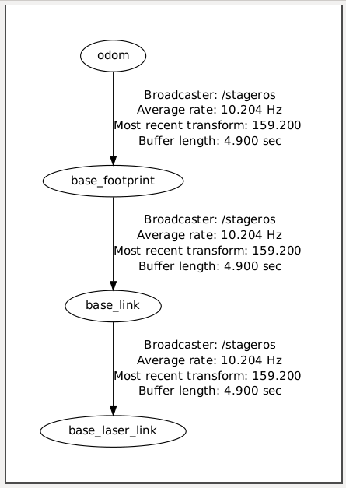
Stage TF Frames
Stage publishes the following TF frames:
odom – The self consistent coordinate frame using the odometry measurements only
base_footprint – The base of the robot at zero height above the ground
base_link – The base link of the robot, placed at the rotational center of the robot
base_laser_link – the location of the laser sensor

Slide 43
Stage TF Frames
These transformations move relative to the /odom frame
If we display the robot model in RViz and set the fixed frame to the /odom frame, the robot's position will reflect where the robot "thinks" it is relative to its starting position
However the robot’s position will not be displayed correctly in relation to the map

Slide 44
Find Robot Location
You can use tf to determine the robot's current location in the world
To get robot’s location in its own coordinate frame create a TF listener from the /base_footprint to the /odom frame

Slide 45
robot_location.cpp (1)
#include <ros/ros.h>
#include <tf/transform_listener.h>
using namespace std;
int main(int argc, char** argv){
ros::init(argc, argv, "robot_location");
ros::NodeHandle node;
tf::TransformListener listener;
ros::Rate rate(2.0);
listener.waitForTransform("/base_footprint", "/odom", ros::Time(0), ros::Duration(10.0));

Slide 46
robot_location.cpp (2)
while (ros::ok()){
tf::StampedTransform transform;
try {
listener.lookupTransform("/base_footprint", "/odom", ros::Time(0), transform);
double x = transform.getOrigin().x();
double y = transform.getOrigin().y();
cout << "Current position: (" << x << "," << y << ")" << endl;
} catch (tf::TransformException &ex) {
ROS_ERROR("%s",ex.what());
}
rate.sleep();
}
return 0;
}

Slide 47
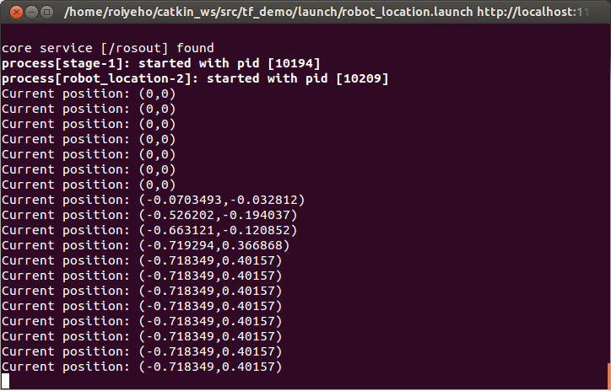
Find Robot Location

Slide 48
Static Transform Publisher
The map → odom transform is published by gmapping
In case you don’t want to use gmapping, you can publish a static transform between these frames to have the robot’s position in the map’s frame
To publish a static transformation between the /map and the /odom frames add the following to the launch file:
<launch>
<!-- Publish a static transformation between /map and /odom -->
<node name="tf" pkg="tf" type="static_transform_publisher" args="-11.28 23.27 0 0 0 0 /odom /map 100" />
</launch>

Slide 49
ROS Clock
Normally, the ROS client libraries will use your computer's system clock as a time source, also known as the "wall-clock“
When you are running a simulation or playing back logged data, is often desirable to instead have the system use a simulated clock so that you can have accelerated, slowed, or stepped control over your system's perceived time
To support this, the ROS client libraries can listen to the /clock topic that is used to publish "simulation time"

Slide 50
ROS Clock
In order for a ROS node to use simulation time according to the /clock topic, the /use_sim_time parameter must be set to true before the node is initialized
If the /use_sim_time parameter is set, the ROS Time API will return time=0 until it has received a value from the /clocktopic
Then, the time will only be updated on receipt of a message from the /clock topic, and will stay constant between updates

Slide 51
Launch File
<launch>
<param name="/use_sim_time" value="true"/>
<!-- Run stage -->
<node name="stage" pkg="stage_ros" type="stageros" args="$(find stage_ros)/world/willow-erratic.world"/>
<!-- Publish a static transformation between /odom and /map -->
<node name="tf" pkg="tf" type="static_transform_publisher" args="-11.28 23.27 0 0 0 0 /odom /map 100" />
<!– Run node -->
<node name="robot_location" pkg="tf_demo" type="robot_location" output="screen" />
</launch>

Slide 52
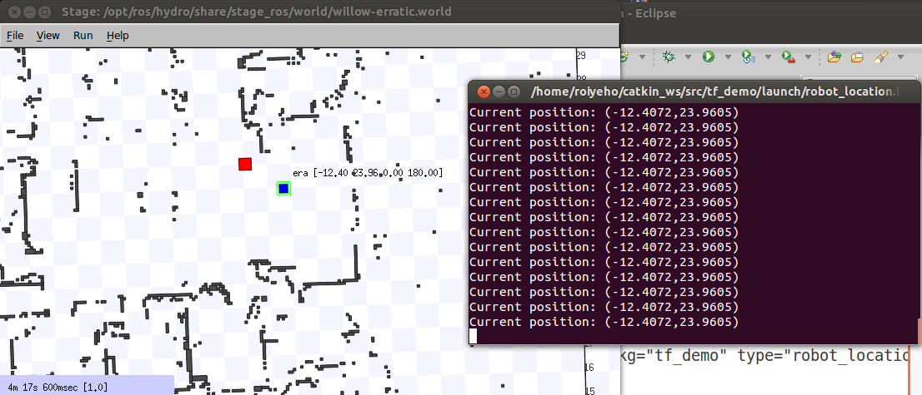
Find Robot Location
You can now change the TF listener to listen to the transform from the /base_footprint frame to the /map frame to get the robot’s location in the map’s frame

Slide 53
Watch the TF Frames in rviz
Type: rosrun rviz rviz
Add the TF display
Make sure the Fixed Frame is set to /map

Slide 54
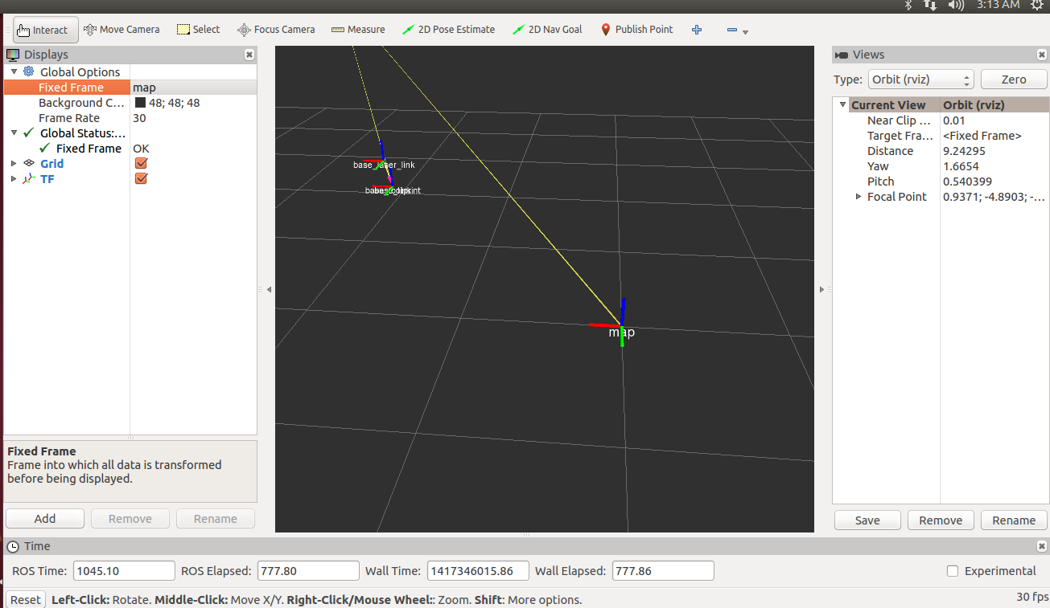
Watch the TF Frames in rviz

