Slide 1

ROS - Lesson 7
Fall 2014
Teaching Assistant: Roi Yehoshua
roiyeho@gmail.com

Slide 2
Agenda
ROS navigation stack
Navigation planners
Costmaps
Running ROS navigation with Stage and rviz
Sending goals to robots

Slide 3
ROS Navigation Stack
http://wiki.ros.org/navigation
The goal of the navigation stack is to move a robot from one position to another position safely (without crashing or getting lost)
It takes in information from the odometry and sensors, and a goal pose and outputs safe velocity commands that are sent to the robot
ROS Navigation Introductory Video

Slide 4
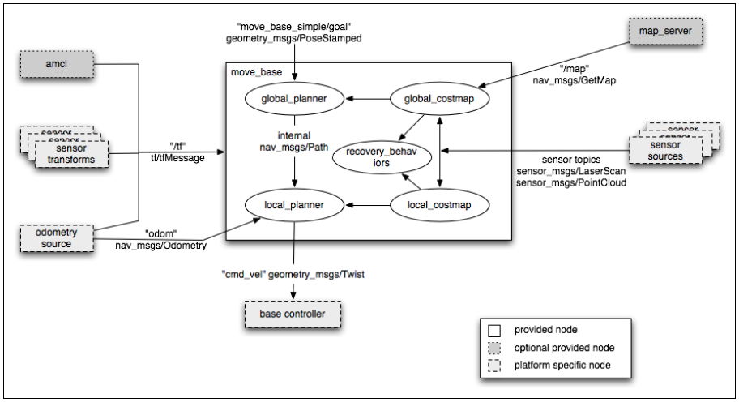
ROS Navigation Stack

Slide 5
Navigation Stack Main Components
Description | Package/Component
offers map data as a ROS Service | map_server
provides laser-based SLAM | gmapping
a probabilistic localization system | amcl
implementation of a fast global planner for navigation | global_planner
implementations of the Trajectory Rollout and Dynamic Window approaches to local robot navigation | local_planner
links together the global and local planner to accomplish the navigation task | move_base

Slide 6
Navigation Main Steps
Goal
AMCL
Path Planner
move_base
/cmd_vel +
/odom
Base Controller

Slide 7
Install Navigation Stack
The navigation stack is not part of the standard ROS Indigo installation
To install the navigation stack type:
In addition, download the navigation tutorials from git
$ sudo apt-get install ros-indigo-navigation
$ cd ~/ros/stacks
$ git clone https://github.com/ros-planning/navigation_tutorials.git

Slide 8
Navigation Stack Requirements
There are three main hardware requirements:
The navigation stack can only handle a differential drive and holonomic wheeled robots
It can also do certain things with biped robots, such as localization, as long as the robot does not move sideways
A planar laser must be mounted on the mobile base of the robot to create the map and localization
Alternatively, you can generate something equivalent to laser scans from other sensors (Kinect for example)
Its performance will be best on robots that are nearly square or circular

Slide 9
Navigation Stack Frames
For the navigation stack to work properly, the robot needs to publish the following tf relationships:
/map → /odom → /base_footprint → /base_link → /base_laser_link
map – the coordinate frame fixed to the map
odom – the self consistent coordinate frame using the odometry measurements only (this will not change on localization updates)
The map → odom transform is published by amcl or gmapping
base_footprint – the base of the robot at zero height above the ground
base_link – the base link of the robot, placed at the rotational center of the robot
base_laser_link – the laser sensor

Slide 10
Navigation Types
Our robot will move through the map using two types of navigation—global and local
The global navigation is used to create paths for a goal in the map or a far-off distance
The local navigation is used to create paths in the nearby distances and avoid obstacles

Slide 11
Global Planner
NavFn provides a fast interpolated navigation function that can be used to create plans for a mobile base
The global plan is computed before the robot starts moving toward the next destination
The planner assumes a circular robot and operates on a costmap to find a minimum cost plan from a start point to an end point in a grid
The navigation function uses Dijkstra's algorithm
The global planner generates a series of waypoints for the local planner to follow

Slide 12
Base Local Planner
http://wiki.ros.org/base_local_planner
The local planner monitors incoming sensor data and chooses appropriate velocity commands for the robot to traverse the current segment of the global path
Combines odometry data with both global and local cost maps
Can recompute the robot's path on the fly to keep the robot from striking objects yet still allowing it to reach its destination
Implements the Trajectory Rollout and Dynamic Window algorithm

Slide 13
Trajectory Rollout Algorithm
Discretely sample in the robot's control space (dx,dy,dθ)
For each sampled velocity, perform forward simulation from the robot's current state to predict what would happen if the sampled velocity were applied for some (short) period of time
Evaluate each trajectory resulting from the forward simulation, using a metric that incorporates characteristics such as: proximity to obstacles, proximity to the goal, proximity to the global path, and speed
Discard illegal trajectories (those that collide with obstacles)
Pick the highest-scoring trajectory and send the associated velocity to the mobile base
Rinse and repeat

Slide 14
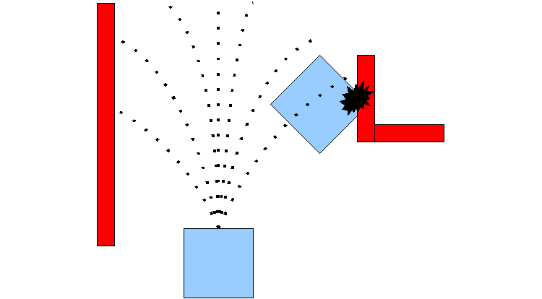
Trajectory Rollout Algorithm
Taken from ROS Wiki

Slide 15
Local Planner Parameters
The file base_local_planner.yaml contains a large number of ROS Parameters that can be set to customize the behavior of the base local planner
These parameters are grouped into several categories:
robot configuration
goal tolerance
forward simulation
trajectory scoring
oscillation prevention
global plan

Slide 16
base_local_planner.yaml (1)
#For full documentation of the parameters in this file, and a list of all the
#parameters available for TrajectoryPlannerROS, please see
#http://www.ros.org/wiki/base_local_planner
TrajectoryPlannerROS:
#Set the acceleration limits of the robot
acc_lim_th: 3.2
acc_lim_x: 2.5
acc_lim_y: 2.5
#Set the velocity limits of the robot
max_vel_x: 0.65
min_vel_x: 0.1
max_rotational_vel: 1.0
min_in_place_rotational_vel: 0.4
#The velocity the robot will command when trying to escape from a stuck situation
escape_vel: -0.1
#For this example, we'll use a holonomic robot
holonomic_robot: true
#Since we're using a holonomic robot, we'll set the set of y velocities it will sample
y_vels: [-0.3, -0.1, 0.1, -0.3]

Slide 17
base_local_planner.yaml (2)
#Set the tolerance on achieving a goal
xy_goal_tolerance: 0.1
yaw_goal_tolerance: 0.05
#We'll configure how long and with what granularity we'll forward simulate trajectories
sim_time: 1.7
sim_granularity: 0.025
vx_samples: 3
vtheta_samples: 20
#Parameters for scoring trajectories
goal_distance_bias: 0.8
path_distance_bias: 0.6
occdist_scale: 0.01
heading_lookahead: 0.325
#We'll use the Dynamic Window Approach to control instead of Trajectory Rollout for this example
dwa: true
#How far the robot must travel before oscillation flags are reset
oscillation_reset_dist: 0.05
#Eat up the plan as the robot moves along it
prune_plan: true

Slide 18
Costmap
A data structure that represents places that are safe for the robot to be in a grid of cells
It is based on the occupancy grid map of the environment and user specified inflation radius
There are two types of costmaps in ROS:
Global costmap is used for global navigation
Local costmap is used for local navigation
Managed by the costmap_2d package

Slide 19
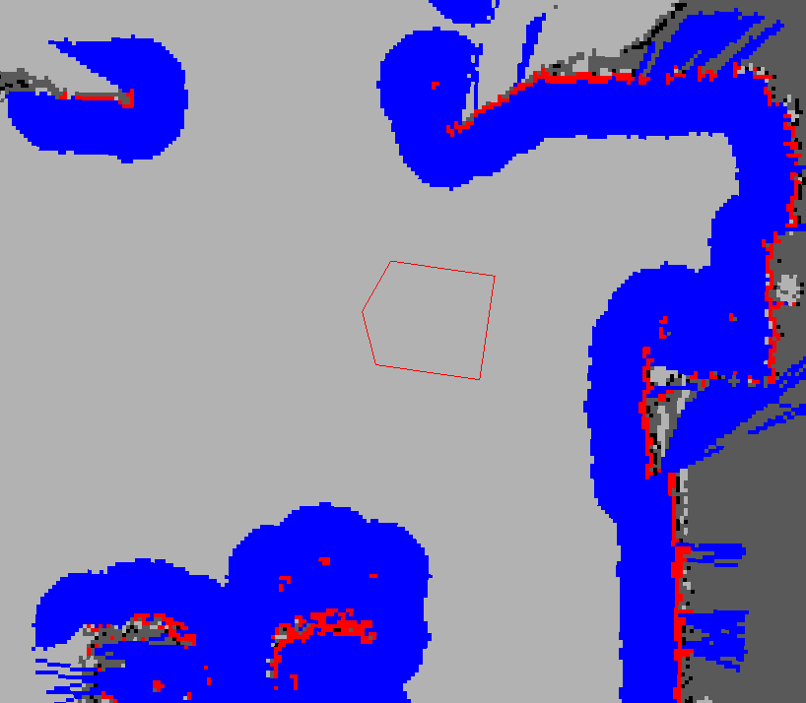
Costmap Example
Taken from ROS Wiki

Slide 20
Costmap Values
Each cell in the costmap has an integer value in the range [0, 255]
There are 5 special symbols for cost values:
NO_INFORMATION (255) - Reserved for cells where not enough information is sufficiently known
LETHAL_OBSTACLE (254) - Indicates a collision causing obstacle was sensed in this cell
INSCRIBED_INFLATED_OBSTACLE (253) - Indicates no obstacle, but moving the center of the robot to this location will result in a collision
POSSIBLY CIRCUMSCRIBED (128-252) – If the robot center lies in that location, then it depends on the orientation of the robot whether it collides with an obstacle or not
FREE_SPACE (0) - Cells where there are no obstacles and the moving the center of the robot to this position will not result in a collision

Slide 21
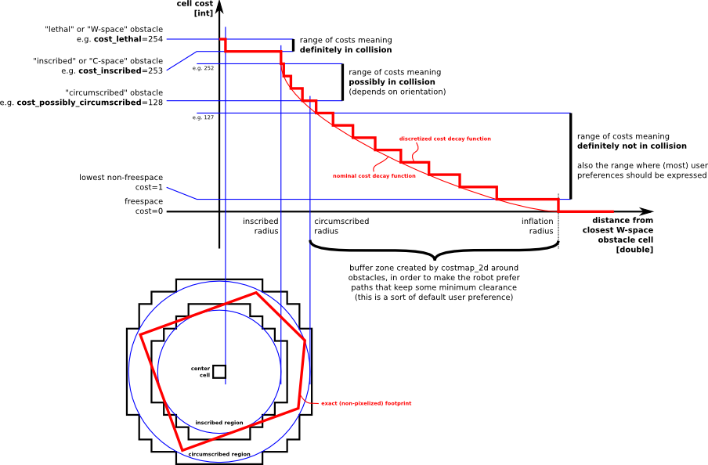
Inflation
Inflation is the process of propagating cost values out from occupied cells that decrease with distance

Slide 22
Map Updates
The costmap performs map update cycles at the rate specified by the update_frequency parameter
In each cycle:
sensor data comes in
marking and clearing operations are perfomed in the underlying occupancy structure of the costmap
this structure is projected into the costmap where the appropriate cost values are assigned as described above
obstacle inflation is performed on each cell with a LETHAL_OBSTACLE value
This consists of propagating cost values outwards from each occupied cell out to a user-specified inflation radius

Slide 23
Costmap Parameters Files
Configuration of the costmaps consists of three files where we can set up different parameters:
costmap_common_params.yaml
global_costmap_params.yaml
local_costmap_params.yaml
Explanation of the meaning of these parameters can be found at http://wiki.ros.org/costmap_2d/hydro/obstacles

Slide 24
costmap_common_params.yaml (1)
#This file contains common configuration options for the two costmaps used in the navigation stack for more details on the parameters in this file, and a full list of the parameters used by the costmaps, please see http://www.ros.org/wiki/costmap_2d
#For this example we'll configure the costmap in voxel-grid mode
map_type: voxel
#Voxel grid specific parameters
origin_z: 0.0
z_resolution: 0.2
z_voxels: 10
unknown_threshold: 9
mark_threshold: 0
#Set the tolerance we're willing to have for tf transforms
transform_tolerance: 0.3
#Obstacle marking parameters
obstacle_range: 2.5
max_obstacle_height: 2.0
raytrace_range: 3.0
#The footprint of the robot and associated padding
footprint: [[-0.325, -0.325], [-0.325, 0.325], [0.325, 0.325], [0.46, 0.0], [0.325, -0.325]]
footprint_padding: 0.01

Slide 25
costmap_common_params.yaml (2)
#Cost function parameters
inflation_radius: 0.55
cost_scaling_factor: 10.0
#The cost at which a cell is considered an obstacle when a map is read from the map_server
lethal_cost_threshold: 100
#Configuration for the sensors that the costmap will use to update a map
observation_sources: base_scan
base_scan: {data_type: LaserScan, expected_update_rate: 0.4,
observation_persistence: 0.0, marking: true, clearing: true, max_obstacle_height: 0.4, min_obstacle_height: 0.08}

Slide 26
global_costmap_params.yaml
#Independent settings for the global planner's costmap. Detailed descriptions of these parameters can be found at http://www.ros.org/wiki/costmap_2d
global_costmap:
#Set the global and robot frames for the costmap
global_frame: /map
robot_base_frame: base_link
#Set the update and publish frequency of the costmap
update_frequency: 5.0
publish_frequency: 0.0
#We'll use a map served by the map_server to initialize this costmap
static_map: true
rolling_window: false
footprint_padding: 0.02

Slide 27
local_costmap_params.yaml
#Independent settings for the local planner's costmap. Detailed descriptions of these parameters can be found at http://www.ros.org/wiki/costmap_2d
local_costmap:
#We'll publish the voxel grid used by this costmap
publish_voxel_map: true
#Set the global and robot frames for the costmap
global_frame: odom
robot_base_frame: base_link
#Set the update and publish frequency of the costmap
update_frequency: 5.0
publish_frequency: 2.0
#We'll configure this costmap to be a rolling window... meaning it is always
#centered at the robot
static_map: false
rolling_window: true
width: 6.0
height: 6.0
resolution: 0.025
origin_x: 0.0
origin_y: 0.0

Slide 28
move_base
The move_base package lets you move a robot to desired positions using the navigation stack
The move_base node links together a global and local planner to accomplish its navigation task
The move_base node may optionally perform recovery behaviors when the robot perceives itself as stuck

Slide 29
move_base.xml
<launch>
<!--
Example move_base configuration. Descriptions of parameters, as well as a full list of all amcl parameters, can be found at http://www.ros.org/wiki/move_base.
-->
<node pkg="move_base" type="move_base" respawn="false" name="move_base_node" output="screen">
<param name="footprint_padding" value="0.01" />
<param name="controller_frequency" value="10.0" />
<param name="controller_patience" value="3.0" />
<param name="oscillation_timeout" value="30.0" />
<param name="oscillation_distance" value="0.5" />
<!--
<param name="base_local_planner" value="dwa_local_planner/DWAPlannerROS" />
-->
<rosparam file="$(find navigation_stage)/move_base_config/costmap_common_params.yaml" command="load" ns="global_costmap" />
<rosparam file="$(find navigation_stage)/move_base_config/costmap_common_params.yaml" command="load" ns="local_costmap" />
<rosparam file="$(find navigation_stage)/move_base_config/local_costmap_params.yaml" command="load" />
<rosparam file="$(find navigation_stage)/move_base_config/global_costmap_params.yaml" command="load" />
<rosparam file="$(find navigation_stage)/move_base_config/base_local_planner_params.yaml" command="load" />
<!--
<rosparam file="$(find navigation_stage)/move_base_config/dwa_local_planner_params.yaml" command="load" />
-->
</node>
</launch>

Slide 30
navigation_stage
The navigation_stage package in navigation_tutorials holds example launch files for running the ROS navigation stack in stage
Description | Launch File
Example launch file for running the navigation stack with amcl at a map resolution of 5cm | launch/move_base_amcl_5cm
Example launch file for running the navigation stack with fake_localization at a map resolution of 10cm | launch/move_base_fake_localization_10cm.launch
Example launch file for running the navigation stack with multiple robots in stage. | launch/move_base_multi_robot.launch
Example launch file for running the navigation stack with gmapping at a map resolution of 5cm | launch/move_base_gmapping_5cm.launch

Slide 31
move_base_gmapping_5cm.launch
<launch>
<master auto="start"/>
<param name="/use_sim_time" value="true"/>
<include file="$(find navigation_stage)/move_base_config/move_base.xml"/>
<node pkg="stage_ros" type="stageros" name="stageros" args="$(find navigation_stage)/stage_config/worlds/willow-pr2-5cm.world" respawn="false" >
<param name="base_watchdog_timeout" value="0.2"/>
</node>
<include file="$(find navigation_stage)/move_base_config/slam_gmapping.xml"/>
<node name="rviz" pkg="rviz" type="rviz" args="-d $(find navigation_stage)/single_robot.rviz" />
</launch>
To run this launch file type:
$ roscd navigation_stage/launch
$ roslaunch move_base_gmapping_5cm.launch

Slide 32
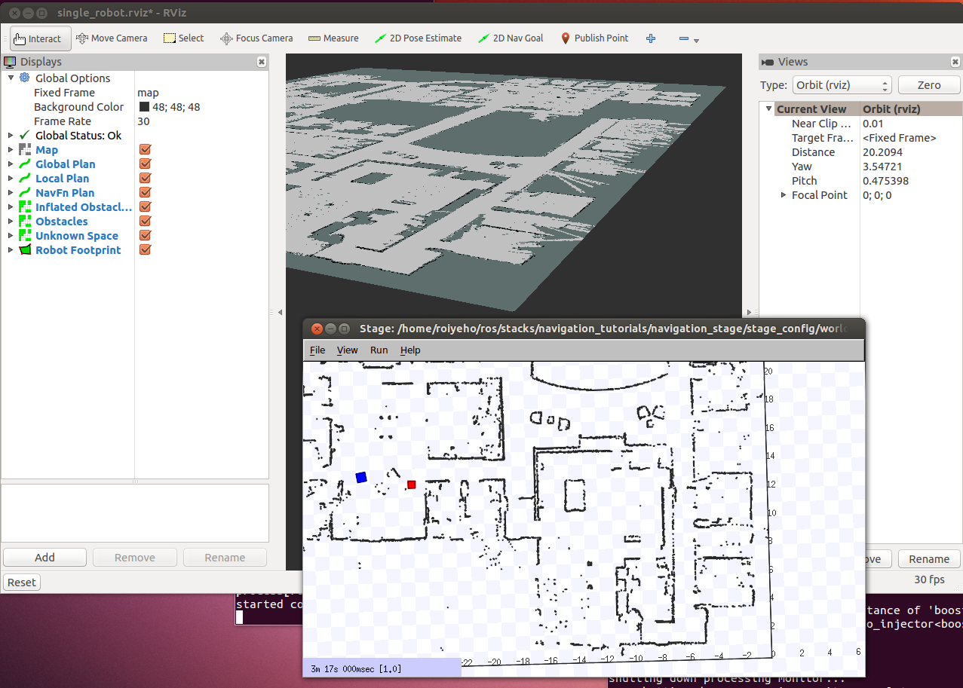
Running the Launch File

Slide 33
Using rviz with Navigation Stack
You can use rviz for:
Setting the pose of the robot for a localization system like amcl
Displaying all the visualization information that the navigation stack provides
Sending goals to the navigation stack with rviz
Tutorial on using rviz with the navigation stack

Slide 34
Robot Footprint
Shows the footprint of the robot
In our case, the robot has a pentagon-shape
Configured in costmap_common_params
Topic: move_base_node/local_costmap/footprint_layer/footprint_stamped
Type: geometry_msgs/PolygonStamped

Slide 35
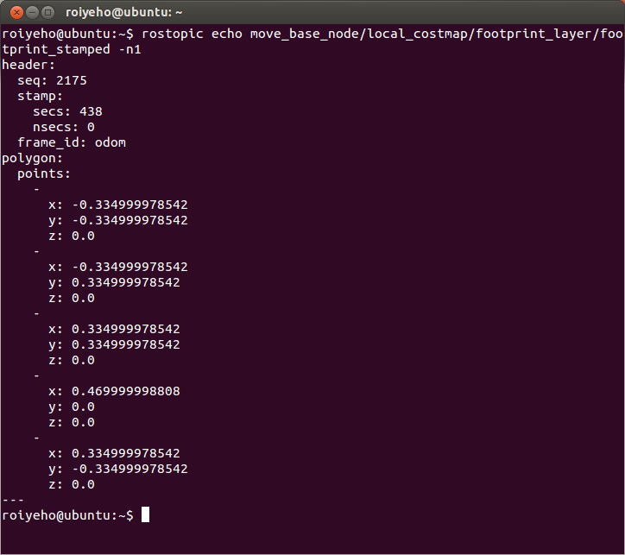
Robot Footprint

Slide 36
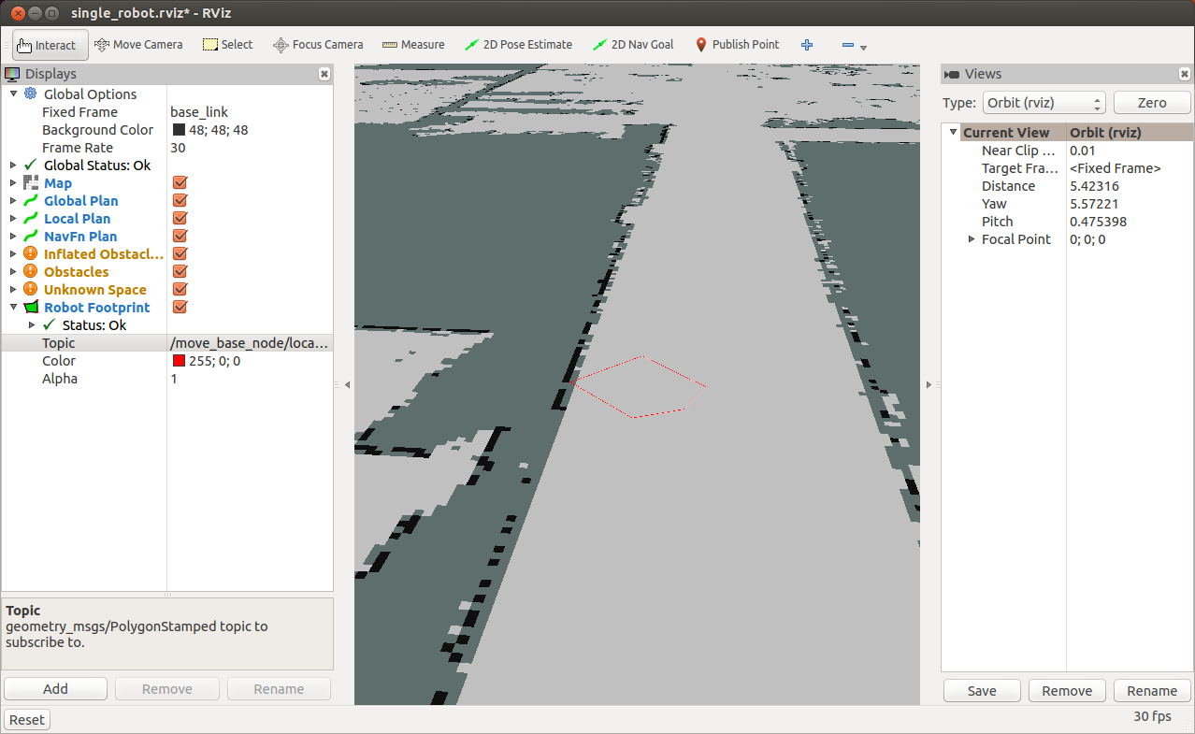
Robot Footprint

Slide 37
2D Nav Goal
The 2D nav goal (G shortcut) allows the user to send a goal to the navigation by setting a desired pose for the robot to achieve
Click on the 2D Nav Goal button and select the map and the goal for your robot
You can select the x and y position and the end orientation for the robot
Note: for the "2D Nav Goal" button to work, the Fixed Frame must be set to "map".

Slide 38
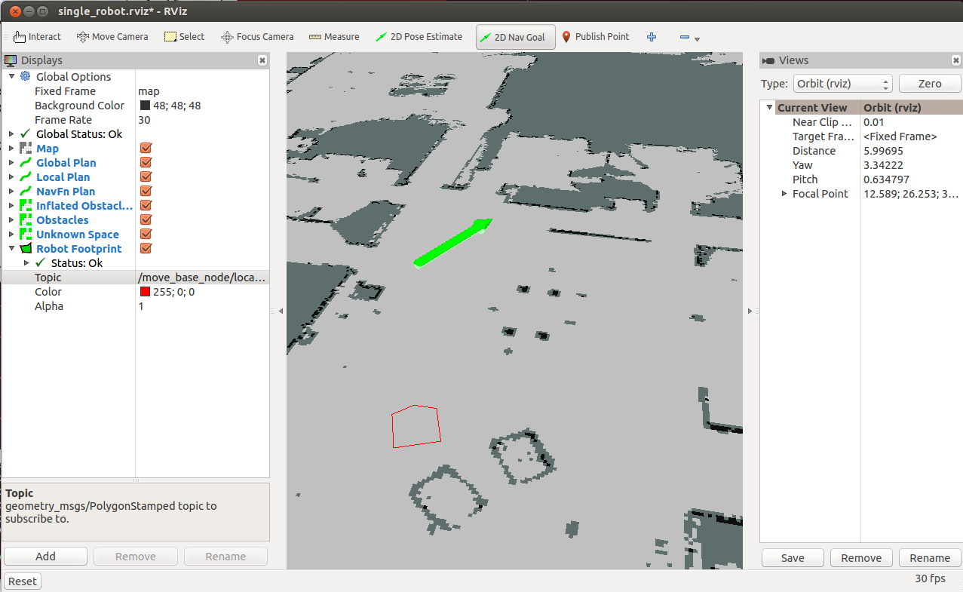
2D Nav Goal

Slide 39
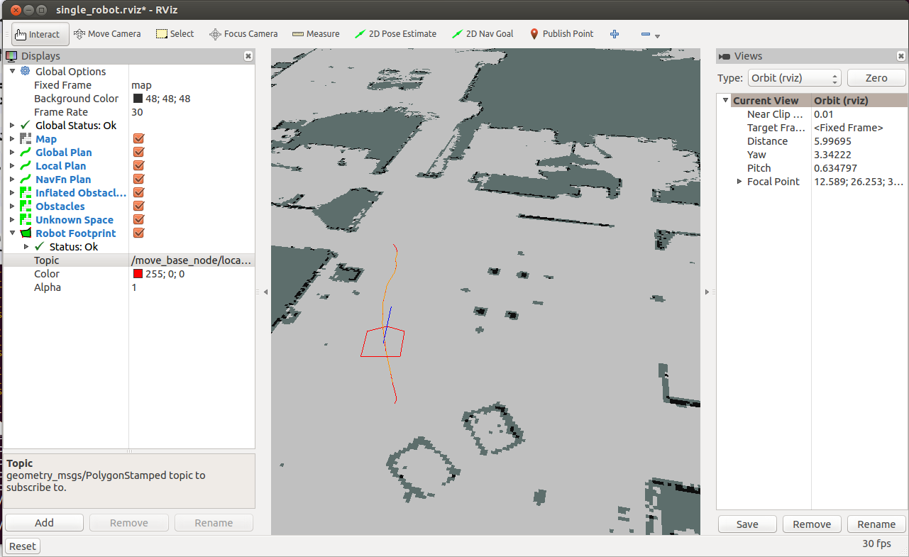
Robot Moves to Destination

Slide 40
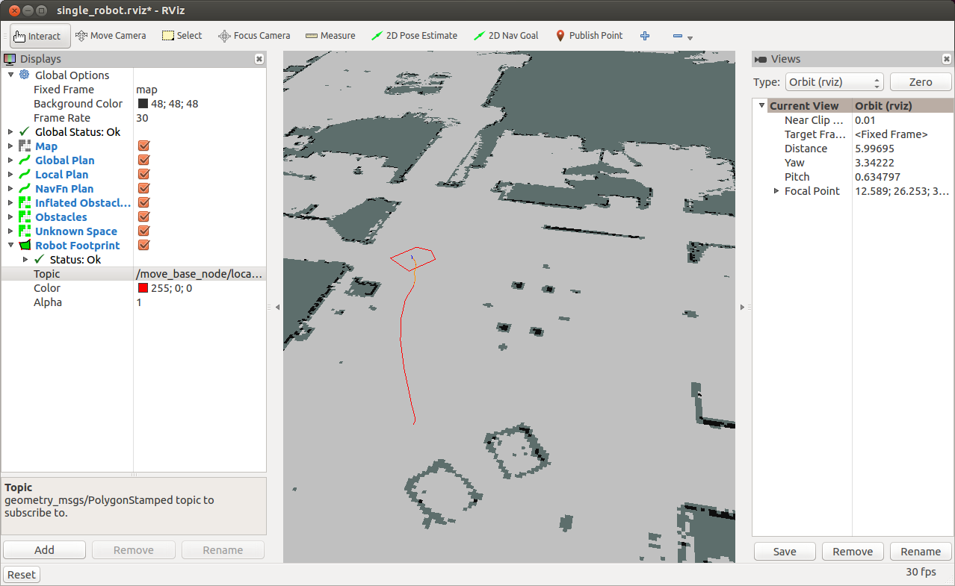
Final Pose

Slide 41
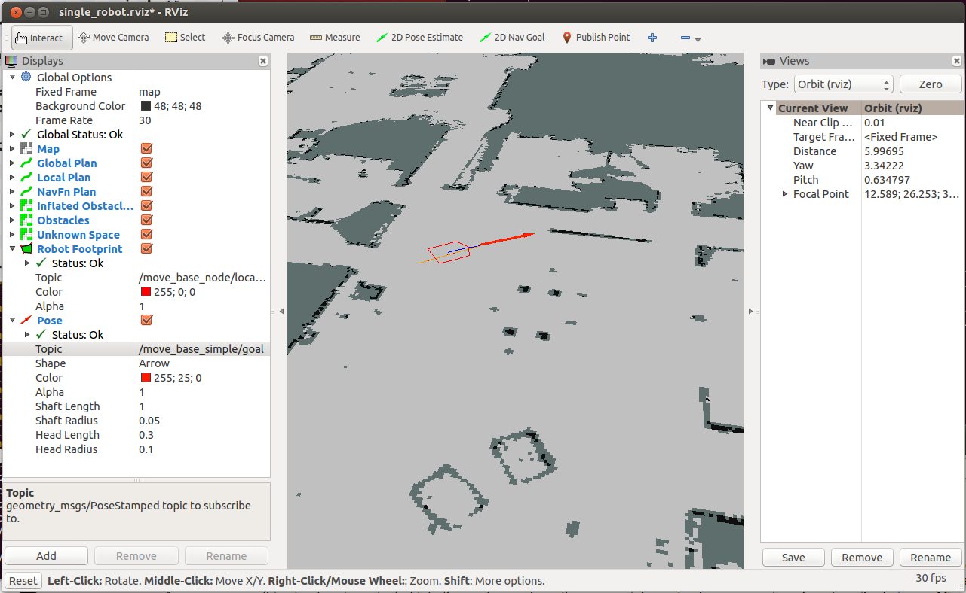
Current Goal
To show the goal pose that the navigation stack is attempting to achieve add a Pose Display
Set its topic to /move_base_simple/goal

Slide 42
Navigation Plans in rviz
NavFn Plan
Displays the full plan for the robot computed by the global planner
Topic: /move_base_node/NavfnROS/plan
Global Plan
Shows the portion of the global plan that the local planner is currently pursuing
Topic: /move_base_node/TrajectoryPlannerROS/global_plan
Local Plan
Shows the trajectory associated with the velocity commands currently being commanded to the base by the local planner
Topic: /move_base_node/TrajectoryPlannerROS/local_plan

Slide 43
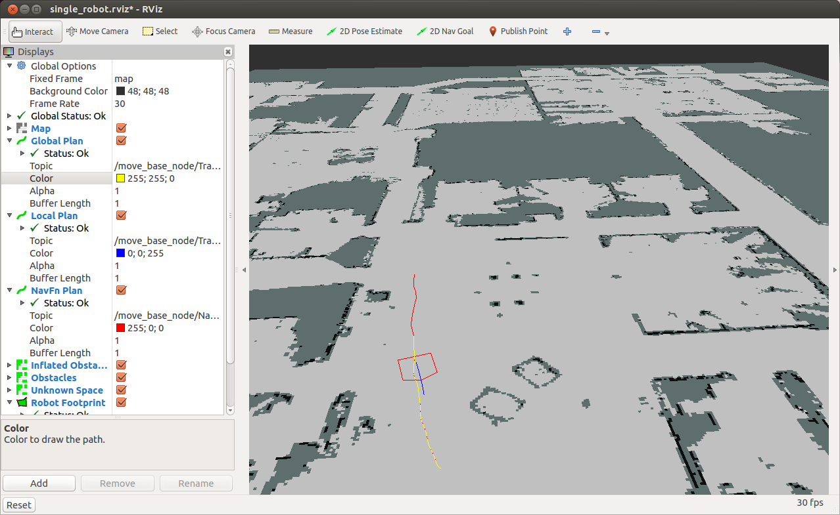
Navigation Plans in rviz
NavFn Plan
Local Plan
Global Plan

Slide 44
Costmaps in rviz
To see the costmap add a Map display
To see the local costmap set the topic to:
/move_base_node/local_costmap/costmap
To see the global costmap set the topic to:
/move_base_node/global_costmap/costmap

Slide 45
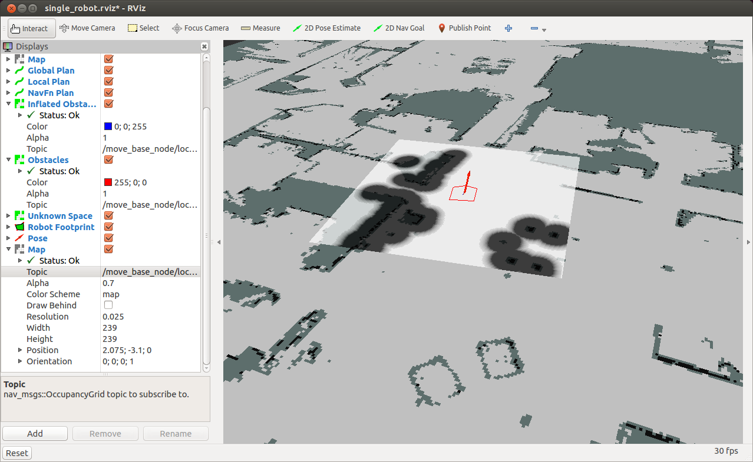
Local Costmap

Slide 46
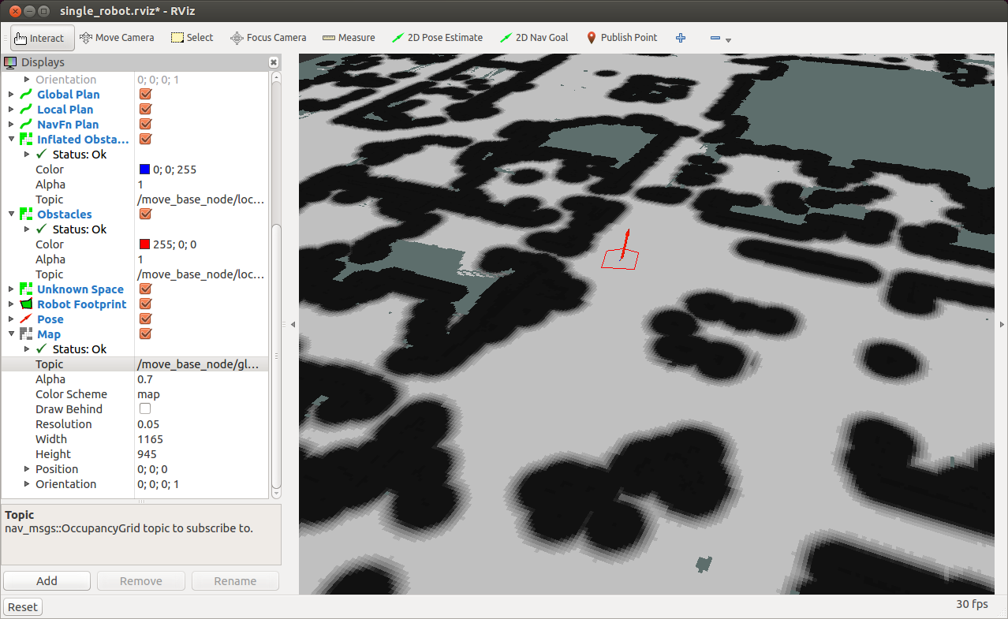
Global Costmap

Slide 47
Cost Grid
To see the cost grid used for navigation planning add a PointCloud2 display
Set its topic to:
/move_base_node/TrajectoryPlannerROS/cost_cloud

Slide 48
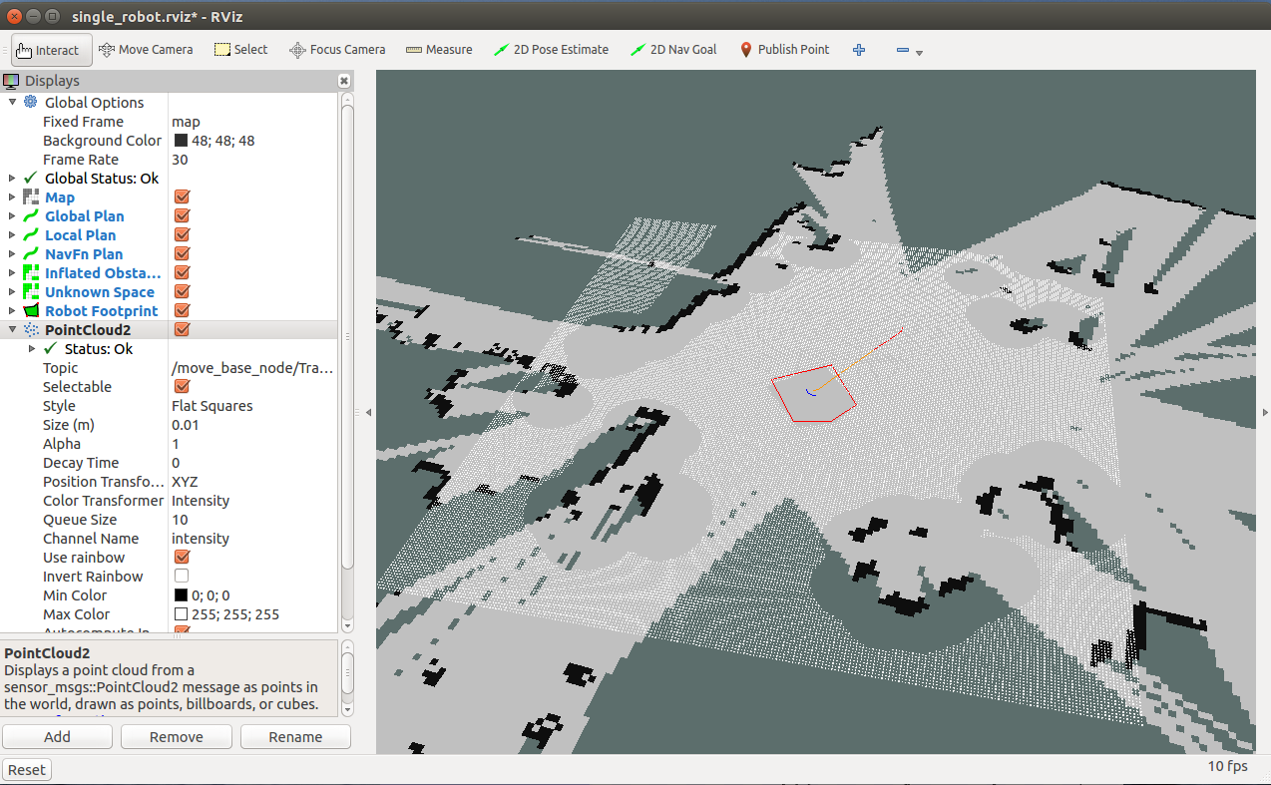
Cost Grid

Slide 49
rqt_reconfigure
A tool for changing dynamic configuration values
To launch rqt_reconfigure, run:
The navigation stack parameters will appear under move_base_node
$ rosrun rqt_reconfigure rqt_reconfigure

Slide 50
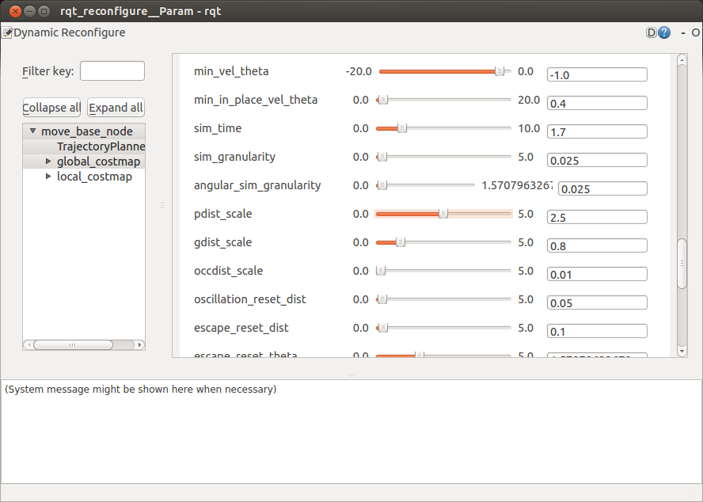
rqt_reconfigure

Slide 51
Homework (not for submission)
Install the navigation stack
Test the different launch files in the navigation_tutorials package
Send goals to the robot via rviz and examine the costmaps created
Play with different configuration parameters of the navigation stack

