Slide 1

ROS - Lesson 8
Fall 2014
Teaching Assistant: Roi Yehoshua
roiyeho@gmail.com

Slide 2
Agenda
Adaptive Monte-Carlo Localization
actionlib
Sending goals from code
Making navigation plans

Slide 3
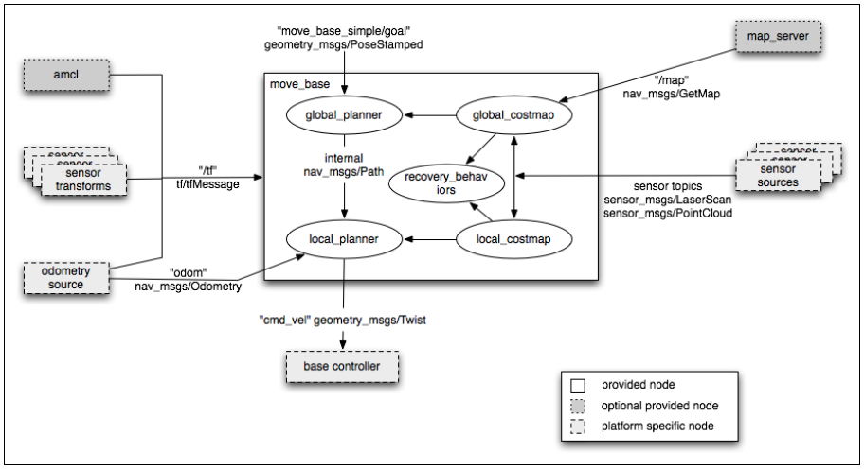
Localization

Slide 4
Localization
Localization is the problem of estimating the pose of the robot relative to a map
Localization is not terribly sensitive to the exact placement of objects so it can handle small changes to the locations of objects
ROS uses the amcl package for localization

Slide 5
AMCL
amcl is a probabilistic localization system for a robot moving in 2D
It implements the adaptive Monte Carlo localization approach, which uses a particle filter to track the pose of a robot against a known map
The algorithm and its parameters are described in the book Probabilistic Robotics by Thrun, Burgard, and Fox (http://www.probabilistic-robotics.org/)
Currently amcl works only with laser scans and laser maps. However, it can be extended to work with other sensor data.

Slide 6
AMCL
amcl takes in a laser-based map, laser scans, and transform messages, and outputs pose estimates
Subscribed topics:
scan – Laser scans
tf – Transforms
initialpose – Mean and covariance with which to (re-) initialize the particle filter
map – the map used for laser-based localization
Published topics:
amcl_pose – Robot's estimated pose in the map, with covariance.
Particlecloud – The set of pose estimates being maintained by the filter

Slide 7
AMCL Parameters
Default | Description | Parameter
100 | Minimum allowed number of particles | min_particles
5000 | Maximum allowed number of particles | max_particles
likelihood_field | Which model to use, either beam or likelihood_field | laser_model_type
2.0 | Maximum distance to do obstacle inflation on map, for use in likelihood_field model | laser_likelihood_max_dist
0.0 | Initial pose mean (x), used to initialize filter with Gaussian distribution | initial_pose_x
0.0 | Initial pose mean (y), used to initialize filter with Gaussian distribution | initial_pose_y
0.0 | Initial pose mean (yaw), used to initialize filter with Gaussian distribution | initial_pose_a

Slide 8
amcl_node.xml (1)
<launch>
<!--
Example amcl configuration. Descriptions of parameters, as well as a full list of all amcl parameters, can be found at http://www.ros.org/wiki/amcl.
-->
<node pkg="amcl" type="amcl" name="amcl" respawn="true">
<remap from="scan" to="base_scan" />
<!-- Publish scans from best pose at a max of 10 Hz -->
<param name="odom_model_type" value="omni"/>
<param name="odom_alpha5" value="0.1"/>
<param name="transform_tolerance" value="0.2" />
<param name="gui_publish_rate" value="10.0"/>
<param name="laser_max_beams" value="30"/>
<param name="min_particles" value="500"/>
<param name="max_particles" value="5000"/>
<param name="kld_err" value="0.05"/>
<param name="kld_z" value="0.99"/>
<param name="odom_alpha1" value="0.2"/>
<param name="odom_alpha2" value="0.2"/>

Slide 9
amcl_node.xml (2)
<!-- translation std dev, m -->
<param name="odom_alpha3" value="0.8"/>
<param name="odom_alpha4" value="0.2"/>
<param name="laser_z_hit" value="0.5"/>
<param name="laser_z_short" value="0.05"/>
<param name="laser_z_max" value="0.05"/>
<param name="laser_z_rand" value="0.5"/>
<param name="laser_sigma_hit" value="0.2"/>
<param name="laser_lambda_short" value="0.1"/>
<param name="laser_lambda_short" value="0.1"/>
<param name="laser_model_type" value="likelihood_field"/>
<!-- <param name="laser_model_type" value="beam"/> -->
<param name="laser_likelihood_max_dist" value="2.0"/>
<param name="update_min_d" value="0.2"/>
<param name="update_min_a" value="0.5"/>
<param name="odom_frame_id" value="odom"/>
<param name="resample_interval" value="1"/>
<param name="transform_tolerance" value="0.1"/>
<param name="recovery_alpha_slow" value="0.0"/>
<param name="recovery_alpha_fast" value="0.0"/>
</node>
</launch>

Slide 10
Navigation Stack with amcl
To run the navigation stack with amcl, you need to run the following nodes:
map_server – for loading the map
stageros – for the Stage simulator
amcl – for the localization system
move_base – manages the navigation stack

Slide 11
move_base_amcl_5cm.launch
<launch>
<master auto="start"/>
<param name="/use_sim_time" value="true"/>
<include file="$(find navigation_stage)/move_base_config/move_base.xml"/>
<node name="map_server" pkg="map_server" type="map_server" args="$(find navigation_stage)/stage_config/maps/willow-full-0.05.pgm 0.05" respawn="false" />
<node pkg="stage_ros" type="stageros" name="stageros" args="$(find navigation_stage)/stage_config/worlds/willow-pr2-5cm.world" respawn="false" >
<param name="base_watchdog_timeout" value="0.2"/>
</node>
<include file="$(find navigation_stage)/move_base_config/amcl_node.xml"/>
<node name="rviz" pkg="rviz" type="rviz" args="-d $(find navigation_stage)/single_robot.rviz" />
</launch>
To run this launch file type:
$ roscd navigation_stage/launch
$ roslaunch move_base_amcl_5cm.launch

Slide 12
rviz 2D Pose Estimate
The navigation stack waits for the new pose by listening to the topic initialpose
The 2D Pose Estimate button (P shortcut) allows the user to initialize the localization system by setting the pose of the robot in the world
Click on the button and then click on the map to indicate the initial position of your robot
Make sure that the Fixed Frame is set to "map”
If you don't do this at the beginning, the robot will try to auto-localize itself

Slide 13
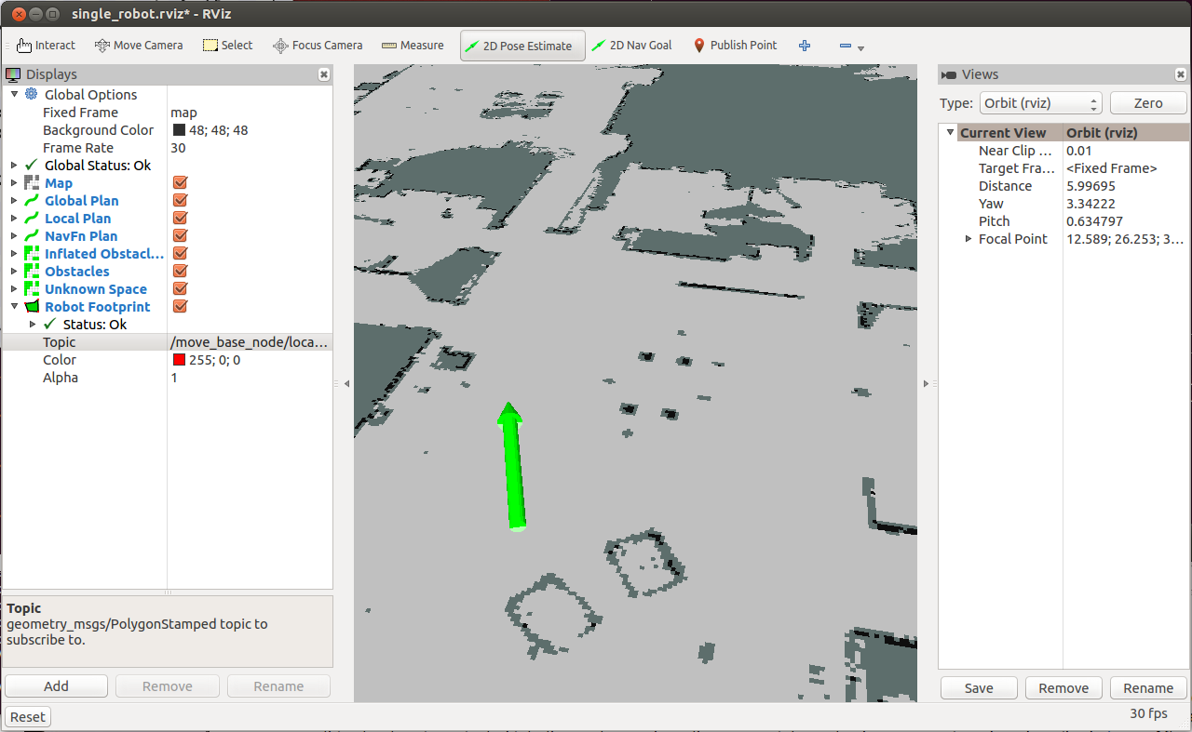
2D Pose Estimate

Slide 14
Particle Cloud in rviz
The Particle Cloud display shows the particle cloud used by the robot's localization system
The spread of the cloud represents the localization system's uncertainty about the robot's pose
A cloud that spreads out a lot reflects high uncertainty, while a condensed cloud represents low uncertainty
As the robot moves about the environment, this cloud should shrink in size as additional scan data allows amcl to refine its estimate of the robot's position and orientation

Slide 15
Particle Cloud in rviz
To watch the particle cloud in rviz:
Click Add Display and choose Pose Array
Set topic name to /particlecloud

Slide 16
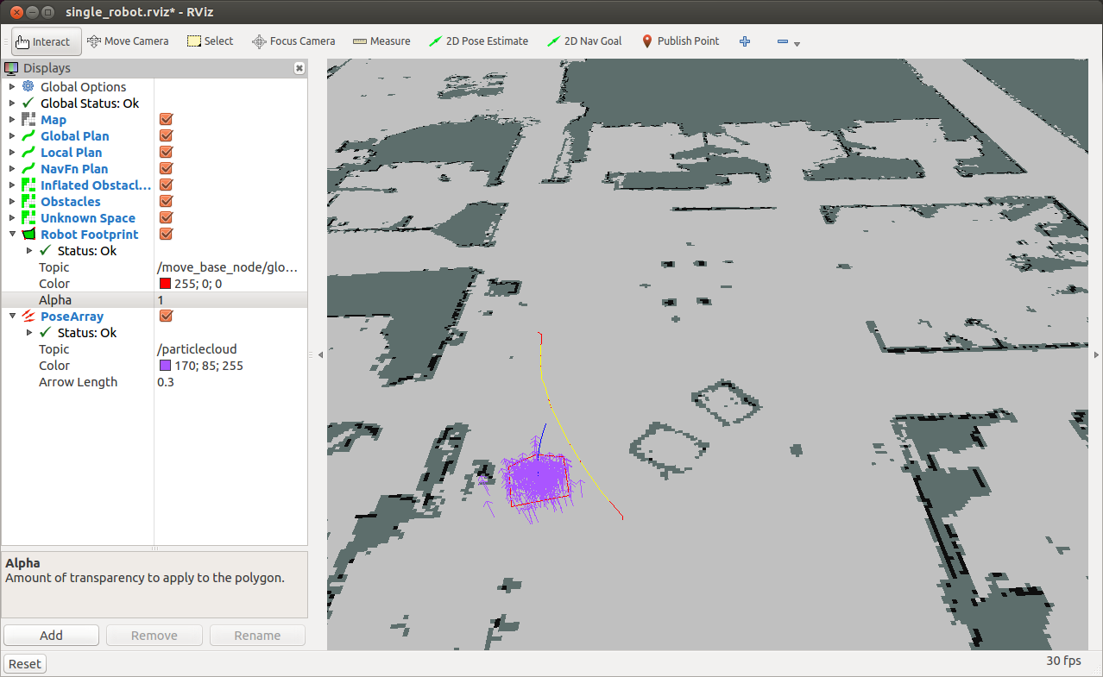
Particle Cloud in rviz

Slide 17
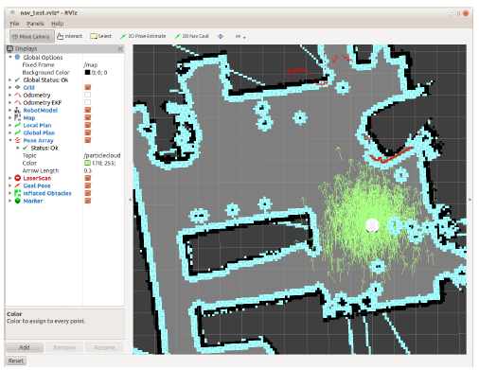
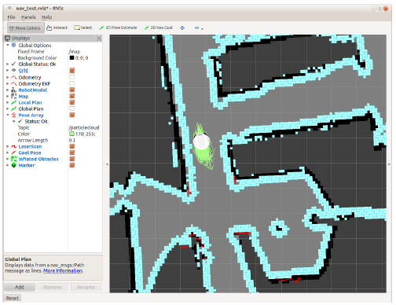
Using amcl with a Real Robot
Taken from ROS by Example / Goebel

Slide 18
actionlib
http://wiki.ros.org/actionlib
The actionlib stack provides a standardized interface for interfacing with tasks including:
Sending goals to the robot
Performing a laser scan
Detecting the handle of a door
Provides abilities that services don’t have:
cancel a long-running task during the execution
get periodic feedback about how the request is progressing

Slide 19
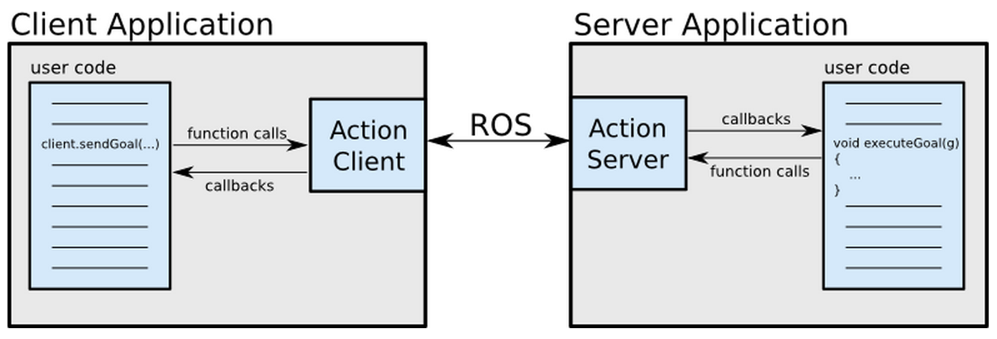
Client-Server Interaction

Slide 20
.action File
From the action file the following message types are generated:
DoDishesAction.msg
DoDishesActionGoal.msg
DoDishesActionResult.msg
DoDishesActionFeedback.msg
DoDishesGoal.msg
DoDishesResult.msg
DoDishesFeedback.msg
These messages are then used internally by actionlib to communicate between the ActionClient and ActionServer

Slide 21
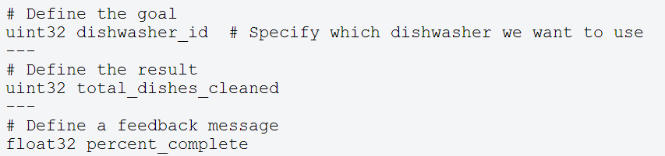
.action File
The action specification is defined using a .action file.
These files are placed in a package’s ./action directory
Example:

Slide 22
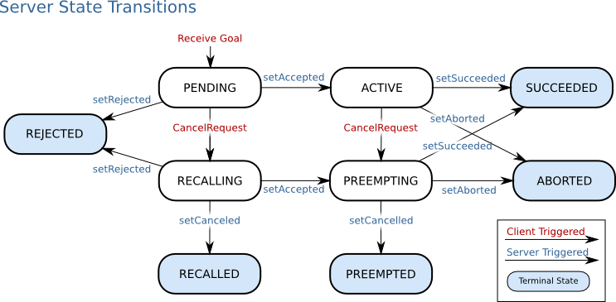
Action Server State Transitions

Slide 23
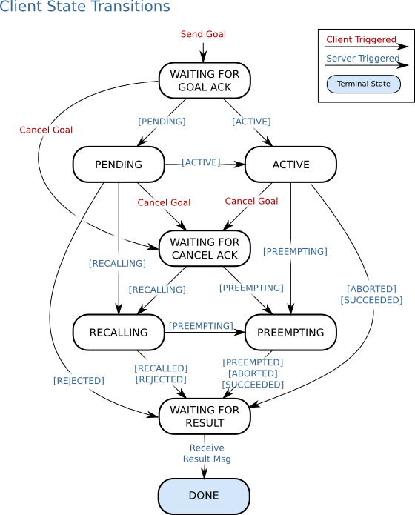
Action Client State Transitions

Slide 24
SimpleActionClient
A simple client implementation which supports only one goal at a time
The action client is templated on the action definition, specifying what message types to communicate to the action server with
The action client c’tor also takes two arguments:
The server name to connect to
A boolean option to automatically spin a thread
If you prefer not to use threads (and you want actionlib to do the 'thread magic' behind the scenes), this is a good option for you.

Slide 25
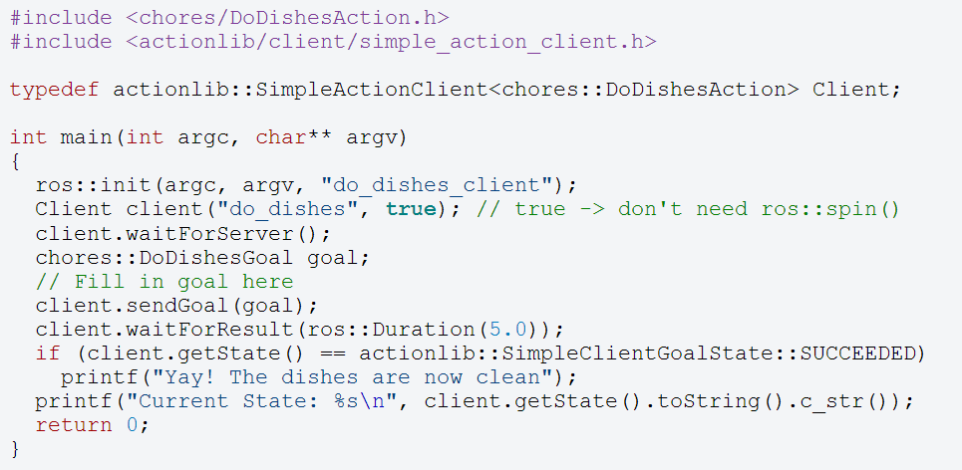
SimpleActionClient

Slide 26
SendGoals Example
The next code is a simple example to send a goal to move the robot
In this case the goal would be a PoseStamped message that contains information about where the robot should move to in the world
http://wiki.ros.org/navigation/Tutorials/SendingSimpleGoals

Slide 27
SendGoals Example
First create a new package called send_goals
This package depends on the following packages:
actionlib
geometry_msgs
move_base_msgs
$ cd ~/catkin_ws/src
$ catkin_create_pkg send_goals std_msgs rospy roscpp actionlib tf geometry_msgs move_base_msgs
$ catkin_make --force-cmake -G"Eclipse CDT4 - Unix Makefiles"

Slide 28
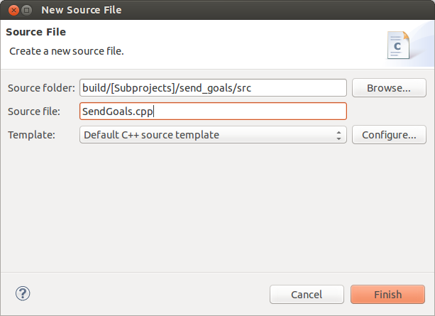
SendGoals Example
Open the project file in Eclipse
Under the src subdirectory, create a new file called SendGoals.cpp

Slide 29
SendGoals.cpp (1)
#include <ros/ros.h>
#include <move_base_msgs/MoveBaseAction.h>
#include <actionlib/client/simple_action_client.h>
typedef actionlib::SimpleActionClient<move_base_msgs::MoveBaseAction> MoveBaseClient;
int main(int argc, char** argv) {
ros::init(argc, argv, "send_goals_node");
// create the action client
// true causes the client to spin its own thread
MoveBaseClient ac("move_base", true);
// Wait 60 seconds for the action server to become available
ROS_INFO("Waiting for the move_base action server");
ac.waitForServer(ros::Duration(60));
ROS_INFO("Connected to move base server");

Slide 30
SendGoals.cpp (2)
// Send a goal to move_base
move_base_msgs::MoveBaseGoal goal;
goal.target_pose.header.frame_id = "map";
goal.target_pose.header.stamp = ros::Time::now();
goal.target_pose.pose.position.x = 18.174;
goal.target_pose.pose.position.y = 28.876;
goal.target_pose.pose.orientation.w = 1;
ROS_INFO("Sending goal");
ac.sendGoal(goal);
// Wait for the action to return
ac.waitForResult();
if (ac.getState() == actionlib::SimpleClientGoalState::SUCCEEDED)
ROS_INFO("You have reached the goal!");
else
ROS_INFO("The base failed for some reason");
return 0;
}

Slide 31
Compiling the Node
Add the following lines to CMakeLists.txt:
Call catkin_make
add_executable(send_goals_node src/SendGoals.cpp)
target_link_libraries(send_goals_node
${catkin_LIBRARIES}
)

Slide 32
Running the Node
First run the navigation stack:
Set the initial pose of the robot in rviz
Then run send_goals_node:
cd ~/ros/stacks/navigation_tutorials/navigation_stage/launch
roslaunch move_base_amcl_5cm.launch
rosrun send_goals send_goals_node

Slide 33
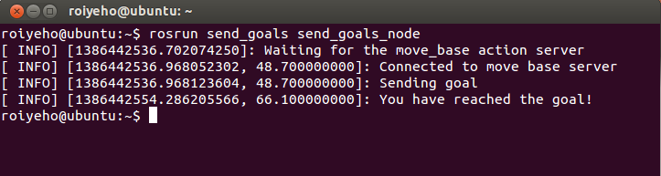
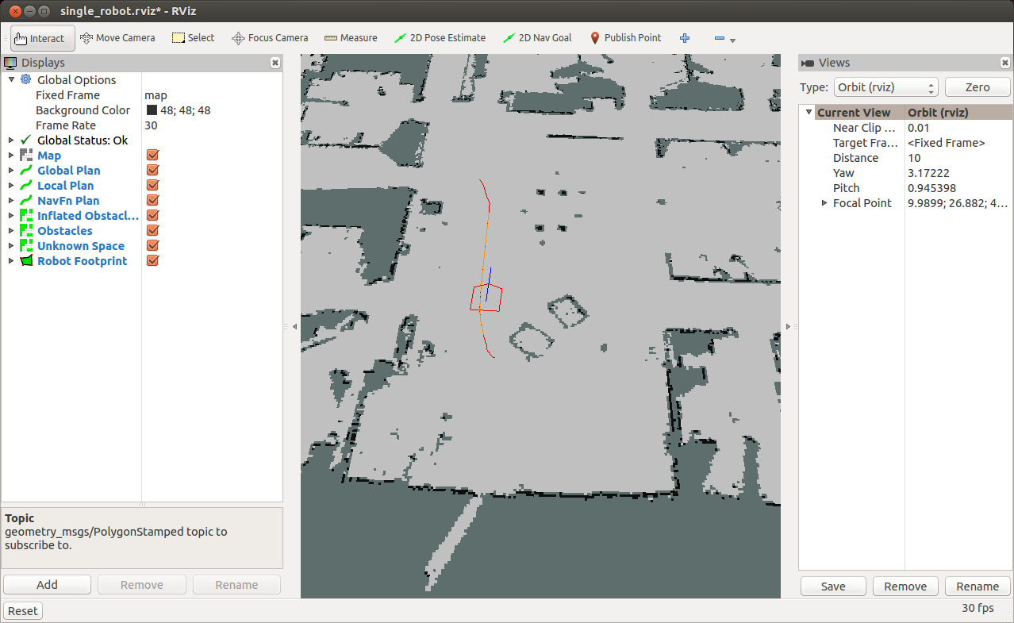
Running the Node

Slide 34
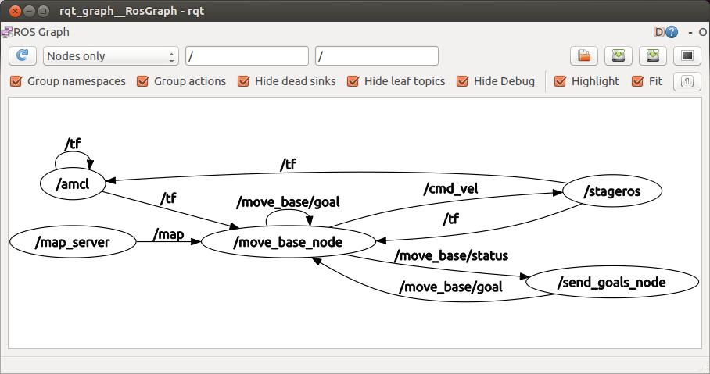
Nodes Graph
The graph shows that the client is subscribing to the status channel of move_base and publishing to the goal channel as expected

Slide 35
Converting Euler Angle to Quaternion
Now let’s specify the desired orientation of the robot in the final pose as 90 degrees
It will be easier to define it with Euler angles and convert it to a quaternion message:
double theta = 90.0;
double radians = theta * (M_PI/180);
tf::Quaternion quaternion;
quaternion = tf::createQuaternionFromYaw(radians);
geometry_msgs::Quaternion qMsg;
tf::quaternionTFToMsg(quaternion, qMsg);
goal.target_pose.pose.orientation = qMsg;

Slide 36
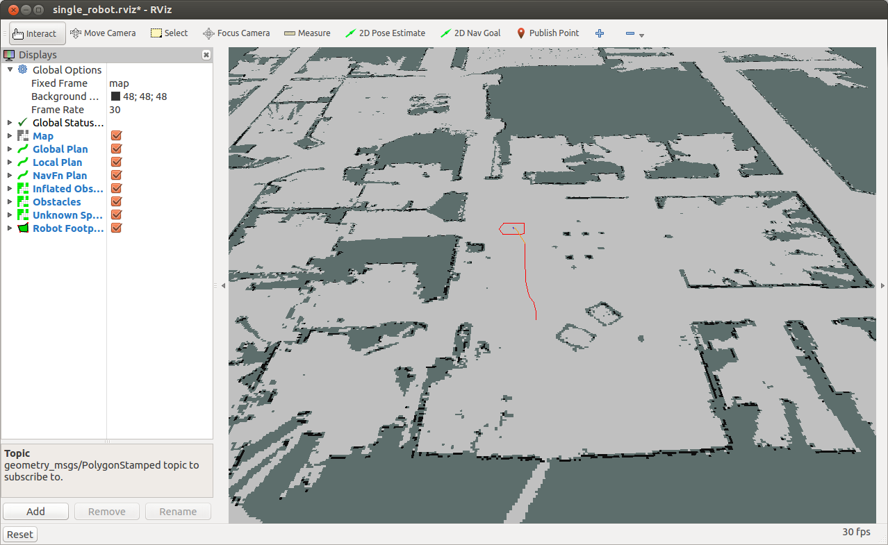
Converting Euler Angle to Quaternion

Slide 37
ROS Parameters
Now let us make the desired pose of the robot configurable in a launch file, so we can send different goals to the robot from the terminal
You can set a parameter using the <param> tag in the ROS launch file:
<launch>
<param name="goal_x" value="18.5" />
<param name="goal_y" value="27.5" />
<param name="goal_theta" value="45" />
<node name="send_goals_node" pkg="send_goals" type="send_goals_node" output="screen"/>
</launch>

Slide 38
Retrieving Parameters
There are two methods to retrieve parameters with a NodeHandle:
getParam(key, output_value)
param() is similar to getParam(), but allows you to specify a default value in the case that the parameter could not be retrieved
Example:
// Read x, y and angle params
ros::NodeHandle nh;
double x, y, theta;
nh.getParam("goal_x", x);
nh.getParam("goal_y", y);
nh.getParam("goal_theta", theta);

Slide 39
Retrieving Lists
Use the <rosparam> tag to define a parameter list:
Example of accessing the list in the code:
<rosparam param="my_list">[1, 2, 3, 4]</rosparam>
std::vector<int> my_list;
int sum = 0;
nh.getParam("my_list", my_list);
for(unsigned i = 0; i < my_list.size(); i++) {
sum += my_list[i];
}

Slide 40
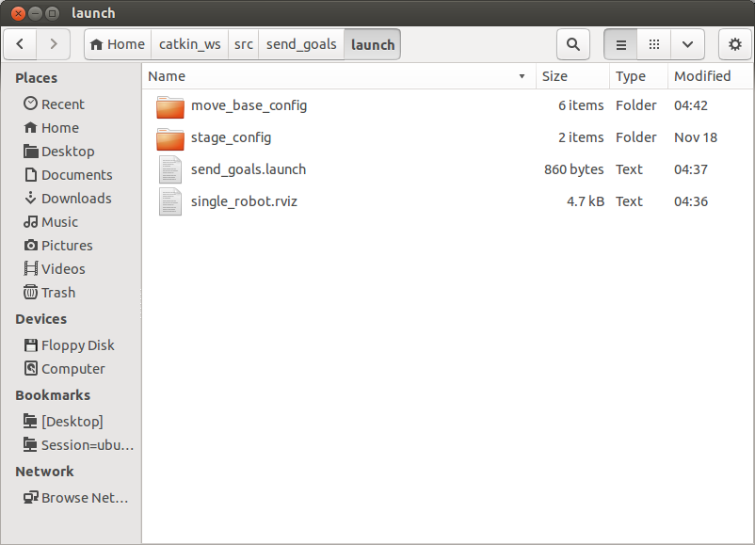
Integrating with move_base
Copy the following directories and files from the navigation_tutorials stack to the launch directory of your package:

Slide 41
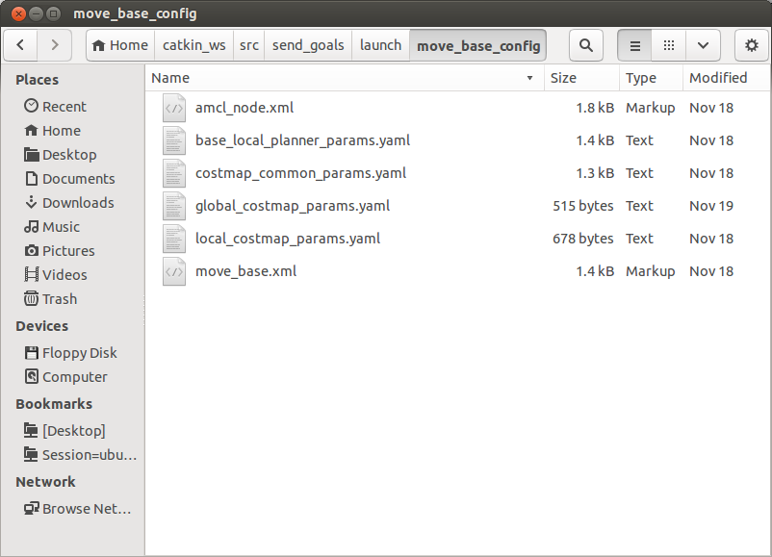
Integrating with move_base
move_base_config files:

Slide 42
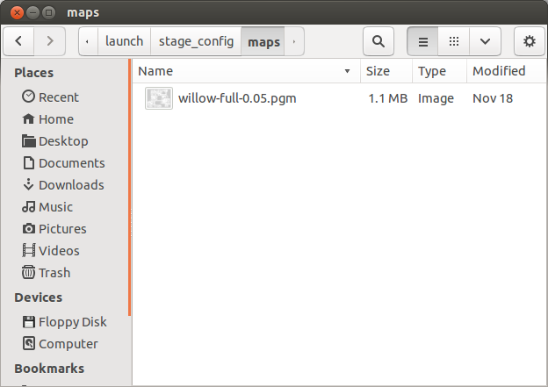
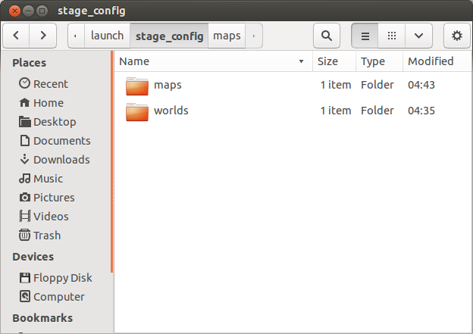
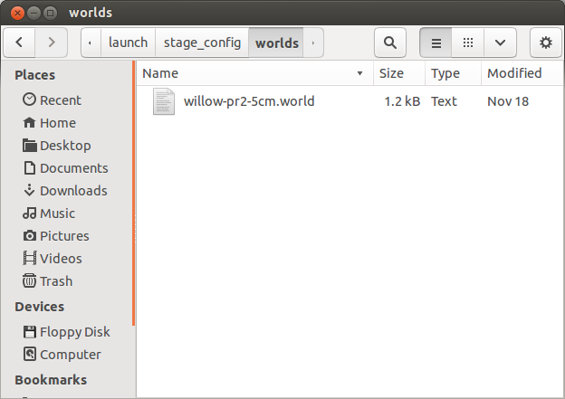
Integrating with move_base
stage_config files:

Slide 43
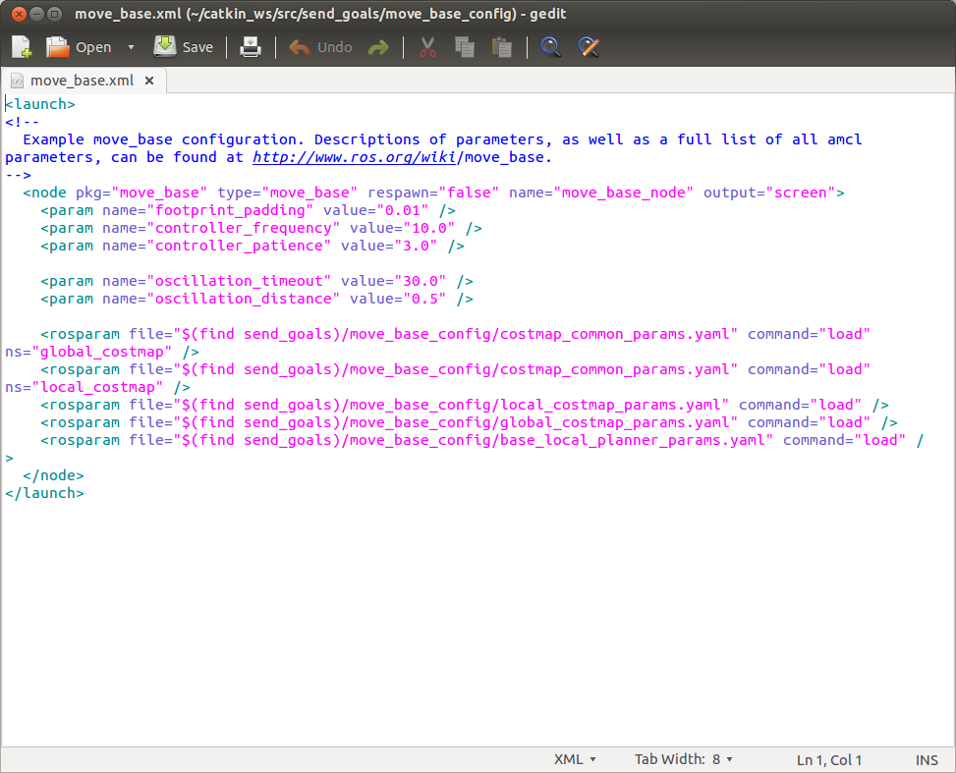
Integrating with move_base
Fix move_base.xml to use the correct package name:

Slide 44
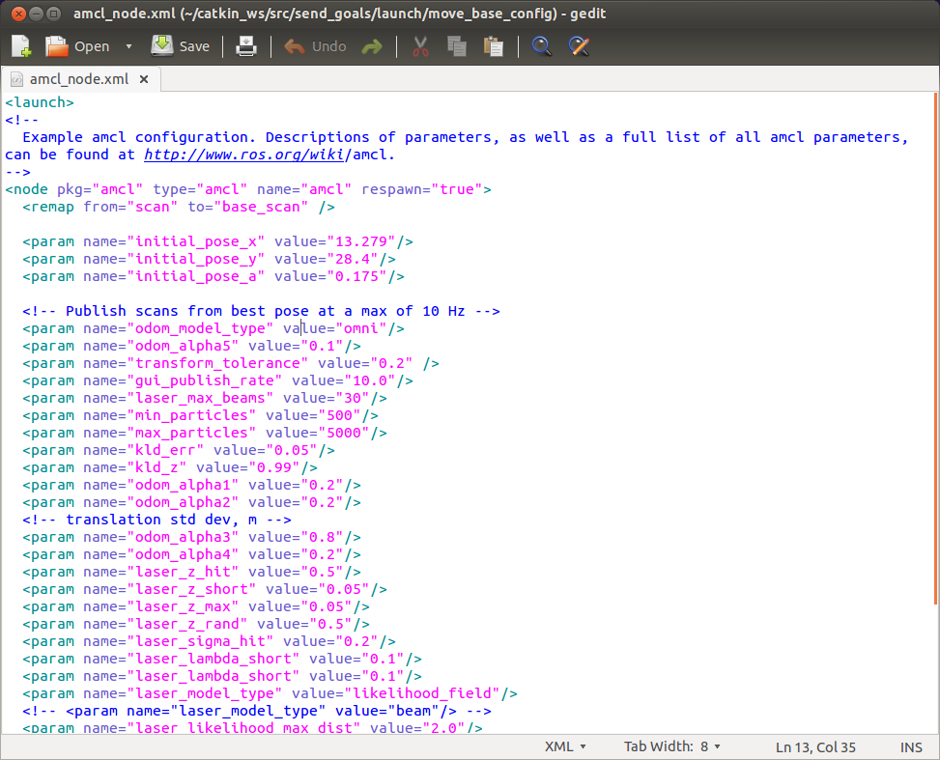
Integrating with move_base
Set the robot’s initial pose in amcl_node.xml:

Slide 45
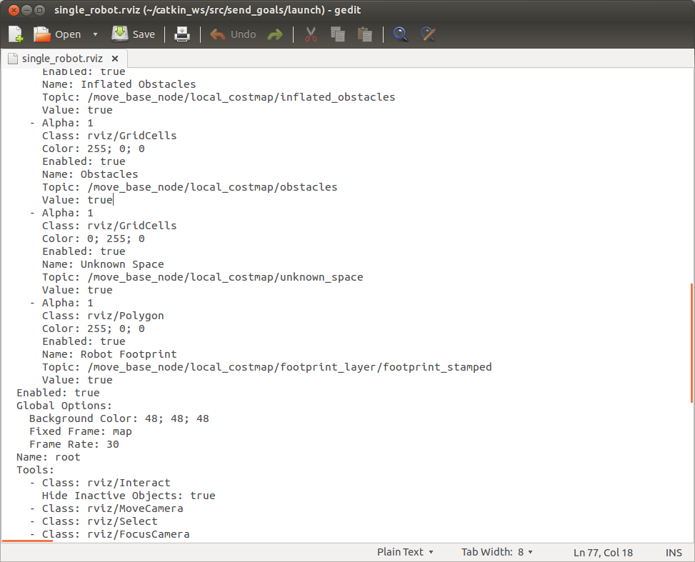
Integrating with move_base
Fix the single_robot.rviz file
Change topic name for the robot footprint

Slide 46
Integrating with move_base
Edit the send_goals.launch file:
<launch>
<param name="goal_x" value="18.5" />
<param name="goal_y" value="27.5" />
<param name="goal_theta" value="45" />
<param name="/use_sim_time" value="true"/>
<include file="$(find send_goals)/move_base_config/move_base.xml"/>
<node name="map_server" pkg="map_server" type="map_server" args="$(find send_goals)/stage_config/maps/willow-full-0.05.pgm 0.05"/>
<node pkg="stage_ros" type="stageros" name="stageros" args="$(find send_goals)/stage_config/worlds/willow-pr2-5cm.world"/>
<include file="$(find send_goals)/move_base_config/amcl_node.xml"/>
<node name="rviz" pkg="rviz" type="rviz" args="-d $(find send_goals)/single_robot.rviz" />
<node name="send_goals_node" pkg="send_goals" type="send_goals_node" output="screen"/>
</launch>

Slide 47
Run the Launch File
Launch send_goals.launch:
You should now see rviz opens and the robot moves from its initial pose to the target pose defined in the launch file
$ roslaunch send_goals send_goals.launch

Slide 48
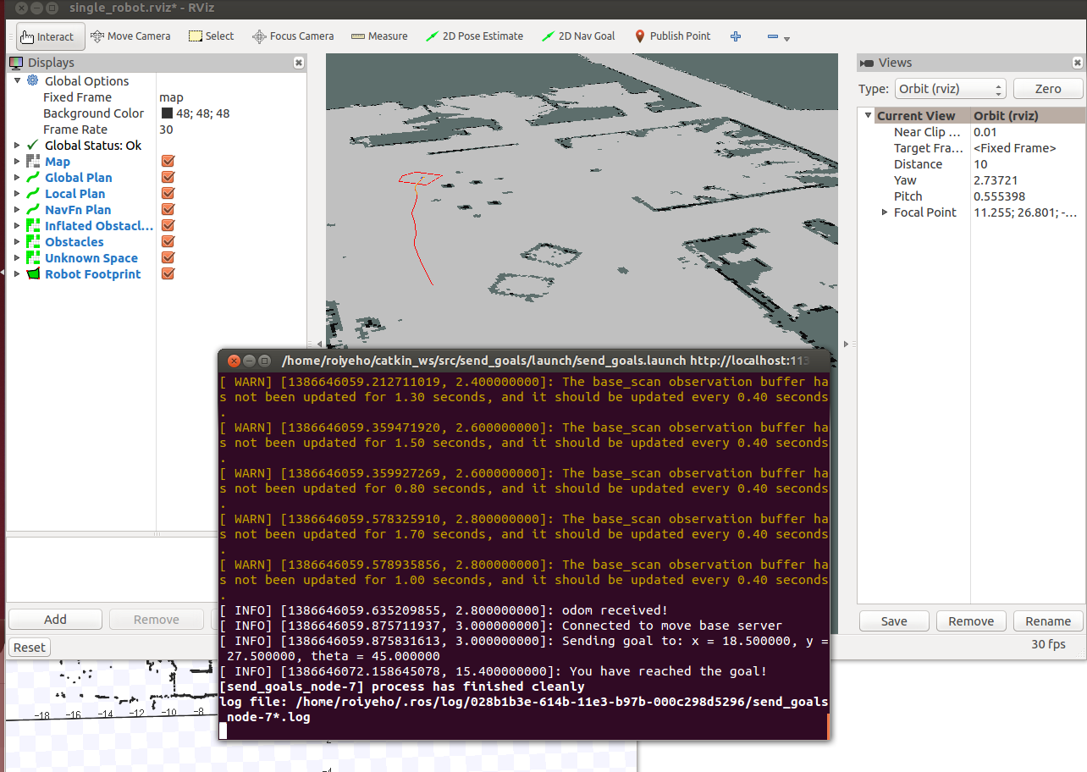
Run the Launch File

Slide 49
make_plan service
Allows an external user to ask for a plan to a given pose from move_base without causing move_base to execute that plan
Arguments:
Start pose
Goal pose
Goal tolerance
Returns:
a message of type nav_msgs/GetPlan

Slide 50
make_plan Node
In our send_goal package we will now create a make_plan_node that will call the make_plan service and print the output path of the plan
Create a new C++ file called MakePlan.cpp

Slide 51
MakePlan.cpp (1)
#include <ros/ros.h>
#include <nav_msgs/GetPlan.h>
#include <geometry_msgs/PoseStamped.h>
#include <string>
using std::string;
#include <boost/foreach.hpp>
#define forEach BOOST_FOREACH
double g_GoalTolerance = 0.5;
string g_WorldFrame = "map";
void fillPathRequest(nav_msgs::GetPlan::Request &req);
void callPlanningService(ros::ServiceClient &serviceClient, nav_msgs::GetPlan &srv);

Slide 52
MakePlan.cpp (2)
int main(int argc, char** argv)
{
ros::init(argc, argv, "make_plan_node");
ros::NodeHandle nh;
// Init service query for make plan
string service_name = "move_base_node/make_plan";
while (!ros::service::waitForService(service_name, ros::Duration(3.0))) {
ROS_INFO("Waiting for service move_base/make_plan to become available");
}
ros::ServiceClient serviceClient = nh.serviceClient<nav_msgs::GetPlan>(service_name, true);
if (!serviceClient) {
ROS_FATAL("Could not initialize get plan service from %s", serviceClient.getService().c_str());
return -1;
}
nav_msgs::GetPlan srv;
fillPathRequest(srv.request);
if (!serviceClient) {
ROS_FATAL("Persistent service connection to %s failed", serviceClient.getService().c_str());
return -1;
}
callPlanningService(serviceClient, srv);
}

Slide 53
MakePlan.cpp (3)
void fillPathRequest(nav_msgs::GetPlan::Request &request)
{
request.start.header.frame_id = g_WorldFrame;
request.start.pose.position.x = 12.378;
request.start.pose.position.y = 28.638;
request.start.pose.orientation.w = 1.0;
request.goal.header.frame_id = g_WorldFrame;
request.goal.pose.position.x = 18.792;
request.goal.pose.position.y = 29.544;
request.goal.pose.orientation.w = 1.0;
request.tolerance = g_GoalTolerance;
}

Slide 54
MakePlan.cpp (4)
void callPlanningService(ros::ServiceClient &serviceClient, nav_msgs::GetPlan &srv)
{
// Perform the actual path planner call
if (serviceClient.call(srv)) {
if (!srv.response.plan.poses.empty()) {
forEach(const geometry_msgs::PoseStamped &p, srv.response.plan.poses) {
ROS_INFO("x = %f, y = %f", p.pose.position.x, p.pose.position.y);
}
}
else {
ROS_WARN("Got empty plan");
}
}
else {
ROS_ERROR("Failed to call service %s - is the robot moving?", serviceClient.getService().c_str());
}
}

Slide 55
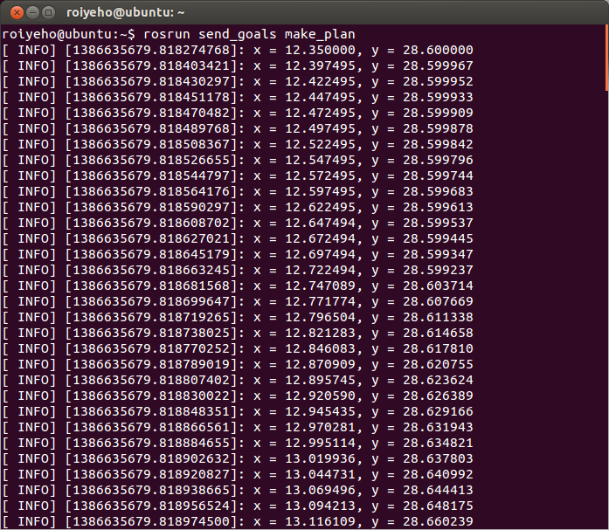
Running make_plan Node

Slide 56
Homework (for submission)
Create a patrol bot program
Read assignment details at http://u.cs.biu.ac.il/~yehoshr1/89-685/assignment2/assignment2.html

