Slide 1
A Tale of Three Optimizers
AIGC 5500 0NA | Advanced Deep Learning
Team: HawkAI Detection
Kevin Joseff Cabrera
Mohd Mujtaba Saighani
Thiago Segantini Nogueira
Sayamon Sittiprom
Yao-Fu Yang

Slide 2
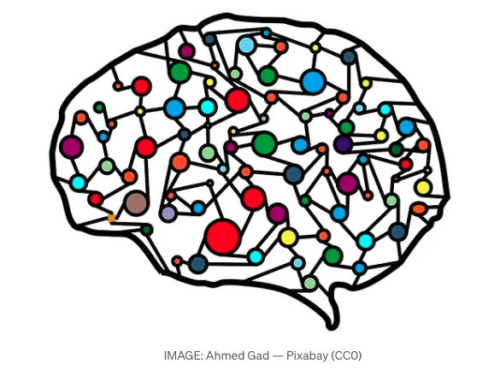
Introduction
Our journey thus far…
Input Standardization
Weight Initialization
Batch Normalization
Dropout Layers
Hidden Layers & Dimensions
Activation Functions
Learning Rate
Etc.
Next Up…
Optimizers
HPO
Cross-Validation

Slide 3
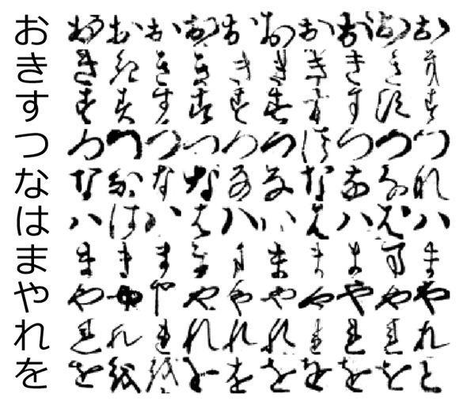
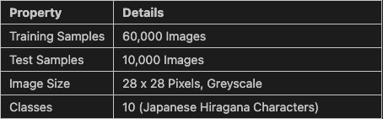
Dataset

Slide 4
Model Architecture
Input Layer | Input Standardization; Flatten 1D; 784 Features
H1 | 128 Neurons; He Init; BatchNorm; ReLU; Dropout
H2 | 64 Neurons; He Init; BatchNorm; ReLU; Dropout
Output | Xavier Init; 10 Neurons
KMNIST 28 x 28 Greyscale

Slide 5
Optimizers
RMSProp
Root Mean Square Propagation
Jeffrey Hinton during a lecture, 2012
SGD & ADA with improved learning rate
Sliding window for past gradients
Adam
ADAptive Moment Estimation
Kingma & Ba, 2015
RMSProp with improved momentum
Uses the mean of the gradients as momentum
AdamW
ADAM with decoupled Weight Decay
Loschilov & Hutter, 2017
AdamW with improved weight decay
Adds weight decay calculation after weight scaling
✅ Datasets with rough loss gradients
❌Lags at datasets with smoother gradients
✅ Versatile, well-rounded algorithm
❌ Limited by its weight decay calculation
✅ Enhanced Weight Generalization
❌ 2x the memory usage

Slide 6
Common Parameters
Learning Rate (lr)
Model Learning Rate
Decay Rate (Alpha (α), Betas (β2))
Historic Gradient scaling rate
Momentum (momentum, Betas (β1))
Historic Gradient adjustment rate
Epsilon (eps, ε)
Prevents zero division during gradient calculation
Weight Decay (weight_decay)
Weight adjustment penalization

Slide 7
Algorithm-specific Parameters
RMSProp
Centered (centered)
Applies a normalization to the gradients using variance estimation
Extra gradient calculation = more stable updates but more training time
Adam
Decoupled Weight Decay (decoupled_weight_decay)
Uses the exact decoupled weight decay mechanism AdamW does
Added as an update 2019 onward after AdamW was established for backward compatibility
AdamW
Maximize (maximize)
Maximizes the losses instead of minimizing it (edge case)
Differentiable (differentiable)
Enables or disables autograd during training
Backpropagates the optimizer math (autograd)
Capturable (capturable)
Moves the tracking values operations into the GPU

Slide 8


Methodology Strategy & Validation Protocol
Systematic Tuning: Employed a manual stepping approach for continuous/discrete variables, varying one parameter at a time from baseline defaults.
Optuna Integration: Leveraged automated continuous random sampling within defined parameter ranges specifically for RMSprop configurations.
5-Fold Cross-Validation: Partitioned the KMNIST set using sklearn's KFold to ensure robust performance metrics and prevent overfitting.
State Isolation: Maintained absolute independence by instantiating fresh model weights and fixed random seeds per CV iteration.

Slide 9



Methodology Execution & Training Pipeline
Epoch Processing
Configuration Trials
Final Evaluation
Engineered isolated functions for forward passing. Training modes handled loss, gradients, and weight updates, while evaluation modes generated clean metrics without modifying parameters.
Built a reusable execution loop accepting optimizer types and configuration lists. Each permutation underwent strict validation to empirically identify the highest-performing parameters.
The optimal configurations for Adam, AdamW, and RMSprop executed a final 20-epoch training cycle against the entirely withheld KMNIST test dataset to synthesize final performance.

Slide 10
Results
Optimizer | Train Acc | CV Mean | CV STD | Test Acc | Train Loss | Test Loss | Convergence | Time(s)
RMSprop (best) | 95.32 | 0.9575 | 0.0016 | 89.53 | 0.1456 | 0.3977 | 1 | 241
Adam (best) | 95.27 | 0.956 | 0.0016 | 89.69 | 0.1461 | 0.3702 | 1 | 247
AdamW (best) | 95.78 | 0.9564 | 0.0015 | 89.67 | 0.1302 | 0.3768 | 1 | 243

Slide 11
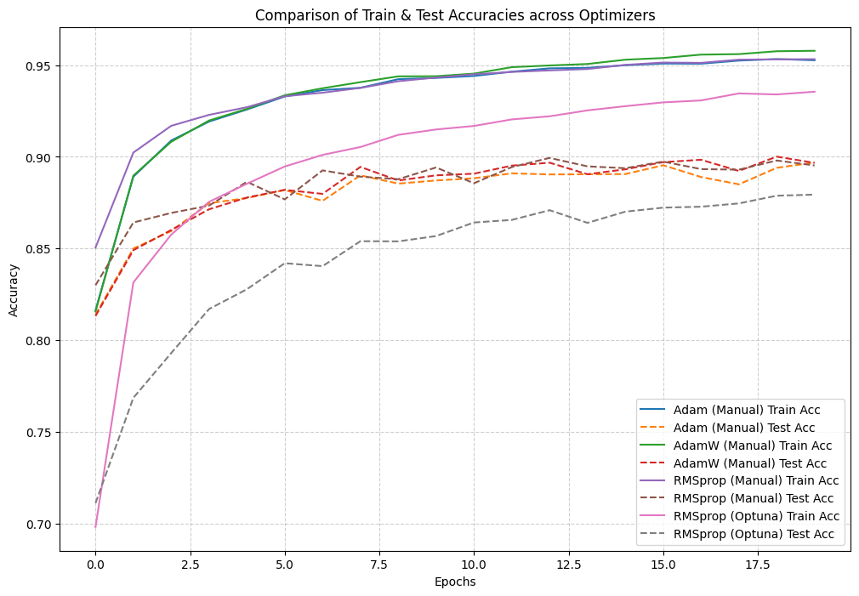
Results

Slide 12
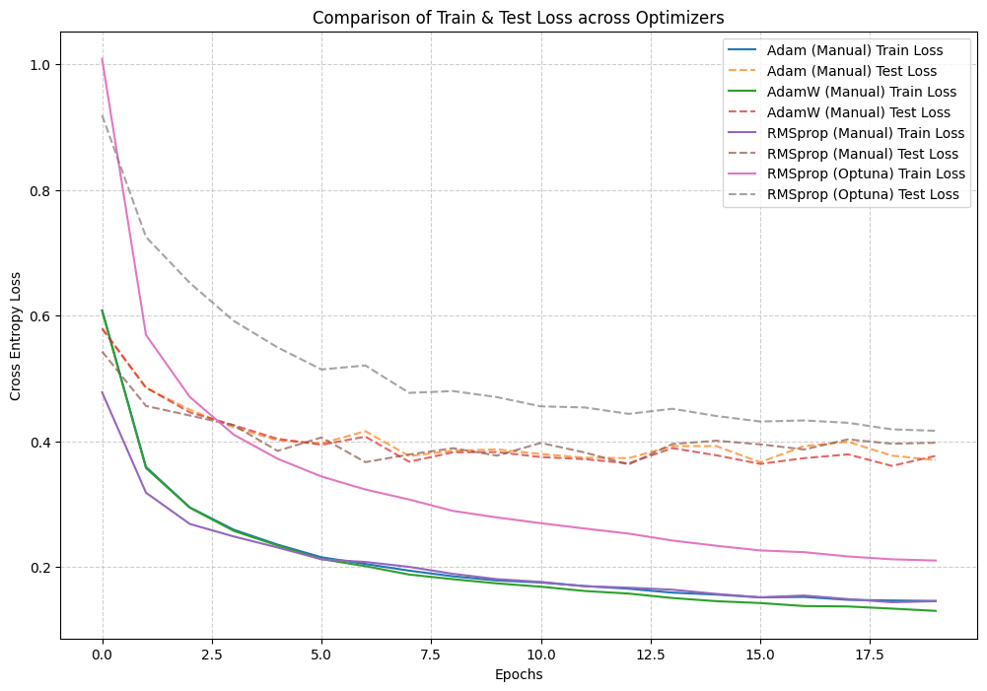
Results

Slide 13
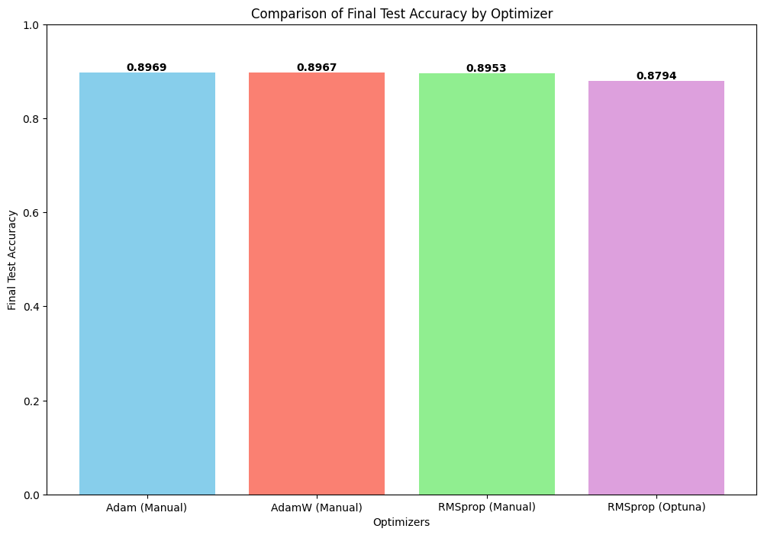
Results

Slide 14
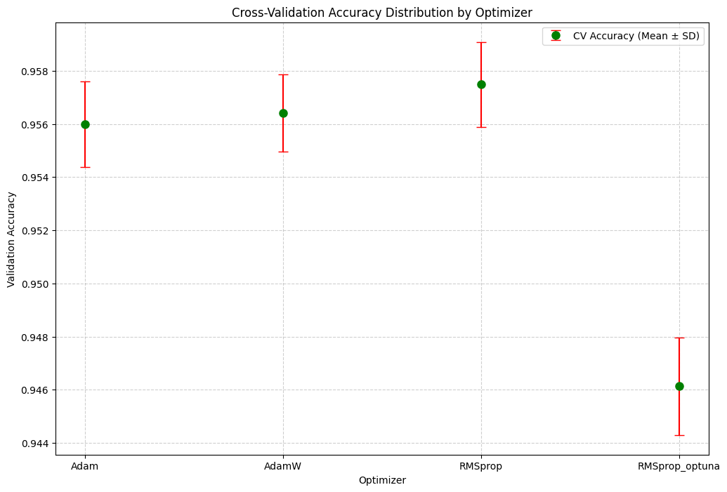
Interpretation & Discussion
Adam, AdamW, and RMSprop (manual) performed virtually the same (~89.5–89.7% test accuracy) — among well-tuned adaptive optimizers, model design mattered more than optimizer choice
Optuna underperformed not due to a weaker algorithm, but because 5 trials and 20 epochs were insufficient for its search space — it was still converging when training stopped
Given more trials and epochs, automated tuning has the potential to match or exceed manual search without relying on domain knowledge

Slide 15
Conclusion
Adam, AdamW, and RMSprop (manual) reached virtually the same accuracy (~89.5–89.7%) — making RMSprop (manual) or AdamW the practical default for this type of task
Optuna's lower score reflects a budget limitation, not a weaker algorithm — 5 trials across a 5-parameter space was too few; re-running with more trials and epochs would make the comparison fair

Slide 16
Limitations & Next Steps
More standardized HPO approach
Increased Epochs for Clearer Patterns
More Complex Datasets

Slide 17
References
Kingma, D. P., & Ba, J. (2015). Adam: A method for stochastic optimization. Proceedings of the 3rd International Conference on Learning Representations (ICLR 2015). https://arxiv.org/abs/1412.6980
Loshchilov, I., & Hutter, F. (2019). Decoupled weight decay regularization. Proceedings of the 7th International Conference on Learning Representations (ICLR 2019). https://arxiv.org/abs/1711.05101
Tieleman, T., & Hinton, G. (2012). Lecture 6.5 - RMSProp. COURSERA: Neural Networks for Machine Learning. https://www.cs.toronto.edu/~tijmen/csc321/slides/lecture_slides_lec6.pdf
Clanuwat, T., Bober-Irizar, M., Kitamoto, A., Lamb, A., Yamamoto, K., & Ha, D. (2018). Deep learning for classical Japanese literature. NeurIPS 2018 Workshop on Machine Learning for Creativity and Design. https://arxiv.org/abs/1812.01718
RMSProp Documentation, pytorch.org https://docs.pytorch.org/docs/2.12/generated/torch.optim.RMSprop.html
RMSProp Optimizer in Deep Learning, geeksforgeeks.org, https://www.geeksforgeeks.org/deep-learning/rmsprop-optimizer-in-deep-learning/
Lecture Notes, Hinton, G. (2012). Lecture 6e, Coursera. https://www.cs.toronto.edu/~tijmen/csc321/slides/lecture_slides_lec6.pdf
Generating Sequences with Recurrent Neural Networks, Alex Graves, Department of Computer Science University of Toronto https://arxiv.org/pdf/1308.0850v5
Understanding Loss Surfaces, apxml.com, https://apxml.com/courses/optimization-techniques-ml/chapter-1-ml-optimization-foundations-review/loss-surface-analysis
PyTorch. (n.d.). AdamW — PyTorch 2.12 documentation. PyTorch Foundation. Retrieved June 21, 2026, from https://docs.pytorch.org/docs/2.12/generated/torch.optim.AdamW.html

Slide 18

Questions

