Slide 1
Lecture 1:
Course Introduction
Guo, Yao

Slide 2
Outline
Course Overview
  Course Topics
  Course Requirements
  Grading
Preparation Materials
  Compiler Review
  Program Analysis Basics
Fall 2011
“Advanced Compiler Techniques”

Slide 3
Course Overview
Graduate level compiler course
  Focusing on advanced materials on program analysis and optimization.
  Assuming that you have basic knowledge & techniques on compiler construction.
  Gain hands-on experience through a programming project to implement a specific program analysis or optimization technique.
Course website:
  http://sei.pku.edu.cn/~yaoguo/ACT11
Fall 2011
“Advanced Compiler Techniques”

Slide 4
Administrivia
Time: 9-12 (6:40pm-) every Thursday
Location: 2-413
TA: TBD
Office Hour: 4-5:30pm Tuesdays
  or by appointment thru email
Contact:
  Phone: 6275-3496
  Email: yaoguo@sei.pku.edu.cn
    Include [ACT11] in the subject.

Slide 5
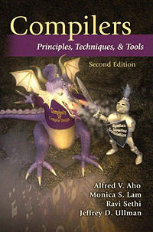
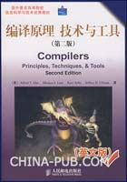
Course Materials
Dragon Book
  Aho, Lam, Sethi, Ullman, “Compilers: Principles, Techniques, and Tools”, 2nd ed, Addison 2007
Related Papers
  Class website
Fall 2011
“Advanced Compiler Techniques”

Slide 6
Requirements
Basic Requirements
  Read materials before/after class.
  Work on your homework individually.
    Discussions are encouraged but don’t copy others’ work.
  Get you hands dirty!
    Experiment with ideas presented in class and gain first-hand knowledge!
  Come to class and DON’T hesitate to speak if you have any questions/comments/suggestions!
  Student participation is important!
Fall 2011
“Advanced Compiler Techniques”

Slide 7
Grading
Grading based on
  Homework: 20%
    ~5 homework assignments
  Midterm: 30%
    Week 10 or 11 (Nov 10/17)
  Final Project: 40%
  Class participation: 10%
Fall 2011
“Advanced Compiler Techniques”

Slide 8
Final Project
Groups of 2-3 students
  Pair Programming recommended!
Topic
  Problem of your choice (recommend project list will be provided)
  Should be an interesting enough (non-trivial) problem
Suggested environment
  Soot (McGill Univ.)
  Joeq, IBM Jikes, SUIF, gcc, etc.
Fall 2011
“Advanced Compiler Techniques”

Slide 9
Project Req.
Week 5: Introduction
Week 7: Proposal due
Week 8: Proposal Presentation
Week 13: Progress Report due
Week 16: Final Presentation
Week 17: Final Report due
Fall 2011
“Advanced Compiler Techniques”

Slide 10
Course Topics
Basic analyses & optimizations
  Data flow analysis & implementation
  Control flow analysis
  SSA form & its application
  Pointer analysis
  Instruction scheduling
  Localization & Parallelization optimization
Selected topics (TBD)
  Program slicing, program testing
  Power-aware Compilation
  GPU Optimization
Fall 2011
“Advanced Compiler Techniques”

Slide 11
About You!
Fall 2011
“Advanced Compiler Techniques”

Slide 12
Compiler Review

Slide 13
What is a Compiler?
A program that translates a program in one language to another language
  The essential interface between applications & architectures
Typically lowers the level of abstraction
  analyzes and reasons about the program & architecture
We expect the program to be optimized, i.e., better than the original
  ideally exploiting architectural strengths and hiding weaknesses
Fall 2011
“Advanced Compiler Techniques”

Slide 14
Compiler vs. Interpreter (1/5)
Compilers: Translate a source (human-writable) program to an executable (machine-readable) program
Interpreters: Convert a source program and execute it at the same time.
Fall 2011
“Advanced Compiler Techniques”

Slide 15
Compiler vs. Interpreter (2/5)
  Ideal concept:
Source code
Compiler
Executable
Input data
Executable
Output data
Source code
Interpreter
Output data
Input data
Fall 2011
“Advanced Compiler Techniques”

Slide 16
Compiler vs. Interpreter (3/5)
Most languages are usually thought of as using either one or the other:
  Compilers: FORTRAN, COBOL, C, C++, Pascal, PL/1
  Interpreters: Lisp, scheme, BASIC, APL, Perl, Python, Smalltalk
BUT: not always implemented this way
  Virtual Machines (e.g., Java)
  Linking of executables at runtime
  JIT (Just-in-time) compiling
Fall 2011
“Advanced Compiler Techniques”

Slide 17
Compiler vs. Interpreter (4/5)
Actually, no sharp boundary between them. General situation is a combo:
Source code
Translator
Intermed. code
Intermed. code
Virtual machine
Output
Input Data
Fall 2011
“Advanced Compiler Techniques”

Slide 18
Compiler vs. Interpreter (5/5)
Compiler
Pros
  Less space
  Fast execution
Cons
  Slow processing
    Partly Solved
    (Separate compilation)
  Debugging
    Improved thru IDEs
Interpreter
Pros
  Easy debugging
  Fast Development
Cons
  Not for large projects
    Exceptions: Perl, Python
  Requires more space
  Slower execution
    Interpreter in memory all the time
Fall 2011
“Advanced Compiler Techniques”

Slide 19
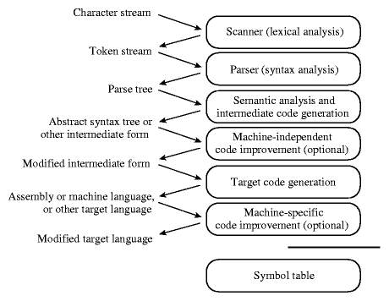
Phase of compilations
Fall 2011
“Advanced Compiler Techniques”

Slide 20
Scanning/Lexical analysis
Break program down into its smallest meaningful symbols (tokens, atoms)
Tools for this include lex, flex
Tokens include e.g.:
  “Reserved words”: do if float while
  Special characters: ( { , + - = ! /
  Names & numbers: myValue 3.07e02
Start symbol table with new symbols found
Fall 2011
“Advanced Compiler Techniques”

Slide 21
Parsing
Construct a parse tree from symbols
A pattern-matching problem
  Language grammar defined by set of rules that identify legal (meaningful) combinations of symbols
  Each application of a rule results in a node in the parse tree
  Parser applies these rules repeatedly to the program until leaves of parse tree are “atoms”
If no pattern matches, it’s a syntax error
yacc, bison are tools for this (generate c code that parses specified language)
Fall 2011
“Advanced Compiler Techniques”

Slide 22
Parse tree
Output of parsing
Top-down description of program syntax
  Root node is entire program
Constructed by repeated application of rules in Context Free Grammar (CFG)
Leaves are tokens that were identified during lexical analysis
Fall 2011
“Advanced Compiler Techniques”

Slide 23
Example:
Parsing rules for Pascal
These are like the following:
program PROGRAM identifier (identifier more_identifiers) ; block .
more_identifiers , identifier more_identifiers | ε
block variables BEGIN statement more_statements END
statement do_statement | if_statement | assignment | …
if_statement IF logical_expression THEN statement ELSE …
Fall 2011
“Advanced Compiler Techniques”

Slide 24
Pascal code example
program gcd (input, output)
var i, j : integer
begin
read (i , j)
while i <> j do
if i>j then i := i – j;
else j := j – i ;
writeln (i);
end .
Fall 2011
“Advanced Compiler Techniques”

Slide 25
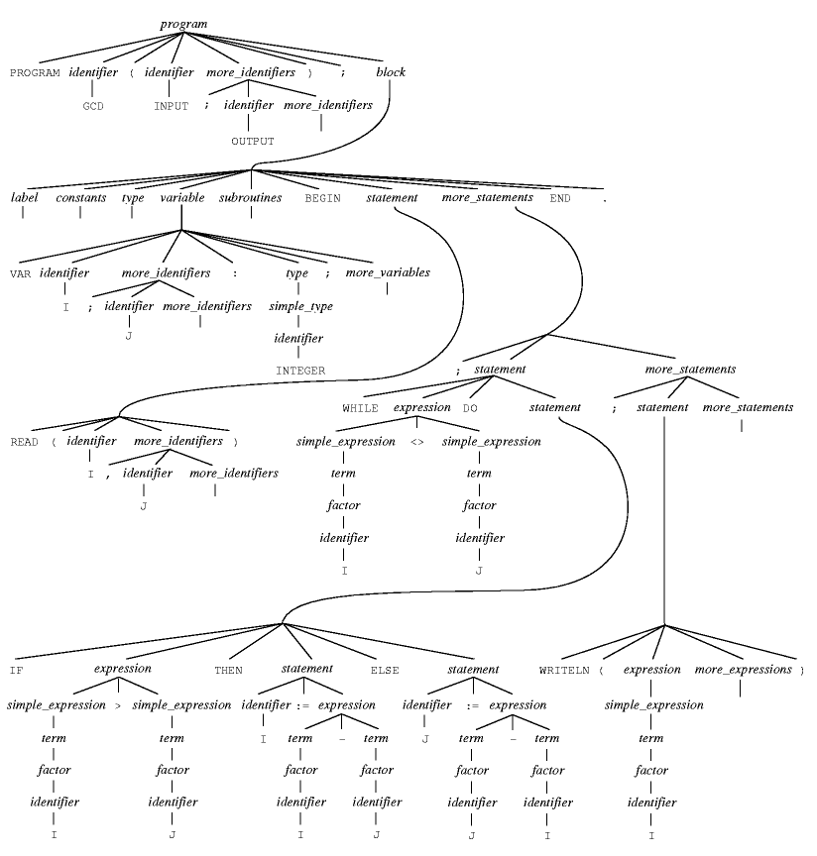
Example: parse tree
Fall 2011
“Advanced Compiler Techniques”

Slide 26
Semantic analysis
Discovery of meaning in a program using the symbol table
  Do static semantics check
  Simplify the structure of the parse tree ( from parse tree to abstract syntax tree (AST) )
Static semantics check
  Making sure identifiers are declared before use
  Type checking for assignments and operators
  Checking types and number of parameters to subroutines
  Making sure functions contain return statements
  Making sure there are no repeats among switch statement labels
Fall 2011
“Advanced Compiler Techniques”

Slide 27
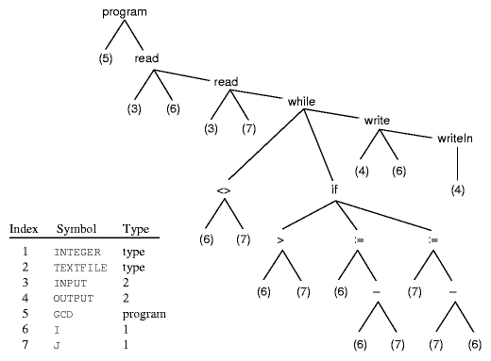
Example: AST
Fall 2011
“Advanced Compiler Techniques”

Slide 28
(Intermediate) Code generation
Go through the parse tree from bottom up, turning rules into code.
e.g.
  A sum expression results in the code that computes the sum and saves the result
Result: inefficient code in a machine-independent language
Fall 2011
“Advanced Compiler Techniques”

Slide 29
Machine independent optimization
Perform various transformations that improve the code, e.g.
  Find and reuse common subexpressions
  Take calculations out of loops if possible
  Eliminate redundant operations
Fall 2011
“Advanced Compiler Techniques”

Slide 30
Target code generation
Convert intermediate code to machine instructions on intended target machine
Determine storage addresses for entries in symbol table
Fall 2011
“Advanced Compiler Techniques”

Slide 31
Machine-dependent optimization
Make improvements that require specific knowledge of machine architecture, e.g.
  Optimize use of available registers
  Reorder instructions to avoid waits
Fall 2011
“Advanced Compiler Techniques”

Slide 32
When should we compile?
Ahead-of-time: before you run the program
Offline profiling: compile several times
compile/run/profile.... then run again
Just-in-time: while you run the program required for dynamic class loading, i.e., Java, Python, etc.
Fall 2011
“Advanced Compiler Techniques”

Slide 33
Aren’t compilers a solved problem?
“Optimization for scalar machines is a problem that was solved ten years ago.”
-- David Kuck, Fall 1990
Fall 2011
“Advanced Compiler Techniques”

Slide 34
Aren’t compilers a solved problem?
“Optimization for scalar machines is a problem that was solved ten years ago.”
-- David Kuck, Fall 1990
Architectures keep changing
Languages keep changing
Applications keep changing - SPEC CPU?
When to compile keeps changing
Fall 2011
“Advanced Compiler Techniques”

Slide 35
Role of compilers
Bridge complexity and evolution in architecture, languages, & applications
Help programs with correctness, reliability, program understanding
Compiler optimizations can significantly improve performance
  1 to 10x on conventional processors
Performance stability: one line change can dramatically alter performance
  unfortunate, but true
Fall 2011
“Advanced Compiler Techniques”

Slide 36
Performance Anxiety
But does performance really matter?
  Computers are really fast
  Moore’s law (roughly):
  hardware performance doubles every 18 months
Real bottlenecks lie elsewhere:
  Disk
  Network
  Human! (think interactive apps)
    Human typing avg. 8 cps (max 25 cps)
    Waste time “thinking”
Fall 2011
“Advanced Compiler Techniques”

Slide 37
Compilers Don’t Help Much
Do compilers improve performance anyway?
  Proebsting’s law
  (Todd Proebsting, Microsoft Research):
    Difference between optimizing and non-optimizing compiler ~ 4x
    Assume compiler technology represents 36 years of progress (actually more)
  Compilers double program performance every 18 years!
    Not quite Moore’s Law…
Fall 2011
“Advanced Compiler Techniques”

Slide 38
A Big BUT
Why use high-level languages anyway?
  Easier to write & maintain
  Safer (think Java)
  More convenient (think libraries, GC…)
But: people will not accept massive performance hit for these gains
  Compile with optimization!
  Still use C and C++!!
  Hand-optimize their code!!!
  Even write assembler code (gasp)!!!!
Apparently performance does matter…
Fall 2011
“Advanced Compiler Techniques”

Slide 39
Why Compilers Matter
Key part of compiler’s job:
make the costs of abstraction reasonable
  Remove performance penalty for:
    Using objects
    Safety checks (e.g., array-bounds)
    Writing clean code (e.g., recursion)
Use program analysis to transform code: primary topic of this course
Fall 2011
“Advanced Compiler Techniques”

Slide 40
Program Analysis
Source code analysis is the process of extracting information about a program from its source code or artifacts (e.g., from Java byte code or execution traces) generated from the source code using automatic tools.
  Source code is any static, textual, human readable, fully executable description of a computer program that can be compiled automatically into an executable form.
  To support dynamic analysis the description can include documents needed to execute or compile the program, such as program inputs.
  Source: Dave Binkely-”Source Code Analysis – A Roadmap”, FOSE’07
Fall 2011
“Advanced Compiler Techniques”

Slide 41
Anatomy of an Analysis
Parser
  parses the source code into one or more internal representations.
Internal representation
  CFG, call graph, AST, SSA, VDG, FSA
  Most common: Graphs
Actual Analysis
Fall 2011
“Advanced Compiler Techniques”

Slide 42
Analysis Properties
Static vs. Dynamic
Sound vs. unsound
  Safe vs. Unsafe
Flow sensitive vs. Flow insensitive
Context sensitive vs. Context insensitive
Precision-Cost trade-off
Fall 2011
“Advanced Compiler Techniques”
Notes:
A deductive system is sound with respect to a given semantics if it proves valid arguments only.
So, a sound analysis makes correctness guarantees. Sound static analyses produce information
that is guaranteed to hold on all program executions; sound dynamic analyses produce information
that is guaranteed to hold for the analyzed execution alone.
Unsound analyses make no such guarantees. A sound analysis for determining the potential
values of global variables might, for example, use pointer analysis to ensure that it correctly
models the effect of indirect assignments that take place via pointers to global variables. An
unsound analysis might simply scan the program to locate and analyze only assignments that
use global variables directly, by name. Because such an analysis ignores the effects of indirect
assignments, it may fail to compute all of the potential values of global variables.
It can be strange why an engineer will be interested in unsound analysis. However, in many
cases, the information from an unsound analysis is correct, and even when incorrect, it may
provide a useful starting point for further investigation. Unsound analyses are therefore often
quite useful for those faced with the task of understanding and maintaining legacy code.
The most important advantages of unsound analyses, however, are their ease of implementation
and efficiency. An unsound analysis may thus be able to analyze programs that are simply
beyond the reach of the corresponding sound analysis, and may be implemented with a small
fraction of the implementation time and effort required for the sound analysis. These pointsjustify the continuing importance of unsound analyses.
A slightly different concept from sound analysis is the notion of safe analysis. Qualifying a
static analysis as safe means that the answer is precise on “one side”.
Safe also means conservative.

Slide 43
Levels of Analysis
(in order of increasing detail & complexity)
Local (single-block) [1960’s]
  Straight-line code
  Simple to analyze; limited impact
Global (Intraprocedural) [1970’s – today]
  Whole procedure
  Dataflow & dependence analysis
Interprocedural [late 1970’s – today]
  Whole-program analysis
  Tricky:
    Very time and space intensive
    Hard for some PL’s (e.g., Java)
Fall 2011
“Advanced Compiler Techniques”

Slide 44
Optimization =
Analysis + Transformation
Key analyses:
  Control-flow
    if-statements, branches, loops, procedure calls
  Data-flow
    definitions and uses of variables
Representations:
  Control-flow graph
  Control-dependence graph
  Def/use, use/def chains
  SSA (Static Single Assignment)
Fall 2011
“Advanced Compiler Techniques”

Slide 45
Applications
architecture recovery
clone detection
program comprehension
debugging
fault location
model checking in formal analysis
model-driven development
optimization techniques in software engineering
reverse engineering
software maintenance
visualizations of analysis results
etc. etc.
Fall 2011
“Advanced Compiler Techniques”

Slide 46
Current Challenges
Pointer Analysis
Concurrent Program Analysis
Dynamic Analysis
Information Retrieval
Data Mining
Multi-Language Analysis
Non-functional Properties
Self-Healing Systems
Real-Time Analysis
Fall 2011
“Advanced Compiler Techniques”

Slide 47
Exciting times
New and changing architectures
  Hitting the microprocessor wall
  Multicore/manycore
  Tiled architectures, tiled memory systems
Object-oriented languages becoming dominant paradigm
  Java and C# coming to your OS soon - Jnode, Singularity
  Security and reliability, ease of programming
Key challenges and approaches
  Latency & parallelism still key to performance
  Language & runtime implementation efficiency
  Software/hardware cooperation is another key issue
Feedback
H/S Profiling
Programmer
Code
Compiler
Code
Runtime
Specification
Future behavior
Fall 2011
“Advanced Compiler Techniques”

Slide 48
Next Time
Control-Flow Analysis
Local Optimizations
Data-Flow Analysis Basics
Read
  Dragonbook: §8.4-8.5, §9.1-9.2
Fall 2011
“Advanced Compiler Techniques”

