Slide 1
Parallelism &
Locality Optimization

Slide 2
Outline
Data dependences
Loop transformation
Software prefetching
Software pipelining
Optimization for many-core
Fall 2011
“Advanced Compiler Techniques”

Slide 3
Data Dependences and Parallelization

Slide 4
Motivation
DOALL loops: loops whose iterations can execute in parallel
New abstraction needed
  Abstraction used in data flow analysis is inadequate
    Information of all instances of a statement is combined
for i = 11, 20
a[i] = a[i] + 3
Fall 2011
“Advanced Compiler Techniques”

Slide 5
Examples
for i = 11, 20
a[i] = a[i] + 3
Parallel
for i = 11, 20
a[i] = a[i-1] + 3
Parallel?
Fall 2011
“Advanced Compiler Techniques”

Slide 6
Examples
for i = 11, 20
a[i] = a[i] + 3
Parallel
for i = 11, 20
a[i] = a[i-1] + 3
Not parallel
for i = 11, 20
a[i] = a[i-10] + 3
Parallel?
Fall 2011
“Advanced Compiler Techniques”

Slide 7
Data Dependence of Scalar Variables
True dependence
Anti-dependence
Output dependence
Input dependence
a =
= a
a =
a =
= a
a =
= a
= a
Fall 2011
“Advanced Compiler Techniques”

Slide 8
Array Accesses in a Loop
for i= 2, 5
a[i] = a[i] + 3
a[2]
a[3]
a[4]
a[5]
read
a[2]
a[3]
a[4]
a[5]
write
Fall 2011
“Advanced Compiler Techniques”

Slide 9
Array Anti-dependence
for i= 2, 5
a[i-2] = a[i] + 3
a[2]
a[3]
a[4]
a[5]
read
a[0]
a[1]
a[2]
a[3]
write
Fall 2011
“Advanced Compiler Techniques”

Slide 10
Array True-dependence
for i= 2, 5
a[i] = a[i-2] + 3
a[0]
a[1]
a[2]
a[3]
read
a[2]
a[3]
a[4]
a[5]
write
Fall 2011
“Advanced Compiler Techniques”

Slide 11
Dynamic Data Dependence
Let o and o’ be two (dynamic) operations
Data dependence exists from o to o’, iff
  either o or o’ is a write operation
  o and o’ may refer to the same location
  o executes before o’
Fall 2011
“Advanced Compiler Techniques”

Slide 12
Static Data Dependence
Let a and a’ be two static array accesses (not necessarily distinct)
Data dependence exists from a to a’, iff
  either a or a’ is a write operation
  There exists a dynamic instance of a (o) and a dynamic instance of a’ (o’) such that
    o and o’ may refer to the same location
    o executes before o’
Fall 2011
“Advanced Compiler Techniques”

Slide 13
Recognizing DOALL Loops
Find data dependences in loop
Definition: a dependence is loop-carried if it crosses an iteration boundary
If there are no loop-carried dependences then loop is parallelizable
Fall 2011
“Advanced Compiler Techniques”

Slide 14
Compute Dependence
for i= 2, 5
a[i-2] = a[i] + 3
There is a dependence between a[i] and a[i-2] if
  There exist two iterations i_{r} and i_{w} within the loop bounds such that iterations i_{r} and i_{w} read and write the same array element, respectively
  There exist i_{r}, i_{w} , 2 ≤ i_{r}, i_{w} ≤ 5, i_{r} = i_{w} -2
Fall 2011
“Advanced Compiler Techniques”

Slide 15
Compute Dependence
for i= 2, 5
a[i-2] = a[i] + 3
There is a dependence between a[i-2] and a[i-2] if
  There exist two iterations i_{v} and i_{w} within the loop bounds such that iterations i_{v} and i_{w} write the same array element, respectively
  There exist i_{v}, i_{w} , 2 ≤ i_{v} , i_{w} ≤ 5, i_{v} -2= i_{w} -2
Fall 2011
“Advanced Compiler Techniques”

Slide 16
Parallelization
for i= 2, 5
a[i-2] = a[i] + 3
Is there a loop-carried dependence between a[i] and a[i-2]?
Is there a loop-carried dependence between a[i-2] and a[i-2]?
Fall 2011
“Advanced Compiler Techniques”

Slide 17
Nested Loops
Which loop(s) are parallel?
for i1 = 0, 5
for i2 = 0, 3
a[i1,i2] = a[i1-2,i2-1] + 3
Fall 2011
“Advanced Compiler Techniques”

Slide 18
Iteration Space
An abstraction for loops
Iteration is represented as coordinates in iteration space.
for i1 = 0, 5
for i2 = 0, 3
a[i1,i2] = 3
i2
i1
Fall 2011
“Advanced Compiler Techniques”

Slide 19
Execution Order
Sequential execution order of iterations: Lexicographic order [0,0], [0,1], …[0,3], [1,0], [1,1], …[1,3], [2,0]…
Let I = (i₁,i₂,… i_{n}). I is lexicographically less than I’, I<I’, iff there exists k such that (i₁,… i_{k-1}) = (i’₁,… i’_{k-1}) and i_{k} < i’_{k}
i₂
i₁
Fall 2011
“Advanced Compiler Techniques”

Slide 20
Parallelism for Nested Loops
Is there a data dependence between a[i1,i2] and a[i1-2,i2-1]?
  There exist i1_{r}, i2_{r}, i1_{w}, i2_{w}, such that
  0 ≤ i1_{r}, i1_{w} ≤ 5,
  0 ≤ i2_{r}, i2_{w} ≤ 3,
  i1_{r} - 2 = i1_{w}
  i2_{r} - 1 = i2_{w}
Fall 2011
“Advanced Compiler Techniques”

Slide 21
Loop-carried Dependence
If there are no loop-carried dependences, then loop is parallelizable.
Dependence carried by outer loop:
  i1_{r} ≠ i1_{w}
Dependence carried by inner loop:
  i1_{r} = i1_{w}
  i2_{r} ≠ i2_{w}
This can naturally be extended to dependence carried by loop level k.
Fall 2011
“Advanced Compiler Techniques”

Slide 22
Nested Loops
Which loop carries the dependence?
for i1 = 0, 5
for i2 = 0, 3
a[i1,i2] = a[i1-2,i2-1] + 3
i2
i1
Fall 2011
“Advanced Compiler Techniques”

Slide 23
Solving Data Dependence Problems
Memory disambiguation is un-decidable at compile-time.
read(n)
for i = 0, 3
a[i] = a[n] + 3
Fall 2011
“Advanced Compiler Techniques”

Slide 24
Domain of Data Dependence Analysis
Only use loop bounds and array indices which are integer linear functions of variables.
for i1 = 1, n
for i2 = 2*i1, 100
a[i1+2*i2+3][4*i1+2*i2][i1*i1] = …
… = a[1][2*i1+1][i2] + 3
Fall 2011
“Advanced Compiler Techniques”

Slide 25
Equations
There is a data dependence, if
  There exist i1_{r}, i2_{r}, i1_{w}, i2_{w}, such that
  0 ≤ i1_{r}, i1_{w} ≤ n, 2*i1_{r} ≤ i2_{r} ≤ 100, 2*i1_{w} ≤ i2_{w} ≤ 100,
  i1_{w} + 2*i2_{w} +3 = 1, 4*i1_{w} + 2*i2_{w} = 2*i1_{r} + 1
Note: ignoring non-affine relations
for i1 = 1, n
for i2 = 2*i1, 100
a[i1+2*i2+3][4*i1+2*i2][i1*i1] = …
… = a[1][2*i1+1][i2] + 3
Fall 2011
“Advanced Compiler Techniques”

Slide 26
Solutions
There is a data dependence, if
  There exist i1_{r}, i2_{r}, i1_{w}, i2_{w}, such that
  0 ≤ i1_{r}, i1_{w} ≤ n, 2*i1_{w} ≤ i2_{w} ≤ 100, 2*i1_{w} ≤ i2_{w} ≤ 100,
  i1_{w} + 2*i2_{w} +3 = 1, 4*i1_{w} + 2*i2_{w} - 1 = i1_{r} + 1
No solution → No data dependence
Solution → there may be a dependence
Fall 2011
“Advanced Compiler Techniques”

Slide 27

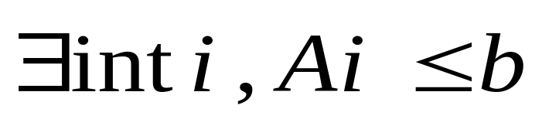
Form of Data Dependence Analysis
Eliminate equalities in the problem statement:
  Replace a =b with two sub-problems: a≤b and b≤a
  We get
Integer programming is NP-complete, i.e. Expensive
Fall 2011
“Advanced Compiler Techniques”

Slide 28
Techniques: Inexact Tests
Examples: GCD test, Banerjee’s test
2 outcomes
  No → no dependence
  Don’t know → assume there is a solution → dependence
Extra data dependence constraints
Sacrifice parallelism for compiler efficiency
Fall 2011
“Advanced Compiler Techniques”

Slide 29
GCD Test
Is there any dependence?
Solve a linear Diophantine equation
  2*i_{w} = 2*i_{r} + 1
for i = 1, 100
a[2*i] = …
… = a[2*i+1] + 3
Fall 2011
“Advanced Compiler Techniques”
Notes:
Diophantine 丢番图
Diophantine 方程是指未知数只取整数值的代数多项式方程

Slide 30
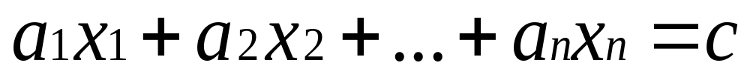
GCD
The greatest common divisor (GCD) of integers a₁, a₂, …, a_{n}, denoted gcd(a₁, a₂, …, a_{n}), is the largest integer that evenly divides all these integers.
Theorem: The linear Diophantine equation
has an integer solution x₁, x₂, …, x_{n} iff gcd(a₁, a₂, …, a_{n}) divides c
Fall 2011
“Advanced Compiler Techniques”

Slide 31
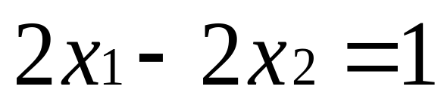
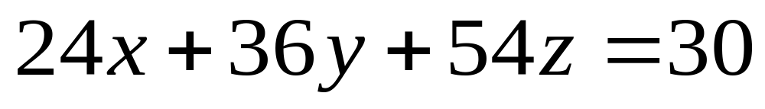
Examples
Example 1: gcd(2,-2) = 2. No solutions
Example 2: gcd(24,36,54) = 6. Many solutions
Fall 2011
“Advanced Compiler Techniques”

Slide 32
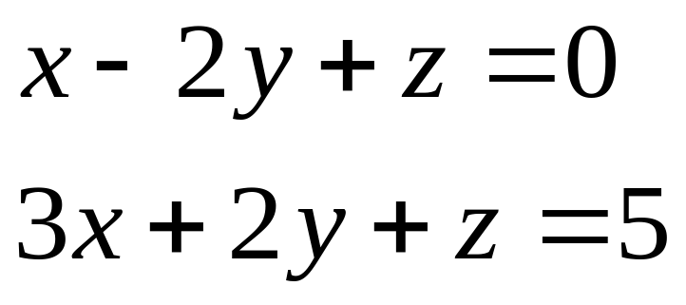
Multiple Equalities
Equation 1: gcd(1,-2,1) = 1. Many solutions
Equation 2: gcd(3,2,1) = 1. Many solutions
Is there any solution satisfying both equations?
Fall 2011
“Advanced Compiler Techniques”

Slide 33
The Euclidean Algorithm
Assume a and b are positive integers, and a > b.
Let c be the remainder of a/b.
  If c=0, then gcd(a,b) = b.
  Otherwise, gcd(a,b) = gcd(b,c).
gcd(a₁, a₂, …, a_{n}) = gcd(gcd(a₁, a₂), a₃ …, a_{n})
Fall 2011
“Advanced Compiler Techniques”

Slide 34
Exact Analysis
Most memory disambiguations are simple integer programs.
Approach: Solve exactly – yes, or no solution
  Solve exactly with Fourier-Motzkin + branch and bound
  Omega package from University of Maryland
Fall 2011
“Advanced Compiler Techniques”

Slide 35
Incremental Analysis
Use a series of simple tests to solve simple programs (based on properties of inequalities rather than array access patterns)
Solve exactly with Fourier-Motzkin + branch and bound
Memoization
  Many identical integer programs solved for each program
  Save the results so it need not be recomputed
Fall 2011
“Advanced Compiler Techniques”

Slide 36
Loop Transformations and Locality

Slide 37
Memory Hierarchy
CPU
C
C
Cache
Memory
Fall 2011
“Advanced Compiler Techniques”

Slide 38
Cache Locality
Suppose array A has column-major layout
A[1,1] | A[2,1] | … | A[1,2] | A[2,2] | … | A[1,3] | …
for i = 1, 100
for j = 1, 200
A[i, j] = A[i, j] + 3
end_for
end_for
Loop nest has poor spatial cache locality.
Fall 2011
“Advanced Compiler Techniques”

Slide 39
Loop Interchange
Suppose array A has column-major layout
A[1,1] | A[2,1] | … | A[1,2] | A[2,2] | … | A[1,3] | …
for i = 1, 100
for j = 1, 200
A[i, j] = A[i, j] + 3
end_for
end_for
for j = 1, 200
for i = 1, 100
A[i, j] = A[i, j] + 3
end_for
end_for
New loop nest has better spatial cache locality.
Fall 2011
“Advanced Compiler Techniques”

Slide 40
Interchange Loops?
for i = 2, 100
for j = 1, 200
A[i, j] = A[i-1, j+1]+3
end_for
end_for
j
i
e.g. dependence from (3,3) to (4,2)
Fall 2011
“Advanced Compiler Techniques”

Slide 41
Dependence Vectors
Distance vector (1,-1) = (4,2)-(3,3)
Direction vector (+, -) from the signs of distance vector
Loop interchange is not legal if there exists dependence (+, -)
j
i
Fall 2011
“Advanced Compiler Techniques”

Slide 42
Loop Fusion
for i = 1, 1000
A[i] = B[i] + 3
end_for
for j = 1, 1000
C[j] = A[j] + 5
end_for
for i = 1, 1000
A[i] = B[i] + 3
C[i] = A[i] + 5
end_for
Better reuse between A[i] and A[i]
Fall 2011
“Advanced Compiler Techniques”

Slide 43
Loop Distribution
for i = 1, 1000
A[i] = A[i-1] + 3
end_for
for i = 1, 1000
C[i] = B[i] + 5
end_for
for i = 1, 1000
A[i] = A[i-1] + 3
C[i] = B[i] + 5
end_for
2nd loop is parallel
Fall 2011
“Advanced Compiler Techniques”

Slide 44
Register Blocking
for j = 1, 2*m, 2
for i = 1, 2*n, 2
A[i, j] = A[i-1,j] + A[i-1,j-1]
A[i, j+1] = A[i-1,j+1] + A[i-1,j]
A[i+1, j] = A[i, j] + A[i, j-1]
A[i+1, j+1] = A[i, j+1] + A[i, j]
end_for
end_for
for j = 1, 2*m
for i = 1, 2*n
A[i, j] = A[i-1, j] + A[i-1, j-1]
end_for
end_for
Better reuse between A[i,j] and A[i,j]
Fall 2011
“Advanced Compiler Techniques”

Slide 45
Virtual Register Allocation
for j = 1, 2*M, 2
for i = 1, 2*N, 2
r1 = A[i-1,j]
r2 = r1 + A[i-1,j-1]
A[i, j] = r2
r3 = A[i-1,j+1] + r1
A[i, j+1] = r3
A[i+1, j] = r2 + A[i, j-1]
A[i+1, j+1] = r3 + r2
end_for
end_for
Memory operations reduced to register load/store
8MN loads to 4MN loads
Fall 2011
“Advanced Compiler Techniques”

Slide 46
Scalar Replacement
t1 = A[1]
for i = 2, N+1
= t1 + 1
t1 =
A[i] = t1
end_for
for i = 2, N+1
= A[i-1]+1
A[i] =
end_for
Eliminate loads and stores for array references
Fall 2011
“Advanced Compiler Techniques”

Slide 47
Large Arrays
Suppose arrays A and B have row-major layout
for i = 1, 1000
for j = 1, 1000
A[i, j] = A[i, j] + B[j, i]
end_for
end_for
B has poor cache locality.
Loop interchange will not help.
Fall 2011
“Advanced Compiler Techniques”

Slide 48
Loop Blocking
for v = 1, 1000, 20
for u = 1, 1000, 20
for j = v, v+19
for i = u, u+19
A[i, j] = A[i, j] + B[j, i]
end_for
end_for
end_for
end_for
Access to small blocks of the arrays has good cache locality.
Fall 2011
“Advanced Compiler Techniques”

Slide 49
Loop Unrolling for ILP
for I = 1, 10, 2
a[i] = b[i];
*p = …
a[i+1] = b[i+1];
*p = …
end_for
for i = 1, 10
a[i] = b[i];
*p = ...
end_for
Large scheduling regions. Fewer dynamic branches
Increased code size
Fall 2011
“Advanced Compiler Techniques”

Slide 50
Data Prefetching

Slide 51
Why Data Prefetching
Increasing Processor – Memory “distance”
Caches do work !!! … IF …
  Data set cache-able, accesses local (in space/time)
Else ? …
Fall 2011
“Advanced Compiler Techniques”

Slide 52
Data Prefetching
What is it ?
  Request for a future data need is initiated
  Useful execution continues during access
  Data moves from slow/far memory to fast/near cache
  Data ready in cache when needed (load/store)
Fall 2011
“Advanced Compiler Techniques”

Slide 53
Data Prefetching
When can it be used ?
  Future data needs are (somewhat) predictable
How is it implemented ?
  in hardware: history based prediction of future access
  in software: compiler inserted prefetch instructions
Fall 2011
“Advanced Compiler Techniques”

Slide 54
Software Data Prefetching
Compiler scheduled prefetches
Moves entire cache lines (not just datum)
  Spatial locality assumed – often the case
Typically a non-faulting access
  Compiler free to speculate prefetch address
Hardware not obligated to obey
  A performance enhancement, no functional impact
  Loads/store may be preferentially treated
Fall 2011
“Advanced Compiler Techniques”

Slide 55
Software Data Prefetching Use
Mostly in Scientific codes
  Vectorizable loops accessing arrays deterministically
    Data access pattern is predictable
    Prefetch scheduling easy (far in time, near in code)
  Large working data sets consumed
    Even large caches unable to capture access locality
Sometimes in Integer codes
  Loops with pointer de-references
Fall 2011
“Advanced Compiler Techniques”

Slide 56
Selective Data Prefetch
do j = 1, n
do i = 1, m
A(i,j) = B(1,i) + B(1,i+1)
enddo
enddo
E.g. A(i,j) has spatial locality, therefore only one prefetch is required for every cache line.
j
A
i
B
1
m
1
Fall 2011
“Advanced Compiler Techniques”

Slide 57
Formal Definitions
Temporal locality occurs when a given reference reuses exactly the same data location
Spatial locality occurs when a given reference accesses different data locations that fall within the same cache line
Group locality occurs when different references access the same cache line
Fall 2011
“Advanced Compiler Techniques”

Slide 58
Prefetch Predicates
If an access has spatial locality, only the first access to the same cache line will incur a miss.
For temporal locality, only the first access will incur a cache miss
If an access has group locality, only the leading reference incurs cache miss.
If an access has no locality, it will miss in every iteration.
Fall 2011
“Advanced Compiler Techniques”

Slide 59
Example Code with Prefetches
do j = 1, n
do i = 1, m
A(i,j) = B(1,i) + B(1,i+1)
if (iand(i,7) == 0)
prefetch (A(i+k,j))
if (j == 1)
prefetch (B(1,i+t))
enddo
enddo
j
A
i
B
1
m
1
Assumed CLS = 64 bytes and data size = 8 bytes
k and t are prefetch distance values
Fall 2011
“Advanced Compiler Techniques”

Slide 60
Spreading of Prefetches
If there is more than one reference that has spatial locality within the same loop nest, spread these prefetches across the 8-iteration window
Reduces the stress on the memory subsystem by minimizing the number of outstanding prefetches
Fall 2011
“Advanced Compiler Techniques”

Slide 61
Example Code with Spreading
j
do j = 1, n
do i = 1, m
C(i,j) = D(i-1,j) + D(i+1,j)
if (iand(i,7) == 0)
prefetch (C(i+k,j))
if (iand(i,7) == 1)
prefetch (D(i+k+1,j))
enddo
enddo
C, D
i
Assumed CLS = 64 bytes and data size = 8 bytes
k is the prefetch distance value
Fall 2011
“Advanced Compiler Techniques”

Slide 62
Prefetch Strategy - Conditional
Example loop
  L:
  Load A(I)
  Load B(I)
  ...
  I = I + 1
  Br L, if I<n
Conditional Prefetching
  L:
  Load A(I)
  Load B(I)
  Cmp pA=(I mod 8 == 0)
  if(pA) prefetch A(I+X)
  Cmp pB=(I mod 8 == 1)
  If(pB) prefetch B(I+X)
  ...
  I = I + 1
  Br L, if I<n
Code for condition generation
Prefetches occupy issue slots
Fall 2011
“Advanced Compiler Techniques”

Slide 63
Prefetch Strategy - Unroll
Example loop
  L:
  Load A(I)
  Load B(I)
  ...
  I = I + 1
  Br L, if I<n
Unrolled
  Unr_Loop:
  prefetch A(I+X)
  load A(I)
  load B(I)
  ...
  prefetch B(I+X)
  load A(I+1)
  load B(I+1)
  ...
  prefetch C(I+X)
  load A(I+2)
  load B(I+2)
  ...
  prefetch D(I+X)
  load A(I+3)
  load B(I+3)
  ...
  prefetch E(I+X)
  load A(I+4)
  load B(I+4)
  ...
  load A(I+5)
  load B(I+5)
  ...
  load A(I+6)
  load B(I+6)
  ...
  load A(I+7)
  load B(I+7)
  ...
  I = I + 8
  Br Unr_Loop, if I<n
Code bloat (>8X)
Remainder loop
Fall 2011
“Advanced Compiler Techniques”

Slide 64
Software Data Prefetching Cost
Requires memory instruction resources
  A prefetch instruction for each access stream
Issues every iteration, but needed less often
  If branched around, inefficient execution results
  If conditionally executed, more instruction overhead results
  If loop is unrolled, code bloat results
Fall 2011
“Advanced Compiler Techniques”

Slide 65
Software Data Prefetching Cost
Redundant prefetches get in the way
  Resources consumed until prefetches discarded!
Non redundant need careful scheduling
  Resources overwhelmed when many issued & miss
Redundant prefetches increases power/energy consumption
Fall 2011
“Advanced Compiler Techniques”

Slide 66
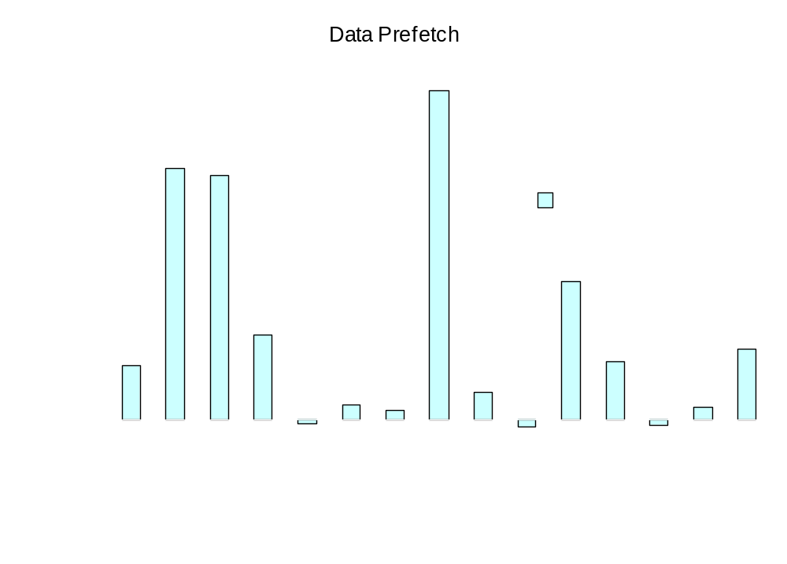
Measurements – SPECfp2000
Fall 2011
“Advanced Compiler Techniques”

Slide 67
References
References for compiler-based data prefetching:
  Todd Mowry, Monica Lam, Anoop Gupta, “Design and evaluation of a compiler algorithm for prefetching”, in ASPLOS’92, http://citeseer.ist.psu.edu/mowry92design.html.
  Gautam Doshi, Rakesh Krishnaiyer, Kalyan Muthukumar, “Optimizing Software Data Prefetches with Rotating Registers”, in PACT’01, http://citeseer.ist.psu.edu/670603.html.
Fall 2011
“Advanced Compiler Techniques”

Slide 68
Software Pipelining

Slide 69
Software Pipelining
Obtain parallelism by executing iterations of a loop in an overlapping way.
We’ll focus on simplest case: the do-all loop, where iterations are independent.
Goal: Initiate iterations as frequently as possible.
Limitation: Use same schedule and delay for each iteration.
Fall 2011
“Advanced Compiler Techniques”

Slide 70
Machine Model
Timing parameters: LD = 2, others = 1 clock cycle.
Machine can execute one LD or ST and one arithmetic operation (including branch) at any one clock.
  I.e., we’re back to one ALU resource and one MEM resource.
Fall 2011
“Advanced Compiler Techniques”

Slide 71
Example
for (i=0; i<N; i++)
B[i] = A[i];
r9 holds 4N; r8 holds 4*i.
L: LD r1, a(r8)
nop
ST b(r8), r1
ADD r8, r8, #4
BLT r8, r9, L
Notice: data dependences
force this schedule. No
parallelism is possible.
Fall 2011
“Advanced Compiler Techniques”

Slide 72
Let’s Run 2 Iterations in Parallel
Focus on operations; worry about registers later.
LD
nop LD
ST nop
ADD ST
BLT ADD
BLT
Oops --- violates
ALU resource
constraint.
Fall 2011
“Advanced Compiler Techniques”

Slide 73
Introduce a NOP
LD
nop LD
ST nop
ADD ST
nop ADD
BLT nop
BLT
LD
nop
ST
ADD
nop
BLT
Add a third iteration.
Several resource
conflicts arise.
Fall 2011
“Advanced Compiler Techniques”

Slide 74
Is It Possible to Have an Iteration Start at Every Clock?
Hint: No.
Why?
An iteration injects 2 MEM and 2 ALU resource requirements.
  If injected every clock, the machine cannot possibly satisfy all requests.
Minimum delay = 2.
Fall 2011
“Advanced Compiler Techniques”

Slide 75
A Schedule With
Delay 2
LD
nop
nop
ST
ADD
BLT
Initialization
LD
nop
nop
ST
ADD
BLT
LD
nop
nop
ST
ADD
BLT
Identical iterations
of the loop
LD
nop
nop
ST
ADD
BLT
Coda
Fall 2011
“Advanced Compiler Techniques”

Slide 76
Assigning Registers
We don’t need an infinite number of registers.
We can reuse registers for iterations that do not overlap in time.
But we can’t just use the same old registers for every iteration.
Fall 2011
“Advanced Compiler Techniques”

Slide 77
Assigning Registers --- (2)
The inner loop may have to involve more than one copy of the smallest repeating pattern.
  Enough so that registers may be reused at each iteration of the expanded inner loop.
Our example: 3 iterations coexist, so we need 3 sets of registers and 3 copies of the pattern.
Fall 2011
“Advanced Compiler Techniques”

Slide 78
Example: Assigning Registers
Our original loop used registers:
  r9 to hold a constant 4N.
  r8 to count iterations and index the arrays.
  r1 to copy a[i] into b[i].
The expanded loop needs:
  r9 holds 12N.
  r6, r7, r8 to count iterations and index.
  r1, r2, r3 to copy certain array elements.
Fall 2011
“Advanced Compiler Techniques”

Slide 79
The Loop Body
Each register handles every
third element of the arrays.
To break the loop early
Iteration i
Iteration i + 1
Iteration i + 2
L: ADD r8,r8,#12 nop LD r3,a(r6)
BGE r8,r9,L’ ST b(r7),r2 nop
LD r1,a(r8) ADD r7,r7,#12 nop
nop BGE r7,r9,L’’ ST b(r6),r3
nop LD r2,a(r7) ADD r6,r6,#12
ST b(r8),r1 nop BLT r6,r9,L
Iteration i + 3
Iteration i + 4
L’ and L’’ are places for appropriate codas.
Fall 2011
“Advanced Compiler Techniques”

Slide 80
Cyclic Data-Dependence Graphs
We assumed that data at an iteration depends only on data computed at the same iteration.
  Not even true for our example.
    r8 computed from its previous iteration.
    But it doesn’t matter in this example.
Fixup: edge labels have two components: (iteration change, delay).
Fall 2011
“Advanced Compiler Techniques”

Slide 81
Example: Cyclic D-D Graph
(A)
LD r1,a(r8)
<1,1>
<0,2>
(A) must wait at
least one clock
after the (C) from
the previous
iteration.
(B)
ST b(r8),r1
<0,1>
(C) must wait at
least one clock
after the (B) from
the same iteration.
(C)
ADD r8,r8,#4
<0,1>
(D)
BLT r8,r9,L
Fall 2011
“Advanced Compiler Techniques”

Slide 82
Matrix of Delays
Let T be the delay between the start times of one iteration and the next.
Replace edge label <i,j> by delay j-iT.
Compute, for each pair of nodes n and m the total delay along the longest acyclic path from n to m.
Gives upper and lower bounds relating the times to schedule n and m.
Fall 2011
“Advanced Compiler Techniques”

Slide 83
Example: Delay Matrix
A
B
C
D
A
B
C
D
A
2
A
2
3
4
B
1
B
2-T
1
2
C
1-T
1
C
1-T
3-T
1
D
D
Edges
Acyclic Transitive Closure
Note: Implies T ≥ 4 (because only
one register used for loop-counting).
If T=4, then A (LD) must be 2 clocks
before B (ST). If T=5, A can be 2-3
clocks before B.
S(B) ≥ S(A)+2
S(A) ≥ S(B)+2-T
S(B)-2 ≥ S(A) ≥ S(B)+2-T
Fall 2011
“Advanced Compiler Techniques”

Slide 84
Iterative Modulo Scheduling
Compute the lower bounds (MII) on the delay between the start times of one iteration and the next (initiation interval, aka II)
  due to resources
  due to recurrences
Try to find a schedule for II = MII
If no schedule can be found, try a larger II.
Fall 2011
“Advanced Compiler Techniques”

Slide 85
Compiler Optimization for Many-core
Adapted from David I. August’s Slides at “Many-core computing workshop 2008”

Slide 86
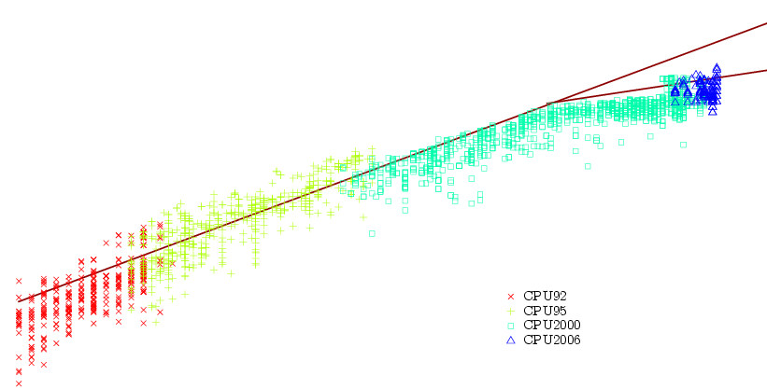
THIS is the Problem!
?
2004
SPEC CPU INTEGER PERFORMANCE
TIME
Fall 2011
“Advanced Compiler Techniques”

Slide 87
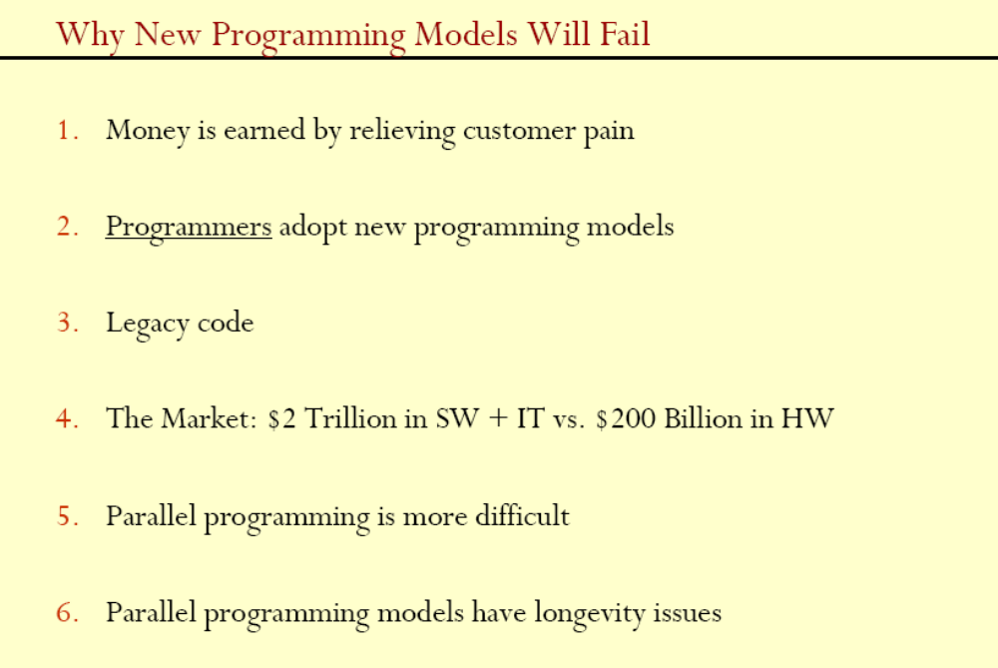
Fall 2011
“Advanced Compiler Techniques”

Slide 88
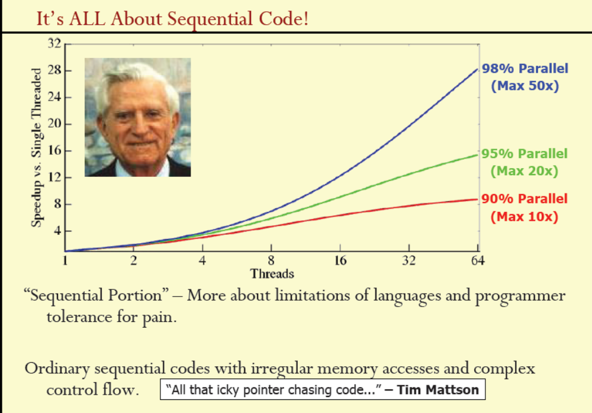
Fall 2011
“Advanced Compiler Techniques”
Notes:
Pictured: Amdahl
Tim Mattson: Intel Researcher.

Slide 89
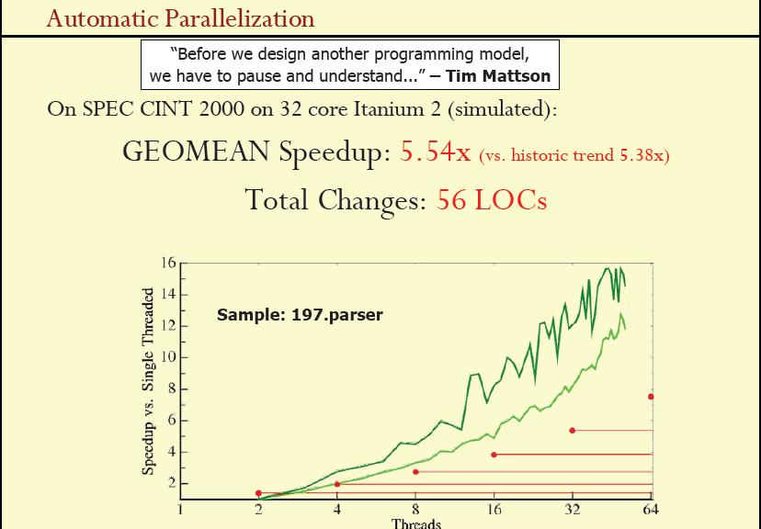
Fall 2011
“Advanced Compiler Techniques”

Slide 90
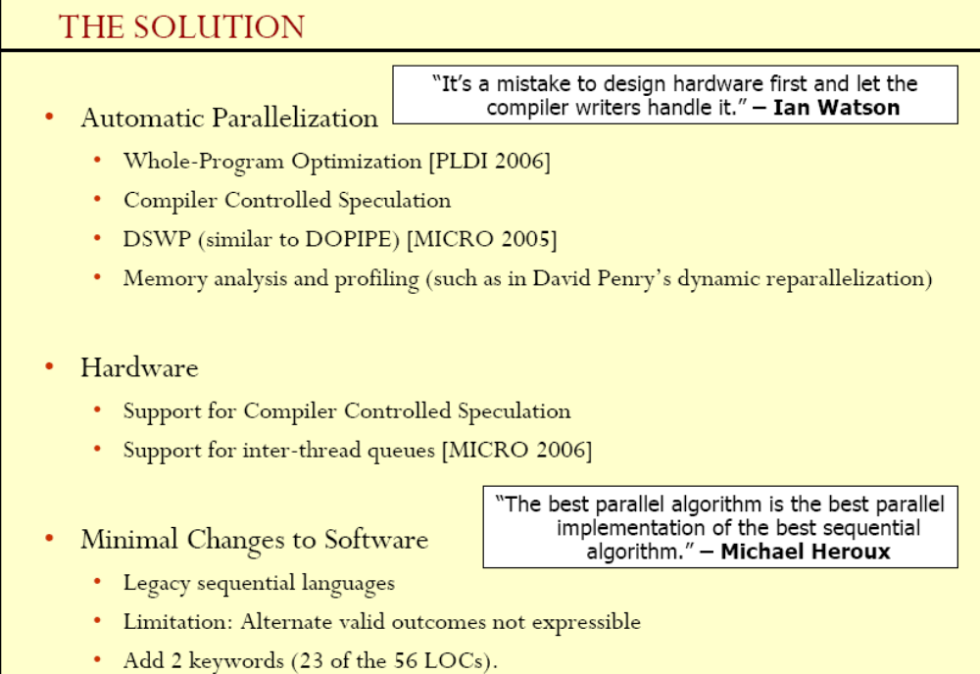
Fall 2011
“Advanced Compiler Techniques”
Notes:
ian watson: british computer scientist, professor, U Manchester
Michael Heroux: Research, US Sandia National Lab

Slide 91
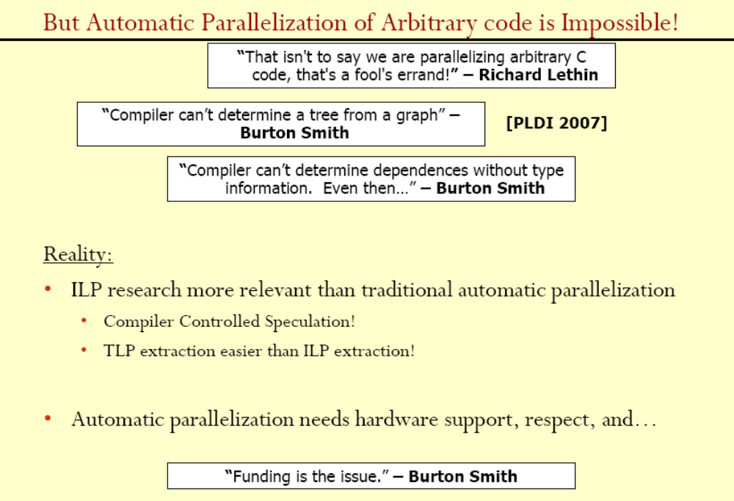
Fall 2011
“Advanced Compiler Techniques”
Notes:
Richard Lethin: President at Reservoir Labs, Inc. Adjunct Associate Professor at Yale University
Burton Smith: MS fellow

Slide 92
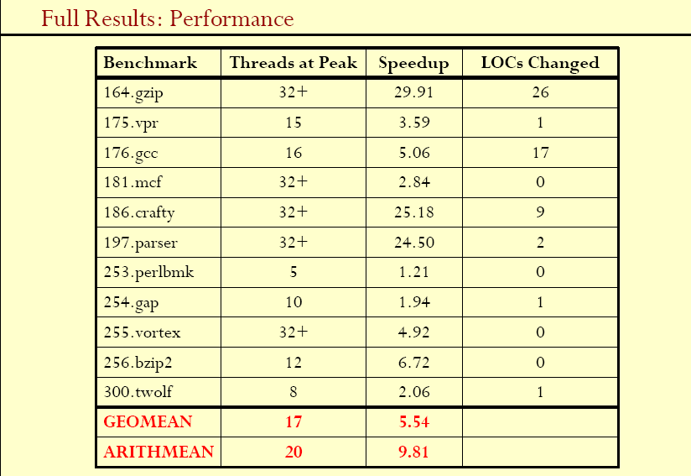
Fall 2011
“Advanced Compiler Techniques”

Slide 93
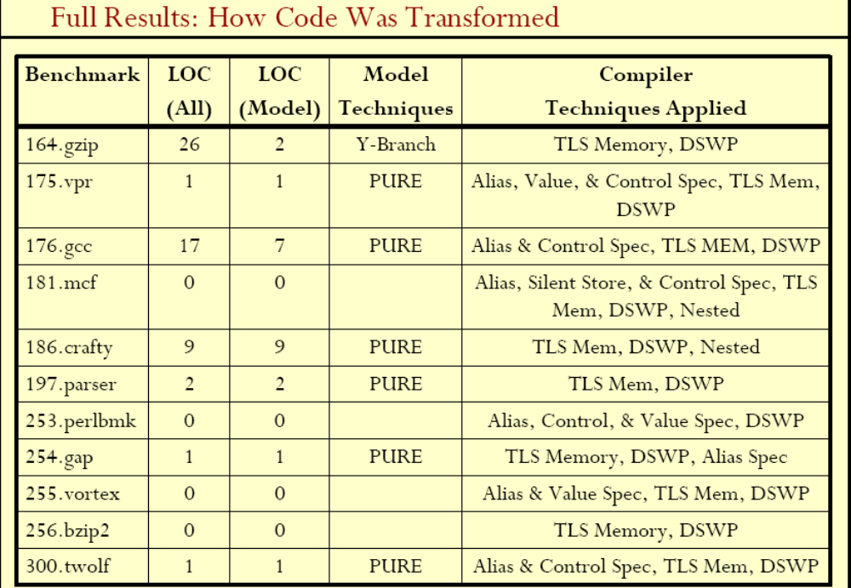
Fall 2011
“Advanced Compiler Techniques”

Slide 94
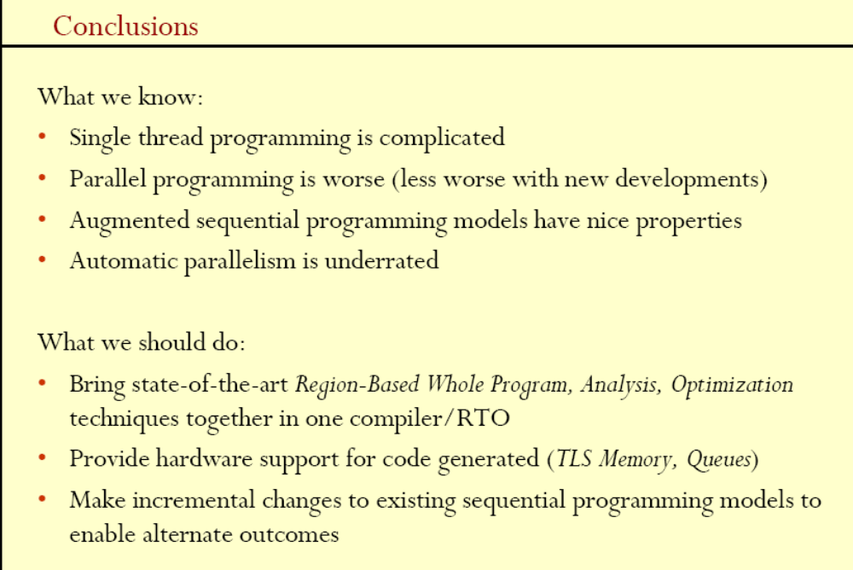
Fall 2011
“Advanced Compiler Techniques”

Slide 95
Summary
Today
  Data dependences
  Loop transformation
  Software prefetching
  Software pipelining
  Optimization for many-core
Next Time
  Project presentation
  15 min per group
Fall 2011
“Advanced Compiler Techniques”

