Slide 1
Dataflow Analysis Introduction
Guo, Yao
Part of the slides are adapted from MIT 6.035 “Computer Language Engineering”

Slide 2
Dataflow Analysis
Last lecture:
  How to analyze and transform within a basic block
This lecture:
  How to do it for the entire procedure
Fall 2011
“Advanced Compiler Techniques”

Slide 3
Outline
Reaching Definitions
Available Expressions
Live Variables
Fall 2011
“Advanced Compiler Techniques”

Slide 4
Reaching Definitions
Concept of definition and use
  a = x+y
  is a definition of a
  is a use of x and y
A definition reaches a use if
  value written by definition
  may be read by use
Fall 2011
“Advanced Compiler Techniques”

Slide 5
Reaching Definitions
s = 0;
a = 4;
i = 0;
k == 0
b = 1;
b = 2;
i < n
s = s + a*b;
i = i + 1;
return s
Fall 2011
“Advanced Compiler Techniques”

Slide 6
Reaching Definitions and Constant Propagation
Is a use of a variable a constant?
  Check all reaching definitions
  If all assign variable to same constant
  Then use is in fact a constant
Can replace variable with constant
Fall 2011
“Advanced Compiler Techniques”

Slide 7
Is a Constant in s = s+a*b?
s = 0;
a = 4;
i = 0;
k == 0
Yes!
On all reaching
definitions
a = 4
b = 1;
b = 2;
i < n
s = s + a*b;
i = i + 1;
return s
Fall 2011
“Advanced Compiler Techniques”

Slide 8
Constant Propagation Transform
s = 0;
a = 4;
i = 0;
k == 0
Yes!
On all reaching
definitions
a = 4
b = 1;
b = 2;
i < n
s = s + 4*b;
i = i + 1;
return s
Fall 2011
“Advanced Compiler Techniques”

Slide 9
Is b Constant in s = s+a*b?
s = 0;
a = 4;
i = 0;
k == 0
No!
One reaching
definition with
b = 1
One reaching
definition with
b = 2
b = 1;
b = 2;
i < n
s = s + a*b;
i = i + 1;
return s
Fall 2011
“Advanced Compiler Techniques”

Slide 10
s = 0;
a = 4;
i = 0;
k == 0
Splitting
Preserves Information Lost At Merges
b = 1;
b = 2;
i < n
s = s + a*b;
i = i + 1;
s = 0;
a = 4;
i = 0;
k == 0
return s
b = 1;
b = 2;
i < n
i < n
s = s + a*b;
i = i + 1;
return s
s = s + a*b;
i = i + 1;
return s
Fall 2011
“Advanced Compiler Techniques”

Slide 11
s = 0;
a = 4;
i = 0;
k == 0
Splitting
Preserves Information Lost At Merges
b = 1;
b = 2;
i < n
s = s + a*b;
i = i + 1;
s = 0;
a = 4;
i = 0;
k == 0
return s
b = 1;
b = 2;
i < n
i < n
s = s + a*1;
i = i + 1;
return s
s = s + a*2;
i = i + 1;
return s
Fall 2011
“Advanced Compiler Techniques”

Slide 12
Computing Reaching Definitions
Compute with sets of definitions
  represent sets using bit vectors
  each definition has a position in bit vector
At each basic block, compute
  definitions that reach start of block
  definitions that reach end of block
Do computation by simulating execution of program until reach fixed point
Fall 2011
“Advanced Compiler Techniques”

Slide 13
1 2 3 4 5 6 7
0000000
1: s = 0;
2: a = 4;
3: i = 0;
k == 0
1110000
1 2 3 4 5 6 7
1 2 3 4 5 6 7
1110000
1110000
4: b = 1;
5: b = 2;
1111000
1110100
1 2 3 4 5 6 7
1111100
1111111
i < n
1111111
1 2 3 4 5 6 7
1111100
1111100
1111111
1 2 3 4 5 6 7
1111100
1111111
6: s = s + a*b;
7: i = i + 1;
return s
1111111
1111100
0101111
Fall 2011
“Advanced Compiler Techniques”

Slide 14
Data-Flow Analysis Schema
Data-flow value: at every program point
Domain: The set of possible data-flow values for this application
IN[S] and OUT[S]: the data-flow values before and after each statement s
Data-flow problem: find a solution to a set of constraints on the IN [s] ‘s and OUT[s] ‘s, for all statements s.
  based on the semantics of the statements ("transfer functions" )
  based on the flow of control.
Fall 2011
“Advanced Compiler Techniques”

Slide 15
Constraints
Transfer function: relationship between the data-flow values before and after a statement.
  Forward: OUT[s] = f_{s}(IN[s])
  Backward: IN[s] = f_{s}(OUT[s])
Within a basic block (s₁,s₂,…,s_{n})
  IN[s_{i}+1 ] = OUT[s_{i}], for all i = 1, 2, ..., n-1
Fall 2011
“Advanced Compiler Techniques”

Slide 16
Data-Flow Schemas on Basic Blocks
Each basic block B (s₁,s₂,…,s_{n}) has
  IN – data-flow values immediately before a block
  OUT – data-flow values immediately after a block
  IN[B] = IN[S₁]
  OUT[B] = OUT[S_{n}]
  OUT[B] = f_{B} (IN[B] )
    Where fB = fs_{n} ◦ ••• ◦ fs₂ ◦ fs₁
Fall 2011
“Advanced Compiler Techniques”

Slide 17
Between Blocks
Forward analysis
  (eg: Reaching definitions)
  IN[B] = U_{P a predecessor of B} OUT[P]
Backward analysis
  (eg: live variables)
  IN[B] = f_{B} (OUT[B])
  OUT[B] = U_{S a successor of B} IN[S].
Fall 2011
“Advanced Compiler Techniques”

Slide 18
Formalizing Reaching Definitions
Each basic block has
  IN - set of definitions that reach beginning of block
  OUT - set of definitions that reach end of block
  GEN - set of definitions generated in block
  KILL - set of definitions killed in block
GEN[s = s + a*b; i = i + 1;] = 0000011
KILL[s = s + a*b; i = i + 1;] = 1010000
Compiler scans each basic block to derive GEN and KILL sets
Fall 2011
“Advanced Compiler Techniques”
Notes:
Gen/kill for a statement.

Slide 19
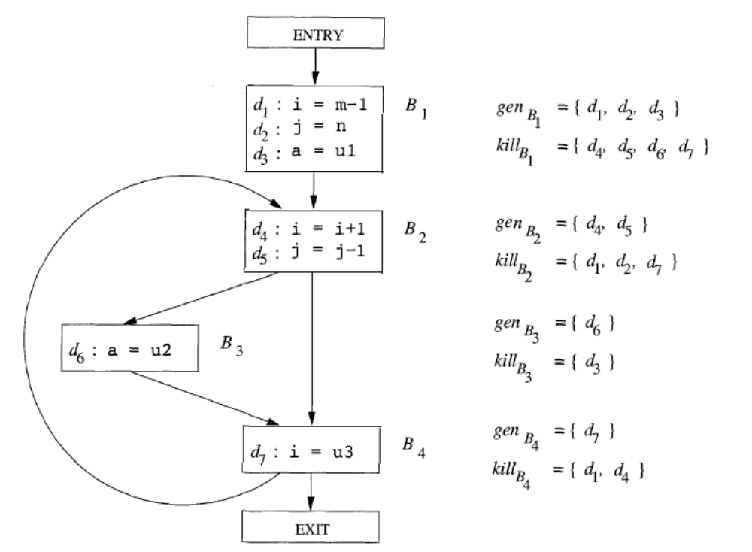
Example
Fall 2011
“Advanced Compiler Techniques”

Slide 20
Dataflow Equations
IN[b] = OUT[b1] U ... U OUT[bn]
  where b1, ..., bn are predecessors of b in CFG
OUT[b] = (IN[b] - KILL[b]) U GEN[b]
IN[entry] = 0000000
Result: system of equations
Fall 2011
“Advanced Compiler Techniques”

Slide 21
Solving Equations
Use fixed point algorithm
Initialize with solution of OUT[b] = 0000000
Repeatedly apply equations
  IN[b] = OUT[b1] U ... U OUT[bn]
  OUT[b] = (IN[b] - KILL[b]) U GEN[b]
Until reach fixed point
Until equation application has no further effect
Use a worklist to track which equation applications may have a further effect
Fall 2011
“Advanced Compiler Techniques”

Slide 22
Reaching Definitions Algorithm
for all nodes n in N
OUT[n] = emptyset; // OUT[n] = GEN[n];
IN[Entry] = emptyset;
OUT[Entry] = GEN[Entry];
Changed = N - { Entry }; // N = all nodes in graph
while (Changed != emptyset)
choose a node n in Changed;
Changed = Changed - { n };
IN[n] = emptyset;
for all nodes p in predecessors(n)
IN[n] = IN[n] U OUT[p];
OUT[n] = GEN[n] U (IN[n] - KILL[n]);
if (OUT[n] changed)
for all nodes s in successors(n)
Changed = Changed U { s };
Fall 2011
“Advanced Compiler Techniques”

Slide 23
Questions
Does the algorithm halt?
  yes, because transfer function is monotonic
  if increase IN, increase OUT
  in limit, all bits are 1
If bit is 0, does the corresponding definition ever reach basic block?
If bit is 1, does the corresponding definition always reach the basic block?
Fall 2011
“Advanced Compiler Techniques”

Slide 24
Outline
Reaching Definitions
Available Expressions
Live Variables
Fall 2011
“Advanced Compiler Techniques”

Slide 25
Available Expressions
An expression x+y is available at a point p if
  every path from the initial node to p must evaluate x+y before reaching p,
  and there are no assignments to x or y after the evaluation but before p.
Available Expression information can be used to do global (across basic blocks) CSE
If expression is available at use, no need to reevaluate it
Fall 2011
“Advanced Compiler Techniques”

Slide 26
Example: Available Expression
a = b + c
d = e + f
f = a + c
b = a + d
h = c + f
g = a + c
j = a + b + c + d
Fall 2011
“Advanced Compiler Techniques”

Slide 27
Is the Expression Available?
YES!
a = b + c
d = e + f
f = a + c
b = a + d
h = c + f
g = a + c
j = a + b + c + d
Fall 2011
“Advanced Compiler Techniques”

Slide 28
Is the Expression Available?
YES!
a = b + c
d = e + f
f = a + c
b = a + d
h = c + f
g = a + c
j = a + b + c + d
Fall 2011
“Advanced Compiler Techniques”

Slide 29
Is the Expression Available?
NO!
a = b + c
d = e + f
f = a + c
b = a + d
h = c + f
g = a + c
j = a + b + c + d
Fall 2011
“Advanced Compiler Techniques”

Slide 30
Is the Expression Available?
NO!
a = b + c
d = e + f
f = a + c
b = a + d
h = c + f
g = a + c
j = a + b + c + d
Fall 2011
“Advanced Compiler Techniques”

Slide 31
Is the Expression Available?
NO!
a = b + c
d = e + f
f = a + c
b = a + d
h = c + f
g = a + c
j = a + b + c + d
Fall 2011
“Advanced Compiler Techniques”

Slide 32
Is the Expression Available?
YES!
a = b + c
d = e + f
f = a + c
b = a + d
h = c + f
g = a + c
j = a + b + c + d
Fall 2011
“Advanced Compiler Techniques”

Slide 33
Is the Expression Available?
YES!
a = b + c
d = e + f
f = a + c
b = a + d
h = c + f
g = a + c
j = a + b + c + d
Fall 2011
“Advanced Compiler Techniques”

Slide 34
Use of Available Expressions
a = b + c
d = e + f
f = a + c
b = a + d
h = c + f
g = a + c
j = a + b + c + d
Fall 2011
“Advanced Compiler Techniques”

Slide 35
Use of Available Expressions
a = b + c
d = e + f
f = a + c
b = a + d
h = c + f
g = a + c
j = a + b + c + d
Fall 2011
“Advanced Compiler Techniques”

Slide 36
Use of Available Expressions
a = b + c
d = e + f
f = a + c
b = a + d
h = c + f
g = a + c
j = a + b + c + d
Fall 2011
“Advanced Compiler Techniques”

Slide 37
Use of Available Expressions
a = b + c
d = e + f
f = a + c
b = a + d
h = c + f
g = f
j = a + b + c + d
Fall 2011
“Advanced Compiler Techniques”

Slide 38
Use of Available Expressions
a = b + c
d = e + f
f = a + c
b = a + d
h = c + f
g = f
j = a + b + c + d
Fall 2011
“Advanced Compiler Techniques”

Slide 39
Use of Available Expressions
a = b + c
d = e + f
f = a + c
b = a + d
h = c + f
g = f
j = a + c + b + d
Fall 2011
“Advanced Compiler Techniques”

Slide 40
Use of Available Expressions
a = b + c
d = e + f
f = a + c
b = a + d
h = c + f
g = f
j = f + b + d
Fall 2011
“Advanced Compiler Techniques”

Slide 41
Use of Available Expressions
a = b + c
d = e + f
f = a + c
b = a + d
h = c + f
g = f
j = f + b + d
Fall 2011
“Advanced Compiler Techniques”

Slide 42
Computing Available Expressions
Represent sets of expressions using bit vectors
Each expression corresponds to a bit
Run dataflow algorithm similar to reaching definitions
Big difference
  definition reaches a basic block if it comes from ANY predecessor in CFG
  expression is available at a basic block only if it is available from ALL predecessors in CFG
Fall 2011
“Advanced Compiler Techniques”

Slide 43
0000
a = x+y;
x == 0
Expressions
1: x+y
2: i<n
3: i+c
4: x==0
1001
x = z;
b = x+y;
1000
i = x+y;
1000
i < n
1100
1100
c = x+y;
i = i+c;
d = x+y
Fall 2011
“Advanced Compiler Techniques”

Slide 44
0000
Global CSE Transform
a = x+y;
t = a
x == 0
Expressions
1: x+y
2: i<n
3: i+c
4: x==0
1001
x = z;
b = x+y;
t = b
1000
i = x+y;
must use same temp
for CSE in all blocks
1000
i < n
1100
1100
c = x+y;
i = i+c;
d = x+y
Fall 2011
“Advanced Compiler Techniques”

Slide 45
0000
Global CSE Transform
a = x+y;
t = a
x == 0
Expressions
1: x+y
2: i<n
3: i+c
4: x==0
1001
x = z;
b = x+y;
t = b
1000
i = t;
must use same temp
for CSE in all blocks
1000
i < n
1100
1100
c = t;
i = i+c;
d = t
Fall 2011
“Advanced Compiler Techniques”

Slide 46
Formalizing Analysis
Each basic block has
  IN - set of expressions available at start of block
  OUT - set of expressions available at end of block
  GEN - set of expressions computed in block (and not killed later)
  KILL - set of expressions killed in in block (and not re-computed later)
GEN[x = z; b = x+y] = 1000
KILL[x = z; b = x+y] = 0001
Compiler scans each basic block to derive GEN and KILL sets
Fall 2011
“Advanced Compiler Techniques”
Notes:
Definition of GEN/KILL is confusing.
Compared to Dragon Book!!!

Slide 47
Dataflow Equations
IN[b] = OUT[b1] ∩ ... ∩ OUT[bn]
  where b1, ..., bn are predecessors of b in CFG
OUT[b] = (IN[b] - KILL[b]) U GEN[b]
IN[entry] = 0000
Result: system of equations
Fall 2011
“Advanced Compiler Techniques”

Slide 48
Solving Equations
Use fixed point algorithm
IN[entry] = 0000
Initialize OUT[b] = 1111
Repeatedly apply equations
  IN[b] = OUT[b1] ∩ ... ∩ OUT[bn]
  OUT[b] = (IN[b] - KILL[b]) U GEN[b]
Use a worklist algorithm to reach fixed point
Fall 2011
“Advanced Compiler Techniques”

Slide 49
Available Expressions
Algorithm
for all nodes n in N
OUT[n] = E;
IN[Entry] = emptyset;
OUT[Entry] = GEN[Entry];
Changed = N - { Entry }; // N = all nodes in graph
while (Changed != emptyset)
choose a node n in Changed;
Changed = Changed - { n };
IN[n] = E; // E is set of all expressions
for all nodes p in predecessors(n)
IN[n] = IN[n] ∩ OUT[p];
OUT[n] = GEN[n] U (IN[n] - KILL[n]);
if (OUT[n] changed)
for all nodes s in successors(n)
Changed = Changed U { s };
Fall 2011
“Advanced Compiler Techniques”

Slide 50
Questions
Does algorithm always halt?
If expression is available in some execution, is it always marked as available in analysis?
If expression is not available in some execution, can it be marked as available in analysis?
Fall 2011
“Advanced Compiler Techniques”

Slide 51
General Correctness
Concept in actual program execution
  Reaching definition: definition D, execution E at program point P
  Available expression: expression X, execution E at program point P
Analysis reasons about all possible executions
For all executions E at program point P,
  if a definition D reaches P in E
  then D is in the set of reaching definitions at P from analysis
Other way around
  if D is not in the set of reaching definitions at P from analysis
  then D never reaches P in any execution E
For all executions E at program point P,
  if an expression X is in set of available expressions at P from analysis
  then X is available in E at P
Fall 2011
“Advanced Compiler Techniques”

Slide 52
Duality In Two Algorithms
Reaching definitions
  Confluence operation is set union
  OUT[b] initialized to empty set
Available expressions
  Confluence operation is set intersection
  OUT[b] initialized to set of available expressions
General framework for dataflow algorithms.
Build parameterized dataflow analyzer once, use for all dataflow problems
Fall 2011
“Advanced Compiler Techniques”

Slide 53
Outline
Reaching Definitions
Available Expressions
Live Variables
Fall 2011
“Advanced Compiler Techniques”

Slide 54
Live Variable Analysis
A variable v is live at point p if
  v is used along some path starting at p, and
  no definition of v along the path before the use.
When is a variable v dead at point p?
  No use of v on any path from p to exit node, or
  If all paths from p redefine v before using v.
Fall 2011
“Advanced Compiler Techniques”

Slide 55
What Use is Liveness Information?
Register allocation.
  If a variable is dead, can reassign its register
Dead code elimination.
  Eliminate assignments to variables not read later.
  But must not eliminate last assignment to variable (such as instance variable) visible outside CFG.
  Can eliminate other dead assignments.
  Handle by making all externally visible variables live on exit from CFG
Fall 2011
“Advanced Compiler Techniques”

Slide 56
Conceptual Idea of Analysis
Simulate execution
But start from exit and go backwards in CFG
Compute liveness information from end to beginning of basic blocks
Fall 2011
“Advanced Compiler Techniques”

Slide 57
Liveness Example
0101110
a = x+y;
t = a;
c = a+x;
x == 0
Assume a,b,c visible outside method
So are live on exit
Assume x,y,z,t not visible
Represent Liveness Using Bit Vector
  order is abcxyzt
1100111
a b c x y z t
b = t+z;
1000111
1100100
a b c x y z t
1100100
c = y+1;
1110000
a b c x y z t
Fall 2011
“Advanced Compiler Techniques”

Slide 58
Dead Code Elimination
0101110
a = x+y;
t = a;
c = a+x;
x == 0
Assume a,b,c visible outside method
So are live on exit
Assume x,y,z,t not visible
Represent Liveness Using Bit Vector
  order is abcxyzt
1100111
a b c x y z t
b = t+z;
1000111
1100100
a b c x y z t
1100100
c = y+1;
1110000
a b c x y z t
Fall 2011
“Advanced Compiler Techniques”

Slide 59
Formalizing Analysis
Each basic block has
  IN - set of variables live at start of block
  OUT - set of variables live at end of block
  USE - set of variables with upwards exposed uses in block (use prior to definition)
  DEF - set of variables defined in block prior to use
USE[x = z; x = x+1;] = { z } (x not in USE)
DEF[x = z; x = x+1; y = 1;] = {x, y}
Compiler scans each basic block to derive USE and DEF sets
Fall 2011
“Advanced Compiler Techniques”

Slide 60
Algorithm
for all nodes n in N - { Exit }
IN[n] = emptyset;
OUT[Exit] = emptyset;
IN[Exit] = use[Exit];
Changed = N - { Exit };
while (Changed != emptyset)
choose a node n in Changed;
Changed = Changed - { n };
OUT[n] = emptyset;
for all nodes s in successors(n)
OUT[n] = OUT[n] U IN[p];
IN[n] = use[n] U (out[n] - def[n]);
if (IN[n] changed)
for all nodes p in predecessors(n)
Changed = Changed U { p };
Fall 2011
“Advanced Compiler Techniques”

Slide 61
Similar to Other Dataflow Algorithms
Backward analysis, not forward
Still have transfer functions
Still have confluence operators
Can generalize framework to work for both forwards and backwards analyses
Fall 2011
“Advanced Compiler Techniques”

Slide 62
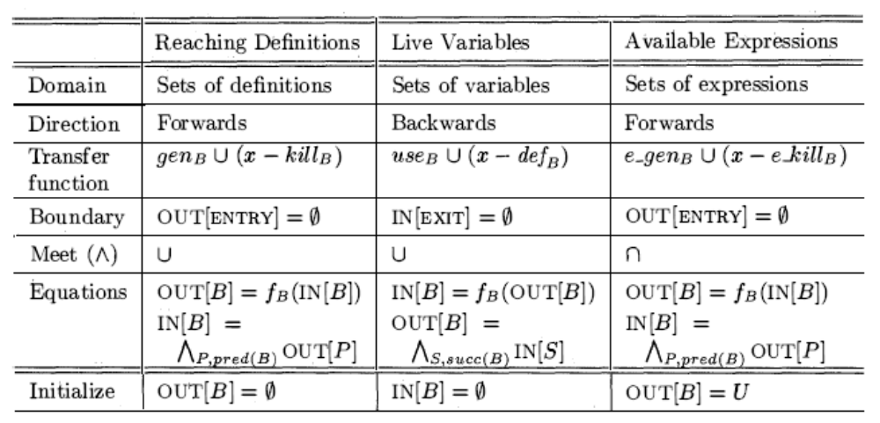
Comparison
Fall 2011
“Advanced Compiler Techniques”

Slide 63
Comparison
Reaching Definitions
for all nodes n in N
OUT[n] = emptyset;
IN[Entry] = emptyset;
OUT[Entry] = GEN[Entry];
Changed = N - { Entry };
while (Changed != emptyset)
choose a node n in Changed;
Changed = Changed - { n };
IN[n] = emptyset;
for all nodes p in predecessors(n)
IN[n] = IN[n] U OUT[p];
OUT[n] = GEN[n] U (IN[n] - KILL[n]);
if (OUT[n] changed)
for all nodes s in successors(n)
Changed = Changed U { s };
Available Expressions
for all nodes n in N
OUT[n] = E;
IN[Entry] = emptyset;
OUT[Entry] = GEN[Entry];
Changed = N - { Entry };
while (Changed != emptyset)
choose a node n in Changed;
Changed = Changed - { n };
IN[n] = E;
for all nodes p in predecessors(n)
IN[n] = IN[n] ∩ OUT[p];
OUT[n] = GEN[n] U (IN[n] - KILL[n]);
if (OUT[n] changed)
for all nodes s in successors(n)
Changed = Changed U { s };
Live Variables
for all nodes n in N - { Exit }
IN[n] = emptyset;
OUT[Exit] = emptyset;
IN[Exit] = use[Exit];
Changed = N - { Exit };
while (Changed != emptyset)
choose a node n in Changed;
Changed = Changed - { n };
OUT[n] = emptyset;
for all nodes s in successors(n)
OUT[n] = OUT[n] U IN[p];
IN[n] = use[n] U (out[n] - def[n]);
if (IN[n] changed)
for all nodes p in predecessors(n)
Changed = Changed U { p };
Fall 2011
“Advanced Compiler Techniques”

Slide 64
Comparison
Reaching Definitions
for all nodes n in N
OUT[n] = emptyset;
IN[Entry] = emptyset;
OUT[Entry] = GEN[Entry];
Changed = N - { Entry };
while (Changed != emptyset)
choose a node n in Changed;
Changed = Changed - { n };
IN[n] = emptyset;
for all nodes p in predecessors(n)
IN[n] = IN[n] U OUT[p];
OUT[n] = GEN[n] U (IN[n] - KILL[n]);
if (OUT[n] changed)
for all nodes s in successors(n)
Changed = Changed U { s };
Available Expressions
for all nodes n in N
OUT[n] = E;
IN[Entry] = emptyset;
OUT[Entry] = GEN[Entry];
Changed = N - { Entry };
while (Changed != emptyset)
choose a node n in Changed;
Changed = Changed - { n };
IN[n] = E;
for all nodes p in predecessors(n)
IN[n] = IN[n] ∩ OUT[p];
OUT[n] = GEN[n] U (IN[n] - KILL[n]);
if (OUT[n] changed)
for all nodes s in successors(n)
Changed = Changed U { s };
Fall 2011
“Advanced Compiler Techniques”

Slide 65
Comparison
Reaching Definitions
for all nodes n in N
OUT[n] = emptyset;
IN[Entry] = emptyset;
OUT[Entry] = GEN[Entry];
Changed = N - { Entry };
while (Changed != emptyset)
choose a node n in Changed;
Changed = Changed - { n };
IN[n] = emptyset;
for all nodes p in predecessors(n)
IN[n] = IN[n] U OUT[p];
OUT[n] = GEN[n] U (IN[n] - KILL[n]);
if (OUT[n] changed)
for all nodes s in successors(n)
Changed = Changed U { s };
Live Variable
for all nodes n in N
IN[n] = emptyset;
OUT[Exit] = emptyset;
IN[Exit] = use[Exit];
Changed = N - { Exit };
while (Changed != emptyset)
choose a node n in Changed;
Changed = Changed - { n };
OUT[n] = emptyset;
for all nodes s in successors(n)
OUT[n] = OUT[n] U IN[p];
IN[n] = use[n] U (out[n] - def[n]);
if (IN[n] changed)
for all nodes p in predecessors(n)
Changed = Changed U { p };
Fall 2011
“Advanced Compiler Techniques”

Slide 66
Pessimistic vs. Optimistic Analyses
Available expressions is optimistic (for common sub-expression elimination)
  Assume expressions are available at start of analysis
  Analysis eliminates all that are not available
  Cannot stop analysis early and use current result
Live variables is pessimistic (for dead code elimination)
  Assume all variables are live at start of analysis
  Analysis finds variables that are dead
  Can stop analysis early and use current result
Dataflow setup same for both analyses
Optimism/pessimism depends on intended use
Fall 2011
“Advanced Compiler Techniques”

Slide 67
Summary
Dataflow Analysis
  Control flow graph
  IN[b], OUT[b], transfer functions, join points
Paired analyses and transformations
  Reaching definitions/constant propagation
  Available expressions/common sub-expression elimination
  Live-variable analysis/Dead code elimination
Stacked analysis and transformations work together
Fall 2011
“Advanced Compiler Techniques”

Slide 68
Next Time
Data Flow Analysis: Foundation
  DragonBook: §9.3
Fall 2011
“Advanced Compiler Techniques”

