Slide 1
Partial Redundancy Elimination
Guo, Yao

Slide 2
Outline
Forms of redundancy
  global common subexpression elimination
  loop invariant code motion
  partial redundancy
Lazy Code Motion Algorithm
  A set of four analyses
Reading: Dragon§9.5
Fall 2011
“Advanced Compiler Techniques”

Slide 3
Role of PRE
Goal: Minimize the number of expression evaluations.
  Keep the value of evaluation in a temporary variable and use it later.
Sources of redundancy:
  Global common subexpressions
  loop-invariant computations
  True partial redundancy: an expression is sometimes available, sometimes not.
Fall 2011
“Advanced Compiler Techniques”

Slide 4
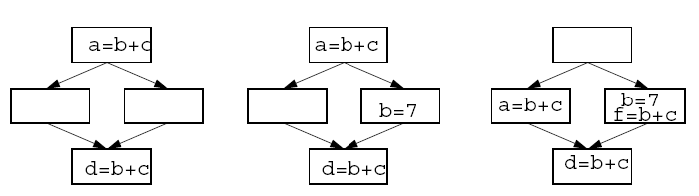
Example: Global Common Subexpression
A common expression may have different values on different paths!
On every path reaching p,
  expression b+c has been computed
  b, c not overwritten after the expression
Fall 2011
“Advanced Compiler Techniques”

Slide 5
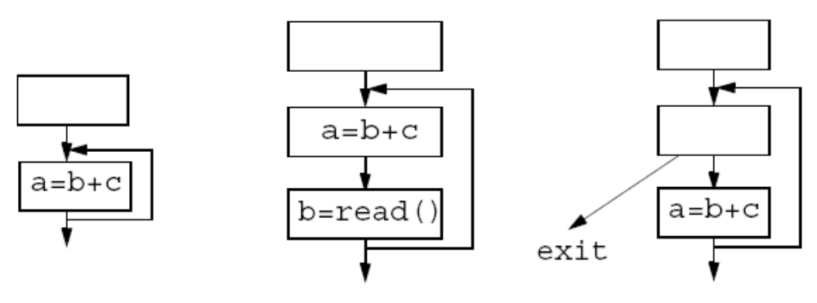
Example: Loop-Invariant Code Motion
Given an expression (b+c) inside a loop,
  does the value of b+c change inside the loop?
  is the code executed at least once?
Fall 2011
“Advanced Compiler Techniques”
Notes:
Is the code executed at least once??

Slide 6
Example: True Partial Redundancy
Can we place calculations of b+c such that no path re-executes the same expression?
= b+c
t = b+c
t = b+c
= b+c
= t
Fall 2011
“Advanced Compiler Techniques”

Slide 7
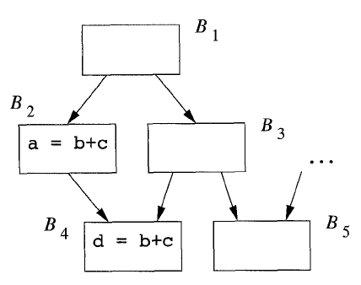
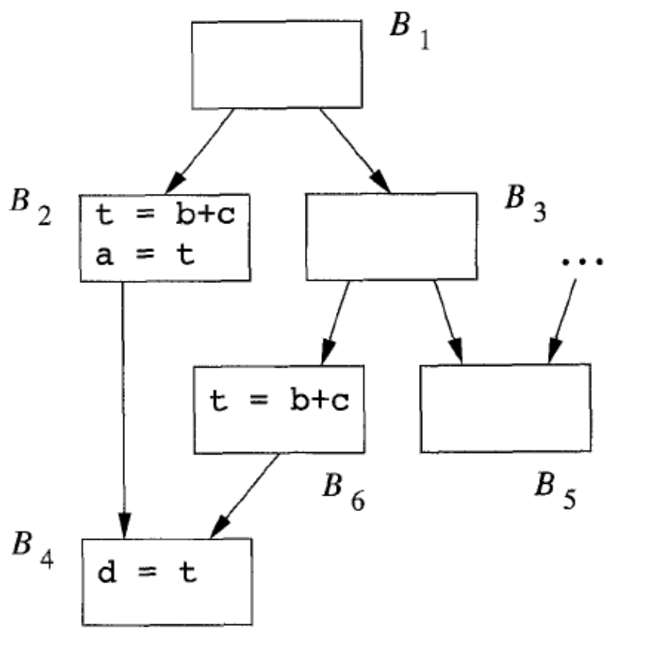
Can All Redundancy Be Eliminated?
Critical edges
  source basic block has multiple successors
  destination basic block has multiple predecessors
Fall 2011
“Advanced Compiler Techniques”

Slide 8
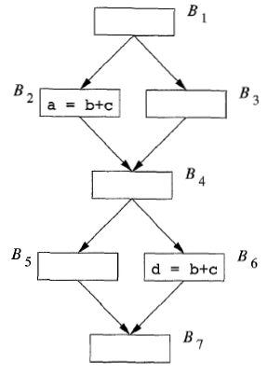
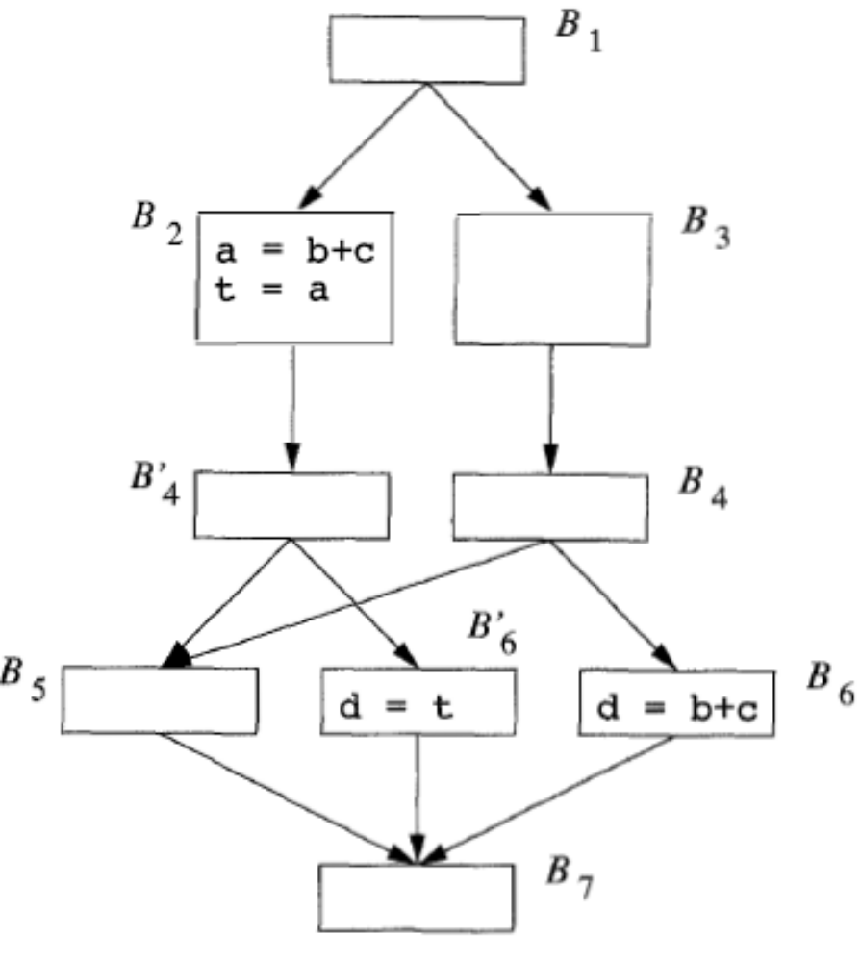
Code Duplication
Fall 2011
“Advanced Compiler Techniques”

Slide 9
Problem With Node-Splitting
Can exponentiate the number of nodes.
Our PRE algorithm needs to move code to new blocks along edges, but will not split blocks.
Convention: All new instructions are either inserted at the beginning of a block or placed in a new block.
Fall 2011
“Advanced Compiler Techniques”

Slide 10
Lazy Code Motion Problem
Desired properties of a PRE algorithm
  All redundant computations of expressions that can be eliminated without code duplication are eliminated.
  The optimized program does not perform any computation that is not in the original program execution.
  Expressions are computed at the latest possible time.
Fall 2011
“Advanced Compiler Techniques”
Notes:
Lazy evaluation -> eager evaluation

Slide 11
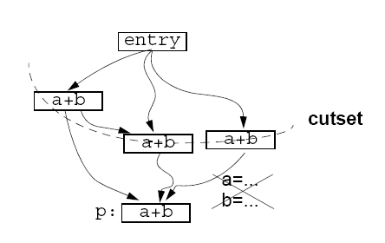
Full Redundancy
Full redundancy at p: expression a+b redundant on all paths
  cutset: nodes that separate entry from p
  cutset contains calculation of a+b
  a, b, not redefined
Fall 2011
“Advanced Compiler Techniques”

Slide 12
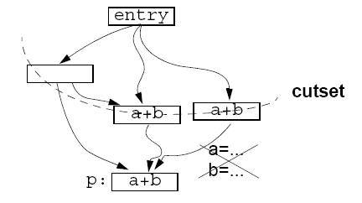
Partial Redundancy
Partial redundancy at p: redundant on some but not all paths
  Add operations to create a cutset containing a+b
  Note: Moving operations up can eliminate redundancy
Fall 2011
“Advanced Compiler Techniques”

Slide 13
Anticipated Expressions
Expression x+y is anticipated at a point if x+y is certain to be evaluated along any computation path, before any recomputation of x or y.
Copies of an expression must be placed only at program points where the expression is anticipated.
  The earlier an expression is placed, the more redundancy can be removed
Fall 2011
“Advanced Compiler Techniques”
Notes:
The earlier an expression is placed, the more redundancy
can be removed, and among all solutions that eliminate the same redundancies,
the one that computes the expressions the latest minimizes the lifetimes of the
registers holding the values of the expressions involved.

Slide 14
Example: Anticipated Expressions
x+y is anticipated
here and could be
computed now rather
than later.
= x+y
x+y is
anticipated
here, but is
also available.
No computa-
tion is needed.
= x+y
= x+y
= x+y
Fall 2011
“Advanced Compiler Techniques”

Slide 15
The Plan
Determine for each expression the earliest place(s) it can be computed while still being sure that it will be used.
Postpone the expressions as long as possible without introducing redundancy.
  We trade space for time --- an expression can be computed in many places, but never if it is already computed.
Fall 2011
“Advanced Compiler Techniques”

Slide 16
The Guarantee
No expression is computed at a place where it its value might have been computed previously, and preserved instead.
  Even along a subset of the possible paths.
Fall 2011
“Advanced Compiler Techniques”

Slide 17
More About the Plan
We use four data-flow analyses, in succession, plus some set operations on the results of these analyses.
  Anticipated Expressions
  Available Expressions
  Postponable Expressions
  Used Expressions
After the first, each analysis uses the results of the previous ones.
Fall 2011
“Advanced Compiler Techniques”

Slide 18
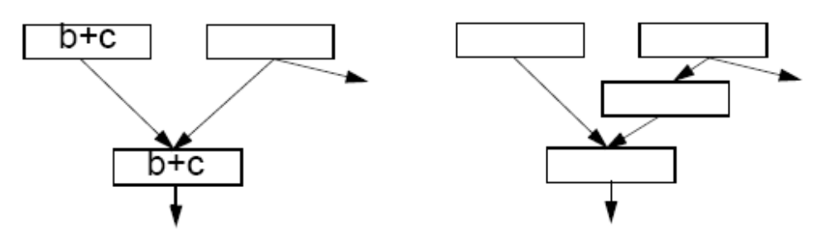
Assumptions
Assume every statement is a basic block
  Only place statements at the beginning of a basic block
  Add a basic block for every edge that leads to a basic block with multiple predecessors
Fall 2011
“Advanced Compiler Techniques”

Slide 19
Computing Anticipated Expressions
Use(B) = set of expressions x+y evaluated in B before any assignment to x or y.
Def(B) = set of expressions one of whose arguments is assigned in B.
Fall 2011
“Advanced Compiler Techniques”

Slide 20
Computing Anticipated Expressions --- (2)
Direction = backwards.
Join (or Meet) = intersection.
Boundary condition: IN[exit] = ∅.
Transfer function:
IN[B] = (OUT[B] – Def(B)) ∪ Use(B)
Fall 2011
“Advanced Compiler Techniques”

Slide 21
Example: Anticipated Expressions
Anticipated
= x+y
= x+y
Backwards; Intersection; IN[B] = (OUT[B] – Def(B)) ∪ Use(B)
Fall 2011
“Advanced Compiler Techniques”

Slide 22
“Available” Expressions
Modification of the usual AE.
x+y is “available” at a point if either:
  It is available in the usual sense; i.e., it has been computed and not killed, or
  It is anticipated; i.e., it could be available if we chose to precompute it there.
Fall 2011
“Advanced Compiler Techniques”

Slide 23
“Available” Expressions
x+y is in Kill(B) if x or y is defined, and x+y is not later recomputed (same as previously).
Confluence = intersection.
Transfer function:
OUT[B] = (IN[B] ∪ IN_{ANTICIPATED}[B]) – Kill(B)
Fall 2011
“Advanced Compiler Techniques”

Slide 24
Earliest Placement
x+y is in Earliest[B] if it is anticipated at the beginning of B but not “available” there.
  That is: when we compute anticipated expressions, x+y is in IN[B], but
  When we compute “available” expressions, x+y is not in IN[B].
I.e., x+y is anticipated at B, but not anticipated at OUT of some predecessor.
Fall 2011
“Advanced Compiler Techniques”

Slide 25
Example: Available/Earliest
Earliest = anticipated
but not available
Anticipated
“Available”
= x+y
= x+y
Forward; Intersection; OUT[B] = (IN[B] ∪ IN_{ANTICIPATED}[B]) – Kill(B)
Fall 2011
“Advanced Compiler Techniques”

Slide 26
Postponable Expressions
Now, we need to delay the evaluation of expressions as long as possible.
  Not past the use of the expression.
  Not so far that we wind up computing an expression that is already evaluated.
Note viewpoint: It is OK to use code space if we save register use.
Fall 2011
“Advanced Compiler Techniques”

Slide 27
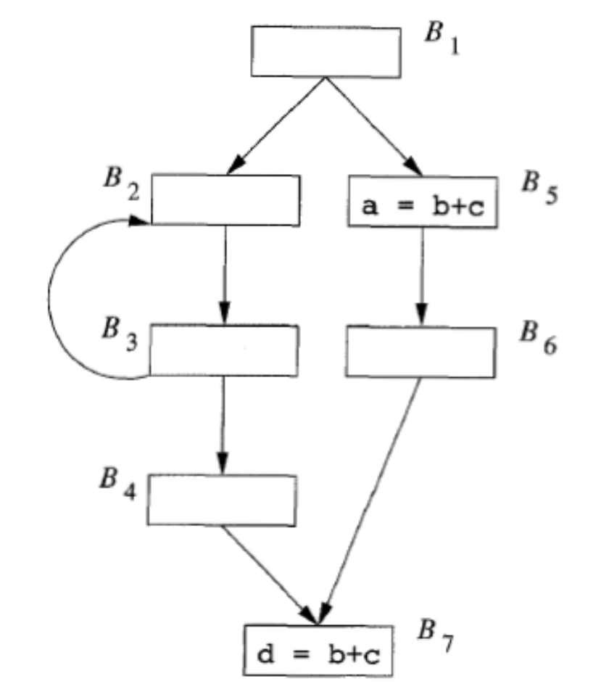
Example
t = b+c
a = t
d = t
Fall 2011
“Advanced Compiler Techniques”

Slide 28
Example
t = b+c
a = t
t = b+c
d = t
Fall 2011
“Advanced Compiler Techniques”

Slide 29
Postponable Expressions - (2)
x+y is postponable to a point p if on every path from the entry to p:
  There is a block B for which x+y is in earliest[B], and
  After that block, there is no use of x+y.
Fall 2011
“Advanced Compiler Techniques”

Slide 30
Postponable Expressions - (3)
Computed like “available” expressions, with two differences:
  In place of killing an expression (assigning to one of its arguments): Use(B), the set of expressions used in block B.
  In place of IN_{ANTICIPATED}[B]: earliest[B].
Fall 2011
“Advanced Compiler Techniques”

Slide 31
Postponable Expressions - (4)
Confluence = intersection.
Transfer function:
OUT[B] = (IN[B] ∪ earliest[B]) – Use(B)
Fall 2011
“Advanced Compiler Techniques”

Slide 32
Example: Postponable Expressions
Earliest
Postponable
= x+y
= x+y
Three places to
compute x+y
= x+y
Forward; Intersection; OUT[B] = (IN[B] ∪ earliest[B]) – Use(B)
Fall 2011
“Advanced Compiler Techniques”

Slide 33
Latest Placement
We want to postpone as far as possible.
How do we compute the “winners” --- the blocks such that we can postpone no further?
Remember --- postponing stops at a use or at a block with another predecessor where x+y is not postponable.
Fall 2011
“Advanced Compiler Techniques”

Slide 34
Latest[B]
For x+y to be in latest[B]:
  x+y is either in earliest[B] or in IN_{POSTPONABLE}[B].
    I.e., we can place the computation at B.
  x+y is either used in B or there is some successor of B for which (1) does not hold.
    I.e., we cannot postpone further along all branches.
Fall 2011
“Advanced Compiler Techniques”

Slide 35
Example: Latest
Earliest
Or Postponable
to beginning
Latest =
green
and red.
= x+y
= x+y
Used
= x+y
Or has a suc-
cessor not red.
Fall 2011
“Advanced Compiler Techniques”

Slide 36
Final Touch --- Used Expressions
We’re now ready to introduce a temporary t to hold the value of expression x+y everywhere.
But there is a small glitch: t may be totally unnecessary.
  E.g., x+y is computed in exactly one place.
Fall 2011
“Advanced Compiler Techniques”

Slide 37
Used Expressions --- (2)
used[B] = expressions used along some path from the exit of B.
Backward flow analysis.
Confluence = union.
Transfer function:
IN[B] = (OUT[B] ∪ e-used[B]) – Latest(B)
  e-used = “expression is used in B.”
Fall 2011
“Advanced Compiler Techniques”

Slide 38
Example: Used
Recall: Latest
= x+y
= x+y
Used
= x+y
Backwards; Union; IN[B] = (OUT[B] ∪ e-used[B]) – Latest(B)
Fall 2011
“Advanced Compiler Techniques”

Slide 39
Rules for Introducing Temporaries
If x+y is in both Latest[B] and OUT_{USED}[B], introduce t = x+y at the beginning of B.
If x+y is used in B, but either
  Is not in Latest[B] or
  Is in OUT_{USED}[B],
replace the use(s) of x+y by uses of t.
Fall 2011
“Advanced Compiler Techniques”

Slide 40
Example: Where is a Temporary Used?
Recall: Latest
Create temp-
orary here
= x+y
= x+y
Use it here
Recall OUT_{USED}
= x+y
But not here ---
x+y is in Latest and
not in OUTUSED
Fall 2011
“Advanced Compiler Techniques”

Slide 41
Example: Here’s Where It’s Used
= x+y
t = x+y
t = x+y
= t
= t
Fall 2011
“Advanced Compiler Techniques”

Slide 42
Summary
Cannot execute any operations not executed originally
  Pass 1: Anticipation: range of code motion
Eliminate as many redundant calculations of an expression as possible, without duplicating code
  Pass 2: Availability: move it up as early as possible
Delay computation as much as possible to minimize register lifetimes
  Pass 3: Postponable: move it down unless it creates redundancy (lazy code motion)
Pass 4: Remove temporary assignment
Fall 2011
“Advanced Compiler Techniques”

Slide 43
Next Time
Loops
  Dragon 9.6
Region-based Analysis
  Dragon 9.7
Fall 2011
“Advanced Compiler Techniques”

