Slide 1
SSA
Guo, Yao

Slide 2
Content
SSA Introduction
Converting to SSA
SSA Example
SSAPRE
Reading
  Tiger Book: 19.1, 19.3
  Related Papers
Fall 2011
“Advanced Compiler Techniques”

Slide 3
Prelude
SSA (Static Single-Assignment): A program is said to be in SSA form iff
  Each variable is statically defined exactly only once, and
  each use of a variable is dominated by that variable’s definition.
So, straight line code is in SSA form ?
Fall 2011
“Advanced Compiler Techniques”

Slide 4
Example
X ←
₁
In general, how to transform an arbitrary program into SSA form?
Does the definition of X₂ dominates its use in the example?
X ←
₂
x ←
X₃ ←φ (X₁, X₂)
₄
Fall 2011
“Advanced Compiler Techniques”

Slide 5
SSA: Motivation
Provide a uniform basis of an IR to solve a wide range of classical dataflow problems
Encode both dataflow and control flow information
A SSA form can be constructed and maintained efficiently
Many SSA dataflow analysis algorithms are more efficient (have lower complexity) than their CFG counterparts.
Fall 2011
“Advanced Compiler Techniques”

Slide 6
Static Single-Assignment Form
Each variable has only one definition in the program text.
This single static definition can be in a loop and
may be executed many times. Thus even in a
program expressed in SSA, a variable can be
dynamically defined many times.
Fall 2011
“Advanced Compiler Techniques”

Slide 7
Advantages of SSA
Simpler dataflow analysis
No need to use use-def/def-use chains, which requires N×M space for N uses and M definitions
SSA form relates in a useful way with dominance structures.
Differentiate unrelated uses of the same variable
  E.g. loop induction variables
Fall 2011
“Advanced Compiler Techniques”

Slide 8
SSA Form – An Example
SSA-form
Each name is defined exactly once
Each use refers to exactly one name
What’s hard
Straight-line code is trivial
Splits in the CFG are trivial
Joins in the CFG are hard
Building SSA Form
Insert Ø-functions at birth points
Rename all values for uniqueness
x ← 17 - 4
x ← a + b
x ← y - z
x ← 13
?
z ← x * q
s ← w - x
Fall 2011
“Advanced Compiler Techniques”

Slide 9
Birth Points
Consider the flow of values in this example:
x ← 17 - 4
The value x appears everywhere
It takes on several values.
Here, x can be 13, y-z, or 17-4
Here, it can also be a+b
If each value has its own name …
Need a way to merge these
distinct values
Values are “born” at merge points
x ← a + b
x ← y - z
x ← 13
z ← x * q
s ← w - x
Fall 2011
“Advanced Compiler Techniques”

Slide 10
Birth Points
Consider the flow of values in this example:
x ← 17 - 4
New value for x here
17 - 4 or y - z
x ← a + b
x ← y - z
x ← 13
New value for x here
13 or (17 - 4 or y - z)
z ← x * q
s ← w - x
New value for x here
a+b or ((13 or (17-4 or y-z))
Fall 2011
“Advanced Compiler Techniques”

Slide 11
Birth Points
Consider the value flow below:
x ← 17 - 4
x ← a + b
x ← y - z
All birth points are join points
Not all join points are birth points
Birth points are value-specific …
x ← 13
z ← x * q
s ← w - x
These are all birth points for values
Fall 2011
“Advanced Compiler Techniques”

Slide 12
Review
A Ø-function is a special kind of copy that selects one of its parameters.
The choice of parameter is governed by the CFG edge along which control reached the current block.
Real machines do not implement a Ø-function directly in hardware.(not yet!)
SSA-form
Each name is defined exactly once
Each use refers to exactly one name
What’s hard
Straight-line code is trivial
Splits in the CFG are trivial
Joins in the CFG are hard
Building SSA Form
Insert Ø-functions at birth points
Rename all values for uniqueness
y₁ ← ...
y₂ ← ...
y₃ ← Ø(y₁,y₂)
*
Fall 2011
“Advanced Compiler Techniques”

Slide 13
Use-def Dependencies in Non-straight-line Code
Many uses to many defs
  Overhead in representation
  Hard to manage
a =
a =
a =
a
a
a
Fall 2011
“Advanced Compiler Techniques”

Slide 14
Factoring Operator φ
Factoring – when multiple edges cross a join point, create a common node Φ that all edges must pass through
Number of edges reduced from 9 to 6
A Φ is regarded as def (its parameters are uses)
Many uses to 1 def
Each def dominates all its uses
a =
a =
a =
a = φ(a,a,a)
a
a
a
Fall 2011
“Advanced Compiler Techniques”

Slide 15
Rename to represent use-def edges
No longer necessary to represent the use-def edges explicitly
a₁ =
a₂=
a₃=
a₄ = φ(a₁,a₂,a₃)
a₄
a₄
a₄
Fall 2011
“Advanced Compiler Techniques”

Slide 16
SSA Form in Control-Flow Path Merges
Is this code in SSA form?
B1
b ← M[x]
a ← 0
No, two definitions of a at B4 appear
in the code (in B1 and B3)
How can we transform this code
into a code in SSA form?
B2
if b<4
B3
a ← b
We can create two versions of
a, one for B1 and another for B3.
B4
c ← a + b
Fall 2011
“Advanced Compiler Techniques”

Slide 17
SSA Form in Control-Flow Path Merges
But which version should we
use in B4 now?
B1
b ← M[x]
a1 ← 0
We define a fictional function that
“knows” which control path was
taken to reach the basic block B4:
B2
if b<4
B3
a2 ← b
B4
c ← a? + b
a1
if
we
arrive
at
B4
from
B2
φ
( )
a1,
a2
=
a2
if
we
arrive
at
B4
from
B3
Fall 2011
“Advanced Compiler Techniques”

Slide 18
SSA Form in Control-Flow Path Merges
But, which version should we
use in B4 now?
B1
b ← M[x]
a1 ← 0
We define a fictional function that
“knows” which control path was
taken to reach the basic block B4:
B2
if b<4
B3
a2 ← b
B4
a3 ← φ(a2,a1)
c ← a3 + b
a1
if
we
arrive
at
B4
from
B2
φ
(
a2,
a1
)
=
a2
if
we
arrive
at
B4
from
B3
Fall 2011
“Advanced Compiler Techniques”

Slide 19
A Loop Example
a ← 0
a1 ← 0
b ← a+1
c ← c+b
a ← b*2
if a < N
a3 ← φ(a1,a2)
b2 ← φ(b0,b2)
c2 ← φ(c0,c1)
b2 ← a3+1
c1 ← c2+b2
a2 ← b2*2
if a2 < N
return
φ(b0,b2) is not necessary because b0 is
never used. But the phase that generates
φ functions does not know it.
Unnecessary functions
are eliminated by dead code elimination.
return
Note: only a,c are first used in
the loop body before it is redefined.
For b, it is redefined right at the
Beginning!
Fall 2011
“Advanced Compiler Techniques”

Slide 20
The φ function
How can we implement a φ function that “knows”
which control path was taken?
Answer 1: We don’t!! The φ function is used only
to connect use to definitions during
optimization, but is never implemented.
Answer 2: If we must execute the φ function, we can
implement it by inserting MOVE instructions
in all control paths.
Fall 2011
“Advanced Compiler Techniques”

Slide 21
Criteria For Inserting φ Functions
We could insert one φ function for each variable
at every join point (a point in the CFG with more
than one predecessor). But that would be wasteful.
What should be our criteria to insert a φ function
for a variable a at node z of the CFG?
Intuitively, we should add a function φ if
there are two definitions of a that can reach
the point z through distinct paths.
Fall 2011
“Advanced Compiler Techniques”

Slide 22
A naïve method
Simply introduce a phi-function at each “join” point in CFG
But, we already pointed out that this is inefficient – too many useless phi-functions may be introduced!
What is a good algorithm to introduce only the right number of phi-functions ?
Fall 2011
“Advanced Compiler Techniques”

Slide 23
Path Convergence Criterion
Insert a φ function for a variable a at a node z if
all the following conditions are true:
1. There is a block x that defines a
2. There is a block y ≠ x that defines a
3. There is a non-empty path Pxz from x to z
4. There is a non-empty path Pyz from y to z
5. Paths Pxz and Pyz don’t have any nodes in
common other than z
6. The node z does not appear within both Pxz
and Pyz prior to the end, but it might appear
in one or the other.
The start node contains an implicit definition
of every variable.
Fall 2011
“Advanced Compiler Techniques”

Slide 24
Iterated Path-Convergence Criterion
The φ function itself is a definition of a.
Therefore the path-convergence criterion
is a set of equations that must be satisfied.
while there are nodes x, y, z satisfying conditions 1-6
and z does not contain a φ function for a
do insert a← φ(a, a, …, a) at node z
This algorithm is extremely costly, because it
requires the examination of every triple of
nodes x, y, z and every path leading from
x to y.
Can we do better?
Fall 2011
“Advanced Compiler Techniques”

Slide 25
Concept of dominance Frontiers
An Intuitive View
bb1
X ←
Blocks dominated by bb1
bbn
Border between dorm and not-dorm (Dominance Frontier)
Fall 2011
“Advanced Compiler Techniques”

Slide 26
Dominance Frontier
The dominance frontier DF(x) of a node x is the set of all node z such that x dominates a predecessor of z, without strictly dominating z.
Recall: if x dominates y and x ≠ y, then
x strictly dominates y
Fall 2011
“Advanced Compiler Techniques”

Slide 27
Calculate The Dominance Frontier
An Intuitive Way
How to Determine the Dominance Frontier of Node 5?
1. Determine the dominance region of node 5:
1
2
5
9
{5, 6, 7, 8}
2. Determine the targets of edges crossing from the dominance region of node 5
3
6
7
10
11
4
8
These targets are the dominance frontier of node 5
DF(5) = { 4, 5, 12, 13}
12
13
NOTE: node 5 is in DF(5) in this case – why ?
Fall 2011
“Advanced Compiler Techniques”

Slide 28
Algorithm: Converting to SSA
Big picture, translation to SSA form is done in 3 steps
  The dominance frontier mapping is constructed form the control flow graph.
  Using the dominance frontiers, the locations of the φ-functions for each variable in the original program are determined.
  The variables are renamed by replacing each mention of an original variable V by an appropriate mention of a new variable V_{i}
Fall 2011
“Advanced Compiler Techniques”

Slide 29
CFG
A control flow graph G = (V, E)
Set V contains distinguished nodes ENTRY and EXIT
  every node is reachable from ENTRY
  EXIT is reachable from every node in G.
  ENTRY has no predecessors
  EXIT has no successors.
Notation: predecessor, successor, path
Fall 2011
“Advanced Compiler Techniques”

Slide 30
Dominance Relation
If X appears on every path from ENTRY to Y, then X dominates Y.
Dominance relation is both reflexive and transitive.
idom(Y): immediate dominator of Y
Dominator Tree
  ENTRY is the root
  Any node Y other than ENTRY has idom(Y) as its parent
  Notation: parent, child, ancestor, descendant
Fall 2011
“Advanced Compiler Techniques”

Slide 31
Dominator Tree Example
ENTRY
ENTRY
a
a
EXIT
b
c
b
c
d
d
CFG
DT
EXIT
Fall 2011
“Advanced Compiler Techniques”

Slide 32
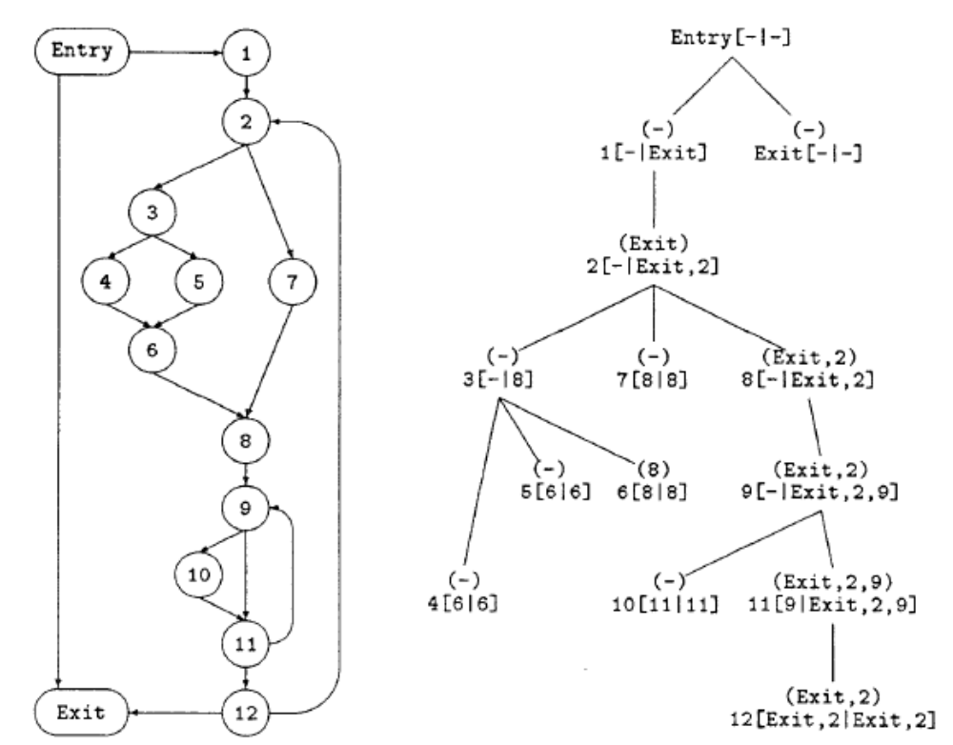
Dominator Tree Example
Fall 2011
“Advanced Compiler Techniques”

Slide 33
Dominance Frontier
Dominance Frontier DF(X) for node X
  Set of nodes Y
  X dominates a predecessor of Y
  X does not strictly dominate Y
Equation 1:
DF(X) ={Y|( ∃P ∈Pred(Y))(X dom P and X !sdom Y )}
Equation 2:
DF(X) = DF_{local}(X)∪ ∪_{Z∈Children(X)}DF_{up}(Z)
DF_{local}(X) = {Y∈Succ(x) | X !sdom Y}
= {Y∈Succ(x) | idom(Y) ≠ X}
DF_{up}(Z) = {Y∈DF(Z) | idom(Z) !sdom Y}
Fall 2011
“Advanced Compiler Techniques”

Slide 34
Dominance Frontier
How to prove equation 1 and equation 2 are correct?
  Easy to See that => is correct
  Still have to show everything in DF(X) has been accounted for.
  Suppose Y ∈DF(X) and U->Y be the edge that X dominate U but doesn’t strictly dominate Y.
  If U == X, then Y ∈ DF_{local}(X)
  If U ≠X, then there exists a path from X to U in Dominator Tree which implies there exists a child Z of X dominate U. Z doesn’t strictly dominate Y because X doesn’t strictly dominate Y.
  So Y ∈DF_{up}(Z).
Fall 2011
“Advanced Compiler Techniques”

Slide 35
Ф-function and Dominance Frontier
Intuition behind dominance frontier
  Y ∈DF(X) means:
    Y has multiple predecessors
    X dominate one of them, say U, U inherits everything defined in X
    Reaching definition of Y are from U and other predecessors
    So Y is exactly the place where Ф-function is needed
Fall 2011
“Advanced Compiler Techniques”

Slide 36
Control Dependences and Dominance Frontier
A CFG node Y is control dependent on a CFG node X if both the following hold:
  There is a nonempty path p: X →⁺ Y such that Y postdominate every node after X.
  The node Y doesn’t strictly postdominate the node X
If X appears on every path from Y to Exit, then X postdominate Y.
Fall 2011
“Advanced Compiler Techniques”

Slide 37
Control Dependences and Dominance Frontier
In other words, there is some edge from X that definitely causes Y to execute, and there is also some path from X that avoids executing Y.
Fall 2011
“Advanced Compiler Techniques”

Slide 38
RCFG
The reverse control flow graph RCFG has the same nodes as CFG, but has edge Y →X for each edge X→Y in CFG.
  Entry and Exit are also reversed.
  The postdominator relation in CFG is dominator relation in RCFG.
Let X and Y be nodes in CFG. Then Y is control dependent on X in CFG iff X∈DF(Y) in RCFG.
Fall 2011
“Advanced Compiler Techniques”

Slide 39
SSA Construction– Place Ф Functions
For each variable V
  Add all nodes with assignments to V to worklist W
  While X in W do
    For each Y in DF(X) do
      If no Ф added in Y then
        Place (V = Ф (V,…,V)) at Y
        If Y has not been added before, add Y to W.
Fall 2011
“Advanced Compiler Techniques”

Slide 40
SSA Construction– Rename Variables
Rename from the ENTRY node recursively
For node X
  For each assignment (V = …) in X
    Rename any use of V with the TOS (Top-of-Stack) of rename stack
    Push the new name V_{i} on rename stack
    i = i + 1
  Rename all the Ф operands through successor edges
  Recursively rename for all child nodes in the dominator tree
  For each assignment (V = …) in X
    Pop V_{i} in X from the rename stack
Fall 2011
“Advanced Compiler Techniques”

Slide 41
Rename Example
TOS
a₁=
a=
a1
a0
a₁+5
a= Ф(a₁,a)
a =
a+5
a+5
Fall 2011
“Advanced Compiler Techniques”

Slide 42
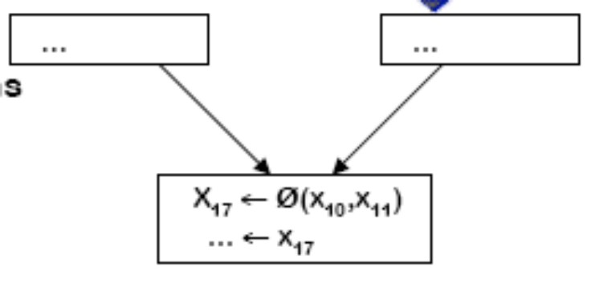
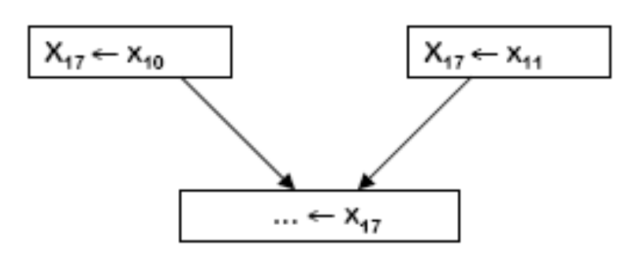
Converting Out of SSA
Eventually, a program must be executed.
The Ф-function have precise semantics, but they are generally not represented in existing target machines.
Fall 2011
“Advanced Compiler Techniques”

Slide 43
Converting Out of SSA
Naively, a k-input Ф-function at entrance to node X can be replaced by k ordinary assignments, one at the end of each control predecessor of X.
Inefficient object code can be generated.
Fall 2011
“Advanced Compiler Techniques”

Slide 44
Dead Code Elimination
Where does dead code come from?
  Assignments without any use
Dead code elimination method
  Initially all statements are marked dead
  Some statements need to be marked live because of certain conditions
  Mark these statements can cause others to be marked live.
  After worklist is empty, truly dead code can be removed
Fall 2011
“Advanced Compiler Techniques”

Slide 45
SSA Example
Dead Code Elimination Intuition
  Because there is only one definition for each variable, if the list of uses of the variable is empty, the definition is dead.
  When a statement v← x ⊕ y is eliminated because v is dead, this statement must be removed from the list of uses of x and y. This might cause those definitions to become dead.
Fall 2011
“Advanced Compiler Techniques”

Slide 46
SSA Example
Simple Constant Propagation Intuition
  If there is a statement v ← c, where c is a constant, then all uses of v can be replaced for c.
  A φ function of the form v ← φ(c1, c2, …, cn) where all ci are identical can be replaced for v ← c.
  Using a work list algorithm in a program in SSA form, we can perform constant propagation in linear time.
Fall 2011
“Advanced Compiler Techniques”

Slide 47
SSA Example
i=1;
j=1;
k=0;
while(k<100)
{
if(j<20)
{
j=i;
k=k+1;
}
else
{
j=k;
k=k+2;
}
}
return j;
}
B1
i ← 1
j ← 1
k← 0
B2
if k<100
B3
if j<20
return j
B4
B5
j ← i
k ← k+1
j ← k
k ← k+2
B6
B7
Fall 2011
“Advanced Compiler Techniques”

Slide 48
SSA Example
i=1;
j=1;
k=0;
while(k<100)
{
if(j<20)
{
j=i;
k=k+1;
}
else
{
j=k;
k=k+2;
}
}
return j;
}
B1
i ← 1
j ← 1
k1← 0
B2
if k<100
B3
if j<20
return j
B4
B5
j ← i
k3 ← k+1
j ← k
k5 ← k+2
B6
B7
Fall 2011
“Advanced Compiler Techniques”

Slide 49
SSA Example
i=1;
j=1;
k=0;
while(k<100)
{
if(j<20)
{
j=i;
k=k+1;
}
else
{
j=k;
k=k+2;
}
}
return j;
}
B1
i ← 1
j ← 1
k1← 0
B2
if k<100
B3
if j<20
return j
B4
B5
j ← i
k3 ← k+1
j ← k
k5 ← k+2
B6
B7
k4 ← φ(k3,k5)
Fall 2011
“Advanced Compiler Techniques”

Slide 50
SSA Example
i=1;
j=1;
k=0;
while(k<100)
{
if(j<20)
{
j=i;
k=k+1;
}
else
{
j=k;
k=k+2;
}
}
return j;
}
B1
i ← 1
j ← 1
k1← 0
B2
k2 ← φ(k4,k1)
if k<100
B3
if j<20
return j
B4
B5
j ← i
k3 ← k+1
j ← k
k5 ← k+2
B6
B7
k4 ← φ(k3,k5)
Fall 2011
“Advanced Compiler Techniques”

Slide 51
SSA Example
i=1;
j=1;
k=0;
while(k<100)
{
if(j<20)
{
j=i;
k=k+1;
}
else
{
j=k;
k=k+2;
}
}
return j;
}
B1
i ← 1
j ← 1
k1← 0
B2
k2 ← φ(k4,k1)
if k2<100
B3
if j<20
return j
B4
B5
j ← i
k3 ← k2+1
j ← k
k5 ← k2+2
B6
B7
k4 ← φ(k3,k5)
Fall 2011
“Advanced Compiler Techniques”

Slide 52
SSA Example
B1
i1 ← 1
j1 ← 1
k1← 0
i=1;
j=1;
k=0;
while(k<100)
{
if(j<20)
{
j=i;
k=k+1;
}
else
{
j=k;
k=k+2;
}
}
return j;
}
B2
j2 ← φ(j4,j1)
k2 ← φ(k4,k1)
if k2<100
B3
if j2<20
return j2
B4
B5
j3 ← i1
k3 ← k2+1
j5 ← k2
k5 ← k2+2
B6
B7
j4 ← φ(j3,j5)
k4 ← φ(k3,k5)
Fall 2011
“Advanced Compiler Techniques”

Slide 53
SSA Example: Constant Propagation
B1
B1
i1 ← 1
j1 ← 1
k1← 0
i1 ← 1
j1 ← 1
k1← 0
B2
B2
j2 ← φ(j4, 1)
k2 ← φ(k4,0)
if k2<100
j2 ← φ(j4,j1)
k2 ← φ(k4,k1)
if k2<100
B3
B4
B3
if j2<20
return j2
B4
if j2<20
return j2
B5
B6
B5
j3 ← 1
k3 ← k2+1
j5 ← k2
k5 ← k2+2
B6
j3 ← i1
k3 ← k2+1
j5 ← k2
k5 ← k2+2
B7
j4 ← φ(j3,j5)
k4 ← φ(k3,k5)
B7
j4 ← φ(j3,j5)
k4 ← φ(k3,k5)
Fall 2011
“Advanced Compiler Techniques”

Slide 54
SSA Example: Dead Code Elimination
B1
i1 ← 1
j1 ← 1
k1← 0
B2
j2 ← φ(j4, 1)
k2 ← φ(k4,0)
if k2<100
B2
j2 ← φ(j4,1)
k2 ← φ(k4,0)
if k2<100
B3
if j2<20
return j2
B4
B3
B4
if j2<20
return j2
B5
j3 ← 1
k3 ← k2+1
j5 ← k2
k5 ← k2+2
B6
B5
B6
j3 ← 1
k3 ← k2+1
j5 ← k2
k5 ← k2+2
B7
j4 ← φ(j3,j5)
k4 ← φ(k3,k5)
B7
j4 ← φ(j3,j5)
k4 ← φ(k3,k5)
Fall 2011
“Advanced Compiler Techniques”

Slide 55
SSA Example: Constant Propagation and Dead Code Elimination
B2
j2 ← φ(j4,1)
k2 ← φ(k4,0)
if k2<100
B2
j2 ← φ(j4,1)
k2 ← φ(k4,0)
if k2<100
B3
B4
B3
if j2<20
return j2
B4
if j2<20
return j2
B5
B6
B5
j3 ← 1
k3 ← k2+1
j5 ← k2
k5 ← k2+2
B6
j3 ← 1
k3 ← k2+1
j5 ← k2
k5 ← k2+2
B7
j4 ← φ(j3,j5)
k4 ← φ(k3,k5)
B7
j4 ← φ(1,j5)
k4 ← φ(k3,k5)
Fall 2011
“Advanced Compiler Techniques”

Slide 56
SSA Example: One Step Further
But block 6 is never
executed! How can we
find this out, and simplify
the program?
B2
j2 ← φ(j4,1)
k2 ← φ(k4,0)
if k2<100
B3
if j2<20
return j2
B4
SSA conditional constant
propagation finds the
least fixed point for the
program and allows
further elimination of
dead code.
B5
k3 ← k2+1
j5 ← k2
k5 ← k2+2
B6
B7
j4 ← φ(1,j5)
k4 ← φ(k3,k5)
Fall 2011
“Advanced Compiler Techniques”

Slide 57
SSA Example: Dead Code Elimination
B2
j2 ← φ(j4,1)
k2 ← φ(k4,0)
if k2<100
B2
j2 ← φ(j4,1)
k2 ← φ(k4,0)
if k2<100
B3
B4
return j2
B4
if j2<20
return j2
k3 ← k2+1
j5 ← k2
k5 ← k2+2
B6
B5
k3 ← k2+1
B7
j4 ← φ(1,j5)
k4 ← φ(k3,k5)
B7
j4 ← φ(1)
k4 ← φ(k3)
Fall 2011
“Advanced Compiler Techniques”

Slide 58
SSA Example: Single Argument φ Function Elimination
B2
j2 ← φ(j4,1)
k2 ← φ(k4,0)
if k2<100
B2
j2 ← φ(j4,1)
k2 ← φ(k4,0)
if k2<100
return j2
B4
B4
return j2
B4
B5
k3 ← k2+1
B5
k3 ← k2+1
B7
j4 ← φ(1)
k4 ← φ(k3)
B7
j4 ← 1
k4 ← k3
Fall 2011
“Advanced Compiler Techniques”

Slide 59
SSA Example: Constant and Copy Propagation
B2
j2 ← φ(j4,1)
k2 ← φ(k4,0)
if k2<100
B2
j2 ← φ(1,1)
k2 ← φ(k3,0)
if k2<100
return j2
B4
B4
return j2
B5
k3 ← k2+1
B5
k3 ← k2+1
B7
j4 ← 1
k4 ← k3
B7
j4 ← 1
k4 ← k3
Fall 2011
“Advanced Compiler Techniques”

Slide 60
SSA Example: More Dead Code
B2
j2 ← φ(1,1)
k2 ← φ(k3,0)
if k2<100
B2
j2 ← φ(1,1)
k2 ← φ(k3,0)
if k2<100
return j2
B4
return j2
B4
B5
k3 ← k2+1
B5
k3 ← k2+1
B7
j4 ← 1
k4 ← k3
Fall 2011
“Advanced Compiler Techniques”

Slide 61
SSA Example: More φ Function Simplification
B2
j2 ← φ(1,1)
k2 ← φ(k3,0)
if k2<100
B2
j2 ← 1
k2 ← φ(k3,0)
if k2<100
return j2
B4
return j2
B4
B5
k3 ← k2+1
B5
k3 ← k2+1
Fall 2011
“Advanced Compiler Techniques”

Slide 62
SSA Example: More Constant Propagation
B2
j2 ← 1
k2 ← φ(k3,0)
if k2<100
B2
j2 ← 1
k2 ← φ(k3,0)
if k2<100
return j2
B4
return 1
B4
B5
k3 ← k2+1
B5
k3 ← k2+1
Fall 2011
“Advanced Compiler Techniques”

Slide 63
SSA Example: Ultimate Dead Code Elimination
B2
j2 ← 1
k2 ← φ(k3,0)
if k2<100
return 1
B4
return 1
B4
B5
k3 ← k2+1
Fall 2011
“Advanced Compiler Techniques”

Slide 64
SSAPRE
Kennedy et al., Partial redundancy elimination in SSA form, ACM TOPLAS 1999
Fall 2011
“Advanced Compiler Techniques”

Slide 65
SSAPRE: Motivation
Traditional data flow analysis based on bit-vectors do not interface well with SSA representation
Fall 2011
“Advanced Compiler Techniques”

Slide 66
Traditional Partial Redundancy Elimination
B₁
a ←x*y
B₂
Before
PRE
SSA form
b ←x*y
B₃
t←x*y
a ←t
After
PRE
B₁
t←x*y
B₂
Not SSA form!
b ←t
B₃
Fall 2011
“Advanced Compiler Techniques”

Slide 67
SSAPRE: Motivation (Cont.)
Traditional PRE needs a postpass transform to turn the results into SSA form again.
SSA is based on variables, not on expressions
Fall 2011
“Advanced Compiler Techniques”

Slide 68
SSAPRE: Motivation (Cont.)
Representative occurrence
  Given a partially redundant occurrence E₀, we define the representative occurrence for E₀ as the nearest to E₀ among all occurrences that dominate E₀.
  Unique and well-defined
Fall 2011
“Advanced Compiler Techniques”

Slide 69
FRG (Factored Redundancy Graph)
E
E
E
E
Control flow edge
E =Φ(E, E, ⊥)
Redundancy edge
E
E
E
E
Without factoring
Factored
Fall 2011
“Advanced Compiler Techniques”

Slide 70
FRG (Factored Redundancy Graph)
E
E
t₀ ← x*y
t₁ ← x*y
E =Φ(E, E, ⊥)
t₂←Φ(t₀, t₁ , t₃)
E
E
← t₂
← t₂
Assume E=x*y
Note: This is in SSA form
Fall 2011
“Advanced Compiler Techniques”

Slide 71
Observation
Every use-def edge of the temporary corresponds directly to a redundancy edge for the expression.
Fall 2011
“Advanced Compiler Techniques”

Slide 72
Intuition for SSAPRE
Construct FRG for each expression E
Refine redundant edges to form the use-def relation for each expression E’s temporary
Transform the program
  For a definition, replace with t←E
  For a use, replace with ←t
  Sometimes need also insert an expression
Fall 2011
“Advanced Compiler Techniques”

Slide 73
Main Steps
Initialization: scan the whole program, collect all the occurrences, and build a worklist of expressions
Then, for each entry in the worklist:
PHI placement: find where the PHI nodes of the FRG must be placed.
Renaming: assign appropriate "redundancy classes" to all occurrences
Analyze: compute various flags in PHI nodes
  This conceptually is composed of two data flow analysis passes, which in practice only scan the PHI nodes in the FRG, not the whole code, so they are not that heavy.
Finalize: make so that the FRG is exactly like the use-def graph for the temporary introduced
Code motion: actually update the code using the FRG.
Fall 2011
“Advanced Compiler Techniques”

Slide 74
An Example
a₁←
t₁← a₁+ b₁
B₁
a₁←
B₁
t₂←φ(t₄ , t₁)
a₂←φ(a₄ , a₁)
a₂←φ(a₄ , a₁)
B₂
B₂
←t₂
a₃←
t₃←a₃+ b₁
←a₂+b
a₃←
B₃
a₄←φ(a₂, a₃)
←a₄+b
t₄←φ(t₂, t₃)
a₄←φ(a₂, a₃)
←t₄
B₄
B₄
exit
B₅
exit
Fall 2011
“Advanced Compiler Techniques”

Slide 75
Benefits of SSAPRE
SSAPRE algorithm is "sparse"
  Original PRE using DFA operates globally.
  SSAPRE operates on expressions individually, looking only at specific nodes it needs.
SSAPRE looks at the whole program (method) only once
  when it scans the code to collect all expression occurrences.
Then, it operates on one expression at a time, looking only at its specific data structures
  which, for each expression, are much smaller than the whole program, so the operations are fast.
Fall 2011
“Advanced Compiler Techniques”

Slide 76
Next Time
Sample Midterm Review
  Midterm Exam (Nov 24th)
Interprocedural Analysis
  Reading: Dragon chapter 12
Fall 2011
“Advanced Compiler Techniques”

