Slide 1
Interprocedural Analysis
Yao Guo

Slide 2
Topics
Up to now
  Intraprocedural analyses
    Dataflow analyses
    Loops
    PRE
    SSA
  Just for individual procedures
Today: Interprocedural analysis
  across/between procedures
Fall 2011
“Advanced Compiler Techniques”

Slide 3
Modularity is a Virtue
Decomposing programs into procedures aids in readability and maintainability
Object-oriented languages have pushed this trend even further
In a good design, procedures should be:
  An interface
  A black box
Fall 2011
“Advanced Compiler Techniques”

Slide 4
The Catch
This inhibits optimization!
The compiler must assume:
  Called procedure may use or change any accessible variable
  Procedure’s caller provides arbitrary values as parameters
Interprocedural optimizations – use the calling relationships between procedures to optimize one or both of them
Fall 2011
“Advanced Compiler Techniques”

Slide 5
Basic Concepts
Procedure (Function )
Caller/ Callee
Call site
Call Graph
Call Context
Call Strings
Formal Arguments
Actual Arguments
Fall 2011
“Advanced Compiler Techniques”

Slide 6
Terminology
  int a, e // globals
  procedure foo(var b, c) // formal args
  b := c
  end
  program main
  int d // locals
  foo(a, d) // call site with
  end // actual args
In procedure body
  formals and/or globals may be aliased (two names refer to same location)
  formals may have constant value
At procedure call
  global vars may be modified or used
  actual args may be modified or used
Fall 2011
“Advanced Compiler Techniques”

Slide 7
The Call Graph
Represent procedure call relationship
by call graph
  G = (V,E,start)
  Each procedure is a unique vertex
  Call site = edge between caller & callee
    (u,v) = call from u to v (u may call v)
    Can label with source line
  Cycles represent recursion
Fall 2011
“Advanced Compiler Techniques”

Slide 8
Call Graphs
f
1 procedure f() {
2 call g()
3 call g()
4 call h()
5 }
6 procedure g() {
7 call h()
8 call i()
9 }
10 procedure h { }
11 procedure i() {
12 call g()
13 call j()
14 }
15 procedure j { }
2,3
4
g
8
h
7
12
i
j
13
Invocation order – process procedure before its callees
Reverse invocation order – process procedure after its callees
Fall 2011
“Advanced Compiler Techniques”

Slide 9
Partial Call Graphs
1 procedure f() {
2 call g()
3 call g()
4 call h()
5 }
6 procedure g() {
7 call h()
8 call i()
9 }
10 procedure h { }
11 procedure i() {
12 call g()
13 call j()
14 }
15 procedure j { }
What if we compile at different times?
f
2,3
4
g
8
h
g
7
12
i
i
j
13
Fall 2011
“Advanced Compiler Techniques”

Slide 10
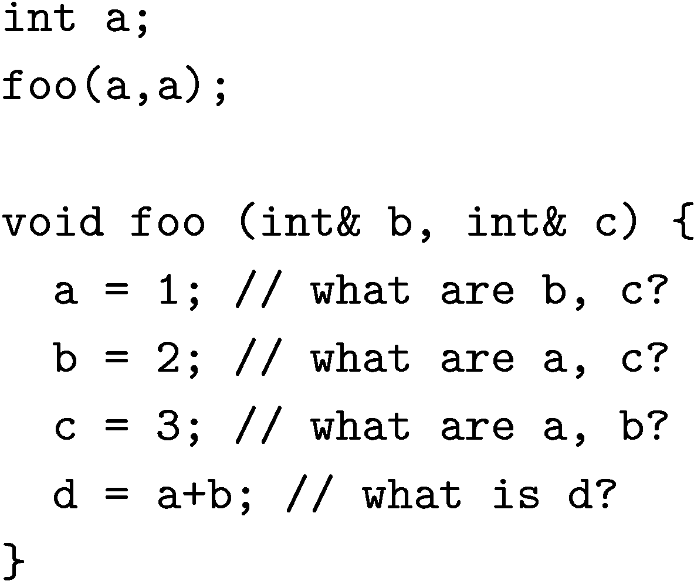
Aliasing Examples, I
Need alias analysis to do:
  Instruction scheduling
  Register allocation
Fall 2011
“Advanced Compiler Techniques”

Slide 11
Aliasing Examples, II
Need alias analysis to do:
  Dead code elimination
  Code motion
Fall 2011
“Advanced Compiler Techniques”

Slide 12
Aliasing Examples, III
Need alias analysis to do:
  Constant propagation
To perform alias analysis, we need…
Fall 2011
“Advanced Compiler Techniques”

Slide 13
Interprocedural Analysis
Goals
  Enable standard optimizations even with procedure calls
  Reduce call overhead for procedures
  Enable optimizations not possible for single procedures
Optimizations
  Register allocation
  Loop transformations
  CSE, etc.
Fall 2011
“Advanced Compiler Techniques”

Slide 14
Analysis Sensitivity
Flow-insensitive
  What may happen (on at least one path)
  Linear-time
Flow-sensitive
  Consider control flow (what must happen)
  Iterative data-flow: possibly exponential
Context-insensitive
  Call treated the same regardless of caller
  “Monovariant” analysis
Context-sensitive
  Reanalyze callee for each caller
  “Polyvariant” analysis
More sensitivity
➔ more accuracy, but more expensive
Fall 2011
“Advanced Compiler Techniques”

Slide 15
Precision of IPA
Flow-insensitive
  result not affected by control flow in procedure
Flow-sensitive
  result affected by control flow in procedure
A
A
B
B
Fall 2011
“Advanced Compiler Techniques”

Slide 16
Context Sensitivity
Reanalyze callee as if procedure was inlined
Too expensive in space & time
  Recursion?
Approximate context sensitivity:
  Reanalyze callee for k levels of calling context
a = id(3);
b = id(4);
3
4
id(x) { return x; }
a = min(3, 4);
s = min(“aardvark”, “vacuum”);
ints
strings
min(x, y) { if (x <= y) return x; else return y; }
Fall 2011
“Advanced Compiler Techniques”

Slide 17
Key Challenges for Interprocedural Analysis
Compilation time, memory
  Key problem: scalability to large programs
  Dominated by analysis time/memory
  Flow-sensitive analyses: bottleneck often memory, not time
  ➔ Often limited to fast but imprecise analyses
Multiple calling environments
Different calls to P() have different properties:
  Known constants
  Aliases
  Surrounding execution context (e.g., enclosing loops)
  Function pointer arguments
  Frequency of the call
Recursion
Fall 2011
“Advanced Compiler Techniques”

Slide 18
Summary Information
Another approach: summarize each procedure
  Effect/result of called procedure for callers
  Effect/input of callers for called procedure
  Store in database for use by later optimization pass
Pros:
  Concise
  Fast
  Practical: separate compilation
Cons:
  Imprecise
Fall 2011
“Advanced Compiler Techniques”

Slide 19
Two Types of Information
Track info that flows into procedures
  “Propagation problems”, e.g.:
    which formals are constant?
    which formals are aliased to globals?
Track info that flows out of procedures
  “Side effect problems”, e.g.:
    which globals defined/used by procedure?
    which locals defined/used by procedure?
    Which actual parameters defined by procedure?
proc(x, y)
{
. . .
}
Fall 2011
“Advanced Compiler Techniques”

Slide 20
Propagation Summaries: Examples
MAY-ALIAS
  Formals that may be aliased to globals
MUST-ALIAS
  Formals definitely aliased to globals
CONSTANT
  Formals that are definitely constant
Fall 2011
“Advanced Compiler Techniques”

Slide 21
Side-Effect Summaries: Examples
MOD
  Variables possibly modified (defined) by procedure call
REF
  Variables possibly referenced (used) by procedure
KILL
  Variables that are definitely killed in procedure
Fall 2011
“Advanced Compiler Techniques”

Slide 22
Computing Summaries
Bottom-up (MOD, REF, KILL)
  Summarizes call effects
Top-down (MAY-ALIAS)
  Summarizes information about caller
Bi-directional (AVAIL, CONSTANT)
  Info to/from caller & callee
Fall 2011
“Advanced Compiler Techniques”

Slide 23
Side-Effect Summarization
At procedure boundaries:
  Translate formal args to actuals at call site
Compute:
  GMOD, GREF = procedure side effects
  MOD, REF = effects at call site
    Possibly specific to call
Fall 2011
“Advanced Compiler Techniques”

Slide 24
Parameter Binding
At procedure boundaries, we need to translate formal arguments of procedure to actual arguments of procedure at call site
  int a,b
  program main // MOD(foo) = b
  foo(b) // REF(foo) = a,b
  end
  procedure foo (var c) // GMOD(foo)= b
  int d // GREF(foo)= a,b
  d := b
  bar(b) // MOD(bar) = b
  end // REF(bar) = a
  procedure bar (var d)
  if (...) // GMOD(bar)= d
  d := a // GREF(bar)= a
  end
Fall 2011
“Advanced Compiler Techniques”

Slide 25
Alternatives to IPA: Inlining
Replaces calls to procedures with copies of their bodies
Converts calls from opaque objects to local code
  Exposes the “effects” of the called procedure
  Extends the compilation region
Language support: the inline attribute
  But the compiler can decide per call-site, rather than per procedure
Fall 2011
“Advanced Compiler Techniques”

Slide 26
Inlining Decisions
Must be based on
  Heuristics, or
  Profile information
Considerations
  The size of the procedure body (smaller=better)
  Number of call sites (1=usually wins)
  If call site is in a loop (yes=more optimizations)
  Constant-valued parameters
Fall 2011
“Advanced Compiler Techniques”

Slide 27
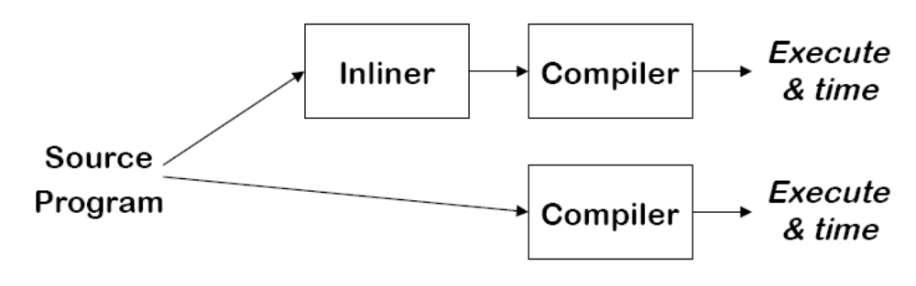
Study on Real Compilers
Cooper, Hall, Torczon (92)
Eight Programs, five compilers, five processors
Eliminated 99% of dynamic calls in 5 of the programs
Measured speed of original vs. transformed code
What do you expect?
V.S.
Fall 2011
“Advanced Compiler Techniques”

Slide 28
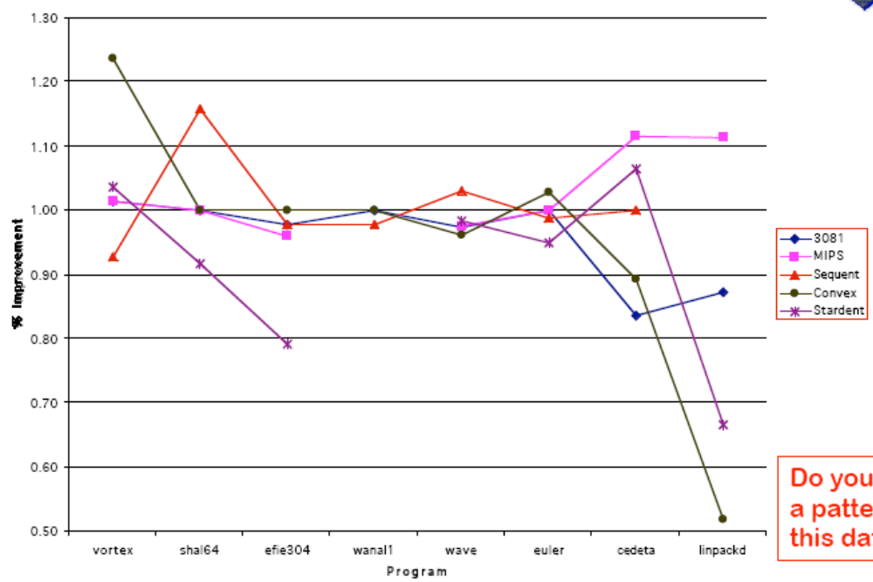
Results on real compilers
Fall 2011
“Advanced Compiler Techniques”

Slide 29
What happened?
Input code violated assumptions made by compiler writers
  Longer procedures
  More names
  Different code shapes
Exacerbated problems that are unimportant on “normal” code
  Imprecise analysis
  Algorithms that scale poorly
  Tradeoffs between global and local speed
  Limitations in the implementations
The compiler writers were surprised!
Fall 2011
“Advanced Compiler Techniques”

Slide 30
Inlining: Summary
Pros
  Exposes context & side effects
  Simple
Cons
  Code bloat (bad for caches, branch predictor)
  Can’t decide statically for OOPs
  Library source?
  Recursion?
  How do we decide when to inline?
Fall 2011
“Advanced Compiler Techniques”

Slide 31
Alternatives to IPA: Cloning
Cloning: customize procedure for certain call sites
Partition call sites to procedure p into equivalence classes
  e.g., {{call₃, call₁}, {call₄}}
Equivalence based on optimization
  Constant propagation: partition based on parameter value
Fall 2011
“Advanced Compiler Techniques”

Slide 32
Cloning
Pros
  Compromise between inlining & IPA
  Less code bloat compared to inlining
  No problem with recursion
  Improves optimization potential (compared to IPA)
Cons
  Some code bloat (compared to IPA)
  Doesn’t eliminate need for IPA
  How do we partition call sites?
Fall 2011
“Advanced Compiler Techniques”

Slide 33
Applications of IPA
Virtual method invocation
Pointer alias analysis
Parallelization
Detection software errors and vulnerabilities
SQL injection
Buffer overflow analysis & protection
Fall 2011
“Advanced Compiler Techniques”

Slide 34
Summary
Interprocedural analysis
  Difficult but expensive
    Need source code, recompilation analysis
    Trade-offs for precision & speed/space
    Better than inlining
  Useful for many optimizations
  IPA and cloning likely to become more important
    Java: many small procedures
Next time:
  Pointer analysis
Fall 2011
“Advanced Compiler Techniques”

