Slide 1
Pointer Analysis

Slide 2
Pointer Analysis
Outline:
  What is pointer analysis
  Intraprocedural pointer analysis
  Interprocedural pointer analysis
    Andersen and Steensgaard
  New Directions
Fall 2011
“Advanced Compiler Techniques”

Slide 3
Pointer and Alias Analysis
Aliases: two expressions that denote the same memory location.
Aliases are introduced by:
  pointers
  call-by-reference
  array indexing
  C unions
Fall 2011
“Advanced Compiler Techniques”

Slide 4
Useful for what?
Improve the precision of analyses that require knowing what is modified or referenced (eg const prop, CSE …)
Eliminate redundant loads/stores and dead stores.
Parallelization of code
  can recursive calls to quick_sort be run in parallel? Yes, provided that they reference distinct regions of the array.
Identify objects to be tracked in error detection tools
x := *p;
...
y := *p; // replace with y := x?
*x := ...;
// is *x dead?
x.lock();
...
y.unlock(); // same object as x?
Fall 2011
“Advanced Compiler Techniques”

Slide 5
Kinds of alias information
Points-to information (must or may versions)
  at program point, compute a set of pairs of the form p->x, where p points to x.
  can represent this information
  in a points-to graph
Alias pairs
  at each program point, compute the set of all pairs (e₁,e₂) where e₁ and e₂ must/may reference the same memory.
Storage shape analysis
  at each program point, compute an
  abstract description of the pointer structure.
x
z
p
y
p
Fall 2011
“Advanced Compiler Techniques”

Slide 6
Intraprocedural Points-to Analysis
Want to compute may-points-to information
Lattice:
  Domain: 2^{{x->y| x∈Var, Y∈Var}}
  Join: set union
  BOT: Empty
  TOP: {x->y| x∈Var, Y∈Var}
Fall 2011
“Advanced Compiler Techniques”

Slide 7
Flow functions
in
F_{x := k}(in) =
in – {x, *}
x := k
out
in
F_{x := a+b}(in) =
in – {x, *}
x := a + b
out
Fall 2011
“Advanced Compiler Techniques”

Slide 8
Flow functions
in
F_{x := y}(in) =
in – {x, *}
U {(x,z) | (y,z)∈in}
x := y
out
in
F_{x := &y}(in) =
in – {x, *}
U {(x, y)}
x := &y
out
Fall 2011
“Advanced Compiler Techniques”

Slide 9
Flow functions
in
F_{x := *y}(in) =
in – {x, *}
U {(x, t) | (y,z)∈in && (z,t) ∈in }
x := *y
out
in
F_{*x := y}(in) =
In – {}
U {(a, b) | (x,a)∈in && (y,b) ∈in }
*x := y
out
Fall 2011
“Advanced Compiler Techniques”

Slide 10
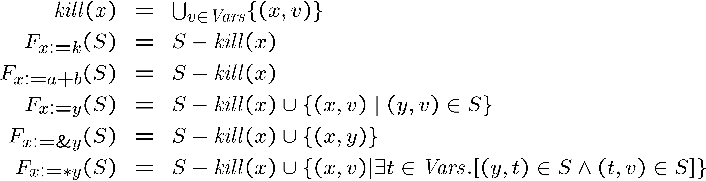
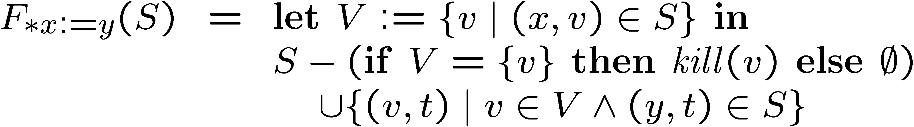
Intraprocedural Points-to Analysis
Flow functions:
Fall 2011
“Advanced Compiler Techniques”

Slide 11
Pointers to dynamically-allocated memory
Handle statements of the form:
x := new T
One idea: generate a new variable each time the new statement is analyzed to stand for the new location:
Fall 2011
“Advanced Compiler Techniques”

Slide 12
Example
l := new Cons
p := l
t := new Cons
*p := t
p := t
Fall 2011
“Advanced Compiler Techniques”

Slide 13
Example solved
l := new Cons
p := l
l
p
t
V1
p
l
V1
V2
t := new Cons
l
p
t
V1
t
V2
p
l
V1
V2
V3
*p := t
p
t
t
l
V1
V2
l
V1
V2
V3
p
p := t
p
t
p
t
l
V1
V2
l
V1
V2
V3
Fall 2011
“Advanced Compiler Techniques”

Slide 14
What went wrong?
Lattice was infinitely tall!
Instead, we need to summarize the infinitely many allocated objects in a finite way.
  introduce summary nodes, which will stand for a whole class of allocated objects.
For example: For each new statement with label L, introduce a summary node loc_{L} , which stands for the memory allocated by statement L.
Summary nodes can use other criterion for merging.
Fall 2011
“Advanced Compiler Techniques”

Slide 15
Example revisited & solved
S1: l := new Cons
Iter 1
Iter 2
Iter 3
p := l
l
p
t
S1
p
l
S1
S2
S2: t := new Cons
l
S1
t
S2
p
*p := t
t
l
S1
S2
p
p := t
p
t
l
S1
S2
Fall 2011
“Advanced Compiler Techniques”

Slide 16
Example revisited & solved
S1: l := new Cons
Iter 1
Iter 2
Iter 3
p := l
p
t
l
p
t
S1
l
S1
S2
p
l
S1
S2
S2: t := new Cons
p
t
p
t
l
S1
t
S2
l
S1
S2
l
S1
S2
p
*p := t
t
p
t
p
t
l
S1
S2
l
S1
S2
l
S1
S2
p
p := t
p
t
p
t
p
t
l
S1
S2
l
S1
S2
l
S1
S2
Fall 2011
“Advanced Compiler Techniques”

Slide 17
Array aliasing, and pointers to arrays
Array indexing can cause aliasing:
  a[i] aliases b[j] if:
    a aliases b and i = j
    a and b overlap, and i = j + k, where k is the amount of overlap.
Can have pointers to elements of an array
  p := &a[i]; ...; p++;
How can arrays be modeled?
  Could treat the whole array as one location.
  Could try to reason about the array index expressions: array dependence analysis.
Fall 2011
“Advanced Compiler Techniques”

Slide 18
Fields
Can summarize fields using per field summary
  for each field F, keep a points-to node called F that summarizes all possible values that can ever be stored in F
Can also use allocation sites
  for each field F, and each allocation site S, keep a points-to node called (F, S) that summarizes all possible values that can ever be stored in the field F of objects allocated at site S.
Fall 2011
“Advanced Compiler Techniques”

Slide 19
Summary
We just saw:
  intraprocedural points-to analysis
  handling dynamically allocated memory
  handling pointers to arrays
But, intraprocedural pointer analysis is not enough.
  Sharing data structures across multiple procedures is one of the big benefits of pointers: instead of passing the whole data structures around, just pass pointers to them (eg C pass by reference).
  So pointers end up pointing to structures shared across procedures.
  If you don’t do an interproc analysis, you’ll have to make conservative assumptions functions entries and function calls.
Fall 2011
“Advanced Compiler Techniques”

Slide 20
Conservative approximation on entry
Say we don’t have interprocedural pointer analysis.
What should the information be at the input of the following procedure:
global g;
void p(x,y) {
...
}
x
y
g
Fall 2011
“Advanced Compiler Techniques”

Slide 21
Conservative approximation on entry
Here are a few solutions:
global g;
void p(x,y) {
...
}
x
y
g
x,y,g &
locations
from alloc
sites prior
to this
invocation
locations
from alloc
sites prior
to this
invocation
They are all very conservative!
We can try to do better.
Fall 2011
“Advanced Compiler Techniques”

Slide 22
Interprocedural pointer analysis
Main difficulty in performing interprocedural pointer analysis is scaling
One can use a bottom-up summary based approach (Wilson & Lam 95), but even these are hard to scale
Fall 2011
“Advanced Compiler Techniques”

Slide 23
Example revisited
Cost:
  space: store one fact at each prog point
  time: iteration
S1: l := new Cons
Iter 1
Iter 2
Iter 3
p := l
p
t
l
p
t
S1
l
S1
S2
p
l
S1
S2
S2: t := new Cons
p
t
p
t
l
S1
t
S2
l
S1
L2
l
L1
L2
p
*p := t
t
p
t
p
t
l
S1
S2
l
S1
S2
l
S1
S2
p
p := t
p
t
p
t
p
t
l
S1
S2
l
S1
S2
l
S1
S2
Fall 2011
“Advanced Compiler Techniques”

Slide 24
New idea: store one dataflow fact
Store one dataflow fact for the whole program
Each statement updates this one dataflow fact
  use the previous flow functions, but now they take the whole program dataflow fact, and return an updated version of it.
Process each statement once, ignoring the order of the statements
This is called a flow-insensitive analysis.
Fall 2011
“Advanced Compiler Techniques”

Slide 25
Flow insensitive pointer analysis
S1: l := new Cons
p := l
S2: t := new Cons
*p := t
p := t
Fall 2011
“Advanced Compiler Techniques”

Slide 26
Flow insensitive pointer analysis
S1: l := new Cons
p := l
l
S1
p
S2: t := new Cons
l
S1
t
S2
p
*p := t
t
l
S1
S2
p
p := t
p
t
l
S1
S2
Fall 2011
“Advanced Compiler Techniques”

Slide 27
Flow sensitive vs. insensitive
S1: l := new Cons
Flow-sensitive Soln
Flow-insensitive Soln
p := l
p
t
l
S1
S2
S2: t := new Cons
p
t
l
S1
S2
p
t
*p := t
l
S1
S2
p
t
l
S1
S2
p := t
p
t
l
S1
S2
Fall 2011
“Advanced Compiler Techniques”

Slide 28
What went wrong?
What happened to the link between p and S1?
  Can’t do strong updates anymore!
  Need to remove all the kill sets from the flow functions.
What happened to the self loop on S2?
  We still have to iterate!
Fall 2011
“Advanced Compiler Techniques”

Slide 29
Flow insensitive pointer analysis: fixed
This is Andersen’s algorithm ’94
Final result
S1: l := new Cons
Iter 1
Iter 2
Iter 3
p := l
p
t
l
p
t
S1
l
S1
S2
p
l
S1
S2
S2: t := new Cons
p
t
p
t
l
S1
t
S2
l
S1
L2
l
L1
L2
p
*p := t
t
p
t
p
t
l
S1
S2
l
S1
S2
l
S1
S2
p
p := t
p
t
p
t
p
t
l
S1
S2
l
S1
S2
l
S1
S2
Fall 2011
“Advanced Compiler Techniques”

Slide 30
Flow insensitive loss of precision
S1: l := new Cons
Flow-sensitive Soln
Flow-insensitive Soln
p := l
p
t
l
S1
S2
S2: t := new Cons
p
t
l
S1
S2
p
t
*p := t
p
t
l
S1
S2
l
S1
S2
p := t
p
t
l
S1
S2
Fall 2011
“Advanced Compiler Techniques”

Slide 31
Flow insensitive loss of precision
Flow insensitive analysis leads to loss of precision!
main() {
x := &y;
...
x := &z;
}
Flow insensitive analysis tells us that x
may point to z here!
However:
  uses less memory (memory can be a big bottleneck to running on large programs)
  runs faster
Fall 2011
“Advanced Compiler Techniques”

Slide 32
Worst case complexity of Andersen
x
y
*x = y
x
y
a
b
c
d
e
f
a
b
c
d
e
f
Worst case: N² per statement, so at least N³ for the whole program. Andersen is in fact O(N³)
Fall 2011
“Advanced Compiler Techniques”

Slide 33
New idea: one successor per node
Make each node have only one successor.
This is an invariant that we want to maintain.
x
y
x
y
*x = y
a,b,c
d,e,f
a,b,c
d,e,f
Fall 2011
“Advanced Compiler Techniques”

Slide 34
More general case for *x = y
x
y
*x = y
Fall 2011
“Advanced Compiler Techniques”

Slide 35
More general case for *x = y
x
y
x
y
x
y
*x = y
Fall 2011
“Advanced Compiler Techniques”

Slide 36
Handling: x = *y
x
y
x = *y
Fall 2011
“Advanced Compiler Techniques”

Slide 37
Handling: x = *y
x
y
x
y
x
y
x = *y
Fall 2011
“Advanced Compiler Techniques”

Slide 38
Handling: x = y (what about y = x?)
x
y
x = y
Handling: x = &y
x
y
x = &y
Fall 2011
“Advanced Compiler Techniques”

Slide 39
Handling: x = y (what about y = x?)
x
y
x
y
x
y
x = y
get the same for y = x
Handling: x = &y
x
y
x
y
x
x = &y
y,…
Fall 2011
“Advanced Compiler Techniques”

Slide 40
Our favorite example, once more!
S1: l := new Cons
1
p := l
2
S2: t := new Cons
3
*p := t
4
p := t
5
Fall 2011
“Advanced Compiler Techniques”

Slide 41
Our favorite example, once more!
1
l
2
l
p
S1: l := new Cons
1
S1
S1
3
p := l
2
l
p
t
l
p
t
S2: t := new Cons
4
3
S1
S2
S1
S2
5
*p := t
4
l
p
t
l
p
t
p := t
5
S1
S2
S1,S2
Fall 2011
“Advanced Compiler Techniques”

Slide 42
Flow insensitive loss of precision
S1: l := new Cons
Flow-insensitive
Unification-
based
Flow-sensitive
Subset-based
Flow-insensitive
Subset-based
p := l
p
t
l
S1
S2
S2: t := new Cons
p
t
l
S1
S2
p
t
l
p
t
*p := t
l
S1
S2
p
t
S1,S2
l
S1
S2
p := t
p
t
l
S1
S2
Fall 2011
“Advanced Compiler Techniques”

Slide 43
Another example
bar() {
i := &a;
j := &b;
foo(&i);
foo(&j);
// i pnts to what?
*i := ...;
}
void foo(int* p) {
printf(“%d”,*p);
}
1
2
3
4
Fall 2011
“Advanced Compiler Techniques”

Slide 44
Another example
p
bar() {
i := &a;
j := &b;
foo(&i);
foo(&j);
// i pnts to what?
*i := ...;
}
void foo(int* p) {
printf(“%d”,*p);
}
1
i
2
i
j
3
i
j
1
2
a
a
b
a
b
3
4
4
p
p
i
j
i,j
a
b
a,b
Fall 2011
“Advanced Compiler Techniques”

Slide 45
Steensgard vs. Anderson
Consider assignment p = q,
i.e., only p is modified, not q
Subset-based Algorithms
  Anderson’s algorithm is an example
  Add a constraint: Targets of q must be subset of targets of p
  Graph of such constraints is also called “inclusion constraint graphs”
  Enforces unidirectional flow from q to p
Unification-based Algorithms
  Steensgard is an example
  Merge equivalence classes: Targets of p and q must be identical
  Assumes bidirectional flow from q to p and vice-versa
Fall 2011
“Advanced Compiler Techniques”

Slide 46
Steensgaard & beyond
A well engineered implementation of Steensgaard ran on Word97 (2.1 MLOC) in 1 minute.
One Level Flow (Das PLDI 00) is an extension to Steensgaard that gets more precision and runs in 2 minutes on Word97.
Fall 2011
“Advanced Compiler Techniques”

Slide 47
Analysis Sensitivity
Flow-insensitive
  What may happen (on at least one path)
  Linear-time
Flow-sensitive
  Consider control flow (what must happen)
  Iterative data-flow: possibly exponential
Context-insensitive
  Call treated the same regardless of caller
  “Monovariant” analysis
Context-sensitive
  Reanalyze callee for each caller
  “Polyvariant” analysis
More sensitivity ) more accuracy, but more expense
Fall 2011
“Advanced Compiler Techniques”

Slide 48
Which Pointer Analysis Should I Use?
Hind & Pioli, ISSTA, Aug. 2000
Compared 5 algorithms
(4 flow-insensitive, 1 flow-sensitive):
  Any address (single points-to set)
  Steensgard
  Anderson
  Burke (like Anderson, but separate solution per procedure)
  Choi et al. (flow-sensitive)
Fall 2011
“Advanced Compiler Techniques”

Slide 49
Which Pointer Analysis Should I Use? (cont’d)
Metrics
  1. Precision: number of alias pairs
  2. Precision of important optimizations: MOD/REF, REACH, LIVE, flow dependences, constant prop.
  3. Efficiency: analysis time/memory, optimization time/memory
Benchmarks
  23 C programs, including some from SPEC benchmarks
Fall 2011
“Advanced Compiler Techniques”

Slide 50
Summary of Results
Hind & Pioli, ISSTA, Aug. 2000
1. Precision: Table 2
  Steensgard much better than Any-Address (6x on average)
  Anderson/Burke significantly better than Steensgard (about 2x)
  Choi negligibly better than Anderson/Burke
2. MOD/REF precision: Table 2
  Steensgard much better than Any-Address (2.5x on average)
  Anderson/Burke significantly better than Steensgard (15%)
  Choi very slightly better than Anderson/Burke (1%)
Fall 2011
“Advanced Compiler Techniques”

Slide 51
Summary of Results (cont’d)
3. Analysis cost:
  Any-Address, Steensgard extremely fast
  Anderson/Burke about 30x slower
  Choi about 2.5x slower than Anderson/Burke
4. Total cost (analysis + optimizations): Steensgard, Burke are 15% faster than Any-Address!
  Anderson is as fast as Any-Address!
  Choi only about 9% slower
Fall 2011
“Advanced Compiler Techniques”

Slide 52
Haven’t We Solved This Problem Yet?
From [Hind, 2001]:
Past 21 years: at least 75 papers and nine Ph.D. theses published on pointer analysis
Fall 2011
“Advanced Compiler Techniques”

Slide 53
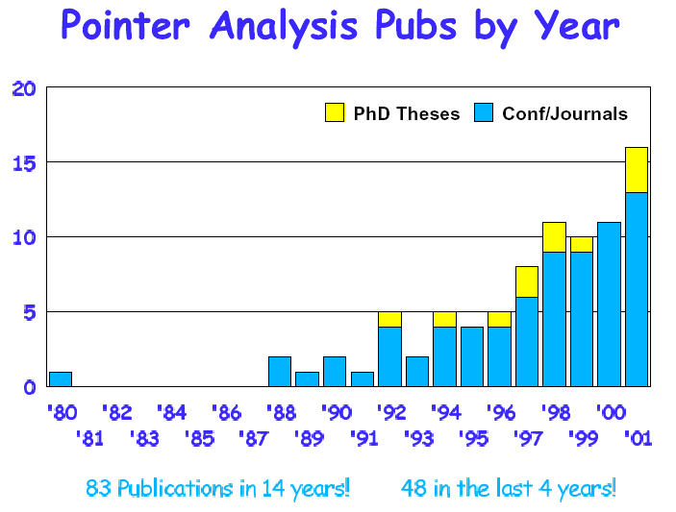
Many Publications…
Fall 2011
“Advanced Compiler Techniques”

Slide 54
So Which Pointer Analysis is Best?
Comparisons between algorithms difficult
  Size of points-to sets inadequate
    Model heap as one blob = one object for all heap pointers!
Trade-offs unclear
  Faster pointer analysis can mean more objects
  = more time for client analysis
  More precise analysis can reduce client analysis time!
Idea: use client to drive pointer analyzer…
Fall 2011
“Advanced Compiler Techniques”

Slide 55
New Approaches
Speculative Pointer Analysis
  Traditional analysis is conservative, to guarantee correctness.
    Applications:
    program transformation, program optimization
  Some application does not require 100% correctness.
    Most important: applicability and usability
Fall 2011
“Advanced Compiler Techniques”

Slide 56
Speculative Pointer Analysis (SPA) – An Example
int a,b;
int *p;
p = &a;
for (i=0…1000){
*p = 5;
p = &b;
}
p
a
a
p
p
b
p
a
b
p
b
p
b
Fall 2011
“Advanced Compiler Techniques”

Slide 57
Purpose of SPA
Optimize pointer location set widths in loop bodies speculatively
Remove unlikely or infrequent location sets
  Improves ability to manage access statically in our context
  Improves precision for the typical case
Fall 2011
“Advanced Compiler Techniques”

Slide 58
Summary of SPA
Traditional pointer analysis
  Based on compile time provable information
  Stops analysis if that cannot be guaranteed
  Used in many performance optimization techniques
Speculative pointer and distance analysis
  Always completes analysis without restrictions
  Extracts precise information for our purposes
  Targets compiler-enabled memory systems
Fall 2011
“Advanced Compiler Techniques”

Slide 59
Probability-based Pointer Analysis (ASPLOS’06)
Silvia & Steffan, U Toronto
Define a probability for a points-to relation
Use matrix calculation to compute the resulting probability for each pointer
Fall 2011
“Advanced Compiler Techniques”

Slide 60




Probabilistic Pointer Analysis (PPA)
Conventional Pointer Analysis
*a = ~
~ = *b
optimize
optimize
p = 1.0
PPA
Definitely
Pointer
Analysis
p = 0.0
Definitely Not
0.0 < p < 1.0
Maybe
*a = ~
~ = *b
Do pointers a and b point to the same location?
  Do this for every pair of pointers at every program point
With what probability p, do pointers a and b point to the same location?
  Do this for every pair of pointers at every program point
Fall 2011
“Advanced Compiler Techniques”

Slide 61
PPA Research Objectives
Accurate points-to probability information
  at every static pointer dereference
Scalable analysis
  Goal: The entire SPEC integer benchmark suite
Understand scalability/accuracy tradeoff
  through flexible static memory model
Improve our understanding of programs
Fall 2011
“Advanced Compiler Techniques”

Slide 62


Algorithm Design Choices
Fixed
  Bottom Up / Top Down Approach
  Linear transfer functions (for scalability)
  One-level context and flow sensitive
Flexible
  Edge profiling (or static prediction)
  Safe (or unsafe)
  Field sensitive (or field insensitive)
Fall 2011
“Advanced Compiler Techniques”
Notes:
1 – level to achieve linearity
Fscs to get probability info

Slide 63
Traditional Points-To Graph
int x, y, z, *b = &x;
void foo(int *a) {
if(…)
b = &y;
if(…)
a = &z;
else(…)
a = b;
while(…) {
x = *a;
…
}
}
= pointer
=
Definitely
= pointed at
=
Maybe
b
a
x
y
z
UND
Results are inconclusive
Fall 2011
“Advanced Compiler Techniques”
Notes:
For simplification purposes lets assume that when we enter foo a is always undefined and b always points to x.

Slide 64
Probabilistic Points-To Graph
int x, y, z, *b = &x;
void foo(int *a) {
if(…)
b = &y;
if(…)
a = &z;
else(…)
a = b;
while(…) {
x = *a;
…
}
}
= pointer
=
p = 1.0
0.1 taken(edge profile)
p
= pointed at
=
0.0<p< 1.0
0.2 taken(edge profile)
b
a
0.72
0.9
0.1
0.2
0.08
x
y
z
UND
Results provide more information
Fall 2011
“Advanced Compiler Techniques”

Slide 65
Summary
Pointer Analysis
  Overview
  Andersen’s Algorithm
  Steensgard’s Algorithm
  New Directions
Next Time
  Locality Analysis
Fall 2011
“Advanced Compiler Techniques”

