Slide 1
Course Report:
Designing Software for Ease of Extension and Contraction
Presenter: Shao, Lingshuang

Slide 2
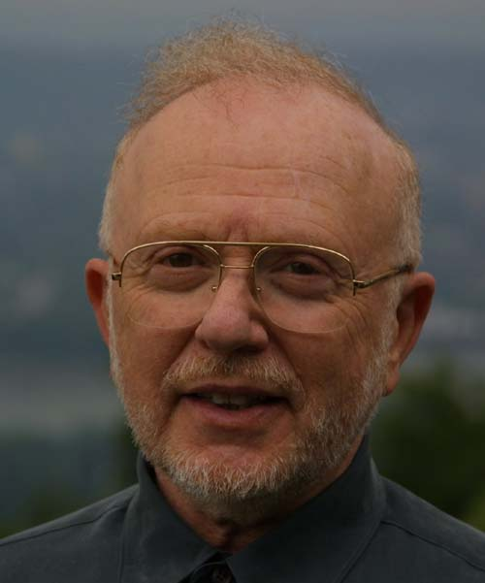
Background: Parnas
David Lorge Parnas (born February 10, 1941) is an early pioneer of software engineering who developed the concept of module design which is the foundation of object oriented programming today. He is also noted for his advocacy of technical realism.
In modular design his double dictum of high cohesion within modules and loose coupling between modules is fundamental to modular design in software. However, in Parnas's seminal 1972 paper On the Criteria to Be Used in Decomposing Systems into Modules, this dictum is expressed in terms of information hiding, and the terms cohesion and coupling are not used.

Slide 3
Background: Parnas
What was your greatest influence?
  I suppose that my early work on "Information Hiding" has had the most influence but I look around and don't see it being used enough. I see it mentioned in papers, and explained (very briefly) in many textbooks but when I look at real systems, I see that it is not being used in most systems.
  Unfortunately, most of the O-O code that I have seen hides nothing. The programs look like COBOL programs with a new syntax.

Slide 4
Background: Parnas
Who do you think has made the greatest impact on software engineering?
An influential academic would be Edsger W. Dijkstra; However, I don't think his work has changed our software very much; few developers read or understand his work.
In contrast, if you look for a single individual who has actually influenced what is done in industry, it would have to be Fred Brooks. "The Mythical Man Month" should be read by every software developer.
Somewhere in the middle, you can find Harlan D. Mills. He had many good ideas such as using "program functions" instead of pre/post-conditions.

Slide 5
Background: Parnas
What advice do you have for computer science/software engineering students?
Most students who are studying computer science really want to study software engineering but they don't have that choice. There are very few programs that are designed as engineering programs but specialize in software.
pay more attention to the fundamental ideas rather than the latest technology. The technology will be out-of-date before they graduate. Fundamental ideas never get out of date. I think there are fundamental design principles, for example structured programming principles, the good ideas in "Object Oriented" programming, etc.

Slide 6
Background: Parnas
What is the most often-overlooked risk in software engineering?
Incompetent programmers. There are estimates that the number of programmers needed in the U.S. exceeds 200,000. This is entirely misleading. It is not a quantity problem; we have a quality problem. One bad programmer can easily create two new jobs a year. Hiring more bad programmers will just increase our perceived need for them. If we had more good programmers, and could easily identify them, we would need fewer, not more.

Slide 7
Background: Parnas
What is the most-repeated mistake in software engineering?
People tend to underestimate the difficulty of the task. Overconfidence explains most of the poor software that I see. Doing it right is hard work. Shortcuts lead you in the wrong direction and they often lead to disaster.
What are the most exciting/promising software engineering ideas or techniques on the horizon?
I don't think that the most promising ideas are on the horizon. They are already here and have been here for years but are not being used properly.

Slide 8
Background
Edsger W. Dijkstra, Go To Statement Considered Harmful, Communications of the Association for Computing Machinery (CACM) in 1968
Structured programming
  O. J. Dahl, E. W. Dijkstra, C. A. R. Hoare
  Year of Publication: 1972
模块化的概念已被提出了近四十年
  1972年Parnas提出了功能独立性这样的概念
Designing Software for Ease of Extension and Contraction", IEEE Transaction on Software Engineering, …
DL Parnas - 1979 - SE-5

Slide 9
Related Publications
David Lorge Parnas: On the Design and Development of Program Families. IEEE Trans. Software Eng. 2(1): 1-9 (1976)
David Lorge Parnas, Georg Handzel, Harald Würges: Design and Specification of the Minimal Subset of an Operating System Family (Abstract). ICSE 1976: 123
David Lorge Parnas: Designing Software for Ease of Extension and Contraction. ICSE 1978: 264-277
On the criteria to be used in decomposing systems into modules
David Lorge Parnas, Paul C. Clements, David M. Weiss: The Modular Structure of Complex Systems. ICSE 1984: 408-419

Slide 10
Four Problems
Subset would not work until everything worked
Want to add simple capability, but need to rewrite almost all the programs
Want to simplify and speed up…
Not flexible enough for tailoring

Slide 11
Software as a family of programs
We consider a set of programs to be a program family if they have so much in common
Exploiting the commonalities, share code and reduce maintenance costs
  Simula 67 introduced most of the key concepts of object-oriented programming: both objects and classes, subclasses (usually referred to as inheritance)

Slide 12
Software as a family of programs
Differences for members of a family
  Run on different hardware configuration
  Same function but Diff. input & output
  Diff. in data structure or algorithm because of
  different resource
  Diff. in data structure or algorithm because of
  size of input data or frequency of certain events
  Subset of features

Slide 13
Software as a family of programs
Comparison between engineer and mathematician
  For mathematician, more general result is always superior
  For electrical engineering, not the same

Slide 14
Motivation of this paper
Some users may require only a subset of the services or features that other users need. These “less demanding” users may demand that they not be forced to pay for the recourses consumed by the unneeded features.
The problem:
  Families of programs in which some members are subsets of other family members, or
  Several members share a common subset

Slide 15
How does the lack of subsets and extensions manifest itself
Problems in extending or shrinking systems
  Excessive info. distribution: assuming a given feature, e.g. languages in TV
  A chain of data transforming components: e.g. payroll program
  Components perform more than one function: e.g. message sending and acknowledgement
  Loops in the “uses” relation: e.g. scheduler and file systems in OS

Slide 16
Steps towards a better structure
Requirements definition: identifying the subset first
  2nd ICSE, identifying req. before designing
  Identification possible subsets is part of identifying the requirements
  One
    first searches for the minimal subset that might conceivably perform a useful service
    Then searches for the minimal increments

Slide 17
Steps towards a better structure
Information hiding: interface and module definition
  One of the most influential concept (also proposed by Parnas)
  Isolating the changeable part and rest of the product remains stable

Slide 18
Steps towards a better structure
The virtual machine concept
  It’s necessary to stop thinking of systems in terms of components that correspond to steps in the processing
  Use the machine at hand to implement a few new instructions
  At each step we take advantage of the newly introduced features

Slide 19
Steps towards a better structure: Use Structure(1)
Designing the uses structure
  Uses vs. invocation
    A is required to invoke B at specific occasion
    A uses the interrupt handling

Slide 20
Steps towards a better structure: Use Structure(2)
Designing the uses hierarchy
  Level 0: all programs that use no other programs
  Level i: use at least one programs in i-1 and no program at level higher than i-1

Slide 21
Steps towards a better structure: Use Structure(3)
A uses B, when all these conditions hold
  A is essentially simpler because it uses B
  B is not substantially more complex because it is not allowed to use A
  There is a useful subset containing B and not needing A
  There is no conceivably useful subset containing A but not B
Sandwiching

Slide 22
Steps towards a better structure: Use Structure(4)
Use of word “convenience”
  Use the word “convenience” to describe a reason for introducing a certain facility at a given level of the hierarchy
  We speak of convenience to make it clear that one could implement any functions on a lower level, but the availability or the additional programs at the higher level is useful

Slide 23
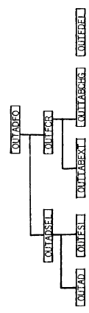
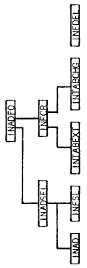
Case Study

Slide 24
Conclusion
The requirements includes subsets and extensions
Advantages of the virtual machine approach

Slide 25
Impact of this paper
The ideas proposed in this and its related papers, such as information hiding, cohesion & coupling, hierarchical systems and program family and the foundations of following researches:
  Object Oriented
  Component Oriented
  Aspect Oriented
  SA
  Requirement engineering, Product Line and Product Family

