Slide 1
Capturing More World Knowledge in the Requirements Specification
------Sol J.Greenspan
John Mylopoulos
Alex Borgida
Liu Yi @OO team
2007-12-18

Slide 2
Agenda
Introduction to the authors
Background
Content of the paper
Influence of the Paper
Typical questions & Discussions

Slide 3
Sol J.Greenspan
Since 2002,Program Director at the National Science Foundation (USA) in the Division of Computing and Communication Foundations
Selected Current Activities
  Associate Program Chair for International Conference on RE
  Automated Software Engineering Journal.
  Requirements Engineering Journal.
  Member and Past Chair of IFIP Working Group 2.9 (Software Requirements Engineering).
main research interests: requirements engineering, technology transfer and business rules.
Notes:
Associate Program chair 副主席
IFIP: International Federation for information processing(国际信息处理联合会)
Business rules商务规则
Technology transfer is the process of developing practical applications for the results of scientific research. (为科学研究的结果开发实际的应用)

Slide 4
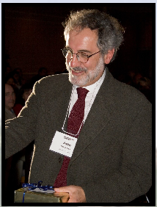
John Mylopoulos
        At present:
        University of Toronto
        Editors of several journals
        main research interests :information systems, knowledge representation, semantic web and requirements engineering.
        Resume
        1966:received his bachelor degree from Brown University
        1970:PhD degree from Princeton
        1970-present: University of Toronto

Slide 5
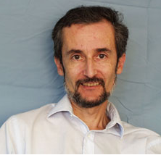
Alex Borgida
      At present
      Rutgers University & Toronto University
      Main research interests:Description Logics, Conceptual modeling. Goal-oriented Database Management.
      Resume:
      M.Sc &Ph.D: University of Toronto 1975,1977
      1981-1992:assistant Professor, Rutgers University
      1984-1999:Bell Laboratories, Stanford University, University of Trento
      1993-present: Proffessor, Rutgers University
      2006-present: Proffessor, Toronto University

Slide 6
Background
Requirements definition is the task of gathering all of the relevant information to be used in understanding a problem situation prior to system development.
The form and content of the requirement specification can have tremendous impact on the task of software throughout its lifetime

Slide 7
Background
“The real problem is the mass of detailed requirements; and the only solution is discovery or invention of general rules and abstractions which cover the many thousands of cases with as few exceptions as possible.”
----C.A.R. Hoare
The fifteenth winner of Turing Award(1980 )
For his fundamental contributions to the definition and design of programming languages

Slide 8
Content of the paper
This paper presents a framework for requirements modeling called RMF
  Three types of conceptual entities
    objects, activities, assertion
  Properties
  Three abstraction principles
    classification, aggregation，generalization

Slide 9
Content of the paper
Introduction
Modeling and Abstraction
The Features of RMF
Related Work
An Assessment of RMF

Slide 10
Introduction
Requirement specification is important
It’s hard to get the requirement right
Software requirements involve the representation (modeling) of considerable real-world knowledge, not just functional specifications
Most current requirements languages concentrate primarily on functional specification

Slide 11
2.Modeling and Abstraction
Introduces the modeling approach and discusses the central theme, abstraction mechanisms

Slide 12
2.1 A modeling approach
The major goal of RMF: Form a synthesis of some modeling principles which are essential to the requirements modeling task
(1) What kind of information should be captured in requirement model?
  RMF offer three kinds of specification units: object, activity, assertion
(2) How should a requirements model be structured?
  abstraction mechanisms

Slide 13
2.2 Abstraction mechanisms
Abstraction mechanism : any descriptive facility that allows certain kinds of information to be included while precluding other, “low-level” or “less important” details.
Aggregation
  Allows an entity to be viewed as a collection of components, or parts
Classification
  Allows a new entity, the class, to capture common characteristics shared by a group of entities
Generalization
  Captures the common characteristics of several classes

Slide 14
A principal design goal of RMF
Apply the abstraction mechanisms uniformly over all the entity categories
In an RMF model
  Classes for object, activity, and assertion entities; entities of all categories can have component parts
  Classes of each entity category are organized according to their generality/specificity

Slide 15
3. The features of RMF
3.1 Tokens, classes and metaclasses
3.2 property—factual and definitional
3.3 Objects, activities, assertions
3.4 Generalization

Slide 16
3.1 Tokens, classes and metaclasses
Classification abstraction
Stratify entities according to whether they are considered “individuals”
Tokens: individuals
  John-smith
  instances of a class
classes: collections of token
  PERSON
  instances of a metaclass
Metaclasses:classes of classes
  PERSON_CLASS

Slide 17
3.2 property—factual and definitional
Aggregation abstraction
Entities can be related to other entities by participating in properties
Three items of information
<subject, attribute(propertyname),value>
<John-smith, age, 23>
Two types of property
  Factual
  Definitional (PERSON,age,AGE_VALUE)
Property induction principle
Notes:
The property induction principle relates these two dimensions in a coherent way

Slide 18
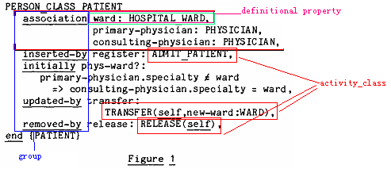
3.3 Objects, activities, assertions
Object represent the “the things” in the world
<attribute>:<value>

Slide 19
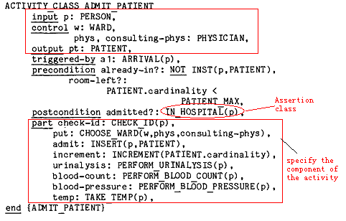
3.3 Objects, activities, assertions
Activity class

Slide 20
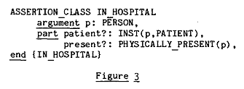
3.3 Objects, activities, assertions
Assertion class

Slide 21
3.4 Generalization
Generalization abstraction
A new relationship—subclass
  It can be declared between two classes or two metaclasses
Between object classes
  PATIENT→PERSON
  Every instance of PATIENT is an instance of PERSON
  All definitional properties of PERSON are inherited by PATIENT
  Concentrate on the additional information of the subclass

Slide 22
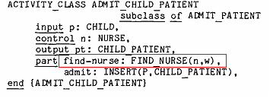
3.4 Generalization
  A form of stepwise refinement that is based on the introduction of detail for special cases
Between activity classes
  ADMIT_CHILD_PATIENT→ADMIT_PATIENT

Slide 23
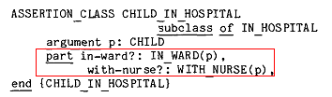
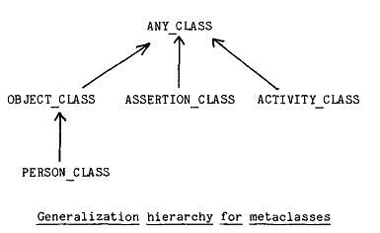
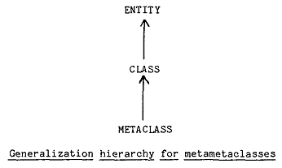
3.4 Generalization
Between assertion classes
Specialization hierachies
Notes:
Point out metaclass are also organized into specialization hierarchies

Slide 24
4. Related work
4.1 Related requirements languages
  Softech’s SADT
    SADT是一种结构化分析与设计的技术
    分析员可以建立一个由许多分层定义的活动图和数据图组成的模型
    Three arrow types: Input/Control/Output
    活动图中：结点表示活动，弧表示活动之间的数据流。数据图中：结点表示数据对象，胡表示对于数据对象的活动
    RMF’s “object” and “activity” correspond to SADT’s data and activity
    RMF adds “assertion” & makes explicit the use of abstraction
    RMF:various kind of relationships
Notes:
Compare to relate work
Argue the advantages
coincidence

Slide 25
4. Related work
4.1 Related requirements languages
  PSL (Problem Statement Language)
    一种用计算机处理的形式语言
    PSL可以从系统的信息流、系统结构、数据结构、数据的推导、系统的规模和容量、系统的动态特性、系统的性质和项目管理８个方面描述系统中的每个对象，以及对象间的关系
    Many of the RMF property categories coincide with these useful PSL relationships, and all PSL statements can be expressed in RMF

Slide 26
4. Related work
4.1 Related requirements languages
  RSL (Requirement Statement Language )
    A functional specification language oriented to real-time systems
    Offers a set of relationships more concise than PSL
    There is no enforced relationship between data associated with its entity-class and data associated with its entity-types
    RMF attempts to provide a more general modeling facility.

Slide 27
4. Related work
4.2 Semantic database modeling and knowledge representation
  In AI and Data Base Management: real-world knowledge is of paramount importance for building computer systems
  AI: Generalization (“Is-A hierarchies”), modulo the assertion class
  Data Bases: aggregation , generalization
  RMF has its roots in previous work in AI and Data Bases

Slide 28
4. Related work
RMF’s novel capabilities:
  Assertions as another category of entities
  Property categories for defining pertinent information types
  The uniform application of the abstraction principles to all object categories

Slide 29
5. An assessment of RMF
5.1 Concerning methodology
5.2 An underlying model for RMF
5.3 Uniformity
5.4 Conclusion

Slide 30
5.1 Concerning methodology
At the heart of many software development methodologies lies one or more abstraction mechanisms.
  Ignore details at some level
  Plus a refinement principle
  E.g:
    aggregation abstraction: core of methodologies such as “stepwise refinement”

Slide 31
5.1 Concerning methodology
The paper’s contention: Generalization is an invaluable organizational tool for system description in general, and for requirement in particular
The main idea guided by generalization
  A model can be constructed by modeling first the most general classes, and then proceeding to more specialized classes.
It is complementary to “aggregation”
Notes:
The generalization abstraction has not been exploited in software engineering as have the other dimensions

Slide 32
5.2 An underlying model for RMF
Based on a logic involving time
The “world” being described is characterized essentially by knowledge of what entities are instances of what classes
  Instances of object class: entities that are deemed to exist
  Instances of activity class: activities that are occurring, or active at that time
  Instances of assertion class: assertions that are true at that moment

Slide 33
5.2 An underlying model for RMF
During the time when an entity belongs to a class, the object is expected to have the factual properties induced by the definitional properties of the class
A description can be expressed in the form of axiom defining the meaning of the “instance of” and “subclass-of” relation
Such an underlying model relates an RMF description to formal semantics which will be useful for developing theoretical and pragmatic tools supporting the consistency of description

Slide 34
5.3 Uniformity
Given the “Instance of “ relation & initial/final situation → define primitive insert/remove actions
Above is intuitive for objects
For activities: activation/termination
For assertion: insertion/removal of entities → true/false
Generalization hierarchies on each category results in an interesting perspective
Property categories: symmetry,duality
  initially, precondition, inserted-by: assert sth about the insert time of the subject
  Postcondition, remove-by : remove time

Slide 35
5.4 Conclusion
Combine the abstraction mechanisms in a simple, constructive way
Explain some principles of interaction and their appropriateness for requirements specification
More world knowledge refers to the semantic information
More formally and without resorting to more implementation concepts
Notes:
Do not claim have invented the abstraction mechanisms
Independently motivated by several modeling endeavors
Conveyed by the EMF

Slide 36
5.4 Conclusion
Successful modeling depends not just on how one represents knowledge but on how one structures or organizes it

Slide 37
Influence of the Paper
Published the paper in 1982
Get the reward in 1994
Since 1980s: Object-oriented Modeling Language emerges
October 1995: UML0.8

Slide 38
Typical Question & Discussions
EMF vs. Use case Diagram
把分类，聚合，泛化等应用到activity，assertion，和meta-class上有些牵强
文中没有说明如何提取entities等信息(SADT-like technique)
文章引入的元类以及元类的元类等概念，作用究竟体现在什么地方？现在的面向对象方法中有没有类似的概念和内容呢？

Slide 39
The end
Thanks
Merry Christmas & Happy New Year
☺

