Slide 1
The True Beauty Filter
Vivian Thai, Yao Poudima, Jessica Castor, Alicia A., Nadia N.

Slide 2
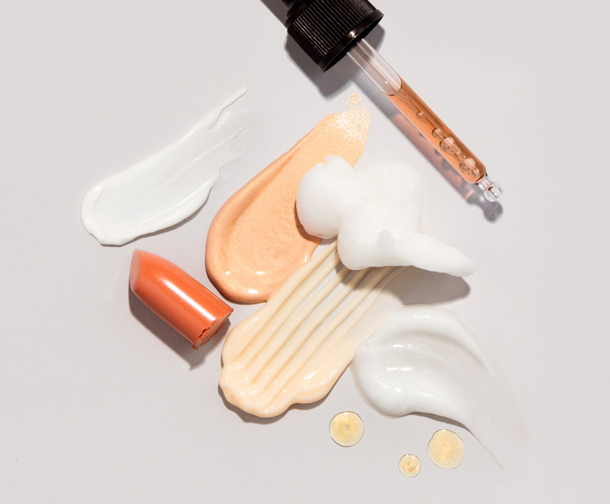
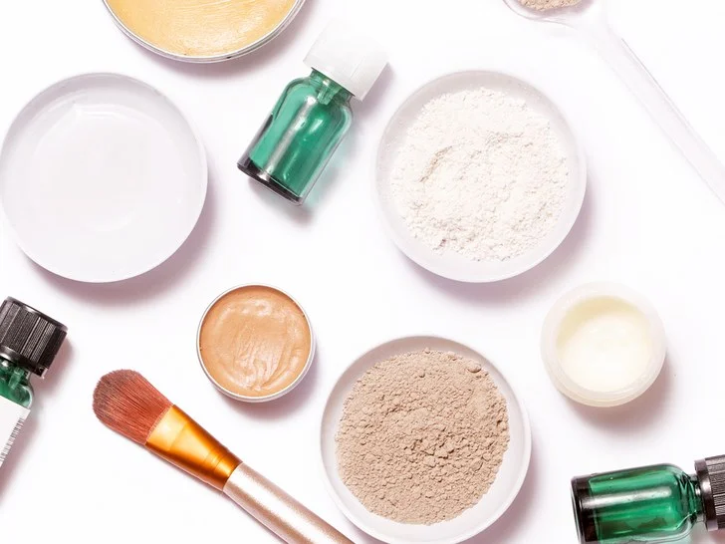
What is the problem?
The average consumer does not make educated purchases in the cosmetic industry. Because of this they are ultimately putting their health at risk.

Slide 3
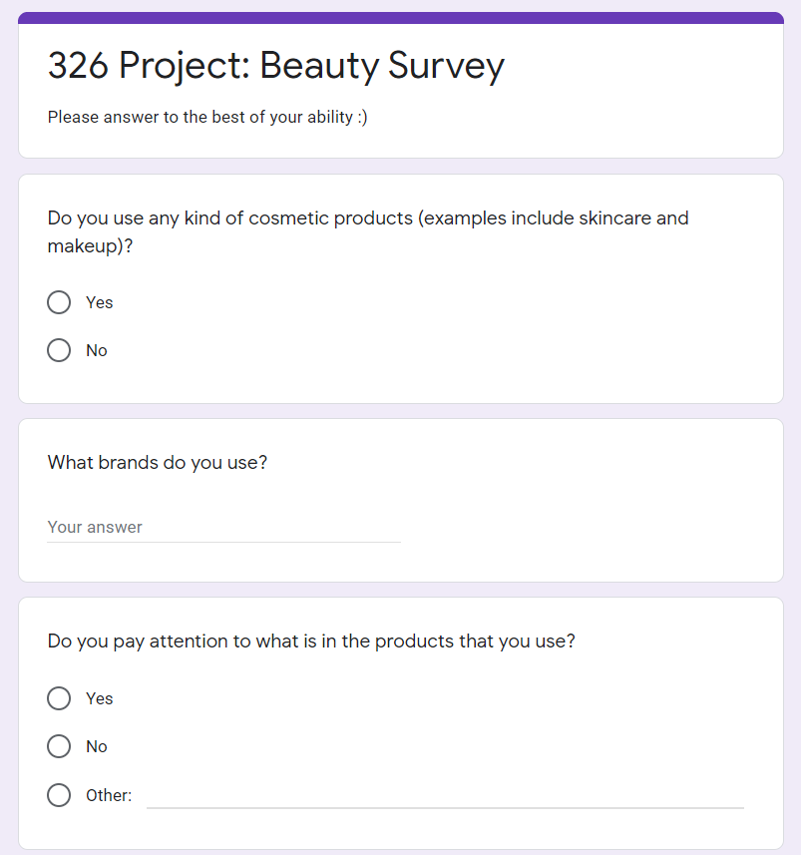
Survey Results
We sent out a quick survey to scope out what exactly people deal with when it comes to their cosmetic consumption.
Notes:
We took a survey to see how many people who use skin care products are aware of what is within their products. The results showed that a shocking __% are not aware of the ingredients in their products. Knowing the ingredients within your products is crucial since over the years many products people have faithfully used have been proven to attribute to some diseases.

Slide 4
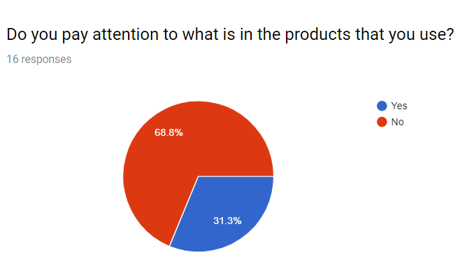
Notes:
Talk about what these results mean about the average consumer

Slide 5
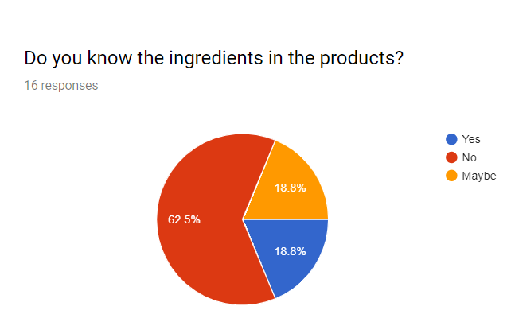
Notes:
Talk about what these results mean about the average consumer

Slide 6
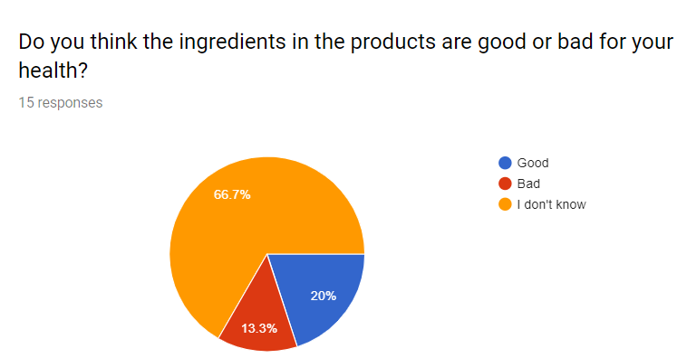
Notes:
Talk about what these results mean about the average consumer

Slide 7
What The True Beauty Filter does:
Enhances consumer experience with education through identifying ingredients that are in cosmetic products.
Functionalities:
Gather user information
Ingredients filter and identification
Data analysis

Slide 8
Ingredients Filter
Allow for user to search their ingredients and/or ingredient list and display information about the ingredient. The output displayed will be information about the subcategory the ingredient falls into and a short description of the ingredient itself.

Slide 9
Data Analysis
Visual display of how different the Europe and USA regulations are within the cosmetic industry.

Slide 10
In Conclusion
From the information, we gathered we realized that people truly don’t know what is in their products. With the true beauty filter, we hope to educate and encourage users to know what is good and bad for their skin. We want to help identify the difference in ingredients between Europe and the USA. This helps users understand what beauty standards differ from each countries.

Slide 11
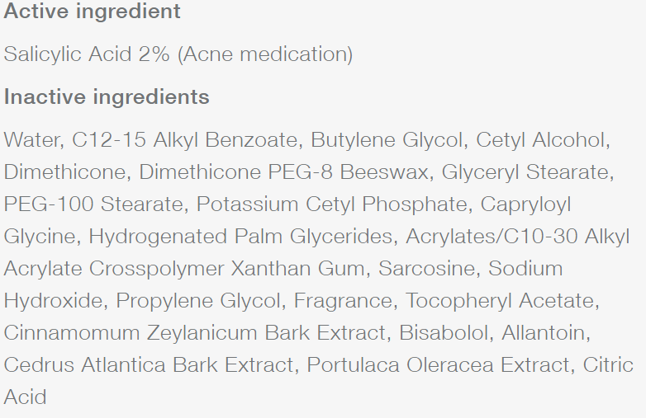
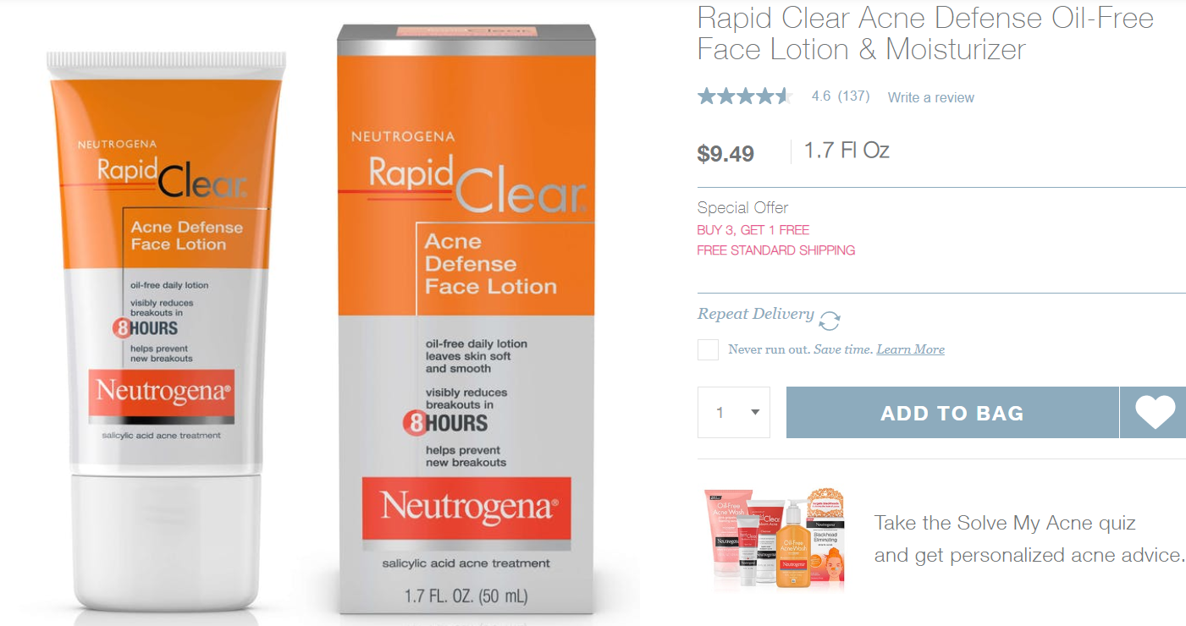
Let’s Test It

