Slide 1

presents
team asia fun time

Slide 2


Slide 3
combineborgs
combineborgs exist for the soul purpose of defending mobile bases no matter what the cost.

Slide 4
combat
With their advanced two pilot fighting styles, COMBINEBORGS are the ultimate in building scale hand-to-hand combat.
One pilot drives the COMBINEBORG from the cockpit located in the bottom half of the Borg, enabling the top pilot to unleash the full fury of the Borg’s fatal flying fists.

Slide 5
Bases
Your main objective is to defend your mobile base. The bottom pilot is in charge of moving and protecting the base while the top half scouts for enemy threats. If a threat is detected you must combine your powers and form the ultimate combineborg to neutralize the threat. This forces the mobile base to be set down and left unprotected.
Mobile bases have a shield that will protect them from damage, but if their COMBINEBORG has been destroyed they have to use all of their power to repair the COMBINEBORG. This leaves the mobile base open to attacks because they can no longer power their shield.

Slide 6
Two Teams
COMBINEBORGS is a four player game with two teams
Each team has a side of the screen
The top player of each side is the fighter
The bottom player is a protector

Slide 7
controls
Top half [scout form]
Left stick:
Move
Turn
“A” button:
Attach to Borg
PRESS START TO RESTART

Slide 8
controls
Top half [Fighter Form]
Triggers:
punch
Bumpers:
Block
Left stick:
Rotation
PRESS START TO RESTART

Slide 9
controls
Bottom half
Left stick
Throttle left
Right stick:
Throttle right
Left bumper:
thrusters
PRESS START TO RESTART

Slide 10
About Game
combineborgs
Pixel Jam Theme: By your powers combined
Combineborgs focuses on teamwork from the start. It’s a game where you and your team member are near useless apart but together you are a unstoppable fighting machine. This was inspired from the theme ‘By your powers combined’ . We felt that the best way to symbolize this theme was with the power of friendship between two Mech pilot.

Slide 11
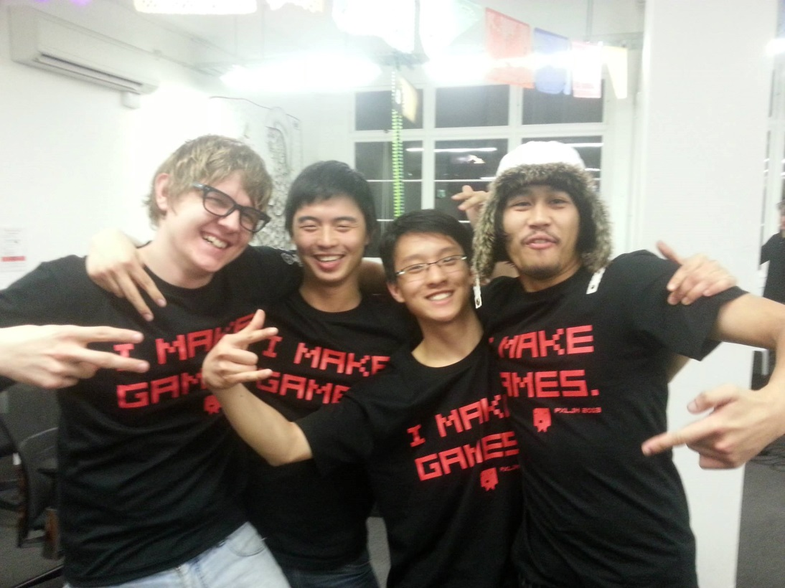
Team Asia Fun Time
-Baoxiong DAI
-Kenji Mendoza
-Yao Hong Chun
-Zachary Freiberg

