Slide 1
Chapter 4
Trees
© 2020 by Greg Ozbirn, UT-Dallas, for use with Data Structures book by Mark Allen Weiss
Fall 2020

Slide 2
Trees
Linked lists require O(N) time to traverse the list.
For large lists this is prohibitive.
A simple data structure called a “tree” can store data with most operations running in O(log N) time.

Slide 3
Preliminaries
A tree is a collection of nodes.
The top node is called the root node.
The root is connected to zero or more subtrees.
The root of each subtree is a child of its parent.

Slide 4
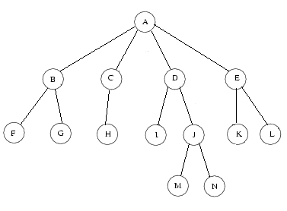
Tree
n nodes, n-1 edges (edge to every node except root)

Slide 5
Terms
Root
Siblings (B,C,D,E because all have same parent A)
Parent
Child
Leaves
(F, G, H, I, M, N, K, L)

Slide 6
Other Tree Terminology
Grandchild and Grandparent
Path: from node n₁ to n_{k} such that n_{i} has parent n_{i+1}
Length of path: number of edges on the path
Node depth: length from root (root at 0)
Node height: length to deepest descendant leaf (leaf at 0)
Tree depth: length from root to deepest leaf (= tree height)
Ancestor: if path exists up the tree
Descendant: if path exists down the tree
Proper Ancestor/Descendant: refers to ancestor or descendant other than itself

Slide 7

Terms
Tree height is 3
D at height 2
B at depth 1
E at height 1
Grandchildren
of A
N has ancestors of N, J, D, A.
Tree depth is 3
M has proper ancestors of J, D, A

Slide 8
Tree Implementation
A binary tree can be implemented by storing the data for a node plus the two child pointers.
Trees having more than two children may be implemented using linked lists of nodes as shown on the next slide.

Slide 9
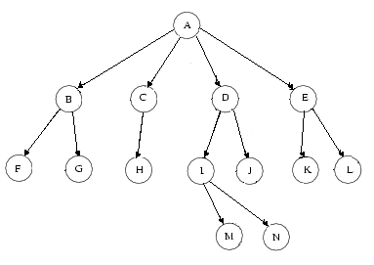
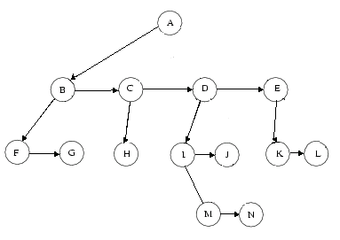
Tree using Linked List
This structure
implements
this tree:
class Node
{
Object element;
Node firstChild;
Node nextSibling;
}

Slide 10
Tree Traversal
Three methods:
Preorder – parent first, then children
Postorder – children first, then parent
Inorder – for binary trees, left child, parent, then right child.

Slide 11
Tree Traversal
Directory structures can be implemented as trees as shown on the next slide.
It makes sense to print a directory in preorder.
Preorder prints the parent before printing its children, thus printing the directory name before printing the files it contains.
We might traverse a directory in postorder if we wished to sum file sizes and roll these up to the parent levels.

Slide 12
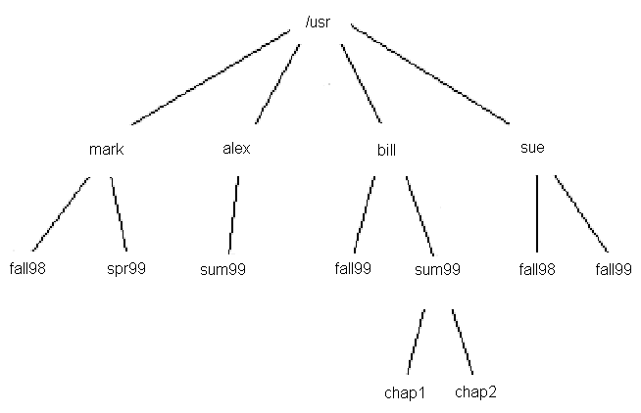
Tree for Directory Structure

Slide 13
Preorder
/usr
mark
fall98
spr99
alex
sum99
bill
fall99
sum99
chap1
chap2
sue
fall98
fall99

Slide 14
Postorder
fall98 1
spr99 1
mark 3
sum99 1
alex 2
fall99 1
chap1 5
chap2 6
sum99 12
bill 14
fall98 1
fall99 1
sue 3
/usr 23
Assume each is a directory
Except chap1 and chap2.
Each directory is 1 block.
chap 1 is 5 blocks.
chap 2 is 6 blocks.
mark is 3 because it counts for 1 and has two children

Slide 15
Binary Trees
Each node has at most two children.
Average depth is O(√N).
Depth can be N-1.

Slide 16
Binary Tree
class Node
{
Object element;
Node left;
Node right;
}
A
B
C
D
E
F
G
H
I
J

Slide 17
Inorder Printing
/* Internal method to print a subtree rooted at t in sorted order. */
private void printTree( BinaryNode<AnyType> t )
{
if( t != null )
{
printTree( t.left );
System.out.println( t.element );
printTree( t.right );
}
}
A
B
C
D
E
F
G
H
I
J

Slide 18
Preorder Printing
/* Internal method to print a subtree rooted at t in preorder. */
private void printTree( BinaryNode<AnyType> t )
{
if( t != null )
{
System.out.println( t.element );
printTree( t.left );
printTree( t.right );
}
}
A
B
C
D
E
F
G
H
I
J

Slide 19
Postorder Printing
/* Internal method to print a subtree rooted at t in postorder. */
private void printTree( BinaryNode<AnyType> t )
{
if( t != null )
{
printTree( t.left );
printTree( t.right );
System.out.println( t.element );
}
}
A
B
C
D
E
F
G
H
I
J

Slide 20
1.
t
5.
Inorder printing example
D
D
B
F
t
B
F
System.out.print(t.Element);
// prints A
A
C
E
A
C
E
t
6.
D
2.
D
printTree(t.left)
printTree(t.right)
B
F
B
F
reach null
t
A
C
E
A
C
E
3.
D
7.
D
t
t
B
F
printTree(t.left)
B
F
System.out.print(t.Element);
// prints B
A
C
E
A
C
E
4.
D
8.
D
t
B
F
printTree(t.right)
B
F
printTree(t.left)
t
A
C
E
reach null
A
C
E

Slide 21
9.
13.
t
D
D
t
B
F
printTree(t.right)
B
F
printTree(t.left)
reach null
A
C
E
A
C
E
10.
D
14.
D
t
t
B
F
System.out.print(t.Element);
// prints C
B
F
printTree(t.left)
A
C
E
A
C
E
11.
D
15.
D
printTree(t.left)
printTree(t.right)
B
F
t
reach null
t
B
F
reach null
A
C
E
A
C
E
12.
D
16.
D
t
t
System.out.print(t.Element);
// prints D
B
F
System.out.print(t.Element);
// prints E
B
F
A
C
E
A
C
E

Slide 22
17.
D
B
F
t
printTree(t.right)
reach null
A
C
E
t
18.
D
B
F
System.out.print(t.Element);
// prints F
A
C
E
19.
D
t
B
F
printTree(t.right)
reach null
A
C
E
20.
both printTree(t.right) calls from F and D return. Done.

Slide 23
Expression Trees
Trees can be used to work with arithmetic expressions.
The leaves are operands.
The other nodes are operators.
The expression can be evaluated by recursively evaluating the left and right subtrees, then applying the operator at the root.

Slide 24
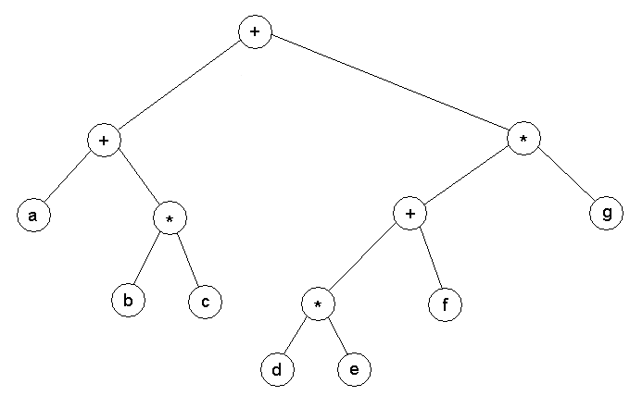
(a+b*c) + ((d*e+f)*g)

Slide 25
Expression Trees
Traversing an expression tree can produce these results:
Inorder traversal: infix notation, a+b
Preorder traversal: prefix notation, +ab
Postorder traversal: postfix notation, ab+

Slide 26
Constructing an Expression Tree
We can use a stack to construct an expression tree from a postfix expression.
The algorithm is:
Read a symbol.
If it is an operand, create a node and push it.
If it is an operator, create a node, then pop two entries and make them children (1st one is right child, 2nd one is left child), then push the operator node.
Repeat for all symbols.

Slide 27
Postfix Expression: ab+c*
b
c
c
a
a
b
b
b
+
+
+
a
*
a
a
Step 1
Push
operand
Step 2
Push
operand
Step 3
Pop
operands,
make tree,
push parent
Step 4
Push
operand
Step 5
Pop
operands,
make tree,
push parent
*
Result is an Expression Tree:
+
c
a
b

Slide 28
Binary Search Tree
A binary search tree has, for every node, all node values in its left subtree smaller than it, and all node values in its right subtree larger than it.
L
H
R
D
J
N
U
B
S
Y

Slide 29
Binary Search Tree Code
For source code, see:
BinarySearchTree.java

Slide 30
Public and Private Methods
The BinarySearchTree code has public methods which in turn call corresponding private methods.
This allows the private methods to be recursive by having a parameter to support the recursion.
This way the client only sees the simpler public methods.

Slide 31
Find
L
H
R
private boolean contains( AnyType x, BinaryNode<AnyType> t )
{
if( t == null )
return false;
int compareResult = x.compareTo( t.element );
if( compareResult < 0 )
return contains( x, t.left );
else if( compareResult > 0 )
return contains( x, t.right );
else
return true; // Match
}
D
J
N
U
B
S
Y
End of search, not found
x<element, so search left tree
x>element, so search right tree
Found, return node.

Slide 32
Insert
L
H
R
D
J
N
U
B
S
Y
private BinaryNode<AnyType> insert( AnyType x, BinaryNode<AnyType> t )
{
if( t == null )
return new BinaryNode<AnyType>( x, null, null );
int compareResult = x.compareTo( t.element );
if( compareResult < 0 )
t.left = insert( x, t.left );
else if( compareResult > 0 )
t.right = insert( x, t.right );
else
; // Duplicate; do nothing
return t;
}
End of search, just insert here.
x<element, insert to left side
x>element, insert to right side

Slide 33
Insert 5
<, Go left
1)
2)
6
6
>, Go right
2
8
2
8
1
4
1
4
3
3
3)
6
4)
6
2
8
2
8
>, Go right
Null, insert here
1
4
1
4
3
3
5

Slide 34
private BinaryNode<AnyType> remove( AnyType x, BinaryNode<AnyType> t )
{
if( t == null )
return t; // Item not found; do nothing
int compareResult = x.compareTo( t.element );
if( compareResult < 0 )
t.left = remove( x, t.left );
else if( compareResult > 0 )
t.right = remove( x, t.right );
else if( t.left != null && t.right != null ) // Two children
{
t.element = findMin( t.right ).element;
t.right = remove( t.element, t.right );
}
else
t = ( t.left != null ) ? t.left : t.right;
return t;
}
Remove
End of search, not found.
x<element, remove to left side
x>element, remove to right side
Repl element w/min element
on right subtree
Remove min element.
1.remove
5
2.replace
7
1
9
1
9
3.remove
7
min
5
5
t
7
t is left subtree if present,
else t is right subtree.
t
delete
9
9

Slide 35
Remove
Remove 2
Result
6
6
3
8
2
8
1
5
1
5
4
3
4

Slide 36
Average Binary Search Tree Depth
Operations on a node in a binary search tree are O(d) where d is the depth of the node.
The sum of the depths of all nodes is called the “internal path length” of a tree.
Let D(N) be the internal path length of a tree of N nodes.
D(1) is 0, since the tree just contains a root node.

Slide 37
A tree of N nodes contains a root and two subtrees.
If the left subtree has i nodes, then the right subtree has N - i - 1 nodes.
N=5
6
2
8
i = 3
N – i – 1 = 1
1
5

Slide 38
The root has depth zero, and all N-1 nodes in the left subtree and the right subtree are one level deeper.
So, a recurrence formula can be written as:
D(N) = D(i) + D(N-i-1) + N – 1
If all subtrees are equally likely, then the average value of both D(i) and D(N-i-1) is:
_{N-1}
(1/N) ∑ D(j)
^{j=0}
_{N-1}
So, D(N) = (2/N) [ ∑ D(j) ] + N - 1
^{j=0}
The solution of this recurrence formula is O(N log N).
Thus, the expected depth of a node is O(log N).

Slide 39
AVL Tree
An Adelson-Velskii and Landis tree, or AVL tree, is a binary search tree with a balance condition.
The balance condition requires that for every node the left and right subtrees can differ in height by at most one.
Ensures O(log N) depth.

Slide 40
4
3
5
2
6
1
7
Balanced, but not an AVL tree because only the root node
has been balanced.
An AVL tree balances left and right subtrees for every node,
not just the root node.

Slide 41
Are these AVL Trees?
5
Not AVL tree
7
AVL tree
2
8
2
8
1
4
7
1
4
3
3
5

Slide 42
AVL Tree
An insert can violate the AVL property.
After an insert, we must rebalance the tree.
This can be done with one of two operations depending upon where the inserted node is compared to its first imbalanced ancestor:
Single rotation:
ancestor’s left child’s left subtree, or to its right child’s right subtree. (outside)
Double rotation:
ancestor’s left child’s right subtree, or to its right child’s left subtree. (inside)

Slide 43
Single Rotation
k2
k1
k1
k2
Z
X
X
Y
Y
Z
k2 is unbalanced. To fix it, we do a single rotation, making k1 the new root.

Slide 44
Single Rotation
4
2
New root
2
1
4
5
1
3
0
3
5
Becomes left
child of 4 (old root)
0
Node 4 is unbalanced.
Node 2 becomes new root, its right subtree becomes left subtree of node 4

Slide 45
Double Rotation
k3
k2
k1
k1
k3
D
k2
A
A
B
C
D
B
C
k3 is unbalanced. To fix it, we do a double rotation, making k2 the new root.

Slide 46
Double Rotation
4
k3
6
k2
2
8
k1
4
k3
k1
8
k2
6
9
2
5
9
5
Which node has been inserted?
Which node is not balanced?
Which node is the new root?
Which nodes are the roots children?
Where does Node 5 go?
Node 5.
Node 4.
Node 6.
Nodes 4 and 8.
Becomes node 4’s right child.

Slide 47
AVL Tree Code
For source code, see:
AVLTree.java
47

Slide 48
Splay Trees
Rotates accessed node to the root to make future accesses cheaper.
Guarantees O(M log N) over M operations starting with an empty tree.
O(log N) amortized cost per operation.
Not the same as O(log N) cost per operation, since some operations may not be O(log N).

Slide 49
Splay Tree Rotations
Rotations occur in three cases:
Child of root: rotate child with root
zig-zag: inside, use zig-zag rotation
(same as double rotation)
zig-zig: outside, use zig-zig rotation

Slide 50
Splay Tree: zig-zag
G
X
P
P
G
D
X
A
A
B
C
D
B
C

Slide 51
Splay Tree: zig-zig
G
X
P
D
A
P
X
C
G
B
A
B
C
D

Slide 52
Example
k5
zig-zig or zig-zag?
Access k1
k4
F
k3
E
zig-zag
k2
D
A
k1
B
C
k5
k4
F
k1
E
k2
k3
A
B
C
D

Slide 53
Example
k5
zig-zig or zig-zag?
Access k1
k4
F
zig-zig
k1
E
k2
k3
A
B
C
D
k1
k2
k4
k3
k5
A
B
C
D
E
F

Slide 54
Splay Tree
Remember to keep performing rotations until the accessed node becomes the root.

Slide 55
B-Trees
When storing a tree on disk, it is desirable to reduce the height to reduce disk accesses.
This can be done with a larger branching factor.
An M-ary search tree uses M-1 keys for M branches.
It has height of log_{M}N.

Slide 56
B-Trees
The B-tree presented by the book is called a “B+-tree”.
The B+-tree stores data only in the leaf nodes.
A regular B-tree stores data throughout the tree.

Slide 57
B+-Tree
A B+-tree is an M-ary tree with these properties:
Data items stored only in the leaves
Nonleaf nodes store up to M-1 keys
The root is either a leaf or has 2 to M children.
All nonleaf nodes have M/2 to M children.
All leaf nodes are at the same depth and have L/2 to L data items, for some L.

Slide 58
41 66 87
8 18 26 35
48 51 54
72 78 83
92 97
2
4
6
8
10
12
14
16
18
20
22
24
26
28
30
31
32
35
36
37
38
39
41
42
44
46
48
49
50
51
52
53
54
56
58
59
66
68
69
70
72
73
74
76
78
79
81
83
84
85
87
89
90
92
93
95
97
98
99
B+-tree, M=5, L=5

Slide 59
41 66 87
8 18 26 35
48 51 54
72 78 83
92 97
2
4
6
8
10
12
14
16
18
20
22
24
26
28
30
31
32
35
36
37
38
39
41
42
44
46
48
49
50
51
52
53
54
56
57
58
59
66
68
69
70
72
73
74
76
78
79
81
83
84
85
87
89
90
92
93
95
97
98
99
Insert 57

Slide 60
41 66 87
8 18 26 35
48 51 54 57
72 78 83
92 97
2
4
6
8
10
12
14
16
18
20
22
24
26
28
30
31
32
35
36
37
38
39
41
42
44
46
48
49
50
51
52
53
54
55
56
57
58
59
66
68
69
70
72
73
74
76
78
79
81
83
84
85
87
89
90
92
93
95
97
98
99
Insert 55, causes leaf split

Slide 61
26 41 66 87
8 18
35 38
48 51 54 57
72 78 83
92 97
2
4
6
8
10
12
14
16
18
20
22
24
26
28
30
31
32
35
36
37
38
39
40
41
42
44
46
48
49
50
51
52
53
54
55
56
57
58
59
66
68
69
70
72
73
74
76
78
79
81
83
84
85
87
89
90
92
93
95
97
98
99
Insert 40, causes leaf split and parent split

Slide 62
B+-Tree
Suppose a node in a B+-tree is stored in a disk block, and suppose the block holds 8192 bytes.
If each key is 32 bytes, and there are M-1 keys, and each of the M pointers takes 4 bytes, then each node uses 36M-32 bytes.
Solving for M gives M=228. (M=(8192+32)/36=228.44)
If each data record is 256 bytes, we could fit 32 records in a block. Thus L=32. (L=8192/256=32)
Since each leaf could be half full, 10 million records could take 625000 leaves.
If each internal node branches at least 114 ways, then the leaves are no deeper than level 4.

Slide 63
Java Sets
The Set interface represents a Collection that does not allow duplicates.
The SortedSet interface is a Set that keeps items in sorted order.
The TreeSet class implements a SortedSet.
Its basic operations take worst-case logarithmic time.

Slide 64
Java Maps
The Map interface represents a Collection of keys and their values.
The SortedMap interface is a Map that keeps items in sorted order.
The TreeMap class implements a SortedMap .
Its basic operations take worst-case logarithmic time.

Slide 65
End of Slides

