Slide 1
Logic
An Example of a
Boolean Algebra

Slide 2
You know about algebra in math
, where
a and b, are variables whose values come from some set: the real-numbers.
+, -, *, /, ^, etc., are operators on these variables
the result of the expression is also a real number.
We sometimes can show that one expression is the same (equal value) as another for all values of the variables …

Slide 3
Logic is an algebra
We have variables: typically p, q, r, s, t, …
Variables can have a value from some set: true or false.
We have operators: ¬, ∧, ∨, →, etc..
We have expressions, whose resulting value is also true or false
(p ∧ q) ∨ (¬r)
We also have expressions that are the same regardless of the values of the variables
¬(p ∧ q) ≡ (¬p) ∨ (¬q)

Slide 4
Propositions
Propositions are assertions (stating a fact) about the world around us: they can either be true or false
Propositional variables are variables whose value corresponds to the value of some proposition.
Let p be “Dr. Cobb is 5’ 2’’ tall”
Is p true or false?
Let q be “the moon is made of cheese”
Is q true or false?
Let r be “the earth’s atmosphere is made mainly from oxygen and nitrogen”.
Is r true or false?

Slide 5
What propositions are not
Propositions are not questions …
Is Dr. Cobb 5’2’’ tall?
Is the moon made of cheese?
These have yes or no answers, not true or false
Propositions are not commands (imperative)
Get up!
Go to work!
Finish your homework!

Slide 6
More proposition examples
The sky is blue.
A car is a vehicle.
A human is a living being.
CS 5333 is a prerequisite for a MS degree in CS at UTD.

Slide 7
What if the proposition is not clear?
Dr. Cobb is 6’ 1’’? (not sure, depends if I stretch in the morning!)
5333 is a requirement for a CS MS degree? (it is now, but will it be 10 years from now)
My point: all the propositions that we will use in the course will be either obviously true or obviously false
It is the algebra of proposition variables that we care about.

Slide 8
Basic Logic Operators
There are three basic logic operators:
Negation: ¬
Conjunction: ∧
Disjunction: ∨
Any logic expression can be written using the above
Other operators (e.g., implication, double implication, exclusive or) are used as a shorthand for expressions using the above.

Slide 9
Negation
Negation (a unary operator)
Let p be “Dr. Cobb is 5’2’’ tall”
Then ¬p represents “Dr. Cobb is not 5’2’’ tall”
Let r be “The moon is made of cheese”
Then ¬r represents “The moon is not made of cheese”

Slide 10
Truth Table
Truth table of an expression: is a table showing all the possible values of the variables, and the corresponding values of an expression from those variables.
Truth table of
the expression: ¬q
q | ¬q
T | F
F | T

Slide 11
Conjunction
The conjunction operator, ∧ , is also known as the “and” operator.
The conjunction of p and q is written as p ∧ q and is read “p and q”
It is true only when both p and q are true
p | q | p ∧ q
T | T | T
T | F | F
F | T | F
F | F | F

Slide 12
Propositional expression example
Let: b be “the sky is blue” g be “the grass is green”
Each of b and g is obviously true ☺
What about the values of each of the following:
¬b
b ∧ g
¬b ∧ (b ∧ g)

Slide 13
Do a truth table to find out different possibilities
b | g | b ∧ g | ¬b | ¬b ∧ (b ∧ g)
T | T | T | F | F
T | F | F | F | F
F | T | F | T | F
F | F | F | T | F
¬b ∧ (b ∧ g) is a fallacy (always false regardless of values of variables)

Slide 14
Disjunction
The disjunction operator, ∨ , is also known as the “or” operator.
The disjunction of p and q is written as p ∨ q and is read “p or q”
It is true if either p is true or q is true
p | q | p ∨ q
T | T | T
T | F | T
F | T | T
F | F | F

Slide 15
Another propositional expression example
Let: b be “the sky is blue” g be “the grass is green”
Each of b and g is obviously true ☺
What about the values of each of the following:
b ∨ g
¬b ∨ g
¬b ∨ ¬g
BTW: order of evaluation? Parenthesis?
¬b ∨ (b ∧ g)

Slide 16
Another example: g ∧ (¬b ∨ g)
b | g | ¬b | ¬b ∨ g | g ∧ (¬b ∨ g)
T | T | F | T | T
T | F | F | F | F
F | T | T | T | T
F | F | T | T | F

Slide 17
Equivalence of Propositional Expressions
P₁ ≡ P₂, where P₁ and P₂ are propositional expressions, means “for all possible values that can be assigned to the variables in P₁ and P₂, both expressions yield the same value.”
Basically, ≡ is the same as =, except that it is applied to propositional expressions, rather than numbers (examples follow)

Slide 18
Examples of ≡
p ∧ ¬p ≡ F because, regardless of the value of p, p ∧ ¬p is false
p ∨ T ≡ T because, regardless of the value of p, p ∨ T yields the value T.
(p ∧ ¬p) ≡ ¬(p ∨ T) why?

Slide 19
Logical equivalences (algebraic laws)
Equivalence | Name
 | Identity laws
 | Domination laws
 | Idempotent laws
 | Double negation law
 | Commutative laws

Slide 20
Logical equivalences (continued…)
Equivalence | Name
 | Associative laws
 | Distributive laws
 | De Morgan’s laws
 | Absorption laws
 | Negation laws

Slide 21
Distributive Rule
You can’t mix disjunction and conjunction for associativity.
Consider the specific case
p = T
r = F
q = who cares ....
what is the value of the left-hand side and the right-hand side?

Slide 22
Implication
The implication operator, →, is as follows p → q
Truth table:
Note, it is NOT commutative
p | q | p → q
T | T | T
T | F | F
F | T | T
F | F | T

Slide 23
Implication (continued…)
p → q is read “if p then q”
When p is true, p → q has the same value as q
When p is false, p → q is true regardless of q.

Slide 24
An example
Let p = “Dr. Cobb is a faculty member in the E. J. School of Engineering” q = “Dr. Cobb is a faculty member at UTD”
What is the value of p?
What is the value of q?
Is p → q true or false?
Is q → p true or false?
Repeat by changing “Dr. Cobb” above by “Dr. Andreescu”.

Slide 25
Example
Let p = “there is a lion in this room”
Let q = “Dr. Cobb is a millionaire”
p → q, is it true or false?
What about q → p?

Slide 26
From English to Logic
“If I go to Harry’s or go to the country I will not go shopping.”
Break the assertion into components, look for the logical operators.
p = “go to Harry’s” q = “go to the country” r = “go shopping”
(p ∨ q) →(¬ r)

Slide 27
Truth Table
p | q | r | (p ∨ q) →(¬ r)
T | T | T | F
T | T | F | T
T | F | T | F
T | F | F | T
F | T | T | F
F | T | F | T
F | F | T | T
F | F | F | T

Slide 28
# of possible operators
Consider an operator of n variables
How many rows are in its truth table?
How many different truth tables with x rows can there be?
Thus, how many different operators with n variables can exist?

Slide 29
Additional notes on →
p → q, p is the antecedent, q is the consequent.
(p → q) ≡ (¬q → ¬p)
¬q → ¬p is known as the contrapositive)
The converse of p → q is q → p
(they are NOT equivalent)
p → q in English is often stated as:
p is a sufficient condition for q
q is a necessary condition for p
p only if q

Slide 30
Logical Equivalences Involving Implications
Note how → is written in terms of ∨ and ¬

Slide 31
Proof of selected equivalences
Consider the following two statements
These can be proved using a truth table and considering all possible truth assignments.
(SEE WARNING ON NEXT SLIDE)
They can also be proved using some of the given equivalence rules

Slide 32
WARNING
You will only be given partial credit (or no credit at all!) if in an exam you use a truth table to prove two expressions are equivalent.
You have been warned!!!

Slide 33
Proof of first statement

Slide 34
A lot simpler, and skipping over some “obvious steps”, and placing the comments on the equivalence symbol ….
p → r ∧ q → r
≡ {→ derived from ∨ and ¬ }
(¬p ∨ r) ∧ (¬ q ∨ r)
≡ {commutativity, distribution of ∨ over ∧, and commutativity again}
(¬p ∧ ¬ q) ∨ r
≡ { deMorgan’s}
¬(p ∨ q) ∨ r
≡ {→ derived from ∨ and ¬ }
(p ∨ q) → r

Slide 35
Remarks
We took advantage of the fact that, if we know P ≡ Q, and Q ≡ R, then we can conclude that P ≡ R.
Also, if p ≡ q, and p occurs in an expression E, then E ≡ E’ where E’ is obtained from E by replacing p by q.

Slide 36
Generalized de Morgan’s

Slide 37
Normal (Canonical) Forms
Every propositional expression has a single Disjunctive Normal Form
Every propositional expression also has a single Conjunctive Normal Form

Slide 38
Disjunctive Normal Form
The following expression is in disjunctive normal form (DNF):
I.e., it is a disjunction of minterms where
Each minterm is a conjunction of all variables
Each variable appears only once in each minterm, and the variable can be negated.
each minterm appears only once

Slide 39
Obtaining the DNF
What is the DNF of (p ∨ q) →(¬ r)?
p | q | r | (p ∨ q) →(¬ r)
T | T | T | F
T | T | F | T
T | F | T | F
T | F | F | T
F | T | T | F
F | T | F | T
F | F | T | T
F | F | F | T

Slide 40
Conjunctive Normal Form
A propositional expression is in Conjunctive Normal Form (CNF) iff
it is a conjunction of maxterms where
each maxterm is a disjunction of all variables
each variable appears only once in each maxterm, and the variable can be negated.
each maxterm appears only once
E.g.

Slide 41
Obtaining the CNF
What is the CNF of (p ∨ q) →(¬ r)?

Slide 42
First, Truth Table of Negation
p | q | r | ¬((p ∨ q) →(¬ r))
T | T | T | T
T | T | F | F
T | F | T | T
T | F | F | F
F | T | T | T
F | T | F | F
F | F | T | F
F | F | F | F

Slide 43
Finally, apply De Morgan’s

Slide 44
Is there another way to obtain the CNF from the original truth table of (p ∨ q) →(¬ r)
???

Slide 45
XOR
p exclusive or q is written as p ⊕ q
It means either p is true, or q is true, but not both
Truth table:
p | q | p ⊕ q
T | T | F
T | F | T
F | T | T
F | F | F

Slide 46
Example
This afternoon, either I will go to the movies or I will go to a football game
p = “I am at the movies”
q = “I am at the football game”
The following is a true statement p ⊕ q
Why is the above statement true?

Slide 47
Double Implication
p “if and only if” q is written as p ↔ q
It is really a shorthand p ↔ q ≡ (p → q) ∧ (q → p)
Truth table:
p | q | p ↔ q
T | T | T
T | F | F
F | T | F
F | F | T

Slide 48
Example
p = “The moon is made of cheese”
q = “Horses have four legs”
The following is a true statement, why? p ↔ (¬q)
Note that p ≡ (¬q), why?
The following is a propositional expression (i.e. it returns a value that is true or false) p ↔ q and its value is ….?

Slide 49
Propositional Equivalences
A tautology is a propositional expression that regardless of the values of its variables it always returns true.
A fallacy is a propositional expression that regardless of the values of its variables it always returns false.
A contingency is a logical expression that is neither a tautology nor a fallacy

Slide 50
Examples

Slide 51
Tautology and Equivalence
Saying that a propositional expression P is a tautology is the same as saying that P ≡ T
Saying that a propositional expression P is a fallacy is the same as saying that P ≡ F

Slide 52
Predicates
A propositional function (a.k.a. a predicate) is a generalization of propositions, in which the value of a proposition depends on an argument (i.e. variable)
Predicates become propositions once every one of its variables is bound by
assigning it a value from the Universe of Discourse (typically denoted by U), or by
quantifying it (we cover this later)

Slide 53
Examples
Let U = Z, the integers = {. . . -2, -1, 0 , 1, 2, . . .}
P(x): x > 0 is the predicate. Note: it has no truth value until the variable x is bound.
Examples of propositions where x is assigned a value:
P(-3) is false,
P(0) is false,
P(3) is true.
The collection of integers for which P(x) is true are the positive integers

Slide 54
Same example, continued …
P(y) ∨ ¬P(0) is not a proposition. The variable y has not been bound. However, P(3) ∨ ¬P(0) is a proposition (which is true).
Let R be the three-variable predicate R(x, y, z): x + y > z
Find the truth value of
R(2, -1, 5), R(3, 4, 7), R(x, 3, z)

Slide 55
Quantifiers
We turn a predicate into a proposition if all its variables are bound by a quantifier.
Typical quantifiers:
Universal
Existential

Slide 56
Quantifiers: Universal
P(x) is true for every x in the universe of discourse is written as ∀x P(x) It is read ‘For all x, P(x)’, also as ‘For every x, P(x)’
The variable x is bound by the universal quantifier, producing a proposition.

Slide 57
Example
U={1,2,3}, P(x): x > 0 ∀x P(x) = P(1) ∧ P(2) ∧ P(3)
U={-2,1,2,3}, P(x): x > 0 ∀x P(x) = P(-2) ∧ P(1) ∧ P(2) ∧ P(3)
What if U is infinite, e.g., U = natural numbers? Does ∀x P(x) make sense then?

Slide 58
Quantifiers: Existential
P(x) is true for at least one value of x in the universe of x ∃x P(x)
It is read as ‘There is an x such that P(x),’ ‘For some x, P(x)’, ‘For at least one x, P(x)’, ‘I can find an x such that P(x).’
The variable x is bound by the existential quantifier, producing a proposition.

Slide 59
Example
U={1,2,3}, P(x): x > 0 ∃x P(x) = P(1) ∨ P(2) ∨ P(3)
U={-2,1,2,3}, P(x): x > 0 ∃x P(x) = P(-2) ∨ P(1) ∨ P(2) ∨ P(3)
What if U is infinite, e.g., U = natural numbers? Is it well defined then?

Slide 60
Quantifier: Unique Existential
P(x) is true for one and only one x in the universe of discourse. Notation: ∃!xP(x)
It is read as: ‘There is a unique x such that P(x),’ ‘There is one and only one x such that P(x),’ ‘One can find only one x such that P(x).’

Slide 61
Truth Table
Assume U = {0, 1, 2}. Consider all possible values of each Q(0), Q(1), and Q(2). What are the values of the qualifiers?
A particular row would correspond to a specific definition of Q.
Q(0) | Q(1) | Q(2) | ∀x Q(x) | ∃x Q(x) | ∃!x Q(x)
T | T | T | T | T | F
T | T | F | F | T | F
T | F | T | F | T | F
T | F | F | F | T | T
F | T | T | F | T | F
F | T | F | F | T | T
F | F | T | F | T | T
F | F | F | F | F | F

Slide 62
Just for fun..
Can you write a definition of the unique existential quantifier using the universal and existential quantifiers? ∃!x P(x) ≡ ???

Slide 63
Lewis Carroll
Consider the following statements
All lions are fierce.
Some lions do not drink coffee
Some fierce creatures do not drink coffee.
We wish to turn this into symbols using an appropriate universe

Slide 64
Continued …
Let the universe be all living creatures.
Consider the following predicates:
L(x) : x is a lion
C(x) : x drinks coffee
F(x) : x is fierce

Slide 65
Continued …
L(x) : x is a lion, C(x) : x drinks coffee, F(x) : x is fierce
All lions are fierce.
Recall, the universe is over ALL creatures, so x ranges over all creatures
We must thus restrict ourselves ONLY to those creatures that are lions.

Slide 66

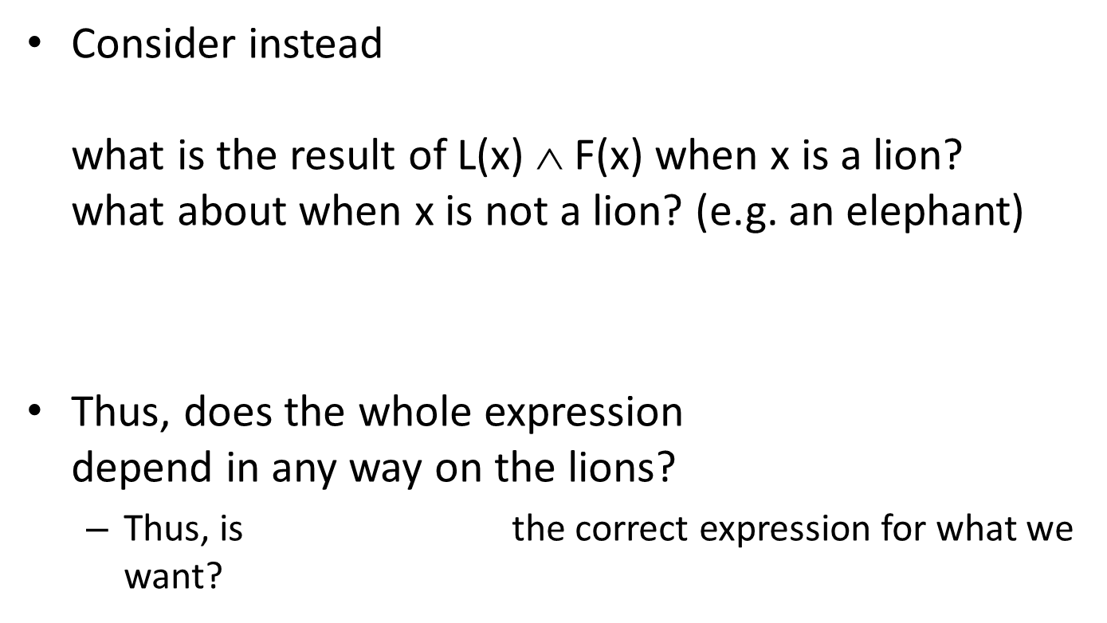


Continued …
Consider instead what is the result of L(x) $$ F(x) when x is a lion? what about when x is not a lion? (e.g. an elephant)
Thus, does the whole expression depend in any way on the lions?
Thus, is the correct expression for what we want?
$$∀x(L\left(x\right) ∧ F\left(x\right))$$
$$\left(L\left({lion}_{1}\right) ∧ F\left({lion}_{1}\right)\right) ∧ \left(L\left({elephant}_{1}\right) ∧ F\left({elephant}_{1}\right)\right) ∧ etc …$$
$$∀x(L\left(x\right) ∧ F\left(x\right))$$
$$∀x(L\left(x\right) ∧ F\left(x\right))$$

Slide 67
Continued …
Some lions do not drink coffee
Some fierce creatures do not drink coffee.
For the first one, why is the following NOT what we want:
∃x(L(x) ∧ ¬C(x))
∃x(F(x) ∧ ¬C(x))
∃x(L(x) → ¬C(x))
$$\left(L\left({lion}_{1}\right) →¬C\left({lion}_{1}\right)\right) ∨ \left(L\left({elephant}_{1}\right)→¬C\left({elephant}_{1}\right)\right) ∧ etc …$$
Notes:
What if x is a Giraffe?

Slide 68
Nested Quantifiers
Read from left to right: is the same as
Example: Let U = R (real numbers), and P(x,y): xy = 0 which ones are true, which false?
What if P(x,y): x/y = 1?

Slide 69
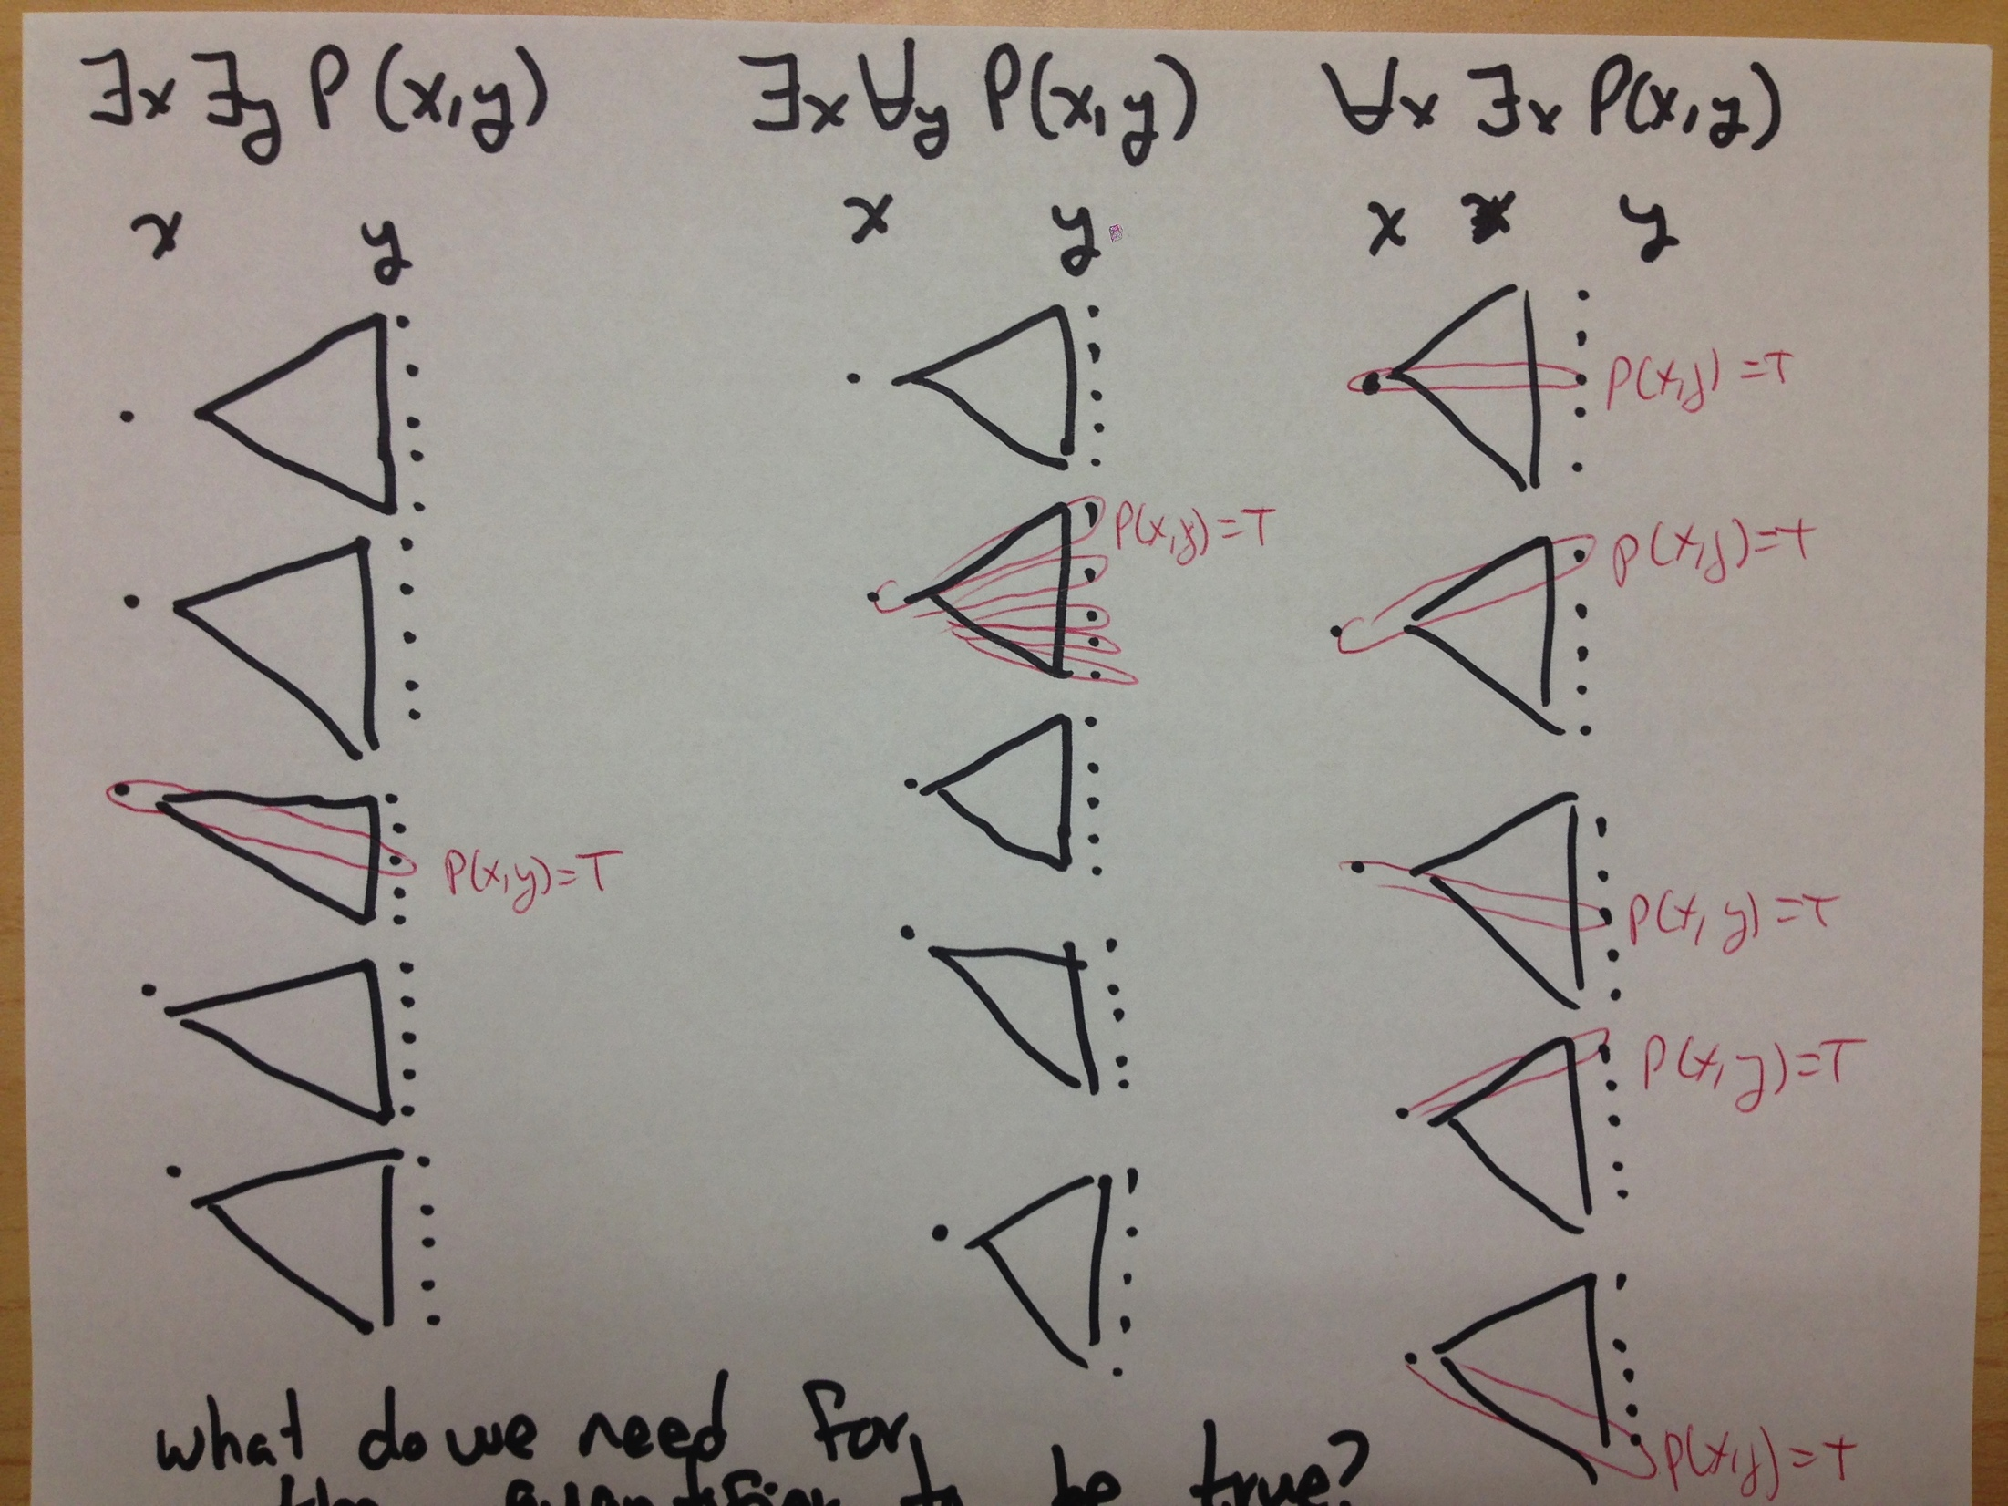

Slide 70
Another example
Let U = {1,2,3}.
Find an expression equivalent to ∀x∃yP(x,y) where the variables are bound by substitution and not quantification.
Solution: Expand from outside in or inside out
∀x∃yP(x,y) ≡
∀x(∃yP(x,y)) ≡
∃yP(1,y) ∧ ∃yP(2,y) ∧ ∃yP(3,y) ≡
(P(1,1) ∨ P(1,2) ∨ P(1,3)) ∧
(P(2,1) ∨ P(2,2) ∨ P(2,3)) ∧
(P(3,1) ∨ P(3,2) ∨ P(3,3))

Slide 71
Scope
The scope of a quantifier is the part of the expression in which the variable is bound by the quantifier.
E.g.,
∀x(P(x)∧Q(x)) is a proposition
∀x(P(x))∧Q(x) is not a proposition because
x in Q(x) is not bound a quantifier

Slide 72
Equivalences using Quantifiers
A proposition using quantifiers is equivalent to another proposition when, for all universes (appropriate for the predicates) and for all possible values of each predicate, the value of the two expressions is the same.

Slide 73
Quantifiers and negations
For one variable:
Why? (think of the finite case with a few values)
¬∀xP(x) ≡ ∃x¬P(x)
¬∃xP(x) ≡ ∀x¬P(x)

Slide 74
Continued …
For multiple variables
Statement | Equivalent Expression
¬∃x∃y P(x,y)
¬∃x∀y P(x,y)
¬∀x∀y P(x,y)
¬∀x∃y P(x,y)

Slide 75
Which are correct below?
∀x∀y P(x, y) ≡ ∀y∀x P( x, y) ???
∀x∀y(P(x) ∧ Q(y)) ≡ ∀xP(x) ∧ ∀yQ(y) ???
∃ x ∃y(P(x) ∨ Q(y)) ≡ ∃xP(x) ∨ ∃yQ(y) ???
∀x∃yP(x, y) ≡ ∃y∀xP(x, y) ???
∀x∃yP(x, y) ≡ ∃x∀yP(x, y) ???

