Slide 1
Proofs
Continuing on chapter 1

Slide 2
Definitions
A theorem is a valid logical assertion which can be proved using:
axioms (statements which are given to be true)
other theorems, and
rules of inference (logical rules which allow the deduction of conclusions from premises).
A lemma (not a “lemon”) is a 'pre-theorem' or a result which is needed to prove a theorem.
A corollary is a 'post-theorem' or a result which follows directly from a theorem.

Slide 3
Rules of inference
Rules of inference are tautologies of the following form:
Where each H_{i} is a hypothesis, and C is the conclusion.
I.e., all rules of inference (and theorems!) are of the form
H₁ ∧ H₂ ∧ . . . H_{n} → C
(H₁ ∧ H₂ ∧ . . . H_{n} → C) ≡ T

Slide 4
Alternative (symbolic) notation
(H₁ ∧ H₂ ∧ . . . H_{n} → C) ≡ T
E.g., the tautology (P ∧ (P → Q)) → Q is written as
It is known as modus ponens
is often written in the following form:

Slide 5
Rule of Inference | Tautology | Name
 |  | Addition
 |  | Simplification
 |  | Conjunction
 |  | Modus ponens

Slide 6
Rule of Inference | Tautology | Name
 |  | Modus tollens
 |  | Hypothetical syllogism
 |  | Disjunctive syllogism
 |  | Resolution

Slide 7
Example of a proof using inference
Consider the argument given in Example 7 in the text:
If you send me an e-mail message, then I will finish writing the program.
If you do not send me an e-mail message, then I will go to sleep early.
If I go to sleep early, then I will wake up feeling refreshed.
Therefore:
If I do not finish writing the program, then I will wake up feeling refreshed

Slide 8
Example continued…
We need to determine what are the building blocks of this argument.
Let
e: you send me an e-mail message.
p: I finish writing the program.
s: I go to sleep early
r: I wake up feeing refreshed.
What we need to prove is that

Slide 9
Truth Table
p | s | r | e
T | T | T | T | T | T | T | T | T
T | T | T | F | T | T | T | T | T
T | T | F | T | T | T | F | T | T
T | T | F | F | T | T | F | T | T
T | F | T | T | T | T | T | T | T
T | F | T | F | T | F | T | T | T
T | F | F | T | T | T | T | T | T
T | F | F | F | T | T | T | T | T
F | T | T | T | F | T | T | T | T
F | T | T | F | T | F | T | T | T
F | T | F | T | F | T | F | F | T
F | T | F | F | T | T | F | F | T
F | F | T | T | F | T | T | T | T
F | F | T | F | T | F | T | T | T
F | F | F | T | F | T | T | F | T
F | F | F | F | T | F | T | F | T

Slide 10
WARNING
You will only be given partial credit (or no credit at all!) if in an exam you use a truth table to prove an inference rule.
You have been warned!!!

Slide 11
Example (continued)
Steps | Reasons
1. 2. 3. 4. 5. 6. | Hypothesis Contra-positive on Step 1 Hypothesis Hypothetical syllogism on steps 2,3 Hypothesis Hypothetical syllogism on steps 4,5
Note, at each step we only used either
an equivalence rule or a rule of inference

Slide 12
Steps
Create a list of logical expressions
Each entry in your list is either
A hypothesis
Obtained using inference rules on previous entries on you list, or using equivalence rules on previous entries on your list.
Your final entry on your list should be the conclusion you are trying to reach.

Slide 13
Fallacies (i.e. screw-ups!!!)
Fallacies are incorrect inferences
The fallacy of affirming the consequent
if the butler did it, he has blood in his hands
the butler had blood in his hands
therefore, the butler did it
This (invalid!!!) argument has the form:
IT IS NOT A TAUTOLOGY!

Slide 14
More fallacies
Fallacy of denying the antecedent (hypothesis)
If the butler is nervous, he did it.
The butler is really mellow (relaxed)
Therefore, the butler didn't do it.
This (invalid!!!) argument has the form:
IT IS NOT A TAUTOLOGY!

Slide 15
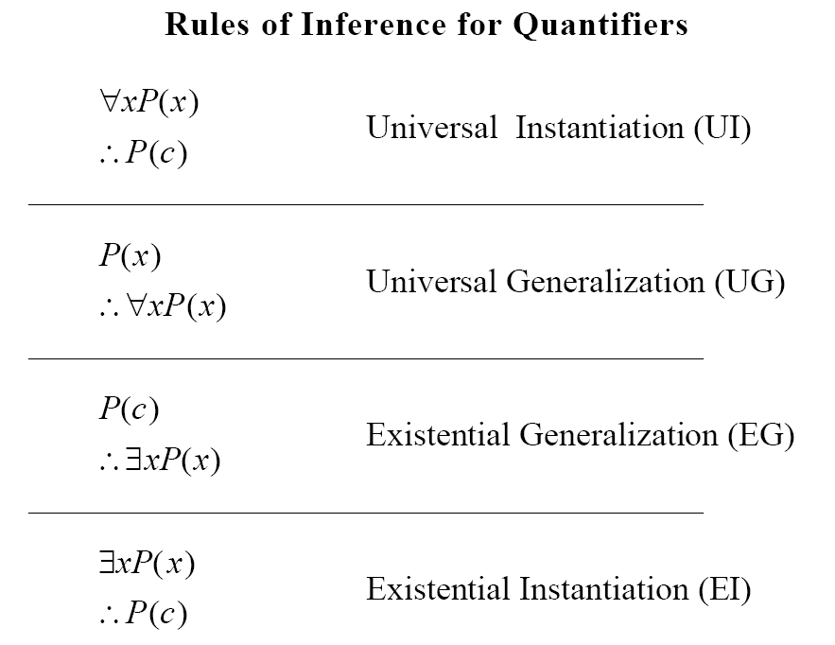
(c can be any element of U that you want)
P(c) for an arbitrary c
(Here, you do need to know the specific value of c)
for some c
(Here, you don’t know the specific value of c!)

Slide 16
Example
Prove the following:
Every man has two legs. John Smith is a man.
Therefore, John Smith has two legs.
Define the predicates:
M(x): x is a man
L(x): x has two legs
J: John Smith, a member of the universe
The argument becomes

Slide 17
Example continued
Steps | Reasons
1. 2. 3. 4. | Hypothesis Universal instantiation on Step 1 Second Hypothesis Modus ponens on steps 2,3

Slide 18
Proof of Lewis Carroll's earlier example
Recall
Step | Reason
1. 2. 3. 4. 5. 6. 7. 8. 9. | Hypothesis Existential instantiation Hypothesis Universal instantiation Simplification, step 2 Simplification, step 2 Modus ponens, step 4,6 Conjunction step 5,7 Existential generalization

Slide 19
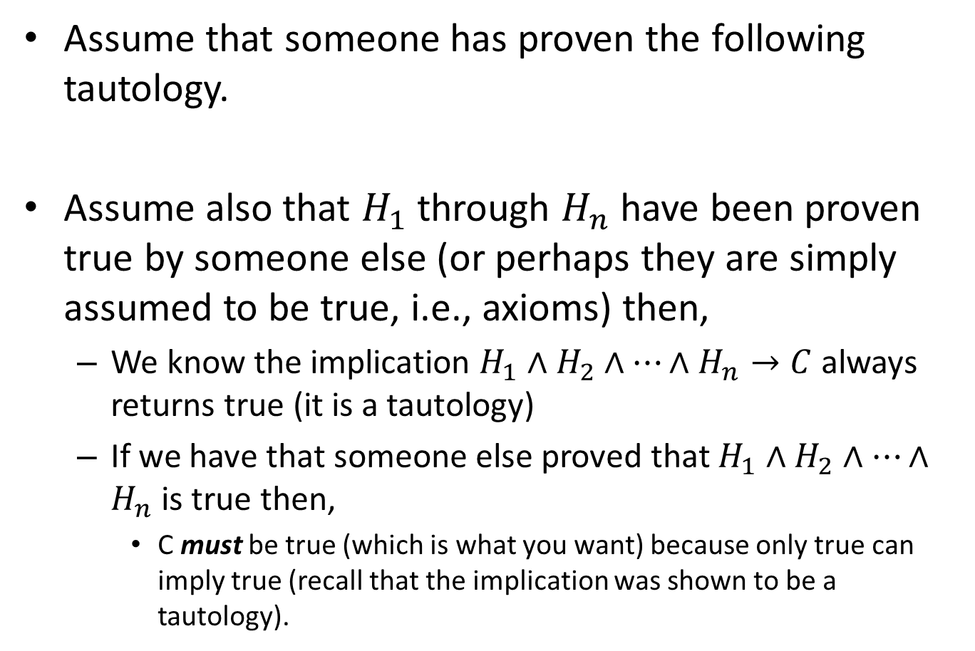
Theorems in practice
Assume that someone has proven the following tautology.
Assume also that $H_{1}$ through $H_{n}$have been proven true by someone else (or perhaps they are simply assumed to be true, i.e., axioms) then,
We know the implication $H_{1}{∧H}_{2}$ $∧⋯∧H_{n}→C$always returns true (it is a tautology)
If we have that someone else proved that $H_{1}{∧H}_{2}$ $∧⋯∧H_{n}$ is true then,
C must be true (which is what you want) because only true can imply true (recall that the implication was shown to be a tautology).
(H₁ ∧ H₂ ∧ . . . H_{n} → C) ≡ T

Slide 20
Proof Methods
There are several forms of proof methods that come in handy depending on what you are trying to prove.
Direct Proof
Trivial Proof
Vacuous Proof
Indirect Proof
Proof by contradiction
Proof by cases

Slide 21
Direct Proof Method
Using rules of inference to derive your result is known as the “direct” method.

Slide 22
Example
Show the following
If horses fly or cows eat artichokes, then the mosquito is the national bird.
If the mosquito is the national bird then peanut butter tastes good on hot dogs.
But peanut butter tastes terrible on hot dogs.
Therefore, cows don't eat artichokes.
Proposition
F Horses fly
A Cows eat artichokes
M The mosquito is the national bird
P Peanut butter tastes good on hot dogs

Slide 23
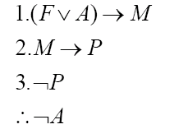
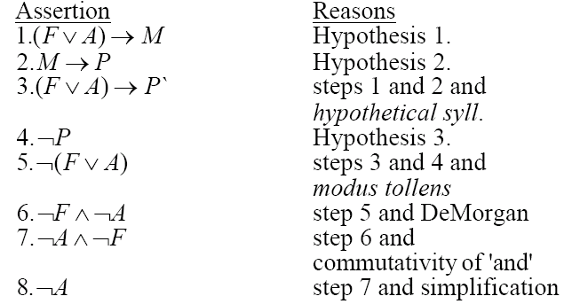
Continued …
Represent the formal argument using the variables
Use the three hypotheses and the rules of inference and any logical equivalences obtain the conclusion.

Slide 24
Trivial Proofs
You want to show H → C, and you “know” C is true,
I.e. if you know that C is true, because C is a proposition (not a variable) and we all know it is true
then you can conclude that H → C regardless of H
Why? because H → T is a tautology
H could be ``dogs can fly’’ and we are still fine.

Slide 25
Trivial Proof (continued …)
E.g., the following are true statements
if Dr. Cobb is ten feet tall then 0 + 1 = 1
If the moon is made of cheese then UT Dallas is part of the UT system

Slide 26
Vacuous Proof
If we know the hypothesis H is a false proposition, then we know H → C for any C.
This is because F → C is a tautology.
E.g., the following are true statements
if 0 = 1 then I am ten feet tall
If the moon is made of cheese then UT Dallas has a football team

Slide 27
Indirect Proof
Remember direct proofs?
An indirect proof is that, instead of a direct proof of H → C, we do a direct proof of ¬C → ¬H
Note that by the contra-positive rule, these two are the same.

Slide 28
Abbreviated Proofs
Writing things down in “perfect logic” often would yield pages and pages and pages of proof
Thus, people use abbreviated (often just English) arguments
This simplifies reading a proof, but if one is not careful, it can introduce errors (invalid proofs!)

Slide 29
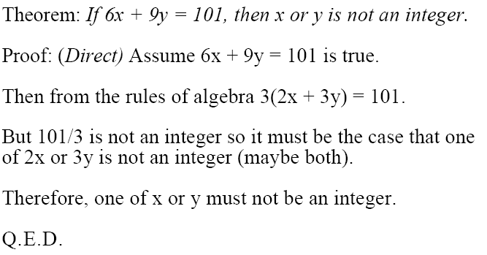
Direct Method example

Slide 30
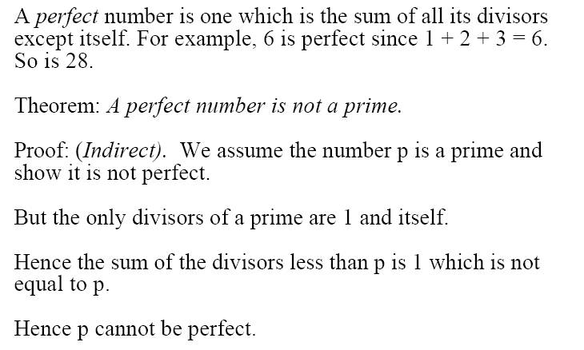
Indirect Proof example
Q.E.D

Slide 31
Proof by Contradiction
To show M, assume ¬M is true, then derive a contradiction (i.e., derive false)
I.e., we are proving that ¬M → F
Note that if we take the contra-positive of the above we have T → M
This is just equivalent to M.

Slide 32
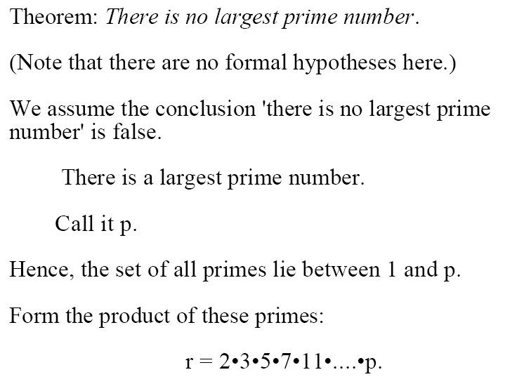
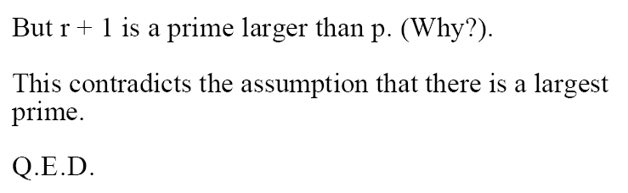
Example

Slide 33
Proof by Cases
Assume we want to show that (H₁ ∨ H₂ ∨ H₃) → C
Then, we take advantage of the following equivalence ((H₁ ∨ H₂ ∨ H₃) → C) ≡ ((H₁ → C) ∧ (H₂ → C) ∧ (H₃ → C))
It is important to show that it holds for ALL cases (in this case, three cases)

Slide 34
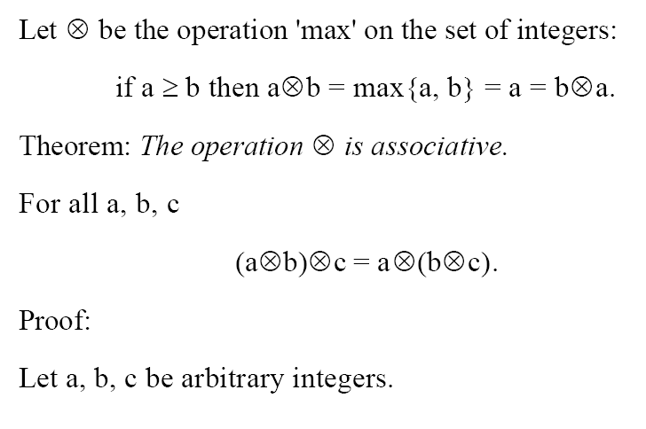
Example

Slide 35
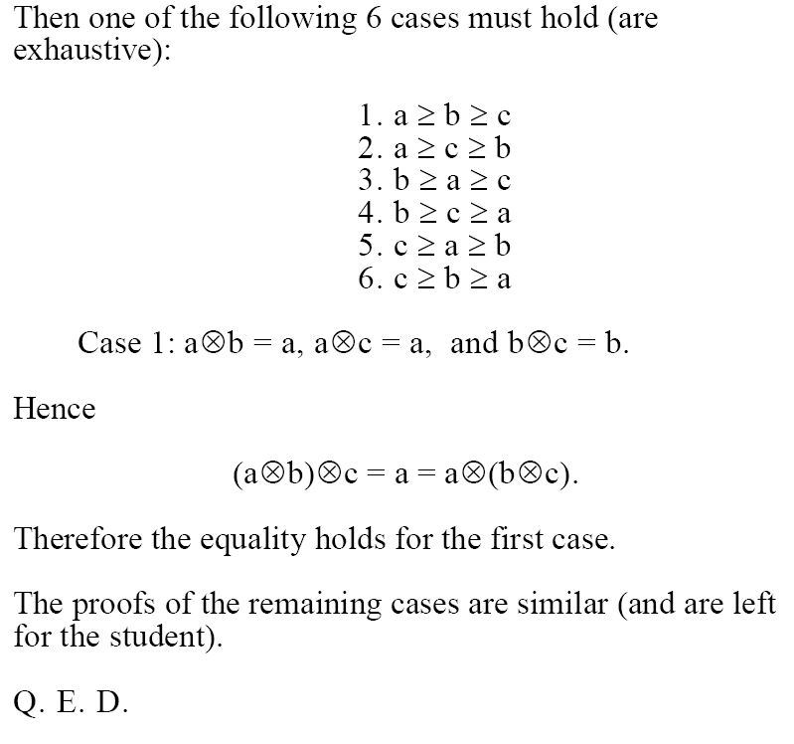
continued …

Slide 36
Existence Proofs
To prove that ∃x P(x), we have constructive and non-constructive proofs
In a constructive proof, simply exhibit a c such that P(c) is true (finding c may be by brute force)
E.g., there exists an integer solution to the equation x² + y² = z²
Proof: simply choose x = 3, y = 4, and z = 5
(finding these values may be by exhaustive search, e.g., by a computer program)

Slide 37
Non-constructive Existence Proof
Want to show that ∃x P(x)
We do so by assuming no c exists such that P(c) is true, and then arrive at a contradiction
We thus prove ¬∃x P(x) → F, i.e. a contradiction proof.
Note you never exhibit a c’ such that P(c’) is true!
Hence, it is ``non-constructive’’

Slide 38
Example
Theorem: There exists an irrational number.
Proof:
Assume there doesn’t exist an irrational number.
Then all numbers must be rational.
Then the set of all numbers must be countable.
Then the real numbers (rational + irrational) in the interval [0, 1] is a countable set.
But we have already shown this set is not countable (page 160).
Hence, we have a contradiction (The rationals in the set [0,1] is countable and not countable).
Therefore, there must exist an irrational number.

Slide 39
Universal Quantification
To show that ∀x P(x),
We consider any element c in the universe
There is nothing specific about c, it can be any element
Show P(c) is true
Your argument must hold irrespective of which c value is chosen (zero is a typical screw up for numbers, think division by zero!).
From universal generalization, ∀x P(x) is true.

Slide 40
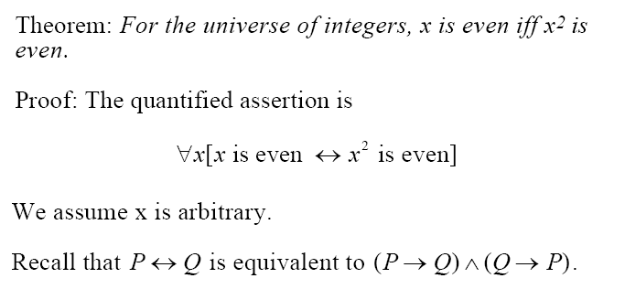
Example

Slide 41
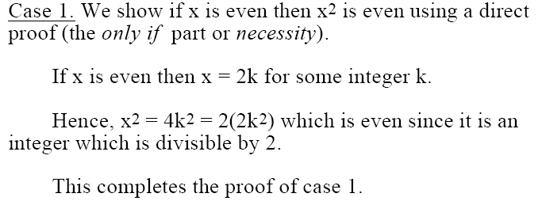
continued …

Slide 42
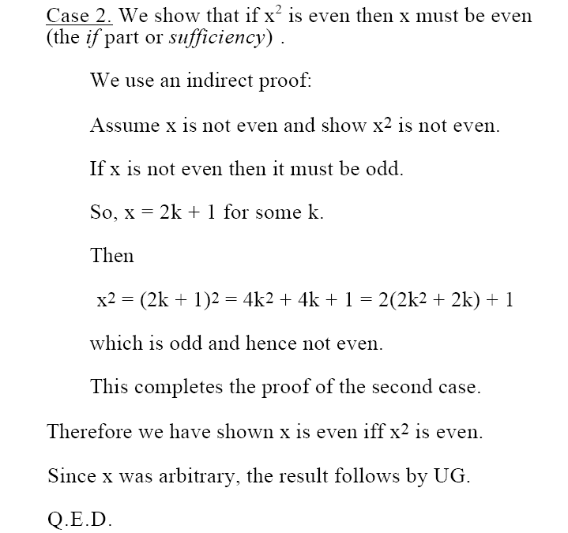
continued . . .

Slide 43
Negation of Universal Quantifier
To show that ¬∀x P(x)
Typically, you do a constructive proof of ∃x ¬P(x), which is equivalent to ¬∀x P(x)
I.e., find an element c such that ¬P(c) holds
This is known as finding a counter-example to ∀x P(x)

Slide 44
Negation of Existential Quantifier
To show that ¬∃x P(x) (which equals ∀x ¬P(x))
Typically, do a contradiction proof as follows.
From universal instantiation, we get ¬P(c)
There is nothing specific about c, it can be any element
Do a contradiction proof of ¬P(c)
I.e., assume P(c), and reach false from this
Hence, you proved ¬P(c)
You could also, perhaps, do a direct proof of ¬P(c)
Since we made no assumptions about c, from universal generalization we get ∀x ¬P(x)

Slide 45
Negation of Existential Quantifier (continued)
Recall, we are trying to prove ¬∃x P(x).
Note: you cannot apply the constructive method since it is used to prove ∃x P(x) rather than ¬∃x P(x).
I.e., if you choose a specific c₀, so what? If P(c₀) is true, you just proved that ¬∃x P(x) is false! If P(c₀) is false, it is not helpful since you need to show ∀x ¬P(x) not just for one c₀.

Slide 46
Remarks
Learning how to construct proofs is quite difficult, and is a slow learning process. One only learns how to do it by practicing.
Be careful of fallacies and incorrect arguments
The book gives you examples of some incorrect proofs.

