Slide 1
Functions
Chapter 2

Slide 2
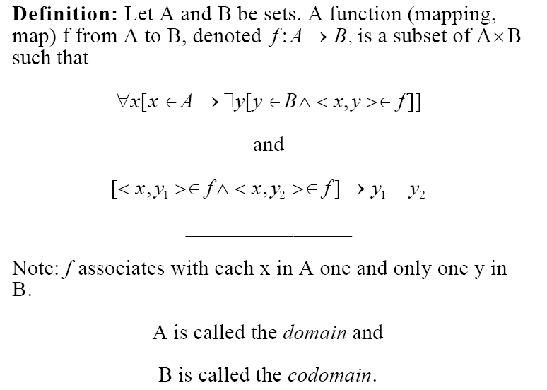
Definitions

Slide 3
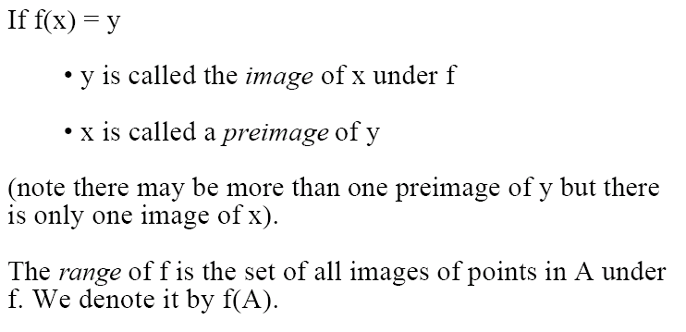
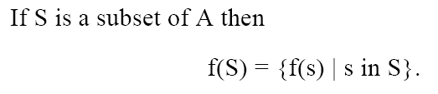
continued…

Slide 4
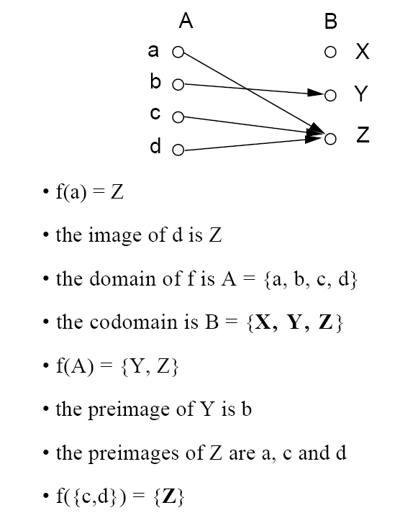
Example
f = {<a,Z>, <b,Y>, <c,Z>, <d,Z> }
Range of A

Slide 5
Let A = {a, b, c, d}, B = {X, Y, Z}, and g = {<a,X>, <c,Z>, <d,Z>}
Is g a function?

Slide 6
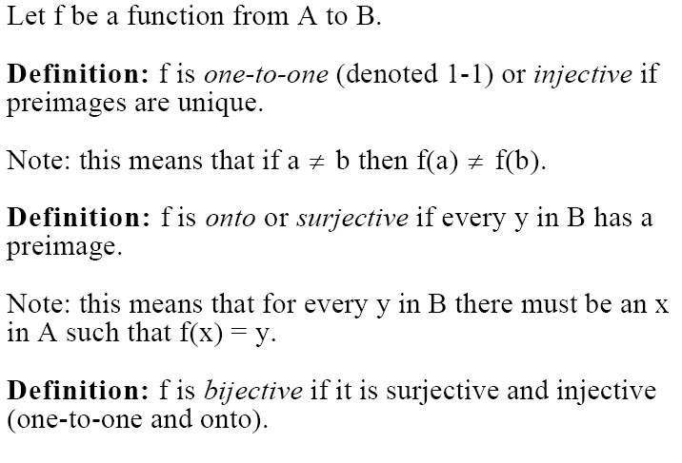
Injections, Surjections, and Bijections

Slide 7
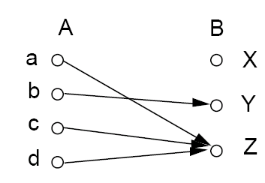
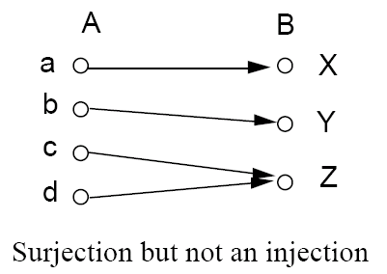


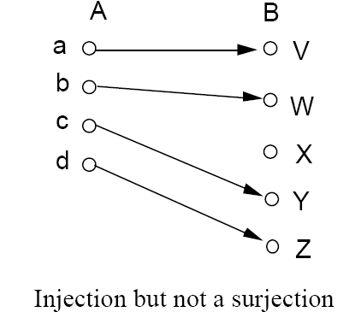
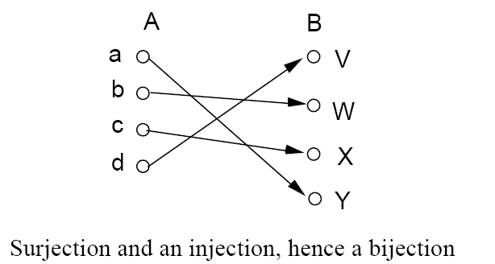
Examples

Slide 8
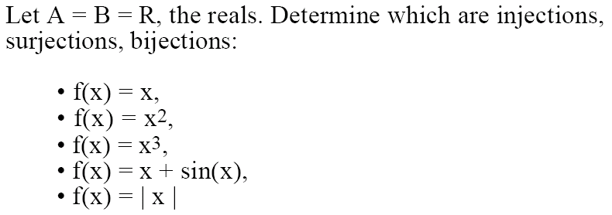
Example

Slide 9
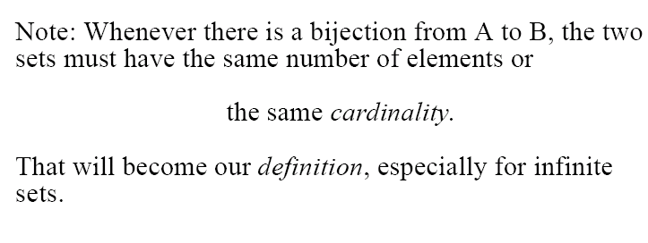
Cardinality

Slide 10
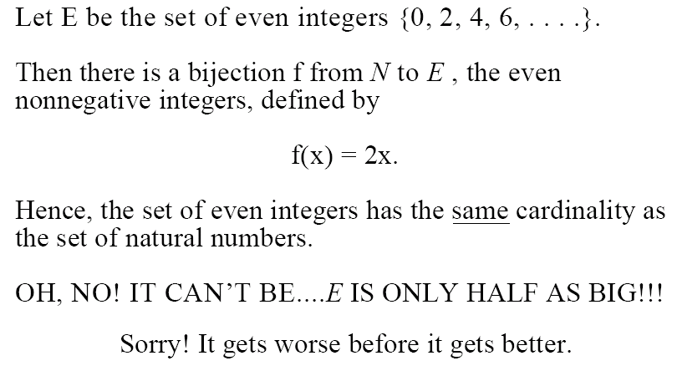
Example

Slide 11
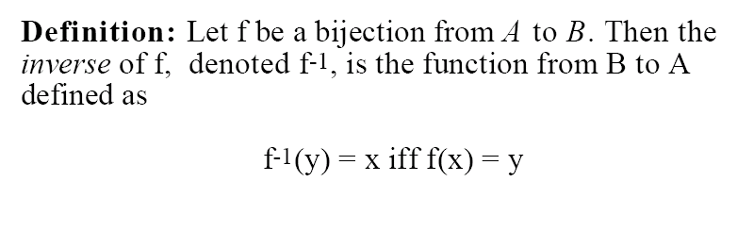
Inverse Functions

Slide 12
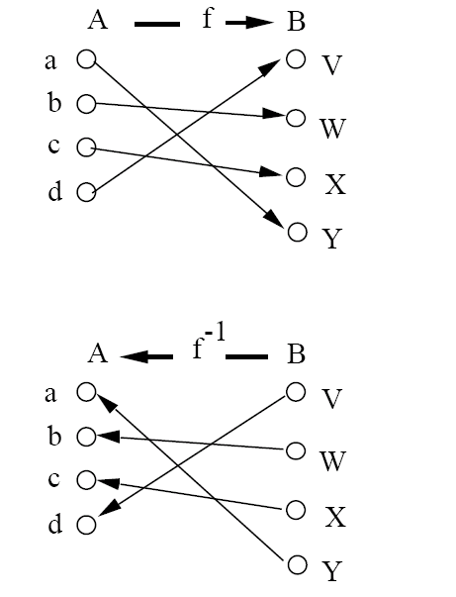
Example

Slide 13
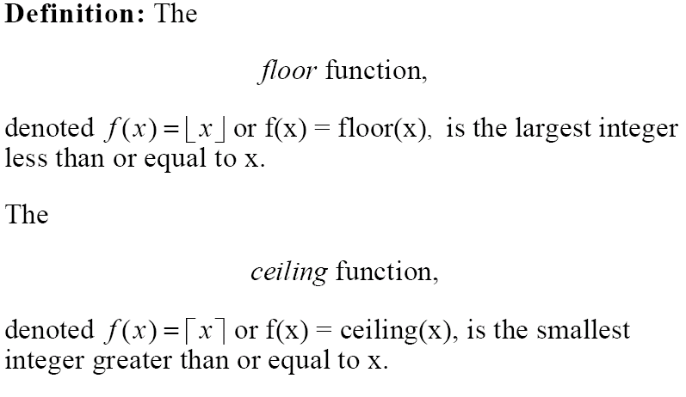
Floor and Ceilings

Slide 14
Examples
Floor(3.7) =
3
Floor(3.2) =
3
Floor(3) =
3
Ceiling(3.7) =
4
Ceiling(3.2) =
4
Ceiling(3) =
3

Slide 15
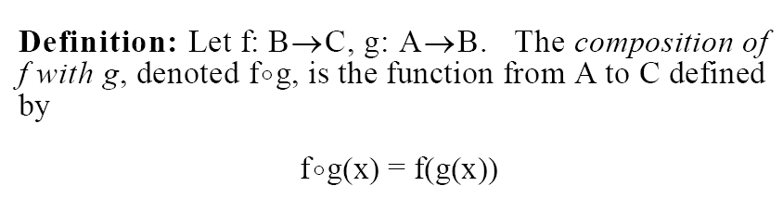
Function Composition

Slide 16
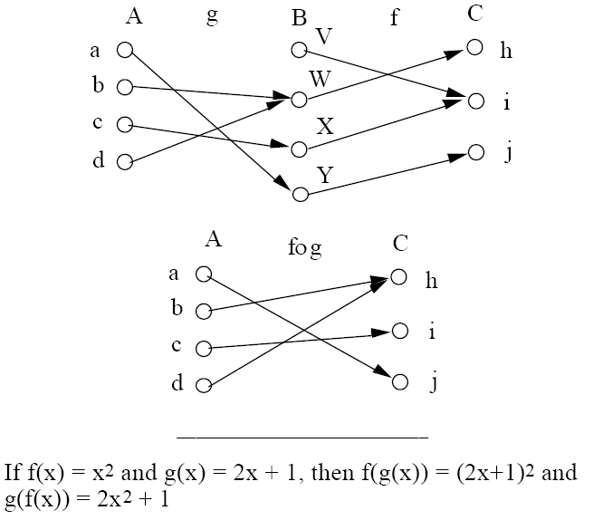
Example

Slide 17
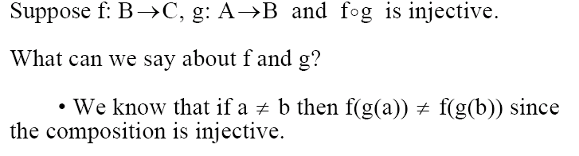
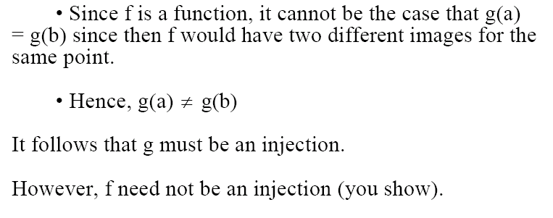
Big Example

