Slide 1
Sets
Chapter 2

Slide 2
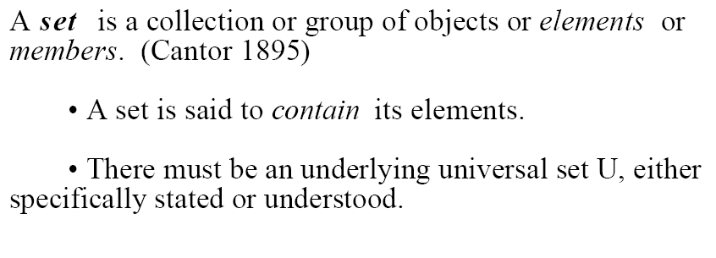
Definition

Slide 3
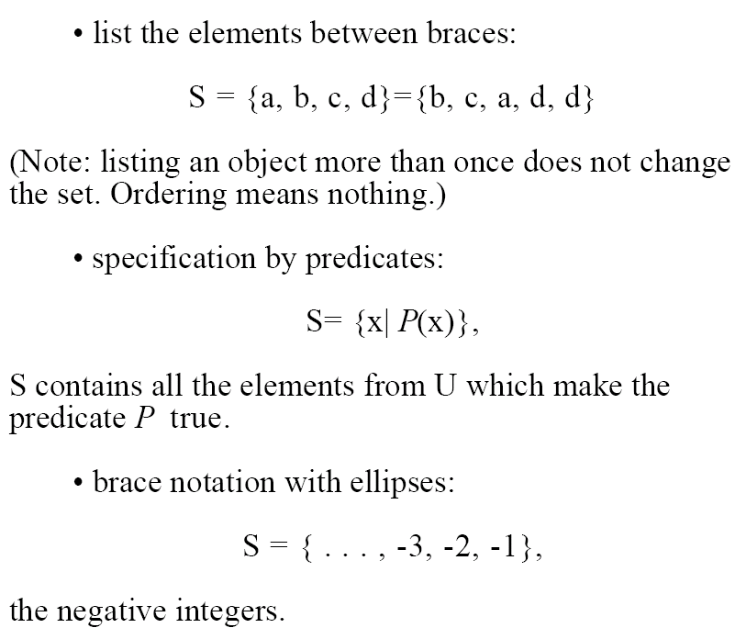
Notation

Slide 4
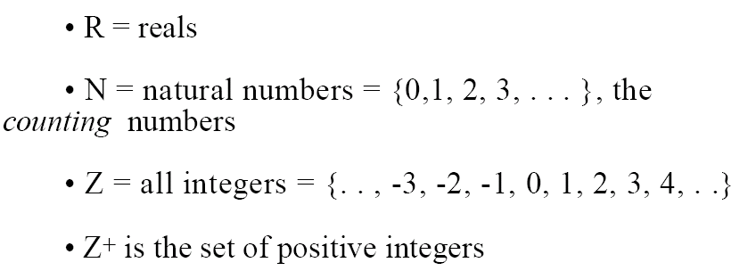
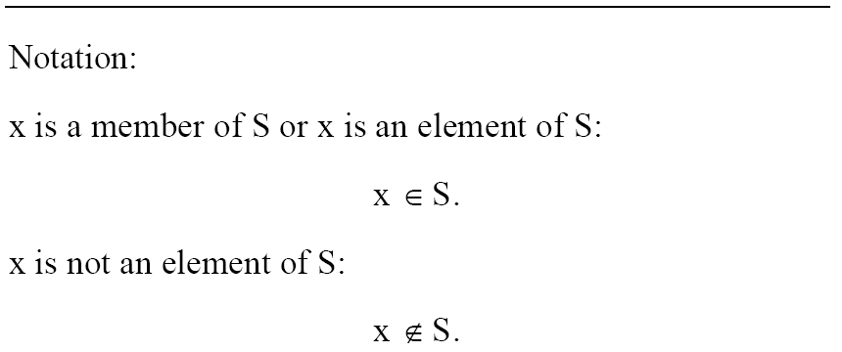
Common Universal Sets

Slide 5
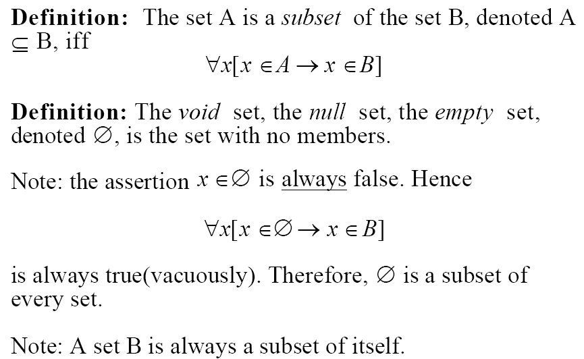
Subsets

Slide 6
Subset examples
Let N be the set of natural numbers
Let Z be the set of integers
Let P = {x | x is a positive integer}
Let G = {x | x is a negative integer}
Let H = {x | x is an integer at most 0}
Is P ⊆ N?
Is N ⊆ P?
Is G ⊆ N?
Is H ⊆ N?

Slide 7
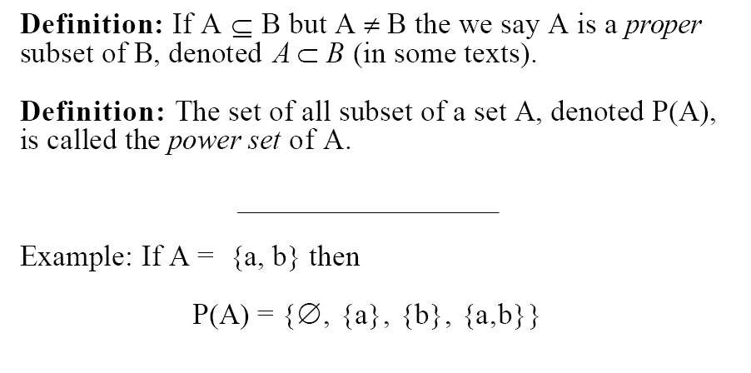
Special Subsets

Slide 8
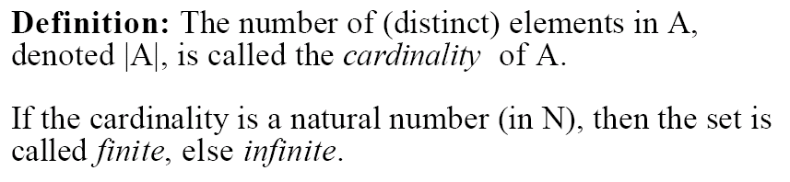
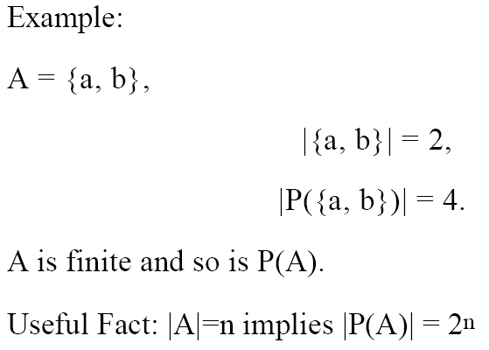
Cardinality

Slide 9
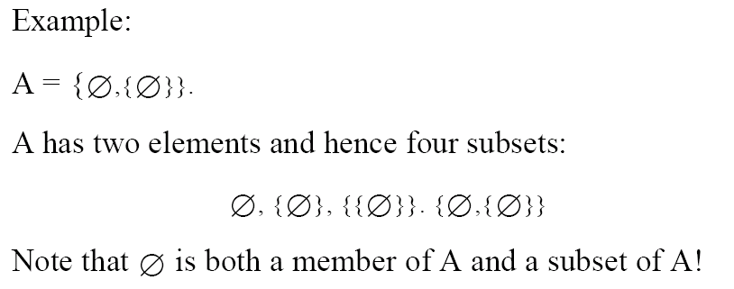
Notes
The power-set of A is often written as 2^{A}
A set can be an element or a subset of another set
Can you write down the power set of A?
,

Slide 10


Paradoxes ☺

