Slide 1
Chapter 3 Algorithms
Section 3.1

Slide 2
Algorithms
Definition: An algorithm is a finite set of precise instructions for performing a computation or for solving a problem
Example 1. Describe an algorithm for finding the maximum (largest) value in a finite sequence of integers. (what is a sequence?)
Solution:
Set the temporary max equal to the first integer in the sequence.
Compare the next integer in the sequence and if it is larger, set the temporary maximum equal to this new value.
Repeat previous step if more integers to test.
Stop when no more integers. At this point the temporary max becomes the max.

Slide 3
Pseudocode
If a particular computer language were chosen, then the resulting algorithm would be expressed in that language only.
So instead, a form of pseudo-code is used. It is a cross between basic computer language operations, mathematical notation and English.
Algorithm 1 in pseudocode
procedure find-max ( a₁,a₂,…,a_{n} : integers)
max := a₁
for i: = 2 to n
if max < a_{i} then max := a_{i}

Slide 4
Linear Search Algorithm
note: algorithms usually have 3 things
assignment statements i := 1
looping statements while … or for …
conditional statements if … then …else …
procedure linear search ( x : integer, a₁, a₂, . . . , a_{n} : distinct integers)
i := 1
while i ≤ n ∧ x ≠ a_{i}
i : = i + 1
if i ≤ n then location := i
else location := 0
{location is the subscript of the term that equals x or is 0 if x is not found)

Slide 5
Binary Search Algorithm
procedure binary search(x: integer, : increasing integers)
i : = 1 ( i is the left endpoint of search interval )
j: = n ( j is the right endpoint of the search interval )
while i < j
begin
if x > a_{m} then
i : = m + 1
else
j: = m
end
if x = a_{i} then location := i
else location : = 0
{location is the subscript of the term that equals x or is 0 if x is not found)

Slide 6
2 6 7 34 76 123 234 567 677 986
i m j
2 6 7 34 76 123 234 567 677 986
i m j
2 6 7 34 76 123 234 567 677 986
i m j
2 6 7 34 76 123 234 567 677 986
im j
2 6 7 34 76 123 234 567 677 986
imj
2 6 7 34 76 123 234 567 677 986
2 6 7 34 76 123 234 567 677 986
Search for 123
i = first
j = last
m = middle point
End when i > j
i := 1
j := n
while i < j
begin
if x > a_{m} then
i : = m + 1
else
j: = m
end
if x = a_{i} then location := i
else location : = 0

Slide 7
Sorting
Sorting rearranges a sequence of numbers so that the numbers are in increasing order (from smallest to largest)
Sorting data is one of the most common operations performed on data.
We begin with bubblesort, where at each pass, the largest (“heaviest”) element is moved to the bottom of the sequence.

Slide 8
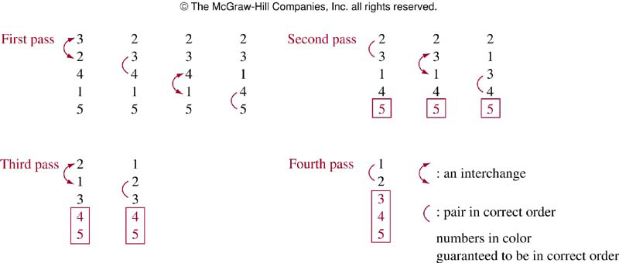
In each pass: exchange adjacent numbers if necesary

Slide 9
Bubblesort PseudoCode
procedure bubblesort(a₁, . . . , a_{n} : real numbers with n ≥ 2)
for i := 1 to n-1 {i is the pass number}
for j := 1 to n-i {j is the position in the column}
if a_{j} > a_{j+1} then interchange a_{j} and a_{j+1}
{a₁, . . . , a_{n} is now in increasing order}

Slide 10
Insertion Sort
Simple, but not efficient
Separate the list in three parts: sorted list, next item to sort (x), and the unsorted list
x goes here
#’s smaller than x
#’s greater than x
Y
Z
X
Sorted sequence
Unsorted sequence
X
Y
Z

Slide 11
Insertion Sort example
3 2 4 1 5 {colored list is sorted}
2 3 4 1 5 {compare 2 and 3, put 2 in front}
2 3 4 1 5 {compare 4 against 2 and 3, already in order}
1 2 3 4 5 {compare 1 against 2 3 4 (actually, just against 2), and put in front.
1 2 3 4 5 {compare 5 against 1 2 3 and 4, so place it at the end}

Slide 12
ai
aj
Sorted sequence
Unsorted sequence
procedure insertion sort (
for j : = 2 to n {a_{j} is the number being inserted}
begin
i : = 1 {a_{i} is the number on the sorted list being compared with a_{j}}
while a_{i} < a_{j}
i : = i + 1 {compare the next number on the list with all those at the beginning of the list until it finds one greater than the number to be inserted. Note those first numbers are in increasing order}
{a_{j} should be inserted into the position where a_{i} is}
m : = a_{j} {save the value to be inserted}
{it should be inserted in position i}
for k := j down to i+1 {make space to insert the item}
a_{k} := a_{k-1}
a_{i} := m
end

Slide 13
Greedy algorithms
Frequently a problem is presented which desires an optimization of some procedure.
Surprisingly, one of the simplest approaches often leads to a solution.
This approach selects the best choice at each step (or locally) instead of considering all sequences of steps possible.
Algorithms which make use of the “BEST” choice at each step are called greedy algorithms.

Slide 14
Greedy Change-making algorithm
Use least number of coins to obtain n cents
Greedy: use the largest denomination at each step.
Procedure change ( : values of denominations of coins, where
; n: integer)
for i := 1 to r
while n ≥ c_{i}
begin
add a coin with value c_{i} to the change;
n := n - c_{i}
end

Slide 15
Lemma 1
If n is a positive integer, then n cents change using quarters, dimes, nickels and pennies using the fewest coins possible has:
a) at most two dimes,
b) at most one nickel,
c) at most four pennies,
d) cannot have two dimes and a nickel,
e) the amount of change in dimes, nickels and pennies cannot exceed 24 cents.
Proof by contrapositive.
The idea of the proof is to assume e.g., that if we have more than two dimes, we can reduce the number of coins, and thus we don’t have the fewest coins possible. We do this for every statement a) through d)

Slide 16
continued …
a) If we have three or more dimes, then three dimes can be replaced by a quarter and a nickel (hence, less coins)
b) If we have two or more nickels, we can replace two nickels for a dime (hence less coins)
c) If we have five or more pennies, we can replace them by a nickel (hence less coins)
d) If we have two dimes and a nickel we can replace them by a quarter.
e) From a) through c) the total change in dimes, nickels and pennies cannot be more than 24 cents.

Slide 17
Theorem: The greedy algorithm makes change with the fewest coins possible.
Proof:
Let C be the change breakup for n cents using greedy algo.
Let C ’ be an optimal change-making breakup for n cents.
Let q be the number of quarters in C (similarly q’ and C’)
Let r be the number of cents using non-quarters in C (similarly r’ and C’)
q’ ≤ q, because greedy algorithm must use the most quarters compared to any other algorithm (it chooses the largest # of quarters possible)
r‘≤ 24 from lemma (add (a) (b) (c) in lemma).
Thus, q’ is also the largest possible (not enough cents remain for another quarter), i.e., it is the same as first grabbing as many quarters as possible
Thus, q’ = q, and also therefore r’ = r

Slide 18
continued …
Both methods have the same cents made from “non-quarters” r = r’.
Let d and d’ be the number of dimes.
From the Lemma, C’ has at most one nickel and at most four pennies
Hence, d’ has the largest number of dimes possible from r’
We know our algorithm also uses as many dimes as possible from r.
Hence, d = d’
Repeat argument a) and b) to show they have the same # of nickels
Thus, what remains after the nickels is the same in both, which can be added up with pennies in only one way.

Slide 19
Exceptions to the change algorithm
If we do not include nickels in our allowable change, this algorithm will not give the fewest coins possible. Notice the use of the lemma was important in proving the theorem.
In fact if we are not allowed nickels, and look at 30 cents, using the algorithm gives us one quarter and 5 pennies for a total of 6 coins. This is not the fewest number of coins because 3 dimes also make 30 cents.
I.e., greedy is not always best!

Slide 20
Characteristics of algorithms
Input. An algorithm has input values from a specified set
Output From each set of input values an algorithm produces output values from a specified set. The output values are the solution to the problem
Definiteness, The steps of the algorithm are defined precisely.
Correctness. An algorithm should produce the correct value for each set of input values.
Finiteness An algorithm should produce the desired output after a finite number of steps for any input allowed.
Effectiveness It must be possible to perform each step of an algorithm exactly and in a finite amount of time.
Generality, The procedure should be applicable for all problems of the desired form, not just for a particular set of input values

Slide 21
The Halting Problem
The Halting Problem asks whether it is possible to devise a procedure H that takes as input the code of another (arbitrary) procedure P and the input I to that procedure and decides (returns yes or no) whether P(I) will eventually halt with the given input.
The Halting Problem is not solvable. The proof will be by contradiction and therefore such a procedure cannot exist
We will assume such a procedure exists and lead to a contradiction.

Slide 22
Proof
Assume there exists a procedure H(P,I) which returns “halt” if P halts on input I, or returns “no halt” if P loops forever on input I.
As any procedure can be encoded to be input, it becomes just a sequence of bits.
This means H (P,P ) makes sense. Also, H (H,H) makes sense.
Now construct a procedure K(P) that uses the output of H(P,P) as follows;

Slide 23
Proof continued
Define K( P) to be
K (P) does the opposite of H ( P, P ).
Consider now what happens when the procedure K is input to K.

Slide 24
Proof continued
From this we see that if H ( K, K ) returns “halt” then K( K ) does not halt.
Consider now what H ( K, K ) means. This is a procedure that determines if procedure K halts upon input K. However, this result is not possible because if H ( K, K ) decides that K halts on input K, then K (K) does not halt. This is not possible.
Similarly if H ( K, K ) returns “no halt”, then K ( K ) halts. This is also not possible.
Such a procedure as H cannot exist.

Slide 25
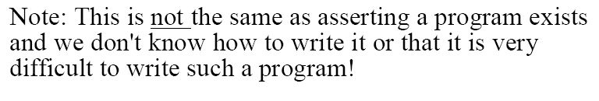
conclusion…
We are simply saying that H cannot exist. There is no such thing as H.

