Slide 1
Chapter 3 Growth of Functions
Section 3.2

Slide 2
Function growth relative to another function
We present the concept of a function g growing at least as fast as another function f.
Why?
We will later analyze the complexity of an algorithm by counting the number of steps it takes.
I.e., for each algorithm we find a function f: N → N such that f(x) is the number of steps taken by the algorithm if the input of the algorithm has size x.
We then compare the functions of two algorithms to see which is better (e.g. linear search vs. binary search)

Slide 3
How is the comparison done?
When comparing two functions f and g, we are not simply asking if f(x) ≤ g(x) it is more complex than that.
Why?
We only care when x (the size of the input) is very large
We don’t care about constant factors

Slide 4
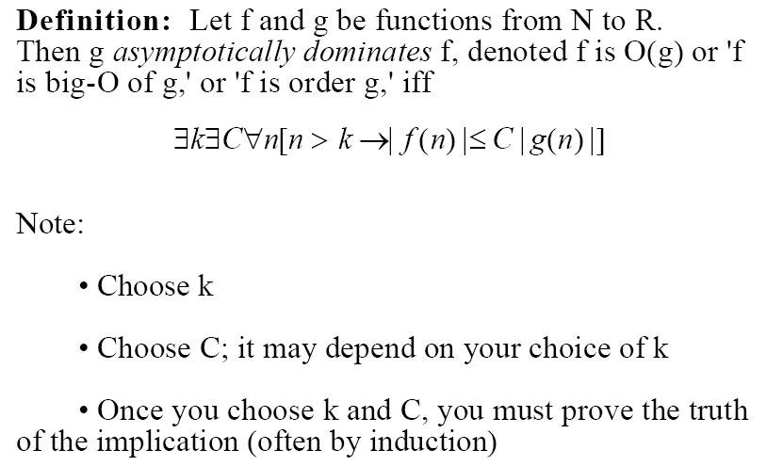
Big-O of a function
R

Slide 5
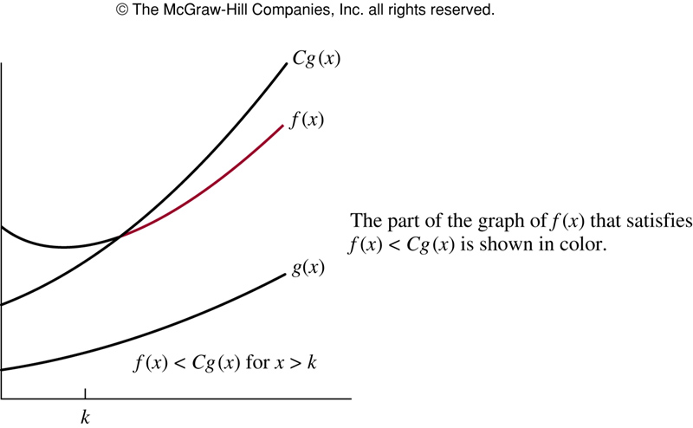
f is O(g)
Trivially true if g(x) >= f(x) for all x.
However, as shown to the left, it is possible when f(x) > g(x) for all x
k

Slide 6
Comments on Notation
If f is O(g) it is sometime written as f = O(g), which is terrible notation!
Notice that there are many functions that are O(g).
In fact, O(g) is a set of functions and writing f ∈O(g) is better than the above (IMHO).

Slide 7
Big-O example
Show that
x² + 2x + 1 is O(x²)
Finding C and k can be done in many ways.
We just need to find some C and some k that works
Note that when 1 ≤ x, we have x ≤ x² (we use k=1)
When 1 ≤ x, we have |x² + 2x + 1 | ≤ x² + 2x + 1 ≤ x² + 2x² + x²= 4x² = 4|x²|
Hence, k =1, C = 4 will do.

Slide 8
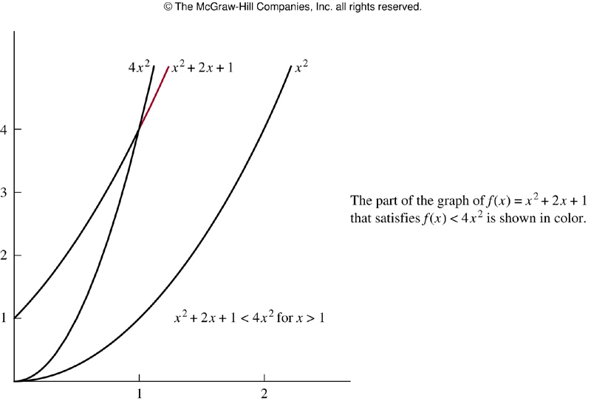
x²+2x+1 is O(x²)

Slide 9
Showing a function is not Big-O of another (example)
Show that n² is not O(n).
Proof (by contradiction)
Assume n² is O(n). Thus, there is a C and k such that
(1) |n²| ≤ C*|n| for all n, n > k
Choose m = max (C, k,1) and n’ = m+1 (note that n’ > C and n’, m ≥ 1)
(2) |n’ ²| = |(m+1)*n’ | = (m+1)*|n’| > C*|n’|
i.e., |n’ ²| > C*|n’ |
Because n’ > k, (1) must hold with n = n’
This, however, contradicts (2).
Thus, there can be no such k and C to make the inequality true.
9

Slide 10
Big-O of Polynomials (very useful!)
Theorem
with x ≥ k = 1

Slide 11
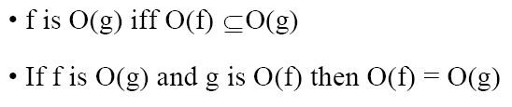
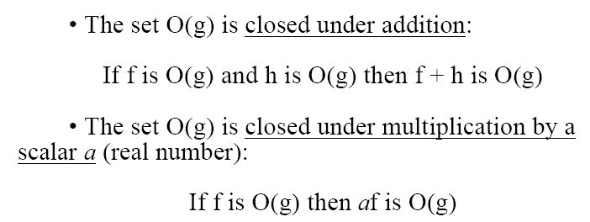
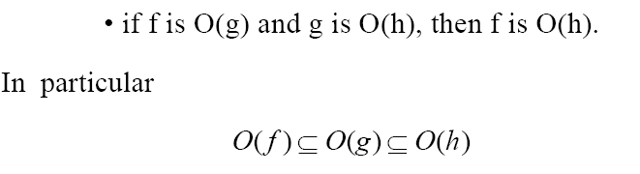
Properties of Big-O

Slide 12
More Big-O results
Examples in the text which are not covered in class are expected to be read and understood.
Theorem 2:

Slide 13
Proof
As with all proofs involving Big – O, a C and a k must be found that satisfies the inequality.
Making use of known facts (always a good place to start a proof)
State what needs to be shown (also a good idea when doing a proof)
We must find a C₃ and a k₃ so that when x > k₃
where g₃(x) is yet to be determined.

Slide 14
Proof continued
Now if we take , both inequalities will be true and we can write for x > k₃,
If we take
then we have

Slide 15
Proof (end)
Now, take
The desired constants are C₃ = 2C’ and we have already specified

Slide 16
Corollary

Slide 17
More results ☺
Theorem 3
Proof: Again the goal is to find a C and a k so that
C|g₁(x)*g₂(x)| where x > k
where k ≤ x

Slide 18
continued …
If we take , then both inequalities hold and we have
Thus taking the above k and , we have that
$$\left|f_{1}\left(x\right)f_{2}\left(x\right)\right| = \left|f_{1}\left(x\right)\right|\left|f_{2}\left(x\right)\right|$$
$$\left|f_{1}\left(x\right)\right|\left|f_{2}\left(x\right)\right| ≤ C_{1}\left|g_{1}\left(x\right)\right|C_{2}\left|g_{2}\left(x\right)\right|$$
$$C_{1}\left|g_{1}\left(x\right)\right|C_{2}\left|g_{2}\left(x\right)\right|=C_{1}C_{2}\left|g_{1}\left(x\right)g_{2}\left(x\right)\right|$$
18

Slide 19
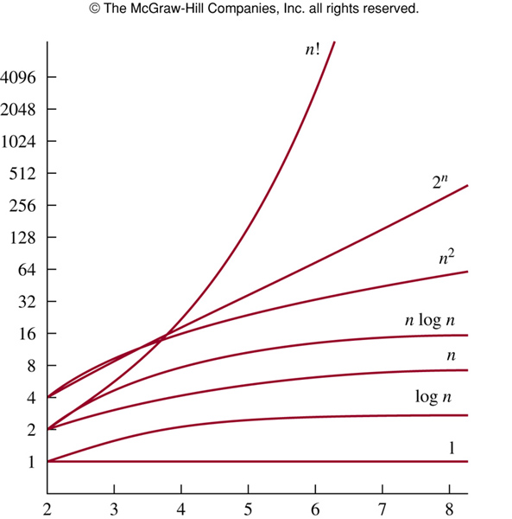

Slide 20
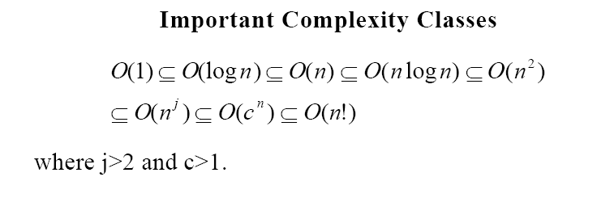

Slide 21

Page 191 #14
Is each one on the left true or not?
$$x^{2}+x^{3}∈O(x^{3})$$

Slide 22
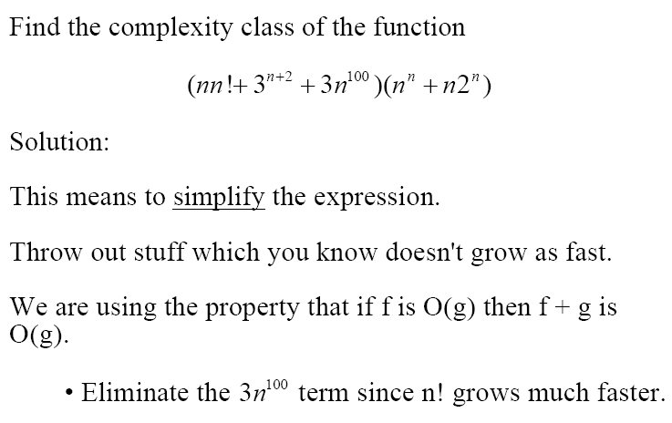

Big example
We are also using Theorem 3.

Slide 23
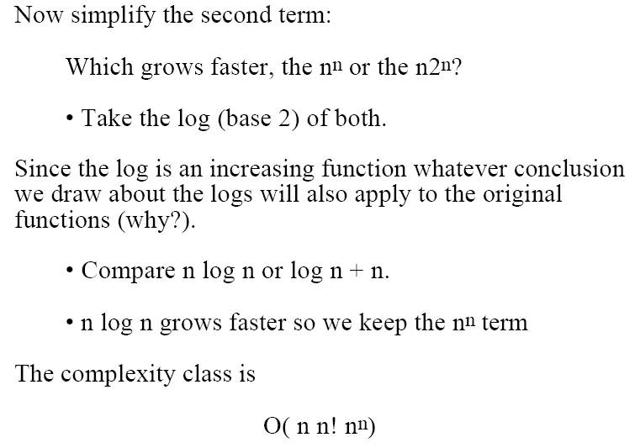
continued …

Slide 24
Big-Omega and Big-Theta Notation
Let f and g be functions from the set of integers or the set of real numbers to the set of real numbers. We say that if there are positive constants C and k such that
Let f and g be functions from the set of integers or the set of real numbers to the set of real numbers. We say that iff f(x) is both O(g(x)) and Ω(g(x)).
We also can say that f(x) is of order g(x)

Slide 25
Exercise for Θ
Show that if f(x) and g(x) are functions from the set of real numbers to the set of real numbers, then f(x) is Θ(g(x)) if and only if there are positive constants k, C, and C’ such that
C |g(x)| ≤ |f(x)| ≤ C’|g(x)|
whenever x > k.

Slide 26
continued …
This is an if and only if statement.
First assume that f(x) is Θ(g(x)). Here we need to find the constants.

Slide 27
continued …
Now assume that the constants C, C’, and k exist such that
whenever x > k.
Each side of the inequality is exactly the definition for O(g(x)) and Ω(g(x))

