Slide 1
Chapter 3 Algorithm Complexity
Section 3.3

Slide 2
Algorithms Efficiency
To determine an algorithms efficiency, two entities are measured:
The amount of space (memory) used by the algorithm (called the space complexity)
The amount of time (execution steps) used to solve the problem (called the time complexity)
The amount of time/space used by an algorithm is usually a function of the size of its input.

Slide 3
Average vs. Maxmum
For both space/time, you can measure
The maximum
i.e., for all inputs of size n, what is an upper bound on the number of steps/memory required?
The average
over all inputs of size n, what is the average number of steps/memory?
Note that both of these are functions of n, the size of the input.

Slide 4
Example: time complexity of finding the largest number in an unordered list
procedure find-max ( a₁,a₂,…,a_{n} : integers)
max := a₁
i := 2
while i ≤ n
if max < a_{i} then max := a_{i}
i := i + 1
# comparisons - 2(n - 1) + 1 = 2n - 1
# assignments - 2 + 2(n - 1) = 2n
# steps - 4n - 1

Slide 5
Focus on comparisons
Note that the number of steps is O(n)
Note that the number of comparisons is O(n)
Note that the number of assignments is O(n)
Thus
For many algorithms, we usually just focus on the # of comparisons, since other operations (such as assignments) are of the same order.

Slide 6
Example: time complexity of finding a number in an unordered list
Linear search
Analysis is similar to the above (see the book)
Running time (max) is O(n).
Note that the best case (item is at the beginning of list) takes just one step!
So, we focus on the worst possible running time (I.e., we are interested in the max, not the best)

Slide 7
Average case complexity: linear search
This is more complicated ☺
Assume x is on the list
There are n possible equally probably choices: x is 1st, 2nd, …, n^{th} element.
If 1st, # comparisons = 3
If 2nd, #comparisons = 5
Two more for another pass at loop.
procedure linear search (
x : integer,
a₁, a₂, . . . , a_{n} : distinct integers)
i := 1
while i ≤ n ∧ x ≠ a_{i}
i : = i + 1
if i ≤ n then location := i
else location := 0

Slide 8
Example: Binary Search
i := 1
j := n
while i < j
begin
if x > a_{m} then
i : = m + 1
else
j: = m
end
if x = a_{i} then location := i
else location : = 0
For this analysis, assume that the number of elements is
Here k = log n
At each stage of the search, we have two comparisons: i < j and x > a_{m}.
The stages consist of the following number of elements:
When one element is left, two more comparisons are needed, i < j (to check the end of the loop) and x = a_{i}. (after the loop).
Thus a total of 2k + 2 = 2(log n + 1 ) are needed.
This is O(log n).

Slide 9
Worst-case complexity: bubble-sort
For the first pass (n-1) comparisons are made, the second (n-2), the third (n-3), etc.
Thus the total is the sum of these
This is big-O of what?

Slide 10
Worst case complexity : insertion sort
Inserts the j^{th} element into the correct place among the first j -1 elements on the list.
Thus there are j comparisons to insert each element
Compare a_{j} against all other j-1 elements, the loop may end when a_{j} is compared against itself!
This begins with j = 2 as there are no comparisons for the first element
This is a total of
Again, big-O of ?

Slide 11
Algorithmic Paradigms
An algorithmic paradigm is a general approach based on a particular concept for constructing algorithms to solve a variety of problems.
Greedy algorithms were introduced in Section 3.1.
We discuss brute-force algorithms in this section.
There are also
divide-and-conquer algorithms
dynamic programming
backtracking
and probabilistic algorithms, among others (covered in the algorithms course)

Slide 12
Brute-Force Algorithms
A brute-force algorithm is solved in the most straightforward manner, without taking advantage of any ideas that can make the algorithm more efficient.
Brute-force algorithms we have previously seen are sequential search, bubble sort, and insertion sort.

Slide 13
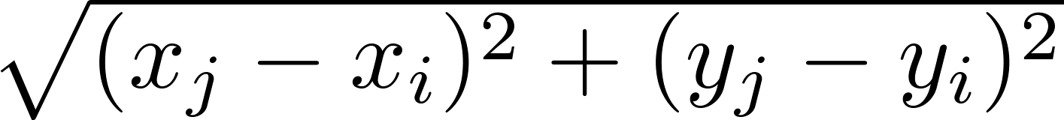
Closest Pair of Points Problem by Brute-Force
Example: Construct a brute-force algorithm for finding the closest pair of points in a set of n points in the plane and provide a worst-case estimate of the number of arithmetic operations
.
Solution: Recall that the distance between (x_{i},y_{i}) and (x_{j}, y_{j}) is . A brute-force algorithm simply computes the distance between all pairs of points and picks the pair with the smallest distance.
Note: There is no need to compute the square root, since the square of the distance between two points is smallest when the distance is smallest.
Continued →

Slide 14
continued…
Algorithm for finding the closest pair in a set of n points.
The algorithm loops through n(n −1)/2 pairs of points, computes the value (x_{j} − x_{i})² + (y_{j} − y_{i})² and compares it with the minimum, etc. So, the algorithm uses Θ(n²) arithmetic and comparison operations.
We will develop an algorithm with O(log n) worst-case complexity in Section 8.3.
procedure closest pair((x₁, y₁), (x₂, y₂), … ,(x_{n}, y_{n}): x_{i}, y_{i} real numbers)
min = ∞
for i := 1 to n
for j := 1 to i-1
if (x_{j} − x_{i})² + (y_{j} − y_{i})² < min
then min := (x_{j} − x_{i})² + (y_{j} − y_{i})²
closest pair := (x_{i}, y_{i}), (x_{j}, y_{j})
return closest pair

Slide 15
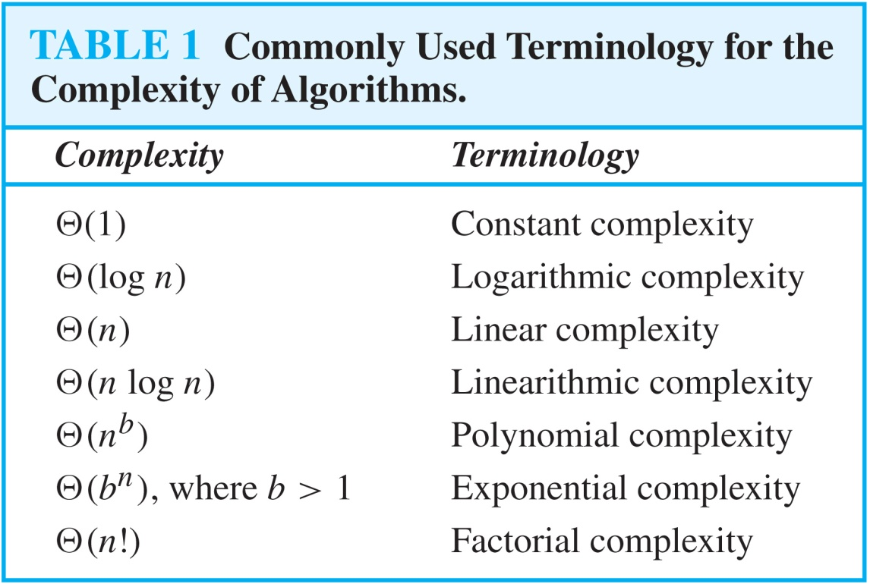
Typical Complexity Classes

Slide 16
Understanding the Complexity of Algorithms
A problem that is solvable using an algorithm with polynomial worst-case complexity is called tractable. A.k.a class P.
However, there can be situations where this is still a very long time. If the power of the largest exponent is large or the coefficients are large, the time may still be quite long.
However, there are problems that cannot be solved with algorithms that have worst-case polynomial time complexity. Such problems are called intractable.
Some problems exist for which it can be shown that no algorithm exists which solves the problem. Such problems are called unsolvable. (The Halting Problem is such a problem)

Slide 17
Class NP
Problems for which a solution can be checked in polynomial time are said to belong to the class NP (nondeterministic polynomial time).
Tractable problems belong to the class NP (i.e. P is a subset of NP).
Why?????
A decision problem (what is this?) C is NP-complete if it is complete for NP, meaning that:
it is in NP
it is NP-hard, i.e. every other problem in NP is reducible to it.
That is, for every problem I in NP, there is a polynomial-time (in the size of the input to the problem) which transforms instances i in I into instances c in C, such that the answer to c is YES if and only if the answer to i is YES.

Slide 18
Example of NP-Complete Problems
Satisfiability of a propositional expression.
Is there an assignment of T or F to each proposition that makes the expression true?
Note that checking if a particular T or F assignment yields T or F can be done in linear time.
Partition problem
Given a list of integers (repetition is possible), can this list be divided into two lists such that the sum of the elements in each list is the same?
How fast can you check if two list of integers are a solution to the above?

Slide 19
More on NP Complete
Nobody has yet been able to prove whether NP-complete problems are in fact solvable in polynomial time, making this one of the great unsolved problems of mathematics
Note if there is a polynomial solution to an NP-Complete problem, then P = NP.
The Clay Mathematics Institute in Cambridge, MA is offering a $1 million reward to anyone who has a formal proof that P=NP or that P≠NP.

