Slide 1
Generalized Permutations and Combinations
Section 6.5

Slide 2
Section Summary
Permutations with Repetition
Combinations with Repetition
Permutations with Indistinguishable Objects
Distributing Objects into Boxes

Slide 3
Permutations with Repetition
Theorem 1: The number of r-permutations of a set of n objects with repetition allowed is n^{r}.
Proof: There are n ways to select an element of the set for each of the r positions in the r-permutation when repetition is allowed. Hence, by the product rule there are n^{r} r-permutations with repetition.
Example: How many strings of length r can be formed from the uppercase letters of the English alphabet?
Solution: The number of such strings is 26^{r}, which is the number of r-permutations of a set with 26 elements.

Slide 4
Another example.
How many ways can 25 distinct flags be assigned to 10 distinct flag poles if the order on the flagpoles is not important?
This says the flags are assigned to the flagpoles with perhaps more than one flag assigned to the same flagpole. Once the set of flags is known for the flagpole, the flags can be put on the flagpole in any order.

Slide 5
Continued …
Here all of the flagpoles are available for the flags. So for each flag there are 10 choices. This means that there are
many ways of doing this
(you are really doing a permutation of the set of poles of length 25 with repetition allowed, you are assigning poles to flags!)
Now, if order is important on the flag poles (totally different problem), then we have
There are 10 choices for the first flag, as each flag is added, because order matter, above and below a flag positioned adds one more choice for the next flag.

Slide 6
Combinations with Repetition
Example: How many ways are there to select five bills from a box containing at least five of each of the following denominations: $1, $2, $5, $10, $20, $50, and $100?
Note: we select five bills, and, since there are at least five of each denomination, we don’t run out of bills of that denomination)
continued →

Slide 7
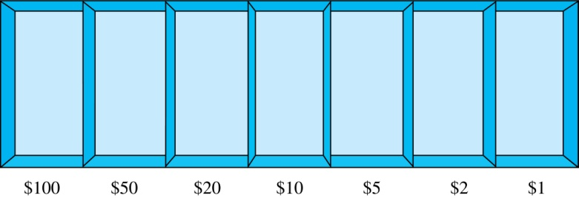
example continues . . .
Solution: Place the selected bills in the appropriate position of a cash box: (the cash box is just to help with the math, but you are actually putting the bills in your pocket, i.e., in one bag only)
continued →

Slide 8
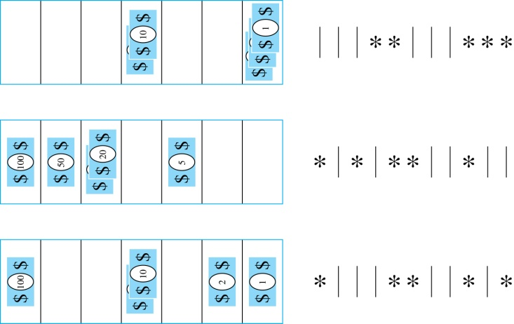

example continues . . .
Some possible ways of
placing the five bills:
The number of ways to select five bills corresponds to the number of ways to arrange six bars and five stars in a row.
This is the number of unordered selections of 5 objects from a set of 11. Hence, there are
ways to choose five bills with seven types of bills.

Slide 9
Combinations with Repetition Theorem
Theorem 2: The number 0f r-combinations from a set with n elements when repetition of elements is allowed is
C(n + r – 1,r) = C(n + r – 1, n –1).
Proof: Each r-combination of a set with n elements with repetition allowed can be represented by a list of n –1 bars and r stars. The bars mark the n cells containing a star for each time the ith element of the set occurs in the combination.
The number of such lists is C(n + r – 1, r), because each list is a choice of the r positions to place the stars, from the total of n + r – 1 positions to place the stars and the bars. This is also equal to C(n + r – 1, n –1), which is the number of ways to place the n –1 bars.

Slide 10
Combinations with Repetition
Example: How many solutions does the equation
x₁ + x₂ + x₃ = 11
have, where x₁ , x₂ and x₃ are nonnegative integers?
Solution: Each solution corresponds to a way to select 11 items from a set with three elements; x₁ elements of type one, x₂ of type two, and x₃ of type three.
By Theorem 2 it follows that there are
solutions.
Note: n < r is possible because of repetition.

Slide 11
Combinations with Repetition
Example: Suppose that a cookie shop has four different kinds of cookies. How many different ways can six cookies be chosen?
Solution: The number of ways to choose six cookies is the number of 6-combinations (with repetition) of a set with four elements. By Theorem 2
is the number of ways to choose six cookies from the four kinds.

Slide 12
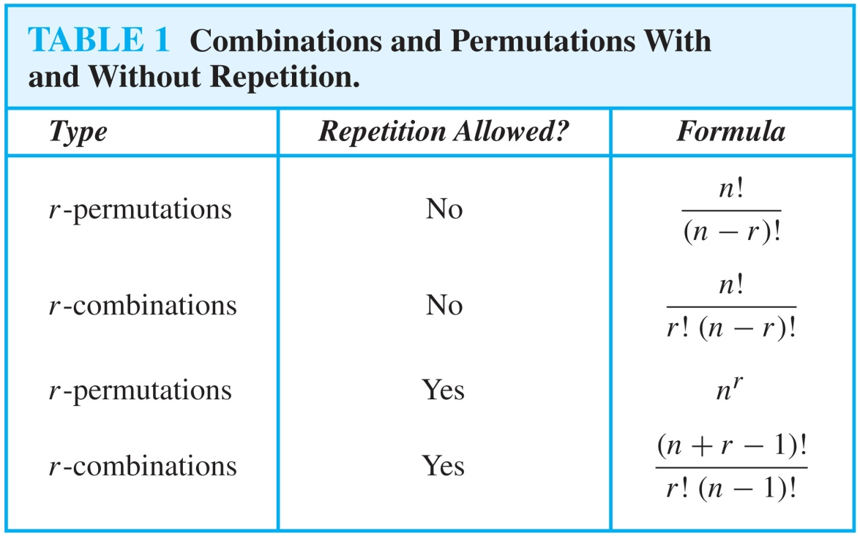
Summarizing the Formulas for Counting Permutations and Combinations with and without Repetition

Slide 13
Permutations with Indistinguishable Objects
Example: How many different strings can be made by reordering the letters of the word SUCCESS.
Solution:
There are seven possible positions for the letters: _ _ _ _ _ _ _
The three S’s can be placed in C(7,3) different ways, leaving four positions free.
For each of the above ways, the two C’s can be placed in C(4,2) different ways, leaving two positions free.
For each of the above ways, the U can be placed in C(2,1) different ways, leaving one position free.
The E can be placed in C(1,1) way.
By the product rule, the number of different strings is:
The reasoning can be generalized to the following theorem. →

Slide 14
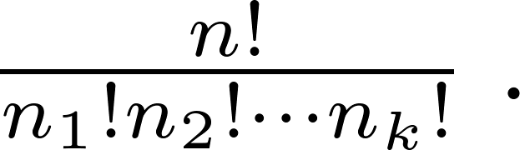
Theorem for Permutations with Indistinguishable Objects
Theorem 3: The number of different permutations of n objects, where there are n₁ indistinguishable objects of type 1, n₂ indistinguishable objects of type 2, …., and n_{k} indistinguishable objects of type k, is:
Note: n₁+ n₂ + . . . + n_{k} = n, because each object belongs to one of the k types of objects,

Slide 15
Proof: By the product rule the total number of permutations is:
C(n, n₁ ) C(n − n₁, n₂ ) ∙∙∙ C(n − n₁ − n₂ − ∙∙∙ − n_{k}, n_{k}) since:
The n₁ objects of type one can be placed in the n positions in C(n, n₁ ) different ways, leaving n − n₁ positions available.
Then, the n₂ objects of type two can be placed in the n − n₁ positions in C(n − n₁, n₂ ) ways, leaving n − n₁ − n₂ positions free.
Continue in this fashion, until n_{k} objects of type k are placed in C(n − n₁ − n₂ − ∙∙∙ − n_{k}, n_{k}) ways.
The product can be manipulated into the desired result as follows:

Slide 16
Distributing Objects into Boxes
Many counting problems can be solved by counting the ways objects can be placed in boxes.
The objects may be either different from each other (distinguishable) or identical (indistinguishable).
The boxes may be labeled (distinguishable) or unlabeled (indistinguishable).

Slide 17
Distinguishable objects into distinguishable boxes
Distribute r objects into n boxes
Each object must go into a box.
A box can hold multiple objects.
This is the same as assigning boxes to objects, with repetition (each box can be “assigned” to multiple objects that it contains)
i.e., r-permutation with repetition, for a total of n^{r} ways.
same problem, different wording.
Let’s work on a different version: where the number of objects placed in each box is fixed.

Slide 18
Distinguishable objects and distinguishable boxes, fixed number of objects per box.
The number of ways to distribute n distinguishable objects into k distinguishable boxes so that for each box b_{i}, 1 ≤ i ≤ k, where exactly n_{i} are placed into box b_{i}, equals
This can be proved using the rule of the product.
First put n1 objects into the first box, then n2 objects into the second box, etc.
For each box n_{i} there are the following many choices

Slide 19
Continued …
If we look at successive choices, we see that the numerator of the next selection is in the denominator of the previous selection.
Thus when all of these are finally selected, the only terms left in the denominator will be the values n₁! n₂! … n_{k}!, and the numerator will be the original n!

Slide 20
Example: From a deck of 52 different cards, how many ways are there to distribute hands of 5 cards each to four different players?
Distinguishable objects: 52 cards
Distinguishable Boxes:
Box 1 – player 1 (5 cards, i.e. n₁ = 5)
Box 2 – player 2 (5 cards)
Box 3 – player 3 (5 cards)
Box 4 – player 4 (5 cards)
Note, however, that the sum of n1, n2 , etc must be equal to the number of objects, so we need another box to hold the remaining cards (think of the dealer holding the remaining cards as being an additional box).
Box 5 – dealer (remaining cards) = 52 – 4*5 = 32
Thus, there are 52!/(5!5!5!5!32!) ways to distribute hands of 5 cards each to four players.

Slide 21
r-permutations and boxes
Is an r-permutation (without repetition) of n objects the same as distributing n distinguishable objects into distinguishable boxes?
If so, do we use r boxes? Or how may?
The r places are the distinguishable boxes
Each place can only hold one object.
The earlier theorem requires ALL elements to be placed in boxes
We have n - r leftovers after using the first r boxes
We need one extra box for the n - r leftovers.
n!/(1!*1* . . . *1! * (n - r)!) = n!/(n - r)! as desired!
r-permutations is thus a special case.

Slide 22
Indistinguishable objects and distinguishable boxes
There are C(n + r − 1, n − 1) ways to place r indistinguishable objects into n distinguishable boxes (no restrictions on number of objects per box).
Think of placing r marbles (all same size and color) into n labelled boxes
Note that the size of r and n need not be related
Proof is based on one-to-one correspondence between:
the ways to place r indistinguishable objects (marbles) into n distinguishable boxes.
r-combinations (pick r elements) from a set with n elements when repetition is allowed
Think of the set of n elements as a set n different boxes
Selecting an element from the set for our r-combination (i.e. selecting a box) is like putting an object into the box.
The number of times we selected the box in our r-combination corresponds to the number of objects we will place into the box.

Slide 23
Indistinguishable objects and distinguishable boxes
If we restrict each box to have a fixed number of objects per box, then there is only one way to do so. Not very exciting.

Slide 24
Bigger Example: Place 25 distinct flags on 10 distinct flag poles (revisited), order on each pole matters
First, assume (temporarily) that all flags are indistinguishable, 10 distinct poles (boxes)
OO OOO OO OOO O OOO OO OOOO OOOOO
1 # 2 # 3 # 4 # 5 # 6 #7# 8 # 9 # 10
There are
many ways that this can be divided.
For one of these divisions (like the one above), consider the 25 flags as 25 distinguishable boxes
O1O2| O3O4O5 | O6O7|O8 O9O10 | O11 |O12O13O14 | | O15O16 | O17O18O19O20 | O21O22O23 O24O25
There are 25! ways to distribute 25 distinguishable flags into 25 distinguishable boxes.
Thus, the answer is the same as that we computed earlier: 34!/9!

Slide 25
No Empty Flagpoles
Now consider the problem where the order is important and no flagpole can be empty.
Again, first consider flags to be indistinguishable.
Here we will have to use 10 of these flags initially to be sure no box is empty (no choice here)
We have 15 remaining flags to distribute over 10 flagpoles. The argument is as before.
Thus the answer is

Slide 26
Distributing Objects into Indistinguishable Boxes
Distinguishable objects and indistinguishable boxes.
Example: There are 14 ways to put four employees into three indistinguishable offices (see Example 10).
There is no simple closed formula for the number of ways to distribute n distinguishable objects into j indistinguishable boxes.
See the text for a formula involving Stirling numbers of the second kind.
Indistinguishable objects and indistinguishable boxes.
Example: There are 9 ways to pack six copies of the same book into four identical boxes (see Example 11).
The number of ways of distributing n indistinguishable objects into k indistinguishable boxes equals p_{k}(n), the number of ways to write n as the sum of at most k positive integers in increasing order.
No simple closed formula exists for this number.

