Slide 1
Divide and Conquer Algorithms
Part II
Jorge A. Cobb
The University of Texas at Dallas

Slide 2
Multiplication of integers
a = (a_{n-1}a_{n-2}...a₀)₂, b= (b_{n-1}b_{n-2}...b₀)₂
Add the following partial products
  For each position j from 0 to n-1
    If a_{j} = 1, add b shifted j bits to the left
How many shifts?
  0 + 1 + 2 + ... + n-1 = O(n²)
How many bit additions?
  n additions of numbers no longer than n bits, total O(n²)
Overall total O(n²)

Slide 3
Recursive multiplication of integers
This algorithm splits each of two n-bit integers into two n/2 bits blocks (n is a power of 2)
It is reduced to only three multiplications of n/2 bit integers, plus shifts and additions
To find the product ab of two n-bit numbers,
a = (a_{n-1}, a_{n-2} , … , a₀)₂ and
b = (b_{n-1}, b_{n-2} , … , b₀)₂,
first, we “break them” in half:
a = 2^{n/2}A₁ + A₀, b = 2^{n/2}B₁ + B₀,

Slide 4
Recursive multiplication of integers …
ab = (2^{n/2}A₁ + A₀)(2^{n/2}B₁ + B₀)
= 2^{n/2}2^{n/2}A₁B₁ + 2^{n/2}(A₁B₀ + B₁A₀) + A₀B₀
Thus we could solve the problem in time
  f(n) = 4f(n/2) + c₁n
Note that we use all 4 overlapping combinations of the two subproblems

Slide 5
Recursive (Faster) multiplication of integers …
Observe that (A₁ – A₀)(B₀ – B₁) =
A₁B₀ + B₁A₀ – A₁B₁ – A₀B₀
ab = (2^{n/2}A₁ + A₀)(2^{n/2}B₁ + B₀) =
= 2^{n}A₁B₁ + 2^{n/2}(A₁B₀ + B₁A₀) + A₀B₀
= 2^{n}A₁B₁ + 2^{n/2}((A₁ – A₀)(B₀ – B₁) + A₁B₁ + A₀B₀)
+ A₀B₀
= (2^{n} + 2^{n/2})A₁B₁ + 2^{n/2}(A₁ – A₀)(B₀ – B₁)
+ (2^{n/2} + 1)A₀B₀
f(n) = 3f(n/2) + c₂n
This motivates our next theorem.

Slide 6
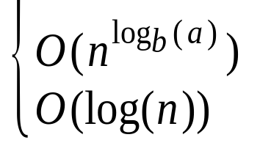
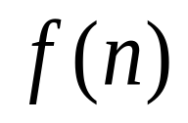
Theorem1
Let f(n) = af(n/b) + c whenever n is divisible by b, where a≥1, b is an integer greater than 1, and c is a positive real number. Then
if a > 1
if a = 1
Furthermore, when n = b^{k}, where k is a positive integer,
f(n) = f(1) + ck if a = 1
f(n) = C₁n^{logba} + C₂ if a > 1
where C₁ = f(1) + c/(a - 1), C₂ = - c/(a - 1)
is

Slide 7
Proving Theorem 1
If n=b^{k} for some k (k = log_{b}n),
f(n) = af(n/b) + c
= a(af(n/b²) + c) + c
= a²f(n/b²) + ac + c
= a²(af(n/b³) + c) + ac + c
= a³f(n/b³) + a²c + ac + c = ... = = a^{k}f(1) + c(1+ a + a² + ... +a^{k-1})
Assume a=1. Then, a^{k} = 1 and the sum is ck, so that
f(n) = f(1) + ck = f(1) + clog_{b}n = O(logn).

Slide 8
Proving Theorem 1
If a=1 but n is not a power of b, there is some k such that b^{k} < n < b^{k+1}.
Because f is increasing, f(b^{k}) ≤ f(n) ≤ f(b^{k+1}).
f(n) ≤ f(b^{k+1})
= f(1) + c(k+1)
= f(1) + c + ck
< f(1) + c + clog_{b}n since k < log_{b}n.
So f(n) is again O(logn).

Slide 9
Proving Theorem 1
Now consider a>1 and first the case where n=b^{k} for some k.
The sum is c(a^{k}-1)/(a-1) (sum of the terms of a geometric progression), so
f(n) = a^{k}f(1) + c(a^{k}-1)/(a-1)
= (f(1)+c/(a-1))a^{k} – c/(a-1)
= (f(1)+c/(a-1))n^{logba} – c/(a-1)
= O(n^{logba}).
The proof for the remaining case is similar to the previous part of the proof, using the next higher k.

Slide 10
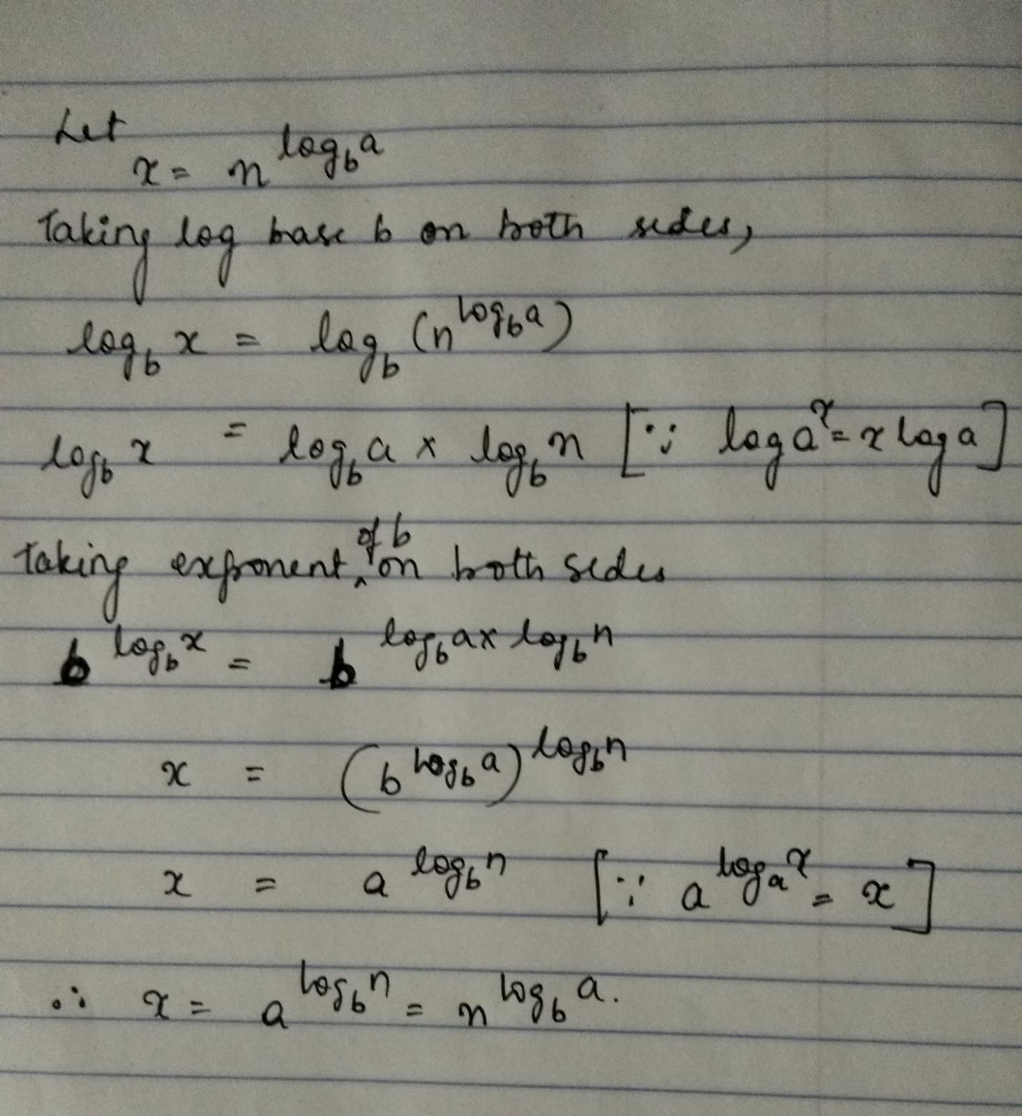
Courtesy of Manasa Bhat (5333 student)

Slide 11
Applying Theorem 1
Binary search
  f(n)=f(n/2)+2 (a = 1)
  O(logn)
Finding the minimum and maximum
  f(n)=2f(n/2)+2 (a > 1)
  O(n^{log22}) = O(n¹) = O(n)

Slide 12
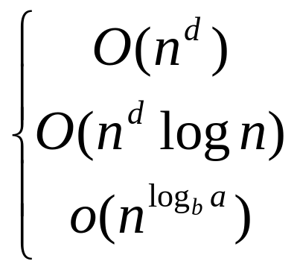
MASTER Theorem
Let f(n) = af(n/b) + cn^{d} whenever
n = b^{k},
a ≥ 1,
b > 1,
c > 0,
d ≥ 0,
  if a < b^{d}
  f(n) is if a = b^{d}
  if a > b^{d}

Slide 13
Applying Theorem 2
Merge sort
  f(n) = 2f(n/2) + cn
  a=2, b=2, d=1
  b^{d} = 2¹ = 2 = a
  O(n¹logn) = O(nlogn)

Slide 14
Multiplication complexity
Classical
  O(n²)
Recursive
  f(n) = 4f(n/2) + c₁n
  a = 4, b = 2, d = 1
  a > b^{d} so O(n^{logba}) = O(n^{log24}) = O(n²)
Faster
  f(n) = 3f(n/2) + c₂n
  a = 3, b = 2, d = 1
  a > b^{d} so O(n^{logba}) = O(n^{log23}) ≈ O(n^{1.6})

