Slide 1
The Principle of Inclusion-Exclusion
Jorge A. Cobb
The University of Texas at Dallas

Slide 2
Counting overlapping combinations
Discrete math is taken by 12 women and 20 Texas residents. How many students are either women or Texans?
Cannot answer this question with the information given because there are some women who also are Texas residents.

Slide 3
Combining two sets
Suppose we have two finite sets A and B. How many elements does A∪B have?
|A|+|B| counts the intersection twice
Answer: |A∪B| = |A| + |B| – |A∩B|
A
A∩B
B
1
2
1

Slide 4
Counting divisible numbers
How many positive integers less than 100 are divisible by either 5 or 3?
There are |A| = ⎣99/5⎦ = 19 such integers divisible by 5, and |B| = ⎣99/3⎦ = 33 such integers divisible by 3
Because 5 and 3 are relatively prime, an integer is divisible by both iff it is divisible by 5·3 = 15, so |A∩B| = ⎣99/15⎦ = 6
Therefore |A∪B| = 19 + 33 – 6 = 46

Slide 5
Extending to three sets
Count by |A| + |B| + |C|
1
2
1
3
2
2
1

Slide 6
Extending to three sets
Count by |A| + |B| + |C| – |A∩B| – |A∩C| – |B∩C|
1
1
1
0
1
1
1

Slide 7
Extending to three sets
Count by |A| + |B| + |C| – |A∩B| – |A∩C| – |B∩C| + |A∩B∩C|
1
1
1
1
1
1
1

Slide 8
Another example
Assume the following
  |S|=1232 students have taken Spanish
  |F|=879 students have taken French
  |R|=114 students have taken Russian
Also
  |S∩F|=103, |S ∩R|=23, |F∩R| =14
  Total # students = 2092
How many students have taken all three languages?
  |S∪F∪R| = |S| + |F| + |R| – |S∩F| – |S∩R| – |F∩R|+ |S∩F ∩R|
  2092 = 1232 + 879 + 114 – 103 -23 -14 + |S∩F ∩R|
  |S∩F ∩R| = 7

Slide 9
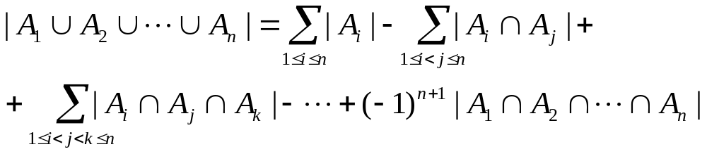
The Principle of Inclusion-Exclusion
Let A₁, A₂, ..., A_{n} be finite sets. Then

Slide 10
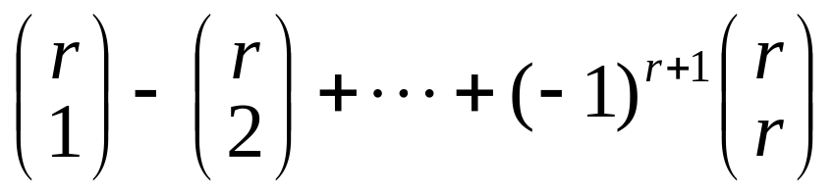
Proving Inclusion-Exclusion
Suppose that a particular element in the union appears in exactly r (out of the n) sets.
  Show that it is counted only once
Focus only on the r sets containing the element
Then it will be included C(r, 1) times (in single set terms), excluded C(r, 2) times (in two-set terms), included C(r, 3) times, and so on.
Total count is

Slide 11
Proving Inclusion-Exclusion
The element is counted exactly
C(r,1) – C(r,2) + C(r,3) - … + (-1)^{r+1}C(r,r).
By Corollary 2 of Section 4.4,
C(r,0) - C(r,1) + C(r,2) - C(r,3) - … + (-1)^{r}C(r,r) = 0.
Thus
1 = C(r,0) = C(r,1) – C(r,2) + C(r,3) - … + (-1)^{r+1}C(r,r)
I.e., a is counted only once.

Slide 12
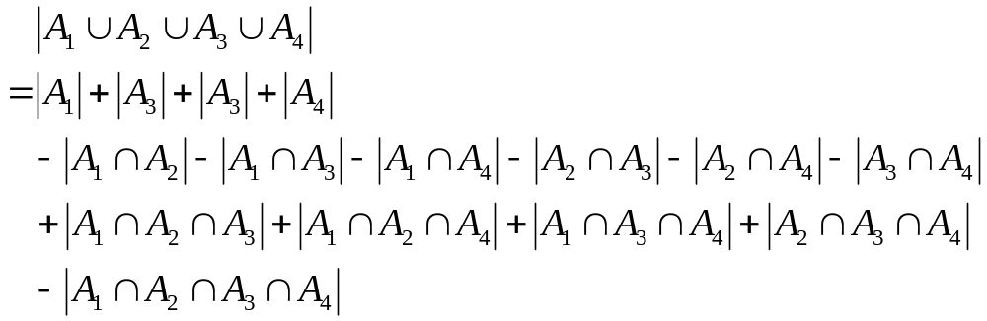
Example
Give a formula for the # of elements in the union of four sets.

