Slide 1
Applications of the Principle of Inclusion-Exclusion
Part I
Jorge A. Cobb
The University of Texas at Dallas

Slide 2
Alternative form of Inclusion-Exclusion
Assume we have a universe U, |U| = N(U)
Assume we have n object properties, P₁, …, P_{n}
Example: Universe of cars
  P₁ = car is sedan P₃ = car is blue
  P₂ = car is minivan P₄ = car is black
Let A_{i} be the subset of U with property P_{i}.
  A₁ = set of cars that are sedans
Let N(P_{j1}P_{j2}...P_{jk}) the number of elements with properties P_{j1},P_{j2}, ..., P_{jk}, i.e., |A_{j1}∩A_{j2} ∩... ∩A_{jk}|
E.g. N(P₁P₄) = number of cars that are black sedans.

Slide 3
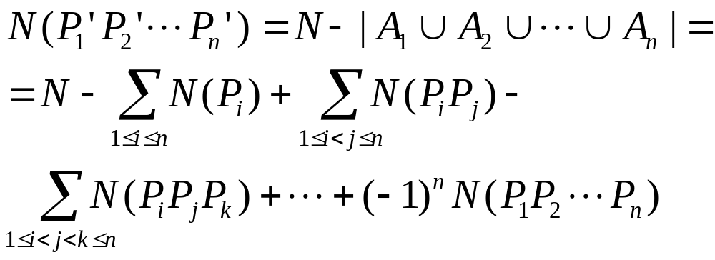
Continued ….
Let N(P_{j1}P_{j2}...P_{jk}) the number of elements with properties P_{j1},P_{j2}, ..., P_{jk}, i.e., |A_{j1}∩A_{j2} ∩... ∩A_{jk}|
Let P_{i}′ be the negation (opposite) of P_{i},
We are interested in the number of objects without any property

Slide 4
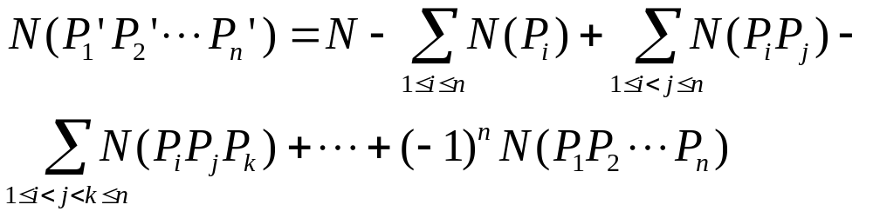
The number of onto functions
A function f : A→B is onto or surjective iff
  for every y∈B, there is an x∈A such that f(x)=y
Our set, is the set of all functions.
Let P_{i} be the property that element i of the codomain B is not in the range of a function (we don’t want this!)
  P_{i} identifies all functions that don’t map anything to element i of B
Then N(P₁′P₂′...P_{|B|}′) is the desired number

Slide 5
The number of onto functions
If |A|=m and |B|=n, what is N (total # of functions)?
  N = n^{m} (each of the m elements of A has n choices)
What is N(P_{i})?
  Each x∈A must map to a y∈B with y ≠ b_{i}
  N(P_{i}) = (n–1)^{m}
  There are n such terms P₁ … P_{n}

Slide 6
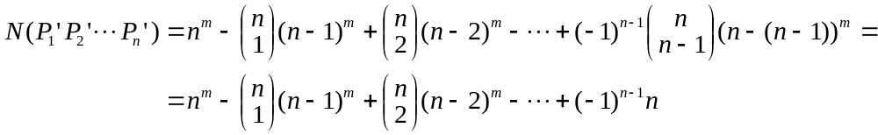
The number of onto functions
What is N(P_{i}P_{j})?
  Each x∈A must map to a y∈B with y ≠ b_{i} and y ≠ b_{j}
  N(P_{i}P_{j}) = (n-2)^{m}
  There are C(n, 2) such terms
Overall,

Slide 7
Example with functions
A team of 3 students collectively submit an assignment with 5 problems. Each problem is worked on by only one student, and each student does at least one problem. How many ways are there for the students to distribute the problems between themselves?

Slide 8
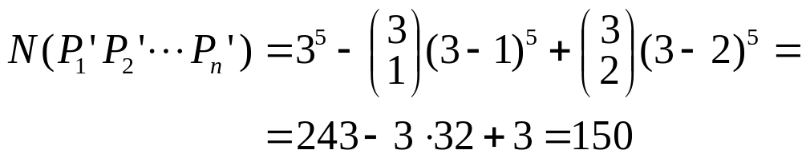
Solving the example
A: set of problems; m = |A| = 5
B: set of students; n = |B| = 3
f : A→B such that f(x) is the student doing problem x
f must be onto (to avoid free-riding students)

Slide 9
The hat check problem
(Original version) n gentlemen go to the opera, checking their hats as they enter. The hatcheck attendant misplaces the claim checks, and returns the hats randomly. What is the probability that no gentleman receives his own hat back?

Slide 10
Solving the hat check problem
Our universe is the set of permutations of the hats
P_{i} is the property that
  gentleman i receives back his own hat
We are interested in N(P₁′P₂′...P_{n}′)
What is N(U)?
  N(U) = n!
What is N(P_{i})?
  N(P_{i}) = (n–1)! (i got his hat back, so i^{th} place is fixed)
  There are n such terms

Slide 11
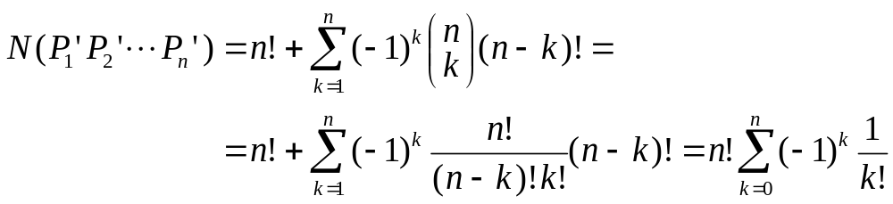
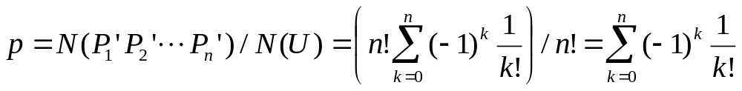
Solving the hat check problem
What is N(P_{i}P_{j})?
  N(P_{i}P_{j}) = (n–2)!
  There are C(n, 2) such terms
In general,
and the probability of no correct hats is

Slide 12
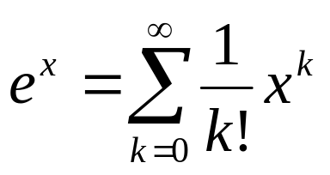
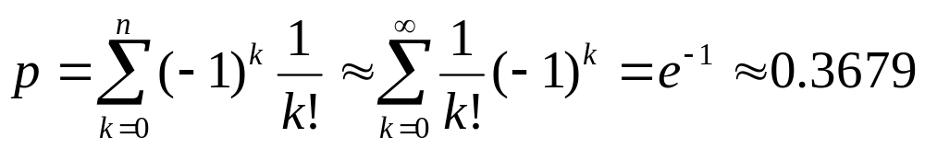
Asymptotic behavior
From generating functions, we know that
Therefore,

Slide 13
How good is the approximation?
Since k! grows fast, later terms in the series have little impact
Recall that 1/e = 0.367879441
n | p
1 | 0
2 | 0.5
3 | 0.333333333
4 | 0.375
5 | 0.366666667
n | p
6 | 0.368055556
7 | 0.367857143
8 | 0.367881944
9 | 0.367879189
10 | 0.367879464

Slide 14
Derangements
A permutation f of the set {1, 2, ..., n} fixes i iff f(i) = i.
A derangement is a permutation with no fixed elements.
The number of derangements of n objects is
  equal to the number of solutions of the hatcheck problem.

