Slide 1
Applications of the Principle of Inclusion-Exclusion
Part II
Jorge A. Cobb
The University of Texas at Dallas

Slide 2
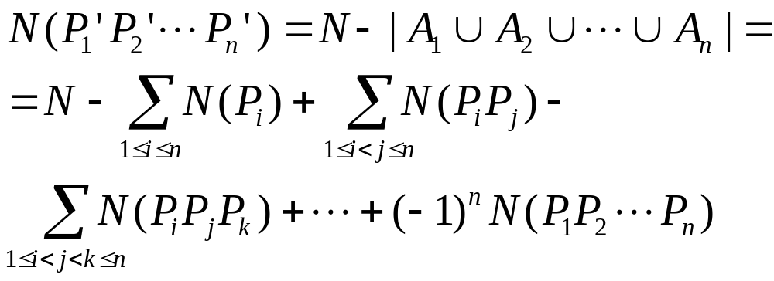
Alternative form of Inclusion-Exclusion
Let A_{i} be the subset of elements with property P_{i}. Let P_{i}′ be the complement of P_{i}, N the total number of elements, and N(P_{j1}P_{j2}...P_{jk}) the number of elements with properties
P_{j1}, P_{j2}, ..., P_{jk}.

Slide 3
The Sieve of Eratosthenes
Eratosthenes was an ancient Greek mathematician (3rd century BC), born in Libya, librarian of the Library of Alexandria
Worked on trigonometry and applied it to astronomy
  calculated circumference of the Earth within (maybe) 2% of its true value (40,000 km)
  possibly calculated the distance to the Sun (an Astronomical Unit) within 1% of its true value (150 million km)

Slide 4
Finding prime numbers
A number is prime iff
  it is a positive integer greater than 1 that is only divisible by 1 and itself

Slide 5
How many prime numbers are there?
Euclid (c. 300 BC) proved that there is an infinite number
  Proof: If p₁, p₂, ..., p_{r} are all the primes that exist, then P = p₁p₂...p_{r} + 1 is either a new prime, or not. If not, it must have a prime factor p, which must be one of p₁, p₂, ..., p_{r}. But then, p must divide 1, which is impossible.
The Prime Number Theorem:
  The number of primes not exceeding n is O(n/logn)

Slide 6
Why are primes important?
Mathematically, related to complex analysis and Riemann’s zeta function
In practice, because of their importance in cryptography
  The task of encrypting a message with a secure key so that the message can be stored or sent over an unrestricted channel, but can also be recovered if we know the key
  Applications: military, diplomatic communications, bank wires, medical records, internet (SSH, SSL, and HTTPS)

Slide 7
Public key cryptography
Rather than having to secretly transmit the key, each user has a pair of keys – a private key and a public key
The private key is known only to the user it is assigned to and is never transmitted
The public key is available to everybody
The algorithm can decrypt a message encoded with one key using the other key

Slide 8
Example uses of PKC
Sending a message (John to Karen):
  John encrypts with Karen’s public key
  Karen can decrypt using her private key
  No one else can decrypt
Digital signing (by John)
  John encrypts a message (like his name) with his private key
  Everybody can decrypt with John’s public key and verify the signature
  No one else can fake John’s signature

Slide 9
How PKC works
Each user is assigned two primes p and q
Two integers d and e are obtained semi-randomly from p, q, and pq
One key is the pair (pq, d) and the other is the pair (pq, e)
The numbers d and e are such that p or q cannot be directly derived from them

Slide 10
Can PKC be broken?
To get one key from the other, one would have to know p or q, i.e., factor pq
But the only known way to factor large numbers (these days pq is 128-bit long) is to try all combinations
For pq an 128-bit long number, there are about 2¹²⁸/128 = 2¹²⁸/2⁹ = 2¹¹⁹ ≈ 10¹¹² prime numbers to try
Number of atoms in the universe: 10⁷⁸ to 10⁸¹

Slide 11
The sieve algorithm
Eratosthenes’ algorithm for finding primes up to N
  label 1 as prime (duh!)
  loop over possible divisors
  (from n = 2 up to n = N – 1)
    for each such number n, mark all k*n ≤ N (note: k > 1)
  all numbers left unmarked are primes
    (this is why we need k > 1, o.w. we mark all numbers)

Slide 12
Refinements to Eratosthenes’ sieve
Potential divisors for which we calculate multiples
  only need to do this for unmarked divisors
Starting point for products
  composite (non-prime) numbers less than n² would have already been marked
    because they must have a factor less than n
  Hence, for divisor n, start from n².

Slide 13
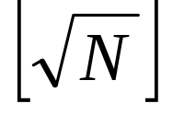
Refinements to Eratosthenes’ sieve
Maximum divisor considered
  we can stop at instead of going all the way to N–1
  Why?
    Any number greater than SQRT(N) that is not prime must have a factor less than SQRT(N)
    i.e., if all factors greater than SQRT(N) the number is greater than N
    We have already considered all of these.

Slide 14
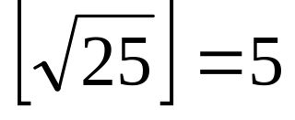
Example of using the sieve
1 | 2 | 3 | 4 | 5
6 | 7 | 8 | 9 | 10
11 | 12 | 13 | 14 | 15
16 | 17 | 18 | 19 | 20
21 | 22 | 23 | 24 | 25

Slide 15
Example of using the sieve
1 | 2 | 3 | 4 | 5
6 | 7 | 8 | 9 | 10
11 | 12 | 13 | 14 | 15
16 | 17 | 18 | 19 | 20
21 | 22 | 23 | 24 | 25

Slide 16
Example of using the sieve
1 | 2 | 3 | 4 | 5
6 | 7 | 8 | 9 | 10
11 | 12 | 13 | 14 | 15
16 | 17 | 18 | 19 | 20
21 | 22 | 23 | 24 | 25

Slide 17
Example of using the sieve
1 | 2 | 3 | 4 | 5
6 | 7 | 8 | 9 | 10
11 | 12 | 13 | 14 | 15
16 | 17 | 18 | 19 | 20
21 | 22 | 23 | 24 | 25

Slide 18
Example of using the sieve
1 | 2 | 3 | 4 | 5
6 | 7 | 8 | 9 | 10
11 | 12 | 13 | 14 | 15
16 | 17 | 18 | 19 | 20
21 | 22 | 23 | 24 | 25

Slide 19
Example of using the sieve
1 | 2 | 3 | 4 | 5
6 | 7 | 8 | 9 | 10
11 | 12 | 13 | 14 | 15
16 | 17 | 18 | 19 | 20
21 | 22 | 23 | 24 | 25

Slide 20
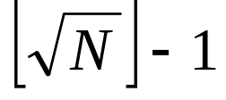
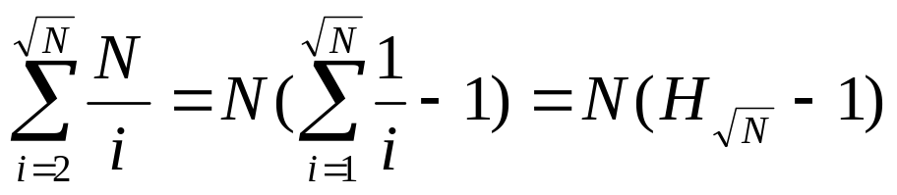
Complexity of Eratosthenes’ sieve
We loop over potential divisors
For divisor i
  we mark N/i numbers
Total number of operations
where H_{n} is the n-th harmonic number

Slide 21
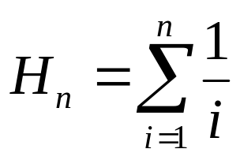
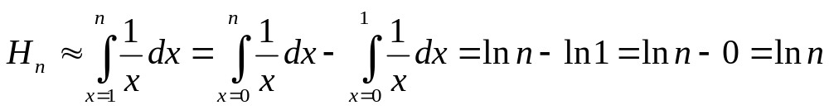
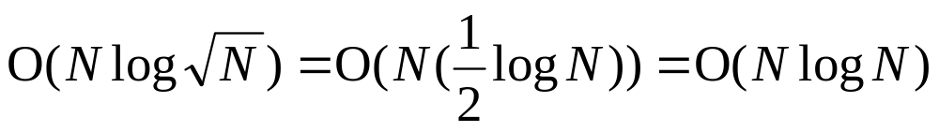
Calculating H_{n}
By definition,
We approximate
This is an upper bound, so the complexity is

Slide 22
Counting prime numbers
P_{i}: a number is divisible by i
Using the alternative form of the principle of inclusion-exclusion, count all primes ≤ N.
The desired count includes:
  all numbers that do not satisfy any of the P_{i}’s for i prime numbers with 2 ≤ i ≤
    (if a number has a prime factor greater than sqrt(N) then it must have prime factors less than sqrt(N), and hence, we only consider numbers not divisible by primes at most sqrt(N))
  it also includes the prime numbers i themselves, in the range 2 ≤ i ≤

Slide 23
Prime numbers greater than 1 and less than 100
SQRT(100) = 10
Prime numbers to be considered: 2, 3, 5, 7
So the total count should be
4 + N(P’₂P’₃P’₅P’₇)
We find N(P’₂P’₃P’₅P’₇) from the modified inclusion-exclusion principle.

Slide 24
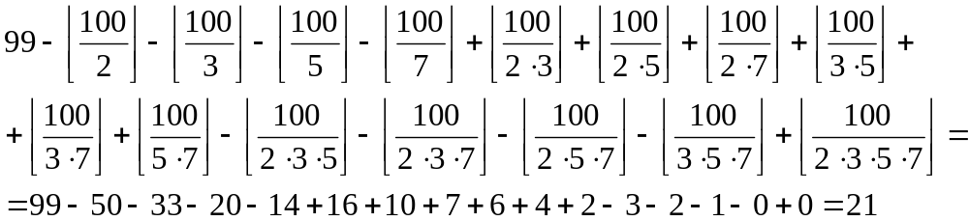
Number of primes not exceeding 100 (continued)
N(P’₂P’₃P’₅P’₇) =
99 – N(P₂) – N(P₃) – N(P₅) – N(P₇) + N(P₂P₃) + N(P₂P₅) + N(P₂P₇) + N(P₃P₅) + N(P₃P₇) + N(P₅P₇) – N(P₂P₃P₅) – N(P₂P₃P₇) – N(P₂P₅P₇) – N(P₃P₅P₇) + N(P₂P₃P₅P₇)

