Slide 1
Relations
Jorge Cobb
The University of Texas at Dallas

Slide 2
What are relations?
Relations are a formal means to specify which elements from two or more sets are related to each other
Examples
  {students} who take {courses}
  {businesses} and their {telephone numbers}
  {integers} and their {divisors}
  {program variables} and the {subroutines} they are used in

Slide 3
Definition of relations
Let A and B be two sets. A binary relation R from A to B is a subset of A × B.
  Note that the order of the two sets matters.
More generally, let A₁, A₂, ..., A_{n} be n sets. An n-ary relation R on these sets is a subset of A₁ × A₂ × ... × A_{n}.
  The sets A_{i} are known as the domains of the relation, and n as its degree
  Again, the order of the domains matters.

Slide 4
Example
Let A = {0,1,2} and B = {a,b,c}.
Then, R = {(0,a), (1,a), (1,b)} is a relation from A to B.
For instance,
  (0,a) in R, but (a,0) is not in R (order matters!)
  Note that no element in A is related to c (which is fine), and 2 is not related to any element in B.
(0,a) in R is also denoted 0 R a

Slide 5
Functions
A function f : A → B is a special case of a relation from A to B
  It satisfies the property: for each x ∈ A, there is exactly one pair (x, f(x)) in the relation
Relations are more general than functions
  They allow unmapped elements from A
  They allow one-to-many mappings where an element from A maps to multiple elements from B
  Of course, they also allow unmapped elements from B, and also many-to-one mappings from A to B.
  I.e., any subset of A x B is a relation.

Slide 6
Relations on a set
A relation R on a set A is a relation from A to A, that is, a subset of A × A, i.e. of, A²
Examples (on the set of integers):
  x is equal to y
  x is greater than y
  x divides y
Note that in these cases both A and the relation R are infinite sets, which is fine.

Slide 7
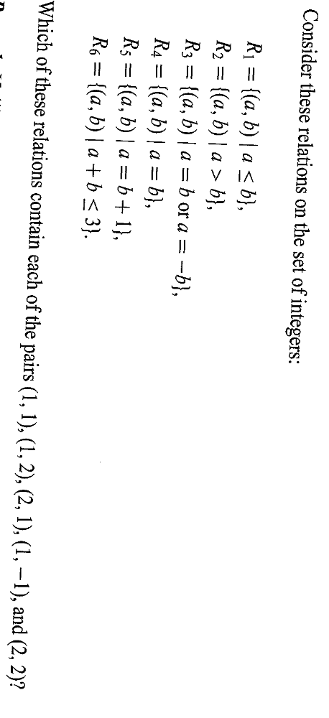
Example

Slide 8
How many relations are there?
How may relations exist on a set A with n elements?
A² has n² elements. We know that the number of subsets of a set with m elements is 2^{m}, so the desired number is 2^{n2}.
The number of functions from A to A is
Is this asymptotically the same?
n^{n} = (2^{logn})^{n} = 2^{nlogn} which grows slower than 2^{n2}.
n^{n}

Slide 9
Properties of relations
A relation R on a set A is
reflexive, iff
  ∀x ∈ A, (x, x) ∈ R
symmetric, iff
  ∀x∀y, (x, y) ∈ R ⇒ (y, x) ∈ R
antisymmetric, iff
  ∀x∀y, (x, y) ∈ R and (y, x) ∈ R ⇒ x = y
transitive, iff
  ∀x∀y∀z, (x, y)∈R and (y, z) ∈ R ⇒ (x, z) ∈ R

Slide 10
Example
Consider the “divides” relation on the set of nonnegative integers: x|y iff x divides y.
Reflexive?
  NO. 0 does not divide 0. (would be reflexive on the set of positive integers, though)
Symmetric?
  NO. 2 divides 4, but not the other way around.
Antisymmetric?
Transitive?
YES
YES

Slide 11
What properties are satisfied by the relation R = {}, when A = {}, and when A = {1,2,3}?

Slide 12
Example
Which of the above relations are reflexive, symmetric, anti-symmetric and transitive?

Slide 13
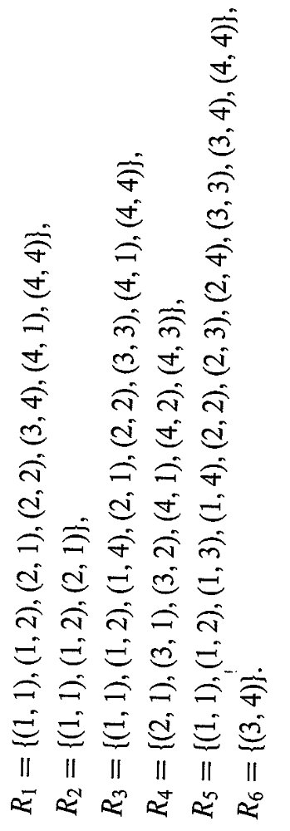
Example
Which of the above relations are reflexive, symmetric, anti-symmetric and transitive on the set A={1,2,3,4}?

Slide 14
Counting the reflexive relations
How many reflexive relations are there on a set A with n elements?
Consider the pairs B:{(x, x) with x ∈ A}.
  There are n such pairs, they must occur in the relation.
  For every pair (x, y) with x ≠ y, (there are n(n-1) of them) it may occur in the relation or it may not
  Thus, there are 2^{n(n-1)} total reflexive relations.

Slide 15
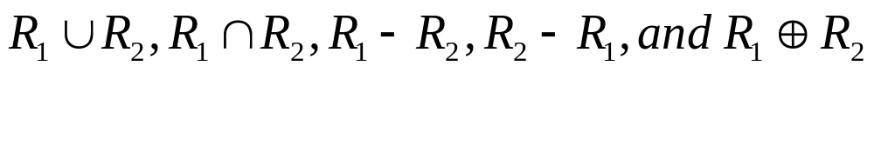
Combining relations
Since relations are by definition sets, they can be combined in any way that sets can be combined, including union, intersection, and set difference.
Let R₁ = {(x,y) | x < y}
R₂ = {(x,y) | x > y}
What is

Slide 16

Closure
A closure of a relation is the smallest superset of the relation that contains the desired property.
E.g., the reflexive closure of a binary relation R on a set X is the smallest reflexive relation on X that contains R.

Slide 17
Closure example
Let domain A = {1, 2, 3}.
Give the symmetric closure of (the reflexive closure of (the transitive closure of
R = {(2,1),(2,3)} ))
Transitive closure :
  {(2,1),(2,3)}
Reflexive closure :
  {(1,1),(2,1),(2,2),(2,3),(3,3)}
Symmetric closure:
  {(1,1),(1,2),(2,1),(2,2),(2,3),(3,2),(3,3)}

Slide 18
More on closures
Does every relation have a transitive closure?
  Yes (more on that later)
Does every relation have a reflexive closure?
  Yes, we saw the formula a few slides ago
Does every relation have a symmetric closure?
  Yes, for every pair (a,b) in R add the pair (b,a)
Does every relation have an anti-symmetric closure?
  No. In a closure you can only add pairs, not take them away. A relation R has an anti-symmetric closure only if R is anti-symmetric to begin with. (The closure is R itself)

Slide 19
Composition of relations
The composite of relations R and S, denoted S○R, where R: A→B and S: B→C, is the relation from A to C containing all pairs (x, z) such that there is one y ∈ B with (x, y) ∈ R and (y, z) ∈ S.

Slide 20
Example
What is the composite S○R, where
  R = {(1,1),(1,4),(2,3),(3,1),(3,4)}
  S = {(1,0),(2,0),(3,1),(3,2),(4,1)}

Slide 21
Composing the parent relation
Let R be the relation on the set of all people such that a R b if a is the parent of b.
If (a,c) in R○R, what is the family relationship between a and c?
If (a,d) in R○R○R, what is the family relationship between a and d?

Slide 22
Powers of relations
The n^{th} power of a relation R, for n ≥ 1, is defined recursively as
  R¹ = R
  R^{n+1} = R^{n} ○ R
Again, let R be the parent relation
Let (a,x) in R^{n}, what is the relationship between a and x?
In general, regardless of how you define R, how you would intuitively picture R^{i} in your mind? hmmm

Slide 23
Example of powers
Let R = {(1,2),(1,3),(3,4),(4,3)}
R¹ = {(1,2),(1,3),(3,4),(4,3)}
R² = {(1,4), (3,3), (4,4)}
R³ = {(1,3), (3,4), (4,3)}

Slide 24
Transitivity and R²
Lemma 1: A relation R is transitive if and only if R² ⊆ R
I.e.,
  if a relation is transitive, then composing it with itself yields no new pairs
  if composing a relation with itself yields no new pairs, then it is transitive.

Slide 25
Transitivity and R² continued ...
Proof:
We first show that if R² ⊆ R then R is transitive
  By the definition of transitivity, we must show that, for any a, b, c,
  if (a,b) and (b,c) are in R then (a,c) is also in R.
  Note that if (a,b) and (b,c) are in R, then by definition of composition (a,c) is in R²
  We are given that R² ⊆ R, and since (a,c) is in R², then (a,c) is in R, as desired.
  Continues …

Slide 26
Transitivity and R² continued ...
We next show that if R is transitive then
R² ⊆ R.
  We must show that any pair, if (a,c) in R², then (a,c) must be also in R.
  By the definition of composition, if a pair (a,c) is in R² then there are two pairs (a,b) and (b,c) in R.
  By the assumption of transitivity, because (a,b) and (b,c) are in R, then (a,c) must also be in R.
    This is our desired result.

Slide 27
Transitivity and R² continued ...
Lemma 2: R² ⊆ R iff (R^{n} ⊆ R, for all n, n ≥ 1)
Proof:
  First: R² ⊆ R → (R^{n} ⊆ R, for all n, n ≥ 1)
  We will prove (R^{n} ⊆ R, for all n, n ≥ 1) by induction under the assumption that R² ⊆ R
  Basis, n = 1, i.e., R¹ ⊆ R, trivial since R¹ = R
  Assume R^{k} ⊆ R, where k ≥ 1, show R^{k+1} ⊆ R

Slide 28
Transitivity and R² continued ...
  Assume R^{k} ⊆ R, where k ≥ 1, show R^{k+1} ⊆ R
  Consider any (a,c) in R^{k+1}, we must show it is also in R
  If (a,c) in R^{k+1} then, by definition of composition, there are pairs (a,b) in R^{k} and (b,c) in R
  From the ind. hyp., (a,b) in R^{k} implies (a,b) is in R
  Since both (a,b) and (b,c) are in R, then (a,c) is in R².
  Recall our assumption that R² ⊆ R
  Hence, (a,c) is in R as desired.
Second: R² ⊆ R ← (R^{n} ⊆ R, for all n, n ≥ 1)
  Trivial, just take n = 2.

Slide 29
R* and Transitive Closures
Let R be any relation (transitive or not)
Let R* be the union of all the powers of R.
I.e., R* = U_{n} R^{n}
Let R = {(1,2),(1,3),(3,4),(4,3)}
  R¹ = {(1,2), (1,3), (3,4), (4,3)}
  R² = {(1,4), (3,3), (4,4)}
  R³ = {(1,3), (3,4), (4,3)} note nothing new ...
  R* = {(1,2), (1,3), (3,4), (4,3), (1,4), (3,3), (4,4)}

Slide 30
R* and Transitive Closures
Another example, let R be the parent relation, and let (a,x) be in R*. What is the relationship between a and x?
Is R* the transitive closure of R?
  Hmmm, maybe, we shall see later ...

Slide 31
Transitive Closures and transitivity
Observation: R = R* iff (R^{n} ⊆ R, for all n ≥ 1)
  because R* by definition is a superset of R, so it is equal to R then all of its components must also be in R.
Put both lemmas together and the above observation and we obtain the following.
Theorem: A relation R is transitive iff R = R*.

Slide 32
Transitive Closure
Is R* is the transitive closure of R?
  Can you prove it? (on your own)
    You have to show that R* is transitive.
    Also, that every new pair (a, b) introduced by R* that is not in R is necessary to make R transitive.

