Slide 1
Graph Representation
Jorge A. Cobb
The University of Texas at Dallas

Slide 2
Representing graphs
Two major approaches
  By listing the edges
  As a matrix
The best approach depends on what we want to do with the graph, and also on how many vertices and edges it has

Slide 3
Adjacency lists
Let G = (V, E) be a simple graph. Consider an arbitrary order for the vertices in V.
Represent the edges in E as one list for each vertex, with the list for vertex v_{i} containing all vertices that are:
  adjacent to v_{i} (for undirected graphs)
  have v_{i} as initial vertex (for directed graphs)
  or have v_{i} as terminal vertex (for directed graphs)

Slide 4
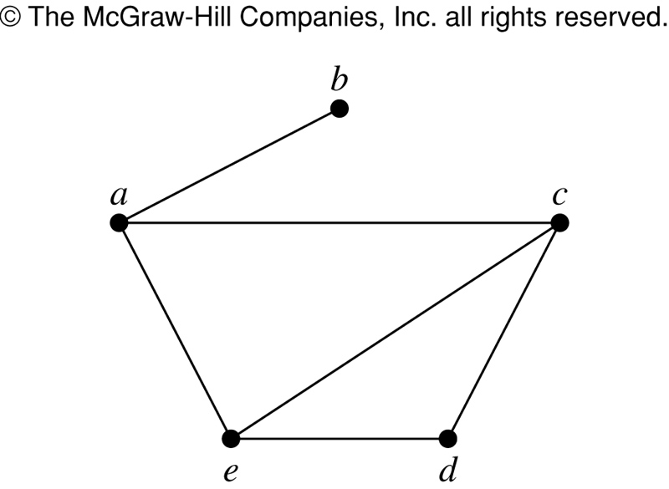
Example
Vertex | Adjacent Vertices
a | b,c,e
b | a
c | a,d,e
d | c,e
e | a,c,d

Slide 5
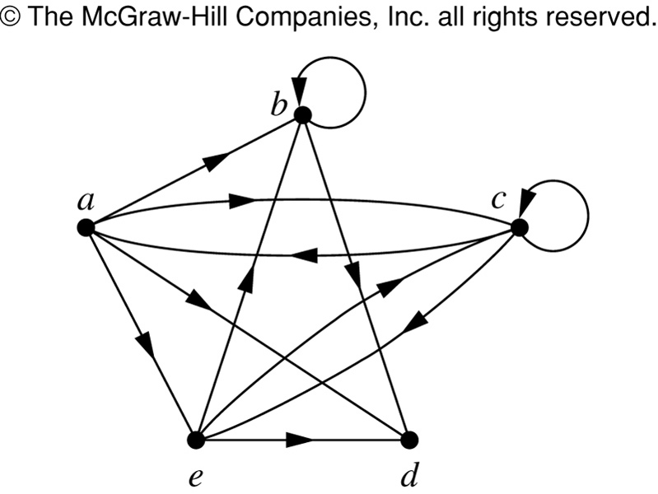
Directed Graph Example
Vertex | Terminal Vertices
a | b,c,d,e
b | b,d
c | a,c,e
d
e | b,c,d

Slide 6
Adjacency matrices
Let G = (V, E) be a simple graph. Construct a |V| × |V| matrix A such that A_{ij} = 1 if an edge from v_{i} to v_{j} exists, and A_{ij} = 0 otherwise.
Less often, we construct an incidence matrix, a |V| × |E| matrix B with B_{ij} = 1 if vertex v_{i} is an endpoint of edge e_{j} and B_{ij} = 0 otherwise.

Slide 7
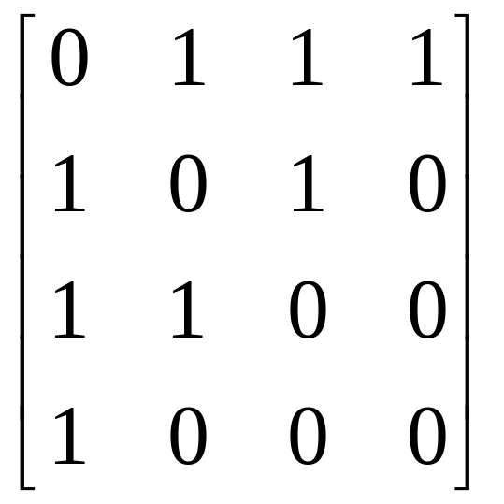
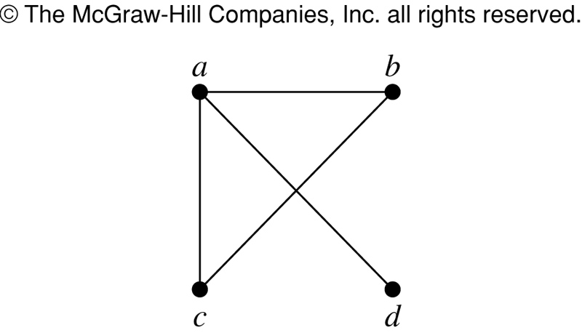
Adjacency matrix example
What is the undirected graph of this matrix?

Slide 8
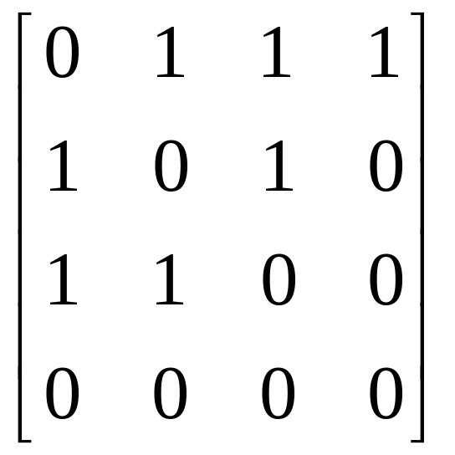
Adjacency matrix example
What is the directed graph of this matrix?
a
b
c
d

Slide 9
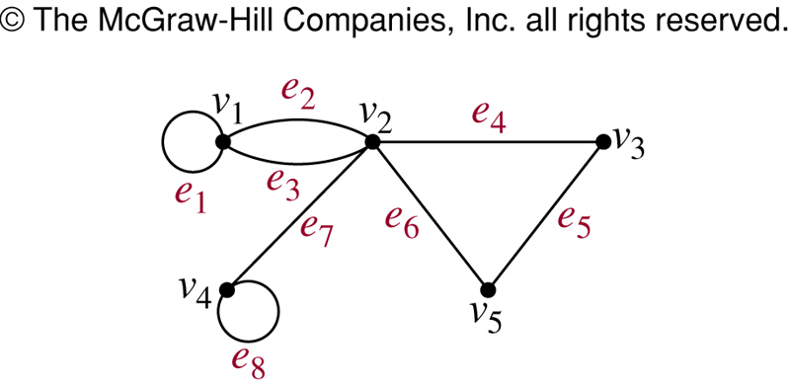
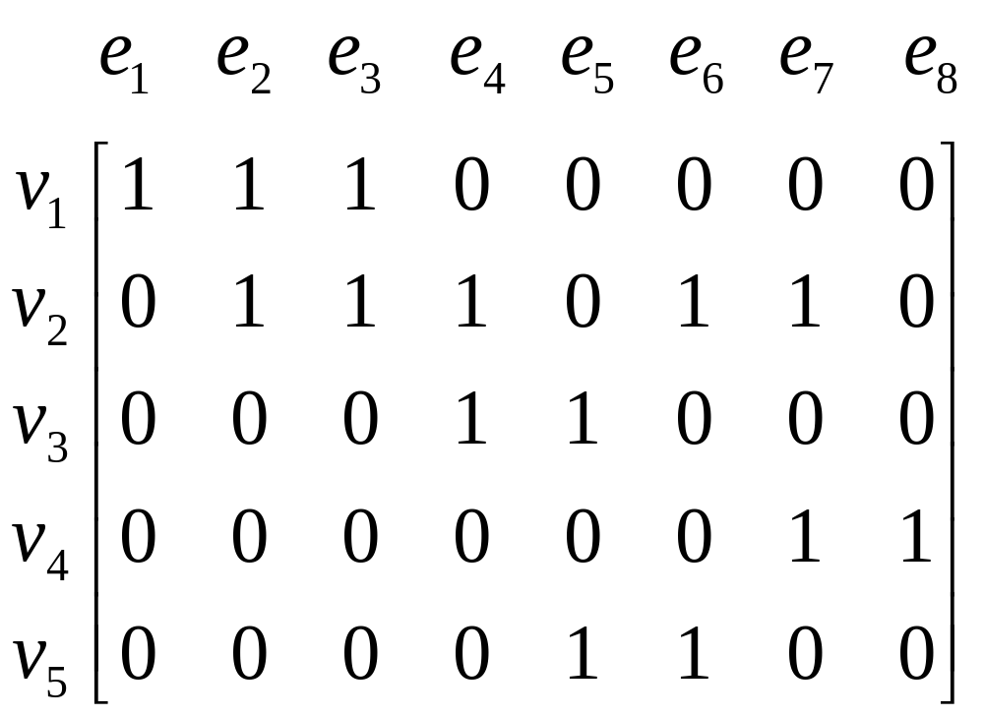
Incidence Matrix Example

Slide 10
Properties of adjacency matrices
How many adjacency matrices exist for a given graph?
  up to n!
Is the matrix symmetric?
  true iff the graph is undirected or the directed graph is symmetric
What is the meaning of A^{k} (boolean matrix multiplication)?
  A^{k}_{ij} = 1 iff there is a path from v_{i} to v_{j} with exactly k edges

Slide 11
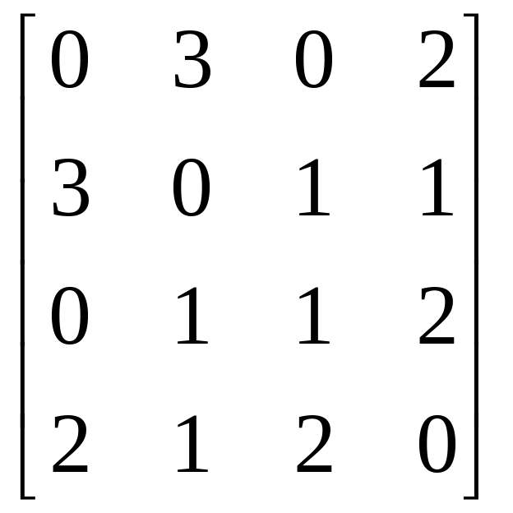
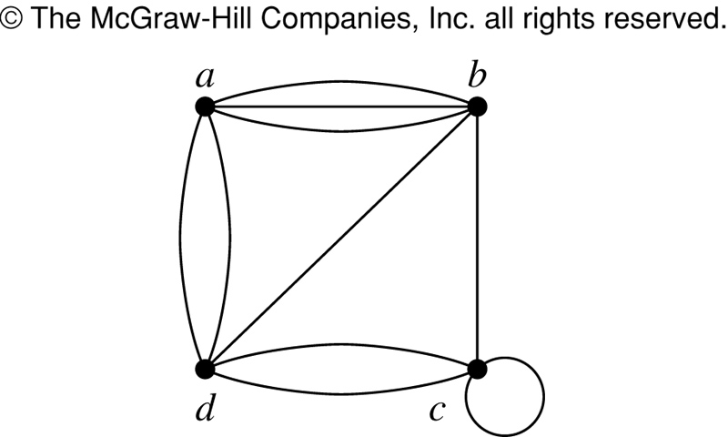
Adjacency Matrix Example

Slide 12
Choosing between adjacency lists and matrices
Finding if an edge exists takes O(1) in the adjacency matrix representation but up to O(|V|) in the adjacency list representation.
Many graphs have relatively few edges. |E| could be as high as |V|² – |V| but is often bounded by c|V|. Such graphs are called sparse graphs.
For sparse graphs, the average cost of finding an edge is c, so the time-space tradeoff may be advantageous.

Slide 13
Isomorphism
Jorge A. Cobb
The University of Texas at Dallas

Slide 14
Review questions
Propose a graph model for the U.S. highway system. Will that graph be directed or undirected? Will it be simple or a multigraph? Will it have loops?.
What does the degree of a vertex represent in the Hollywood graph?
Draw graphically and construct the adjacency matrices for the graphs C₇ and K₄,₃.

Slide 15
Isomorphism
Two simple graphs G₁ = (V₁, E₁) and G₂ = (V₂, E₂) are isomorphic if there is a one-to-one and onto function f: V₁ → V₂ such that f(a) and f(b) are adjacent in G₂ if and only if a and b are adjacent in G₁.
  In essence, they are the same graphs except that the names of the vertices are different.
Isomorphism is an equivalence relation on the set of all graphs.

Slide 16
Checking isomorphism
Are the two graphs below isomorphic?
Answer: Yes; 1→a, 2→d, 3→b, 4→c
Are there others?
1
2
a
b
a
d
4
3
c
d
c
b

Slide 17
Graph invariance
A property of a graph is called graph invariant if it is preserved by any isomorphism.
Invariant properties for simple graphs:
  number of vertices
  number of edges
  degrees of vertices

Slide 18
Checking for Isomorphism
There are n! mappings from one graph to the other
  Way to time consuming to check them all
  The best algorithm takes exponential time.
  There are algorithms that on “average” have good running time
If you check by hand, then the invariant properties must be preserved
  The two graphs must have the same number of vertices and the same number of edges
  The number of vertices of each degree must be the same.

Slide 19
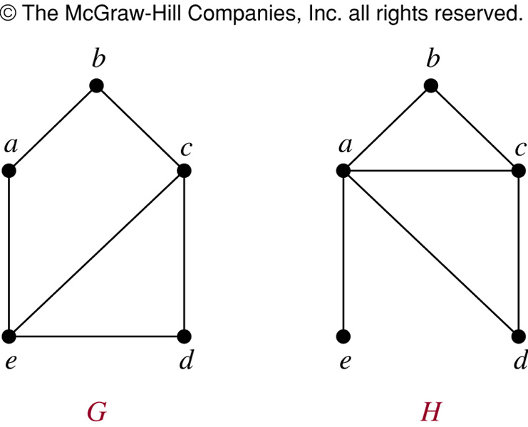
Example
Same # nodes
Same # of edges
H has a vertex of degree 1
G has no vertex of degree 1.
Not isomorphic

Slide 20
NOTE: if the invariant properties are preserved it means that the graphs could be isomorphic
You are not sure they are until you actually construct the function f mapping vertices between the graphs.

Slide 21
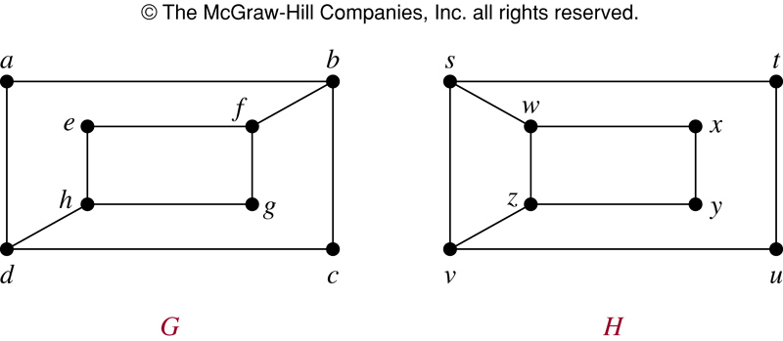
Another example
Same # vertices, same # edges.
4 vertices of degree 2 and 4 vertices of degree 3
However, they are not isomorphic
  Deg(a) = 2 in G, so a must correspond to t,u,x,y in H
  However, each of the 2 neighbors of a has degree 3
    But each of t,u,x,y has a neighbor of degree 2.

